Slide 2
To God Be the Glory
Hymn 55*
Text: Fanny J. Crosby
Music: William H. Doane (*Trinity Hymnal)

Slide 3
To God be the glory, great things he has done!
So loved he the world that he gave us his Son,
who yielded his life an atonement for sin,
and opened the life-gate that we may go in.
Praise the Lord, praise the Lord, let the earth hear his voice!
Praise the Lord, praise the Lord, let the people rejoice! O come to the Father through Jesus the Son, and give him the glory, great things he has done!

Slide 4
O perfect redemption, the purchase of blood!
To ev’ry believer the promise of God;
the vilest offender who truly believes,
that moment from Jesus forgiveness receives.
Praise the Lord, praise the Lord, let the earth hear his voice!
Praise the Lord, praise the Lord, let the people rejoice! O come to the Father through Jesus the Son, and give him the glory, great things he has done!

Slide 5
Great things he has taught us, great things he has done,
and great our rejoicing through Jesus the Son;
but purer and higher and greater will be
our wonder, our transport, when Jesus we see.
Praise the Lord, praise the Lord, let the earth hear his voice!
Praise the Lord, praise the Lord, let the people rejoice! O come to the Father through Jesus the Son, and give him the glory, great things he has done!

Slide 7
Doctrine of the Covenant
Unfolding the Divine Covenants: A Journey Through Scripture

Slide 8
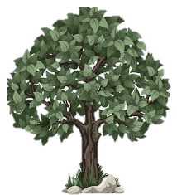
Plan of Salvation: Overlap of the Covenants
†
Christ’s Return
*
Old Testament
New Testament
EDEN
Covenant of Works
Covenant of Grace

Slide 9
Different Administrations
Partial Knowledge of Grace conveyed by the law and sacrificial system. Sacraments proper to the knowledge and purpose. Salvation by grace through faith.
Full Knowledge of God’s Grace through the revelation of God’s Son, Jesus Christ. Sacraments are proper to the realized act of redemption. Salvation by Grace through faith.

Slide 10
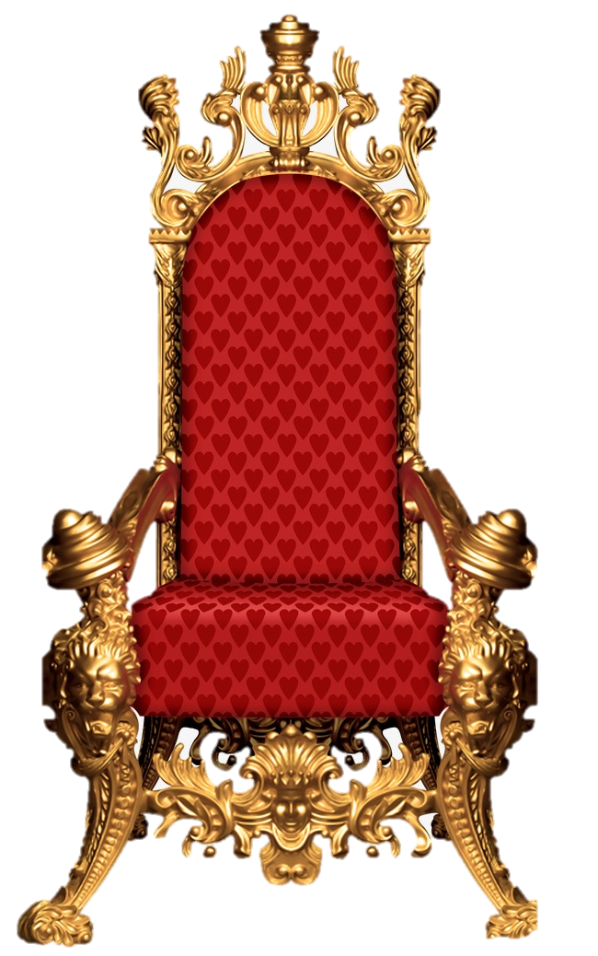
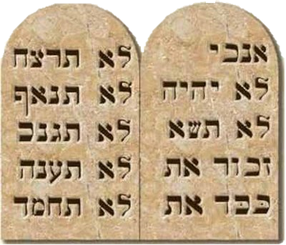
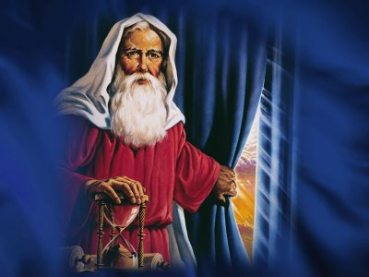
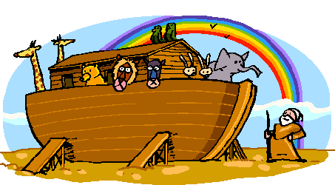
Salvation Plan
Covenant of Works
Covenant of Grace
Davidic Covenant
New Covenant
Eternity
Covenant of Sinai
Abrahamic Covenant
†
Noahic Covenant
Adamic Covenant
Christ’s Return
*
EDEN

Slide 11
Covenantal Mediators
Noah
Abraham
Jacob
Judah
David
Semites
Humanity
Jews
Israelites
House of David

Slide 12
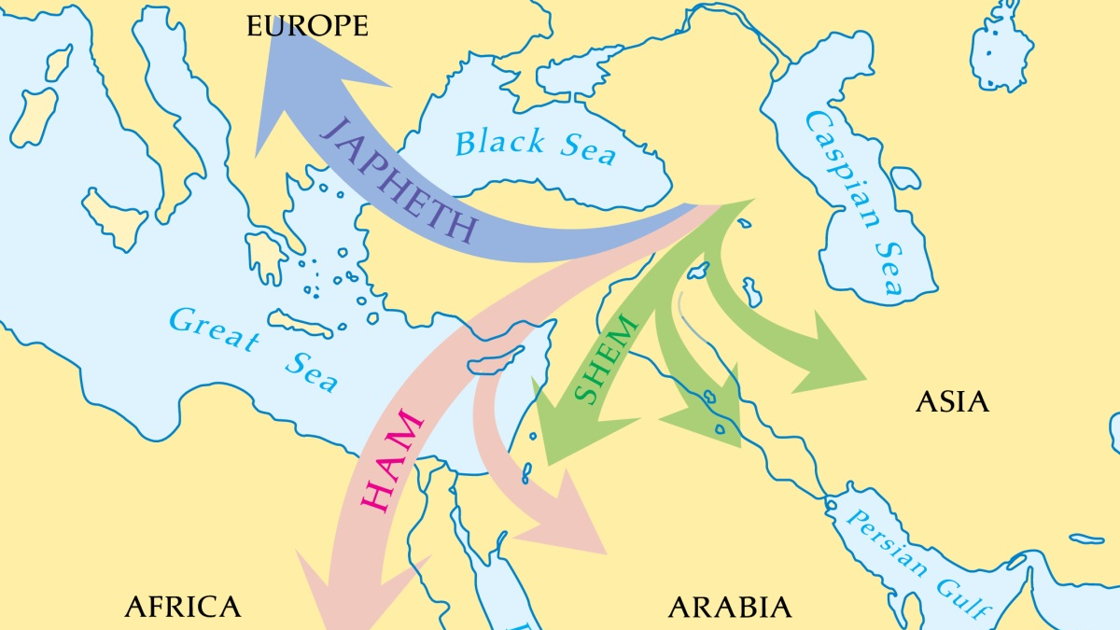

Slide 13
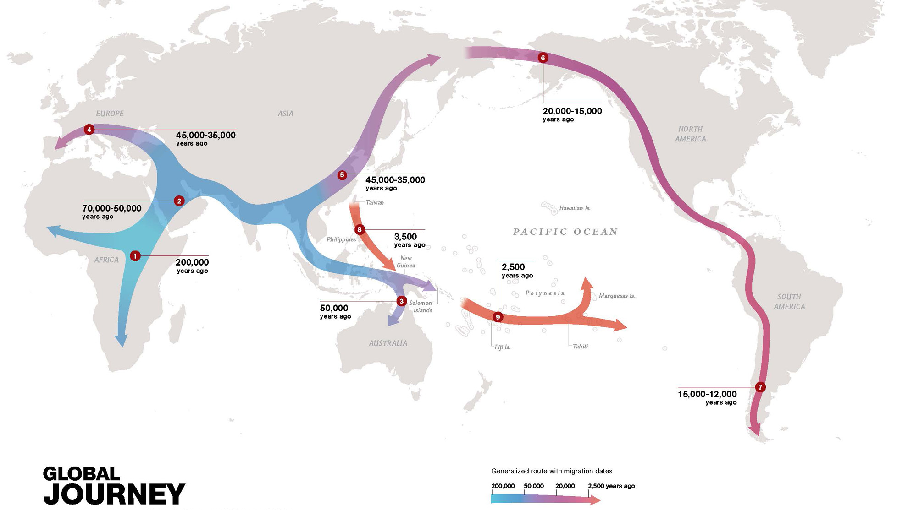
Source: National Geographic Education Global Human Journey

Slide 14
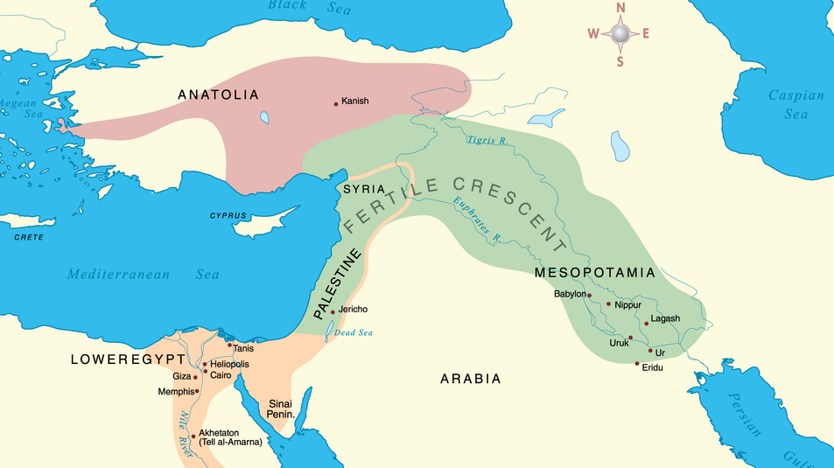

Slide 15
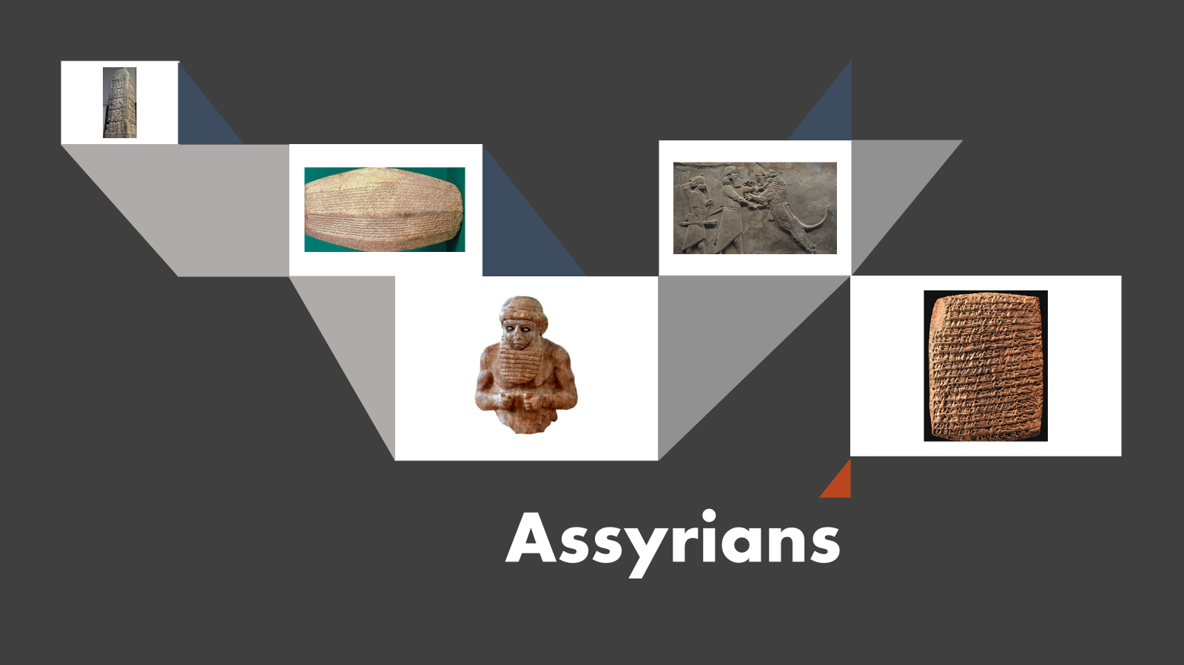
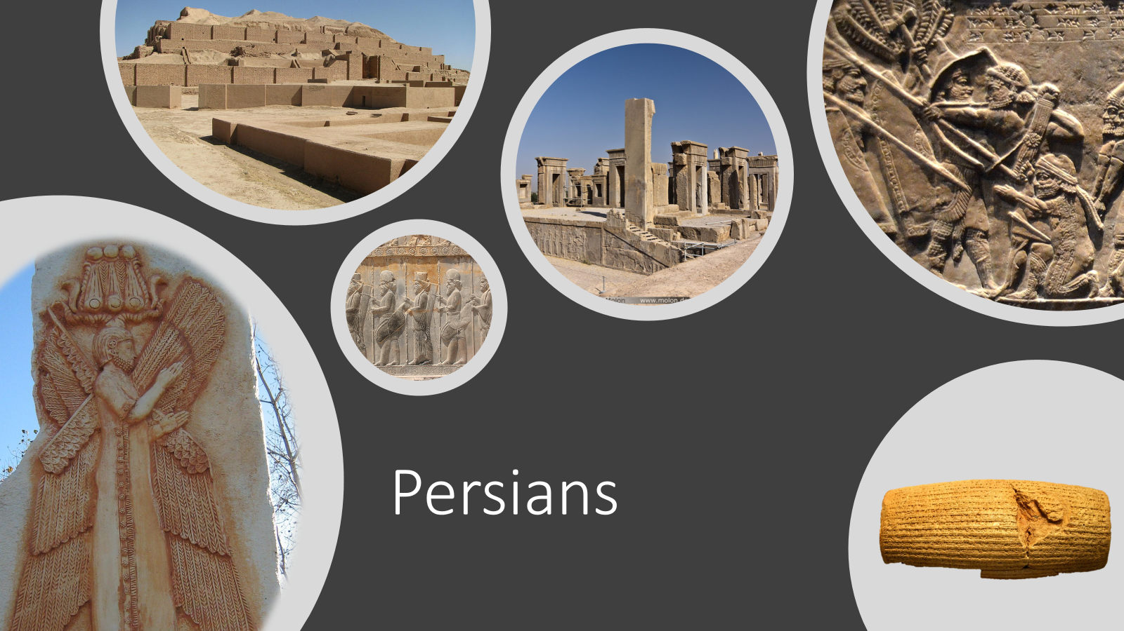
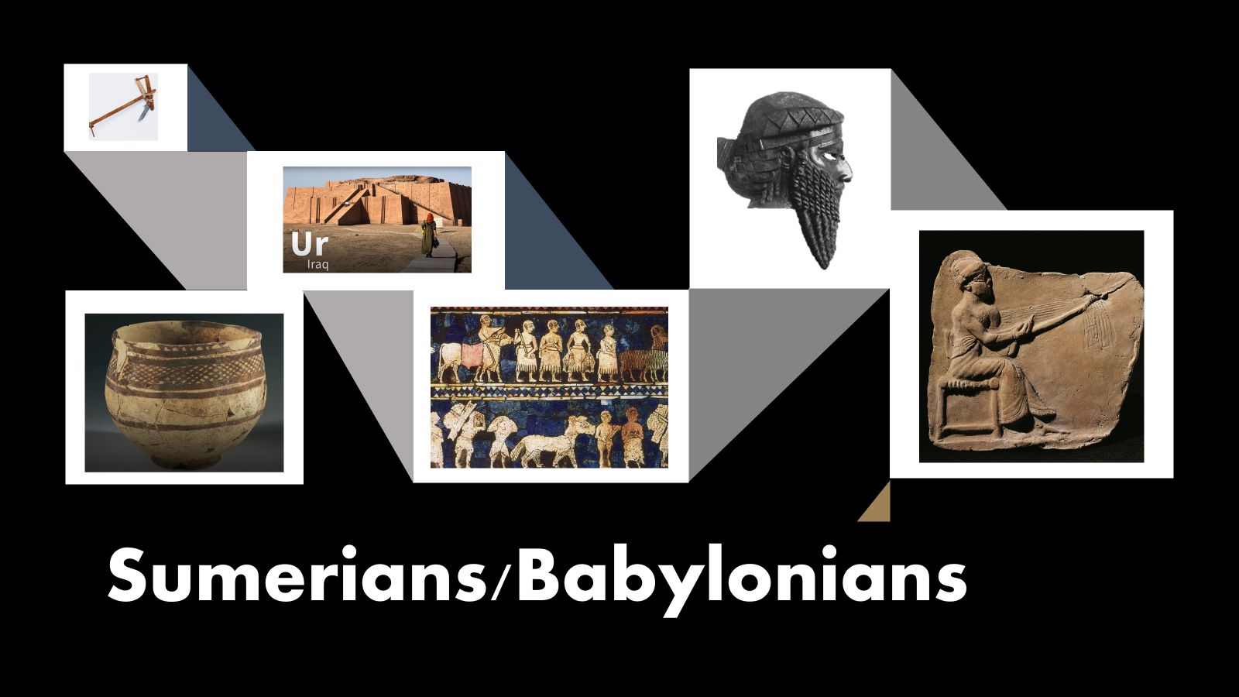
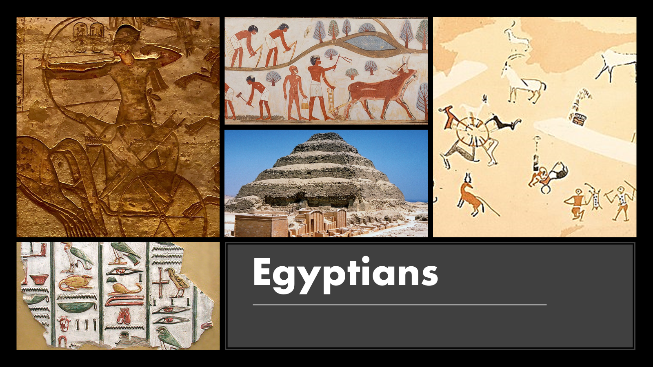

Slide 16
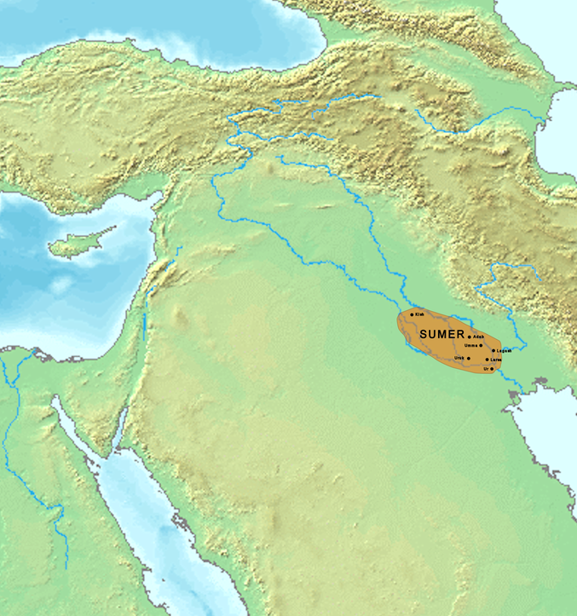
Plains of Shinar
In Genesis, after the flood, the majority of the people settled in the “Plains of Shinar” (Gen 10.10; 11.2; 14.1,9), which is lower Mesopotamia.
Archeology found there some of the most ancient cities on earth and from there is believed a major migration started to the corners of the earth.

Slide 17
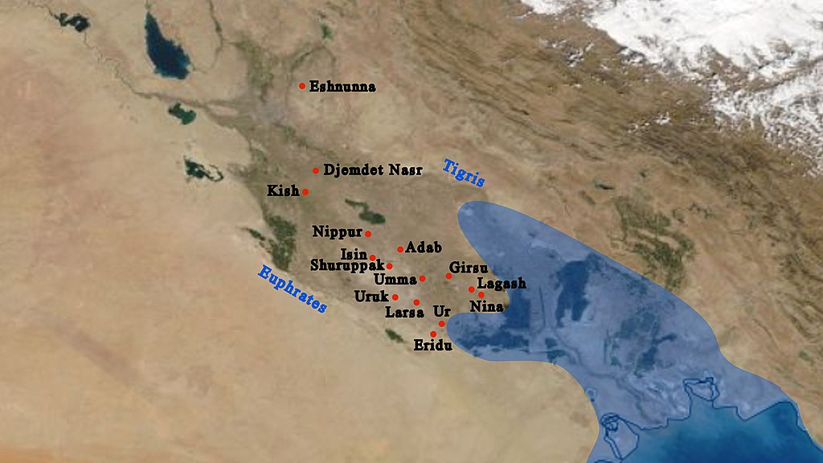
Map of the cities of Mesopotamia (now Iraq) in the 2nd millennium BC.
Source: Wikicommons

Slide 18
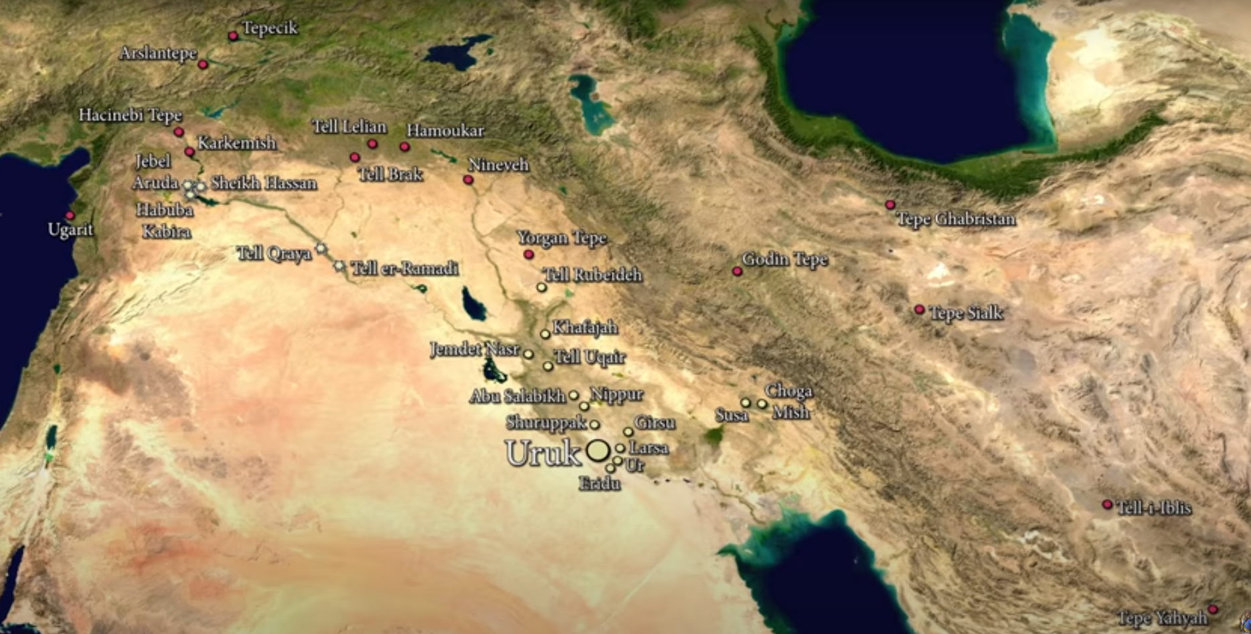
Mesopotamia (circa 3200 B.C.)
Source: The Birth of Civilisation - Rise of Uruk (6500 BC to 3200 BC) - YouTube

Slide 19
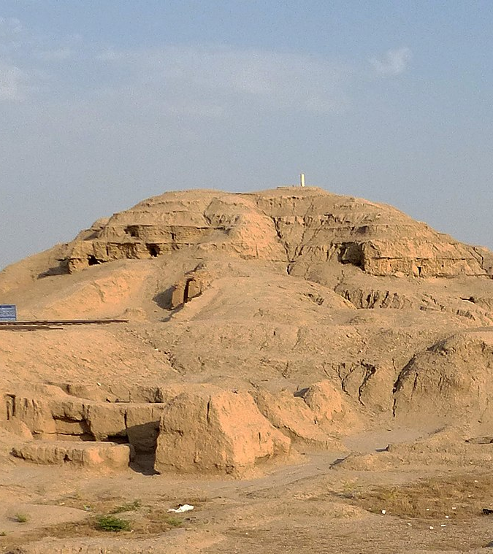
Building of Towers
Among the knowledge carried out of the ark, was the capacity of engineering towers. This was further developed. Ancient towers in pyramidal shape are found in the 4 millennia B.C. on in several parts of the Ancient World, mainly in the Mesopotamia and Egypt.
White Temple ziggurat in Uruk
Source: wikicommons

Slide 20
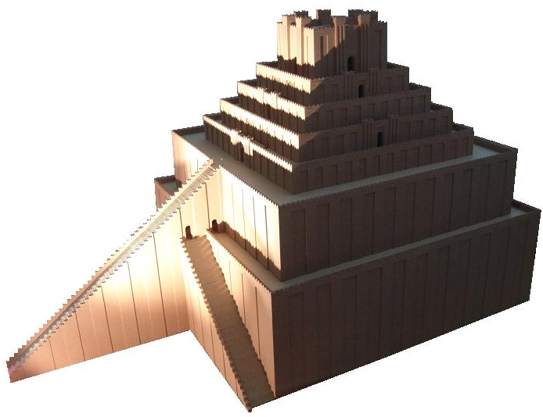
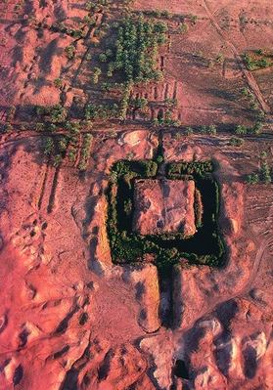
Etemenanki
On the left a drawing of how it was believed to be with 300 ft in height.
Below an aerial view of the site.
The Etemenanki ziggurat,
located 56 miles south of
Bagdad, where was ancient Babylon, is one the candidates to be the “Tower of Babel”. It was build in honor to God Marduk and it is mentioned in the Eluma Elish account. Its date in debated. But most schoolars believe it is from the 27th century b.C. Some defend it was never finished.

Slide 21
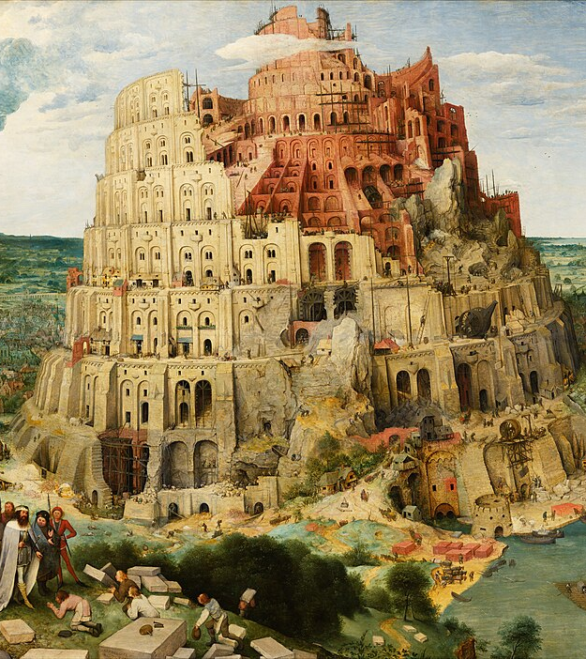
Formation of the Ethnicities
The last event of the old world is the division of humanity. God confused the language of people building the tower of Babel in the plain of Shinar and by that formed difference ethnicities which spread throughout the world.
Tower of Babel. Oil on Canvas. Pieter Brueghel the Elder.
Kunsthistorisches Museum, Viena
Source: Originally from Google Art Project., Public Domain, https://commons.wikimedia.org/w/index.php?curid=22179117

Slide 22
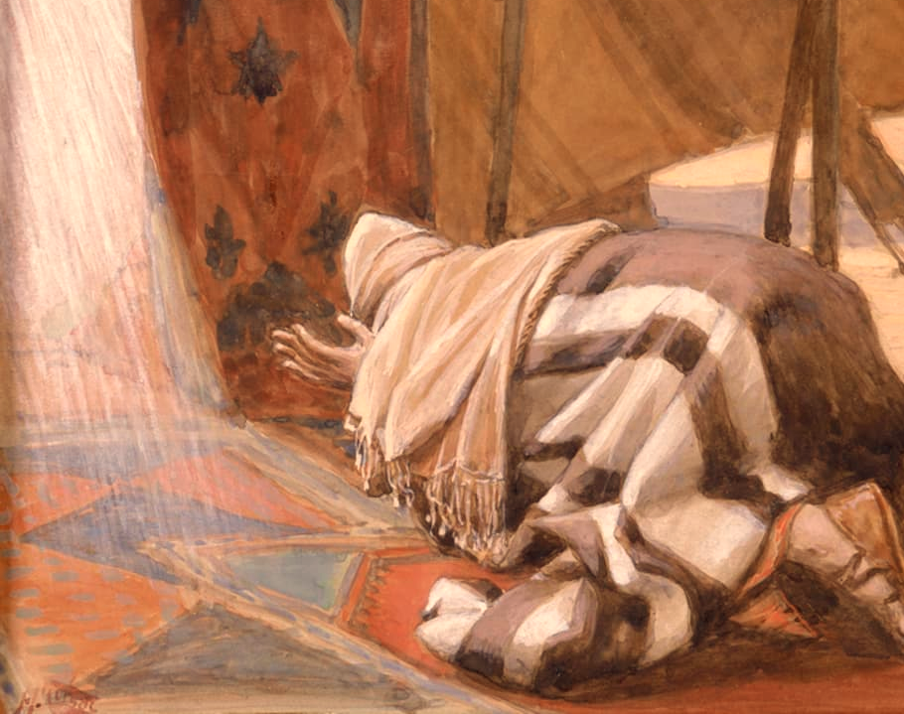
Abram’s Calling
God’s Promises to Abram,
James Tissot (1896-1902), Gouache on board
Source: The Jewish Museum - Collection - God's Promises to Abram
In Genesis chapter 12 God calls a Chaldean from the city of Ur to leave his city and his family, establishing a covenant with him, to make of him a new people to bless to the nations upon the earth.

Slide 23
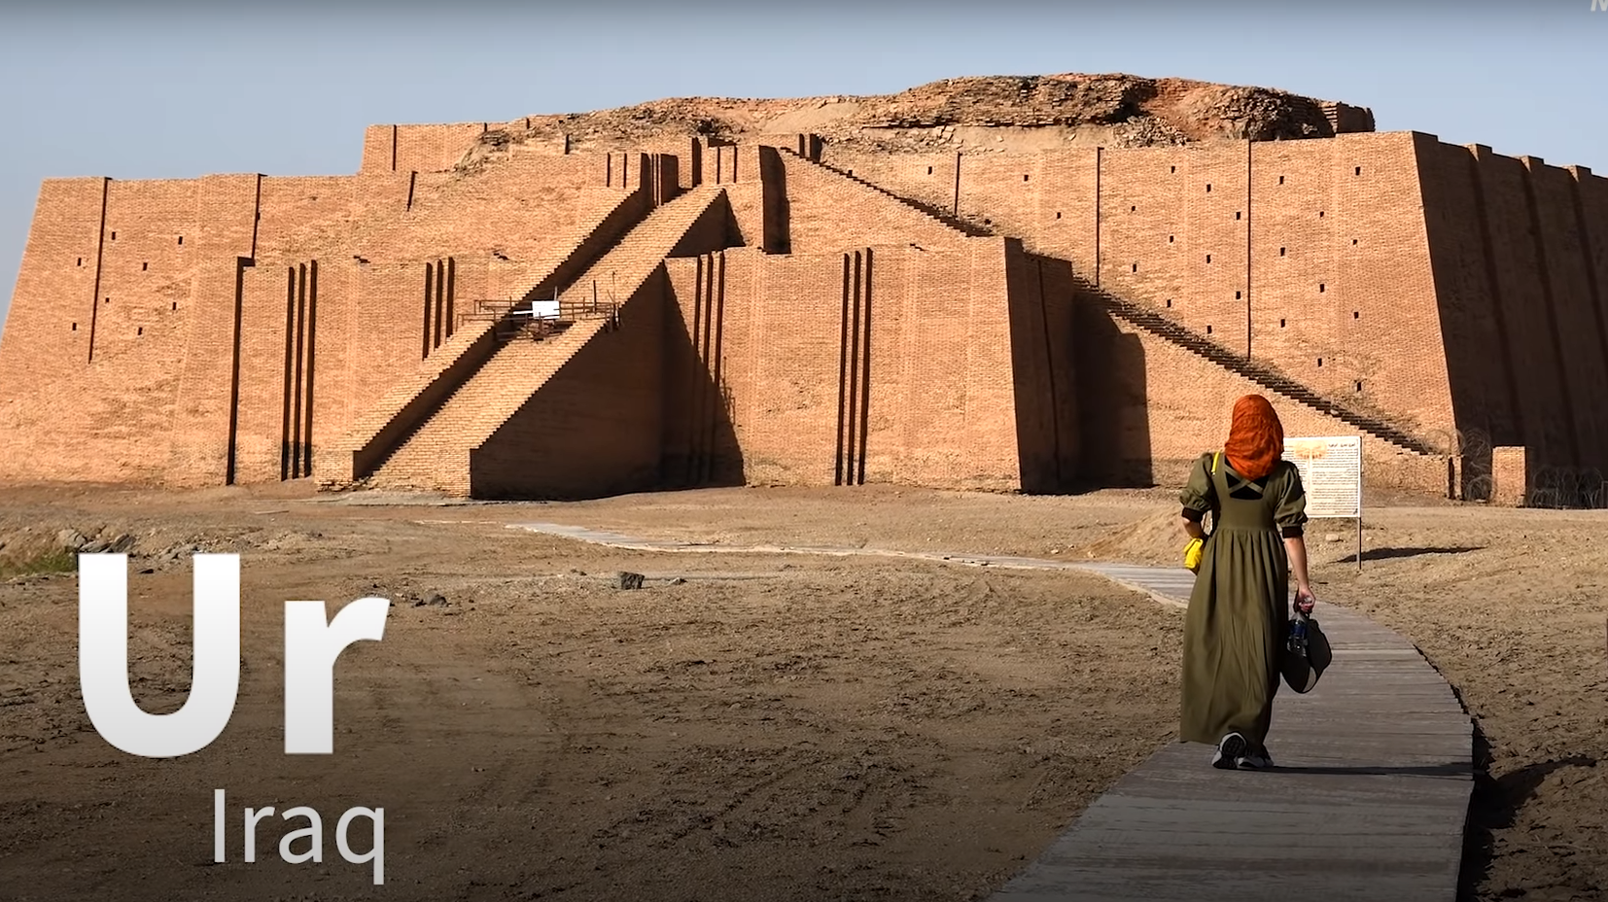
Source: Discover Ur, Iraq - YouTube

Slide 24
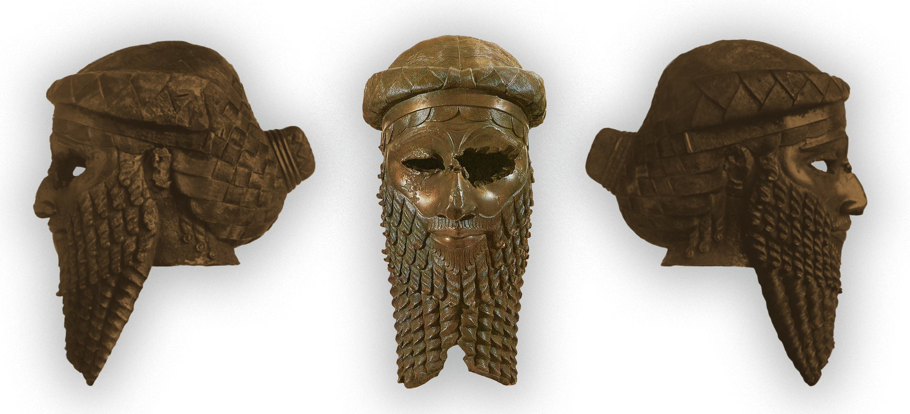
Bronze head of a king of the Old Akkadian dynasty, most likely representing either Naram-Sin or Sargon of Akkad (circa 2300 B.C.). Unearthed in Nineveh (now in Iraq). In the National Museum of Iraq, Baghdad.

Slide 25
Genesis 12:1 Striping of Abaham’s Identify
Country
Kindred
Father’s House

Slide 26
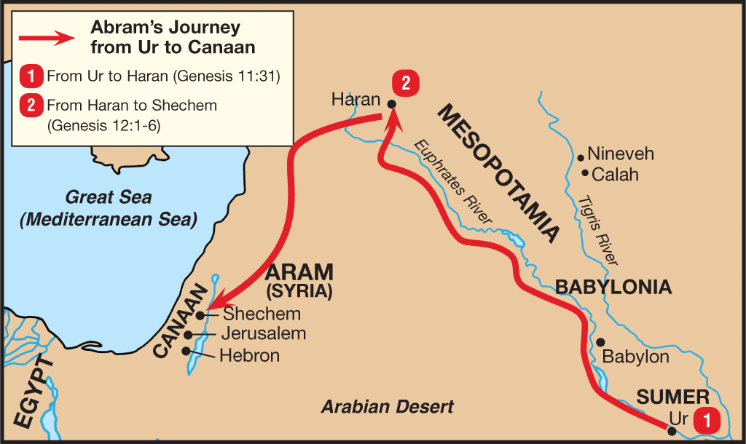
Source: The Beginning of the Blessing – Abraham – Genesis 12-25 | Upwards Church

Slide 27
Promisse (Gen 12:2)
The Lord’s promises to Abraham:
Make You a great nation
Make your name great
Be a Blessing (“in you all the families of the earth shall be blessed”, v. 3)

Slide 28
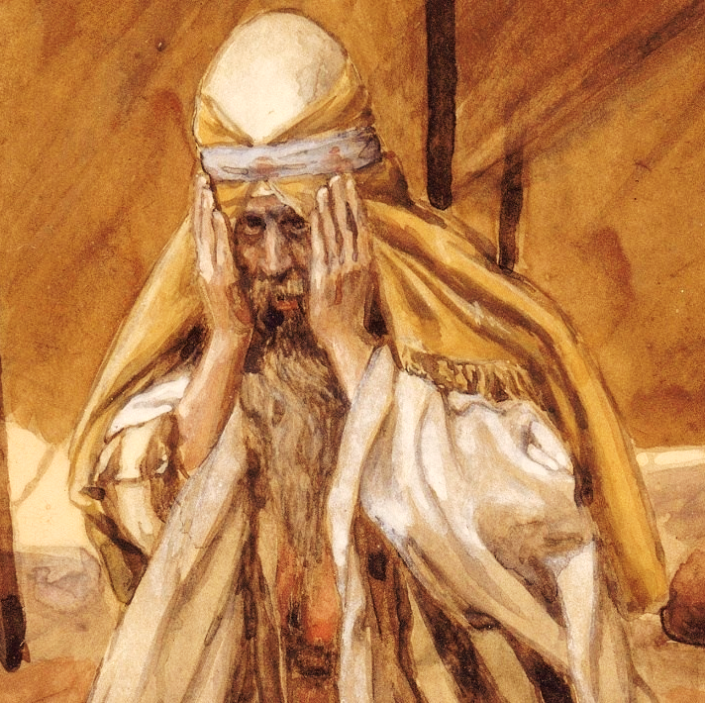
“In You”
God’s promise to Abraham is that “through” him all the ethnicities of the earth would be blessed. This promise accentuates the mediatorial role of Abraham descendancy in the redemptive plan (Gal 3:8, 16).
Jacques Joseph Tissot (1836-1902): God Renews His Promises to Abraham

Slide 29
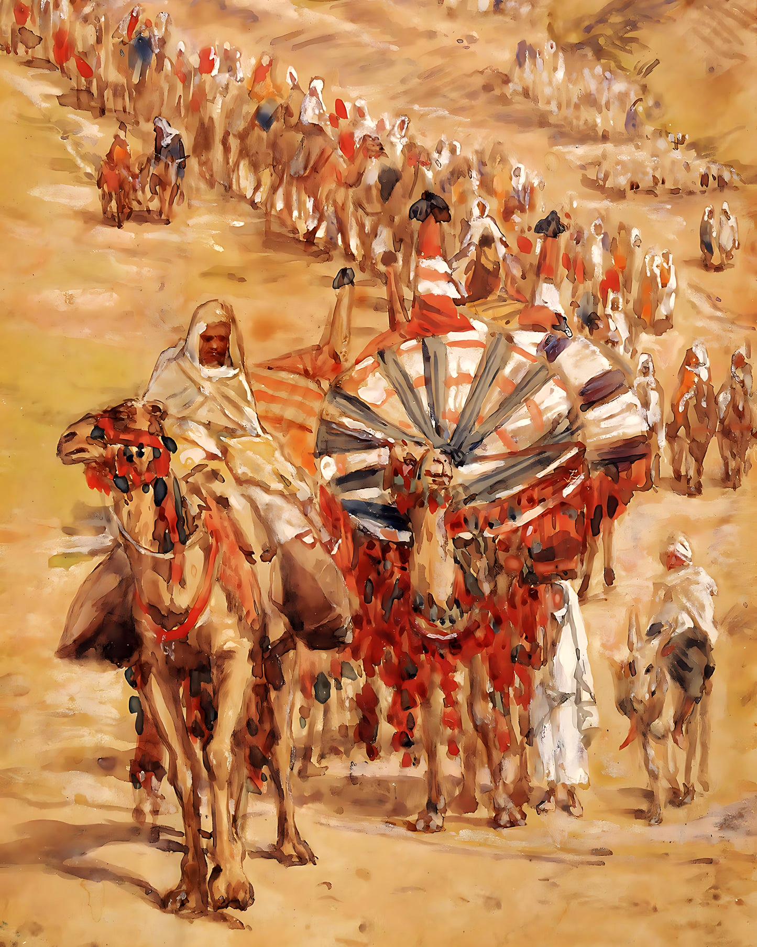
Blessing
To fulfill the purpose of the Covenant, the Lord made a direct promise of blessing to Abraham. While this blessing is often mistakenly attributed solely to Israel, Scripture reveals it as a personal assurance to Abraham himself, intended for the preservation and flourishing of his life
Abraham’s journey. Watercolor by James Tissot (1903)

Slide 30
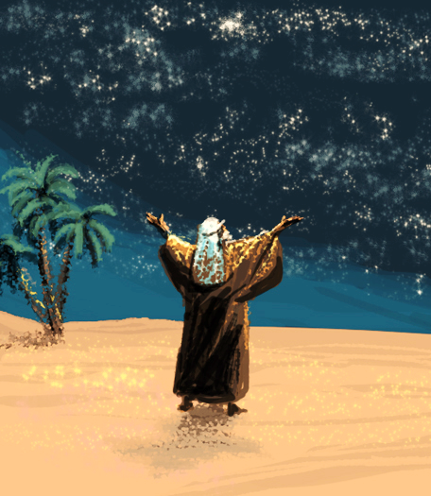
Faith of Abraham
Abraham take matters into his own hand and has a son with his Sarah’s servant, Hagar. The Lord appears to him again to renew his covenant with Abraham. The Lord tell him that Ishmael should not be his heir (15:4). Showing Abraham the starts the Lord promises his descendants will be as many as the starts in Heaven. Upon this promise Abraham believes. His faith bring justification to Abraham (Gen 15:6).

Slide 31
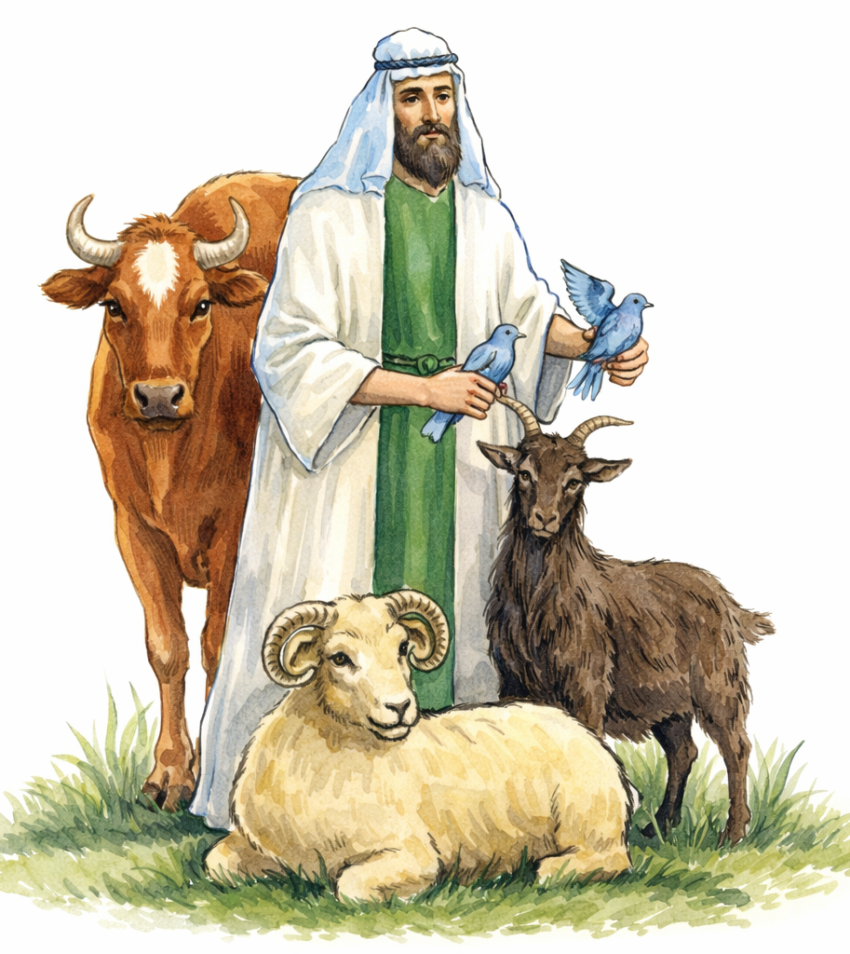
Justification by Faith
Paul argues in Romans 4 that faith was the instrument of salvation in the Old Testament. Abraham was not justified by works, but by faith (Rom 4:3-5). He argues he was saved as any person in the New Covenant (Rom 4:16).

Slide 32
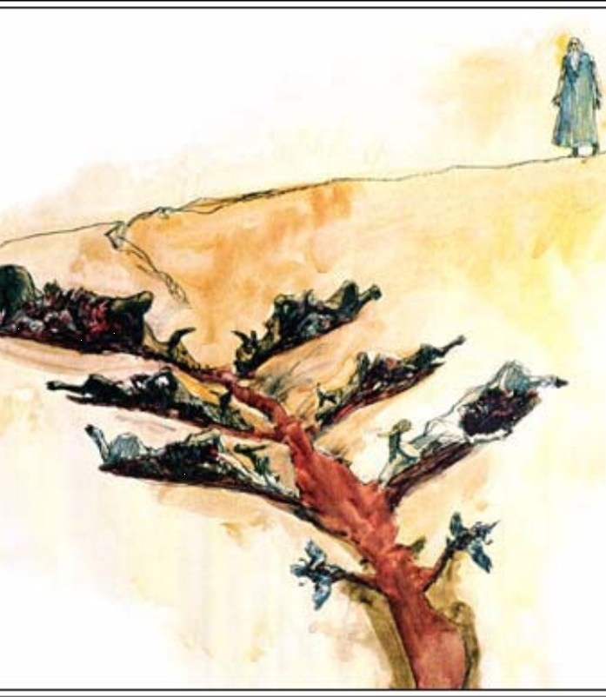
Cutting a Covenant
The Covenant with Abraham is sealed with a ceremonial commitment. Abraham is ordered to cut in half heifer, a goat, a ram, a turtle dove and a pigeon and set each half against the other, forming a walk in the middle. Only the Lord passes through the parts with fire and therefore seals his covenant with Abraham. He alone is the guarantor of the Covenant.

Slide 33
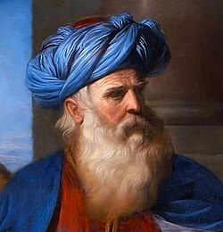
Sacrament of the Abrahamic Covenant
The Lord renews his covenant with Abraham one more time before giving him a son. The Lord changes his name from Abraam to Abraham, meaning “Father of a nation” and commands his a sacramental symbol of his Covenant with Abraham, circumcision. Paul explains that the circumcision was not an instrument of salvation, but sacramental sign of the faith (Rom 4:11).

