Slide 1
Doctrine of the Covenant
Unfolding the Divine Covenants: A Journey Through Scripture

Slide 2

Plan of Salvation: Overlap of the Covenants
†
Christ’s Return
*
Old Testament
New Testament
EDEN
Covenant of Works
Covenant of Grace

Slide 3
Different Administrations
Partial Knowledge of Grace conveyed by the law and sacrificial system. Sacraments proper to the knowledge and purpose. Salvation by grace through faith.
Full Knowledge of God’s Grace through the revelation of God’s Son, Jesus Christ. Sacraments are proper to the realized act of redemption. Salvation by Grace through faith.

Slide 4

Progression of the Revelation
In the Covenant of Grace, God revealed himself progressively (Heb 1:1-2). Knowledge of Him and his salvation was built through centuries as he disclosed his will through different ways, reaching its fullness in Christ (Joh 1:17). The law in the Old Testament was given as one stage in the progression of knowledge of God’s salvation by Grace (Heb 3:3-6).

Slide 5
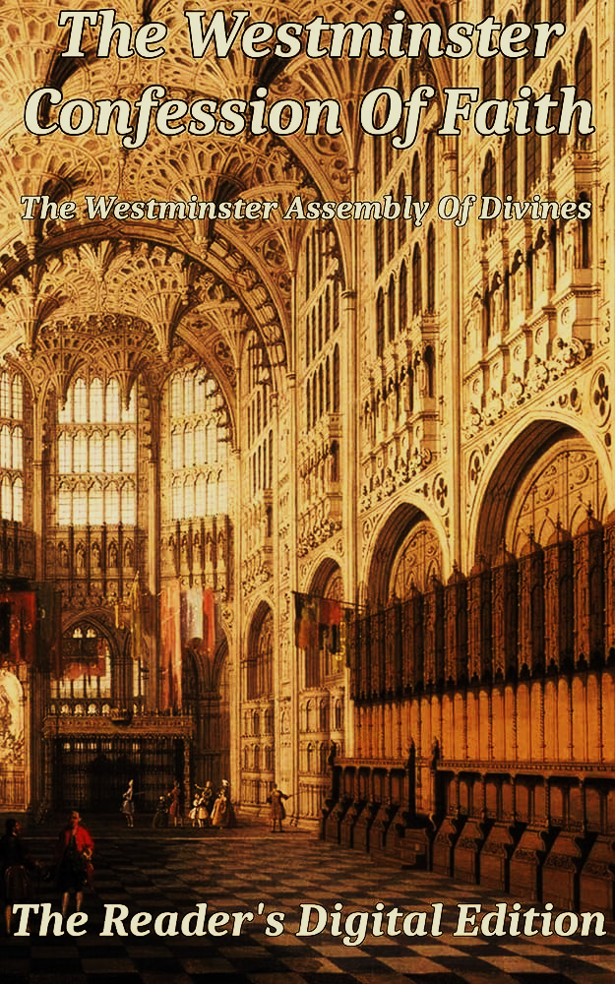
Of God’s Covenant With Man (7.6)
Under the gospel, when Christ, the substance, was exhibited, the ordinances in which this covenant is dispensed are the preaching of the Word, and the administration of the sacraments of baptism and the Lord’s Supper: which, though fewer in number, and ministered with more simplicity, and less outward glory, yet, in them, it is held forth in more fullness, evidence, and spiritual efficacy, to all nations, both Jews and Gentiles; and is called the new testament. There are not therefore two covenants of grace, differing in substance, but one and the same, under various dispensations.
Col 2:17; 1Cor 1:21; Mat 28:19-20; 1Cor 11:23-25; Heb 12:22-24; 2 Cor 3:9-11; Luke 2:32; Acts 13:40; Eph 2:15-19; Luke 22:20; Gal 3:8-9, 14, 16; Rom 3:21-22, 30; Rom 4:3, 6-8; Gen 15;6; Psa 32:1-2; Rom 4:16-17; 23-24; Heb 4:2; Rom 10:6-10; 1 Cor 10:3-4.

Slide 6
Various “Dispensations”
In the Reformed circles, this term gained a negative connotation during the 20th century due to the influence of “Dispensational Eschatology”. But what it means in the Westminster Confession of Faith, the Lord related to his people in different times through different modes, i.e., different forms of administration of his grace, which followed the growth in Revelation.

Slide 7
“Temporal” Covenants
God has established within the Covenant of Grace “temporal covenants” with individuals and peoples advancing the purpose of the Covenant of Grace, preparing it for its full completion and revealing especial provisions of the redemption.

Slide 8

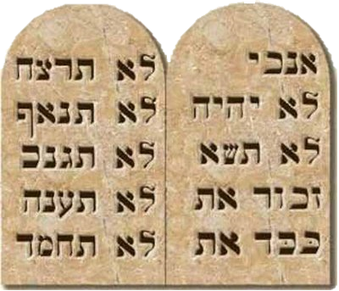
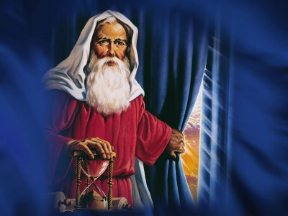
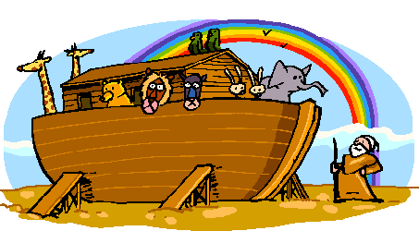
Salvation Plan (Pre-Millennialist)
Covenant of Works
Covenant of Grace
Davidic Covenant
New Covenant
Eternity
Covenant of Sinai
Abrahamic Covenant
†
Noahic Covenant
Adamic Covenant
Christ’s Return
*
EDEN

Slide 9
Sons of God Versus Sons of Man
After Adan was expelled from the Garden of Eden, two contingents come out of him. One after Cain (Gen 4:17) and another from Seth (Gen 4:25, 5:3-4), after the death of Abel. These two contingents lead to the formation of two distinct peoples: the sons of God, from the lineage of Seth (Gen 4:26) and the sons of man, after the lineage of Cain (Gen 4:19-24). These contingents were not defined by race, or place, or language, or culture, or knowledge, but faith.

Slide 10

Blurred Lines
The problem arises when the sons of God mingle with the sons of man’s daughters (Gen 6:2-3). The Lord decides to make a new beginning choosing the family of Noah (Gen 6:5-7). God’s people were being unfaithful.

Slide 11
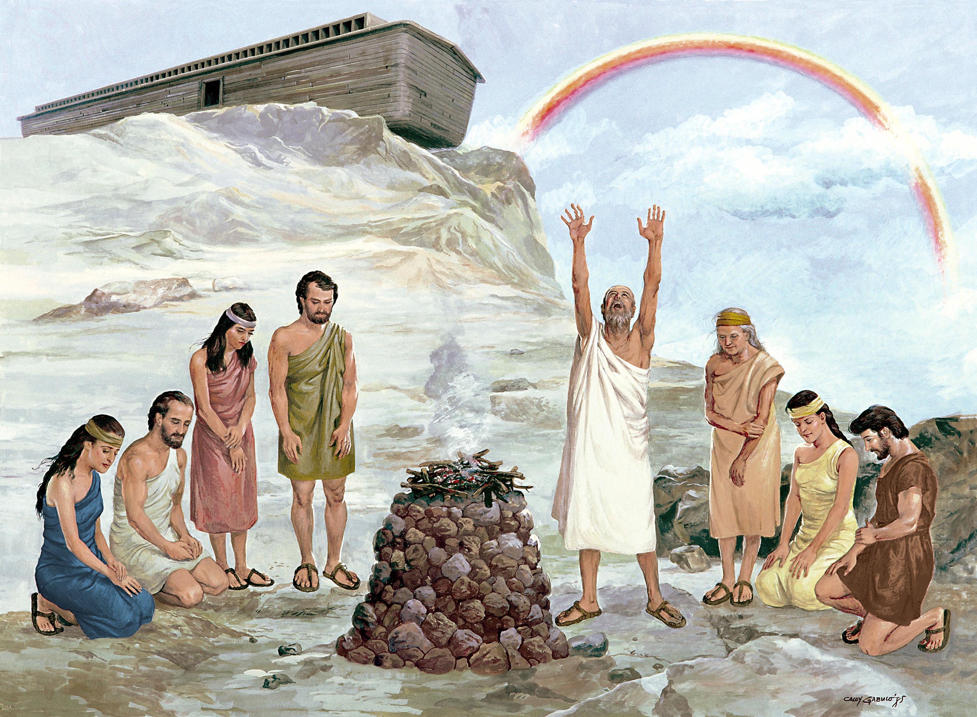
Covenant With Noah
The first thing Noah does after leaving the ark is build an altar and worship the God (Gen 8:20-21). The Lord appears to him an makes a covenant with as a representative of the whole creation (Gen 9:8-10), consequently with all humanity.

Slide 12
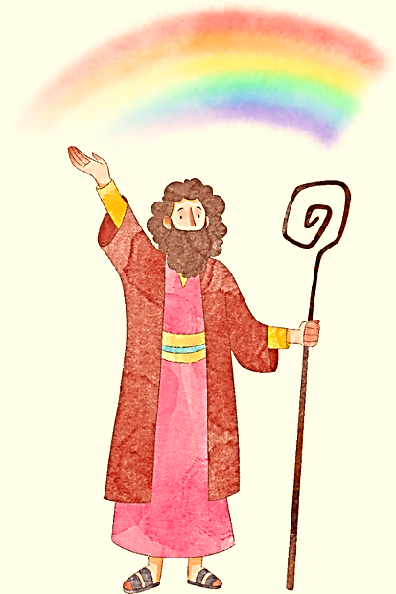
Covenant Renewal
This is not a new covenant, but the renewal of the covenant of grace built upon the covenant of works. We see overlapping elements with an increase in redemptive knowledge.
  Parties: God and Noah (mediator of humanity)
  Goal: Life (preservation of life), assurance of promises

Slide 13
Mandates of the Covenant of Works
Social
Cultural
Spiritual

Slide 14
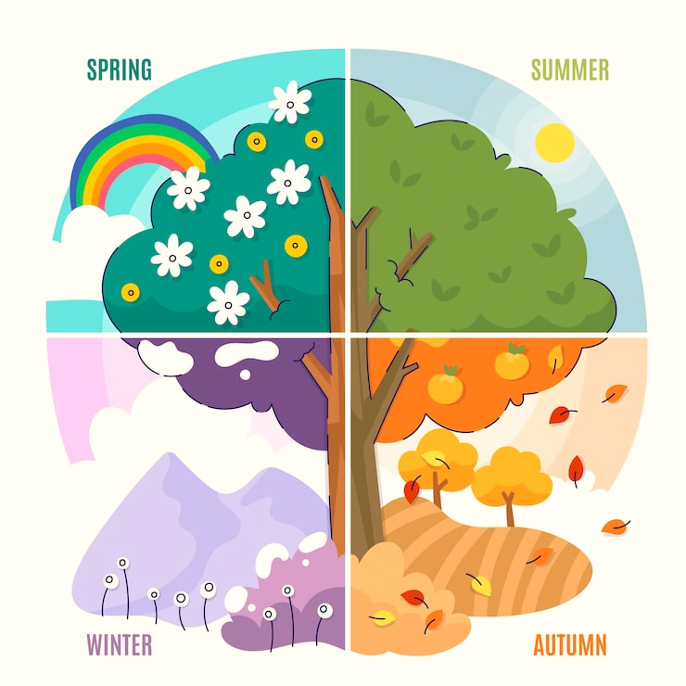
Terms of the Noahic Covenant
Continuous Seasons (Gen 8:22, 9:11)
Social Mandate (Gen 9:1, 7; as in 1:28)
Dominion (Gen 9:2-3; as in 1:26)
Prohibition of eating blood (Gen 9:4)
Moral Law (Gen 9:5-6)
Covenantal Sign (Gen 9:12-17)

Slide 15
What does it accomplish?
Re-organizes creation under the reality of corruption.
Family is again placed at the center of creation (Social mandate).
Dominion is reestablished to man for the fulfillment of the Cultural mandate (liberty to eat meat).
Sets human life as valuable above all others in the moral scale.
Promises humanity continuation (grace extended).
Assures God’s graceful promise of continuation of humanity through signs.

