Slide 1
Doctrine of the Covenant
Unfolding the Divine Covenants: A Journey Through Scripture

Slide 2

Plan of Salvation: Overlap of the Covenants
†
Christ’s Return
*
Old Testament
New Testament
EDEN
Covenant of Works
Covenant of Grace

Slide 3
Different Administrations
Partial Knowledge of Grace conveyed by the law and sacrificial system. Sacraments proper to the knowledge and purpose. Salvation by grace through faith.
Full Knowledge of God’s Grace through the revelation of God’s Son, Jesus Christ. Sacraments are proper to the realized act of redemption. Salvation by Grace through faith.

Slide 4

Progression of the Revelation
In the Covenant of Grace, God revealed himself progressively (Heb 1:1-2). Knowledge of Him and his salvation was built through centuries as he disclosed his will through different ways, reaching its fullness in Christ (Joh 1:17). The law in the Old Testament was given as one stage in the progression of knowledge of God’s salvation by Grace (Heb 3:3-6).

Slide 5

Of God’s Covenant With Man (7.6)
Under the gospel, when Christ, the substance, was exhibited, the ordinances in which this covenant is dispensed are the preaching of the Word, and the administration of the sacraments of baptism and the Lord’s Supper: which, though fewer in number, and ministered with more simplicity, and less outward glory, yet, in them, it is held forth in more fullness, evidence, and spiritual efficacy, to all nations, both Jews and Gentiles; and is called the new testament. There are not therefore two covenants of grace, differing in substance, but one and the same, under various dispensations.
Col 2:17; 1Cor 1:21; Mat 28:19-20; 1Cor 11:23-25; Heb 12:22-24; 2 Cor 3:9-11; Luke 2:32; Acts 13:40; Eph 2:15-19; Luke 22:20; Gal 3:8-9, 14, 16; Rom 3:21-22, 30; Rom 4:3, 6-8; Gen 15;6; Psa 32:1-2; Rom 4:16-17; 23-24; Heb 4:2; Rom 10:6-10; 1 Cor 10:3-4.

Slide 6
Various “Dispensations”
In the Reformed circles, this term gained a negative connotation during the 20th century due to the influence of “Dispensational Eschatology”. But what it means in the Westminster Confession of Faith, the Lord related to his people in different times through different modes, i.e., different forms of administration of his grace, which followed the growth in Revelation.

Slide 7
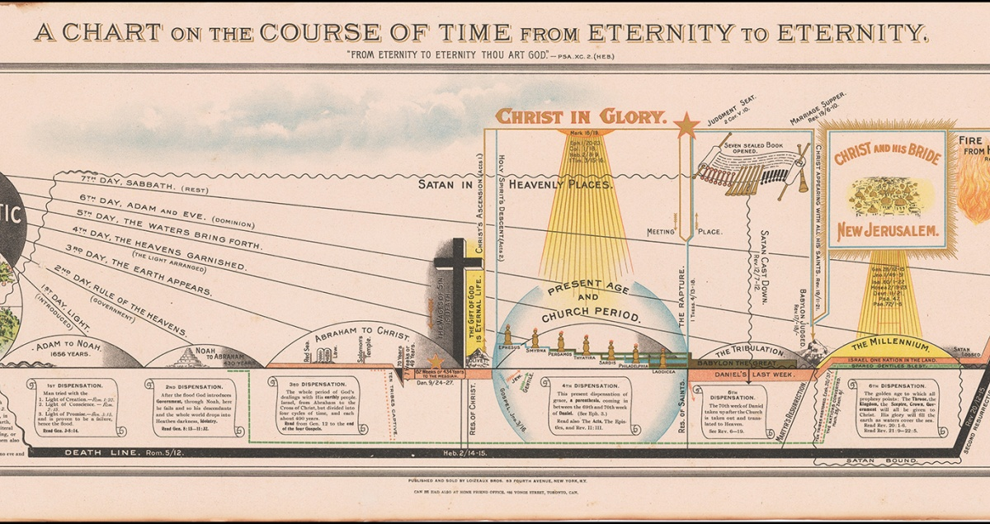
Dispensational System

Slide 8
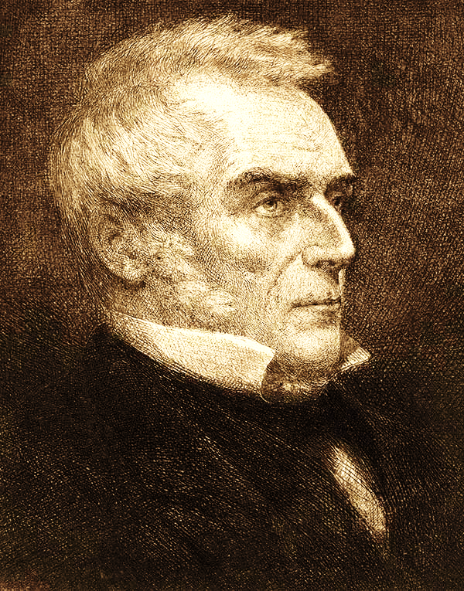
Origin of Dispensationalism
John Nelson Darby (1800-1882) was the founder of modern dispensationalism. Born in London, he was ordained in the Church of Ireland but left the denomination as his views changed. Studying Isaiah, he concluded that the “Kingdom of Israel” is a different body from the “Church”. This led him to the belief in a future Millennial Kingdom of Israel. From this perspective, he interpreted the whole history of redemption. Alongside other ministers, he founded the Plymouth Brethren Church around 1831. He spent the rest of his life promoting his views through conferences and writings.

Slide 9
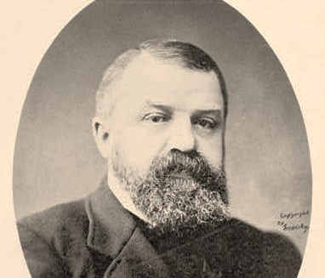
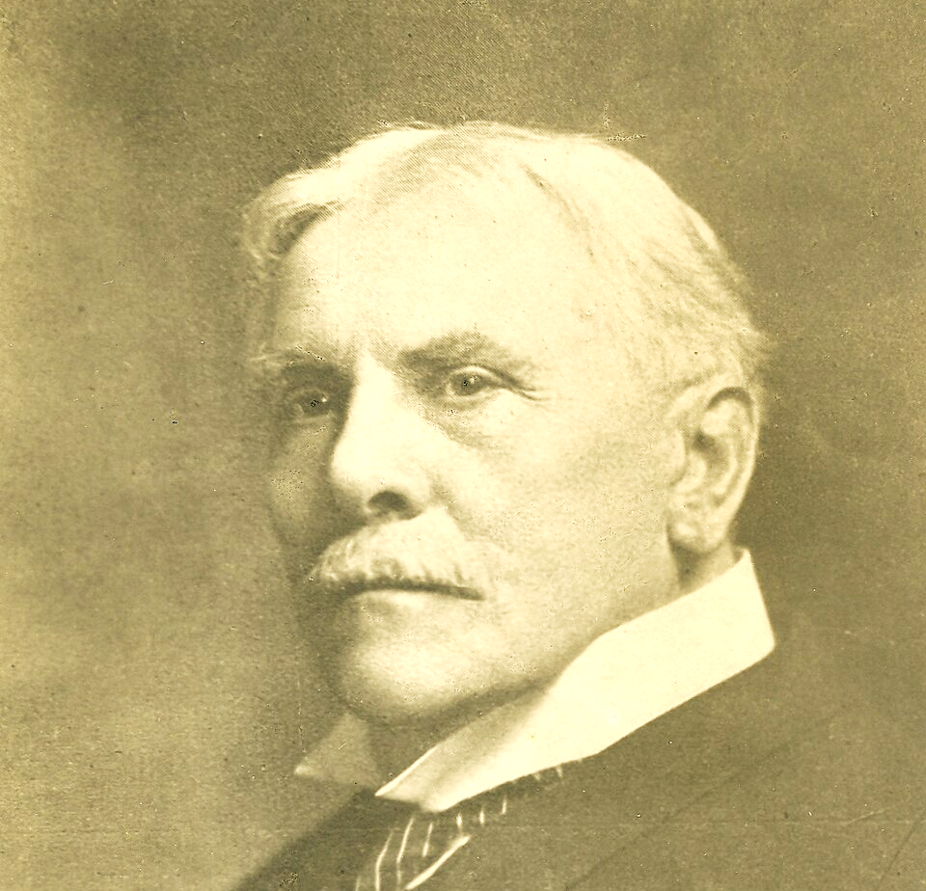
Dissemination
Dispensationalism spread in the
US at the end of the 19th century
Through the Niagara Bible Conference.
Among those adopting this view, Dwight
L. Moody (1837-1899) was the most famous. Through the influence of both, after his conversion, C. I. Scofield (1843-1921) became a Congregational pastor and the most influential Dispensationalist preacher in the US. His Study Bible, published in 1909, became the standard textbook for this doctrine.

Slide 10
Dispensational Beliefs
It is a system of doctrine that uses a literal hermeneutics.
It divides history into “Dispensations” (usually seven), each with a different provision, most ending in judgment after the spiritual failure of the chosen to fulfil God’s will.
It distinguishes sharply “Israel” (or “Kingdom”) from the “Church”, seen both as God’s people under different provisions and each with their respective promises.
It understands the New Testament (present era) to be the time of the Church, which will end with the rapture of the church and a Great tribulation on earth.
After the Tribulation, Christ will return and establish a millennial Kingdom of Israel on earth.

Slide 11
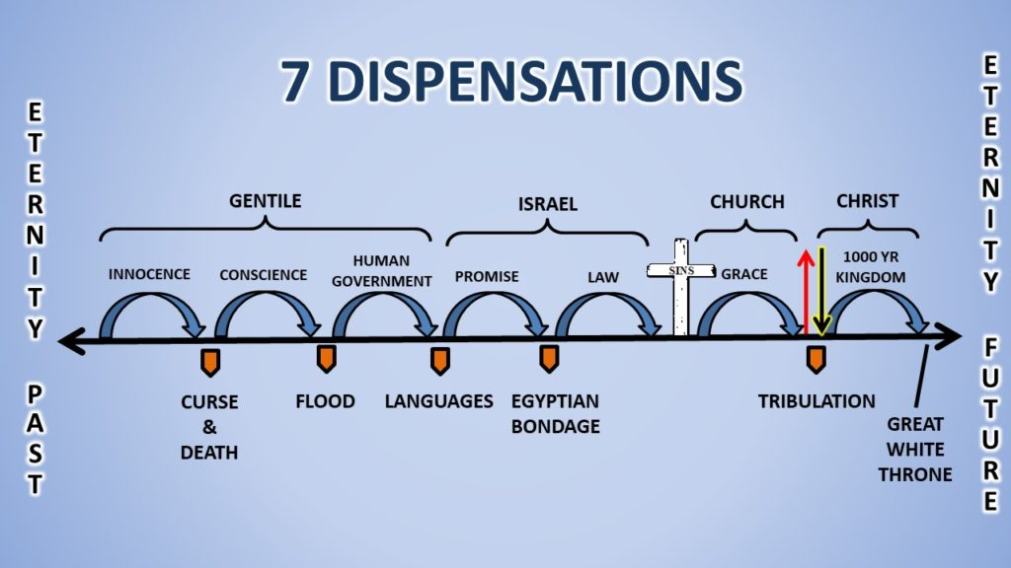

Slide 12
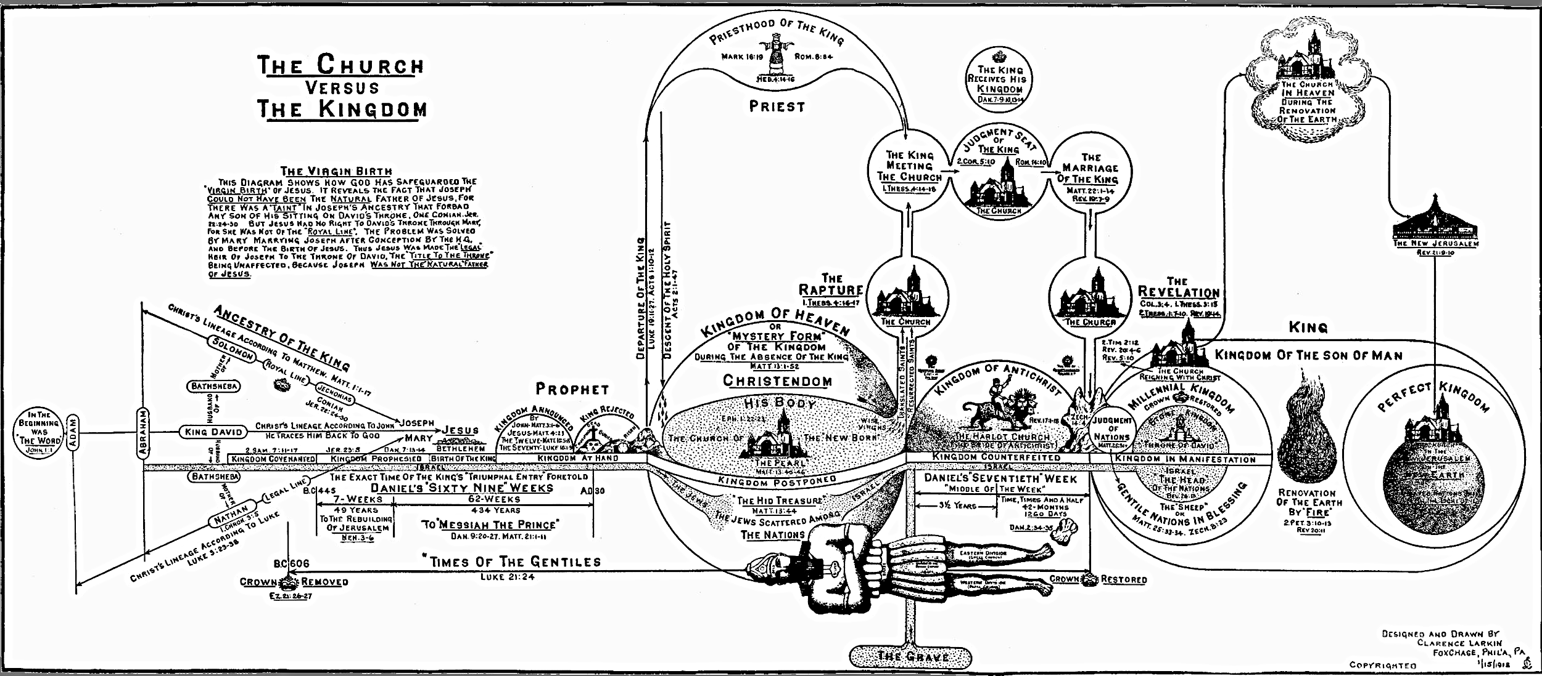

Slide 13

Israel
Israel is the people of God (cf. Gen 12:3). God will restore them in the future (cf. Isa 32).
The church was chosen because Israel rejected the Messiah (Jo 1:11-12). This failure led God to show his love for the world saving Gentiles and promoting jealousy in Israel.
After the “fullness of the gentiles”, the Lord will begin the process of salvation of Israel (cf. Rom 11:25-31).
Israel will be restored spiritually through a revival during the Great Tribulation (Am 9:11-15). The Temple will be rebuilt, and sacrifices restarted.
After the defeat of the Dragon and his army in the battle of Armageddon, Christ will establish the “Kingdom” on earth for a thousand years, reigning as King in Jerusalem over Israel and all the earth in submission to him (Isa 2:2-4; 49:3-6).

Slide 14



Dispensationalist Millennial Kingdom
Church in Heaven
Defeat of Satan and Final Judgment
Rapture of the church
Christ returns and defeats the Anti-Christ in the Battle of
New Heaven and Earth
Rebellion
Lake of Fire
Great Tribulation
Christ’s Millennial Kingdom on Earth

Slide 15

Comparison of Millennial Views
Rapture of the Church
Christ’s Return
Great Tribulation
Millennial Kingdom
Final Rebellion
Age of the Church
Christ’s Return
Eternal Life
Eternal Judgment
Rapture
Great Tribulation
Millennial Kingdom

Slide 16
Different Futurist Positions: Amillennialists
Christ’s Return
Mark 13.14-22
Mark 13.3-13
Great Tribulation
Birth Pains
Rapture

Slide 17
Points of Contention
The “literal” interpretation.
Preference of the OT over the NT.
The emphasis on the literal fulfillment of the OT promises on the “ethnic/national Israel”.
Discontinuity between the OT and NT.
Distinction of God’s people into two separate and distinct groups with different promises and purposes.
Undermining of the salvation by grace.
Notes:
Literal: Understanding of the “seed of Abraham” as the ethnic people of Israel, when scripture is clear that it is not of the flesh. Otherwise, what blessings is there over Ishmaelites?
The literal interpretation of the OT contradicts the key principle of the light of the NT over the OT.
Undermining of the Universal Church. Paul is clear in the Hebrews 11 that the cloud of witnesses is waiting for us. Are these only Israelites?
How were the OT people saved?

Slide 18
Points of Confusion
Dispensationalism leads to “Christian Zionism”. Here are some the main areas of confusion caused by this view:
Christians end up settling for a smaller kind of God’s love. They see themselves as a second-class of “elect”.
Legalistic tendency of looking to the OT law as prescriptive.
Defense of a subservient role of the church to Israel.
Emphasis on the importance of the “land of Israel”.
All of the above leads to the geo-political unconditional support of Israel. The church is led to engage publicly in politics. The lines between church and state get blurred (if not erased).

Slide 19
Biblical Critique
The text of Gen 12:3 does not have Israel as the subject, but Abraham. It was promised that through him all peoples would be blessed.
Amos 9:11 is interpreted in Acts 15:13-19 as being fulfilled in the conversion of Gentiles.
Jesus spoke of being a shepherd of one fold (Joh 10:16).
Jesus is sitting on the throne now (Col 3:1; 1 Pe 3:22). He reigns now (1 Cor 11:15). His future coming is the fruit of his ruling now.
Paul is clear about Jesus dividing the wall of Separation between Israelites and Gentiles, uniting them under one body (Eph 2:13-21). The apostle teaches the unity of all under Christ (Galatians 3:28; 6:14-15).

Slide 20
Biblical Critique
Paul defends the salvation by faith of Abraham, uncircumcised, before the law, in the same way as any gentile (Rom 4:11, 16-17). He affirms the Jew has no advantage (Rom 2:28-3:1).
Consequently, Paul clearly teaches that the descendants of Abraham are not according to the flesh (Rom 9:6-8; Gal 6:16; Philippians 3:3).
Hebrews is clear that the OT sacrificial system was a shadow of things to come (Heb 10:1-8), which was now abolished (Heb 8:13). There is no sense in rebuilding the Temple.
Why interpret the 1000 years literary and not 144 thousand as well?

Slide 21

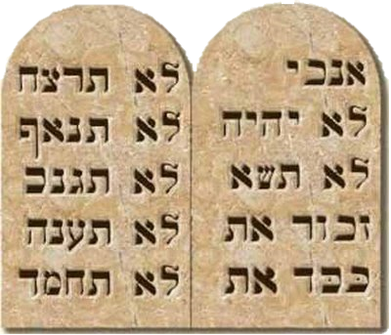
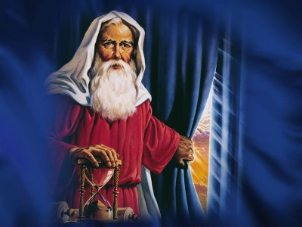
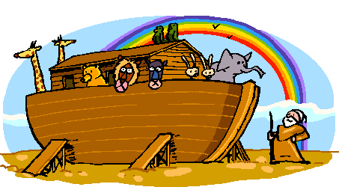
Stages of the Convenant of Grace
†
Gen 3.15
Gen 6.18
Gen 15.18
Exo 24.7-8
Jos 24.25
Neh 9.38
2 Chr 7.18
*
ÉDEN

Slide 22
Salvation Plan
Covenant of Works
Covenant of Grace
Davidic Covenant
New Covenant
Eternity
Covenant of Sinai
Abrahamic Covenant
†
Noahic Covenant
Adamic Covenant
Christ’s Return
*
EDEN

