Slide 2
May the Peoples Praise You
CCLI #50180610
Text: Keith Getty, Kristyn Getty, Stuart Townend, Ed Cash, and David Zimmer
Music: Keith Getty, Kristyn Getty, Stuart Townend, Ed Cash, and David Zimmer

Slide 3
You have called us out of darkest night,
Into Your glorious light,
That we may sing the wonders of
the risen Christ.
May our ev’ry breath retell the grace
That broke into our strife
With boundless love and deepest joy,
with endless life.

Slide 4
May the peoples praise You,
Let the nations be glad!
All Your blessing comes that we may praise,
May praise the name of Jesus.

Slide 5
All the earth is Yours and all within,
Each harvest is Your own,
And from Your hand we give to You,
to make Christ known.
May the seeds of mercy grow in us
For those who have not heard,
May songs of praise build lives of grace
to spread Your Word.

Slide 6
May the peoples praise You,
Let the nations be glad!
All Your blessing comes that we may praise,
May praise the name of Jesus.

Slide 7
This our holy priv’lege to declare
Your praises and Your Name
to ev’ry nation, tribe, and tongue
Your church proclaim.
May the peoples praise You,
Let the nations be glad!
All Your blessing comes that we may praise,
May praise the name of Jesus.

Slide 8
Holy, holy is the Lord Almighty.
Worthy, worthy is the Lamb who was slain.
Holy, holy is the Lord Almighty.
All creation praise Your glorious Name.
May the peoples praise You,
Let the nations be glad!
All Your blessing comes that we may praise,
May praise the name of Jesus.

Slide 10
Doctrine of the Covenant
Unfolding the Divine Covenants: A Journey Through Scripture

Slide 11

Plan of Salvation: Overlap of the Covenants
†
Christ’s Return
*
Old Testament
New Testament
EDEN
Covenant of Works
Covenant of Grace

Slide 12
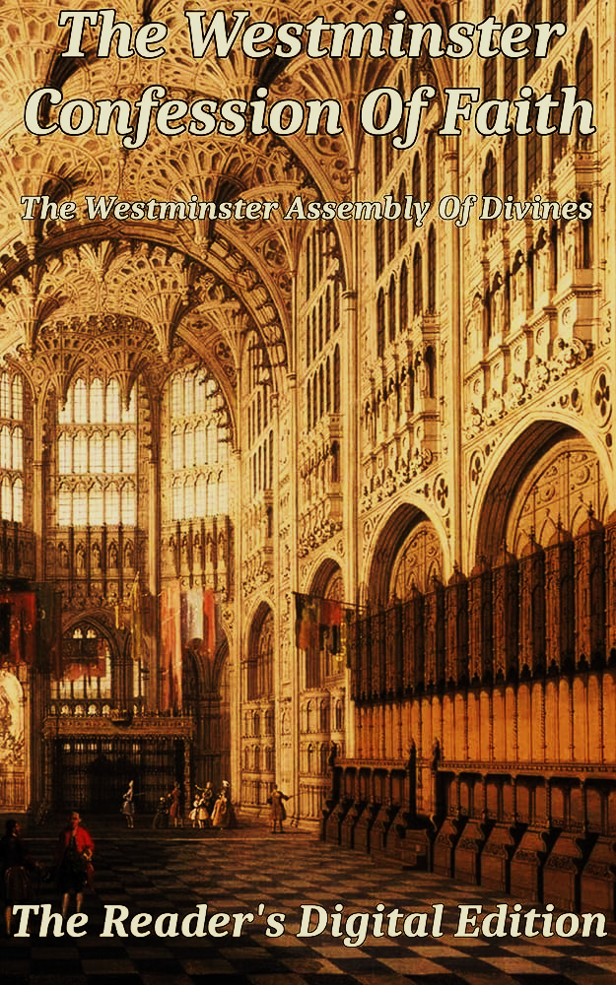
Of God’s Covenant With Man (7.5)
This covenant was differently administered in the time of the law, and in the time of the gospel: under the law, it was administered by promises, prophecies, sacrifices, circumcision, the paschal lamb, and other types and ordinances delivered to the people of the Jews, all fore signifying Christ to come; which were, for that time, sufficient and efficacious, through the operation of the Spirit, to instruct and build up the elect in faith in the promised Messiah, by whom they had full remission of sins, and eternal salvation; and is called the Old Testament.
2 Cor. 3:6–9; [Jo 1:17] Heb. 8–10; Rom. 4:11; Col. 2:11–12; 1 Cor. 5:7.

Slide 13
Different Administrations
Partial Knowledge of Grace conveyed by the law and sacrificial system. Sacraments proper to the knowledge and purpose. Salvation by grace through faith.
Full Knowledge of God’s Grace through the revelation of God’s Son, Jesus Christ. Sacraments are proper to the realized act of redemption. Salvation by Grace through faith.

Slide 14

Progression of the Revelation
In the Covenant of Grace, God revealed himself progressively (Heb 1:1-2). Knowledge of Him and his salvation was built through centuries as he disclosed his will through different ways, reaching its fullness in Christ (Joh 1:17). The law in the Old Testament was given as one stage in the progression of knowledge of God’s salvation by Grace (Heb 3:3-6).

Slide 15
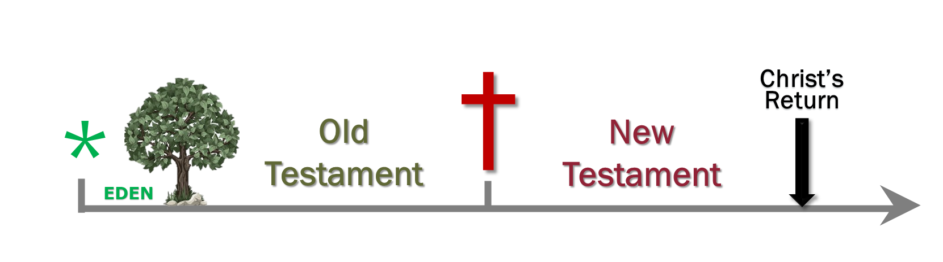
Progression of the Revelation

Slide 16
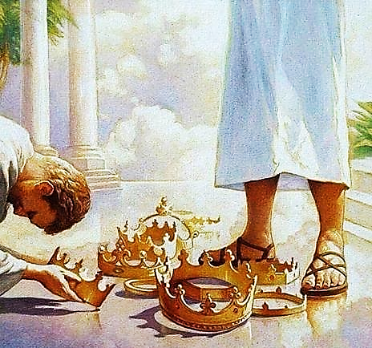
Growth of “Science”
We believe there is more revelation under the New Testament than before. However, those under the New Covenant will never reach full understanding. It will be given by the final redemption, after the resurrection of the body (1 Cor 13:8-13). The full knowledge will render faith unnecessary.

Slide 17
Of God’s Covenant With Man (7.6)
Under the gospel, when Christ, the substance, was exhibited, the ordinances in which this covenant is dispensed are the preaching of the Word, and the administration of the sacraments of baptism and the Lord’s Supper: which, though fewer in number, and ministered with more simplicity, and less outward glory, yet, in them, it is held forth in more fullness, evidence, and spiritual efficacy, to all nations, both Jews and Gentiles; and is called the new testament. There are not therefore two covenants of grace, differing in substance, but one and the same, under various dispensations.
Col 2:17; 1Cor 1:21; Mat 28:19-20; 1Cor 11:23-25; Heb 12:22-24; 2 Cor 3:9-11; Luke 2:32; Acts 13:40; Eph 2:15-19; Luke 22:20; Gal 3:8-9, 14, 16; Rom 3:21-22, 30; Rom 4:3, 6-8; Gen 15;6; Psa 32:1-2; Rom 4:16-17; 23-24; Heb 4:2; Rom 10:6-10; 1 Cor 10:3-4.

Slide 18
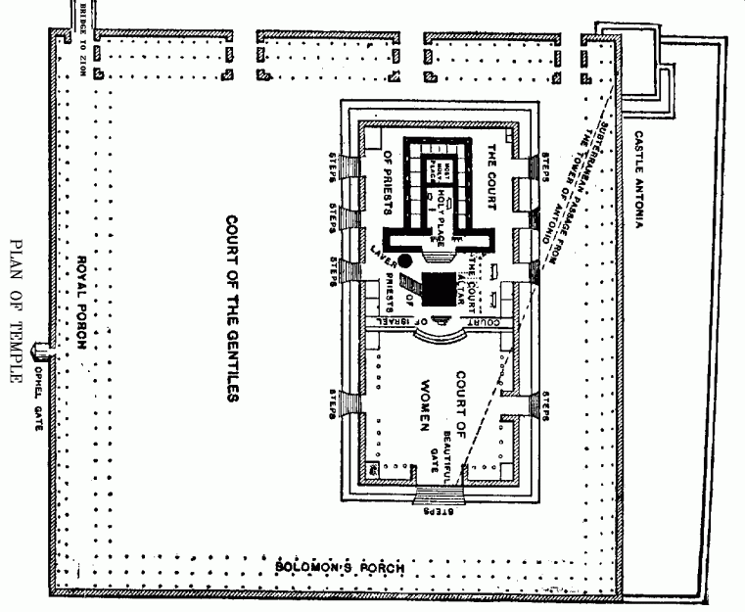
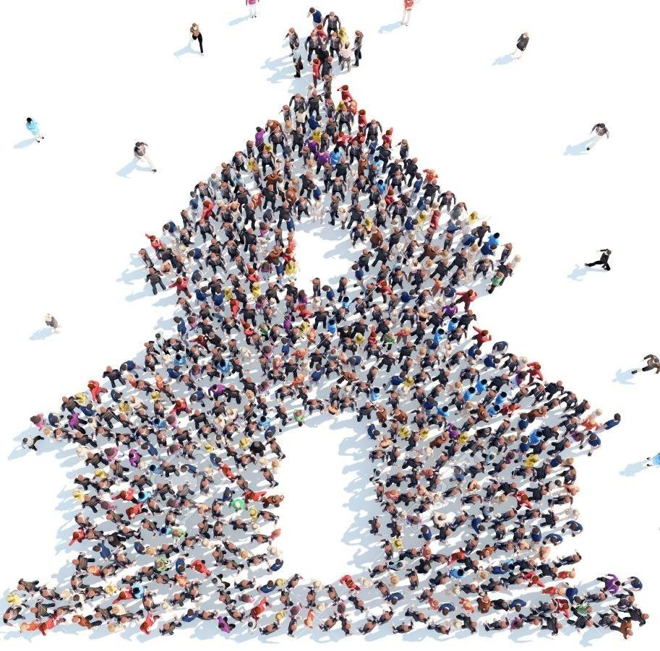
One People
Since the promise of grace in Genesis 3:15, God’s purpose was to save the elect. This was His purpose before the foundation of the earth (Eph 1:4). The Lord has only one people (Eph 2:13-18). In Christ all are united. There is no separate plan for the Jews apart from the gentiles, and vice versa (John 10:14-16, 25-26; 1:10-13; Heb 11:39-40).

Slide 19
Various “Dispensations”
In the Reformed circles, this term gained a negative connotation during the 20th century due to the influence of “Dispensational Eschatology”. But what it means in the Westminster Confession of Faith, the Lord related to his people in different times through different modes, i.e., different forms of administration of his grace, which followed the growth in Revelation.

Slide 20
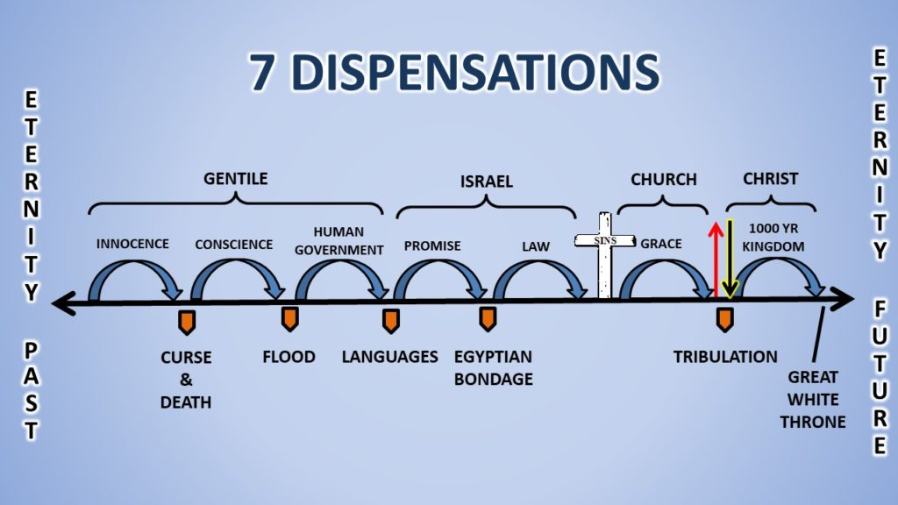

Slide 21
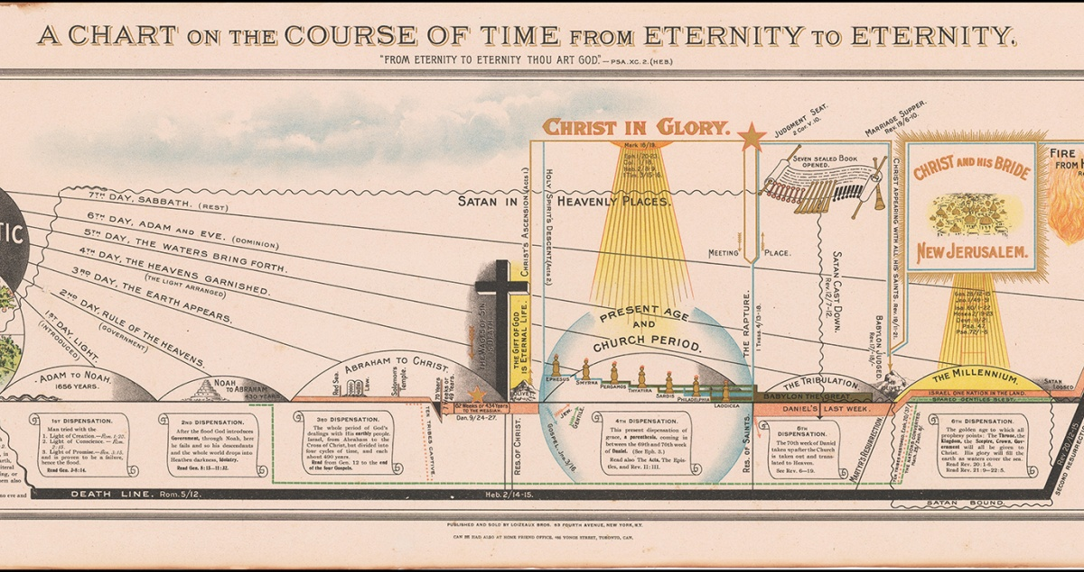

Slide 22
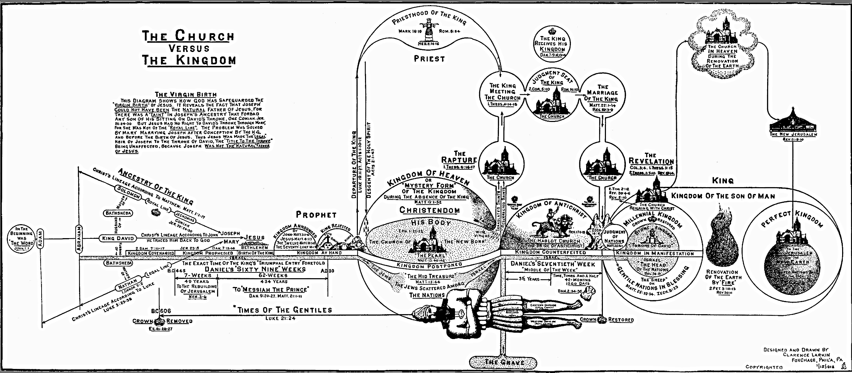

Slide 23

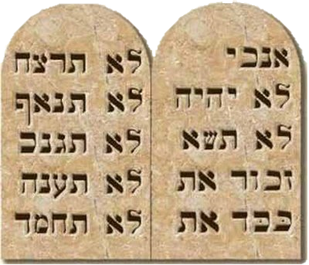
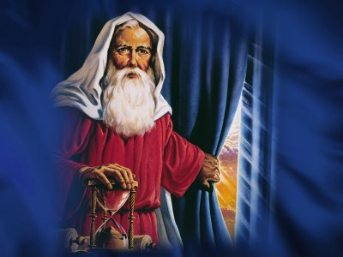
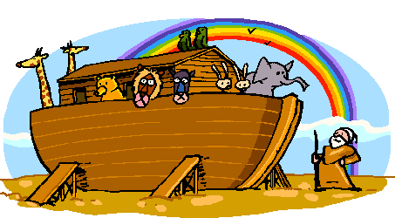
Stages of the Convenant of Grace
†
Gen 3.15
Gen 6.18
Gen 15.18
Exo 24.7-8
Jos 24.25
Neh 9.38
2 Chr 7.18
*
ÉDEN

Slide 24
Salvation Plan
Covenant of Works
Covenant of Grace
Davidic Covenant
New Covenant
Eternity
Covenant of Sinai
Abrahamic Covenant
†
Noahic Covenant
Adamic Covenant
Christ’s Return
*
EDEN

