Slide 2
Nothing but the Blood
Hymn 307*
Text: Robert Lowry (*Trinity Hymnal)
Music: Robert Lowry

Slide 3
What can wash away my sin?
nothing but the blood of Jesus;
What can make me whole again?
nothing but the blood of Jesus.
O, precious is the flow
that makes me white as snow;
No other fount I know,
nothing but the blood of Jesus.

Slide 4
For my cleansing this I see—
nothing but the blood of Jesus;
For my pardon this my plea—
nothing but the blood of Jesus.
O, precious is the flow
that makes me white as snow;
No other fount I know,
nothing but the blood of Jesus.

Slide 5
Nothing can for sin atone—
nothing but the blood of Jesus;
Naught of good that I have done—
nothing but the blood of Jesus.
O, precious is the flow
that makes me white as snow;
No other fount I know,
nothing but the blood of Jesus.

Slide 6
This is all my hope and peace—
nothing but the blood of Jesus;
This is all my righteousness—
nothing but the blood of Jesus.
O, precious is the flow
that makes me white as snow;
No other fount I know,
nothing but the blood of Jesus.

Slide 7
Now by this I’ll overcome—
nothing but the blood of Jesus;
Now by this I’ll reach my home—
nothing but the blood of Jesus.
O, precious is the flow
that makes me white as snow;
No other fount I know,
nothing but the blood of Jesus.

Slide 9
Doctrine of the Covenant
Unfolding the Divine Covenants: A Journey Through Scripture

Slide 10
Covenant in the Bible
בריתי
Berit
διαθηκην
Diateke
Noun appears 284 times in the OT
Noun appears 31 times in the NT

Slide 11

History Timeline
The Covenant of Works is made in the Garden of Eden
†
Christ’s Return
*
Old Testament
New Testament
EDEN

Slide 12
History Timeline
The Covenant of Grace is introduced in the Eden soon after man’s disobedience
†
Christ’s Return
*
Old Testament
New Testament
EDEN

Slide 13
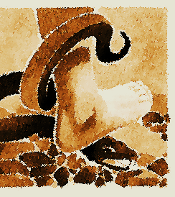
The First Promise
Genesis 3:15 marks the first promise of redemption in Scripture—a divine declaration of hope amid judgment. In this verse, the cursed alliance between the woman and the Serpent is shattered, and the woman is restored to her husband. From this restored union, a Son is foretold—one who will not merely resist evil but decisively crush the Serpent’s head. This is not just a prophecy; it is the foundation of the gospel, the beginning of God’s plan to conquer sin and restore humanity.

Slide 14
Plan of Salvation: Overlap of the Covenants
†
Christ’s Return
*
Old Testament
New Testament
EDEN
Covenant of Works
Covenant of Grace

Slide 15
Elements of the Covenant of Grace
PARTIES: | SOVEREIGN GOD | JESUS CHRIST Representing the Elect
STIPULATIONS
Goal: | Redeem a people to the glory of the Son | Eternal Life
Duties of each part: | Just Judge and Justifier | Perfect Obedience and Satisfaction
Penalties:

Slide 16
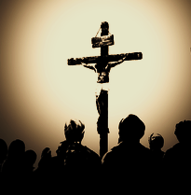
Christ is the Mediator
Jesus Christ is the mediator and guarantor of the Second Covenant. He is the one who represents the people under the Second Covenant (Heb 7:22; 8:6; 12:24). He presents those who were elected for salvation (Eph 1:4, 11). It is in Christ, therefore, that those represented by him in this Covenant receive blessings( Eph 1:6-7).

Slide 17
Plan of Salvation: Overlap of the Covenants
†
Christ’s Return
*
Old Testament
New Testament
EDEN
Covenant of Works
Covenant of Grace

Slide 18
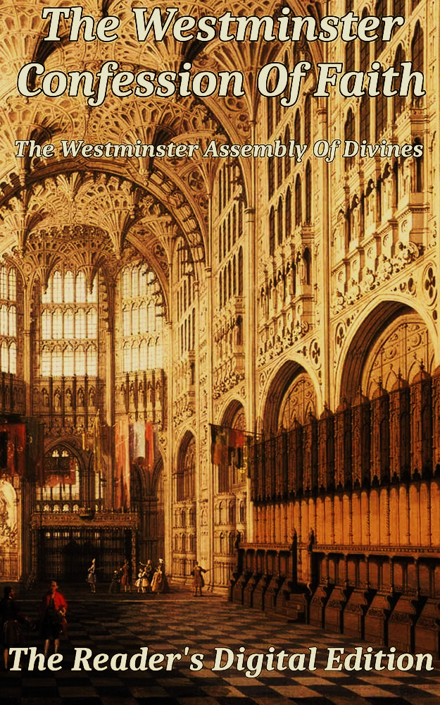
Of God’s Covenant With Man (7.5)
This covenant was differently administered in the time of the law, and in the time of the gospel: under the law, it was administered by promises, prophecies, sacrifices, circumcision, the paschal lamb, and other types and ordinances delivered to the people of the Jews, all fore signifying Christ to come; which were, for that time, sufficient and efficacious, through the operation of the Spirit, to instruct and build up the elect in faith in the promised Messiah, by whom they had full remission of sins, and eternal salvation; and is called the Old Testament.
2 Cor. 3:6–9; [Jo 1:17] Heb. 8–10; Rom. 4:11; Col. 2:11–12; 1 Cor. 5:7.

Slide 19
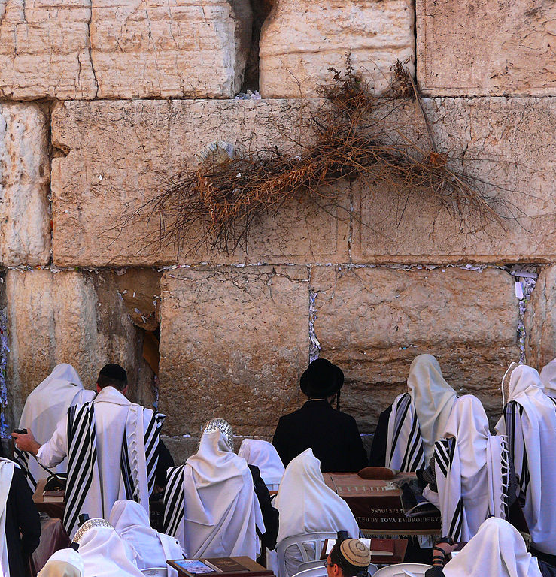
Different Administrations
The Old Testament was administered differently from the New Testament (2 Cor 3:7-10). The law given in the time of the OT was never an instrument of Salvation, by an instrument of Grace (Rom 3:19-20; Gal 3:10-13; Rom 5:20-21;10:5-8; Col 2:11-12). The Jews failed to understand this for the most part (Rom 9:4-8; 30-32).

Slide 20
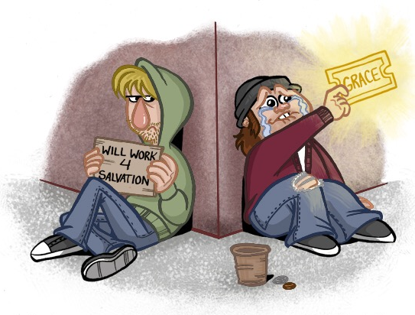
Always By Faith
No Jew was saved by circumcision in the Old Testament, as no Christian is saved in the New Testament by baptism (Heb 11:2, 6, 39-40; Psa 78:21-22, 32). Salvation was always given by grace, through Faith (Rom 4:9-11, 14-16). Faith, under any administration of the Covenant of Grace, has always been the instrumental cause of Salvation (Eph 2:8-10).

Slide 21

Progression of the Revelation
In the Covenant of Grace, God revealed himself progressively (Heb 1:1-2). Knowledge of Him and his salvation was built through centuries as he disclosed his will through different ways, reaching its fullness in Christ (Joh 1:17). The law in the Old Testament was given as one stage in the progression of knowledge of God’s salvation by Grace (Heb 3:3-6).

Slide 22
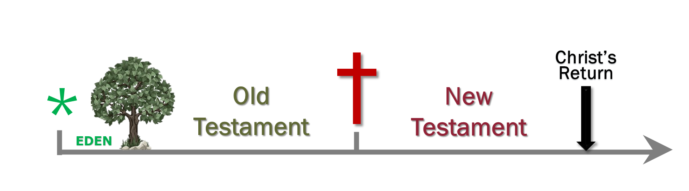
Progression of the Revelation

Slide 23
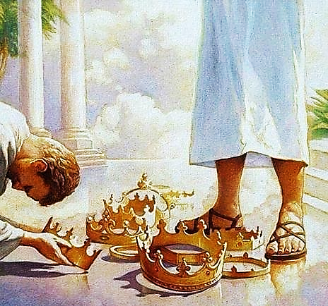
Growth of “Science”
We believe there is more revelation under the New Testament than before. However, those under the New Covenant will never reach full understanding. It will be given by the final redemption, after the resurrection of the body (1 Cor 13:8-13). The full knowledge will render faith unnecessary.

