Slide 1
Notes:
1

Slide 2
Christ the True and Better Adam
Notes:
2

Slide 3
Christ, the true and better Adam
Son of God and Son of man
Who, when tempted in the garden
Never yielded, never sinned
He, who makes the many righteous
Brings us back to life again
Dying, He reversed the curse, then
Rising, crushed the serpent's head

Slide 4
Amen! Amen!
From beginning to end
Christ the story, His the glory
Alleluia! Amen!

Slide 5
Christ, the true and better Isaac
Humble son of sacrifice
Who would climb the fearful mountain
There to offer up his life
Laid with faith upon the altar
Father's joy and only son
There salvation was provided
Oh, what full and boundless love
Amen! Amen!
From beginning to end
Christ the story, His the glory
Alleluia! Amen!
Christ, the true and better Moses
Called to lead a people home
Standing bold to earthly powers
God's great glory to be known
With his arms stretched wide to heaven
See the waters part in two
See the veil is torn forever
Cleansed with blood we pass now through
Amen! Amen!
From beginning to end
Christ the story, His the glory
Alleluia! Amen!
Christ, the true and better David
Lowly shepherd, mighty king
He the champion in the battle
Where, o death, is now thy sting?
In our place He bled and conquered
Crown Him Lord of majesty
His shall be the throne forever
We shall e'er His people be
Amen! Amen!
From beginning to end
Christ the story, His the glory
Alleluia! Amen!

Slide 6
Amen! Amen!
From beginning to end
Christ the story, His the glory
Alleluia! Amen!

Slide 7
Christ, the true and better Moses
Called to lead a people home
Standing bold to earthly powers
God's great glory to be known
With his arms stretched wide to heaven
See the waters part in two
See the veil is torn forever
Cleansed with blood we pass now through

Slide 8
Amen! Amen!
From beginning to end
Christ the story, His the glory
Alleluia! Amen!

Slide 9
Christ, the true and better David
Lowly shepherd, mighty king
He the champion in the battle
Where, o death, is now thy sting?
In our place He bled and conquered
Crown Him Lord of majesty
His shall be the throne forever
We shall e'er His people be

Slide 10
Amen! Amen!
From beginning to end
Christ the story, His the glory
Alleluia! Amen!

Slide 12
Doctrine of the Covenant
Unfolding the Divine Covenants: A Journey Through Scripture

Slide 13
Covenant in the Bible
בריתי
Berit
διαθηκην
Diateke
Noun appears 284 times in the OT
Noun appears 31 times in the NT

Slide 14
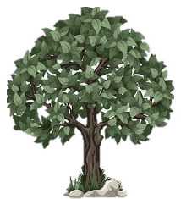
History Timeline
The Covenant of Works is made in the Garden of Eden
†
Christ’s Return
*
Old Testament
New Testament
EDEN

Slide 15
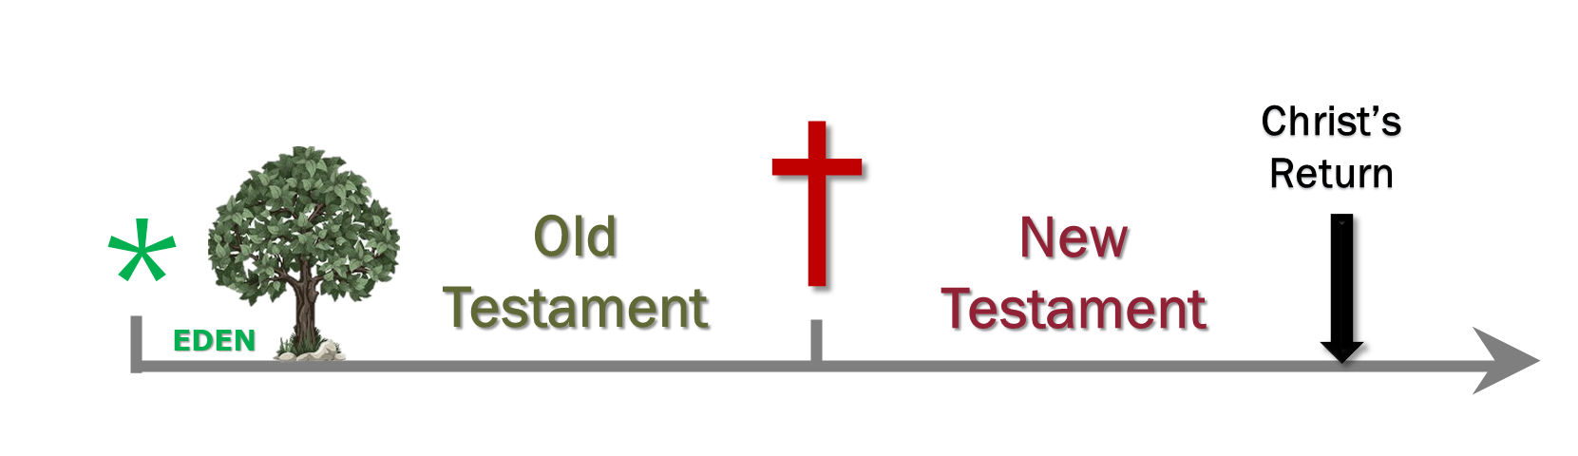
Consequence of the Covenant of Works
Spiritual death (Rom 5.12; Eph 2.1. Gen 3.7-12: malice, fear, lie)
Biological death (Gen 3.19 = Gen 5.5; Mat 10.28)
Lake of Fire (Rev 20.6, 14; 21.8)

Slide 16

Of God’s Covenant With Man (7.3)
Man, by his fall, having made himself uncapable of life by that covenant, the Lord was pleased to make a second, commonly called the Covenant of Grace; wherein he freely offers unto sinners life and salvation by Jesus Christ; requiring of them faith in him, that they may be saved, and promising to give unto all those that are ordained unto eternal life his Holy Spirit, to make them willing, and able to believe.
Gal. 3:21. Rom. 3:20–21; Rom. 8:3; Gen. 3:15; Isa. 42:6; John 3:16; Rom. 10:6, 9; Rev. 22:17; Acts 13:48; Ezek. 36:26–27; John 6:37, 44–45; 1 Cor. 12:3.

Slide 17
History Timeline
The Covenant of Grace is introduced in the Eden soon after man’s disobedience
†
Christ’s Return
*
Old Testament
New Testament
EDEN

Slide 18
Plan of Salvation: Overlap of the Covenants
†
Christ’s Return
*
Old Testament
New Testament
EDEN
Covenant of Works
Covenant of Grace

Slide 19
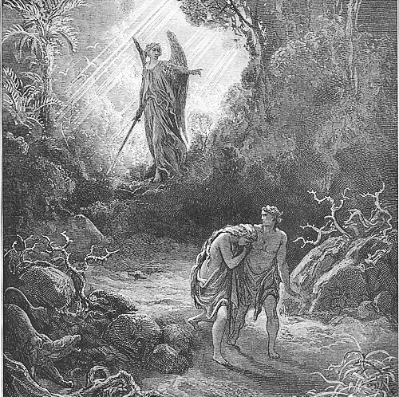
The first elements of grace are seen in God’s curse. The words “life” (v. 14), “offspring” (v. 15), “childbearing” (v. 16), “life” (v. 17), and “bring forth” (v. 18) imply continuation and not separation. Curse is mingled with signs of grace.

Slide 20
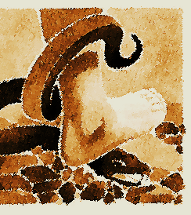
The First Promise
Genesis 3:15 marks the first promise of redemption in Scripture—a divine declaration of hope amid judgment. In this verse, the cursed alliance between the woman and the Serpent is shattered, and the woman is restored to her husband. From this restored union, a Son is foretold—one who will not merely resist evil but decisively crush the Serpent’s head. This is not just a prophecy; it is the foundation of the gospel, the beginning of God’s plan to conquer sin and restore humanity.

Slide 21
Elements of the Covenant of Grace
PARTIES: | SOVEREIGN GOD | JESUS CHRIST Representing the Elect
STIPULATIONS
Goal: | Redeem a people to the glory of the Son | Eternal Life
Duties of each part: | Just Judge and Justifier | Perfect Obedience and Satisfaction
Penalties:

Slide 22
Of God’s Covenant With Man (7.4)
This covenant of grace is frequently set forth in Scripture by the name of a testament, in reference to the death of Jesus Christ the Testator, and to the everlasting inheritance, with all things belonging to it, therein bequeathed.
Heb. 9:15–17, also 7:22; 8:6; 12:24

Slide 23
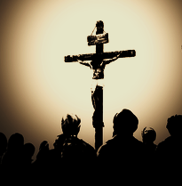
Christ is the Mediator
Jesus Christ is the mediator and guarantor of the Second Covenant. He is the one who represents the people under the Second Covenant (Heb 7:22; 8:6; 12:24). He presents those who were elected for salvation (Eph 1:4, 11). It is in Christ, therefore, that those represented by him in this Covenant receive blessings( Eph 1:6-7).

Slide 24
Elements of the Covenant of Grace
PARTIES: | SOVEREIGN GOD | JESUS CHRIST Representing the Elect
STIPULATIONS
Goal: | Redeem a people to the glory of the Son | Eternal Life
Duties of each part: | Just Judge and Justifier | Perfect Obedience and Satisfaction
Penalties:

Slide 25
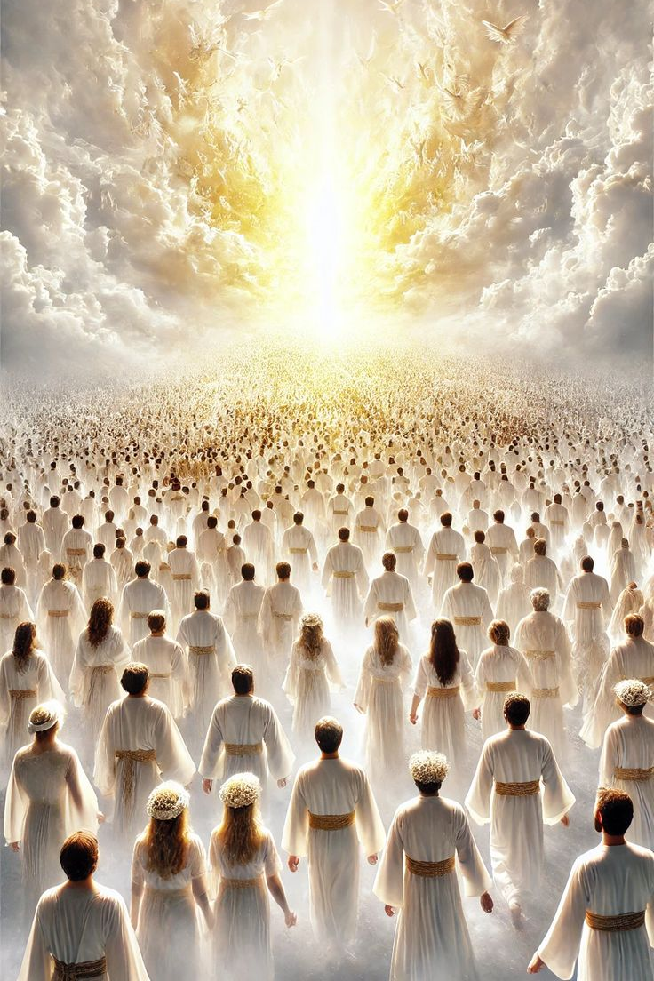
Covenant to Glory of the Son
The Covenant of Grace is a covenant established for the redemption of the elect, to glorify the Son, redeeming a people for himself (Tit 2:4). The elect were given by the Father to the Son before the creation of all things (John 10:27-29; 17:11, 24).

Slide 26
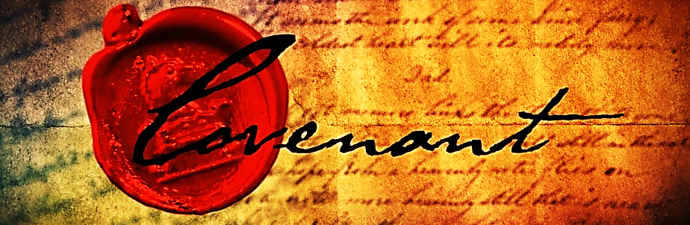
Covenant of Redemption Pactum Salutis
The Covenant of Grace is founded upon an eternal covenant made before the creation of all things between the three persons of the Trinity for the salvation of the elect. This Covenant has been called the Covenant of Redemption. It was made not between God and man, but between the three persons of the Trinity. In this
covenant, the Father, Son, and Holy Spirit commit to work out in unity the salvation of the elect (Heb 13:20).

Slide 27
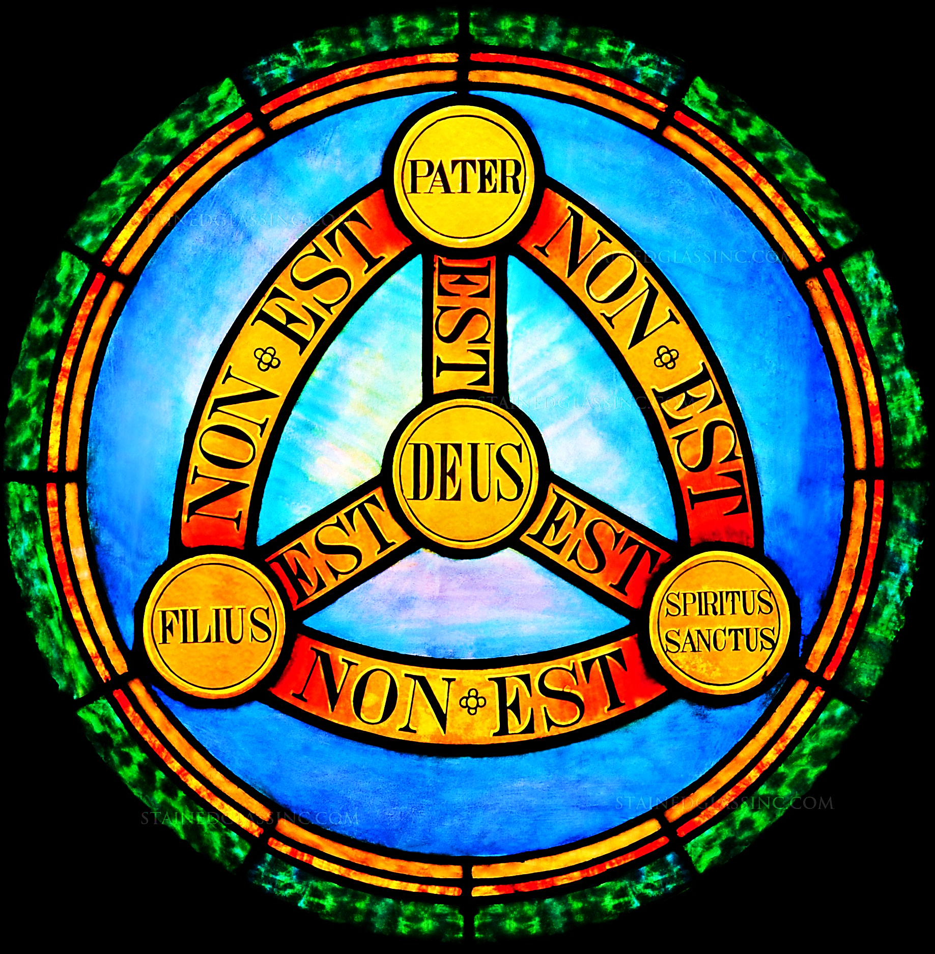
Economy of the Trinity
This covenant is treated more formally by some than others. Some reformed theologians call it simply the “plan of salvation”, while others “economy of salvation”. However, it is undeniable in Scripture that each person of the Trinity takes part in the work of redemption in a different way according to a plan predestined in eternity. Each of them bestows grace through prerogatives and functions which are peculiar to themselves.

Slide 28
Economic Work
Father – Elected a people for adoption through the Son (Eph 1:3-6)
Son – Purchased Redemption Offering Perfect Satisfaction (Eph 1:7-8)
Holy Spirit – Applies and guarantees the work of Christ (Eph 1:13).

