Slide 1
Doctrine of the Covenant
Unfolding the Divine Covenants: A Journey Through Scripture

Slide 2
Covenant in the Bible
בריתי
Berit
διαθηκην
Diateke
Noun appears 284 times in the OT
Noun appears 31 times in the NT

Slide 3
Covenant
(Pact)
Formal Agreement
(Contract)

Slide 4
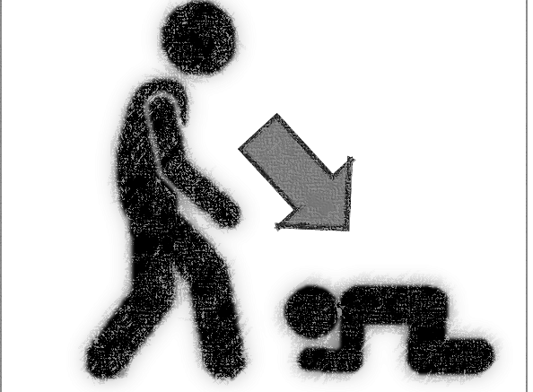
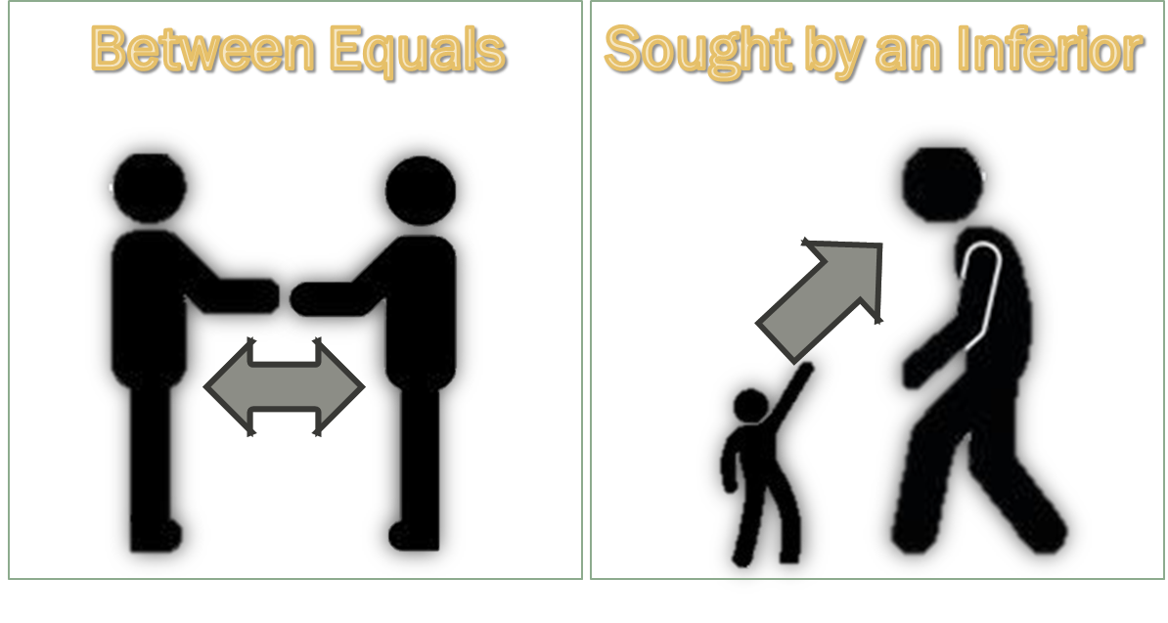
Unilateral Covenant
All covenants between God and men are proposed by God, as the Sovereign Lord. Men do not have a say on the terms of a Covenant proposed by God. But God does not need a Covenant to secure anything for Himself. He establishes Covenants for the benefit of men.

Slide 5
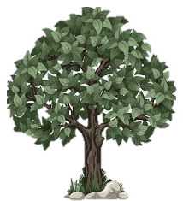
History Timeline
The Covenant of Works is made in the Garden of Eden
†
Christ’s Return
*
Old Testament
New Testament
EDEN

Slide 6
Elements of the Covenant of Grace
PARTIES: | SOVEREIGN GOD | JESUS CHRIST Representing the Elect
STIPULATIONS
Goal: | Redeem a people to the glory of the Son | Eternal Life
Duties of each part: | Just Judge and Justifier | Perfect Obedience and Satisfaction
Penalties:

Slide 7

Goal: Life
Adam was created pure and had a perfect life. He could die, as it would be the penalty of his disobedience, but he was preserved by God, as long as he did not eat the fruit of the forbidden tree. The maintenance of his life depended on his own obedience (Rom 7:10).

Slide 8
Mandates
Social
Cultural
Spiritual

Slide 9
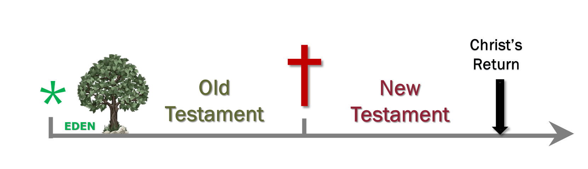
Consequence of the Covenant of Works
Spiritual death (Rom 5.12; Eph 2.1. Gen 3.7-12: malice, fear, lie)
Biological death (Gen 3.19 = Gen 5.5; Mat 10.28)
Lake of Fire (Rev 20.6, 14; 21.8)

Slide 10
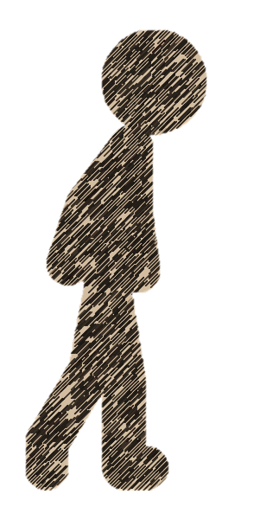
Adam Out of the Eden
Eternal Life
Adam’s Original State
Sinful State

Slide 11

Of God’s Covenant With Man (7.3)
Man, by his fall, having made himself uncapable of life by that covenant, the Lord was pleased to make a second, commonly called the Covenant of Grace; wherein he freely offers unto sinners life and salvation by Jesus Christ; requiring of them faith in him, that they may be saved, and promising to give unto all those that are ordained unto eternal life his Holy Spirit, to make them willing, and able to believe.
Gal. 3:21. Rom. 3:20–21; Rom. 8:3; Gen. 3:15; Isa. 42:6; John 3:16; Rom. 10:6, 9; Rev. 22:17; Acts 13:48; Ezek. 36:26–27; John 6:37, 44–45; 1 Cor. 12:3.

Slide 12
History Timeline
The Covenant of Grace is introduced in the Eden soon after man’s disobedience
†
Christ’s Return
*
Old Testament
New Testament
EDEN

Slide 13
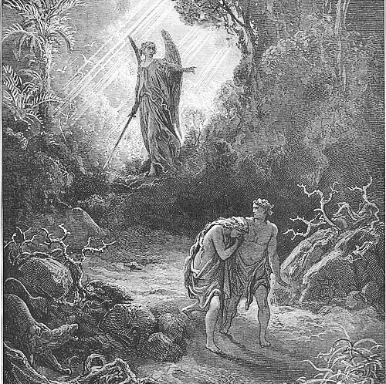
The first elements of grace are seen in God’s curse. The words “life” (v. 14), “offspring” (v. 15), “childbearing” (v. 16), “life” (v. 17), and “bring forth” (v. 18) imply continuation and not separation. Curse is mingled with signs of grace.

Slide 14
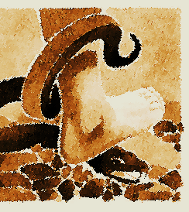
The First Promise
Genesis 3:15 marks the first promise of redemption in Scripture—a divine declaration of hope amid judgment. In this verse, the cursed alliance between the woman and the Serpent is shattered, and the woman is restored to her husband. From this restored union, a Son is foretold—one who will not merely resist evil but decisively crush the Serpent’s head. This is not just a prophecy; it is the foundation of the gospel, the beginning of God’s plan to conquer sin and restore humanity.

Slide 15
Plan of Salvation: Overlap of the Covenants
The distance between God and the creature is so great that although reasonable creatures do owe obedience unto Him as their Creator, yet they could never have any fruition of Him, as their blessedness and reward, but by some voluntary condescension on God’s part, which He hath been pleased to express by way of covenant.
†
Christ’s Return
*
Old Testament
New Testament
EDEN
The first covenant made with man was a covenant of works, wherein life was promised to Adam, and in him to his posterity, upon condition of perfect and personal obedience.
Man by his fall having made himself incapable of life by that covenant, the Lord was pleased to make a second, commonly called the covenant of grace: wherein He freely offered unto sinners life and salvation by Jesus Christ, requiring of them faith in Him, that they may be saved, and promising to give unto all those that are ordained unto life, His Holy Spirit, to make them willing and able to believe.
Covenant of Works
Covenant of Grace

