Slide 2
Before the Throne of God Above
CCLI #50180610
Text: Charitie Lees Bancroft, Vikki Cook
Music: Charitie Lees Bancroft, Vikki Cook, ©PDI Worship, ©1997 Sovereign Grace Worship (ASCAP)

Slide 3
Before the throne of God above,
I have a strong, a perfect plea,
A great High Priest whose name is “Love,”
Who ever lives and pleads for me.
My name is graven on His hands;
my name is written on His heart;
I know that while in heav’n He stands
no tongue can bid me thence depart,
no tongue can bid me thence depart.

Slide 4
Behold him there! The risen Lamb,
my perfect, spotless Righteousness,
The great unchangeable I am,
the king of glory and of grace!
One with Himself I cannot die;
my soul is purchased by His blood;
My life is hid with Christ on high,
with Christ, my Savior and my God,
with Christ, my Savior and my God.

Slide 5
One with Himself I cannot die;
my soul is purchased by His blood;
My life is hid with Christ on high,
with Christ, my Savior and my God,
with Christ, my Savior and my God.

Slide 6
Doctrine of the Covenant
Unfolding the Divine Covenants: A Journey Through Scripture

Slide 7
Is the Covenant a Relevant Theme in the Bible?
LOVE
COVENANT
552
Times
First ref. Gen 22:2
Vs.
316
Times
First ref. in Gen 6.18

Slide 8
Luke 22:20 (ESV)
…This cup that is poured out for you is the new covenant in my blood.

Slide 9
Luke 22:20 (Vulgata)
hic est calix NOVUM TESTAMENTUM in sanguine meo quod pro vobis funditur

Slide 10
Hebrews 8:13 (ESV)
In speaking of a new covenant, he makes the first one obsolete. And what is becoming obsolete and growing old is ready to vanish away.

Slide 11
Important Questions
What is the Old/First Covenant, and what is the New Covenant?
What are their provisions
How do they relate? Do they relate?
Is the Old completely invalid?
Why did a New replace the First?
How is the relation of Israel and the church?

Slide 12
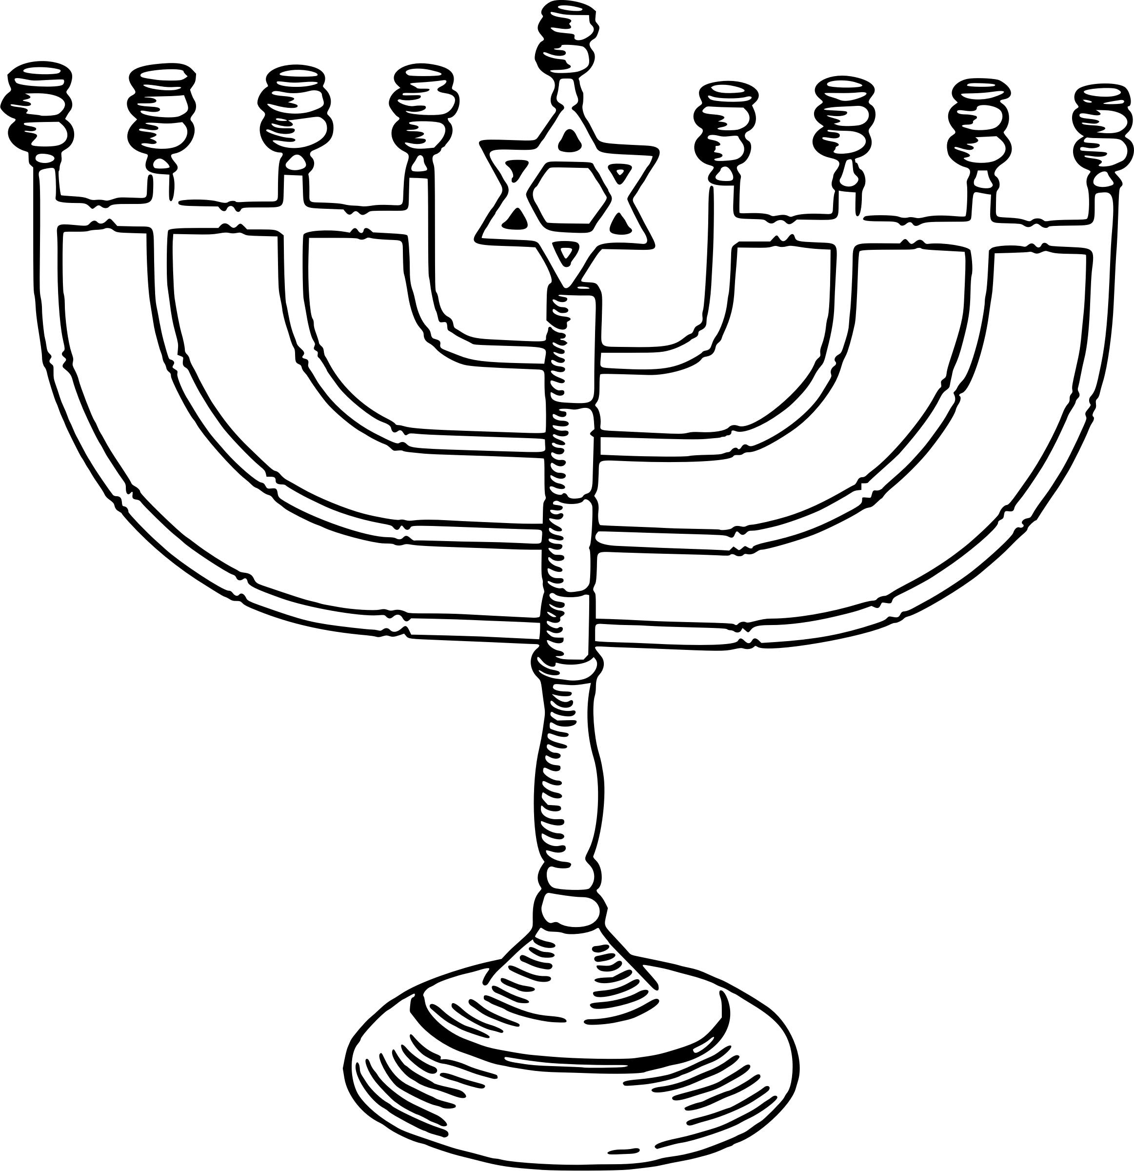
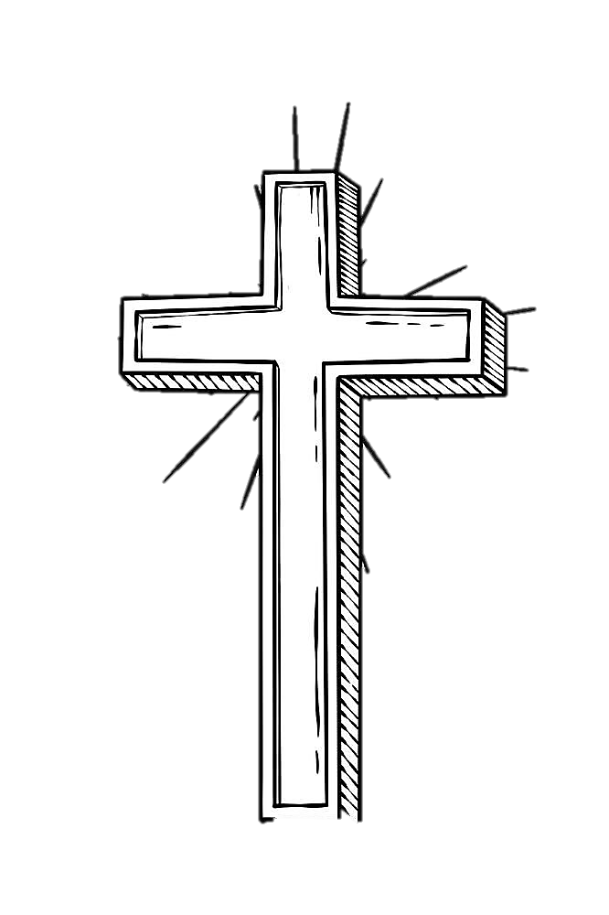
Incorrect Simplification
Old Covenant
Israel
Law (Torah)
New Covenant
Church
Grace (Gospel)

Slide 13
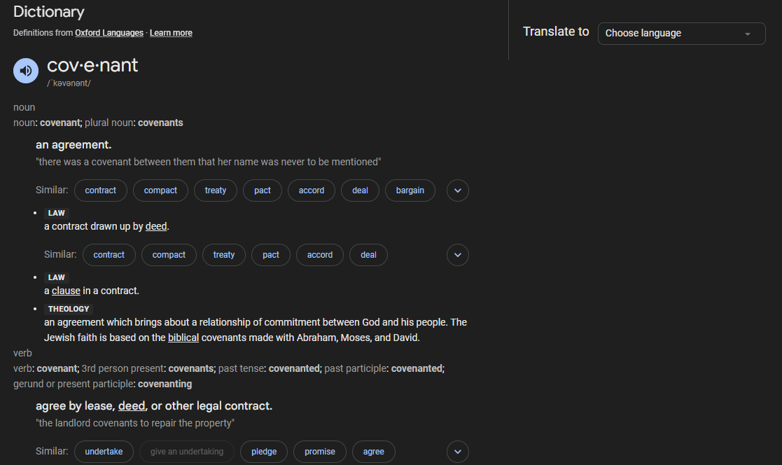

Slide 14
Covenant in the Bible
בריתי
Berit
διαθηκην
Diateke
Noun appears 284 times in the OT
Noun appears 31 times in the NT

Slide 15
Covenant
(Pact)
Formal Agreement
(Contract)

Slide 16

Elements of a Contract
  Parties
  Stipulations
    Goal
    Duties of each part
    Penalties

Slide 17
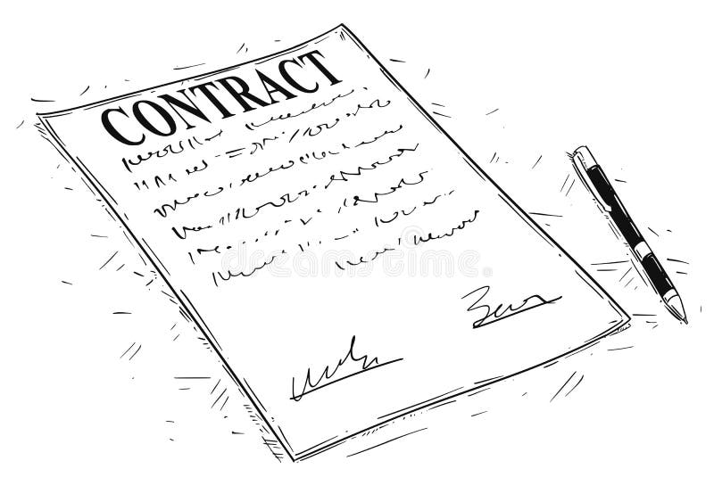
Why would one want a contract?
Regulate a transaction
Security for the parties
Expression of commitment
Terms imposed by a superior

Slide 18
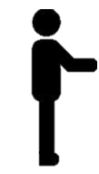

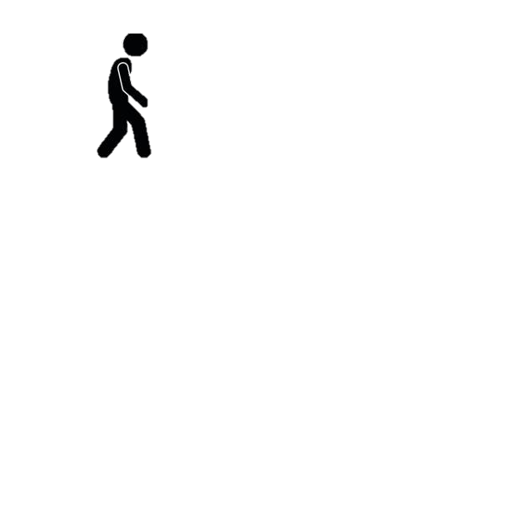
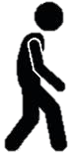
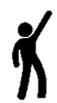

VARIABLE TERMS
Between Equals
Sought by an Inferior
Imposed by a Superior

Slide 19

Of God’s Covenant With Man (7.1)
The distance between God and the creature is so great that although reasonable creatures do owe obedience unto him as their Creator, yet they could never have any fruition of him as their blessedness and reward but by some voluntary condescension on God’s part, which he hath been pleased to express by way of covenant.
Isa. 40:13–17; Job 9:32–33; Ps. 113:5–6; Job 22:2–3; Job 35:7–8; Luke 17:10; Acts 17:24–25

