Slide 2
Christ, We Do All Adore Thee
Hymn 737*
Translator and Adapter: Theodore Baker (1899)
Composer: Théodore Dubois

Slide 3
Christ, we do all adore thee,
and we do praise thee forever;
Christ, we do all adore thee,
and we do praise thee forever;
for on the holy cross hast thou
the world from sin redeemed.
Christ, we do all adore thee,
and we do praise thee forever.
Christ, we do all adore thee.

Slide 4
Glory to God
Bible Study – Faith Presbyterian Church

Slide 5
RECAP
The One glorious God, from whom all glory derives, created man for his glory. So, man can only find joy living for God’s glory.
The beauty and complexity of creation reveal the Creator’s glory. God’s continuous care for creation reveals his glory.
Man under sin is blind to see it. Through grace, one can see God’s glory in creation and providence.
The Incarnate Son of God revealed the Glory of the Father more fully. On the Cross, Jesus showed the glory of God’s love.
The transformation of sinners reveals the glory of God’s grace.

Slide 6
God’s Glory
Revealed in Creation
Revelated in Providence
Revelated in Redemption
Revealed in the Incarnate Son
Revealed in the Believers
Earthly experiences of the Glory of God

Slide 7
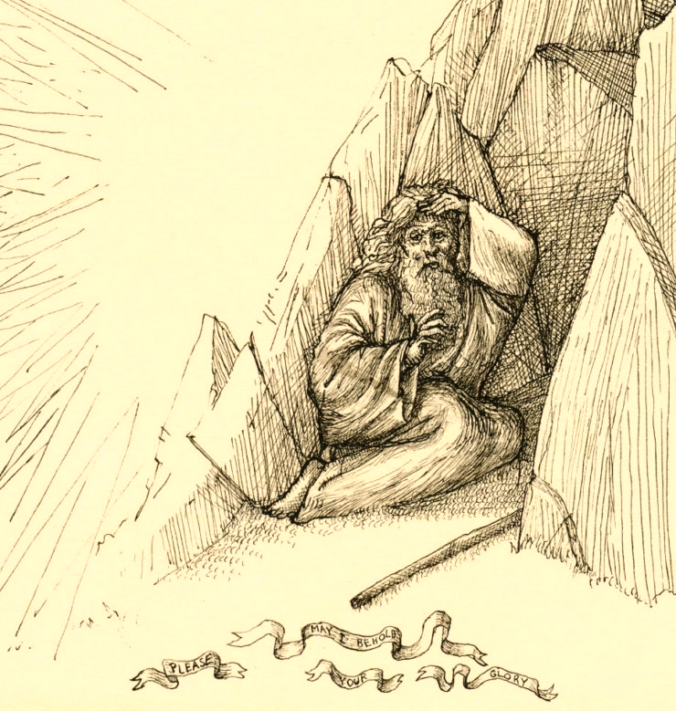
God’s Glory Passes by Moses
After successfully interceding for the people of Israel, Moses asks to see God’s glory. God grants him a glimpse of his glory (Exo 33:12-23).

Slide 8
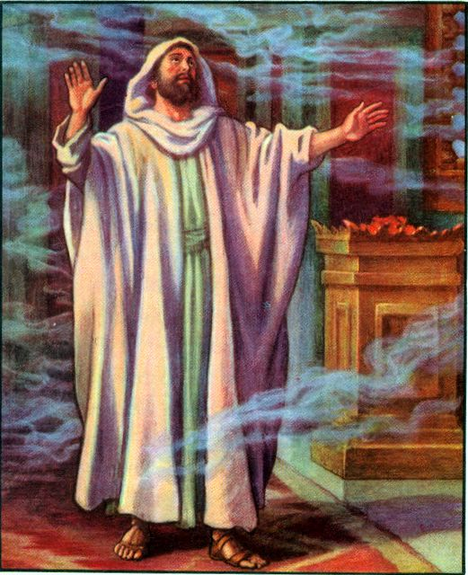
Isaiah Smoked
In a time of turmoil, the prophet Isaiah sees the glory of the Lord in the temple (Isa 6:1-8).

Slide 9
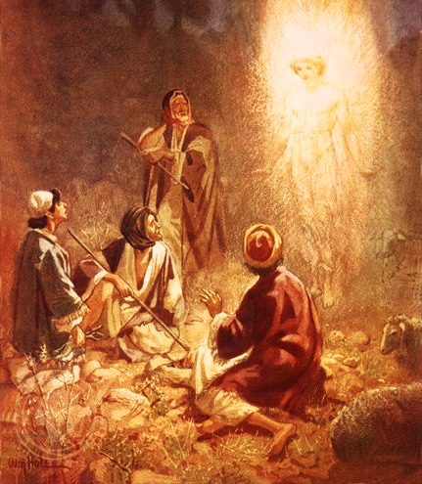
Shepherds
The night Jesus was born, the glory of the Lord was shown to shepherds in the field near Bethlehem (Luke 2:1-20).

