Slide 2
To God Be the Glory
Hymn 55*
Text: Fanny J. Crosby
Music: William H. Doane (*Trinity Hymnal)

Slide 3
To God be the glory, great things he has done!
So loved he the world that he gave us his Son,
who yielded his life an atonement for sin,
and opened the life-gate that we may go in.
Praise the Lord, praise the Lord, let the earth hear his voice!
Praise the Lord, praise the Lord, let the people rejoice! O come to the Father through Jesus the Son, and give him the glory, great things he has done!

Slide 4
O perfect redemption, the purchase of blood!
To ev’ry believer the promise of God;
the vilest offender who truly believes,
that moment from Jesus forgiveness receives.
Praise the Lord, praise the Lord, let the earth hear his voice!
Praise the Lord, praise the Lord, let the people rejoice! O come to the Father through Jesus the Son, and give him the glory, great things he has done!

Slide 5
Great things he has taught us, great things he has done,
and great our rejoicing through Jesus the Son;
but purer and higher and greater will be
our wonder, our transport, when Jesus we see.
Praise the Lord, praise the Lord, let the earth hear his voice!
Praise the Lord, praise the Lord, let the people rejoice! O come to the Father through Jesus the Son, and give him the glory, great things he has done!

Slide 7
Glory to God
Bible Study – Faith Presbyterian Church

Slide 8
RECAP
The One glorious God, from whom all glory derives, created man for his glory. So, man can only find joy living for God’s glory.
The beauty and complexity of creation reveal the Creator’s glory. But man under sin is blind to see it.
God’s providence in history reveals the glory of power and sovereignty.
The salvation of the elect reveals the glory of God’s grace. Through grace one can see God’s the glory on creation and providence.
The Incarnate Son of God revealed the Glory of the Father more fully. On the Cross, Jesus showed the glory of God’s love.

Slide 9
God’s Glory
Revealed in Creation
Revelated in Providence
Revelated in Redemption
Revealed in the Incarnate Son
Revealed in the Believers

Slide 10
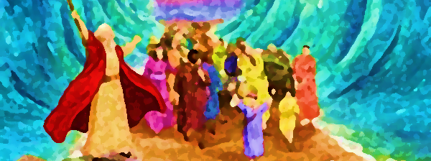
God’s Glory in Israel
God chose to make his name glorious among the nations in the Old Testament through Israel (Jer 33:9). God’s salvific actions in Israel show forth his glory (Exo 15:6; Isa 63:11-12).

Slide 11
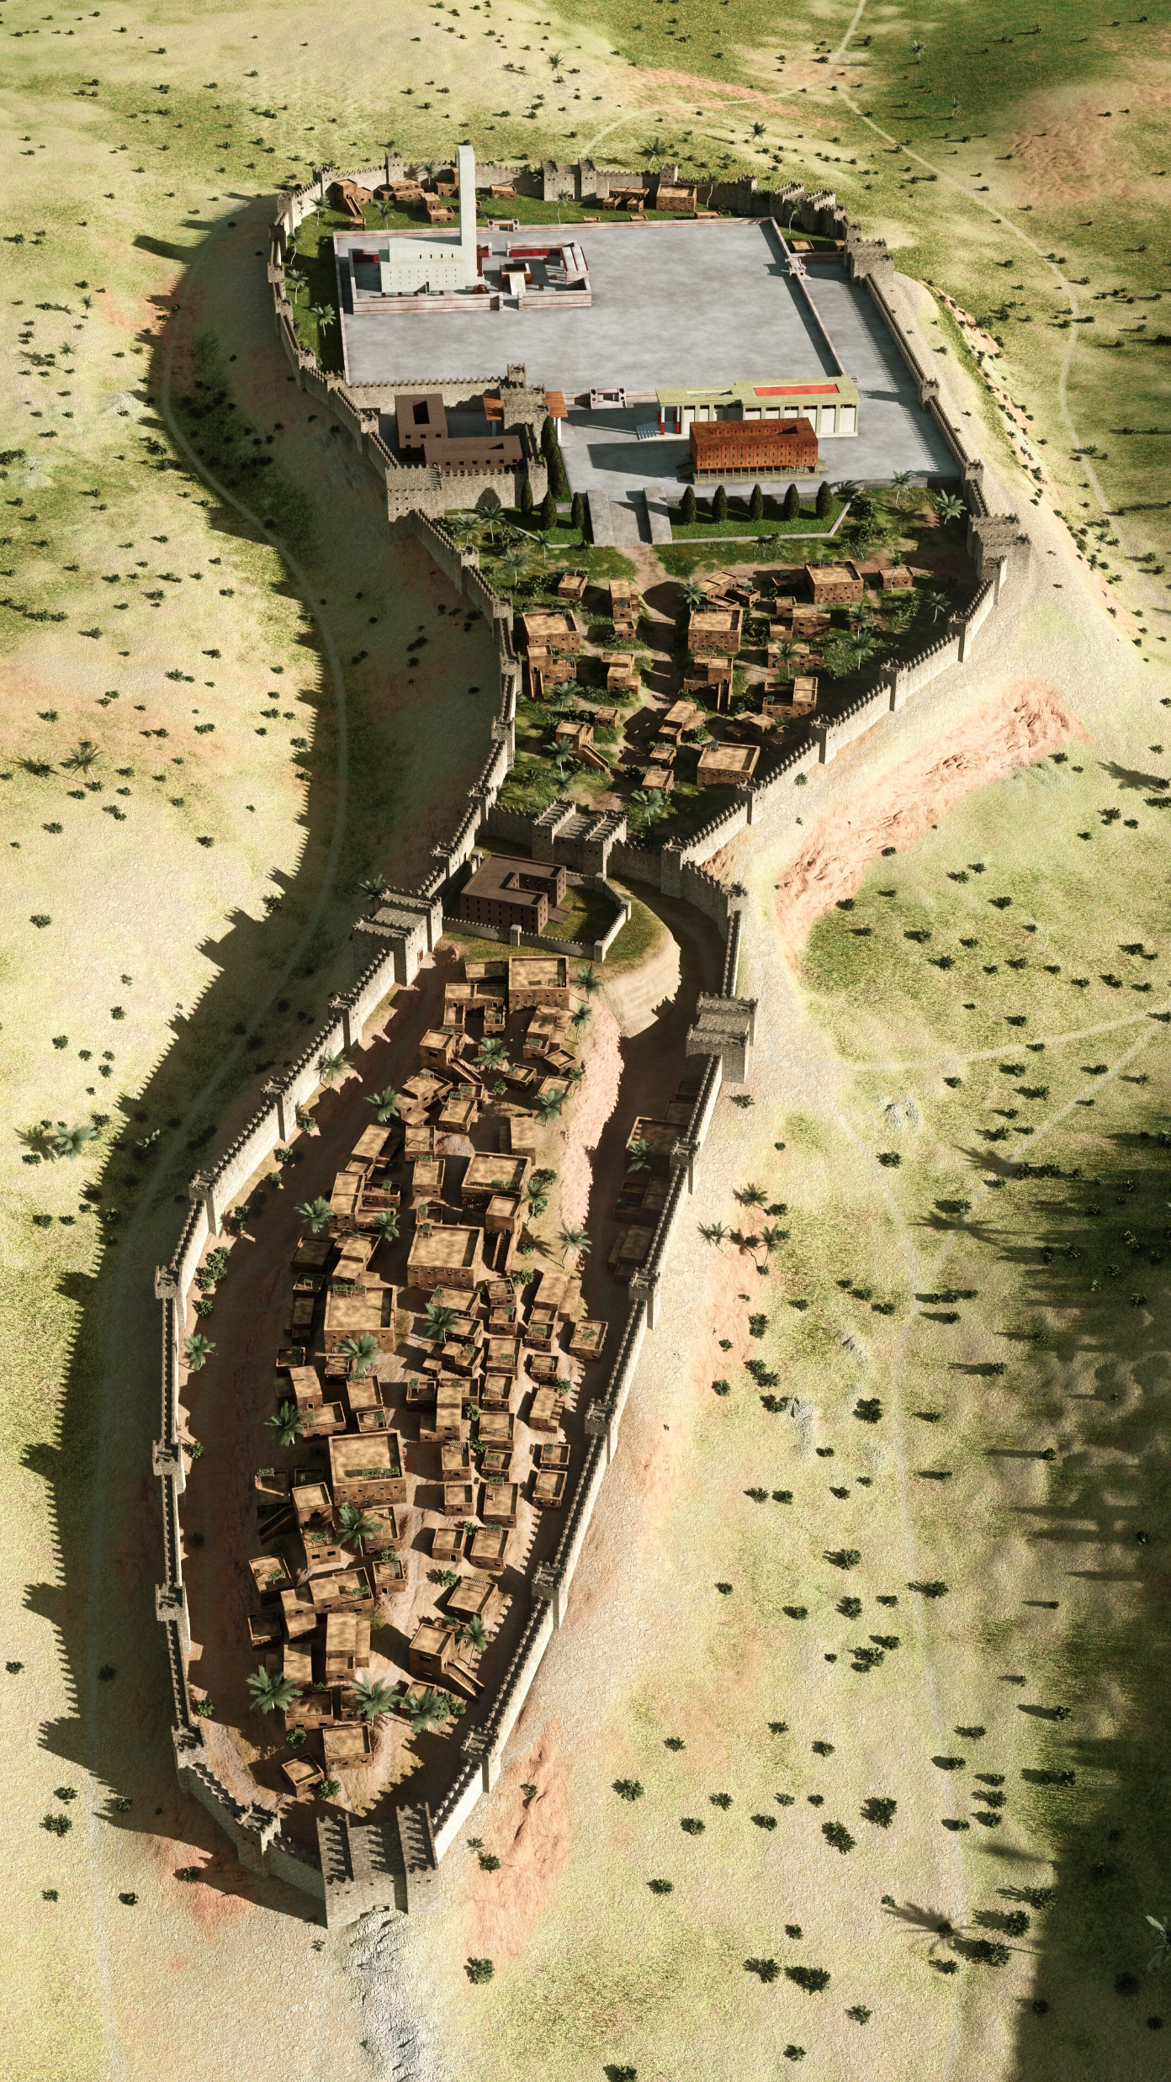
God’s Glory in the Temple
In the Old Covenant, nowhere else was the Glory of God more plainly shown than in the Tabernacle/temple (Exo 40:34-35; 2 Chro 7:1-3). It was the prelude of the glory of the new temple erected by Jesus Christ (Hag 2:9).

Slide 12
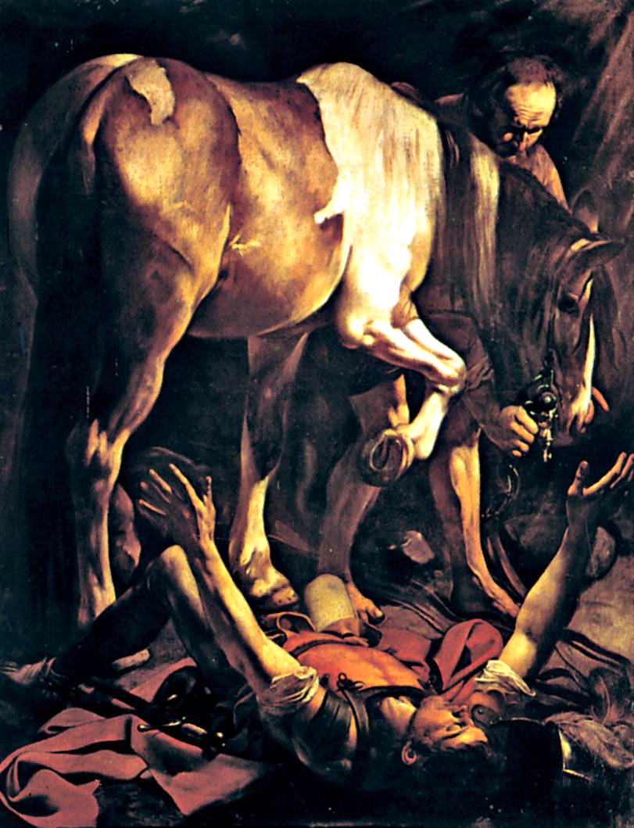
God’s Glory in Redemption
God is glorified by the work he does on the lives of sinners (Isa 61:3; 2 Cor 4:15). Their fruit of righteousness results in the glory of God (Phil 1:11)
The Conversion of St. Paul (c. 1601, Caravaggio, Oil on Canvas)
This is the second version of Paul’s conversion made by the artists. It hangs in the funerary chapel of Tiberio Cerasi in thebasilica of Santa Maria del Popolo, Rome (Image: Britannica.com)

Slide 13
One Degree of Glory to Another
The redeemed are the workmanship of God, in whom his glory is revealed as the grace of Christ gradually transforms them (2 Cor 3:18).

