Slide 1
Glory to God
Bible Study – Faith Presbyterian Church

Slide 2
RECAP
God’s Glory is his supreme beauty, power, and majesty.
God has all the glory in himself. Any glory is derived from him.
Man was created for God’s glory. Only by fulfilling his purpose can man find real enjoyment.
God’s glory is hidden from the natural man but is revealed by the Holy Spirit through the grace of faith.
Worship is man’s answer to the knowledge of God’s glory.
God saved sinners to make them participants in His glory.

Slide 3
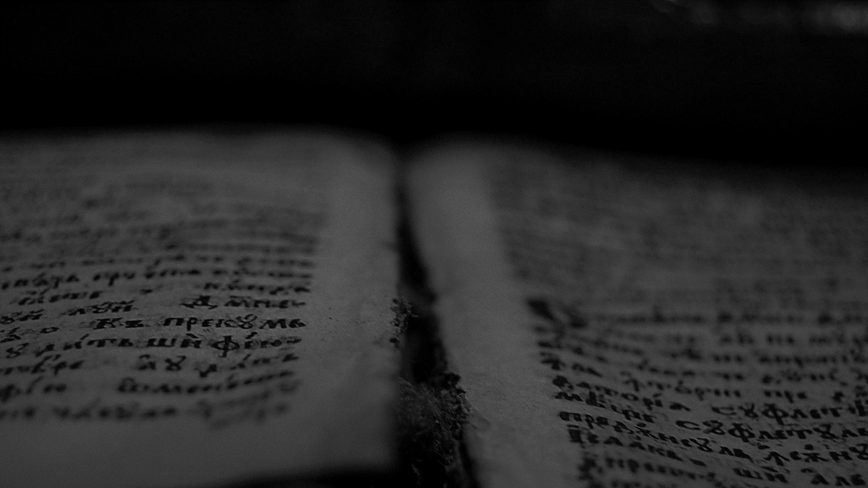
Ascribe to the LORD the glory due his name; bring an offering and come before him! Worship the LORD in the splendor of holiness; tremble before him, all the earth; yes, the world is established; it shall never be moved. Let the heavens be glad, and let the earth rejoice, and let them say among the nations, “The LORD reigns!”
1 Chronicles 16:29-31
ESV

Slide 4
CWCF II.2 - God hath all life, glory, goodness, blessedness, in and of himself; and is alone in and unto himself all-sufficient, not standing in need of any creatures which he hath made, nor deriving any glory from them, but only manifesting his own glory in, by, unto, and upon them. He is the alone fountain of all being, of whom, through whom, and to whom are all things; and hath most sovereign dominion over them, to do by them, for them, or upon them whatsoever himself pleaseth.

Slide 5
GOD
Transcendence
Immanence
Notes:
The emphasis on God’s transcendence or immanence leads to a worship that emphasizes ceremony or relationship, respectively.
Idolatry is the substitution of the glory of God for a false glory in the creation.

Slide 6
God’s Glory
Revealed in Creation
Revelated in Providence
Revelated in Redemption
Revealed in the Incarnate Son
Revealed in the Believers

Slide 7
God’s Glory in Creation
God’s glory is revealed in his general creation (Psa 19:1-3; Rev 4:11). The creation's complexity reveals the creator's knowledge and power (Rom 1:20; Isa 40:25-26).

Slide 8
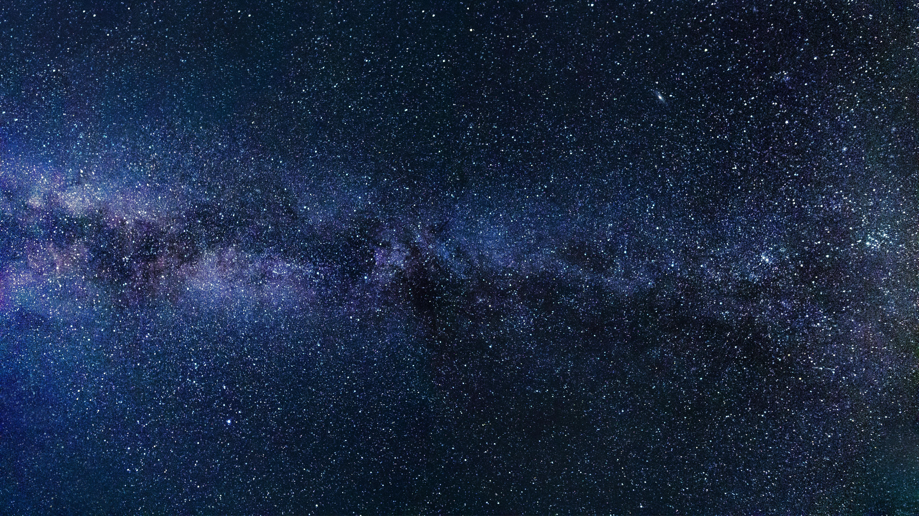
EXAMPLE 1
Notes:
93 billion light-years (28 billion parsecs). Speed of light is 670,616,629 mph
100 to 200 billion Galaxys (How Many Galaxies Are There? | Space)

Slide 9
EXAMPLE 2
Notes:
80 times per second. Wings rotate to change direction. Fly backwards.
They need much more energy than a man. Fast metabolism.
Large (for its size) and highly developed brain to control movement in microseconds.
They have ultraviolet vision, far more acute than human.
They use a highly complex ultrasonic communication system.

Slide 10
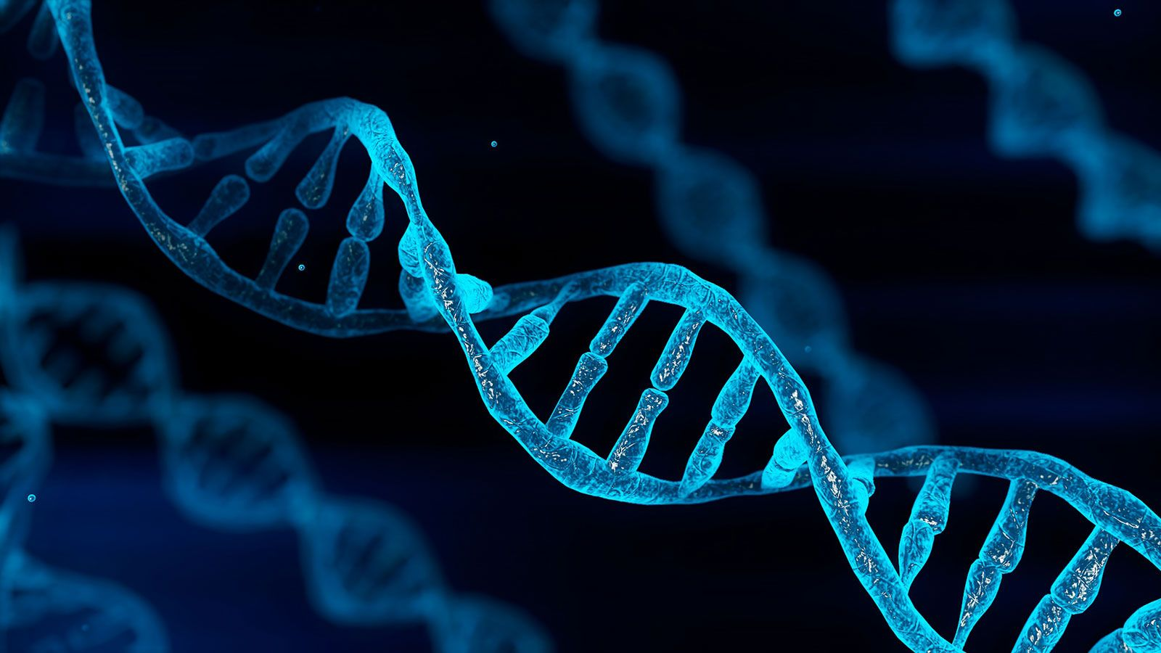
EXAMPLE 3
Notes:
It is an acid molecule inside the cell nucleus that carries information.
It is formed by the pairing of Adenine, Thymine, Guanine, and Cytosine.
In a single human cell, there are 3.2 million base pairs.
One gram of DNA has 125 petabytes, which is equivalent to 10 million hours of high-def video. Less than 10% of these for all the books in the world (1mb/book per 175 million books total 175 terabytes).

Slide 11
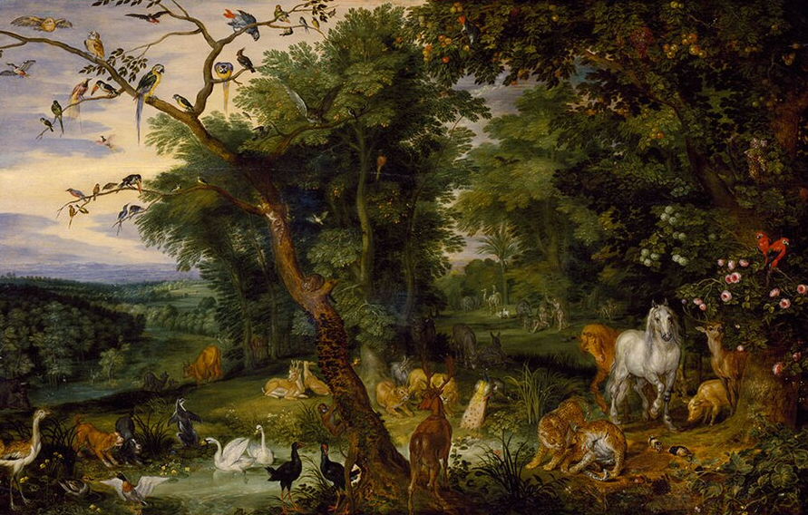
The Crown of Creation
The crown of creation, man and woman, reflect God’s glory as his image bearers (Gen 1:26; Psa 8:5-8).
The Temptation in the Garden of Eden (1659)
Jan Brueghel the Elder – Oil on Canvas
Victoria and Albert Museum, London
Image: Wikicommons

Slide 12
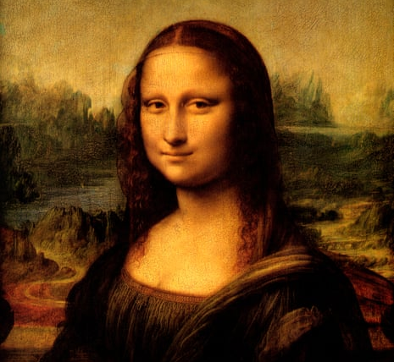

Slide 13
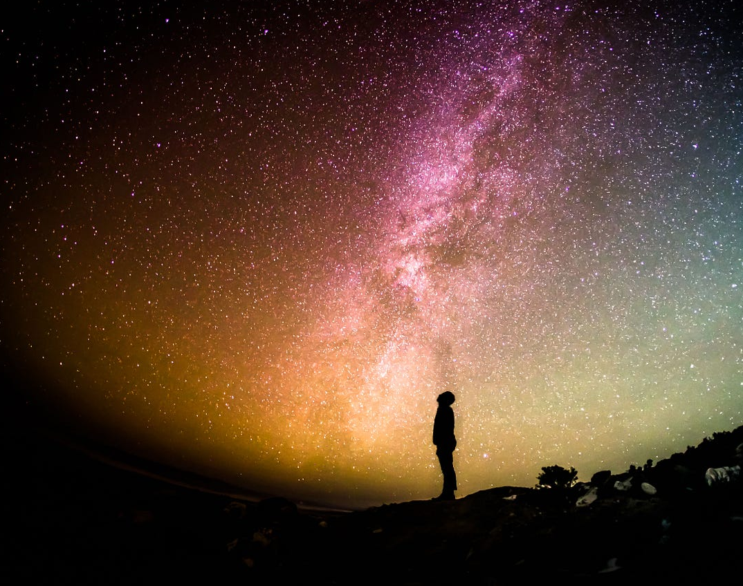
The Right Tools
God’s glory revealed in creation can only be perceived by faith. Science (inductive knowledge) cannot reach knowledge of God’s glory, despite perceiving the complexity and beauty of the creation (2 Cor 10:3-6).

Slide 14
God’s Glory in His Providence
God continues to create and control his creation (Heb 1:3; Col 1:16-17). His acts of PROVIDENCE reveal the glory of this sovereign power (Psalm 104:27-30). He keeps the seasons, rules over the processes, and controls the powers (Acts 17:24-28; 14:15-17; Jer 27:5). He leads history, raising rulers and nations and abating them in his wisdom (Hag 2:7).

Slide 15
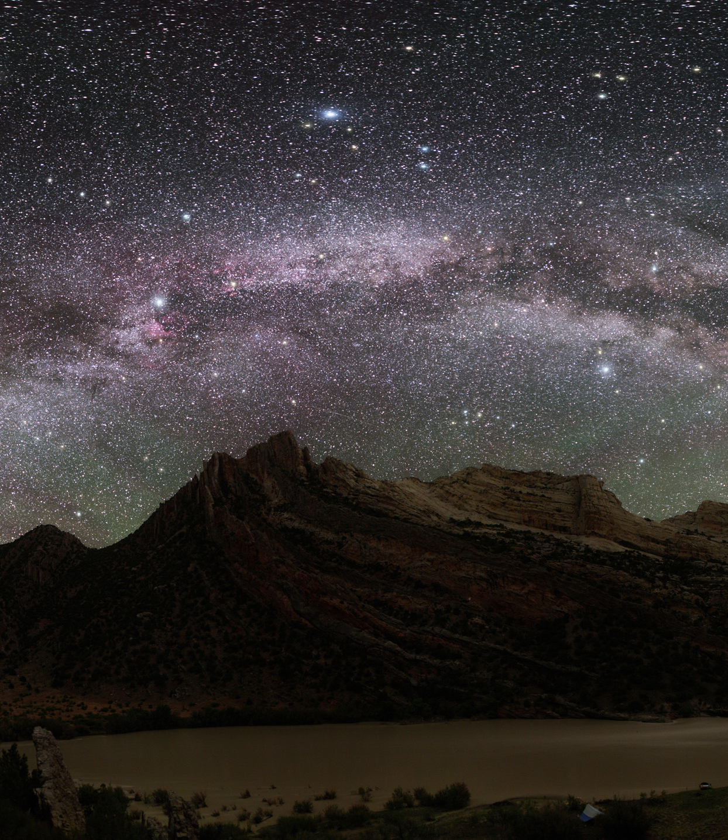
An Unlikely Glory
God’s glory is shown in some acts of providence, which can only be understood by faith.
Pharaoh’s destruction (Exo 14:4)
Mana (Exo 16:6-7).
Judging the nations (Ez 39:13,21)
In sickness and healing (John 11:4).
In a small wooden temple (Hag 1:8)
Stephen’s stoning (Acts 7:55).

