Slide 2
To God Be the Glory
Hymn 55*
Text: Fanny J. Crosby
Music: William H. Doane (*Trinity Hymnal)

Slide 3
To God be the glory, great things he has done!
So loved he the world that he gave us his Son,
who yielded his life an atonement for sin,
and opened the life-gate that we may go in.
Praise the Lord, praise the Lord, let the earth hear his voice!
Praise the Lord, praise the Lord, let the people rejoice! O come to the Father through Jesus the Son, and give him the glory, great things he has done!

Slide 4
O perfect redemption, the purchase of blood!
To ev’ry believer the promise of God;
the vilest offender who truly believes,
that moment from Jesus forgiveness receives.
Praise the Lord, praise the Lord, let the earth hear his voice!
Praise the Lord, praise the Lord, let the people rejoice! O come to the Father through Jesus the Son, and give him the glory, great things he has done!

Slide 5
Great things he has taught us, great things he has done,
and great our rejoicing through Jesus the Son;
but purer and higher and greater will be
our wonder, our transport, when Jesus we see.
Praise the Lord, praise the Lord, let the earth hear his voice!
Praise the Lord, praise the Lord, let the people rejoice! O come to the Father through Jesus the Son, and give him the glory, great things he has done!

Slide 7
Glory to God
Bible Study – Faith Presbyterian Church

Slide 8
God’s Glory is his supreme beauty, power, and majesty.

Slide 9
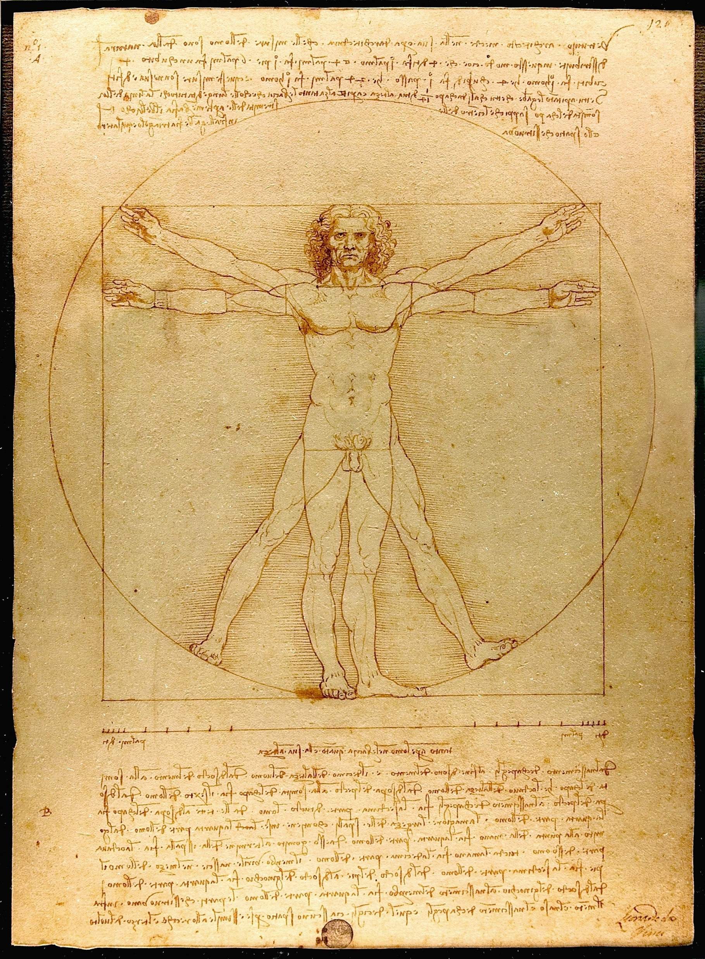
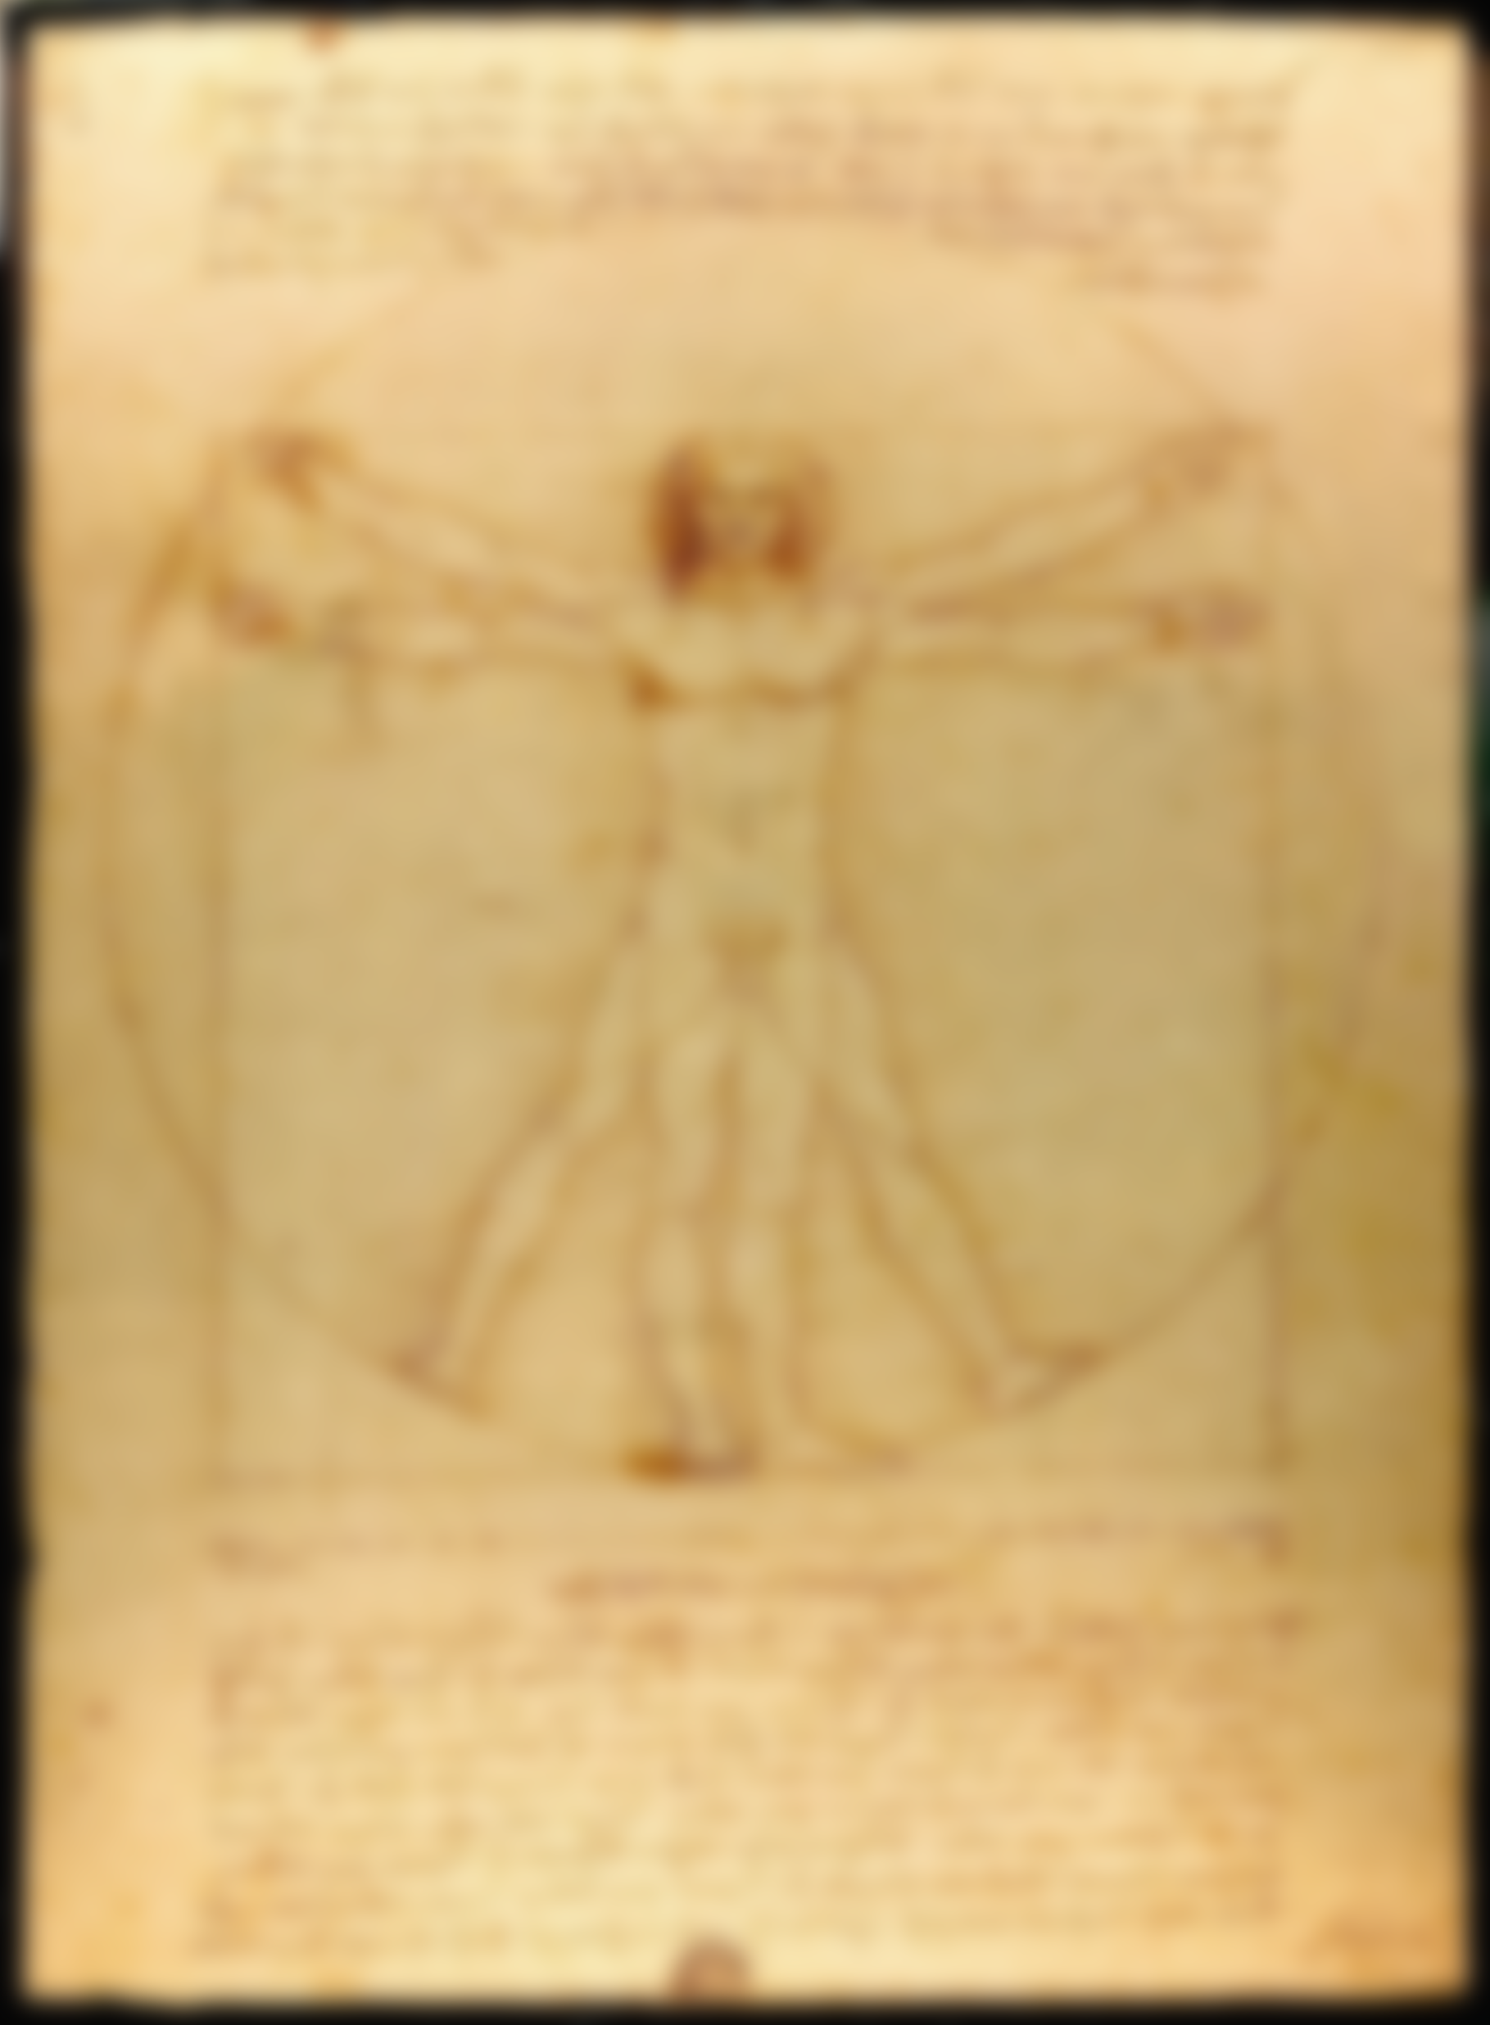
The perfect man as the measure of all things.
Vitruvian Man
Leonardo da Vinci
Drawing (1490)
Gallerie dell’Academia, Napoles.
Image: Wikicommons

Slide 10
COMPARISON
Humanism
Christianity
Center: Humanity (Man/Men)
Instrument: Science
Objective: Betterment of Humanity
Center: God
Instrument: Revelation
Objective: Glory of God

Slide 11
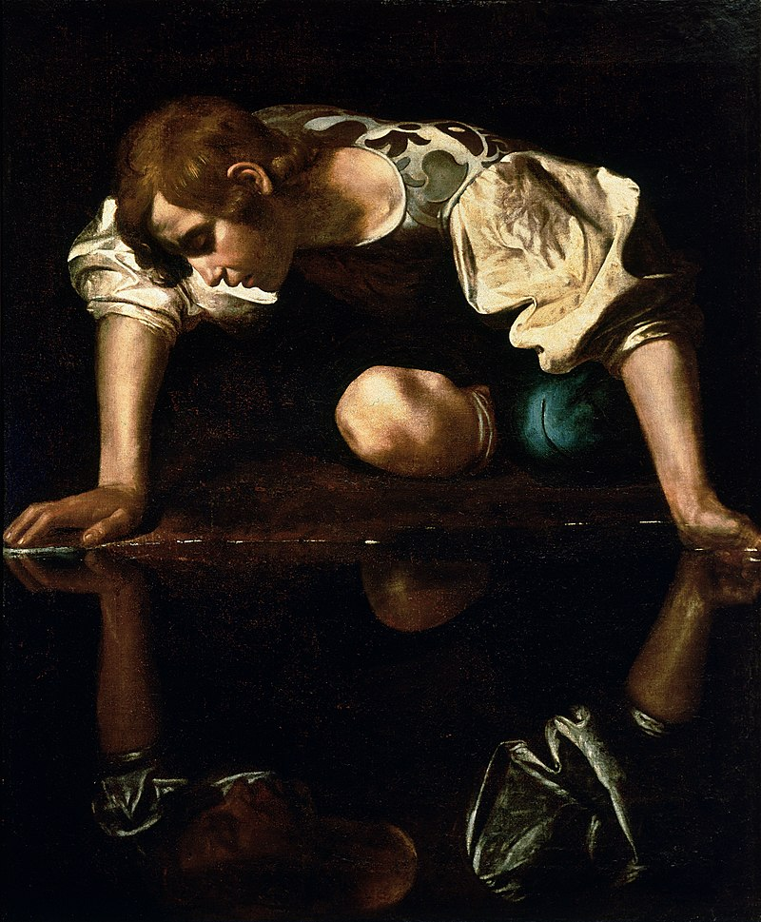
Some Old Attempts Rekindled
Hedonism: pleasure as an end.
Narcissism: Love of self.
Narcisus (1590)
Caravaggio
Oil on Canvas
Galleria Nazionale d'Arte Antica, Roma
Image: Wikicommons

Slide 12
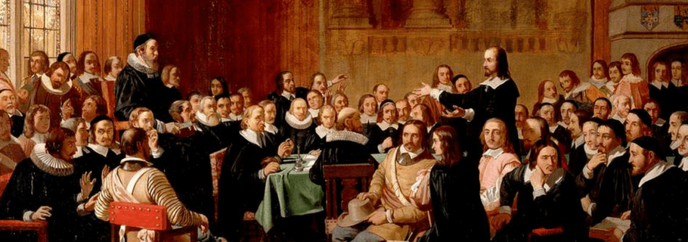
What is the chief end of man? (Short Catechism of Westminster, Question 1)
Man’s chief end is to glorify God and to enjoy him forever.

Slide 13
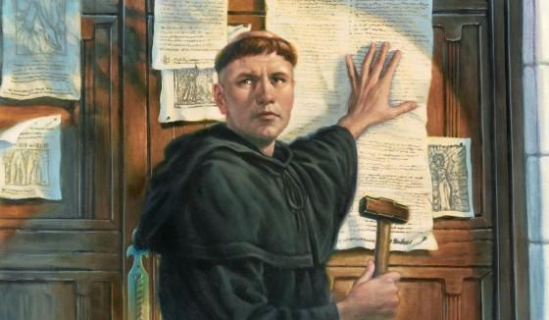
Soli deo gloria = Glory Only to God
To God belongs all Glory, because he is the Only glorious in Himself. In him all Glory originates. From his Glory all Glory derives.

Slide 14

CWCF II.2 - God hath all life, glory, goodness, blessedness, in and of himself; and is alone in and unto himself all-sufficient, not standing in need of any creatures which he hath made, nor deriving any glory from them, but only manifesting his own glory in, by, unto, and upon them. He is the alone fountain of all being, of whom, through whom, and to whom are all things; and hath most sovereign dominion over them, to do by them, for them, or upon them whatsoever himself pleaseth.

Slide 15

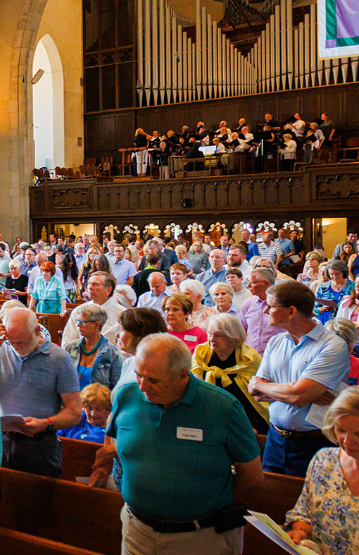
God’s Glory in Worship
God’s glory is reflected in worship. Worship is the praise of God’s glory, and the contemplation of God’s Glory is the highest honor on Earth.

Slide 16
God’s Glory
Glory Only to God (Rev 4:11; Acts 17:24-25).
All should be done for God’s Glory (1 Cor 10:31).
God does not share His glory (Isaiah 42.8).
Falling short of the glory (Rom 3:23).
God’s Glory is the Radiance of the Celestial City (Rev 21:10-11)

Slide 17
God’s Glory is his supreme beauty, power, and majesty.

Slide 18

Hidden Glory
God’s Glory is hidden for the unbelievers (2Co 4.3-4).

Slide 19

God’s Glory in the Salvation of Men
God saved sinners to make them participants in His glory. The final stage in the process of redemption is “glorification”, when the resurrection of the body eliminates all corruption (Rom 8:29-30).

Slide 20
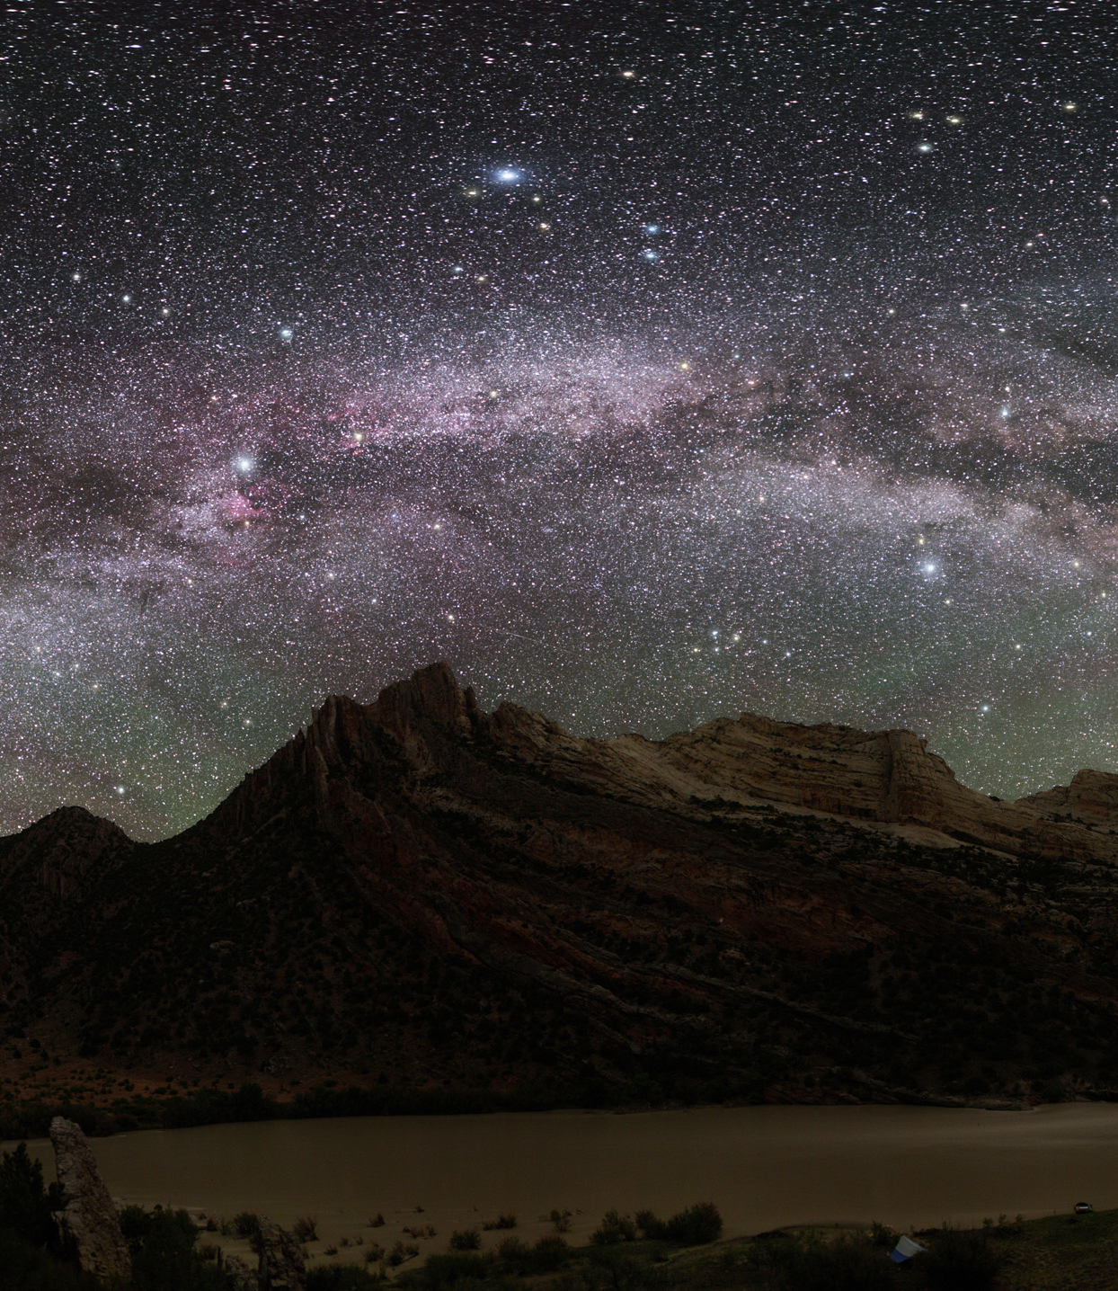
An Unlikely Glory
God’s Glory can only be seen by grace through faith. It is at times an unlikely glory.
In Creation Psalm 19.1).
Pharaoh’s destruction (Exo 14.4)
Mana (Exo 16.7).
Judging the nations (Ez 28:2, 39:13)
In sickness and healing (Jo 11.4).
In a small temple (Hag 1:8)
Stephen’s stoning (Acts 7:55).

Slide 21

Glória da Cruz
A glória de Deus foi manifesta na encarnação do Filho (Jo 1.14), na cruz e ressurreição de Jesus Cristo (Jo 12.23; 13.31).

