Slide 2
Amazing Grace (My Chains Are Gone)
Notes:
2

Slide 3
Amazing grace how sweet the sound
That saved a wretch like me
I once was lost, but now I'm found
Was blind, but now I see
'Twas grace that taught my heart to fear
And grace my fears relieved
How precious did that grace appear
The hour I first believed

Slide 4
My chains are gone, I've been set free
My God, my Savior has ransomed me
And like a flood His mercy reigns
Unending love
Amazing grace
The Lord has promised good to me
His word my hope secures
He will my shield and portion be
As long as life endures

Slide 5
My chains are gone, I've been set free
My God, my Savior has ransomed me
And like a flood His mercy reigns
Unending love
Amazing grace

Slide 6
My chains are gone, I've been set free
My God, my Savior has ransomed me
And like a flood His mercy reigns
Unending love
Amazing grace

Slide 7
The earth shall soon dissolve like snow
The sun forbear to shine
But God who called me here below
Will be forever mine, will be forever mine
You are forever mine

Slide 8
Notes:
8

Slide 9
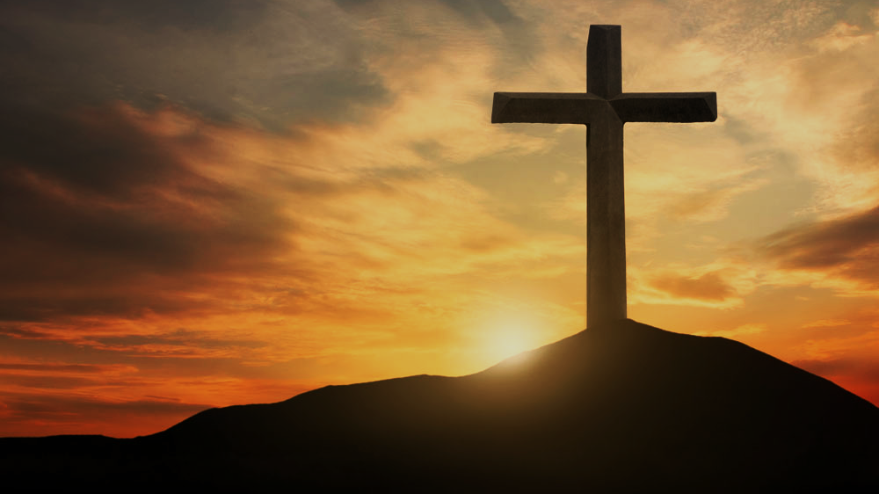
Doctrine of Salvation (Soteriology)
Wednesday Bible Study
Faith Presbyterian Church

Slide 10
Soteri + ology
Salvation + Study

Slide 11
Ordo Salutis
Election
Predestination
Calling (external and effectual)
Regeneration
Repentance
Saving Faith
Justification
Adoption
Sanctification
Glorification
Eternity
Single Act
Personal History
Process
Fullness of Time

Slide 12
PROCESS OF SALVATION
Election
Predestination
Regeneration (New Birth)
Conversion (Effectual Calling)
Justification (Merits of Christ)
Adoption as God’s Children
Sanctification
Glorification
Before all things were created
New Heavens and New Earth
1ª Coming of Christ
2ª Coming of Christ
*

Slide 13
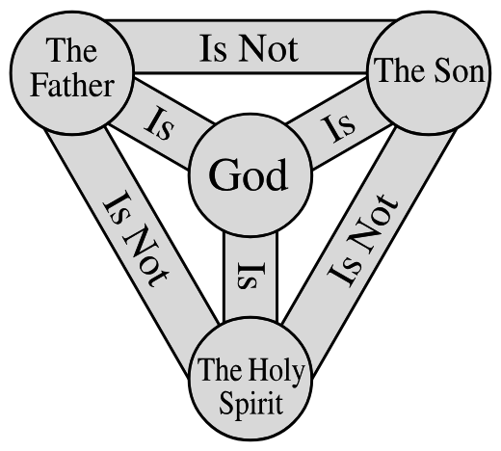
TRIUNE WORK
Salvation is a triune work. Father, Son, and Holy Spirit work together for the salvation of the elect. Their work is in perfect harmony. The Father elected, the Son redeemed the elect, and the Holy Spirit applies the redemption to the elect.

Slide 14
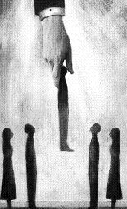
PREDESTINATION
Election and predestination are biblical words that teach the sovereignty of God over all things. God freely elected men for salvation before all things came to exist and predestined them according to the purpose of his free will. It means God did not elect or predestine by necessity or based on something he saw
Notes:
No predestined person will reach salvation.

Slide 15
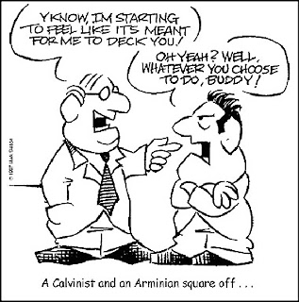
FREE WILL
Adam was endowed with free-will. He could choose against his natural inclination. This was lost after his disobedience, once he became enslaved by sin. However, Adam retained his capacity to choose. Man is responsible for his actions because he has the
freedom to choose what he wills. Men’s will and God’s sovereignty concur together.

Slide 16
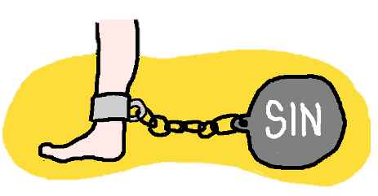
DEPRAVITY
No part of man was left untainted by sin. All of man is corrupted by sin. In its natural state, man cannot know God or believe in him. Man cannot do any moral good acceptable to God as a means of salvation. However, man is capable
of doing good to one another
and knowing creation.

Slide 17
GRACE
Salvation is by grace. Man does not contribute to his salvation. The smallest participation of man in salvation would invalidate grace. Grace is a concept of totality, not majority. If God offers salvation by grace but leaves it to man to confirm it, then God’s grace itself is not sufficient for salvation. It is only by grace if God freely chooses and unconditionally redeems.

Slide 18
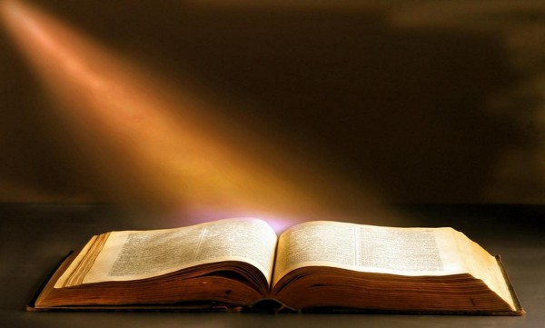
INSTRUMENTS OF GRACE
God’s grace operates through instruments. Salvation is an immediate work.
It is led by the Holy
Spirit, who operates
through Scripture and
other graces on the
elect.

Slide 19
SANCTIFICATION
The believer’s personal progress in sanctification pleases the Lord and brings glory to him, but it does not make the Lord love him more. The Father sees the redeemed elect as holy in Christ and treats them with
mercy and grace. Prayers and worship are acceptable to him because of Christ when offered in faith.

Slide 20
PERSEVERANCE
Salvation cannot be lost. Because it is by grace and does not depend on man, it is not in man’s power to lose it. As it depends only on God, he will complete the work by grace. All things will work for the salvation of the elect. A redeemed man
may fall in sin and walk in darkness
for some time, but grace will
ultimately restore him.

Slide 21
FUTURE SALVATION
Salvation will not be completed in this life. The holiest person cannot achieve a state of sinlessness. The redeemed experience some measure of holiness in this life, but the competition of salvation will happen on the final resurrection of the dead.

