Slide 2
Resurrection Hymn
CCLI #50180610
Text: Stuart Townend and Keith Getty
Music: Stuart Townend and Keith Getty, ©2003 Thankyou Music

Slide 3
See, what a morning, gloriously bright,
with the dawning of hope in Jerusalem;
Folded the grave clothes, tomb filled with light,
as the angels announce Christ is risen!
See God’s salvation plan, wrought in love,
borne in pain, paid in sacrifice,
fulfilled in Christ, the Man, for He lives:
Christ is risen from the dead!

Slide 4
See Mary weeping, “Where is He laid?”
As in sorrow she turns from the empty tomb;
Hears a voice speaking, calling her name;
It’s the Master, the Lord raised to life again!
The voice that spans the years, speaking life,
stirring hope, bringing peace to us,
will sound till He appears, for He lives:
Christ is risen from the dead!

Slide 5
One with the Father, Ancient of Days,
through the Spirit who clothes faith with certainty,
honor and blessing, glory and praise
to the King crowned with pow’r and authority!
And we are raised with Him, death is dead,
love has won, Christ has conquered;
And we shall reign with Him, for He lives:
Christ is risen from the dead!

Slide 7
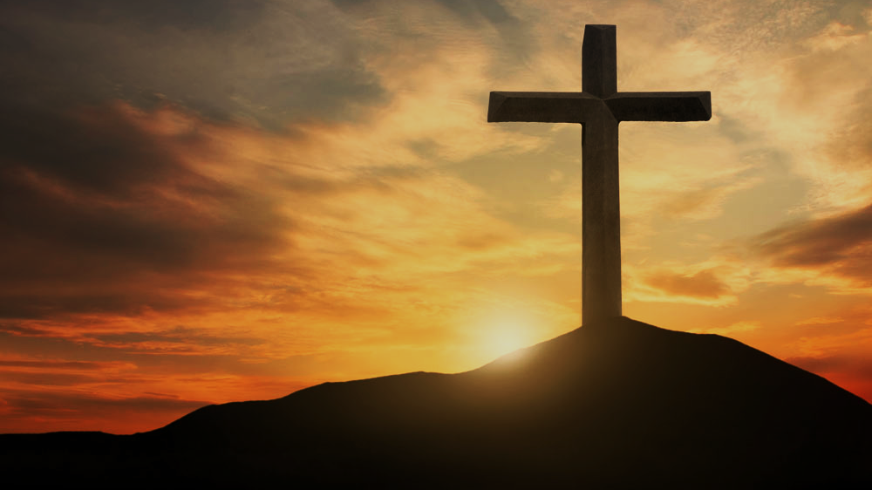
Doctrine of Salvation
(Soteriology)
Wednesday Bible Study
Faith Presbyterian Church

Slide 8
Soteri + ology
Salvation + Study

Slide 9
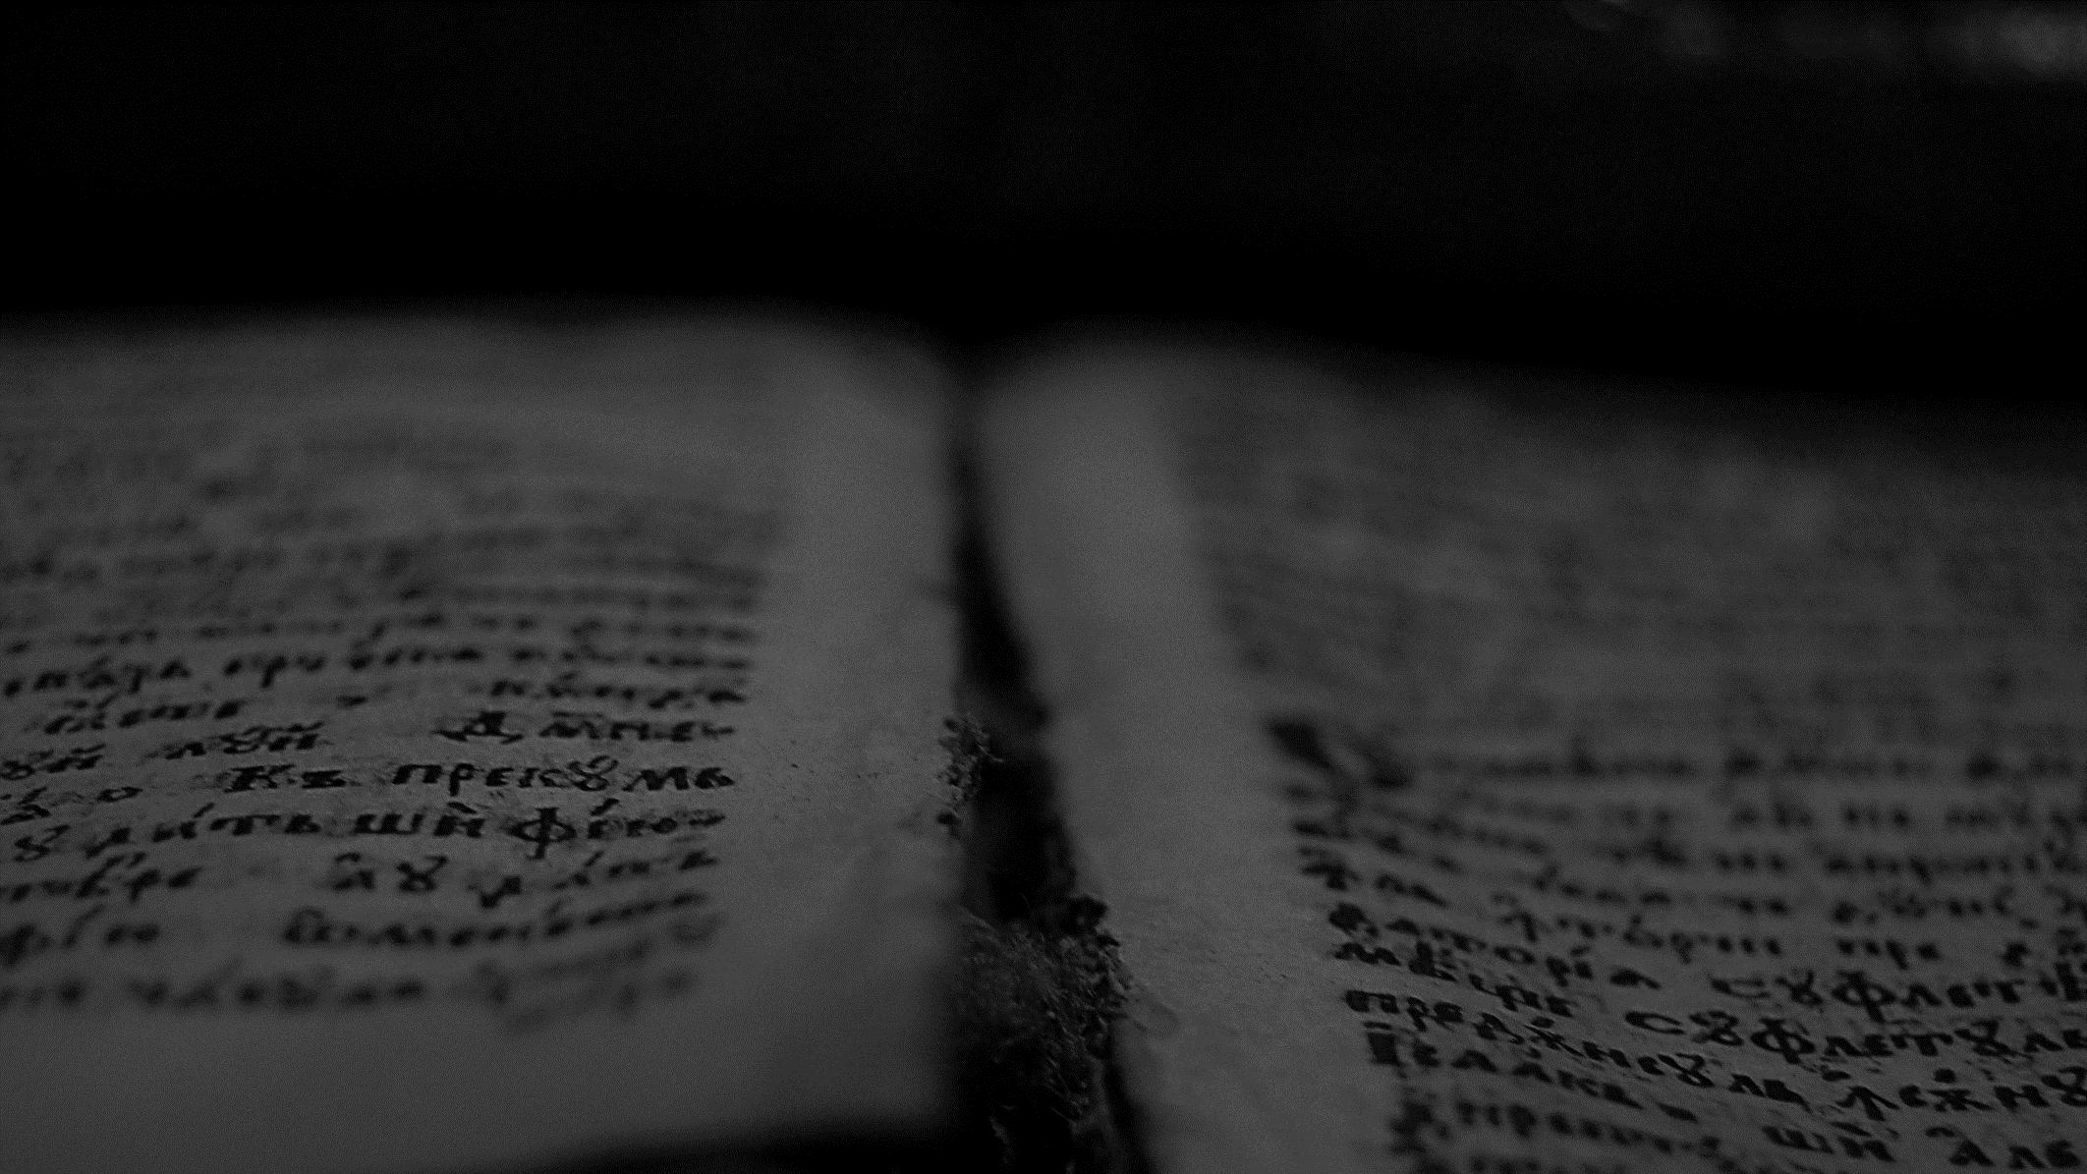
And we know that for those who love God all things work together for good, for those who are called according to his purpose. For those whom he foreknew he also predestined to be conformed to the image of his Son, in order that he might be the firstborn among many brothers. And those whom he predestined he also called, and those whom he called he also justified, and those whom he justified he also glorified.
Romans 8.28-30
ESV

Slide 10
Ordo Salutis
Election
Predestination
Calling (external and effectual)
Regeneration
Repentance
Saving Faith
Justification
Adoption
Sanctification
Glorification
Eternity
Single Act
Personal History
Process
Fullness of Time

Slide 11
Ordo Salutis
Election
Predestination
Calling
Regeneration
Repentance
Saving Faith
Justification
Adoption
Sanctification
Glorification
Foreknew
Predestined
Called
Justified
Glorified
Eternity
Personal History
Romans 8:28-30
Fullness of Time

Slide 12


PROCESS OF SALVATION
Election
Predestination
Regeneration (New Birth)
Conversion (Effectual Calling)
Justification (Merits of Christ)
Adoption as God’s Children
Sanctification
Glorification
Before all things were created
New Heavens and New Earth
1ª Coming of Christ
2ª Coming of Christ
*

Slide 13
Besides this you know the time, that the hour has come for you to wake from sleep. For salvation is nearer to us now than when we first believed.
Romans 13:11
ESV

Slide 14
Since, therefore, we have now been justified by his blood, much more shall we be saved by him from the wrath of God.
Romans 5:9
ESV

Slide 15
Blessed be the God and Father of our Lord Jesus Christ! According to his great mercy, he has caused us to be born again to a living hope through the resurrection of Jesus Christ from the dead, to an inheritance that is imperishable, undefiled, and unfading, kept in heaven for you, who by God's power are being guarded through faith for a salvation ready to be revealed in the last time.
1 Peter 1:3-5
ESV

Slide 16
PROCESS OF SALVATION
Election
Predestination
Regeneration (New Birth)
Conversion (Effectual Calling)
Justification (Merits of Christ)
Adoption as God’s Children
Sanctification
Glorification
Before all things were created
New Heavens and New Earth
1ª Coming of Christ
2ª Coming of Christ
*

Slide 17
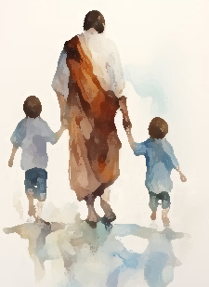
Sanctification as an End
In Romans, Paul teaches that the elect were predestined to be conformed to the Image of the Son. The Father gave the son a gift: a people of his own and for his glory. The Son redeemed these people to perfect them in his image to glory his name (Rom 8:29).

Slide 18
For those whom he foreknew he also predestined to be conformed to the image of his Son, in order that he might be the firstborn among many brothers.
Romans 8.29
ESV

Slide 19
Beloved, we are God's children now, and what we will be has not yet appeared; but we know that when he appears we shall be like him, because we shall see him as he is.
And everyone who thus hopes in him purifies himself as he is pure.
1 John 3:2-3
ESV

Slide 20
CAUSE OF SANCTIFICATION
Christ’s Sacrifice
Justification
(Full forgiveness)
Sanctification

Slide 21
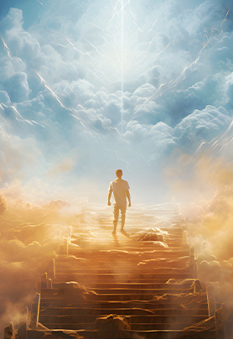
Complete Sanctification is Necessary
Hebrews 12:14 makes it very clear that we will not see the Lord without holiness. This is the full sanctification purchased by Christ. We must be fully rid of sin to abide in God’s presence. No sin can enter the high havens.

Slide 22
Blessed be the God and Father of our Lord Jesus Christ, who has blessed us in Christ with every spiritual blessing in the heavenly places, even as he chose us in him before the foundation of the world, that we should be holy and blameless before him.
Ephesians 1:3-4
ESV

Slide 23

Gradual Sanctification
Those who experience the grace of salvation desire and strive to honor Christ by sanctifying themselves. For this they use all the means of grace given by God to gradually clean themselves from the corruption of sin (1Cor 9.27; 2 Pet 1:10-11; Eph 4.11-14; 1 Tim 4.7)

Slide 24
And we all, with unveiled face, beholding the glory of the Lord, are being transformed into the same image from one degree of glory to another. For this comes from the Lord who is the Spirit.
2 Corinthians 3:18
ESV

Slide 25
…and to put on the new self, created after the likeness of God in true righteousness and holiness.
Ephesians 4:24
ESV

Slide 26
But our citizenship is in heaven, and from it we await a Savior, the Lord Jesus Christ, who will transform our lowly body to be like his glorious body, by the power that enables him even to subject all things to himself.
Philippians 3:20-21
ESV

Slide 27
State of Glory
This final state is described by Scripture as a state of “glory”. It is a superior state to the original state of Adam. Not only is all sin eliminated with its corruption, but eternal life is given. This second state is not qualitatively better than the first but is quantitively better. This glory, in some small measure, can already be experienced and seen in this life.

Slide 28
The glory that you have given me I have given to them, that they may be one even as we are one…
John 17:22
ESV

Slide 29
For it was fitting that he, for whom and by whom all things exist, in bringing many sons to glory, should make the founder of their salvation perfect through suffering.
Hebrews 2:10
ESV

Slide 30
To them God chose to make known how great among the Gentiles are the riches of the glory of this mystery, which is Christ in you, the hope of glory.
Colossians 1:27
ESV

Slide 31
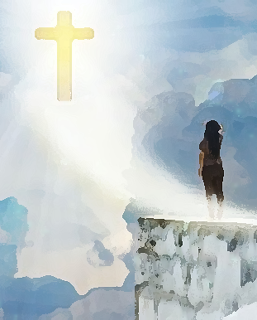
The time of Glorification
The process of glorification starts when a believer dies. His body becomes dust, but his soul is perfected to enter Heaven. All sin is removed from us, and our soul, heart, and mind are completely purified. This intermediary state is the beginning of the glorification which will be completed in the coming of Christ.

Slide 32




Intermediary State
Christ’s Ascension
Christ seats at the right hand of the Father
Paradise
*
Old Testament
Éden

Slide 33
When Christ who is your life appears, then you also will appear with him in glory.
Colossians 3:4
ESV

Slide 34
Resurrection of the Body (1 Cor 15:50-53)
Christ’s Ascension
Christ seats at the right hand of the Father
Jesus’s Return
Genneral Ressurection
Judgment of the living and the dead
Eternal Life
Paradise
*
Eternal Punishment
Old Testament
Éden

Slide 35
The Elements of Glorification
The elements of glorification are:
Removal of all guilt of the original sin.
Removal of the all the corruption of the original sin.
Purification of the soul
Purification of the body

