Slide 2
‘Tis So Sweet to Trust in Jesus
Hymn 679*
Text: Louisa M. R. Stead (*Trinity Hymnal)
Music: William J. Kirkpatrick

Slide 3
‘Tis so sweet to trust in Jesus,
just to take him at his word;
Just to rest upon his promise,
just to know, “Thus saith the Lord.”
Jesus, Jesus, how I trust him!
How I’ve proved him o’er and o’er!
Jesus, Jesus, precious Jesus!
O for grace to trust him more!

Slide 4
O how sweet to trust in Jesus,
just to trust his cleansing blood,
Just in simple faith to plunge me
‘neath the healing, cleansing flood!
Jesus, Jesus, how I trust him!
How I’ve proved him o’er and o’er!
Jesus, Jesus, precious Jesus!
O for grace to trust him more!

Slide 5
Yes, ‘tis sweet to trust in Jesus,
just from sin and self to cease,
Just from Jesus simply taking
life and rest, and joy and peace.
Jesus, Jesus, how I trust him!
How I’ve proved him o’er and o’er!
Jesus, Jesus, precious Jesus!
O for grace to trust him more!

Slide 6
I’m so glad I learned to trust thee,
precious Jesus, Savior, Friend;
And I know that thou art with me,
wilt be with me to the end.
Jesus, Jesus, how I trust him!
How I’ve proved him o’er and o’er!
Jesus, Jesus, precious Jesus!
O for grace to trust him more!

Slide 7
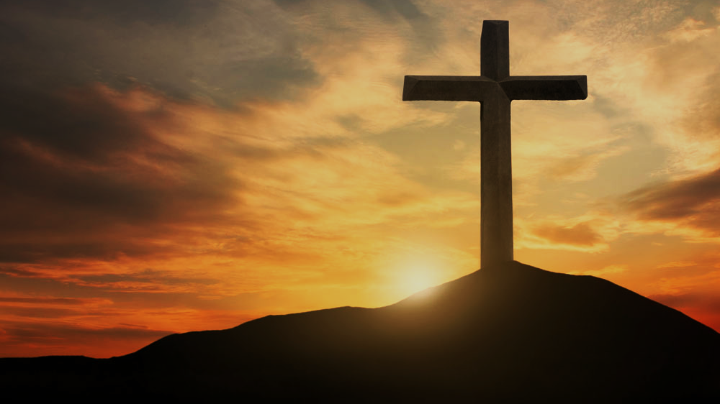
Doctrine of Salvation
(Soteriology)
Wednesday Bible Study
Faith Presbyterian Church

Slide 8
Ordo Salutis
Election
Predestination
Calling (external and effectual)
Regeneration
Repentance
Saving Faith
Justification
Adoption
Sanctification
Glorification
Eternity
Single Act
Personal History
Process
Fullness of Time

Slide 9
SANCTITY
קדוש
αγιω
Sanctity, or holiness, is the quality of one “separated” from corruption. God is holy, independent from all that exists, and all pure, uncontaminated (Rev 15.4; Isah 6.3). God’s people are called to be holy (Exo 19.2).

Slide 10

The End Goal
There will not be corruption in the New Heavens and the New Earth (Rev 21:1-4). No sin can stand in the presence of God. Without a complete sanctification, no one will see God (Heb 12.14). The end goal of salvation is the complete sanctification of the body and the soul (1Thess 5:23).

Slide 11
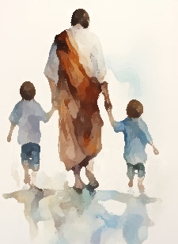
Predestined
In Romans, Paul teaches that the elect were predestined to be conformed to the Image of the Son. The Father gave the son a gift: a people of his own and for his glory. The Son redeemed these people to perfect them in his image to glory his name (Rom 8:29).

Slide 12
CONFESSION OF FAITH
Chapter 13
Paragraph 1
They, who are once effectually called, and regenerated, having a new heart, and a new spirit created in them, are further sanctified, really and personally, through the virtue of Christ’s death and resurrection, by his Word and Spirit dwelling in them: the dominion of the whole body of sin is destroyed, and the several lusts thereof are more and more weakened and mortified; and they more and more quickened and strengthened in all saving graces, to the practice of true holiness, without which no man shall see the Lord.

Slide 13
Regeneration
Effectual Calling
Justification
Adoption
SANCTIFICATION
Col 1:21-23

Slide 14
CAUSE OF SANCTIFICATION
Christ’s Sacrifice
Justification
(Full forgiveness)
Sanctification

Slide 15
FALSE CONCEPT
Grace of forgiveness
Sanctification
Salvation

Slide 16

Regeneration
Calling
Justification
Adoption
1 Thess. 5:23–24

Slide 17

Regeneration
Calling
Justification
Adoption
Romans 8:15; John 8:31-36; Romans 6:6-22

Slide 18

Regeneration
Calling
Justification
Adoption
Holy Spirit
Word of God
2 Thess. 2:13
John 17:17, 19

Slide 19
CONFESSION OF FAITH
Chapter 13
Paragraph 2
This sanctification is throughout, in the whole man; yet imperfect in this life, there abiding still some remnants of corruption in every part; whence arises a continual and irreconcilable war, the flesh lusting against the Spirit, and the Spirit against the flesh.

Slide 20

Galatians 5:1, 16-24
Rom 7:23

Slide 21
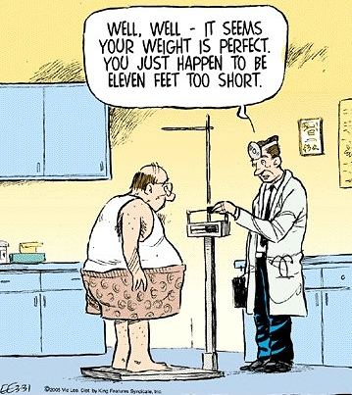
Perfection?!
The end goal of salvation is the complete sanctification of the body and the soul (1Thess 5:23). The body will not experience any measure of sanctification in this life, since it awaits the resurrection when it will be fully sanctified of any consequence of sin (Rom 8:8-11, 23-24). But the soul experiences in this life some measure of sanctification, however never close to perfection (Phil 3.12).

Slide 22
CONFESSION OF FAITH
Chapter 13
Paragraph 3
In which war, although the remaining corruption, for a time, may much prevail; yet, through the continual supply of strength from the sanctifying Spirit of Christ, the regenerate part doth overcome; and so, the saints grow in grace, perfecting holiness in the fear of God.

Slide 23

Gradual Sanctification
Those who experience the grace of salvation desire and strive to honor Christ by sanctifying themselves. For this they use all the means of grace given by God to gradually clean themselves from the corruption of sin (1Cor 9.27; 2 Pet 1:10-11; Eph 4.11-14; 1 Tim 4.7)

