Slide 2
He Is Exalted
CCLI #50180610
Text: Twila Paris
Music: Twila Paris

Slide 3
He is exalted, the King is exalted on high,
I will praise Him.
He is exalted, forever exalted, and I will
praise His name!
He is the Lord, forever His truth shall reign
Heaven and earth rejoice in His holy name.
He is exalted, the King is exalted on high.

Slide 4
He is exalted, the King is exalted on high,
I will praise Him.
He is exalted, forever exalted, and I will
praise His name!
He is the Lord, forever His truth shall reign
Heaven and earth rejoice in His holy name.
He is exalted, the King is exalted on high.

Slide 5
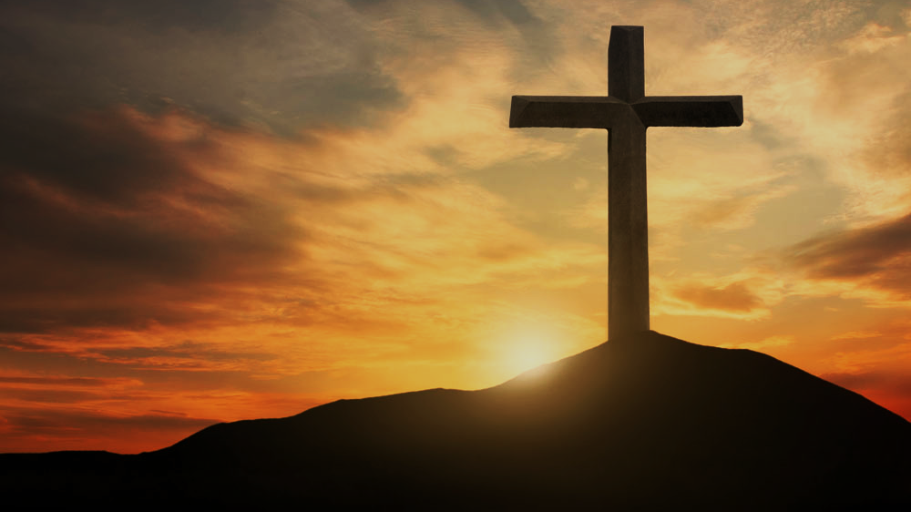
Doctrine of Salvation
(Soteriology)
Wednesday Bible Study
Faith Presbyterian Church

Slide 6
Ordo Salutis
Election
Predestination
Calling (external and effectual)
Regeneration
Repentance
Saving Faith
Justification
Adoption
Sanctification
Glorification
Eternity
Single Act
Personal History
Process
Fullness of Time

Slide 7

CONVERSION
Conversion (effectual calling) is the consequence of regeneration. The new birth is operated and confirmed by faith and repentance. All of those effectually called are justified.
REPENTANCE
Faith

Slide 8
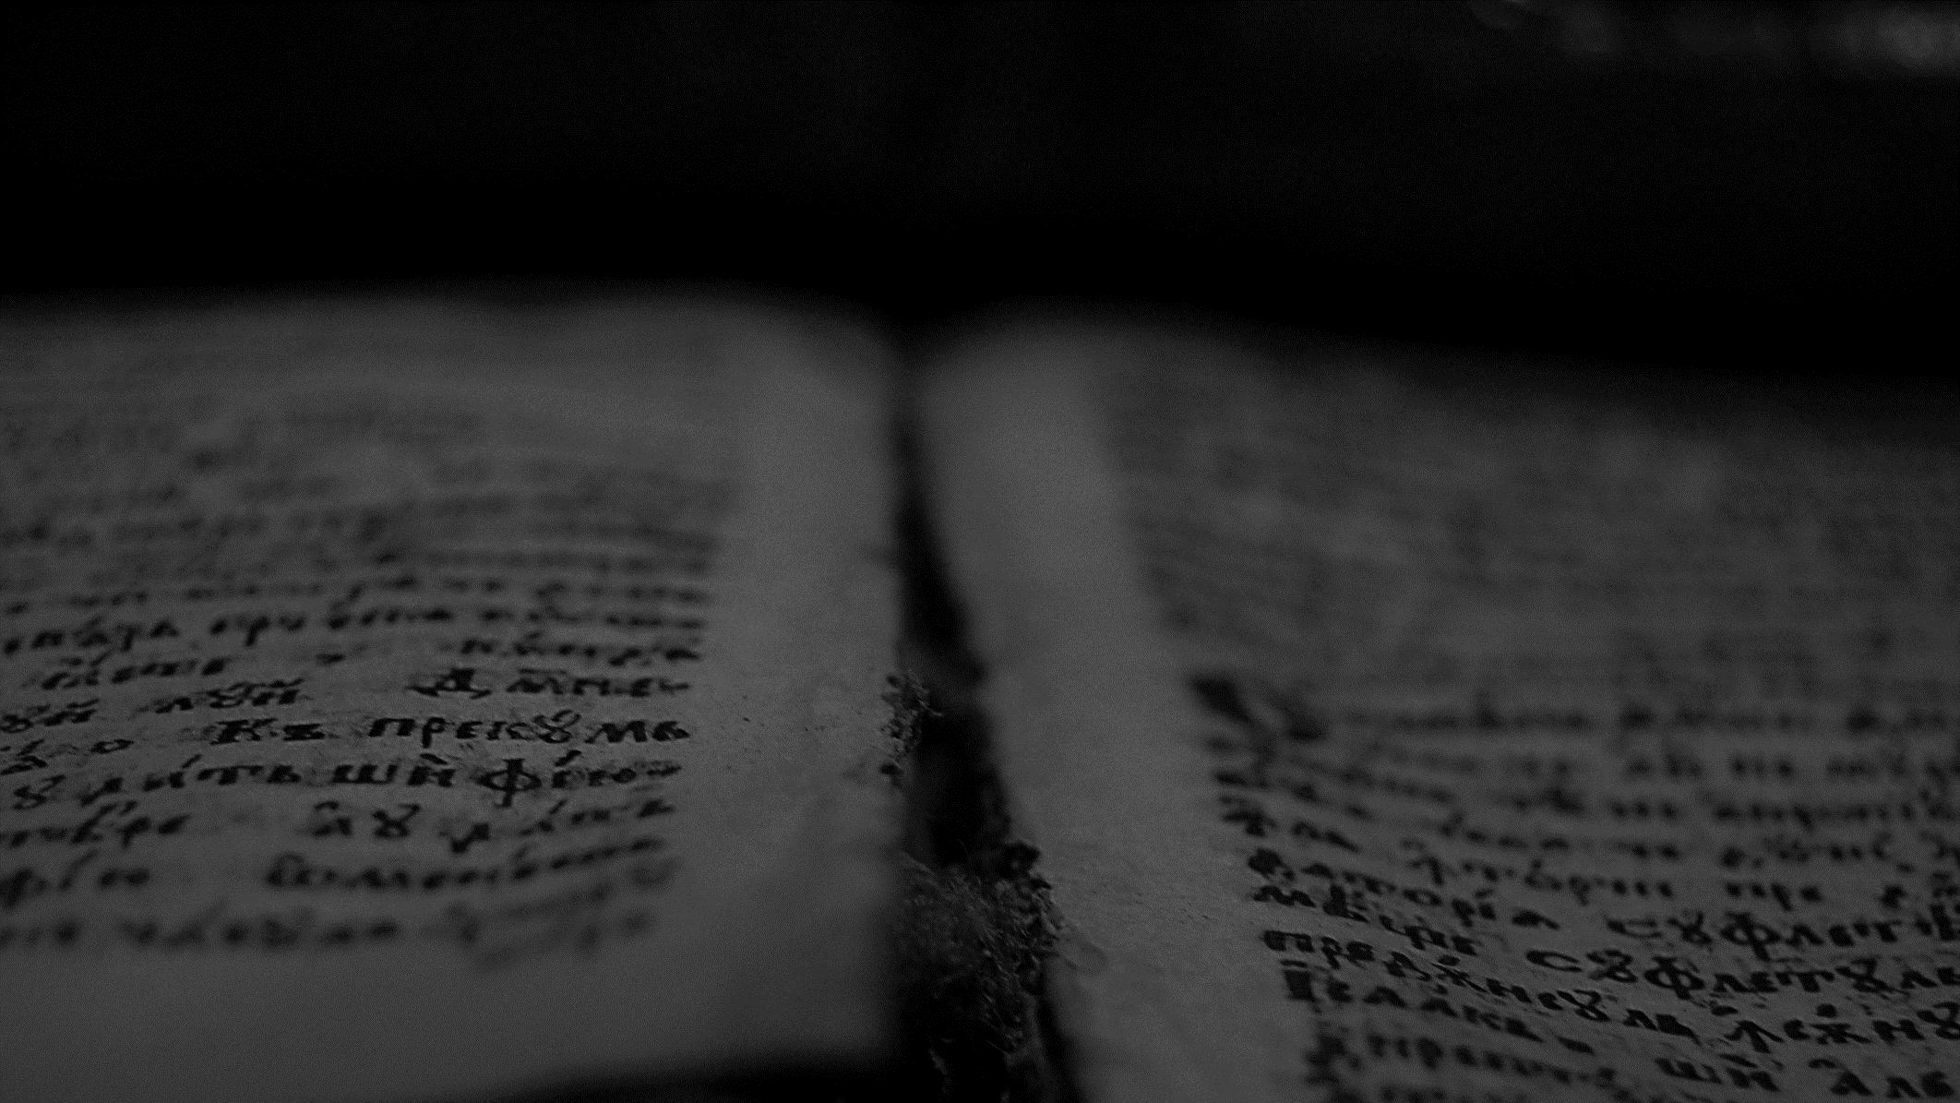
And those whom he predestined he also called, and those whom he called he also justified, and those whom he justified he also glorified.
Romans 8.30
ESV

Slide 9
δικαιόω
The word justification (also “righteousness”) means “making righteous” or “acquit”. It is used by the apostle Paul in a theological sense derived to the Old Testament concept of “righteousness” (Ex 23.7; Deut 25.1; Prov 17.15; Isa 5.23).

Slide 10
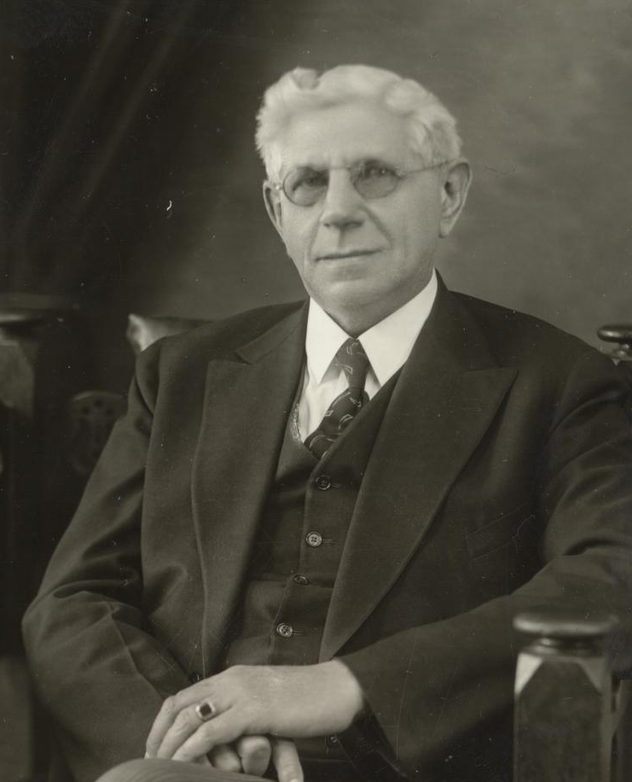
Louis Berkhof explains that in the Old Testament the word righteousness has a legal sense (forensic). It “means ‘to declare judicially that one’s state is in harmony with the demands of the law’.”
Systematic Theology (1977, 15th printing), 510.

Slide 11
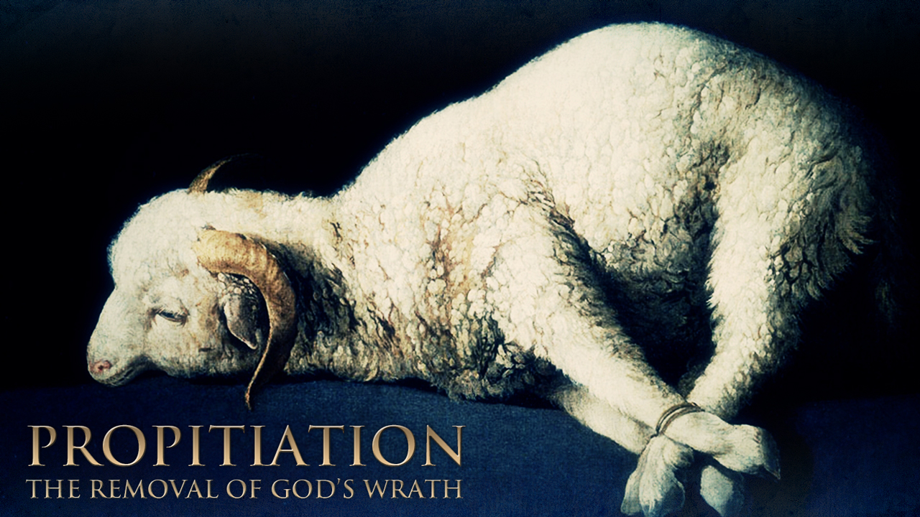
Justification
Some have interpreted righteousness as a moral concept, instead of legal, but in opposition to that Paul connects righteousness with the ceremonial concept of propitiation.

Slide 12
All have sinned and fall short of the glory of God, and are justified by his grace as a gift, through the redemption that is in Christ Jesus, whom God put forward as a propitiation by his blood, to be received by faith. This was to show God's righteousness, because in his divine forbearance, he had passed over former sins.
Romans 3.23-25
ESV

Slide 13
Complex Meaning
Forensic
+
Ceremonial
= JUSTIFICATION

Slide 14
CONFESSION OF FAITH
Chapter 11
Paragraph 1
Those whom God effectually calleth, he also freely justifies: not by infusing righteousness into them, but by pardoning their sins, and by accounting and accepting their persons as righteous; not for anything wrought in them, or done by them, but for Christ’s sake alone; nor by imputing faith itself, the act of believing, or any other evangelical obedience to them, as their righteousness; but by imputing the obedience and satisfaction of Christ unto them, they receiving and resting on him and his righteousness, by faith; which faith they have not of themselves, it is the gift of God.

Slide 15
What is Justification? (LCW Q.70)
A. Justification is an act of God’s free grace unto sinners, in which he pardons all their sins, accepts and accounts their persons righteous in his sight; not for anything wrought in them, or done by them, but only for the perfect obedience and full satisfaction of Christ, by God imputed to them, and received by faith alone.

Slide 16
What is Justification?
It is the act of God imputing Christ’s justice upon the regenerated elect.
It means their past, present, and future sins are forgiven. God treats them as righteous and will never bring their sins against them (Romans 3.21-31).

Slide 17
Canons of the Council of Trent (1547-63)
XVI. CANON IX. If anyone shall say, that by faith alone the impious is justified; so as to mean that nothing else is required to co-operate in order unto the obtaining the grace of justification, and that it is not in any respect necessary that he be prepared and disposed by the movement of his own will; let him be anathema.

Slide 18
Canons of the Council of Trent (1547-63)
XVI. CANON XXIV. If anyone shall say, that the justice received is not preserved, and also increased in the sight of God through good works; but that the said works are merely the fruits and signs of justification received, but not a cause of the increase thereof; let him be anathema.

Slide 19
Medieval Concept Preserved in Trent
Justification is the basis of forgiveness of sins.
It is infused making the sinner righteous (virtuous).
It works with merit to be increased.

Slide 20
CONFESSION OF FAITH
Chapter 11
Paragraph 2
Faith, thus receiving and resting on Christ and his righteousness, is the alone instrument of justification: yet is it not alone in the person justified, but is ever accompanied with all other saving graces, and is no dead faith, but worketh by love.
Notes:
Rom 3:28
James 2:17-26

Slide 21
CONFESSION OF FAITH
Chapter 11
Paragraph 3
Christ, by his obedience and death, did fully discharge the debt of all those that are thus justified, and did make a proper, real, and full satisfaction to his Father’s justice in their behalf. Yet, inasmuch as the Father gave him for them; and his obedience and satisfaction accepted in their stead; and both, freely, not for anything in them; their justification is only of free grace; that both the exact justice and rich grace of God might be glorified in the justification of sinners.

Slide 22
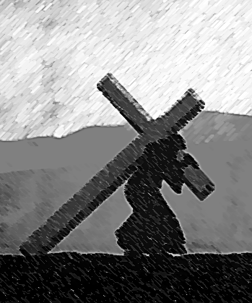
Double Imputation
Christ’s work in favor of the elect accomplished “obedience and satisfaction” for them. These are two distinctive actions. One of them undoes what Adam did and the other does what he did not do. They are commonly called the “passive and active obedience of Jesus”.

Slide 23
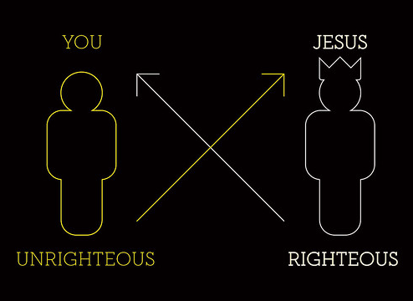
Union With Christ
Christ is so united to the elect that his obedience and satisfaction is their obedience and satisfaction. On the Cross, Christ was acting vicariously for the elect. Christ died for the elect, in their place.

Slide 24


Adam in the Garden of Eden
Eternal Life
“Ladder” of personal obedience
Adam’s Original State
Sinful State

Slide 25
Adam Expelled from the Garden
Eternal Life
“Ladder” of personal obedience
Adam’s Original State
Sinful State

Slide 26
Adam Under Sin
Eternal Life
Obedience
Adam’s Original State
Death
Sinful State

Slide 27
Double Justice of Christ
Eternal Life
Obedience
Active Obedience
What Adam did not do
Rom 5.8-19
1 Tim 2.6
Heb 10.10,14
Mat 3.15; 5.17
Phi 2.8
Adam’s Original State
Death
Passive Obedience
Undoing what Adam did
2Cor 5.19-21
Rom 3.24-25
Eph 1.7; 5.2
John 10.11,14-17, 26-29
Sinful State

Slide 28
Comparison of Positions
 | Calvinists (Westminster) | Remonstrants (Arminians) | Wesleyans
Passive Obedience | Penal Satisfaction Limited to the Elect | Real Propitiation Graciously Accepted | Penal Substitution for All
Active Obedience | Perfect Obedience Limited to the Elect | Imputed by Faith | Imputed by Faith through Free will

Slide 29
CONFESSION OF FAITH
Chapter 11
Paragraph 4
God did, from all eternity, decree to justify all the elect, and Christ did, in the fullness of time, die for their sins, and rise again for their justification: nevertheless, they are not justified, until the Holy Spirit doth, in due time, actually apply Christ unto them.

Slide 30
Logical Process of Justification
Eternity
Past History
Present History
Decree of Justification
Act of Justice
Imputation by Faith

Slide 31
CONFESSION OF FAITH
Chapter 11
Paragraph 5
God doth continue to forgive the sins of those that are justified; and, although they can never fall from the state of justification, yet they may, by their sins, fall under God’s fatherly displeasure, and not have the light of his countenance restored unto them, until they humble themselves, confess their sins, beg pardon, and renew their faith and repentance.

Slide 32
CONFESSION OF FAITH
Chapter 11
Paragraph 6
The justification of believers under the old testament was, in all these respects, one and the same with the justification of believers under the new testament.

Slide 33


Justification In Relation to the Testaments
1ª Coming of Christ
2ª Coming of Christ
Daniel 9.24-26
Isaiah 53.4-6, 10-12
*
Antigo
Testamento
Novo
Testamento
Justified by Faith in future justification
Justified by Faith in Christ’s Accomplished Work
Eden
Covenant of Works
Covenant of Grace

