Slide 1
Notes:
1

Slide 2
Go, Tell It on the Mountain
Hymn 224*
Text: Spiritual (*Trinity Hymnal)
Music: Spiritual
Notes:
2

Slide 3
Go, tell it on the mountain,
over the hills and ev’rywhere;
Go, tell it on the mountain
that Jesus Christ is born.
While shepherds kept their watching
o’er silent flocks by night,
Behold, throughout the heavens
there shone a holy light.

Slide 4
Go, tell it on the mountain,
over the hills and ev’rywhere;
Go, tell it on the mountain
that Jesus Christ is born.
The shepherds feared and trembled
when, lo! above the earth
Rang out the angel chorus
that hailed our Savior’s birth.

Slide 5
Go, tell it on the mountain,
over the hills and ev’rywhere;
Go, tell it on the mountain
that Jesus Christ is born.
Down in a lowly manger
our humble Christ was born,
And God sent us salvation
that blessèd Christmas morn.

Slide 6
Go, tell it on the mountain,
over the hills and ev’rywhere;
Go, tell it on the mountain
that Jesus Christ is born.

Slide 8
Prepare Him Room
Notes:
8

Slide 9
O behold, the mystery now unfolds
See the star shine on the virgin foretold
Angels sing and light up the sky
Hope rings out in a newborn's cry
Swing wide, you ancient gates
For Christ is born today!
Prepare Him room
Prepare Him room
Let the King of glory enter in

Slide 10
God with us, the promise has come to be
This, the one the prophets were longing to see
In the darkness a blazing light
To the hungry the words of life
His kingdom now is near
For those with ears to hear
Prepare Him room
Prepare Him room
Let the King of glory enter in

Slide 11
Prepare Him room
Prepare Him room
Let the King of glory enter in
Oh, our hearts, as busy as Bethlehem
Hear Him knock, don't say there's no room in the inn
Through the cradle, cross, and grave
See the love of God displayed
Now He's risen and He reigns
Praise the Name above all names!

Slide 12
Prepare Him room
Prepare Him room
Let the King of glory enter in
Prepare Him room
Prepare Him room
Let the King of glory enter in
Let the King of glory enter in

Slide 14
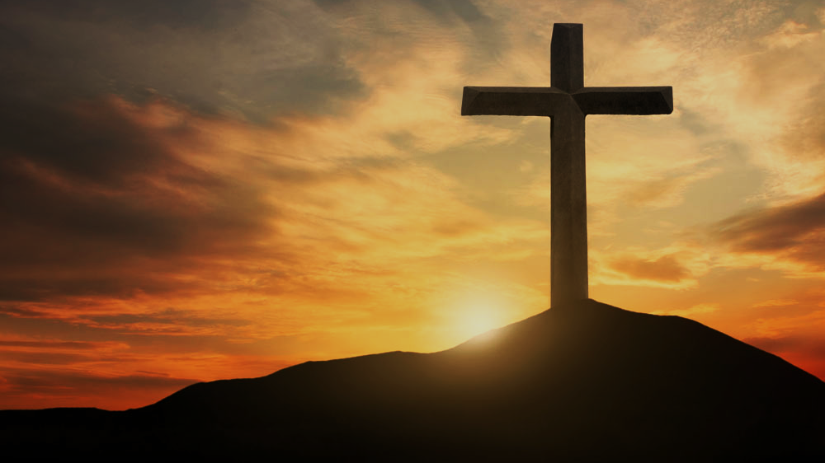
Doctrine of Salvation (Soteriology)
Wednesday Bible Study
Faith Presbyterian Church

Slide 15
By Word and Spirit
The Holy Spirit works upon the preaching of the Word as the instrumental cause of salvation.

Slide 16
Ordo Salutis
Election
Predestination
Calling (external and effectual)
Regeneration
Repentance
Saving Faith
Justification
Adoption
Sanctification
Glorification
Eternity
Single Act
Personal History
Process
Fullness of Time

Slide 17
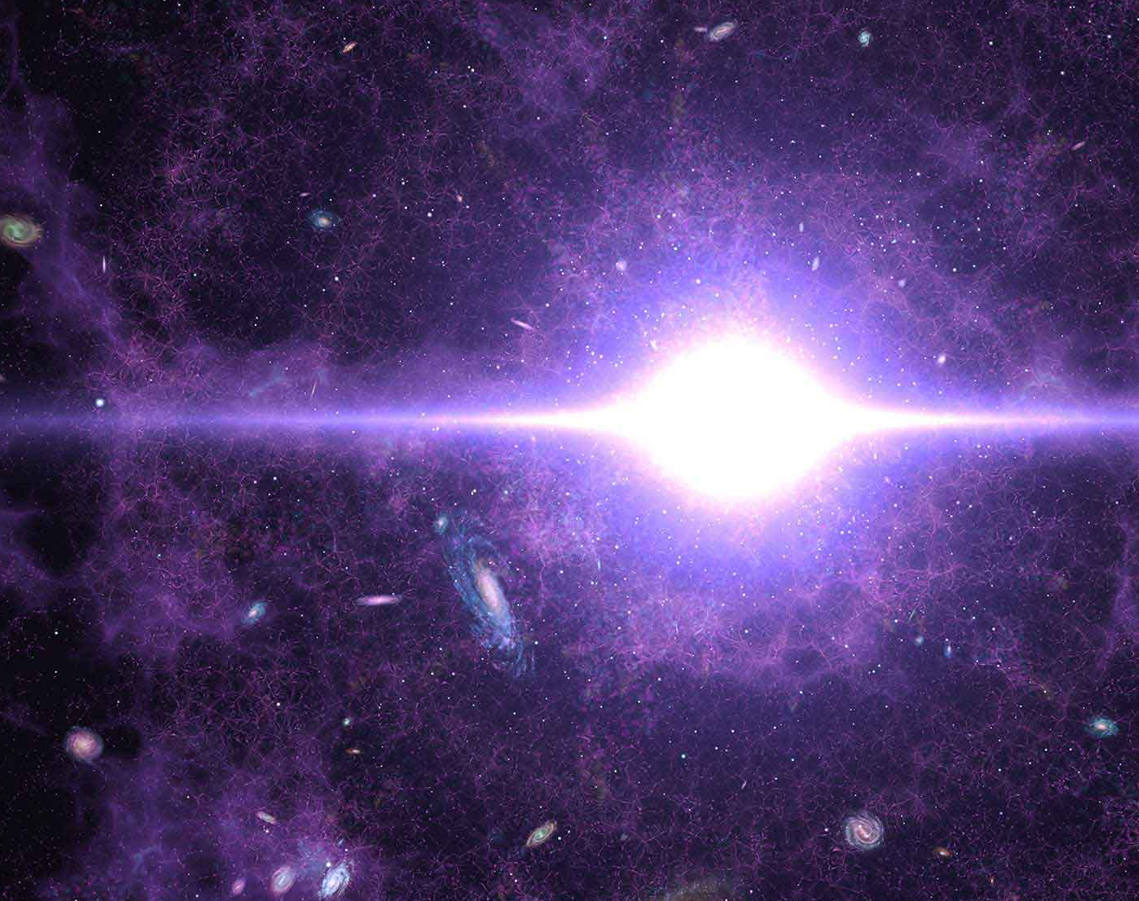
SOVEREIGNTY
There is no other way of interpreting “predestination” than as God’s sovereign plan of history before it came to be (creation, fall, redemption). God pre-ordered all things before they existed. They were written in his book (Psalm 139.16; Isa 46.10-11;48.3-5). Otherwise, the book of Revelation is just a fantasy (Rev 1.19; 4.1; 22.6).

Slide 18
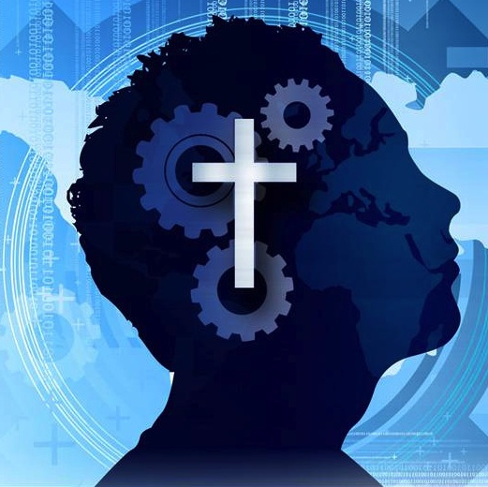
The Operation of the Spirit
Enlightening our minds to understand (2Cor 2.6-15; Eph 1.17-18; Acts 16.14)
Renewing our wills (Deut 30.6; Ezek 36.27; 1Pe 1.23).
Leading us to what is good (Rom 6.19-23).

Slide 19
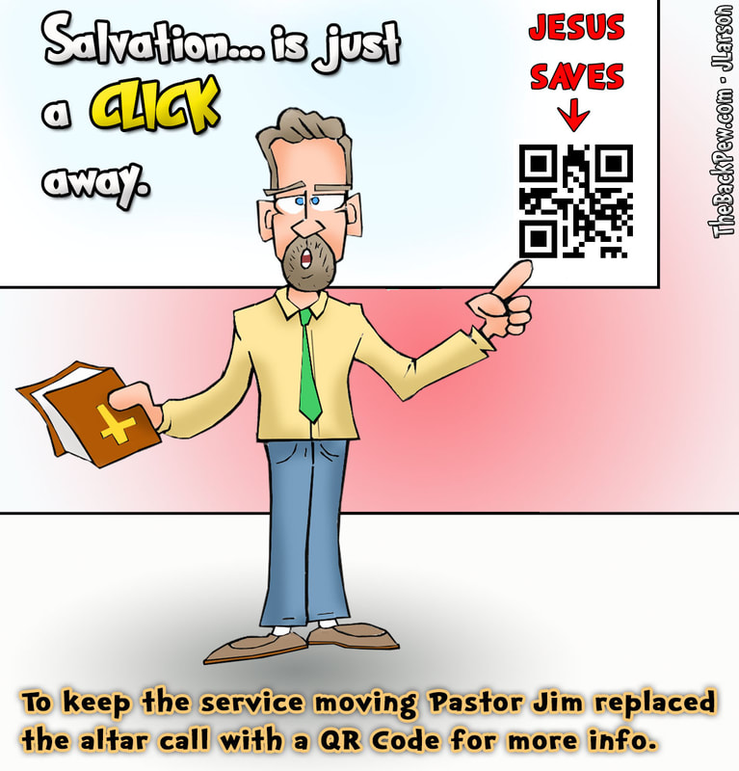
The Right Response?
How can we identify one who has been regenerated and, therefore, has his mind and will renewed for a new life?
What are the first marks of conversion?
What is the right response to the Gospel?
What preachers of the Gospel should appeal to their listeners?

Slide 20
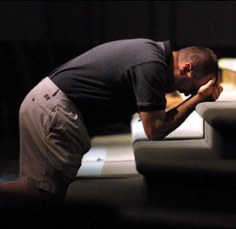
Jesus’ Call
We learn in Mark that Jesus’ preaching was the “proclamation of the Gospel” because the “Kingdom of God” was at hand. This led to his call to REPENT and BELIEVE in the Gospel (Mark 1.14-15).

Slide 21
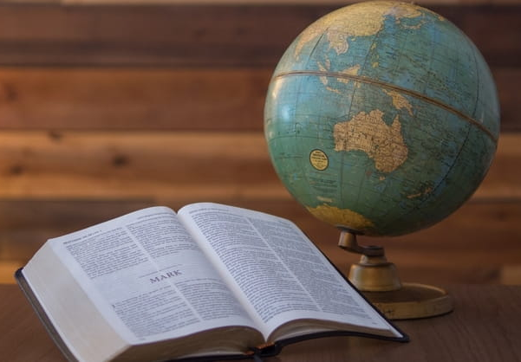
Great Commission (Mark 16.15-16)
When Jesus sent his apostles into the world he commanded them to preach the Gospel as he did, and to baptize, something he didn’t, however, only those who believed.

Slide 22
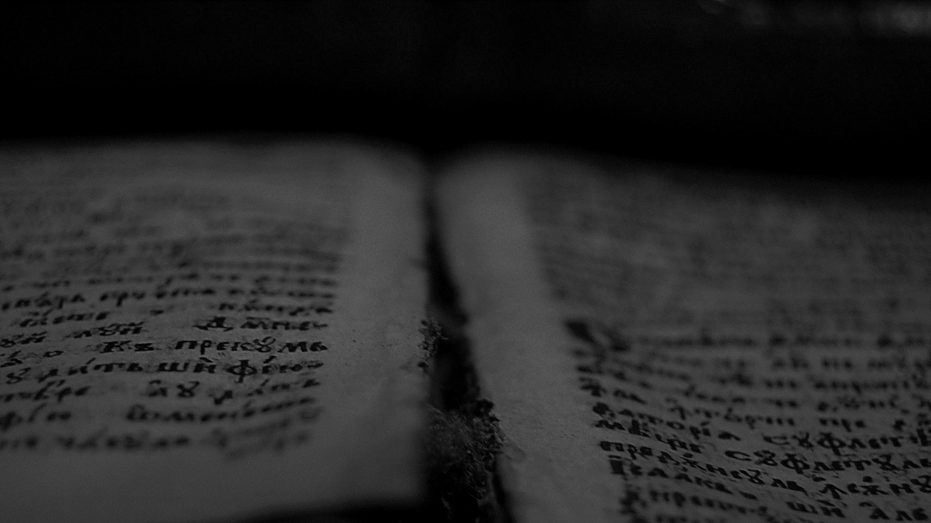
And he said to them, Go into all the world and proclaim the gospel to the whole creation. Whoever believes and is baptized will be saved, but whoever does not believe will be condemned.
Mark 16.15-16
ESV

Slide 23
CONFESSION OF FAITH
Chapter 14
Paragraph 1
The grace of faith, whereby the elect are enabled to believe to the saving of their souls, is the work of the Spirit of Christ in their hearts; and is ordinarily wrought by the ministry of the Word: by which also, and by the administration of the sacraments, and prayer, it is increased and strengthened.

Slide 24
To sum up:
Faith is caused by the Holy Spirit.
It works by the preaching of the Word of God.
It is increased by the Sacraments and Prayer.

Slide 25
For by grace you have been saved through faith. And this is not your own doing; it is the gift of God.
Ephesians 2.8
ESV

Slide 26
In him you also, when you heard the word of truth, the gospel of your salvation, and believed in him, were sealed with the promised Holy Spirit…
…the Father of glory, may give you the Spirit of wisdom and of revelation in the knowledge of him, having the eyes of your hearts enlightened, that you may know what is the hope to which he has called you, what are the riches of his glorious inheritance in the saints, and what is the immeasurable greatness of his power toward us who believe, according to the working of his great might.
Ephesians 1.13
ESV

Slide 27
CONFESSION OF FAITH
Chapter 14
Paragraph 2
By this faith, a Christian believeth to be true whatsoever is revealed in the Word, for the authority of God Himself speaking therein; and acteth differently, upon that which each particular passage thereof containeth; yielding obedience to the commands, trembling at the threatenings, and embracing the promises of God for this life, and that which is to come. But the principal acts of saving faith are, accepting, receiving, and resting upon Christ alone for justification, sanctification, and eternal life, by virtue of the covenant of grace.

Slide 28
To Sum Up
By Faith, one is led to believe in the authority of Scriptures.
Faith leads to obedience, reverent fear, and trust in God’s promises.
True faith leads one to accept and rest in Christ alone for justification, sanctification, and eternal life because of the covenant of grace.

Slide 29
CONFESSION OF FAITH
Chapter 14
Paragraph 3
This faith is different in degrees, weak or strong; may be often and many ways assailed and weakened, but gets the victory; growing up in many to the attainment of a full assurance through Christ, who is both the author and finisher of our faith.

Slide 30
Solus Christus
Real faith can be weak or strong, knowledgeable or simple, but it always rests in Christ alone.

Slide 31
The Companion
I couldn’t go anywhere without you!!!
Faith must always have a companion. Faith is confirmed through repentance. Faith without repentance is mere intellectual assent.
REPENTANCE
Faith

Slide 32
For you know that afterward, when he [Esau] desired to inherit the blessing, he was rejected, for he found no chance to repent, though he sought it with tears.
Hebrews 12.17
ESV

Slide 33
CONFESSION OF FAITH
Chapter 15
Paragraph 1
Repentance unto life is an evangelical grace, the doctrine whereof is to be preached by every minister of the gospel, as well as that of faith in Christ.
By it a sinner, out of the sight and sense, not only of the danger, but also of the filthiness and odiousness of his sins, as contrary to the holy nature and righteous law of God, and upon the apprehension of His mercy in Christ to such as are penitent, so grieves for, and hates his sins, as to turn from them all unto God, purposing and endeavoring to walk with Him in all the ways of His commandments.

Slide 34
To Sum Up
Repentance is a grace given by God.
It is necessary that preachers talk about repentance and call people to repentance.
The negative side of repentance is the understanding the offense of sin to God which causes sadness.
The positive part of repentance is faith in God’s mercy which moves man away from sin.

Slide 35
…or do you presume on the riches of his kindness and forbearance and patience, not knowing that God's kindness is meant to lead you to repentance?
Romans 2.4
ESV

Slide 36
As it is, I rejoice, not because you were grieved, but because you were grieved into repenting. For you felt a godly grief, so that you suffered no loss through us. For godly grief produces a repentance that leads to salvation without regret, whereas worldly grief produces death. For see what earnestness this godly grief has produced in you, but also what eagerness to clear yourselves, what indignation, what fear, what longing, what zeal, what punishment! At every point you have proved yourselves innocent in the matter.
2Corinthians 2.7-11
ESV

Slide 37
CONFESSION OF FAITH
Chapter 15
Paragraphs
3. Although repentance be not to be rested in as any satisfaction for sin, or any cause of the pardon thereof, which is the act of God’s free grace in Christ; yet is it of such necessity to all sinners, that none may expect pardon without it.
4. As there is no sin so small but it deserves damnation; so there is no sin so great that it can bring damnation upon those who truly repent.
5. Men ought not to content themselves with a general repentance, but it is every man’s duty to endeavor to repent of his particular sins, particularly.

Slide 38
To Sum Up
Repentance is not penitence nor does it have any value in itself.
The grace of pardon is not given without repentance.
All sins require repentance, however small or big.
Repentance should be nominal as much as possible.

Slide 39
CONFESSION OF FAITH
Chapter 15
Paragraph 6
As every man is bound to make private confession of his sins to God, praying for the pardon thereof, upon which, and the forsaking of them, he shall find mercy: so he that scandalizeth his brother, or the church of Christ, ought to be willing, by a private or public confession and sorrow for his sin, to declare his repentance to those that are offended; who are thereupon to be reconciled to him, and in love to receive him.

Slide 40
Bear fruit in keeping with repentance.
Matthew 3.8
ESV

Slide 41
…but declared first to those in Damascus, then in Jerusalem and throughout all the region of Judea, and also to the Gentiles, that they should repent and turn to God, performing deeds in keeping with their repentance.
Acts 26.20
ESV

