Slide 1
Notes:
1

Slide 2
Christus Victor
Words and Music by Matt Boswell, Bryan Fowler, Keith Getty, Kristyn Getty, and Matt Papa © 2024 Getty Music Publishing (BMI), Messenger Hymns (BMI), LIVINGHYMNS (BMI), Getty Music Hymns and Songs (ASCAP), Love Your Enemies Publishing (ASCAP) (all adm at CapitolCMGPublishing.com)
Notes:
2

Slide 3
O Most High, King of the ages
Great I AM, God of wonders
By the blood You have redeemed us
Led us through mighty waters
Our strength, our song, our sure salvation
  Now to the Lamb upon the throne
  Be blessing, honor, glory, power
  For the battle You have won
  Hallelujah! Amen
O Most High, dwelling among us
Son of man sent for sinners
By Your blood You have redeemed us
Spotless Lamb, mighty Savior
Who lived, who died, who rose victorious
Now to the Lamb upon the throne
Be blessing, honor, glory, power
For the battle You have won
Hallelujah! Amen
With every tribe and every tongue
We join the anthem of the angels
In the triumph of the Son
Hallelujah! Amen
Sing the victory of the Lamb
Hallelujah! Amen
O Most High, King of the nations
Robed in praise, crowned with splendor
On that day who will not tremble?
When You stand Christ the Victor
Who was, and is, and is forever
Amen, amen, amen
Amen, amen, amen, amen

Slide 4
O Most High, dwelling among us
Son of man sent for sinners
By Your blood You have redeemed us
Spotless Lamb, mighty Savior
Who lived, who died, who rose victorious

Slide 5
    Now to the Lamb upon the throne
    Be blessing, honor, glory, power
    For the battle You have won
    Hallelujah! Amen
    With every tribe and every tongue
    We join the anthem of the angels
    In the triumph of the Son
    Hallelujah! Amen

Slide 6
Sing the victory of the Lamb
Hallelujah! Amen
O Most High, King of the nations
Robed in praise, crowned with splendor
On that day who will not tremble?
When You stand Christ the Victor
Who was, and is, and is forever

Slide 7
    Now to the Lamb upon the throne
    Be blessing, honor, glory, power
    For the battle You have won
    Hallelujah! Amen
    With every tribe and every tongue
    We join the anthem of the angels
    In the triumph of the Son
    Hallelujah! Amen
Amen, amen, amen
Amen, amen, amen, amen

Slide 9
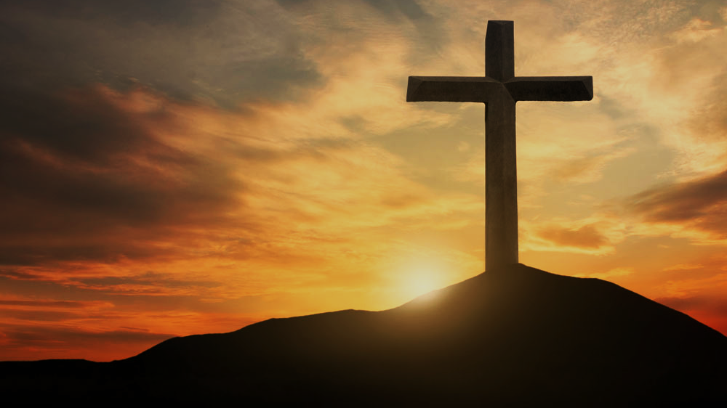
Doctrine of Salvation
(Soteriology)
Wednesday Bible Study
Faith Presbyterian Church

Slide 10
Ordo Salutis
Election
Predestination
Calling (external and effectual)
Regeneration
Repentance
Saving Faith
Justification
Adoption
Sanctification
Glorification
Eternity
Single Act
Personal History
Process
Fullness of Time

Slide 11

Reformed
Catholics
Evangelicals
Christ’s Satisfaction
Christ’s Satisfaction
Christ’s Satisfaction
Foundation
Faith
Obedience
Means
Faith
Faith
Sacraments
MAN
NAN
MAN

Slide 12

Summary Points
God did not predestine men for salvation because of something he knew beforehand, but because of his free purpose. He did not predestine all things moved by anything out of himself or necessity.
All those predestined to salvation will effectually be called and preserved to eternal life.

Slide 13
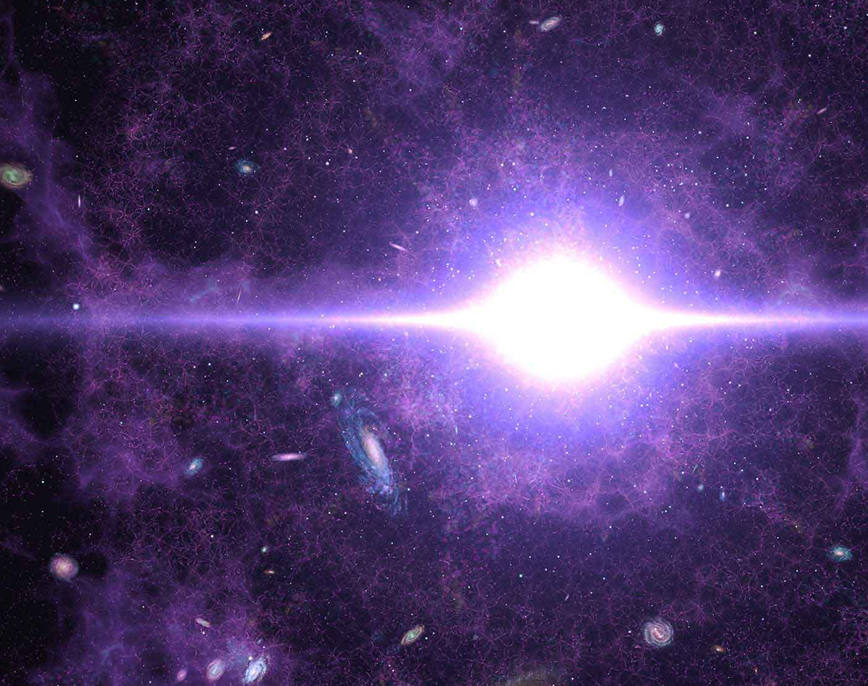
SOVEREIGNTY
There is no other way of interpreting “predestination” than as God’s sovereign plan of history before it came to be (creation, fall, redemption). God pre-ordered all things before they existed. They were written in his book (Psalm 139.16; Isa 46.10-11;48.3-5). Otherwise, the book of Revelation is just a fantasy (Rev 1.19; 4.1; 22.6).

Slide 14
CONFESSION OF FAITH
;
Chapter 10
Paragraph 1
All those whom God hath predestinated unto life, and those only, he is pleased, in his appointed and accepted time, effectually to call, by his Word and Spirit, out of that state of sin and death, in which they are by nature, to grace and salvation, by Jesus Christ; enlightening their minds spiritually and savingly to understand the things of God, taking away their heart of stone, and giving unto them a heart of flesh; renewing their wills, and, by his almighty power, determining them to that which is good, and effectually drawing them to Jesus Christ: yet so, as they come most freely, being made willing by his grace.

Slide 15
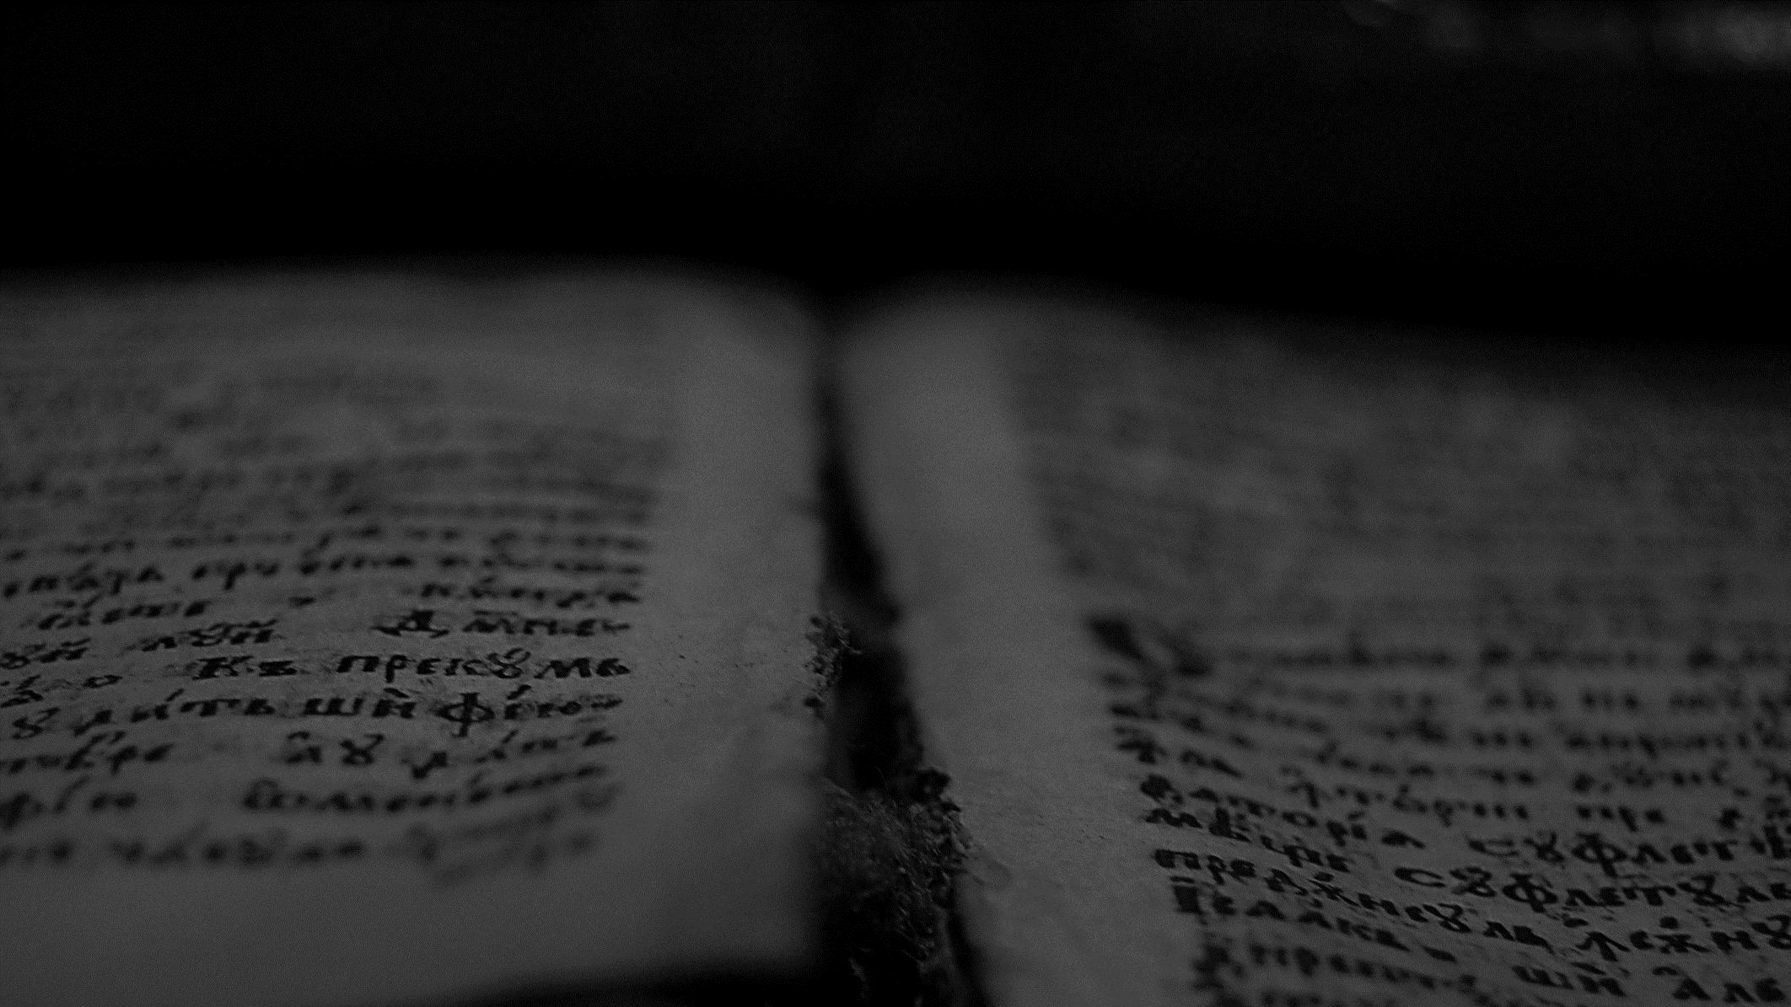
And when the Gentiles heard this, they were glad, and glorified the word of the Lord: and as many as were ordained to eternal life believed.
Acts 13.48
ESV

Slide 16
. … who hath saved us, and called us with a holy calling, not according to our works, but according to his own purpose and grace, which was given us in Christ Jesus before the world began, but is now made manifest by the appearing of our Saviour Jesus Christ, who hath abolished death, and hath brought life and immortality to light through the gospel.
2 Timothy 1.9-10
ESV

Slide 17
By Word and Spirit
The Holy Spirit works upon the preaching of the Word as the instrumental cause of salvation.

Slide 18
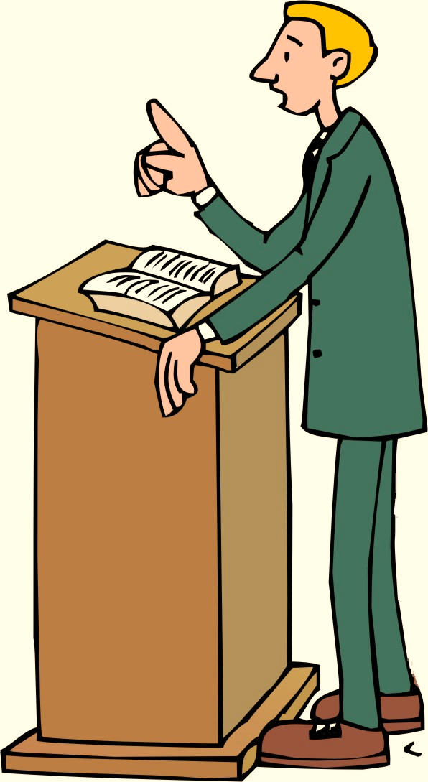
“They still did not believe”
If the Spirit works upon the preaching of the word, can we say the preacher’s skills and faithfulness to the text will lead people to salvation? NO. it is more complicated than that.
Who was the best preacher that ever lived? Was he successful? In John 12.37-40 the apostle makes a comment that all his miracles did not lead people to believe.

Slide 19
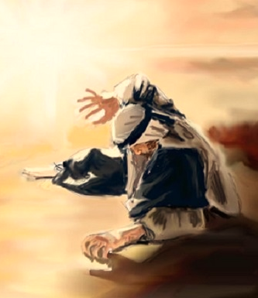
“Made Alive”
If one is not made alive to believe he cannot believe. Paul is very clear about Ephesians 2.1-5. He is conscious this is what happened to him (Gal 1.15-16). This is regeneration (Titus 3.5), or being born of the water and the Spirit (Joh 3.5).

Slide 20
CONFESSION OF FAITH
;
Chapter 10
Paragraph 1
All those whom God hath predestinated unto life, and those only, he is pleased, in his appointed and accepted time, effectually to call, by his Word and Spirit, out of that state of sin and death, in which they are by nature, to grace and salvation, by Jesus Christ; enlightening their minds spiritually and savingly to understand the things of God, taking away their heart of stone, and giving unto them a heart of flesh; renewing their wills, and, by his almighty power, determining them to that which is good, and effectually drawing them to Jesus Christ: yet so, as they come most freely, being made willing by his grace.

Slide 21
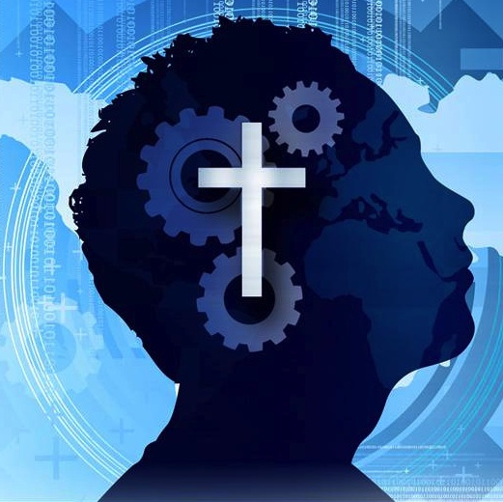
The Operation of the Spirit
Enlightening our minds to understand (2Cor 2.6-15; Eph 1.17-18; Acts 16.14)
Renewing our wills (Deut 30.6; Ezek 36.27; 1Pe 1.23).
Leading us to what is good (Rom 6.19-23).

Slide 22
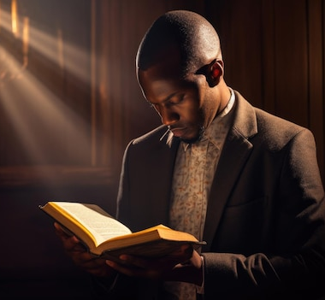
The Operation of the Spirit: Enlightenment
The natural man has a seared mind (1 Tim 4.2). When the heart is changed, the mind is enlightened to understand the spiritual truths (2Cor 2.6-15; Eph 1.17-18; Acts 16.14).

Slide 23

The Operation of the Spirit: Renewed will
The natural man follows the voluntarily the course of the world (Eph 2.2-3). The regeneration operates a change in the inclination of the will (Deut 30.6; Ezek 36.27; 1Pe 1.23).

Slide 24

The Operation of the Spirit: New choices
The understanding of the truth and changing to the will to now obey, causes a natural effect in the choices that a man makes. He now chooses what is good (Rom 6.19-23). It is deliverance from bondage.

Slide 25
CONFESSION OF FAITH
;
Chapter 10
Paragraph 1
All those whom God hath predestinated unto life, and those only, he is pleased, in his appointed and accepted time, effectually to call, by his Word and Spirit, out of that state of sin and death, in which they are by nature, to grace and salvation, by Jesus Christ; enlightening their minds spiritually and savingly to understand the things of God, taking away their heart of stone, and giving unto them a heart of flesh; renewing their wills, and, by his almighty power, determining them to that which is good, and effectually drawing them to Jesus Christ: yet so, as they come most freely, being made willing by his grace.

Slide 26

No Robots
When they are regenerated and their will changed to choose the good, the decision to come to Christ is made consciously, in such a way that the this person makes a voluntary decision.

Slide 27
CONFESSION OF FAITH
;
Chapter 10
Paragraph 3
Elect infants, dying in infancy, are regenerated, and saved by Christ, through the Spirit, who worketh when, and where, and how he pleaseth: so also are all other elect persons who are uncapable of being outwardly called by the ministry of the Word.

Slide 28
He that hath the Son hath life; and he that hath not the Son of God hath not life.
1 John 5.12
ESV

Slide 29
And you will have joy and gladness, and many will rejoice at his birth, for he will be great before the Lord. And he must not drink wine or strong drink, and he will be filled with the Holy Spirit, even from his mother's womb.
Also Luke 1.44.
Luke 1.14-15
ESV

Slide 30
CONFESSION OF FAITH
;
Chapter 10
Paragraph 4
Others, not elected, although they may be called by the ministry of the Word, and may have some common operations of the Spirit, yet they never truly come unto Christ, and therefore cannot be saved: much less can men, not professing the Christian religion, be saved in any other way whatsoever, be they never so diligent to frame their lives according to the light of nature, and the laws of that religion they do profess. And, to assert and maintain that they may, is very pernicious, and to be detested.

Slide 31

Impossible to Restore Them
The text of Hebrews 6.4-6 is greatly used by “arminians” as text proof of the loss of salvation. However, the text does not bring the world salvation, but describes operations of the Spirit in those who professed their faith in Christ externally and lived among God’s people. They however, cannot be restored, because having heard and witnessed the grace of Christ, having experienced in some measured the operations of the Holy Spirit, they rejected him and wandered off into the world.

