Slide 1
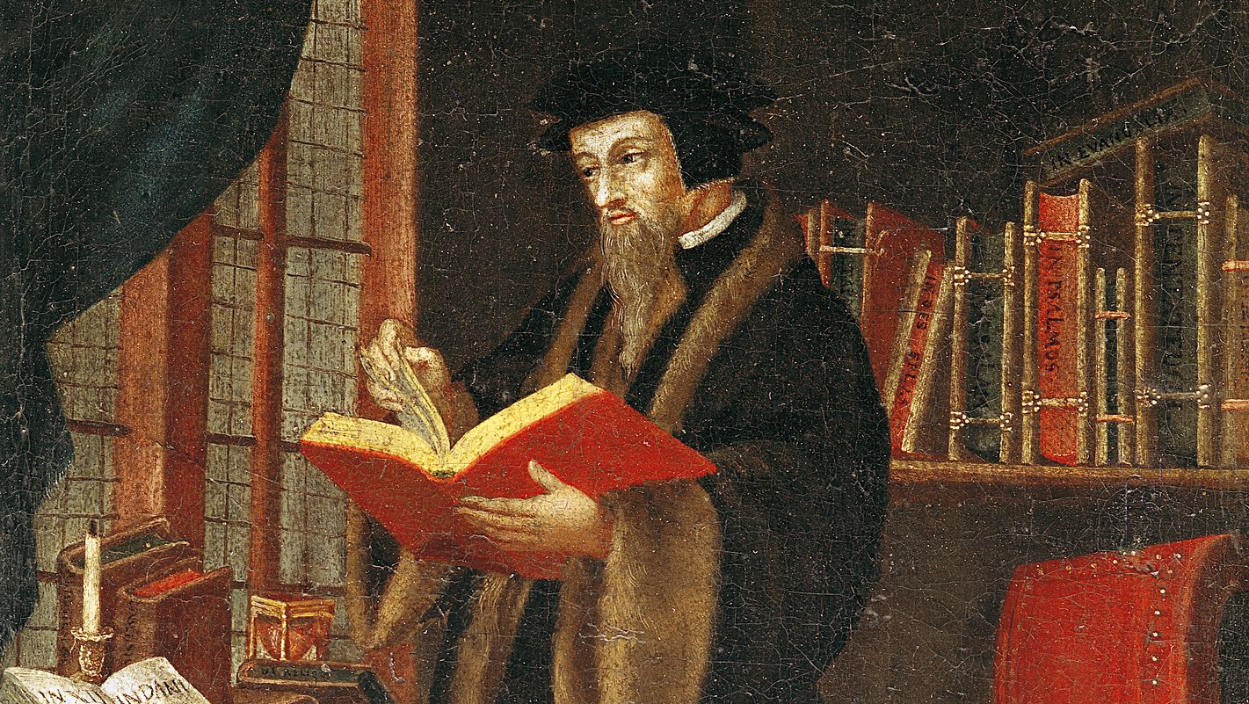
John Calvin on the doctrine of Predestination
Pastor John dos Santos

Slide 2
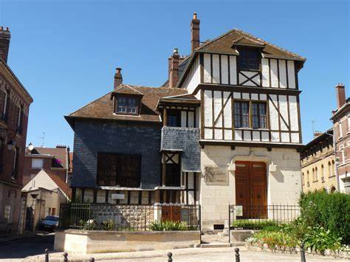
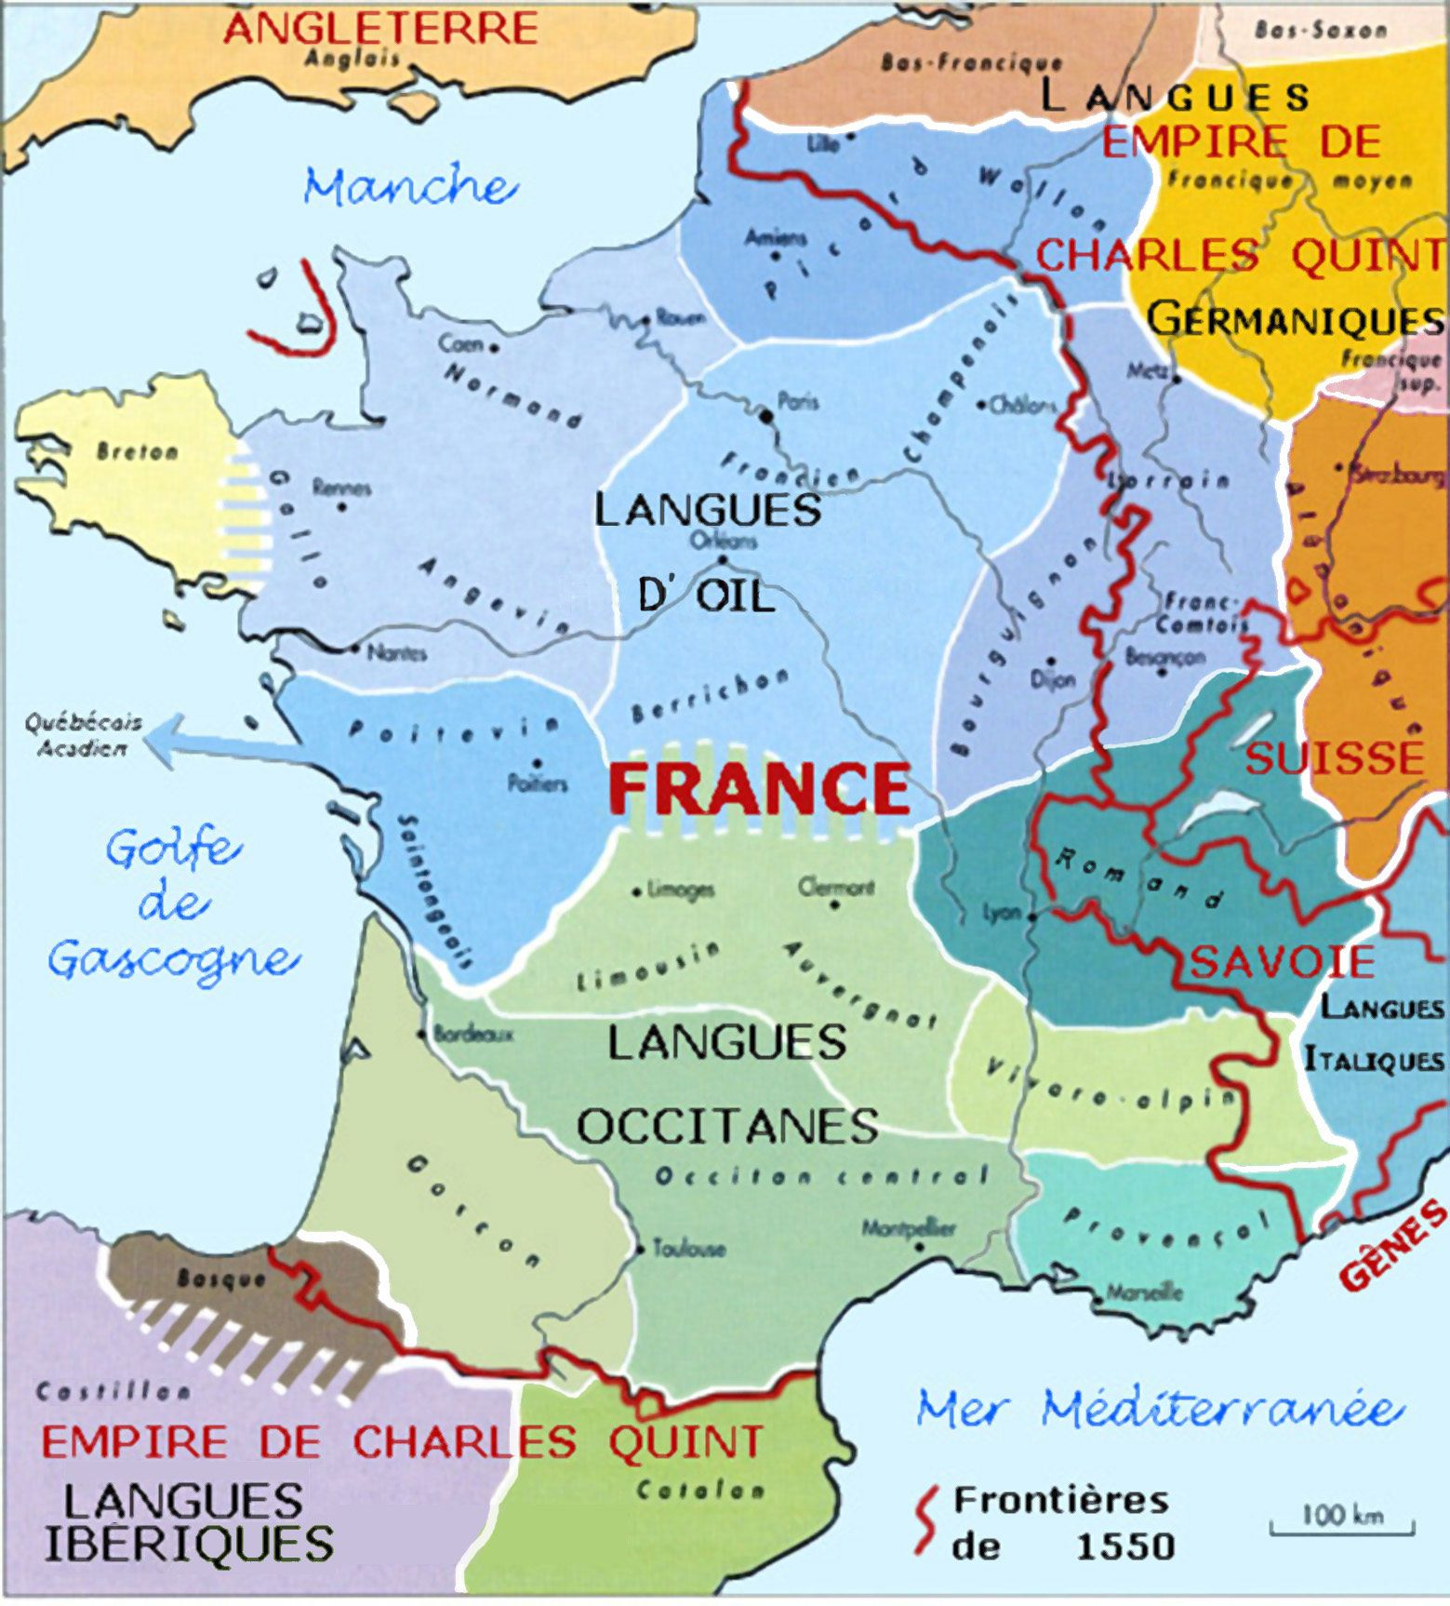
NOYON
Calvin was born July 10, 1509 in Noyon, northern France. He was born of the most important local lawyer. Hi father prestige allowed him to study in private schools and in his youth to go to Paris.

Slide 3
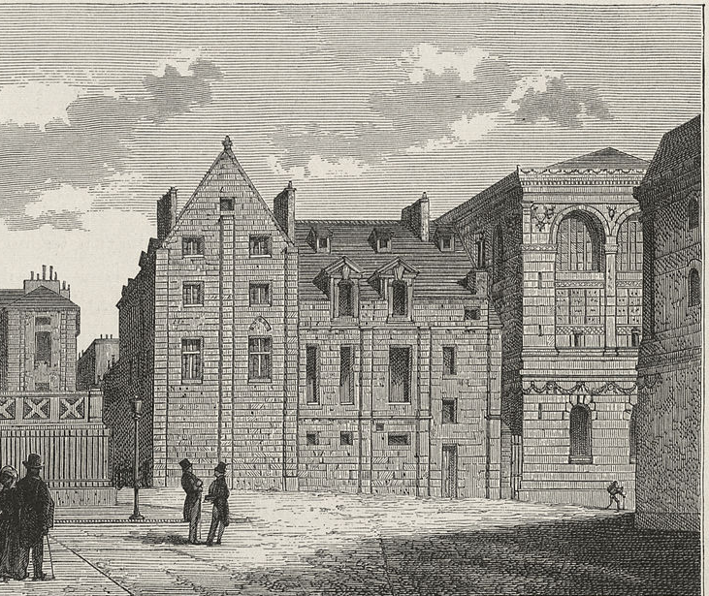
Calvin completed his studies in Paris and was send to the university of Orleans to study law, to become a lawyer as his father. After the death of his father, he engaged in the University of Bourges to study humanities. Here, around the year 1534 his conversion to protestant faith happened.
Collége de Montaigú
Image: Wiki commons

Slide 4
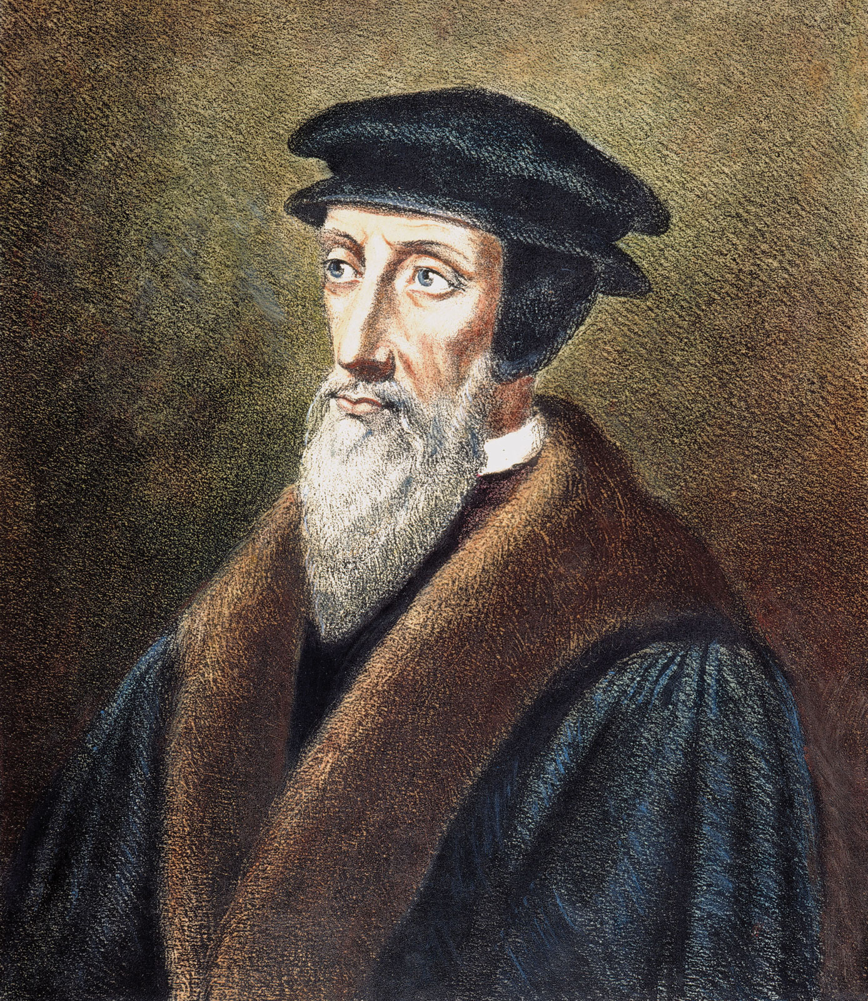
Being exceedingly alarmed at the misery into which I had fallen, and much more at that which threatened me in view of eternal death, I, duty bound, made it my first business to betake myself to your way, condemning my past life, not without groans and tears. And now, O Lord, what remains to a wretch like me, but instead of defense, earnestly to supplicate you not to judge that fearful abandonment of your Word according to its deserts, from which in your wondrous goodness you have at last delivered me.

Slide 5
God by a sudden conversion subdued and brought my mind to a teachable frame, which was more hardened in such matters than might have been expected from one at my early period of life. Having thus received some taste and knowledge of true godliness, I was immediately inflamed with so intense a desire to make progress therein, that although I did not altogether leave off other studies, yet I pursued them with less ardor.
J. Calvin, preface to Commentary on the Book of Psalms, trans. James Anderson, vol. 1 (Grand Rapids: Eerdmans, 1948), pp. xl–xli.

Slide 6
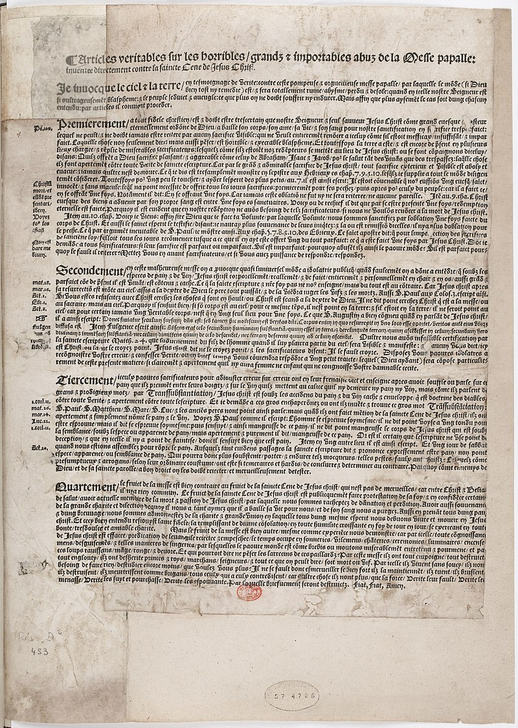
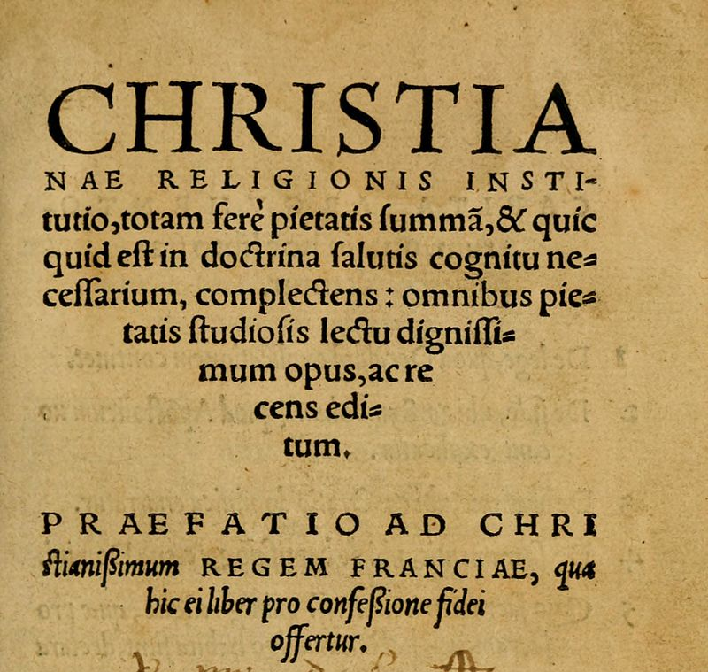
Being identified as a rebel in the affair of the placards in Paris, Calvin flees the city in the summer of 1534 and passes the next two years travelling, studying, writing and meeting reformers. He published his first theological book in 1536, the Institutes of Christian Religion. It becomes a sales success, and Calvin is turned into a celebrity.

Slide 7
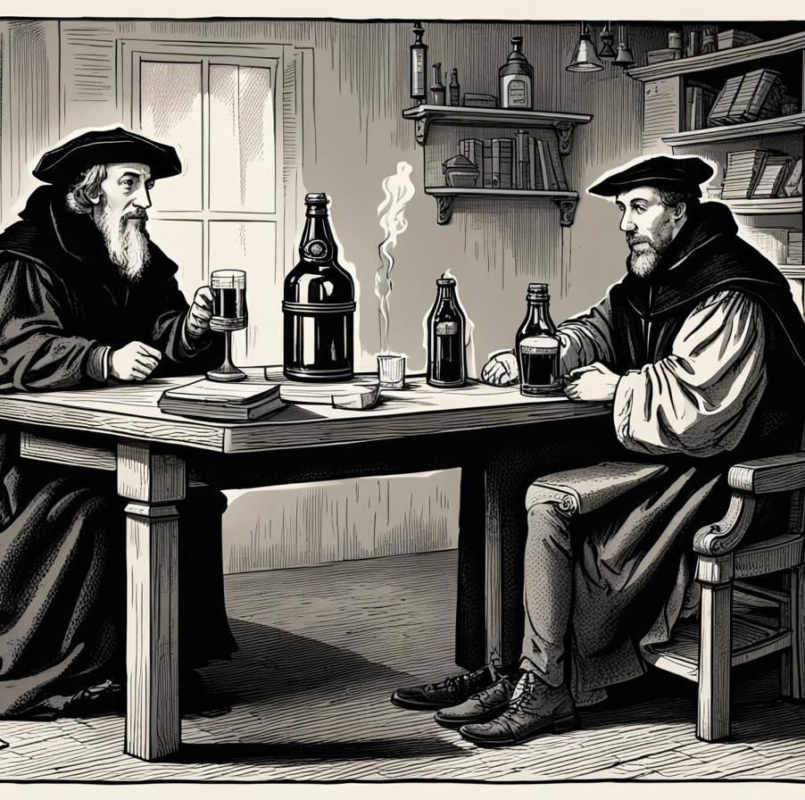
Traveling to Basel (Switzerland) in 1536 he stops in Geneva for the night. Calvin is urged to stay in the city and help to solidify the new adopted protestant faith. He stays and is expelled in 1538. He returns in 1541 and dies in city in 1564.

Slide 8
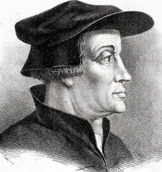
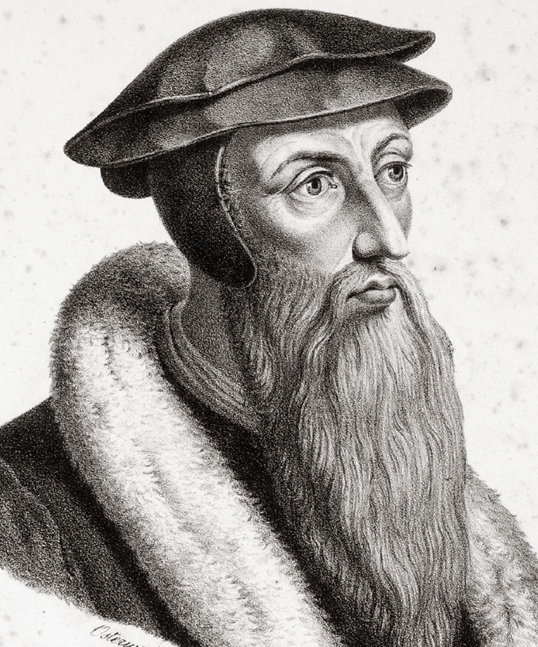
Reformed Movement
Country: Switzerland
Reformer: Ulrich Zwingli (1483-1531) and John Calvin (1509-1564)
Beggining: 1522
Result: Reformed and Presbiterian Churches

Slide 9
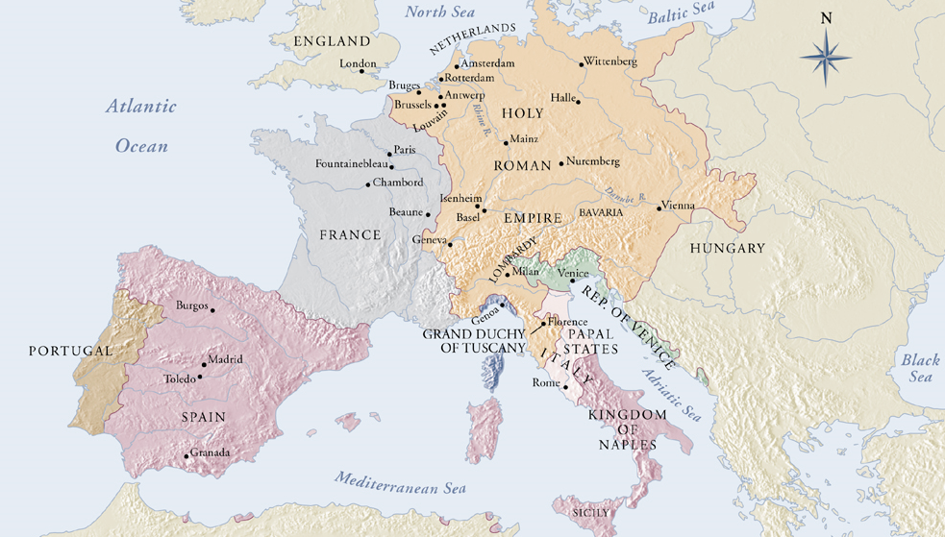
Anglican Reform
1525
Lutheran
Reform
1517
Anabaptist Reform
1525
Swiss Reformation
1522
Protestant Branches

Slide 10
Did Calvin Invent the Doctrine of Predestination?

Slide 11
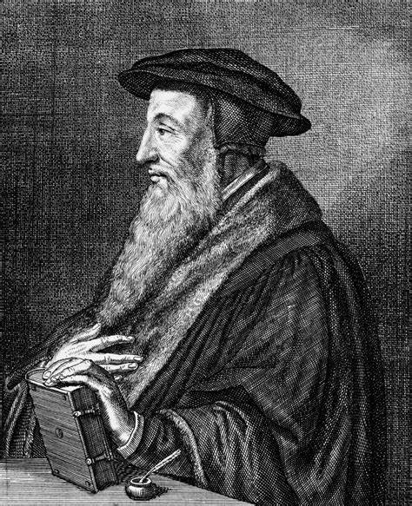
“To seek any other knowledge of predestination than what the Word of God discloses is not less insane than if one should purpose to walk in a pathless waste” Institutes (3.21.2).
“There are others who, wishing to cure this evil, all but require that every mention to predestination be buried… Scripture is the school of the Spirit, in which, as nothing is omitted that is both necessary and useful to know.” Institutes (3.21.3).

Slide 12
“That holy man, [Saint Augustine] having a remarkable zeal for edification, tempers his method of teaching the truth so that as far as possible he prudently avoid giving offense. He reminds us that those things which are truly said can at the same time be fittingly said.”
Institutes (3.23.14).

Slide 13
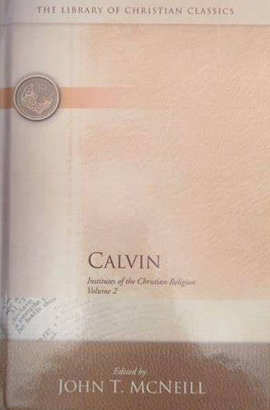
“While predestination is much stressed by Calvin, the formal treatment of the topic falls under the head not of the doctrine of God, but the doctrine of salvation, reserved to this point after the main outlines of the latter doctrine have been made clear. Calvin argues from Scripture, with much aid from Augustine… His position had, in fact, been in the main anticipated in the writings of medieval Augustinians, especially those of the fourteenth century, such as Thomas Brandwardine and Gregory Rimmi.”
Footnote 1, p. 920, Book II.

Slide 14
“We call predestination God’s eternal decree, by which he compacted with himself what he willed to become of each man. For all are not created in equal condition; rather, eternal life is foreordained for some, eternal damnation for others. Therefore, as anu man has been created to one or the other of these ends, we speak of him as predestined to life or to death.”
Institutes (3.21.5).

Slide 15
“God is said to set apart those whom he adopts into salvation; it will be highly absurd to say that others acquire by chance or by their own effort what election alone confers on a few. Therefore, whom God passes over, he condemns: and this he does for no other reason than that he wills to exclude them from the inheritance which he predestines for his own children.”
Institutes (3.21.5)

Slide 16
“ We assert that, with respect to the elect, this plan was founded upon his freely given mercy, without regard for human worth; but by his just and irreprehensible but incomprehensible judgment he has barred the door of life for those whom he has given over to damnation. Now among the elect we regard the call as a testimony of the election. Then we hold justification another sign of its manifestation, until they come into glory in which the fulfillment of that election lies.”
Institutes (3.21.7)

Slide 17
Summary Points
God did not predestine men for salvation because of something he knew beforehand, but because of his free purpose. He did not predestine all things moved by anything out of himself or necessity.
All those predestined to salvation will effectually be called and preserved to eternal life.

Slide 18
CONFESSION OF FAITH
Chapter 3
Paragraph 1
God, from all eternity, did, by the most wise and holy counsel of his own will, freely, and unchangeably ordain whatsoever comes to pass: yet so, as thereby neither is God the author of sin, nor is violence offered to the will of the creatures; nor is the liberty or contingency of second causes taken away, but rather established.

Slide 19
CONFESSION OF FAITH
Chapter 3
Paragraph 3
By the decree of God, for the manifestation of his glory, some men and angels are predestinated unto everlasting life; and others foreordained to everlasting death.

