Slide 1
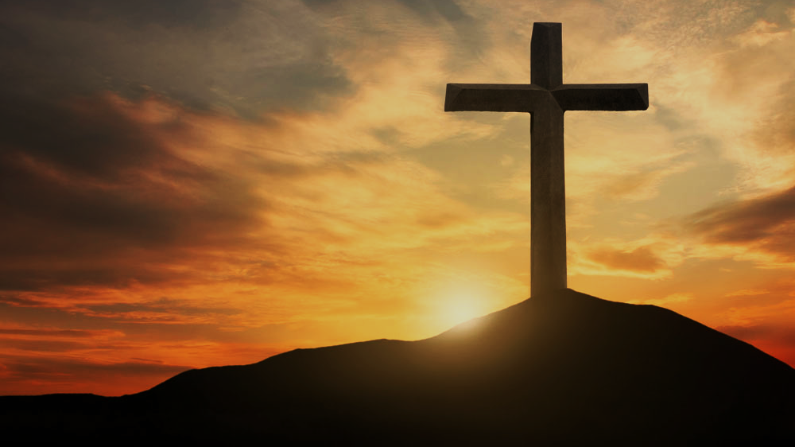
Doctrine of Salvation (Soteriology)
Wednesday Bible Study
Faith Presbyterian Church

Slide 2
Ordo Salutis
Election
Predestination
Calling (external and effectual)
Regeneration
Repentance
Saving Faith
Justification
Adoption
Sanctification
Glorification
Eternity
Single Act
Personal History
Process
Fullness of Time

Slide 3
Five Articles of the Remonstrants (1610) Arminianism
Those who shall believe were elected for salvation.
Jesus died for all men but forgiveness is applied only to those who will believe.
Men’s mind in completely under the effect of sin and needs to be renewed by Prevenient Grace so it can believe in the Gospel.
Cooperative Grace is effectual for salvation.
The Holy Spirit gives assurance of salvation and all necessary power to resist temptation and the Devil. But if man can fall it is not clear in Scripture.

Slide 4
Reformed
Catholics
Evangelicals
Christ’s Satisfaction
Christ’s Satisfaction
Christ’s Satisfaction
Foundation
Faith
Obedience
Means
Faith
Faith
Sacraments
MAN
NAN
MAN

Slide 5
T
U
L
I
P
otal depravity
nconditional Election
imited Atonement
rresistible Grace
erseverance of the Saints

Slide 6
Summary Points
God did not predestine men for salvation because of something he knew beforehand, but because of his free purpose. He did not predestine all things moved by anything out of himself or necessity.
All those predestined to salvation will effectually be called and preserved to eternal life.

Slide 7
CONFESSION OF FAITH
Chapter 3
Paragraph 1
God, from all eternity, did, by the most wise and holy counsel of his own will, freely, and unchangeably ordain whatsoever comes to pass: yet so, as thereby neither is God the author of sin, nor is violence offered to the will of the creatures; nor is the liberty or contingency of second causes taken away, but rather established.

Slide 8
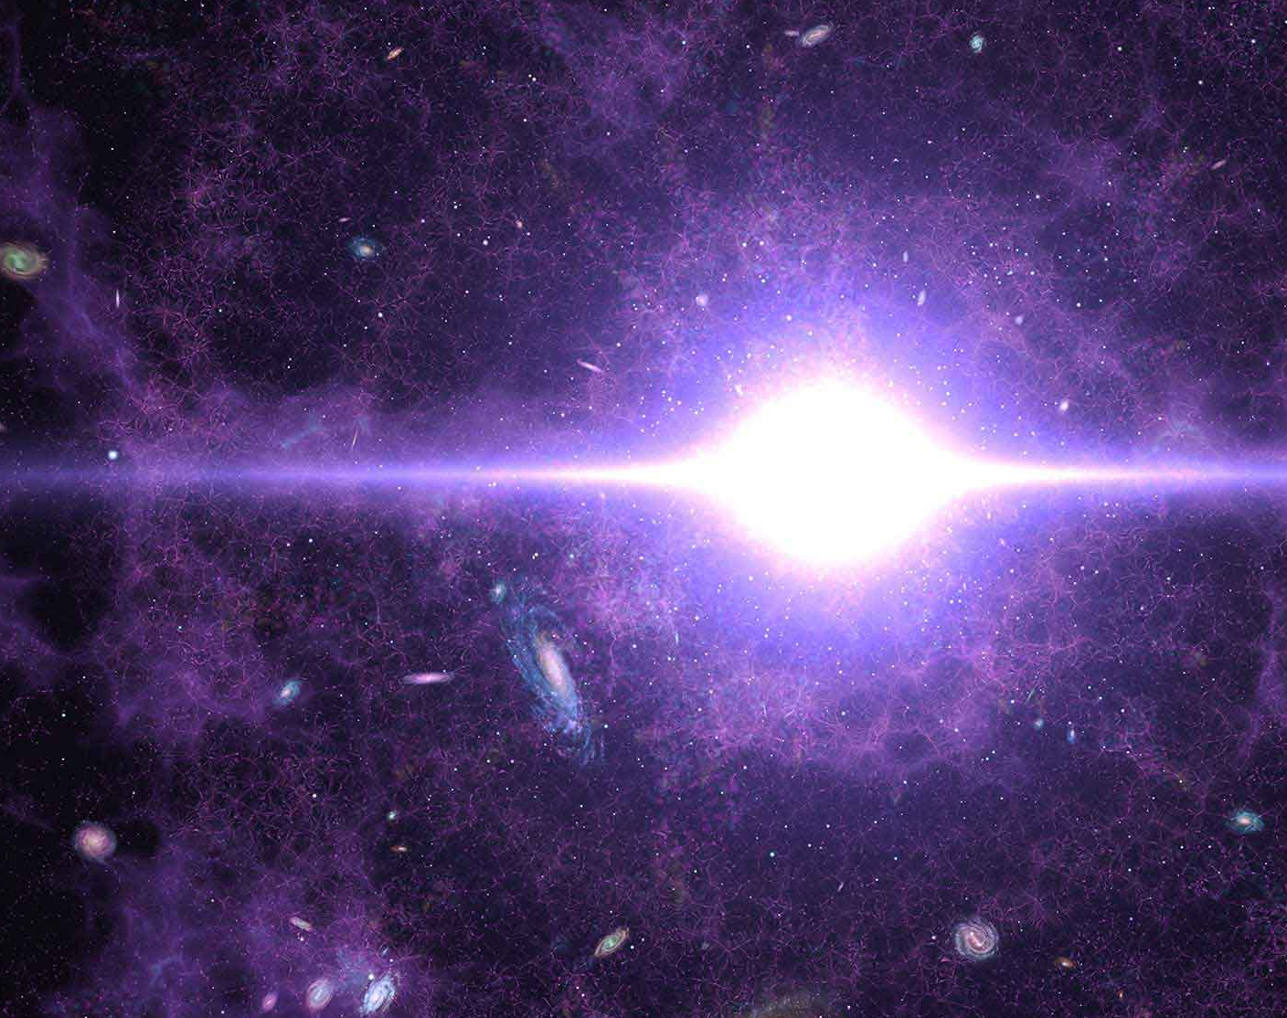
SOVEREIGNTY
There is no other way of interpreting “predestination” than as God’s sovereign plan of history before it came to be (creation, fall, redemption). God pre-ordered all things before they existed. They were written in his book (Psalm 139.16; Isa 46.10-11;48.3-5). Otherwise, the book of Revelation is just a fantasy (Rev 1.19; 4.1; 22.6).

Slide 9
CONFESSION OF FAITH
Chapter 3
Paragraph 2
Although God knows whatsoever may or can come to pass upon all supposed conditions, yet hath he not decreed anything because he foresaw it as future, or as that which would come to pass upon such conditions.

Slide 10
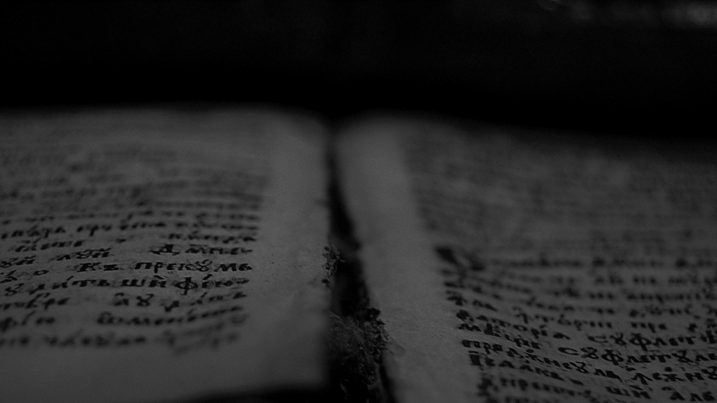
In him we have obtained an inheritance, having been predestined according to the purpose of him who works all things according to the counsel of his will…
Ephesians 1.11
ESV

Slide 11
So when God desired to show more convincingly to the heirs of the promise the unchangeable character of his purpose, he guaranteed it with an oath…
Hebrews 6.17
ESV

Slide 12
…this Jesus, delivered up according to the definite plan and foreknowledge of God, you crucified and killed by the hands of lawless men.
Acts 2.23
ESV

Slide 13
Logical Process of Divine Decree
opera exeuntia
KNOWLEDGE
DECREE
REALIZATION

Slide 14
Then David said, “O LORD, the God of Israel, your servant has surely heard that Saul seeks to come to Keilah, to destroy the city on my account. Will the men of Keilah surrender me into his hand? Will Saul come down, as your servant has heard? O LORD, the God of Israel, please tell your servant.” And the LORD said, “He will come down.”
Then David said, “Will the men of Keilah surrender me and my men into the hand of Saul?” And the LORD said, “They will surrender you.”
Then David and his men, who were about six hundred, arose and departed from Keilah, and they went wherever they could go.
1 Samuel 23.10-13
ESV

Slide 15
“Woe to you, Chorazin! Woe to you, Bethsaida! For if the mighty works done in you had been done in Tyre and Sidon, they would have repented long ago in sackcloth and ashes.
But I tell you, it will be more bearable on the day of judgment for Tyre and Sidon than for you.
And you, Capernaum, will you be exalted to heaven? You will be brought down to Hades. For if the mighty works done in you had been done in Sodom, it would have remained until this day.
Matthew 11.21-23
ESV

Slide 16
CONFESSION OF FAITH
Chapter 3
Paragraph 3
By the decree of God, for the manifestation of his glory, some men and angels are predestinated unto everlasting life; and others foreordained to everlasting death.

Slide 17
In him we have obtained an inheritance, having been predestined according to the purpose of him who works all things according to the counsel of his will…
Ephesians 1.11
ESV

Slide 18
For those whom he foreknew he also predestined to be conformed to the image of his Son, in order that he might be the firstborn among many brothers.
Romans 8.29
ESV

Slide 19
In the presence of God and of Christ Jesus and of the elect angels I charge you to keep these rules without prejudging, doing nothing from partiality.
1 Timothy 5.21
ESV

Slide 20
CONFESSION OF FAITH
Chapter 3
Paragraph 4
These angels and men, thus predestinated, and foreordained, are particularly and unchangeably designed, and their number so certain and definite, that it cannot be either increased or diminished.

Slide 21
For many are called, but few are chosen.
Matthew 22.14
ESV

Slide 22
It is the Spirit who gives life; the flesh is no help at all. The words that I have spoken to you are spirit and life. But there are some of you who do not believe.” (For Jesus knew from the beginning who those were who did not believe, and who it was who would betray him.) And he said, “This is why I told you that no one can come to me unless it is granted him by the Father.”
John 6.63-65
ESV

Slide 23
I am not speaking of all of you; I know whom I have chosen. But the Scripture will be fulfilled, ‘He who ate my bread has lifted his heel against me.’
John 13.18
ESV

Slide 24
I am the good shepherd. I know my own and my own know me…
And I have other sheep that are not of this fold. I must bring them also, and they will listen to my voice. So there will be one flock, one shepherd…
My sheep hear my voice, and I know them, and they follow me. I give them eternal life, and they will never perish, and no one will snatch them out of my hand. My Father, who has given them to me, is greater than all, and no one is able to snatch them out of the Father's hand.
John 10.14,16, 27-29
ESV

Slide 25
“Father, the hour has come; glorify your Son that the Son may glorify you, since you have given him authority over all flesh, to give eternal life to all whom you have given him…
“I have manifested your name to the people whom you gave me out of the world. Yours they were, and you gave them to me, and they have kept your word…
I am praying for them. I am not praying for the world but for those whom you have given me, for they are yours. All mine are yours, and yours are mine, and I am glorified in them. And I am no longer in the world, but they are in the world, and I am coming to you. Holy Father, keep them in your name, which you have given me, that they may be one, even as we are one. While I was with them, I kept them in your name, which you have given me. I have guarded them, and not one of them has been lost except the son of destruction, that the Scripture might be fulfilled.
John 17.2,6,9-12
ESV

Slide 26
But God's firm foundation stands, bearing this seal: “The Lord knows those who are his,” and, “Let everyone who names the name of the Lord depart from iniquity.”
2 Timothy 2.19
ESV

Slide 27
CONFESSION OF FAITH
;
Chapter 3
Paragraph 5
Those of mankind that are predestinated unto life, God, before the foundation of the world was laid, according to his eternal and immutable purpose, and the secret counsel and good pleasure of his will, hath chosen, in Christ, unto everlasting glory, out of his mere free grace and love, without any foresight of faith, or good works, or perseverance in either of them, or any other thing in the creature, as conditions, or causes moving him thereunto; and all to the praise of his glorious grace.

Slide 28
Summary Points
God did not predestine men for salvation because of something he knew beforehand, but because of his free purpose. He did not predestine all things moved by anything out of himself or necessity.
All those predestined to salvation will effectually be called and preserved to eternal life.

Slide 29
Blessed be the God and Father of our Lord Jesus Christ, who has blessed us in Christ with every spiritual blessing in the heavenly places, even as he chose us in him before the foundation of the world, that we should be holy and blameless before him.
In love he predestined us for adoption to himself as sons through Jesus Christ, according to the purpose of his will, to the praise of his glorious grace, with which he has blessed us in the Beloved.
Ephesians 1.3-6
ESV

Slide 30
Free Will of God
Many English versions translate ευδοκιαν του θεληματος αυτου as “good pleasure of his will” (KJV, MKJV, LEB, LSV, ASV, AFV) to convey the intensive expression used by the apostle to convey the free desire of God. He is not compelled or moved by any necessity.

Slide 31
…making known to us the mystery of his will, according to his purpose, which he set forth in Christ as a plan for the fullness of time, to unite all things in him, things in heaven and things on earth.
In him we have obtained an inheritance, having been predestined according to the purpose of him who works all things according to the counsel of his will…
Ephesians 1.9-11
ESV

Slide 32
Not Because He Knew
God’s purpose was not moved because of a necessity, as it was not moved by the knowledge of future events. If God had elected based on the knowledge it his will was not free but moved. Paul makes this clear in Romans 9.

Slide 33
…though they were not yet born and had done nothing either good or bad—in order that God's purpose of election might continue, not because of works but because of him who calls…
Romans 9.11
ESV

Slide 34
who saved us and called us to a holy calling, not because of our works but because of his own purpose and grace, which he gave us in Christ Jesus before the ages began,
2 Timothy 1.9
ESV

Slide 35
For by grace, you have been saved through faith. And this is not your own doing; it is the gift of God, not a result of works, so that no one may boast. For we are his workmanship, created in Christ Jesus for good works, which God prepared beforehand, that we should walk in them.
Ephesians 2.8-10
ESV

Slide 36
CONFESSION OF FAITH
;
Chapter 3
Paragraph 6
As God hath appointed the elect unto glory, so hath he, by the eternal and most free purpose of his will, foreordained all the means thereunto. Wherefore, they who are elected, being fallen in Adam, are redeemed by Christ, are effectually called unto faith in Christ by his Spirit working in due season, are justified, adopted, sanctified, and kept by his power, through faith, unto salvation. Neither are any other redeemed by Christ, effectually called, justified, adopted, sanctified, and saved, but the elect only.

Slide 37
But we ought always to give thanks to God for you, brothers beloved by the Lord, because God chose you as the firstfruits to be saved, through sanctification by the Spirit and belief in the truth.
2Thessalonians 2.13
ESV

Slide 38
And we know that for those who love God all things work together for good, for those who are called according to his purpose. For those whom he foreknew he also predestined to be conformed to the image of his Son, in order that he might be the firstborn among many brothers. And those whom he predestined he also called, and those whom he called he also justified, and those whom he justified he also glorified.
Romans 8.28-30
ESV

Slide 39
CONFESSION OF FAITH
Chapter 3
Paragraph 8
The doctrine of this high mystery of predestination is to be handled with special prudence and care, that men, attending the will of God revealed in his Word, and yielding obedience thereunto, may, from the certainty of their effectual vocation, be assured of their eternal election. So shall this doctrine afford matter of praise, reverence, and admiration of God; and of humility, diligence, and abundant consolation to all that sincerely obey the gospel.

Slide 40
CONFESSION OF FAITH
Chapter 17
Paragraph 2
This perseverance of the saints depends not upon their own free will, but upon the immutability of the decree of election, flowing from the free and unchangeable love of God the Father; upon the efficacy of the merit and intercession of Jesus Christ, the biding of the Spirit, and of the seed of God within them, and the nature of the covenant of grace: from all which ariseth also the certainty and infallibility thereof.

Slide 41
CONFESSION OF FAITH
Chapter 18
Paragraph 3
This infallible assurance doth not so belong to the essence of faith, but that a true believer may wait long, and conflict with many difficulties, before he be partaker of it: yet, being enabled by the Spirit to know the things which are freely given him of God, he may, without extraordinary revelation, in the right use of ordinary means, attain thereunto. And therefore it is the duty of everyone to give all diligence to make his calling and election sure, that thereby his heart may be enlarged in peace and joy in the Holy Ghost, in love and thankfulness to God, and in strength and cheerfulness in the duties of obedience, the proper fruits of this assurance; so far is it from inclining men to looseness.

