Slide 2
Be Thou My Vision
Hymn 642*
Text: Ancient Irish hymn; tr. Mary E. Byrne, versified Eleanor H. Hull (*Trinity Hymnal)
Music: Irish folk melody; arr. David Allen

Slide 3
Be thou my Vision, O Lord of my heart;
naught be all else to me, save that thou art—
thou my best thought, by day or by night,
waking or sleeping, thy presence my light.
Be thou my wisdom, and thou my true word;
I ever with thee and thou with me, Lord;
thou my great Father, I thy true son;
thou in me dwelling, and I with thee one.

Slide 4
Be thou my battle shield, sword for my fight;
be thou my dignity, thou my delight,
thou my soul’s shelter, thou my high tow’r:
raise thou me heav’nward, O Pow’r of my pow’r.
Riches I heed not, nor man’s empty praise,
thou mine inheritance, now and always;
thou and thou only, first in my heart,
High King of heaven, my treasure thou art.

Slide 5
High King of heaven, my victory won,
may I reach heaven’s joys, O bright heav’n’s Sun!
Heart of my own heart, whatever befall,
still be my vision, O Ruler of all.

Slide 6
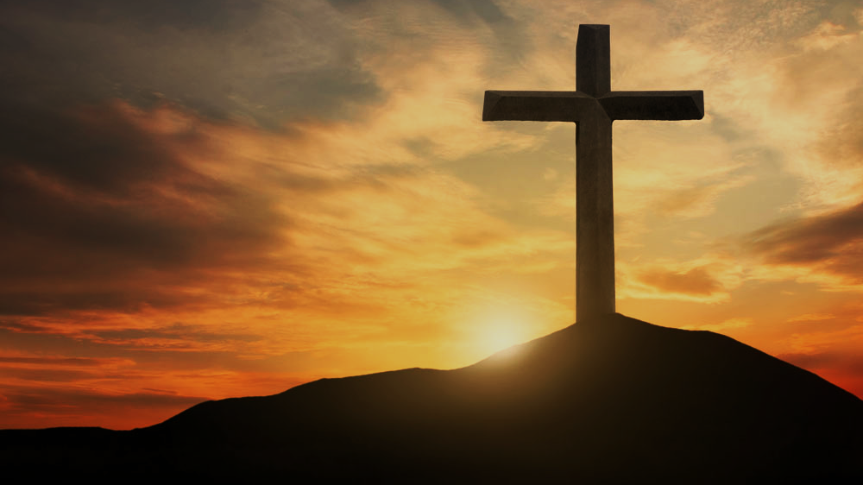
Doctrine of Salvation
(Soteriology)
Wednesday Bible Study
Faith Presbyterian Church

Slide 7
Soteri + ology
Salvation + Study

Slide 8
CONFESSION OF FAITH
Chapter 9
Paragraph 3
Man, by his fall into a state of sin, hath wholly lost all ability of will to any spiritual good accompanying salvation: so as, a natural man, being altogether averse from that good, and dead in sin, is not able, by his own strength, to convert himself, or to prepare himself thereunto.

Slide 9

Liberty Vs Responsibility
Throughout Scripture, we learn a man can make his own choices and he will be made responsible for them (Mat 17.12; Jam 1.14; Deut 30.19; Eze 18.20). Personal responsibility is founded upon the premise of the exercise of the will. God created man free and bound to his conscience. Free will is an additional endowment.

Slide 10
CONFESSION OF FAITH
Chapter 9
Paragraph 1-2
God hath endued the will of man with that natural liberty, that it is neither forced, nor, by any absolute necessity of nature, determined to good, or evil.
Man, in his state of innocency, had freedom, and power to will and to do that which was good and well-pleasing to God; but yet, mutably, so that he might fall from it.

Slide 11

Free Will
Free will is the liberty to act contrary to the natural inclination of the will and a capacity to do something contrary to one’s nature.

Slide 12


Adam Expelled from the Garden
Eternal Life
Ladder of personal obedience
Adam’s Original State
Sinful State

Slide 13

Completely Dead
Men’s intellect, will and affections are completely under the influence of sin and cannot understand the gospel and do spiritual good acceptable to God. His heart is deceitful and spiritually sick.

Slide 14

Loss of “Free” Will
After sin man continues to be free and bound to his conscience and responsible for his actions, but he is not inclined to sin and has lost the capacity to choose contrary to his will, i.e. freedom of the will.

Slide 15
Five Articles of the Remonstrants (1610)
Arminianism
Those who shall believe were elected for salvation.
Jesus died for all men but forgiveness is applied only to those who will believe.
Men’s mind in completely under the effect of sin and needs to be renewed by Prevenient Grace so it can believe in the Gospel.
Cooperative Grace is effectual for salvation.
The Holy Spirit gives assurance of salvation and all necessary power to resist temptation and the Devil. But if man can fall it is not clear in Scripture.

Slide 16

Reformed
Catholics
Evangelicals
Christ’s Satisfaction
Christ’s Satisfaction
Christ’s Satisfaction
Foundation
Faith
Obedience
Means
Faith
Faith
Sacraments
MAN
NAN
MAN

Slide 17
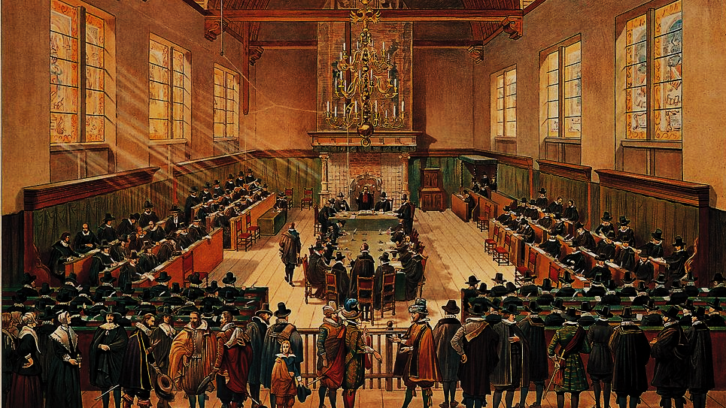
Synod of Dort (1618)
(5 Points of Calvinism)
By Hove, G. van - http://www.entoen.nu/media/18_NationaleSynode.jpg, Public Domain, https://commons.wikimedia.org/w/index.php?curid=25851125

Slide 18

T
U
L
I
P
otal depravity
nconditional Election
imited Atonement
rresistible Grace
erseverance of the Saints

Slide 19

Definition of Prevenient Grace
Prevenient Grace (i.e. “grace that comes before”) is an operation of the Holy Spirit in the hearts of all men which enables their minds to understand the Gospel and restores their will to believe and receive it for salvation. Prevenient grace works directly over the effects of total depravity but it is not a saving grace. It does not redeem man but transforms him to believe.

Slide 20
Biblical Support Claimed For Prevenient Grace (NVI)
John 1:9 - The true light that gives light to everyone was coming into the world.
John 12:32 - And I, when I am lifted up from the earth, will draw all people to myself.
Romans 2:4 - Or do you show contempt for the riches of his kindness, forbearance, and patience, not realizing that God’s kindness is intended to lead you to repentance?
Titus 2:11 – For the grace of God has appeared that offers salvation to all people.

Slide 21

Ordo Salutis?
At this point, we need to talk about the several aspects of salvation are interconnected, how God works salvation. This is called ordo salutis (order of salvation). The ordo salutis is the backbone of someone’s belief about salvation. It presupposes salvation is a process.

Slide 22
John Wesley Ordo Salutis
Prevenient
Grace
Faith
Justifying
Grace
Obed.
Sanctifying
Grace

Slide 23
Reformed
Catholics
Evangelicals
Christ’s Satisfaction
Christ’s Satisfaction
Christ’s Satisfaction
Foundation
Faith
Obedience
Means
Faith
Faith
Sacraments
MAN
NAN
MAN

Slide 24
Wesleyan Salvation Process
Eternal Life
Adam’s Original State
Sinful State

Slide 25
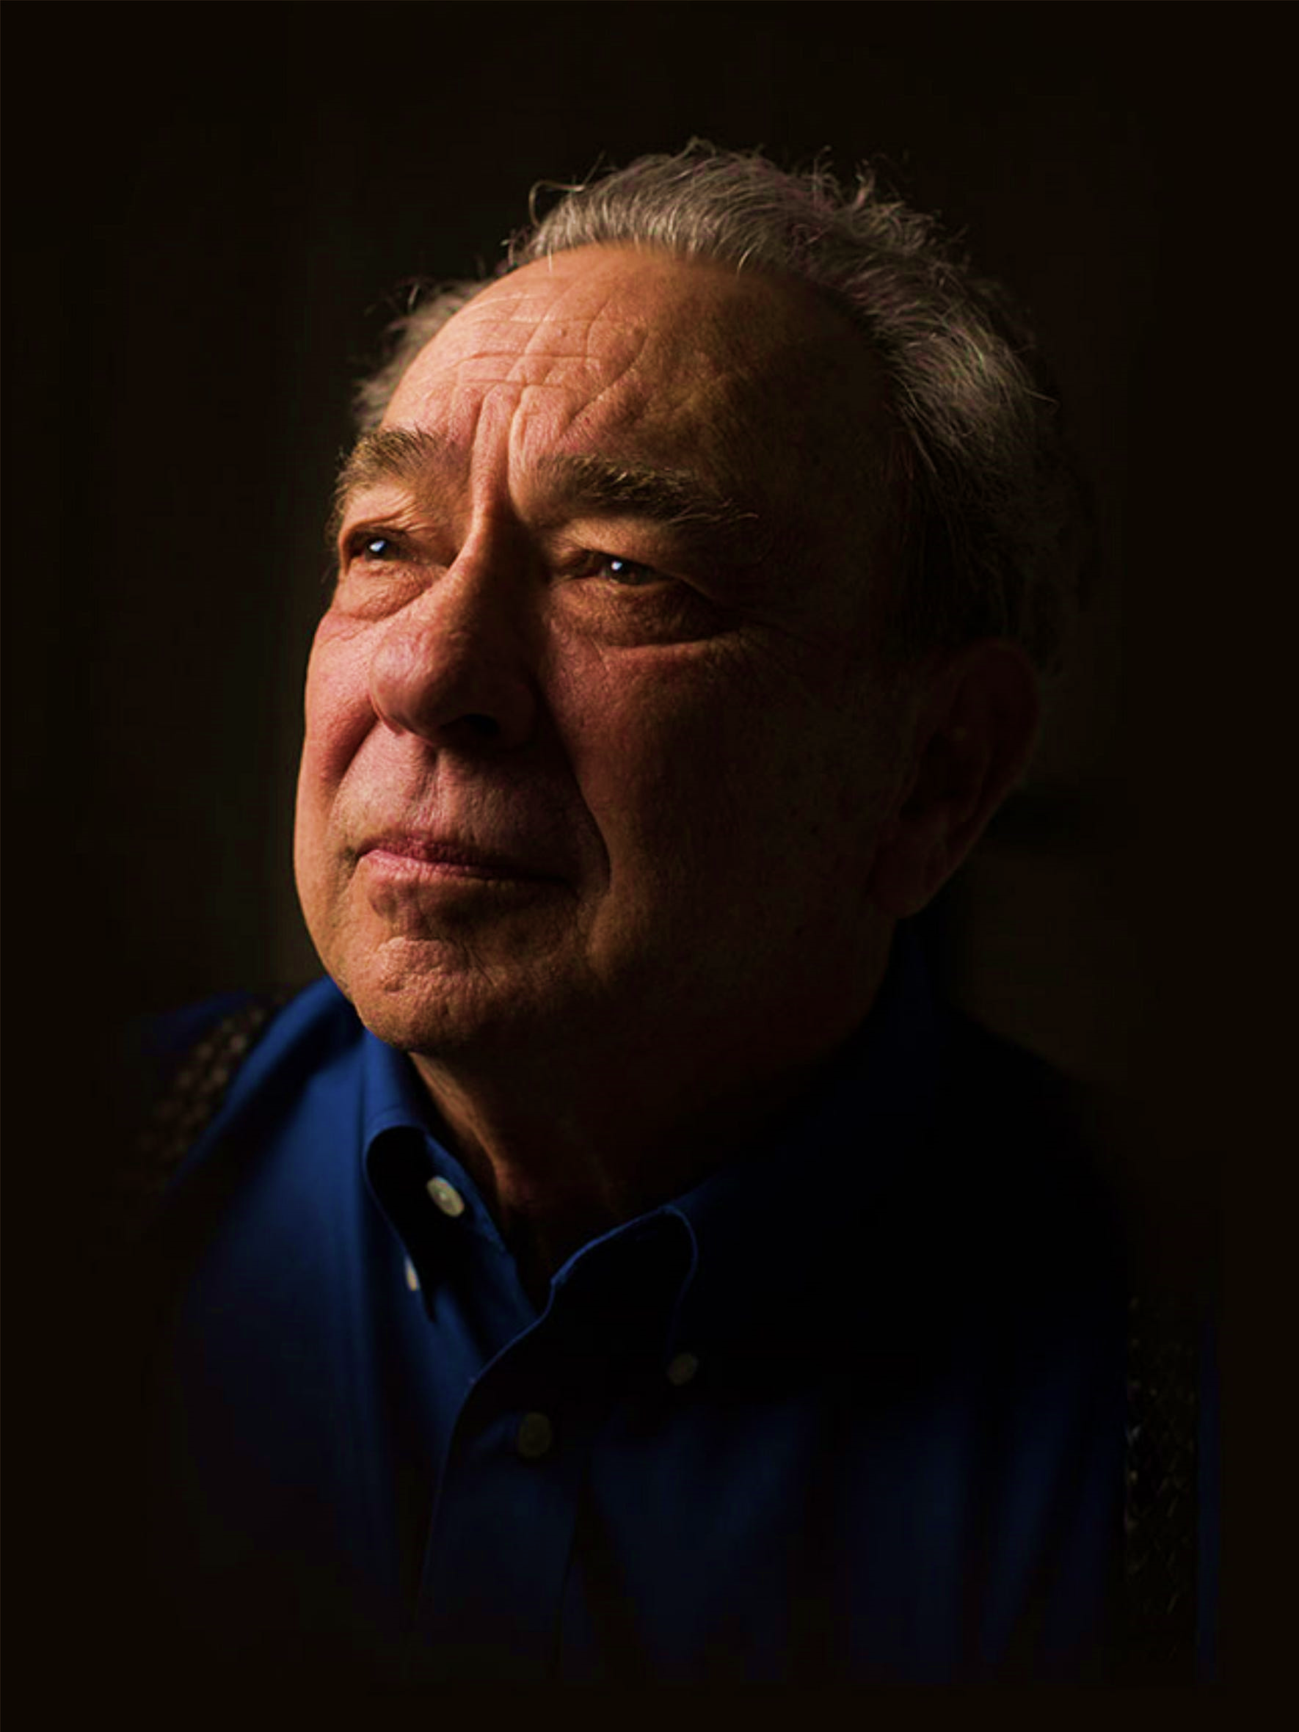
Think of it this way, in personal terms. If you are a Christian you are surely aware of other people who are not Christians. Why is it that you have chosen Christ and they have not? Why did you say yes to prevenient grace while they said no? Was it because you were more righteous than they were? If so, then indeed you have something in which to boast. Was that greater righteousness something you achieved on your own or was it the gift of God? If it was something you achieved, then at the bottom line your salvation depends on your own righteousness. If the righteousness was a gift, then why didn't God give the same gift to everybody?
R. C. Sproul, Chosen by God. Tyndale House Publishers: Wheaton, Ill., p. 124.

Slide 26
Ordo Salutis in Romans 8.28-30
Foreknew
Predestined
Called
Glorified
Justified

Slide 27
Order in Romans 10.14-17
Sent
Preaching
Heard
Believed
Call

Slide 28
Ordo Salutis
Calling
Regeneration
Repentance
Saving Faith
Justification
Adoption
Sanctification

Slide 29
Ordo Salutis
Election
Predestination
Calling (external and effectual)
Regeneration
Repentance
Saving Faith
Justification
Adoption
Sanctification
Glorification

Slide 30
Ordo Salutis
Election
Predestination
Calling (external and effectual)
Regeneration
Repentance
Saving Faith
Justification
Adoption
Sanctification
Glorification

Slide 31
Ordo Salutis
Election
Predestination
Calling (external and effectual)
Regeneration
Repentance
Saving Faith
Justification
Adoption
Sanctification
Glorification
Eternity
Personal History
Fullness of Time

Slide 32
Ordo Salutis
Election
Predestination
Calling (external and effectual)
Regeneration
Repentance
Saving Faith
Justification
Adoption
Sanctification
Glorification
Single Act
Personal History
Process

Slide 33
Ordo Salutis
Election
Predestination
Calling (external and effectual)
Regeneration
Repentance
Saving Faith
Justification
Adoption
Sanctification
Glorification
Eternity
Single Act
Personal History
Process
Fullness of Time

Slide 34
Ordo Salutis
Election
Predestination
Calling (external and effectual)
Regeneration
Repentance
Saving Faith
Justification
Adoption
Sanctification
Glorification

Slide 35
Ordo Salutis
Election
Predestination
Calling (external and effectual)
Regeneration
Repentance
Saving Faith
Justification
Adoption
Sanctification
Glorification
God sovereignly before the foundation of the world has chosen in his Son a people for himself (Eph 1.3-4).

Slide 36
Ordo Salutis
Election
Predestination
Calling (external and effectual)
Regeneration
Repentance
Saving Faith
Justification
Adoption
Sanctification
Glorification
God has sovereignly decreed all things that will come to pass before the foundation of the world, foreordaining some men for salvation and others for death (Eph 1.5-6).

Slide 37
Ordo Salutis
Election
Predestination
Calling (external and effectual)
Regeneration
Repentance
Saving Faith
Justification
Adoption
Sanctification
Glorification
In time the elect hear the preaching and Gospel (external), believe in it, and are converted from their ways (effectual). (Gal 1.15; 2Tim 1.9)

Slide 38
Ordo Salutis
Election
Predestination
Calling (external and effectual)
Regeneration
Repentance
Saving Faith
Justification
Adoption
Sanctification
Glorification
The Holy Spirit gives life to those dead in sin enabling them to believe (Titus 3.5).

Slide 39
Ordo Salutis
Election
Predestination
Calling (external and effectual)
Regeneration
Repentance
Saving Faith
Justification
Adoption
Sanctification
Glorification
The effectual calling is evidenced by repentance from sins (2Cor 7.10).

Slide 40
Ordo Salutis
Election
Predestination
Calling (external and effectual)
Regeneration
Repentance
Saving Faith
Justification
Adoption
Sanctification
Glorification
True faith is given by the action of the Holy Spirit in the heart of those regenerated (Eph 2.8).

Slide 41
Ordo Salutis
Election
Predestination
Calling (external and effectual)
Regeneration
Repentance
Saving Faith
Justification
Adoption
Sanctification
Glorification
God pardons the sins of those regenerated counting them as righteous by imputing on them the obedience and satisfaction of Jesus Christ (Rom 5.8-9, 18-19).

Slide 42
Ordo Salutis
Election
Predestination
Calling (external and effectual)
Regeneration
Repentance
Saving Faith
Justification
Adoption
Sanctification
Glorification
Those justified are made children of God by adoption (Gal 4.4-7).

Slide 43
Ordo Salutis
Election
Predestination
Calling (external and effectual)
Regeneration
Repentance
Saving Faith
Justification
Adoption
Sanctification
Glorification
Through the graces of Jesus Christ those regenerated are made holy really and personally by the work of the Holy Spirit (1Cor 6.11; Heb 10.10)

Slide 44
Ordo Salutis
Election
Predestination
Calling (external and effectual)
Regeneration
Repentance
Saving Faith
Justification
Adoption
Sanctification
Glorification
In the life to come God will renew from all sin those elected for Salvation giving them a completely new heart and body (Rom 8.30; Heb 2.10).

