Slide 2
Ancient Words

Slide 3
Holy words long preserved
for our walk in this world,
They resound with God's own heart
Oh, let the Ancient words impart.
Words of Life, words of Hope
Give us strength, help us cope
In this world, where e'er we roam
Ancient words will guide us Home.
We have come with open hearts Oh let the ancient words impart.
Ancient words ever true Changing me, and changing you. We have come with open hearts Oh let the ancient words impart.
Ancient words ever true Changing me, and changing you. We have come with open hearts Oh let the ancient words impart.
We have come with open hearts
Oh let the ancient words impart.

Slide 4
Ancient words ever true Changing me, and changing you. We have come with open hearts Oh let the ancient words impart.
Holy words of our Faith
Handed down to this age.
Came to us through sacrifice
Oh heed the faithful words of Christ.

Slide 5
Holy words long preserved
For our walk in this world.
They resound with God's own heart
Oh let the ancient words impart.
Ancient words ever true
Changing me, and changing you.
We have come with open hearts
Oh let the ancient words impart.

Slide 6
Holy words long preserved
for our walk in this world,
They resound with God's own heart
Oh, let the Ancient words impart.
Ancient words ever true
Changing me, and changing you.
We have come with open hearts
Oh let the ancient words impart.

Slide 7
Ancient words ever true
Changing me, and changing you.
We have come with open hearts
Oh let the ancient words impart.
We have come with open hearts
Oh let the ancient words impart.

Slide 8
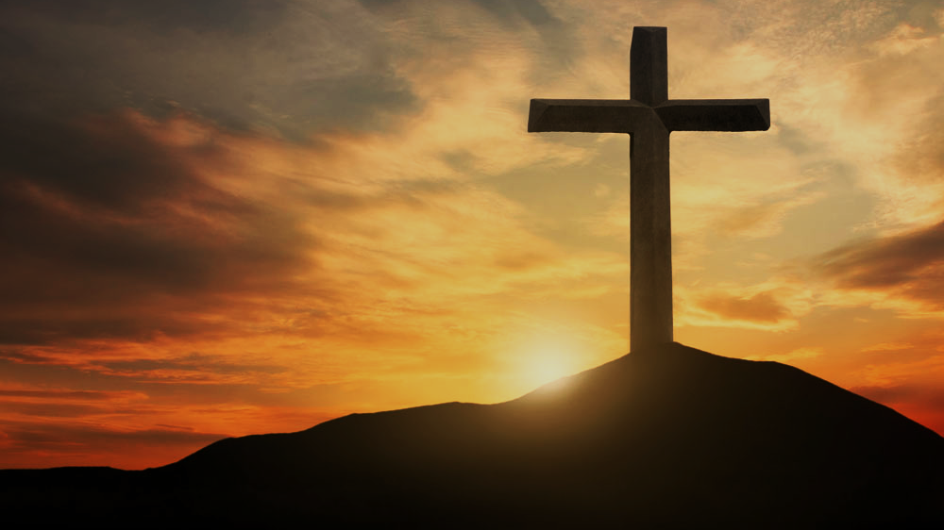
Doctrine of Salvation (Soteriology)
Wednesday Bible Study
Faith Presbyterian Church

Slide 9
Soteri + ology
Salvation + Study

Slide 10
CONFESSION OF FAITH
Chapter 9
Paragraph 3
Man, by his fall into a state of sin, hath wholly lost all ability of will to any spiritual good accompanying salvation: so as, a natural man, being altogether averse from that good, and dead in sin, is not able, by his own strength, to convert himself, or to prepare himself thereunto.

Slide 11
Liberty Vs Responsibility
Throughout Scripture, we learn a man can make his own choices and he will be made responsible for them (Mat 17.12; Jam 1.14; Deut 30.19; Eze 18.20). Personal responsibility is founded upon the premise of the exercise of the will. God created man free and bound to his conscience. Free will is an additional endowment.

Slide 12
CONFESSION OF FAITH
Chapter 9
Paragraph 1-2
God hath endued the will of man with that natural liberty, that it is neither forced, nor, by any absolute necessity of nature, determined to good, or evil.
Man, in his state of innocency, had freedom, and power to will and to do that which was good and well-pleasing to God; but yet, mutably, so that he might fall from it.

Slide 13
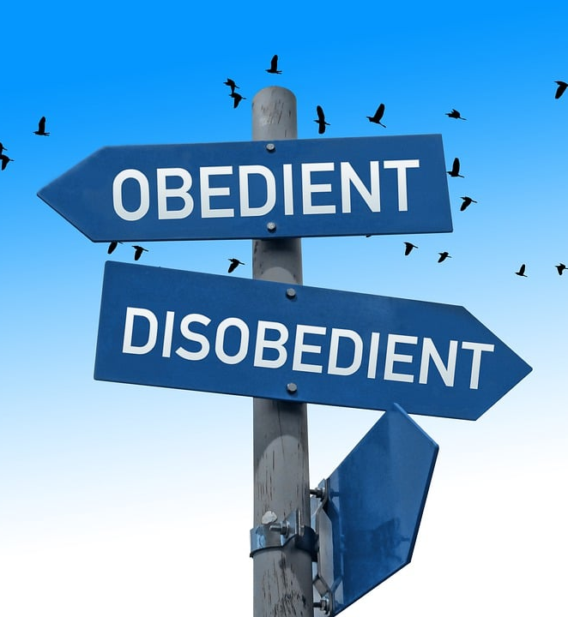
Free Will
Free will is the liberty to act contrary to the natural inclination of the will and a capacity to do something contrary to one’s nature.

Slide 14
Adam Expelled from the Garden
Eternal Life
Ladder of personal obedience
Adam’s Original State
Sinful State

Slide 15
Completely Dead
Men’s intellect, will and affections are completely under the influence of sin and cannot understand the gospel and do spiritual good acceptable to God. His heart is deceitful and spiritually sick.

Slide 16
Loss of “Free” Will
After sin man continues to be free and bound to his conscience and responsible for his actions, but he is not inclined to sin and has lost the capacity to choose contrary to his will, i.e. freedom of the will.

Slide 17
Five Articles of the Remonstrants (1610) Arminianism
Those who shall believe were elected for salvation.
Jesus died for all men but forgiveness is applied only to those who will believe.
Men’s mind is completely under the effect of sin and needs to be renewed by Prevenient Grace so it can believe in the Gospel.
Cooperative Grace is effectual for salvation.
The Holy Spirit gives assurance of salvation and all necessary power to resist temptation and the Devil. But if man can fall it is not clear in Scripture.

Slide 18
Reformed
Catholics
Evangelicals
Christ’s Satisfaction
Christ’s Satisfaction
Christ’s Satisfaction
Foundation
Faith
Obedience
Means
Faith
Faith
Sacraments
MAN
NAN
MAN

Slide 19
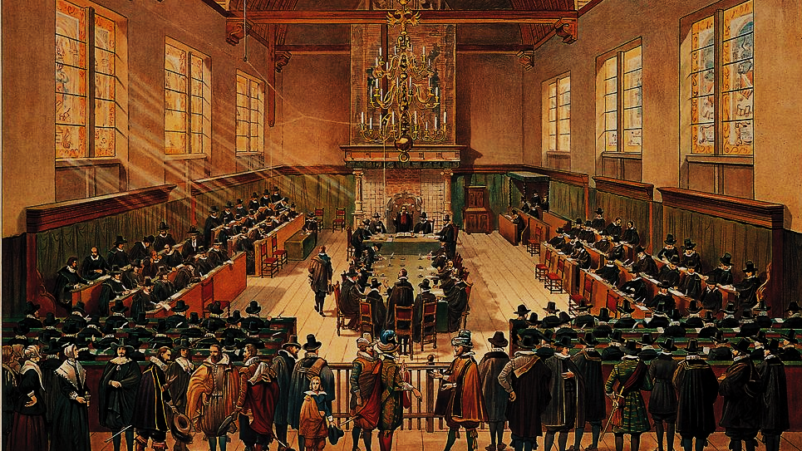
Synod of Dort (1618)
(5 Points of Calvinism)
By Hove, G. van - http://www.entoen.nu/media/18_NationaleSynode.jpg, Public Domain, https://commons.wikimedia.org/w/index.php?curid=25851125

Slide 20
T
U
L
I
P
otal depravity
nconditional Election
imited Atonement
rresistible Grace
erseverance of the Saints

Slide 21
Definition of Prevenient Grace
Prevenient Grace (i.e. “grace that comes before”) is an operation of the Holy Spirit in the hearts of all men which enables their minds to understand the Gospel and restores their will to believe and receive it for salvation. Prevenient grace works directly over the effects of total depravity but it is not a saving grace. It does not redeem man but transforms him to believe.

Slide 22
Biblical Support Claimed For Prevenient Grace (NVI)
John 1:9 - The true light that gives light to everyone was coming into the world.
John 12:32 - And I, when I am lifted up from the earth, will draw all people to myself.
Romans 2:4 - Or do you show contempt for the riches of his kindness, forbearance, and patience, not realizing that God’s kindness is intended to lead you to repentance?
Titus 2:11 – For the grace of God has appeared that offers salvation to all people.

Slide 23
Ordo Salutis?
At this point, we need to talk about the several aspects of salvation are interconnected, how God works salvation. This is called ordo salutis (order of salvation). The ordo salutis is the backbone of someone’s belief about salvation. It presupposes salvation is a process.

Slide 24
John Wesley Ordo Salutis
Prevenient
Grace
Faith
Justifying
Grace
Obed.
Sanctifying
Grace

Slide 25
Reformed
Catholics
Evangelicals
Christ’s Satisfaction
Christ’s Satisfaction
Christ’s Satisfaction
Foundation
Faith
Obedience
Means
Faith
Faith
Sacraments
MAN
NAN
MAN

Slide 26
Wesleyan Salvation Process
Eternal Life
Adam’s Original State
Sinful State

Slide 27
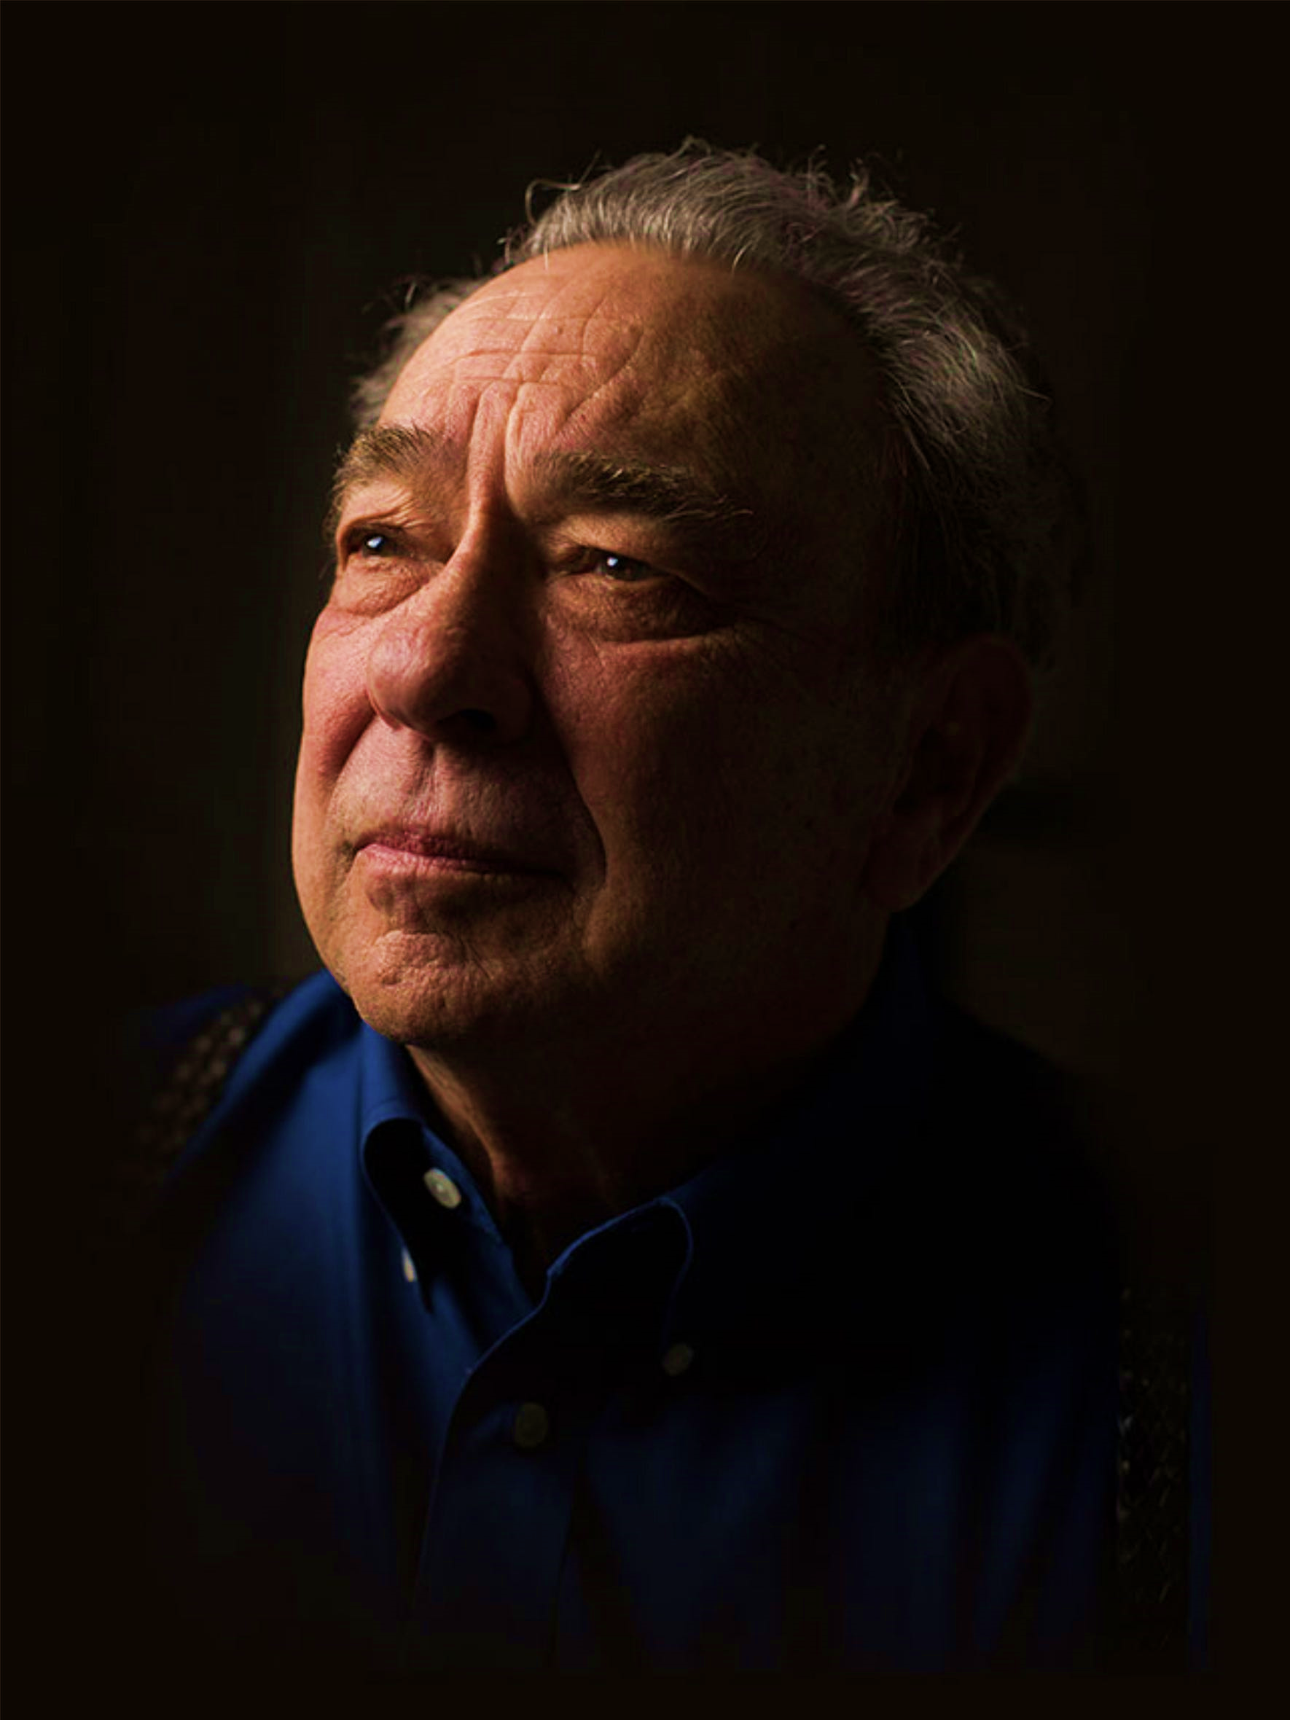
Think of it this way, in personal terms. If you are a Christian you are surely aware of other people who are not Christians. Why is it that you have chosen Christ and they have not? Why did you say yes to prevenient grace while they said no? Was it because you were more righteous than they were? If so, then indeed you have something in which to boast. Was that greater righteousness something you achieved on your own or was it the gift of God? If it was something you achieved, then at the bottom line your salvation depends on your own righteousness. If the righteousness was a gift, then why didn't God give the same gift to everybody?
R. C. Sproul, Chosen by God. Tyndale House Publishers: Wheaton, Ill., p. 124.

Slide 28
Ordo Salutis in Romans 8.28-30
Foreknew
Predestined
Called
Glorified
Justified

Slide 29
Order in Romans 10.14-17
Sent
Preaching
Heard
Believed
Call

Slide 30
Ordo Salutis
Calling
Regeneration
Repentance
Saving Faith
Justification
Adoption
Sanctification

Slide 31
Ordo Salutis
Election
Predestination
Calling (external and effectual)
Regeneration
Repentance
Saving Faith
Justification
Adoption
Sanctification
Glorification

