Slide 2
Amazing Grace
Hymn 460*
Text: John Newton; John P. Rees (st. 5) (*Trinity Hymnal)
Music: Trad. American melody; Carrell and Clayton’s Virginia Harmony, 1831

Slide 3
Amazing grace!—How sweet the sound—
that saved a wretch like me!
I once was lost but now am found,
was blind but now I see.
‘Twas grace that taught my heart to fear,
and grace my fears relieved;
How precious did that grace appear
the hour I first believed.

Slide 4
When we’ve been there ten thousand years,
bright shining as the sun,
we’ve no less days to sing God’s praise
than when we’ve first begun.

Slide 6
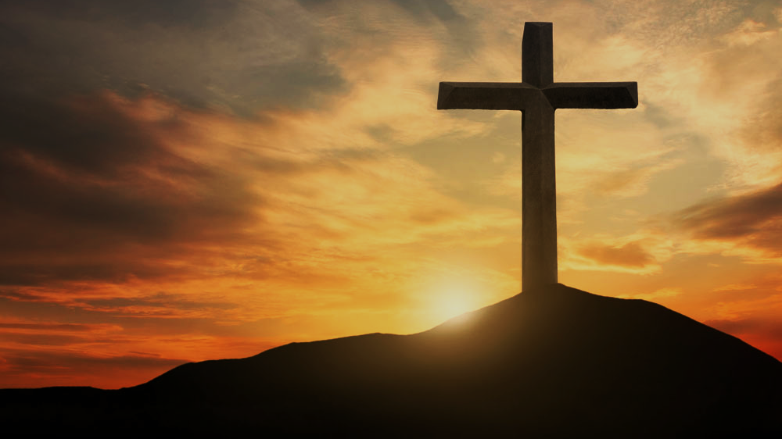
Doctrine of Salvation
(Soteriology)
Wednesday Bible Study
Faith Presbyterian Church

Slide 7
Soteri + ology
Salvation + Study

Slide 8
Paradigms of Salvation
GOD
GOD
GOD
MEN
MEN
MEN
Paganism
Sinergism
Monergism

Slide 9

Reformed
Catholics
Evangelicals
Christ’s Satisfaction
Christ’s Satisfaction
Christ’s Satisfaction
Foundation
Faith
Obedience
Means
Faith
Faith
Sacraments
MAN
NAN
MAN

Slide 10
Westminster Confession of Faith (1647)
Chapter I. Of the Holy Scripture
Chapter II. Of God, and of the Holy Trinity
Chapter III. Of God's Eternal Decree
Chapter IV. Of Creation
Chapter V. Of Providence
Chapter VI. Of the Fall of Man, of Sin, and of the Punishment thereof
Chapter VII. Of God's Covenant with Man
Chapter VIII. Of Christ the Mediator
Chapter IX. Of Free Will
Chapter X. Of Effectual Calling
Chapter XI. Of Justification
Chapter XII. Of Adoption
Chapter XIII. Of Sanctification
Chapter XIV. Of Saving Faith
Chapter XV. Of Repentance Unto Life
Chapter XVI. Of Good Works
Chapter XVII. Of The Perseverance of the Saints
Chapter XVIII. Of the Assurance of Grace and Salvation
Chapter XIX. Of the Law of God
Chapter XX. Of Christian Liberty, and Liberty of Conscience
Chapter XXI. Of Religious Worship and the Sabbath-day
Chapter XXII. Of Lawful Oaths and Vows
Chapter XXIII. Of the Civil Magistrate
Chapter XXIV. Of Marriage and Divorce
Chapter XXV. Of the Church
Chapter XXVI. Of the Communion of the Saints
Chapter XXVII. Of the Sacraments
Chapter XXVIII. Of Baptism
Chapter XXIX. Of the Lord's Supper
Chapter XXX. Of Church Censures
Chapter XXXI. Of Synods and Councils
Chapter XXXII. Of the State of Man After Death, and of the Resurrection of the Dead
Chapter XXXIII. Of the Last Judgment

Slide 11

The Doctrine of Salvation is dependent on one’s doctrine of Sin. This is where we are going to start.

Slide 12
Westminster Confession of Faith (1647)
Chapter I. Of the Holy Scripture
Chapter II. Of God, and of the Holy Trinity
Chapter III. Of God's Eternal Decree
Chapter IV. Of Creation
Chapter V. Of Providence
Chapter VI. Of the Fall of Man, of Sin, and of the Punishment thereof
Chapter VII. Of God's Covenant with Man
Chapter VIII. Of Christ the Mediator
Chapter IX. Of Free Will
Chapter X. Of Effectual Calling
Chapter XI. Of Justification
Chapter XII. Of Adoption
Chapter XIII. Of Sanctification
Chapter XIV. Of Saving Faith
Chapter XV. Of Repentance Unto Life
Chapter XVI. Of Good Works
Chapter XVII. Of The Perseverance of the Saints
Chapter XVIII. Of the Assurance of Grace and Salvation
Chapter XIX. Of the Law of God
Chapter XX. Of Christian Liberty, and Liberty of Conscience
Chapter XXI. Of Religious Worship and the Sabbath-day
Chapter XXII. Of Lawful Oaths and Vows
Chapter XXIII. Of the Civil Magistrate
Chapter XXIV. Of Marriage and Divorce
Chapter XXV. Of the Church
Chapter XXVI. Of the Communion of the Saints
Chapter XXVII. Of the Sacraments
Chapter XXVIII. Of Baptism
Chapter XXIX. Of the Lord's Supper
Chapter XXX. Of Church Censures
Chapter XXXI. Of Synods and Councils
Chapter XXXII. Of the State of Man After Death, and of the Resurrection of the Dead
Chapter XXXIII. Of the Last Judgment

Slide 13
Five Articles of the Remonstrants (1610)
Arminianism
Those who shall believe were elected for salvation
Jesus died for all men but forgiveness is applied only to those who will believe.
Men’s mind in completely under the effect of sin and needs to be renewed by prevenient grace so it can believe in the Gospel.
Cooperative Grace is effectual for salvation
The Holy Spirit gives assurance of salvation and all necessary power to resist temptation and the Devil. But if man can fall it is not clear in Scripture.

Slide 14
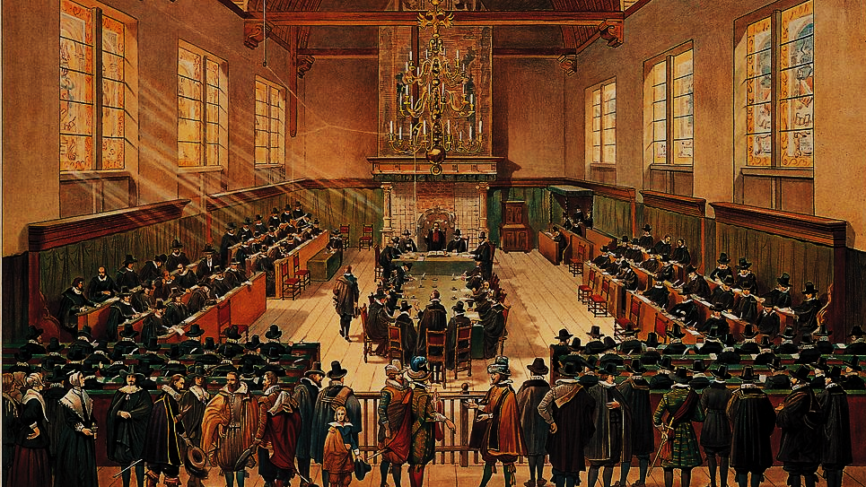
Synod of Dort (1618)
(5 Points of Calvinism)
By Hove, G. van - http://www.entoen.nu/media/18_NationaleSynode.jpg, Public Domain, https://commons.wikimedia.org/w/index.php?curid=25851125

Slide 15

T
U
L
I
P
otal depravity
nconditional Election
imited Atonement
rresistible Calling
erseverance of the Saints

Slide 16
CONFESSION OF FAITH
Chapter 6
Paragraph 1
Our first parents, being seduced by the subtlety and temptation of Satan, sinned, in eating the forbidden fruit. This their sin, God was pleased, according to his wise and holy counsel, to permit, having purposed to order it to his own glory.

Slide 17

An Extraordinary Gift
Being created holy and pure, Adam was given by God “free will”, through which we could disobey. He was created pure and inclined to good but could choose the opposite of good without being inclined or compelled by his heart to do so.

Slide 18
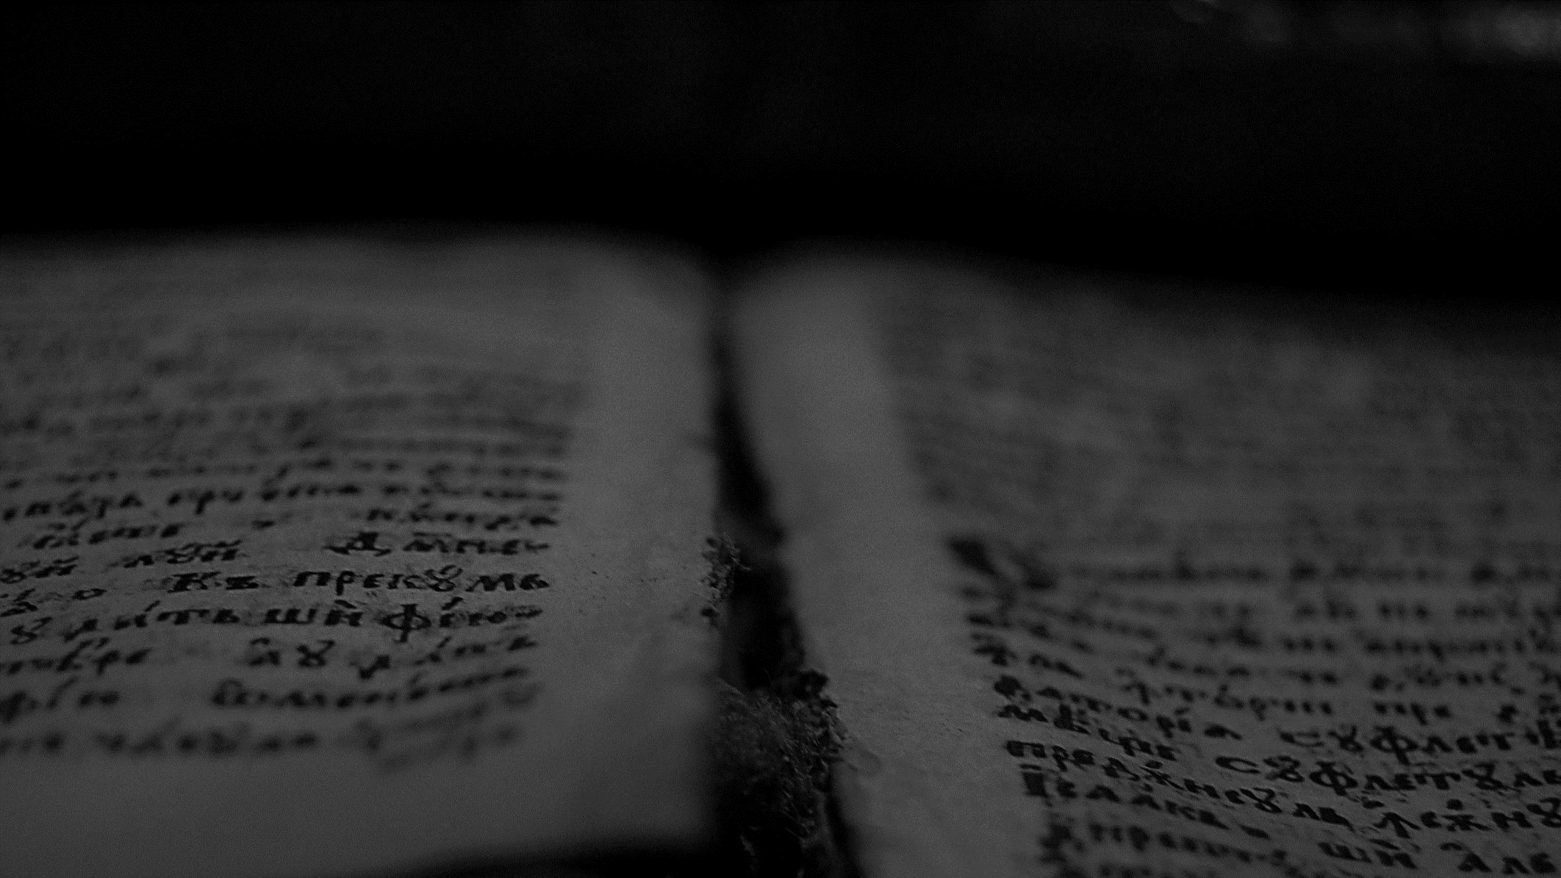
And the LORD God commanded the man, saying, “You may surely eat of every tree of the garden, but of the tree of the knowledge of good and evil you shall not eat, for in the day that you eat of it you shall surely die.”
Genesis 2.16-17
ESV

Slide 19
See, this alone I found, that God made man upright, but they have sought out many schemes.
Ecclesiastes 7.29
ESV

Slide 20
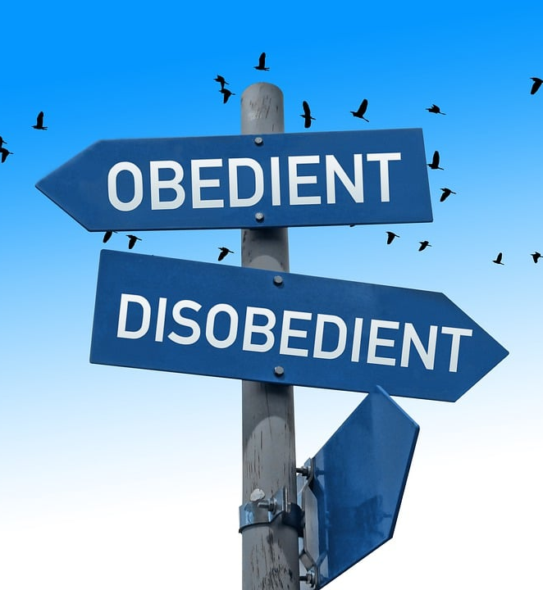
Free Will
Free will is the liberty to act contrary to the natural inclination of the will and a capacity to do something contrary to one’s nature.

Slide 21
CONFESSION OF FAITH
Chapter 9
Paragraph 1-2
God hath endued the will of man with that natural liberty, that it is neither forced, nor, by any absolute necessity of nature, determined to good, or evil.
Man, in his state of innocency, had freedom, and power to will and to do that which was good and well-pleasing to God; but yet, mutably, so that he might fall from it.

Slide 22

Liberty Vs Responsibility
Throughout Scripture, we learn a man can make his own choices and he will be made responsible for them (Mat 17.12; Jam 1.14; Deut 30.19; Eze 18.20). Personal responsibility is founded upon the premise of the exercise of the will. God created man free and bound to his conscience. Free will is an additional endowment.

Slide 23


Saving Good Works
By this, we can conclude that Adam’s own actions were the means of the maintenance of his pure life and the hope of eating of the fruit of the tree of eternal life one day.

Slide 24


Adam in the Garden of Eden
Eternal Life
“Ladder” of personal obedience
Adam’s Original State
Sinful State

Slide 25
CONFESSION OF FAITH
Chapter 6
Paragraph 2
By this sin they fell from their original righteousness and communion with God, and so became dead in sin, and wholly defiled in all the parts and faculties of soul and body.

Slide 26
And you were dead in the trespasses and sins in which you once walked, following the course of this world, following the prince of the power of the air, the spirit that is now at work in the sons of disobedience— among whom we all once lived in the passions of our flesh, carrying out the desires of the body and the mind, and were by nature children of wrath, like the rest of mankind.
Ephesians 2.1-3
ESV

Slide 27
But of the tree of the knowledge of good and evil you shall not eat, for in the day that you eat of it you shall surely die.
Genesis 2.17
ESV

Slide 28
CONFESSION OF FAITH
Chapter 6
Paragraph 3
They being the root of all mankind, the guilt of this sin was imputed; and the same death in sin, and corrupted nature, conveyed to all their posterity descending from them by ordinary generation.

Slide 29
Therefore, just as sin came into the world through one man, and death through sin, and so death spread to all men because all sinned
Romans 5.12
ESV

Slide 30
CONFESSION OF FAITH
Chapter 6
Paragraph 4
From this original corruption, whereby we are utterly indisposed, disabled, and made opposite to all good, and wholly inclined to all evil, do proceed all actual transgressions.

Slide 31
Adam in the Garden of Eden
Eternal Life
“Ladder” of personal obedience
Adam’s Original State
Sinful State

Slide 32
Adam Expelled from the Garden
Eternal Life
Ladder of personal obedience
Adam’s Original State
Sinful State

Slide 33
Eternal Life
Obedience
Adam’s Original State
Death
Sinful State

Slide 34
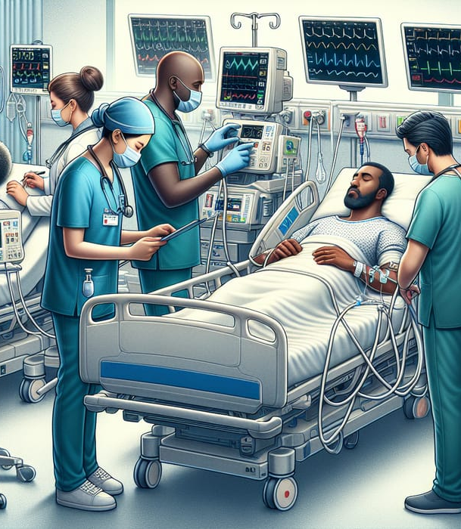
Physical Corruption
There is little debate about the physical effects of sin. Biological death is certainly the ultimate consequence of sin in this life (Gen 3.19). But this is followed by aging, diseases, congenital problems, psychological disorders, and mental health issues. These are all part of God’s curse over men for Adam’s sin.

Slide 35
CONFESSION OF FAITH
Chapter 9
Paragraph 3
Man, by his fall into a state of sin, hath wholly lost all ability of will to any spiritual good accompanying salvation: so as, a natural man, being altogether averse from that good, and dead in sin, is not able, by his own strength, to convert himself, or to prepare himself thereunto.

Slide 36
The extent of the Corruption of Sin Over the Mind
The debate about the noetic Effects of Sins
The debate about the corruption of the mind (nous in Greek) is more complex. The big question is: can the corrupt man know the truth?

Slide 37
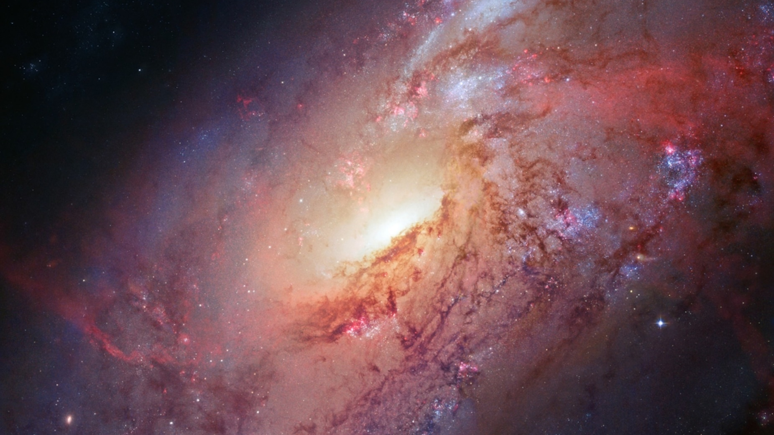

Slide 38
Romans 1.18-32

Slide 39
Can the Ethiopian change his skin or the leopard his spots? Then also you can do good who are accustomed to do evil.
Jeremiah 13.23
ESV

Slide 40
Romans 3.9-18,23

Slide 41
The heart is deceitful above all things, and desperately sick; who can understand it?
Jeremiah 17.9
ESV

Slide 42
Do you not see that whatever goes into the mouth passes into the stomach and is expelled? But what comes out of the mouth proceeds from the heart, and this defiles a person. For out of the heart come evil thoughts, murder, adultery, sexual immorality, theft, false witness, slander. These are what defile a person. But to eat with unwashed hands does not defile anyone.”
Matthew 15.17-20
ESV

Slide 43

Completely Dead
Men’s intellect, will and affections are completely under the influence of sin and cannot understand the gospel and do spiritual good acceptable to God. His heart is deceitful and spiritually sick.

Slide 44
CONFESSION OF FAITH
Chapter 6
Paragraph 5
This corruption of nature, during this life, doth remain in those that are regenerated; and although it be, through Christ, pardoned, and mortified; yet both itself, and all the motions thereof, are truly and properly sin.

Slide 45
CONFESSION OF FAITH
Chapter 6
Paragraph 6
Every sin, both original and actual, being a transgression of the righteous law of God, and contrary thereunto, doth, in its own nature, bring guilt upon the sinner, whereby he is bound over to the wrath of God, and curse of the law, and so made subject to death, with all miseries spiritual, temporal, and eternal.

Slide 46
No one can come to me unless the Father who sent me draws him. And I will raise him up on the last day.
John 6.44
ESV

Slide 47
Therefore, my beloved, as you have always obeyed, so now, not only as in my presence but much more in my absence, work out your own salvation with fear and trembling, for it is God who works in you, both to will and to work for his good pleasure.
Philippians 2.12
ESV

Slide 48

Loss of “Free” Will
After sin man continues to be free and bound to his conscience and responsible for his actions, but he is now inclined to sin and has lost the capacity to choose contrary to his will, i.e. freedom of the will.

