Slide 1
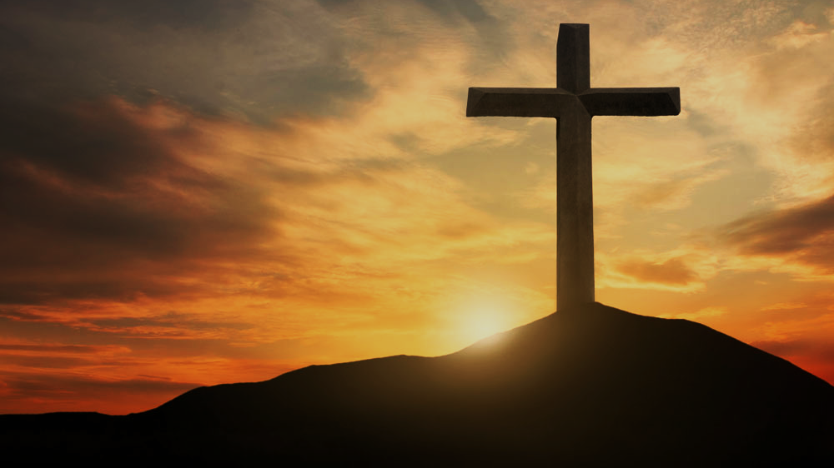
Doctrine of Salvation (Soteriology)
Wednesday Bible Study
Faith Presbyterian Church

Slide 2
Soteri + ology
Salvation + Study

Slide 3
GOD
Natural Revelation
Common Grace
Special Grace
Special Revelation
Acts of providence
Acts of salvation

Slide 4
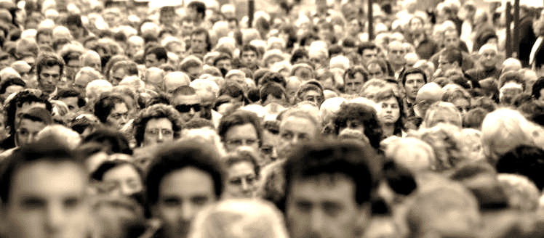
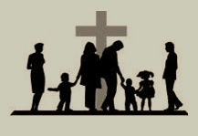
GOD
Natural Revelation
Comom Grace
Special Grace
Special Revelation
God Creator and Provident
Psalm 19.1-4;
Romans 1.18-23; 2.14
Triune Redeemer God revealed fully in Jesus Christ
Acts 17.22-31; Colossians 1.26-27; 1Corinthians 1.21
Arts
Music
Engineering
Literature
Medicine
Carpentry
Spiritual Gifts
Romans 12.3-8; 2Corinthians 12; Ephesians 4.7-16; Exodus 31.1-6
Acts 14.15- 17
Genesis 4.17-22
Genesis 11.2-4
1Kings 7.13-15

Slide 5
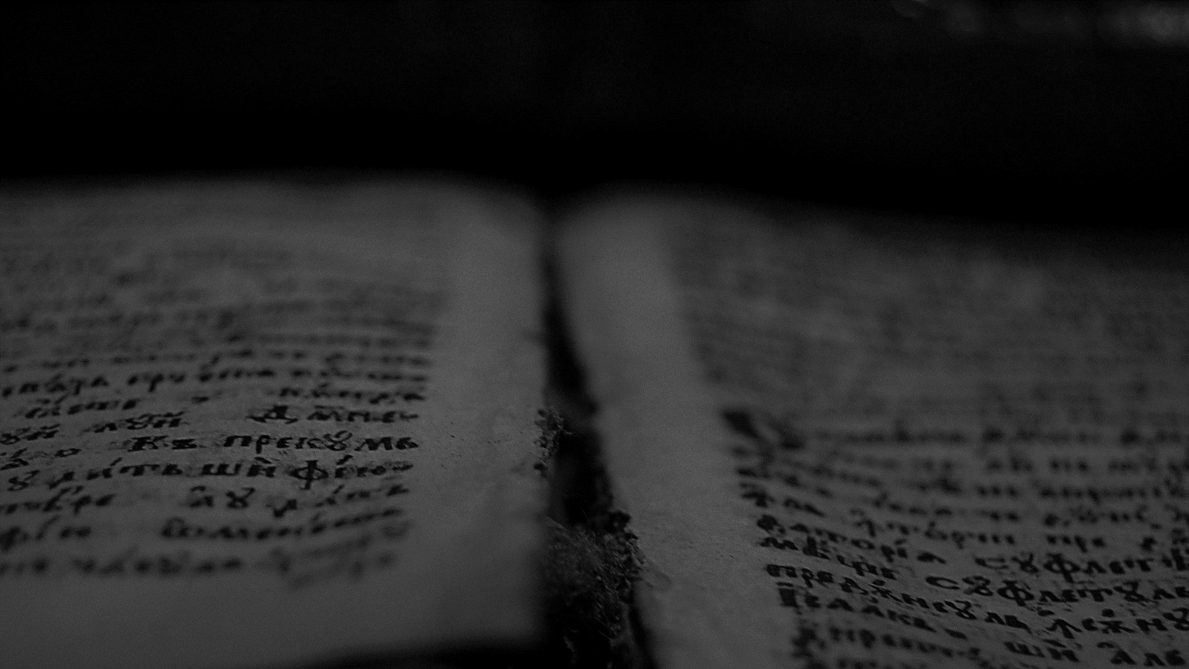
For I am not ashamed of the gospel, for it is the power of God for salvation to everyone who believes, to the Jew first and also to the Greek.
Romans 1.16
ESV

Slide 6
For godly grief produces a repentance that leads to salvation without regret, whereas worldly grief produces death.
2Corinthians 7.10
ESV

Slide 7
Although he was a son, he learned obedience through what he suffered. And being made perfect, he became the source of eternal salvation to all who obey him, being designated by God a high priest after the order of Melchizedek.
Hebrews 5.8-10
ESV

Slide 8
For so the Lord has commanded us, saying, “‘I have made you a light for the Gentiles, that you may bring salvation to the ends of the earth.’” And when the Gentiles heard this, they began rejoicing and glorifying the word of the Lord, and as many as were appointed to eternal life believed.
Acts 13.47-48
ESV

Slide 9
Therefore, my beloved, as you have always obeyed, so now, not only as in my presence but much more in my absence, work out your own salvation with fear and trembling,
Philippians 2.12
ESV

Slide 10
who by God's power are being guarded through faith for a salvation ready to be revealed in the last time.
1 Petter 1.5
NVI

Slide 11
And count the patience of our Lord as salvation, just as our beloved brother Paul also wrote to you according to the wisdom given him, as he does in all his letters when he speaks in them of these matters. There are some things in them that are hard to understand, which the ignorant and unstable twist to their own destruction, as they do the other Scriptures.
2 Peter 3.15-16
ESV

Slide 12
Paradigms of Salvation
GOD
GOD
GOD
MEN
MEN
MEN
Paganism
Sinergism
Monergism

Slide 13
Reformed
Catholics
Evangelicals
Christ’s Satisfaction
Christ’s Satisfaction
Christ’s Satisfaction
Foundation
Faith
Obedience
Means
Faith
Faith
Sacraments
MAN
NAN
MAN

Slide 14
Westminster Confession of Faith (1647)
Chapter I. Of the Holy Scripture
Chapter II. Of God, and of the Holy Trinity
Chapter III. Of God's Eternal Decree
Chapter IV. Of Creation
Chapter V. Of Providence
Chapter VI. Of the Fall of Man, of Sin, and of the Punishment thereof
Chapter VII. Of God's Covenant with Man
Chapter VIII. Of Christ the Mediator
Chapter IX. Of Free Will
Chapter X. Of Effectual Calling
Chapter XI. Of Justification
Chapter XII. Of Adoption
Chapter XIII. Of Sanctification
Chapter XIV. Of Saving Faith
Chapter XV. Of Repentance Unto Life
Chapter XVI. Of Good Works
Chapter XVII. Of The Perseverance of the Saints
Chapter XVIII. Of the Assurance of Grace and Salvation
Chapter XIX. Of the Law of God
Chapter XX. Of Christian Liberty, and Liberty of Conscience
Chapter XXI. Of Religious Worship and the Sabbath-day
Chapter XXII. Of Lawful Oaths and Vows
Chapter XXIII. Of the Civil Magistrate
Chapter XXIV. Of Marriage and Divorce
Chapter XXV. Of the Church
Chapter XXVI. Of the Communion of the Saints
Chapter XXVII. Of the Sacraments
Chapter XXVIII. Of Baptism
Chapter XXIX. Of the Lord's Supper
Chapter XXX. Of Church Censures
Chapter XXXI. Of Synods and Councils
Chapter XXXII. Of the State of Man After Death, and of the Resurrection of the Dead
Chapter XXXIII. Of the Last Judgment

Slide 15
CONFESSION OF FAITH
Chapter 3
Paragraph 3
By the decree of God, for the manifestation of his glory, some men and angels are predestinated unto everlasting life; and others foreordained to everlasting death.

Slide 16
CONFESSION OF FAITH
Chapter 3
Paragraph 6
As God hath appointed the elect unto glory, so hath he, by the eternal and most free purpose of his will, foreordained all the means thereunto. Wherefore, they who are elected, being fallen in Adam, are redeemed by Christ, are effectually called unto faith in Christ by his Spirit working in due season, are justified, adopted, sanctified, and kept by his power, through faith, unto salvation. Neither are any other redeemed by Christ, effectually called, justified, adopted, sanctified, and saved, but the elect only.

Slide 17
The Doctrine of Salvation is dependent on one’s doctrine of Sin. This is where we are going to start.

