Slide 2
Fling Out the Banner! Let it Float
Trinity Hymnal # 446
George W. Doane
J. Baptiste Calkin

Slide 3
1 Fling out the banner! Let it float
skyward and seaward, high and wide;
the sun that lights its shining folds,
the cross on which the Savior died.
2 Fling out the banner! Angels bend
in anxious silence o'er the sign,
and vainly seek to comprehend
the wonder of the love divine,

Slide 4
3 Fling out the banner! Heathen lands
shall see from far the glorious sight,
and nations, crowding to be born,
baptize their spirits in its light.
4 Fling out the banner! Sin-sick souls,
that sink and perish in the strife,
shall touch in faith its radiant hem
and spring immortal into life.

Slide 5
5 Fling out the banner! Let it float
skyward and seaward, high and wide,
our glory, only in the cross;
our only hope, the Crucified!
6 Fling out the banner! Wide and high,
seaward and skyward, let it shine:
nor skill, nor might, nor merit ours;
we conquer only in that sign.

Slide 7

Modern Missions
Carey and Duty of Missions

Slide 8
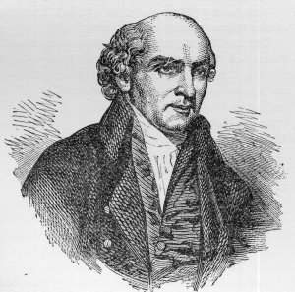
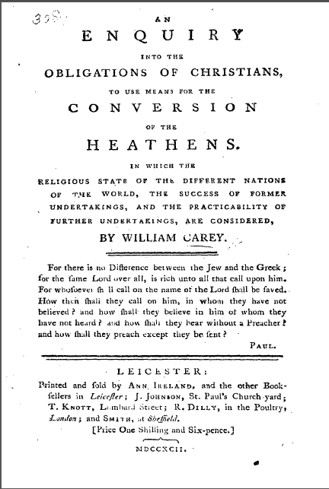
The Trailblazer
Willian Carrey (1761-1834) was the pioneer of missionary planning. He started a movement that led to modern worldwide missions.
His book, published in 1792 seems to have been a driving force behind this movement. It is the first book to openly defend the need of Obligations of Christians to Use Means for the Conversion of the Heathen.

Slide 9

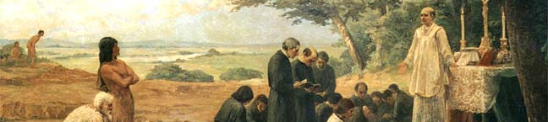
Catholic Missions
The Jesuits and Carmelites were the first to use the word “mission” to define their job of catechization of native peoples in the newly found and conquered lands of the Americas and Southern Asia.

Slide 10
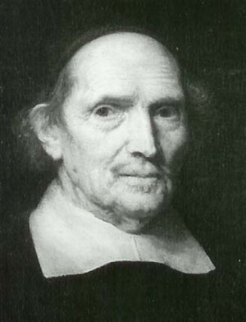
Gisbertus Voetius
Before Willian Carey, there was a Dutch reformed theologian, which was instrumental in the writing of the Cannons of Dort (1618), who spoke about missions.
Gisbertus Voetius (1589-1676) is believed to have been the first to write a theological treatise on Christian missions. He dealt with the issue of missions in the context of Dutch expansionism.

Slide 11
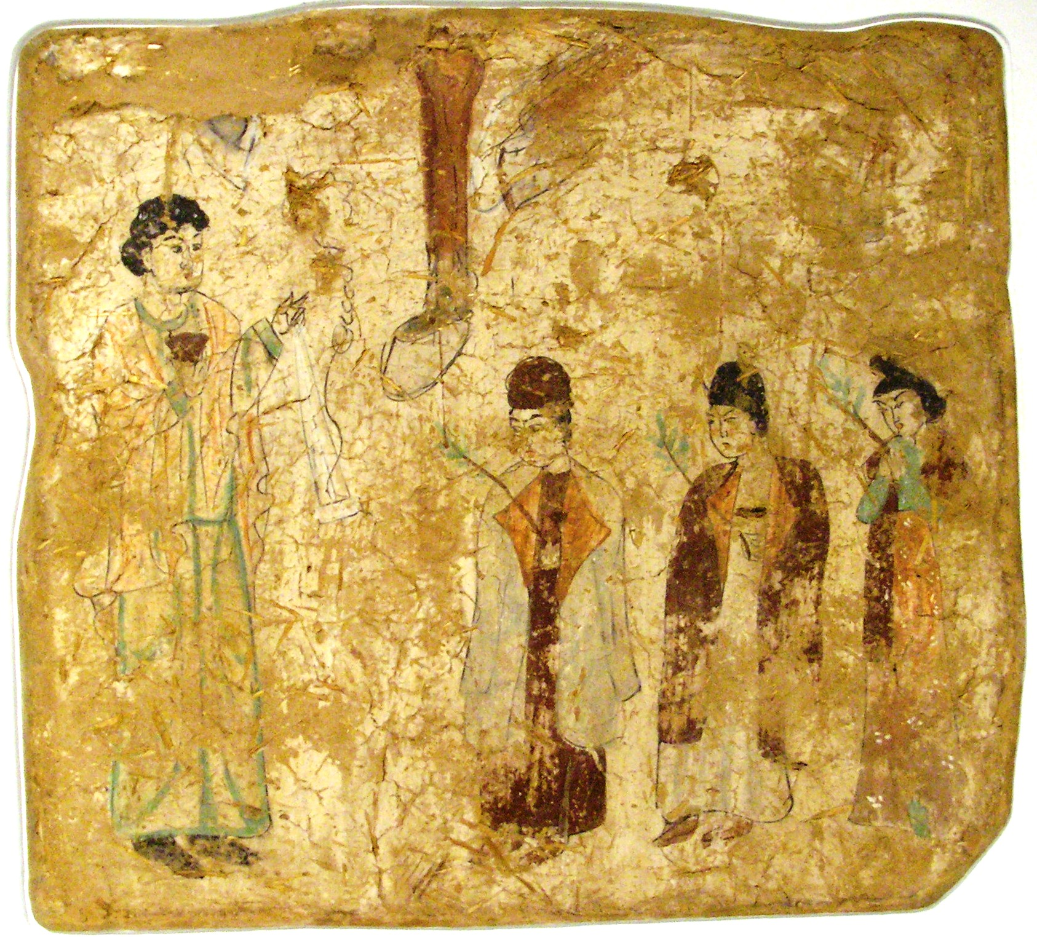
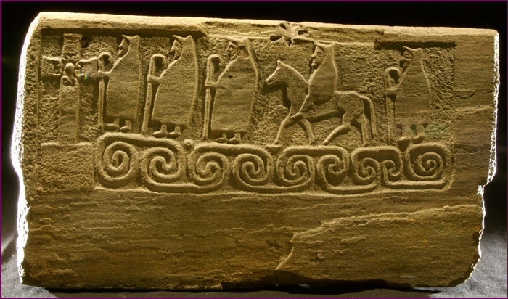
An Old Task
But in its way Christians always did missions. In the apostolic era, it is believed the whole known world was reached. Christians went to the ends of the Earth.
Some evidence of this can be found. Like the painting of Nestorian missionaries in China dated of the 8th century (right).
Or the Monk Stone in Shetland dated of the 4th century (on the left).
Nestorian Missionaries (8th Cent.)
Museum Für Indische Kunst Dahlem, Berlin
Pict Althar of Papil in Shetland, Scotland (700 d.C.)
National Museum of Scotland, Edinburgh

Slide 12
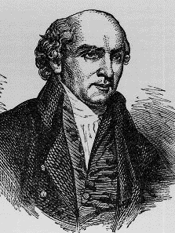
Reflecting on the state of affairs in his own time William Carey wrote:
Some attempts are still making, but they are inconsiderable in comparison of what might be done if the whole body of Christians entered heartily into the spirit of the divine command on this subject. Some think little about it, others are unacquainted with the state of the world, and others love their wealth better than the souls of their fellow-creatures.
Carey, Inquiry, 9-10.

Slide 13
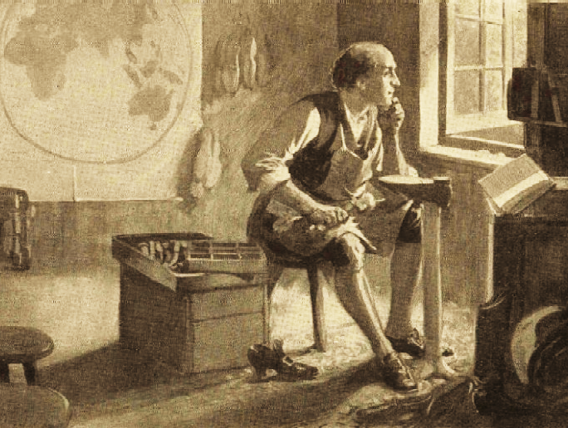
William Carey (1761-1834)
Carey was a shoemaker from Northamptonshire, England, who studied theology by himself and was ordained pastor by the Particular Baptists in 1886. As he repaired shoes and studied theology Carey dreamed about preaching the gospel to the heathen nations.
https://www.wmcarey.edu/carey/portraits/portraits.htm

Slide 14
It has been objected that there are multitudes in our own nation, and within our immediate spheres of action, who are as ignorant as the South-Sea savages, and that therefore we have work enough at home, without going into other countries…Our own countrymen have the means of grace and may attend on the word preached if they chose it. They have the means of knowing the truth, and faithful ministers are placed in almost every part of the land, … but with them [the heathen] the case is widely different, who have no Bible, no written language, (which many of them have not) no ministers, no good civil government, nor any of those advantages which we have. Pity therefore, humanity, and much more Christianity, call loudly for every possible exertion to introduce the gospel amongst them.

Slide 15
Suppose a company of serious Christians, ministers and private persons, were to form themselves into a society, and make a number of rules respecting the regulation of the plan, and the persons who are to be employed as missionaries, the means of defraying the expense. This society must consist of persons whose hearts are in the work, men of serious religion, and possessing a spirit of perseverance; there must be a determination not to admit any person who is not of this description, or to retain him longer than he answers to it.
Carey, Inquiry, 82-83.

Slide 16
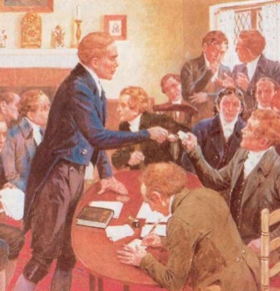
William Carey (1761-1834)
William Carey (1761-1834)
Finally, Carey’s church decided in 1794 to create the Particular Baptist Society for the Propagation of the Gospel Amongst the Heathen with eight members, all candidates to be missionaries in India. They set sail to Asia in the following year. This is considered the beginning of modern missions.

Slide 17
Our Lord Jesus Christ, a little before his departure, commissioned his apostles to Go, and teach all nations; or, as another evangelist expresses it, Go into all the world, and preach the gospel to every creature. This commission was as extensive as possible, and laid them under obligation to disperse themselves into every country of the habitable globe, and preach to all the inhabitants, without exception, or limitation. They accordingly went forth in obedience to the command, … but the work has not been taken up, or prosecuted of late years (except by a few individuals) with that zeal and perseverance with which the primitive Christians went about it

Slide 18
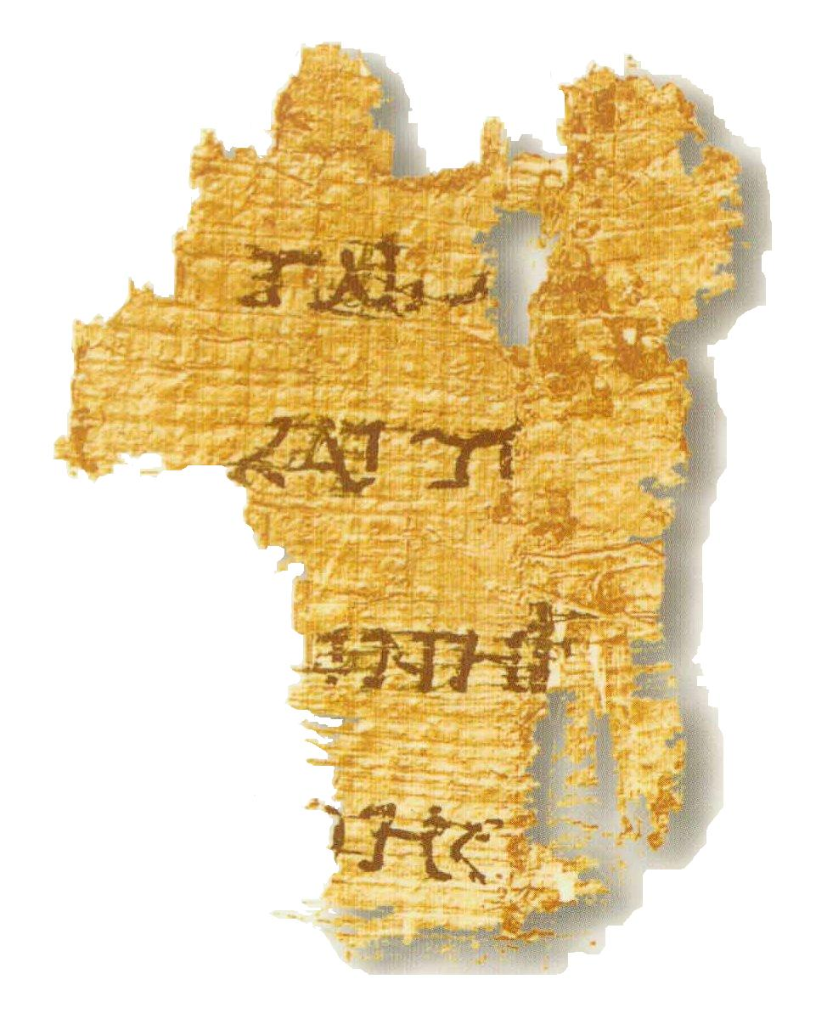
The Commission in Mark 16.15-16
Fragment 7Q5 (dated of circa 50 AD)
It supposedly contains Mark 6.52-53

Slide 19
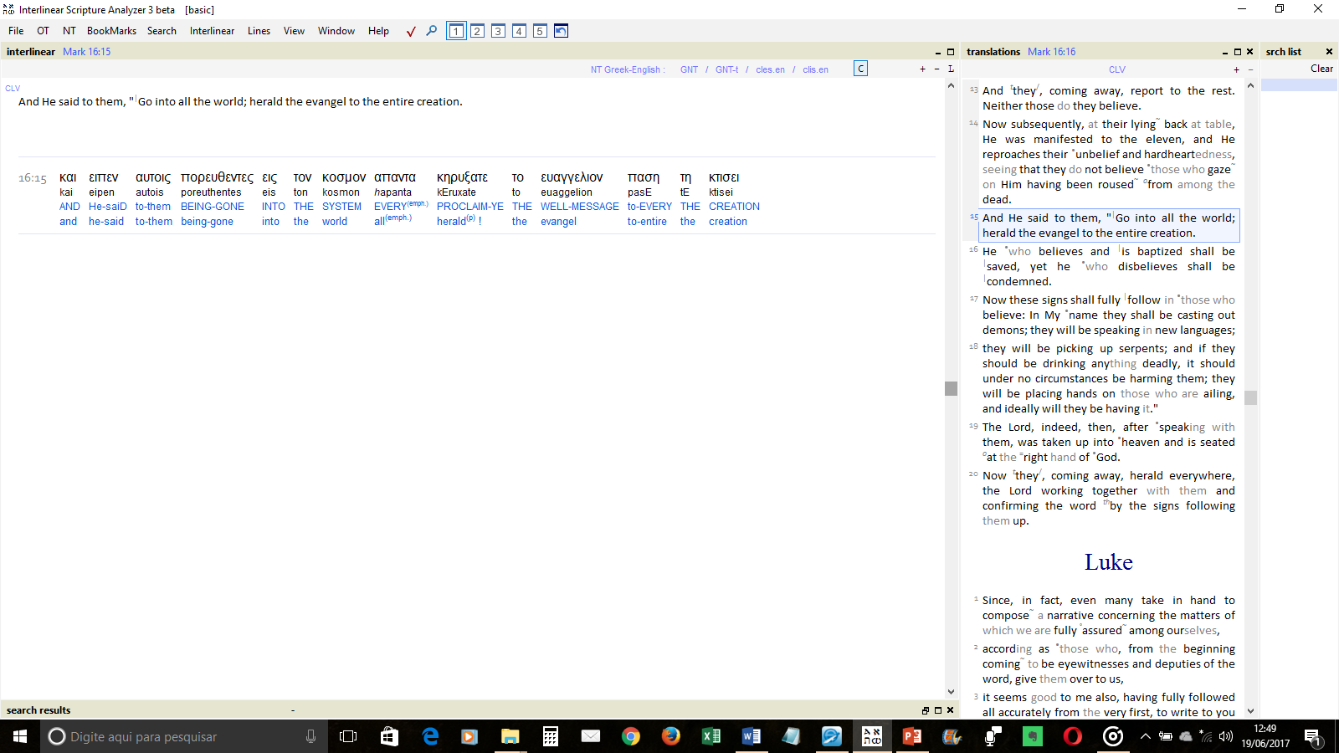
Mark 16.15
Go into all the world and proclaim the gospel to the whole creation.

Slide 20
Commission of Mark 16.15-16
ACTION | Proclaim (Kerygma, imperative) Go (going is instrumental) | Also v. 19; Mat 4.17; Acts 8.5, 28,31; Rom 10.14-15
CONTENT | Gospel (εὐαγγέλιον) | Mark 1.1; Rom 1.16
TARGET | Into all the world (Kosmos) All creation (meaning creatures) | Acts 1.8; Rom 1.8; 2Cor 5.17; Gal 6.15

Slide 21
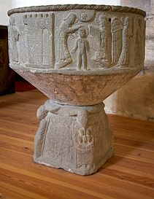
Belief and Baptism
Jesus makes it clear that there will be two answers to the proclamation of the gospel:
Some will believe and desire to be baptized (as in Acts 8.36; 2.38,41).
Some will not believe (Acts 13.50-51; as Mark 6.11).

Slide 22
The Commission in Matthew 28.18-20

Slide 23
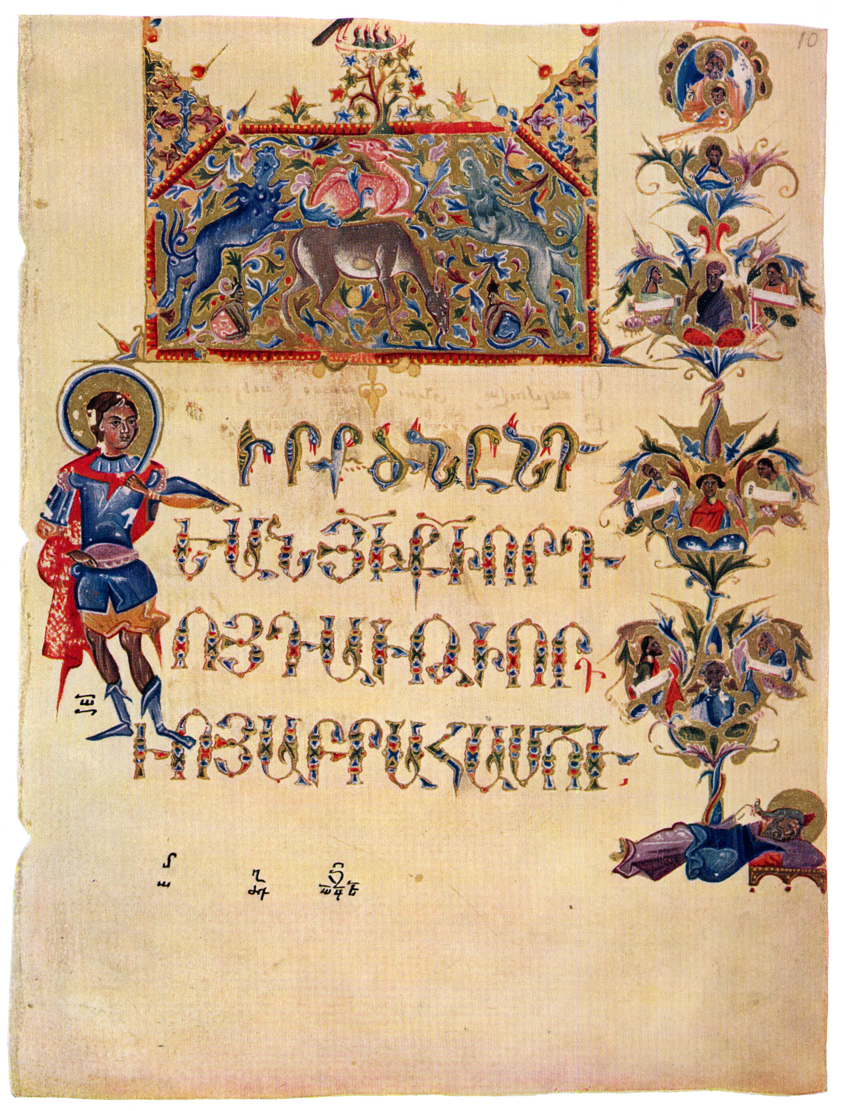
Matthew 28.18-20
“All authority in heaven and on earth has been given to me.
Go therefore and make disciples of all nations, baptizing them in the name of the Father and of the Son and of the Holy Spirit, teaching them to observe all that I have commanded you.
And behold, I am with you always, to the end of the age.”
Gospel of the Eight Painters of Toros Roslin
Title page of the Gospel of Matthew of the Illustrated Armenian manuscript from 13th Century

Slide 24
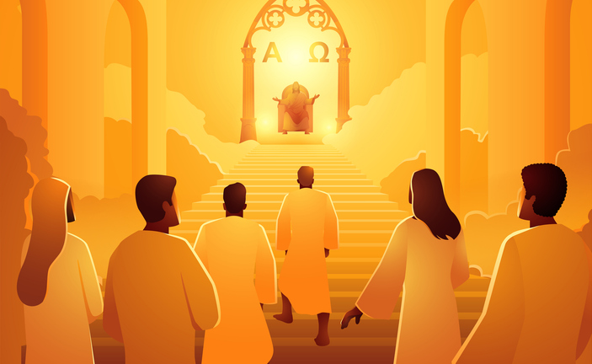

Authority
The commission given by Jesus is based on the authority he conquered by his Victory over death (Phil 2.9-10). Jesus was exalted to the right hand of the Father and reigns above (Eph 1.20-21; 1Cor 15.27). Those who fulfill the commission go in the authority and power of Jesus Christ.

Slide 25
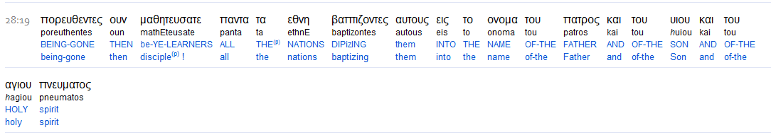
Comparison of Mark and Matthew

Slide 26
Grammatical Structure of Matthew 28.19
Make Disciples
Go
Baptizing
Teaching

Slide 27
Commission of Matthew 28.18-20
ACTION | Make Disciples (imperative) Baptizing (the authority is seen in the expression “in the name”) Teaching | Mat 13.52; Acts 14.21 Acts 2.41; 8.12 Acts 5.21, 42; 11.26; 18.11; 28.31
CONTENT | All that I have commanded you | Acts 20.27
TARGET | All nations (ethne) | Acts 11.19-21; Rom 3.29

Slide 28

Escathology of Missions
On the Cross Jesus cried “It is finished” (John 19.30). The first part of redemption had been accomplished. Now he sends his disciples to proclaim the good news of the Cross. As the disciples go Jesus will be with them (Mat 28.20). When the message reaches all nations the second part of the redemption will be accomplished (Mt 24.14; 26.13).

