Slide 1
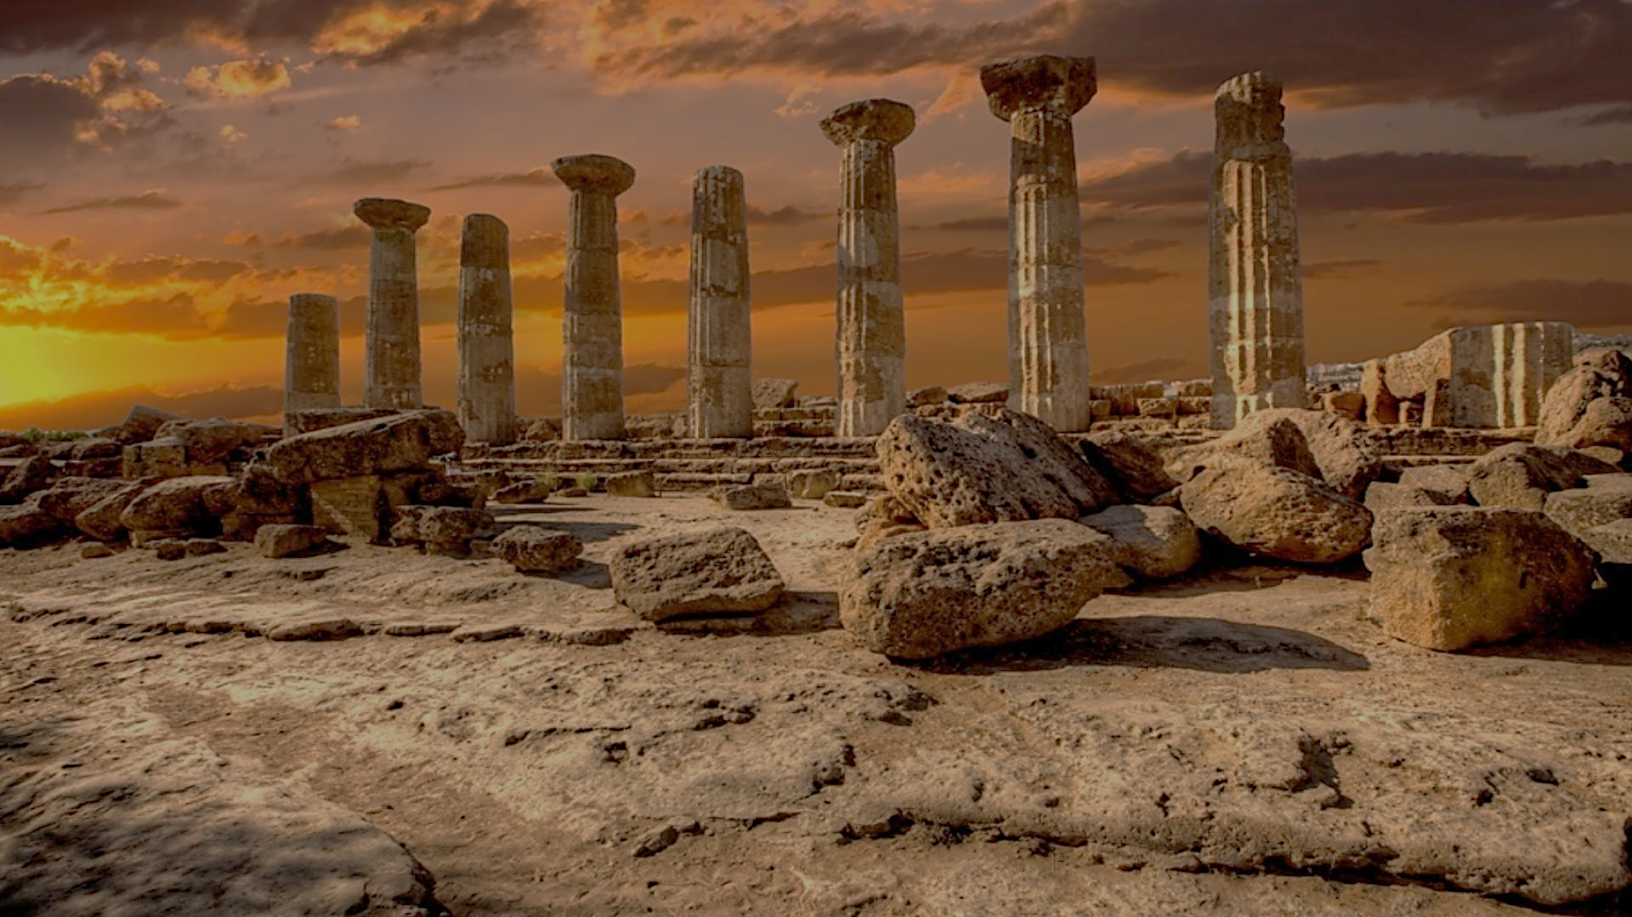
Archeology of Bible Times
Pastor John dos Santos - Faith Presbyterian Church

Slide 2
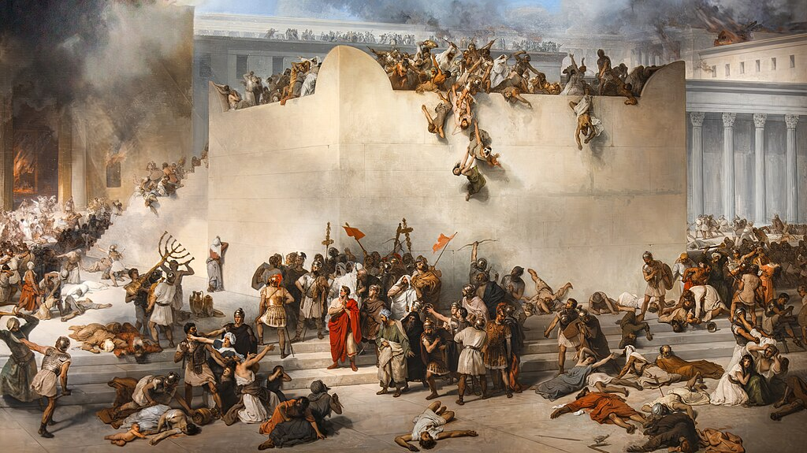
Jesus prophesized the Temple's destruction and Jerusalem's punishment (Mat 23.37-24.2; Luk 23.29-31). This happened in 70 AD.
Destruction of the Temple in Jerusalem
Francesco Hayez. Oil on canvas, 1867.
By Didier Descouens - Own work, Public Domain, https://commons.wikimedia.org/w/index.php?curid=132796743

Slide 3
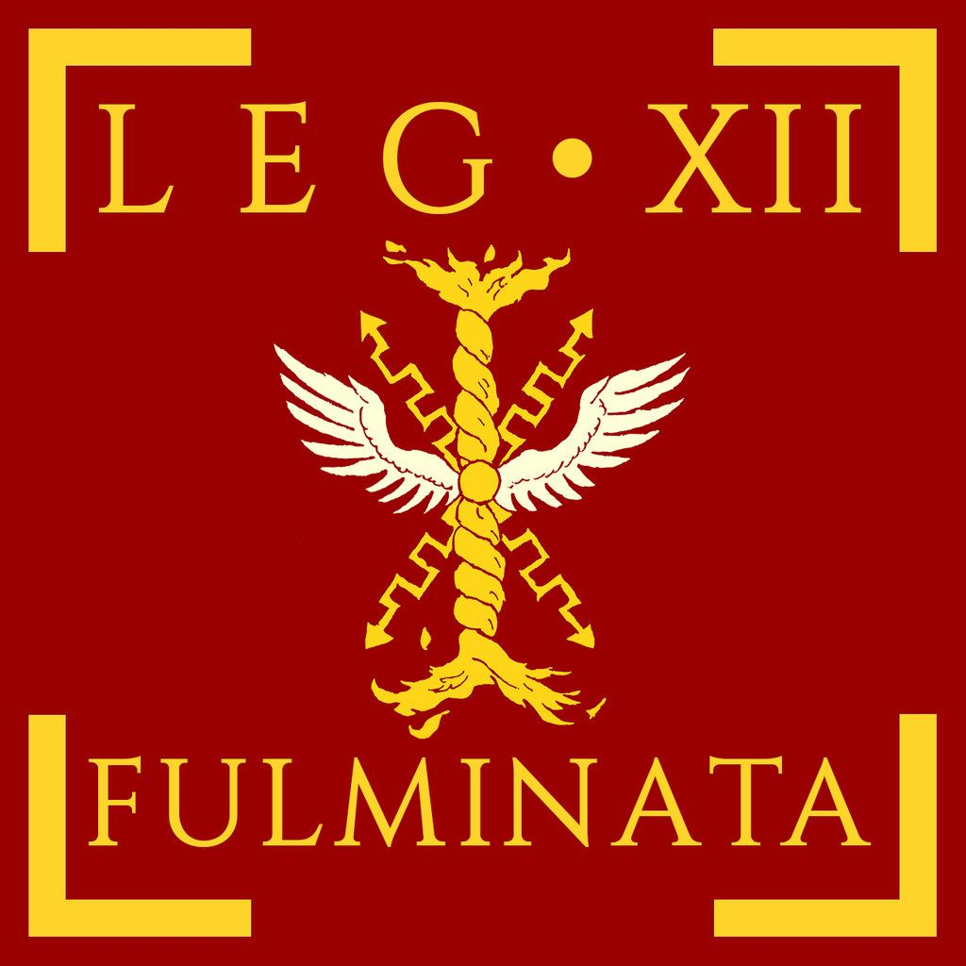
First Jewish Revolt (66-70 AD)
The Jewish revolt started in 66 AD, during the reign of Nero (54-68 AD).
The tension started because of the desecration of Jewish sacred places and abusive Roman taxation. That year the Roman governor retained money from the temple and arrested Jewish leaders.
Riots in Jerusalem led to the expulsion of the Roman garrison from the city. Legion XII Fulminata was brought from Syria to quell the revolt, but lost the battle of Ben Horon, with six thousand Roman soldiers dead.
The Jews declared their independence and established a provisional government in Judea and Galilee.

Slide 4
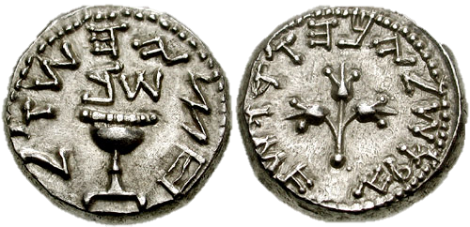
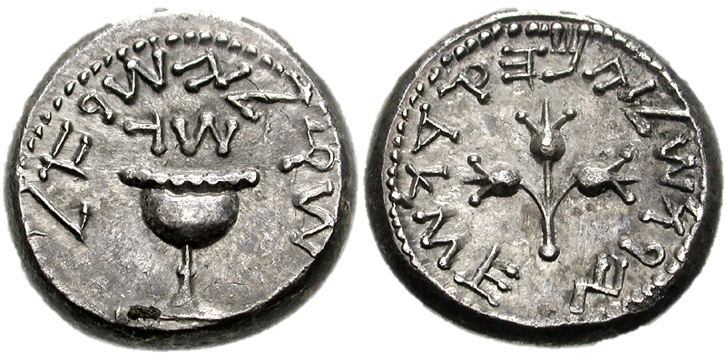
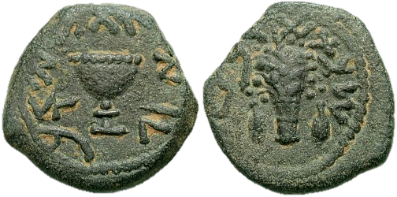
Half Shekel coin issued by the Jewish rebels in 67–68 CE, note Paleo-Hebrew alphabet. Obverse: "Half Shekel Year 2". Reverse: "Jerusalem the Holy".
A coin issued by the Jewish rebels in 68–69 CE, note Paleo-Hebrew alphabet. Obverse: "Shekel, Israel. Year 3". Reverse: "Jerusalem the Holy".
Bronze prutah eighth of a shekel of year 4 (69–70 CE) issued during the First Jewish Revolt.

Slide 5
First Jewish Revolt (66-70 AD)
General Vespasian was given the command of four legions and tasked by Nero with the capture of Jerusalem. He started his campaign in 67 AD by Galilee and advanced south quickly.
With the death of Nero in June of 68 Vespasian returned to Rome to claim for himself his place. He would eventually become Emperor. Vespasian left in charge of the campaign in Judea his son Titus.
Titus arrived at the gates of Jerusalem in early 70 AD. He besieged the city for four months.

Slide 6
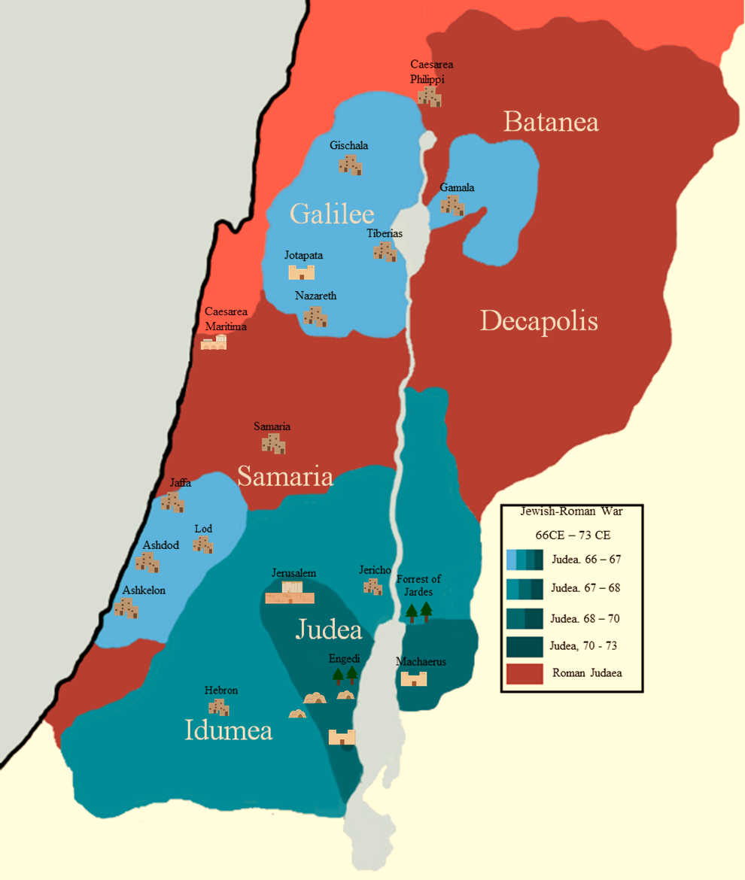
This map shows the extension of the Judean provisional government in 66 AD and its gradual loss of territory.

Slide 7
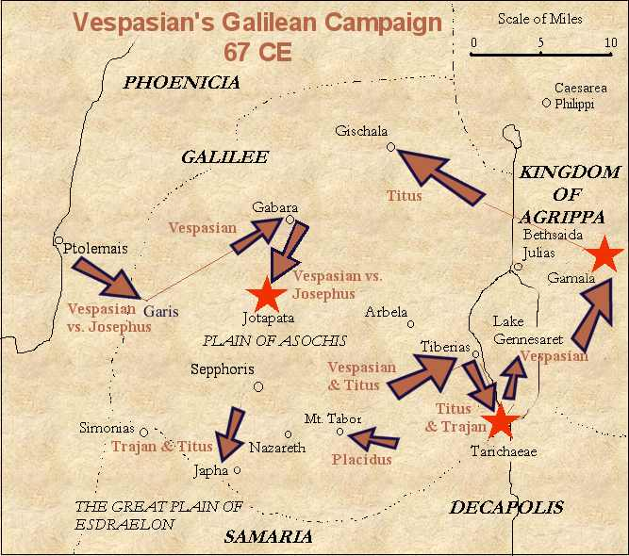
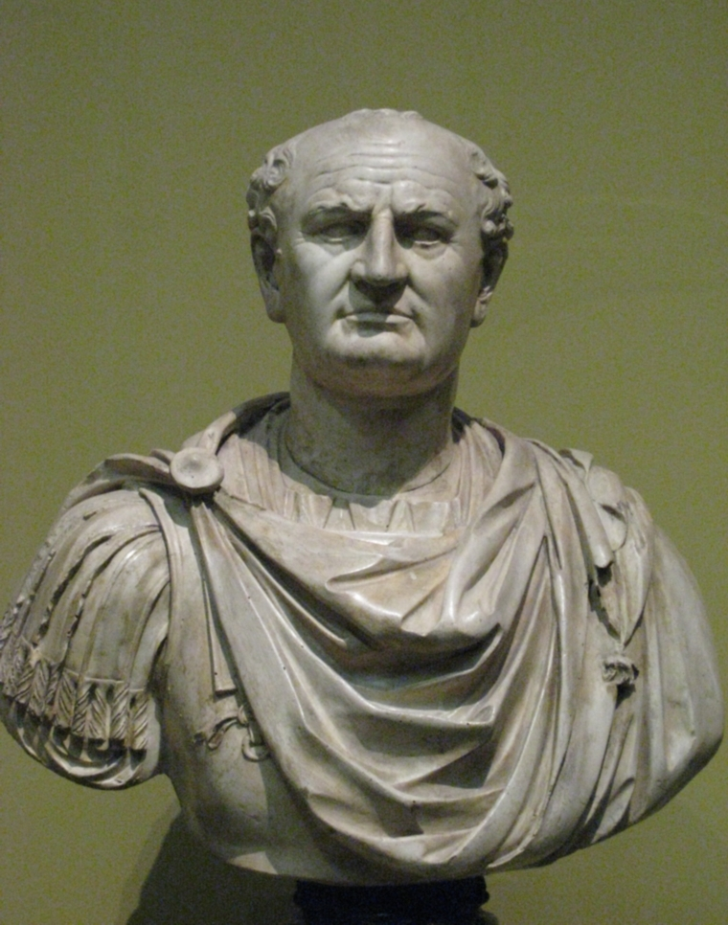
Emperor Vespasian Bust

Slide 8
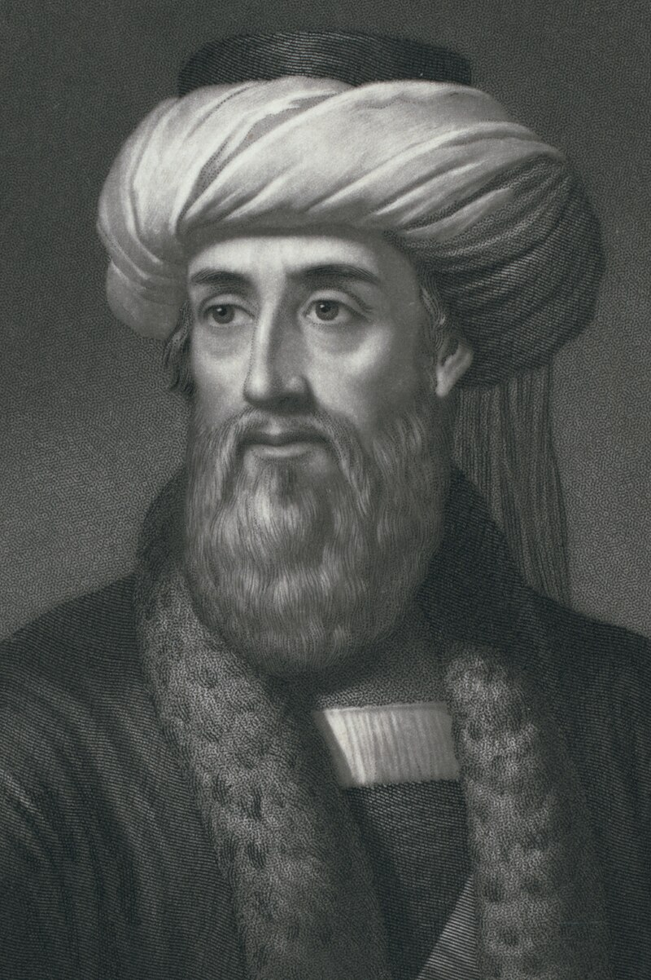
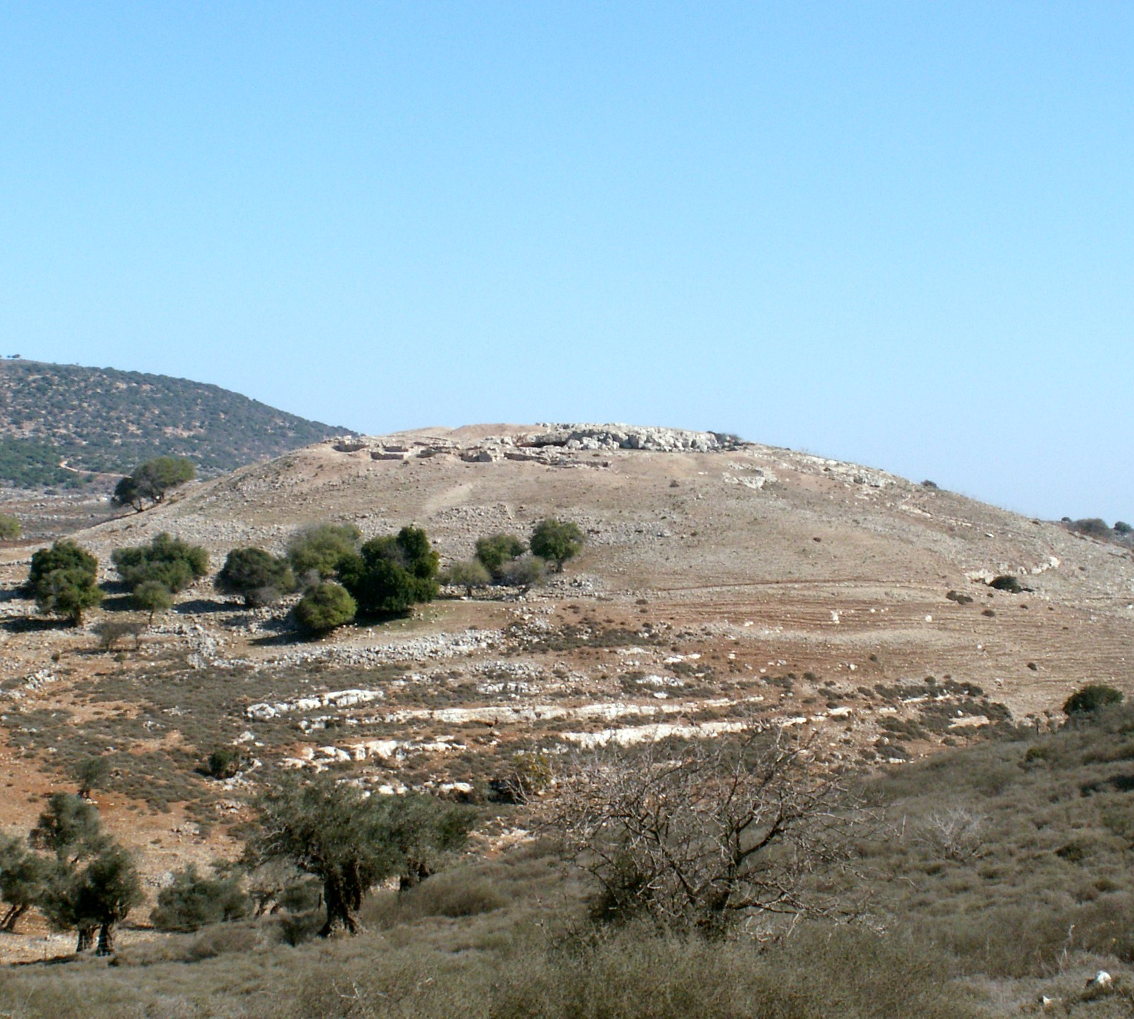
Favius Josephus (37-100 AD) was born in a noble Jewish family in Jerusalem. He became a general in the revolt. He was captured in 67 AD after a 47 days siege to Yodfat. Vespasian used him as interpreter. He later was made free by the emperor.

Slide 9
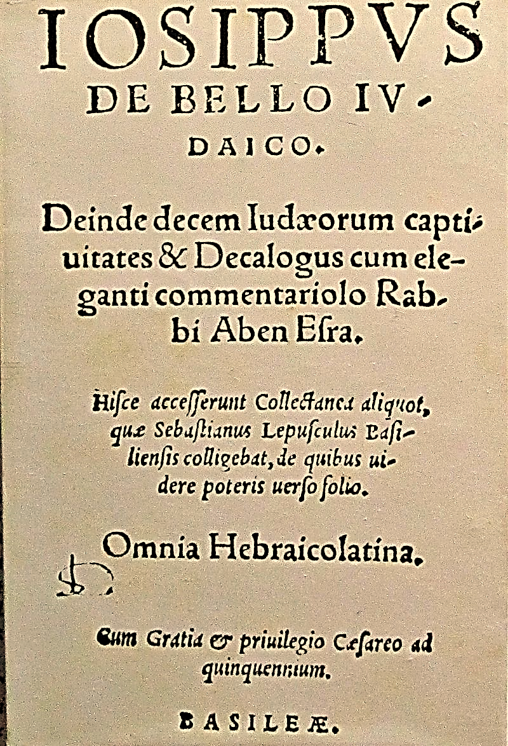
Flavius Josephus’ War of the Jews is the only literary source of the Jewish Revolt. It brings great insight into first-century Judaism. Later in his life, he wrote Antiquities of the Jews, recounting the history of the Jewish people.
Hebrew-Latin edition of the Jewish War by Josephus Flavius, Basle 1559.
Source: Wikicommons

Slide 10
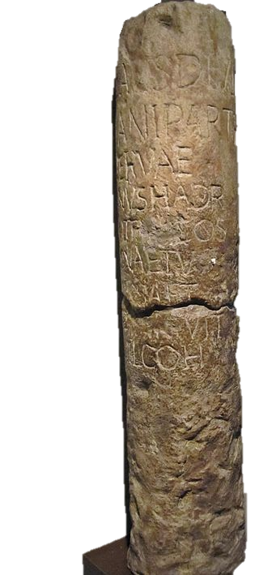
This milestone found in the outskirts of Cyrene, contains inscriptions celebrating Emperor Hadrian reconstruction of the road destroyed during the Jewish Revolt.
“THE EMPEROR CAESAR, SON OF THE LATE TRAJAN, WHO VANQUISHED THE PARTHIANS, GRANDSON OF THE LATE NERVA TRAJAN HADRIAN AUGUSTUS, THE HIGH PRIEST, SERVING AS TRIBUNE FOR THE SECOND TERM & AS CONSUL FOR THE THIRD, HAS REPAVED THE ROAD WHICH WAS OVERTURNED & SHATTERED IN THE JEWISH REVOLT."
By Sodabottle - Own work, CC BY-SA 3.0, https://commons.wikimedia.org/w/index.php?curid=16336327

Slide 11
Video

Slide 12
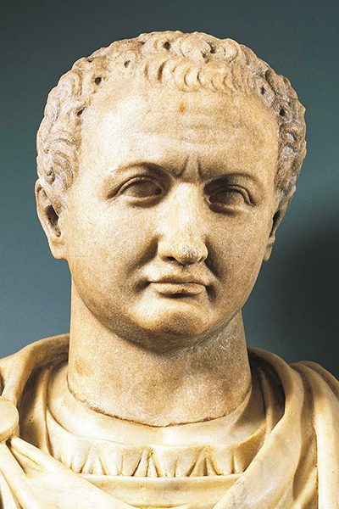
Titus Caesar Vespasianus
Titus was the son of Vespasian. He was responsible for the final Roman victory in the First Jewish Revolt taking the city of Jerusalem in 70 AD. After his father died in 79 AD, he became emperor. His reign was short. He died of a sickness in 81 AD. He finished the building of the Colosseum started by his father. He was replaced by his younger brother Domitian

Slide 13
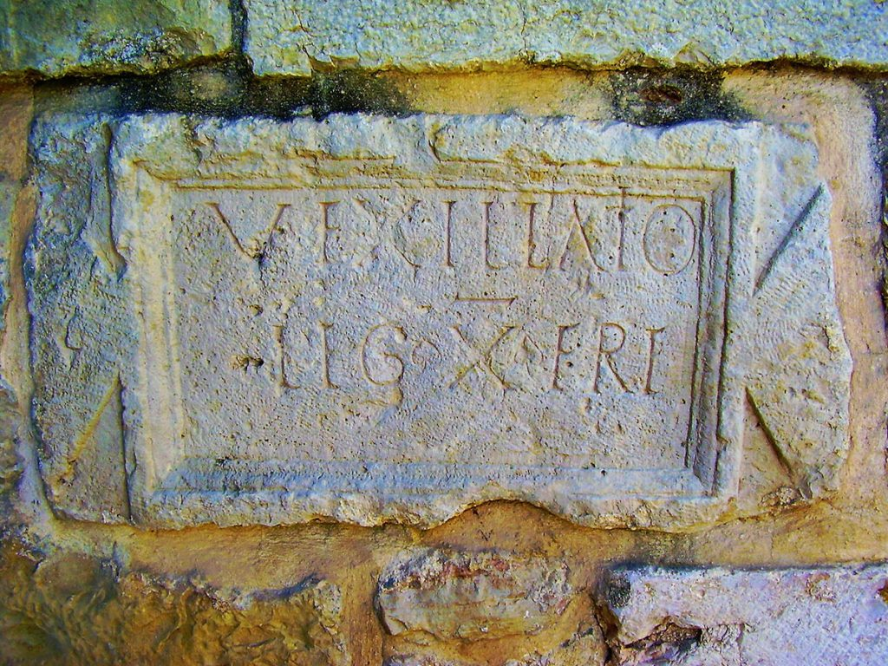
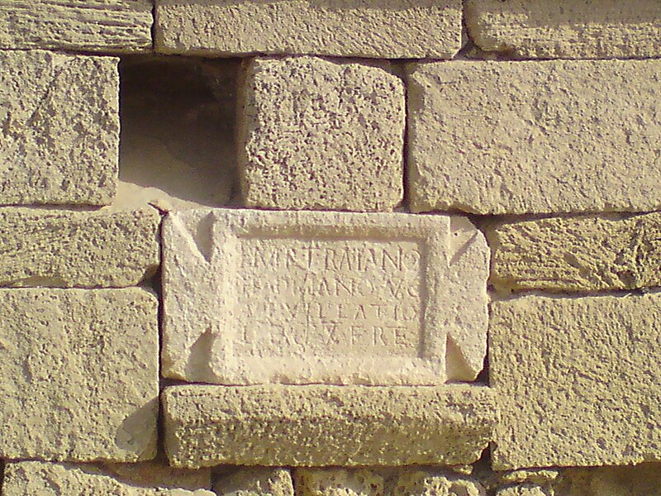
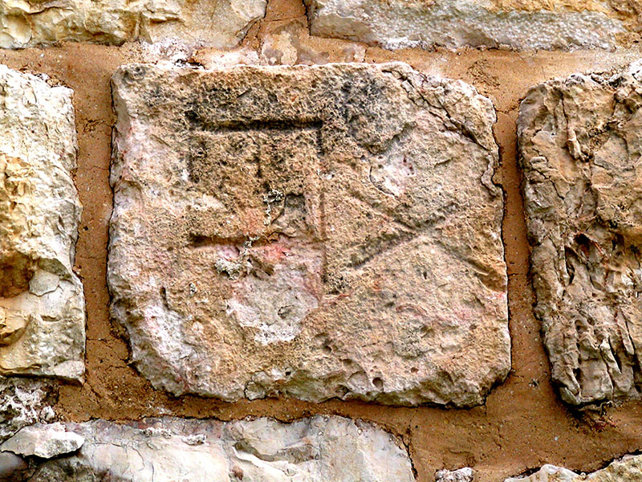
Legio X Fretensis Stone
General Titus led the Tenth Roman Legion, Legio Fretensis, in the Jewish revolt. At the end of the war, this legion remained in Jerusalem. Several inscriptions show their presence in the region.
A stone inscription in the Church of Abu Gosh.
A stone inscription in the Port of Caesarea.
A stone inscription “L.X.F.” in the tower of David in Jerusalem. It was repurposed by the ottoman to repair the wall.

Slide 14
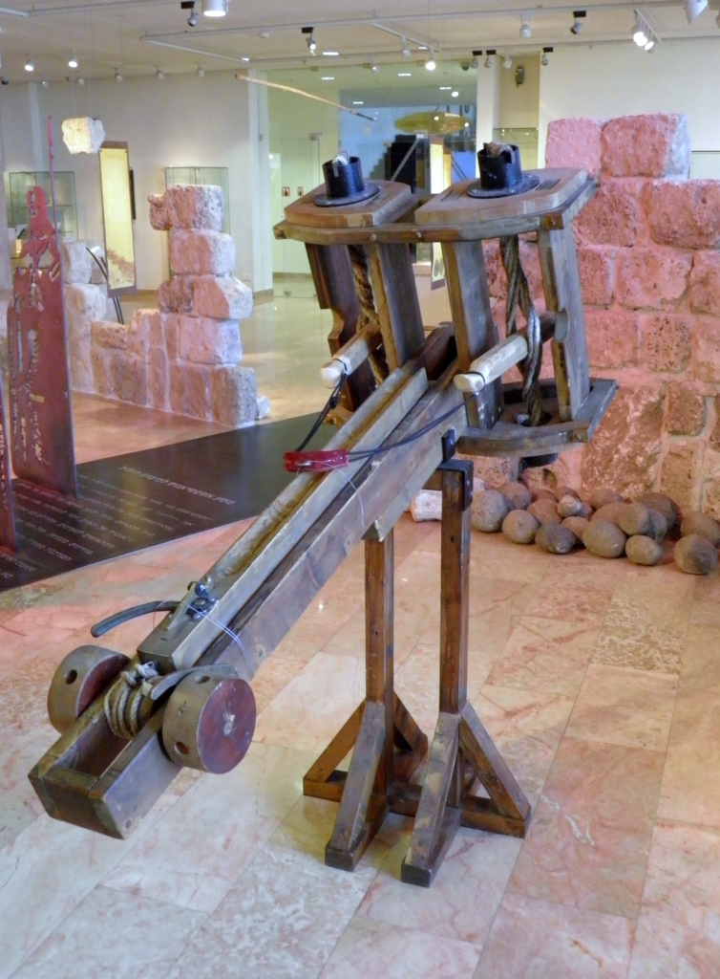
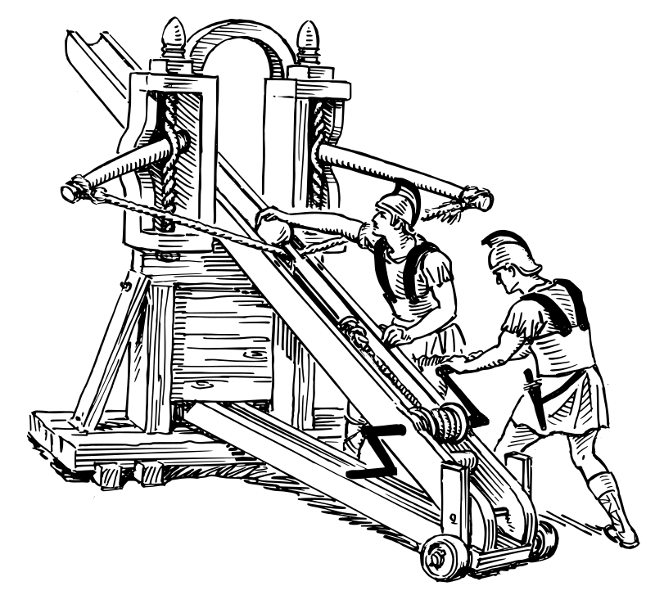

Slide 15
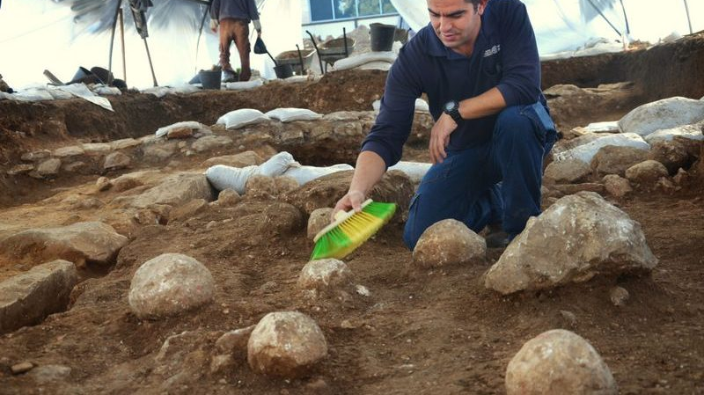

Slide 16
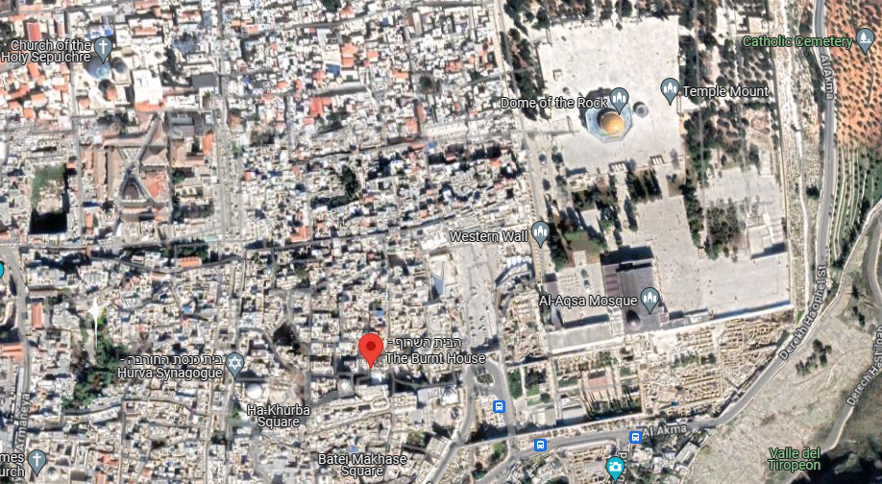

Slide 17
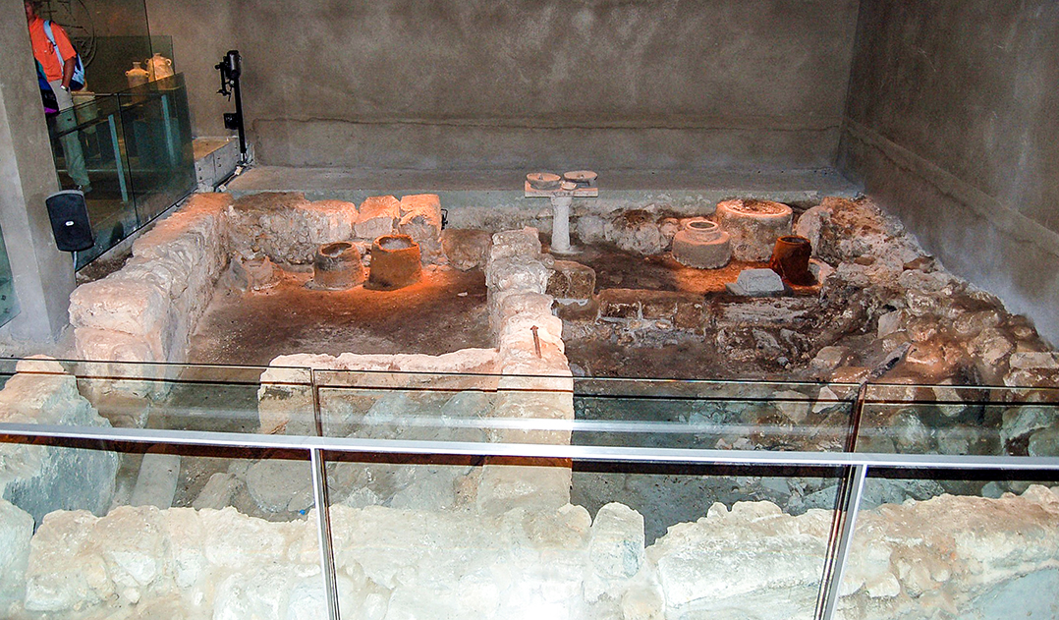

Slide 18
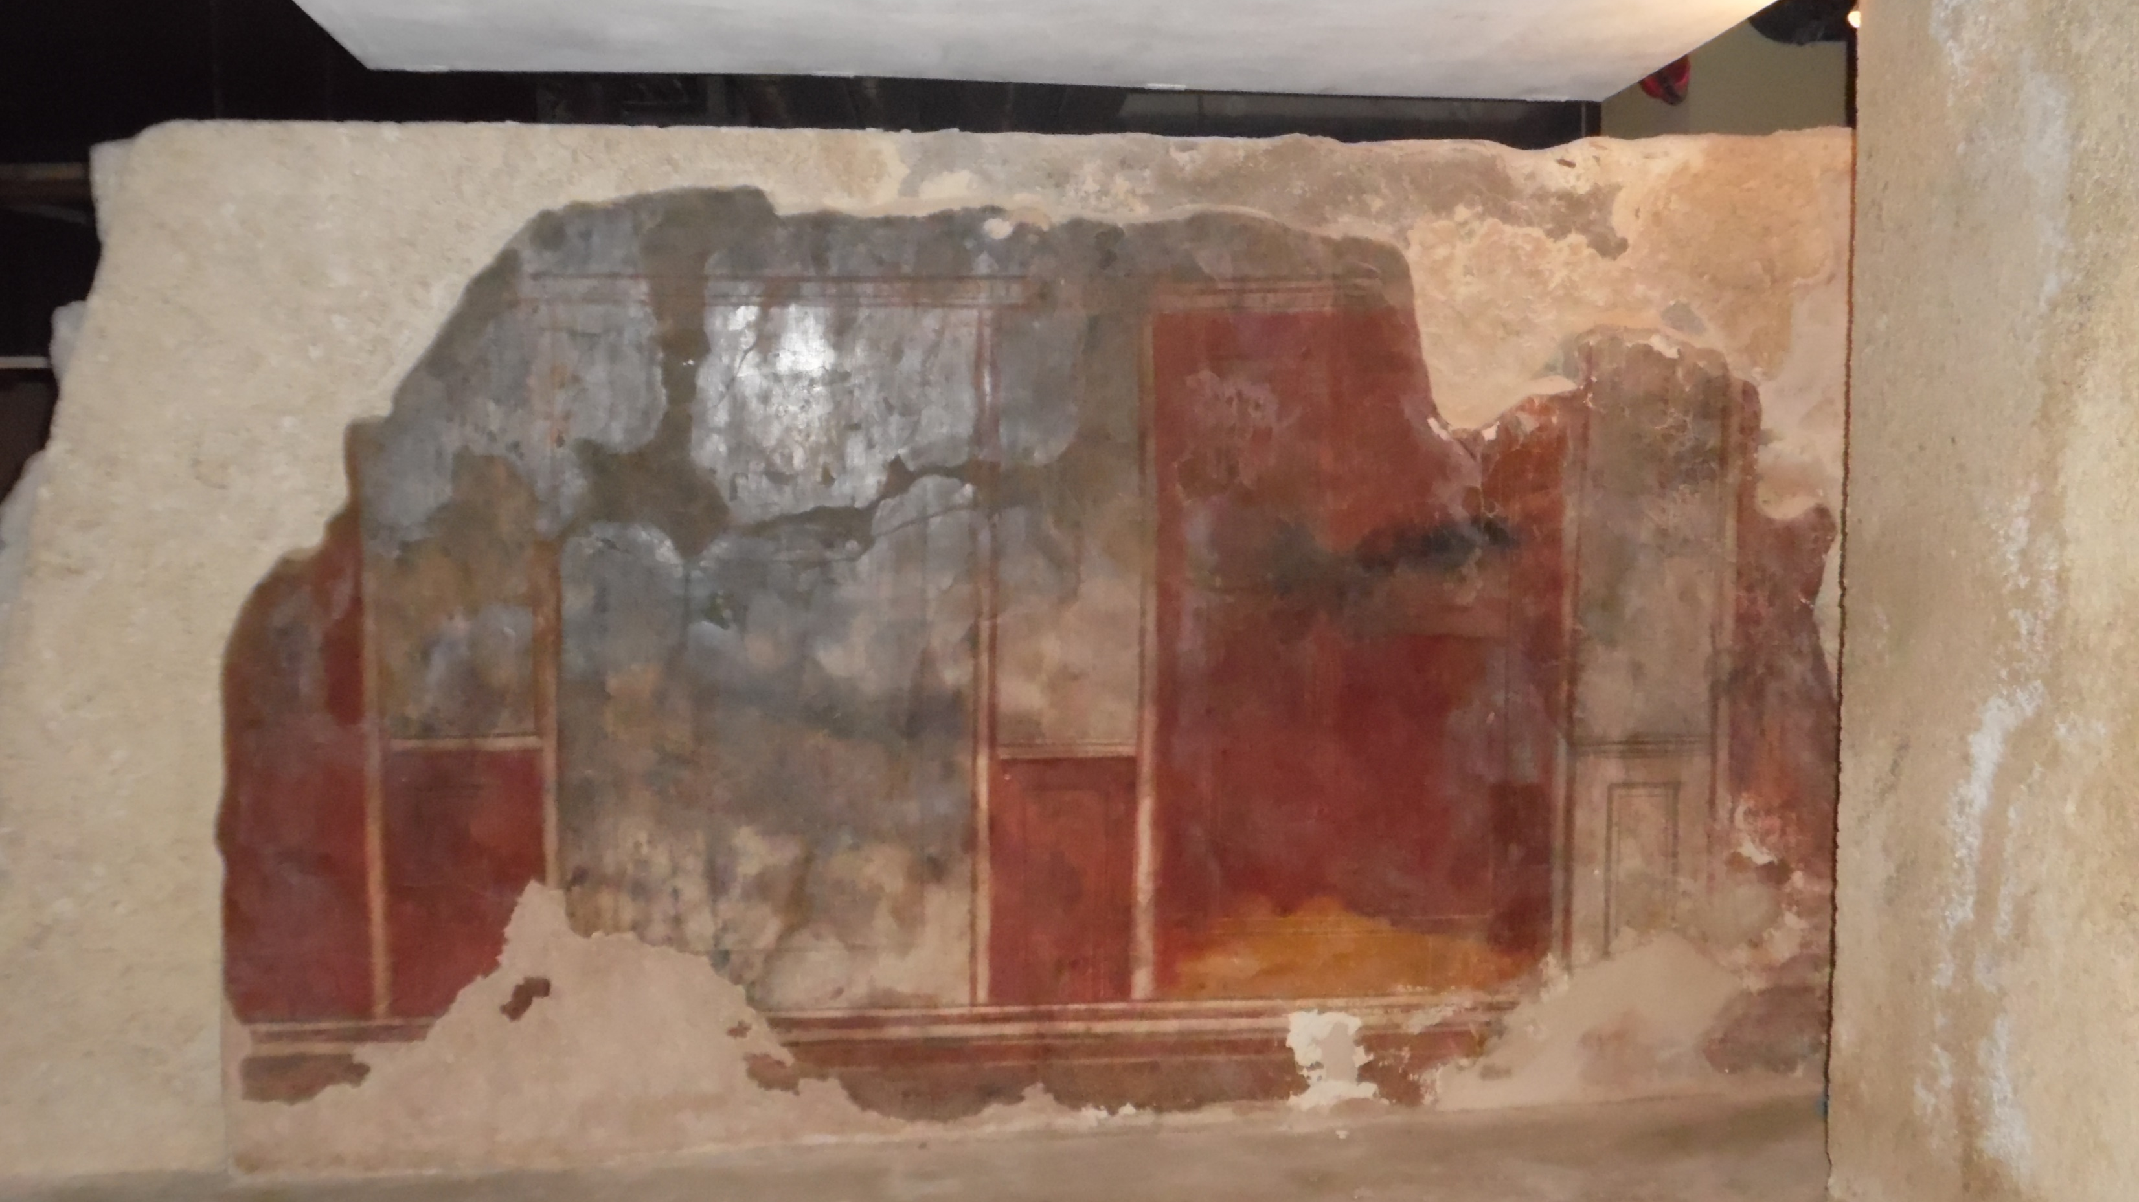

Slide 19
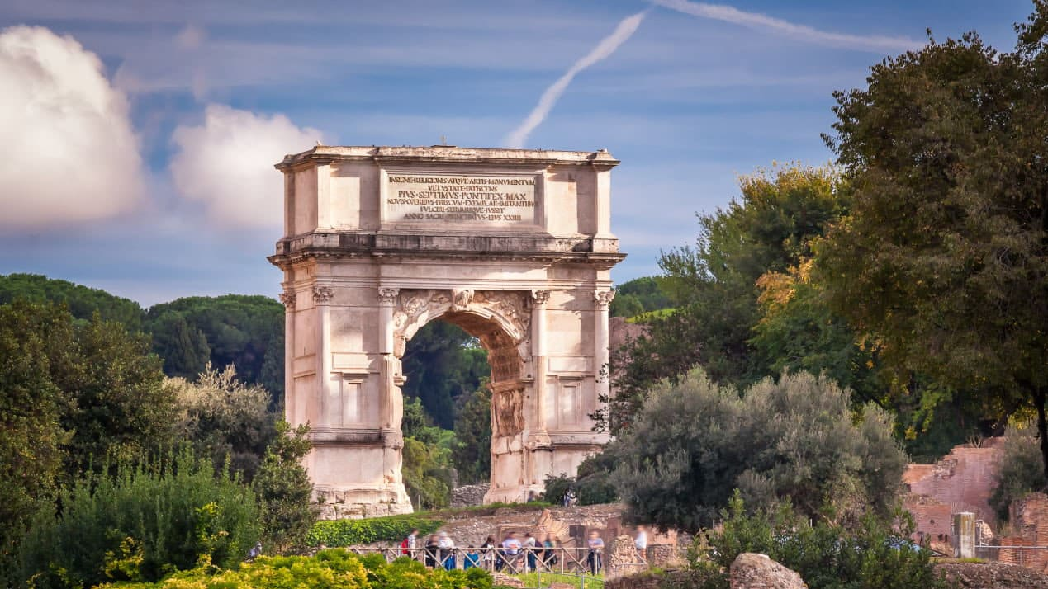
A Triumphal Arch was built in Rome by Emperor Domitian (brother of Titus) shortly after he died in 81 AD honoring his victory in Jerusalem.

Slide 20
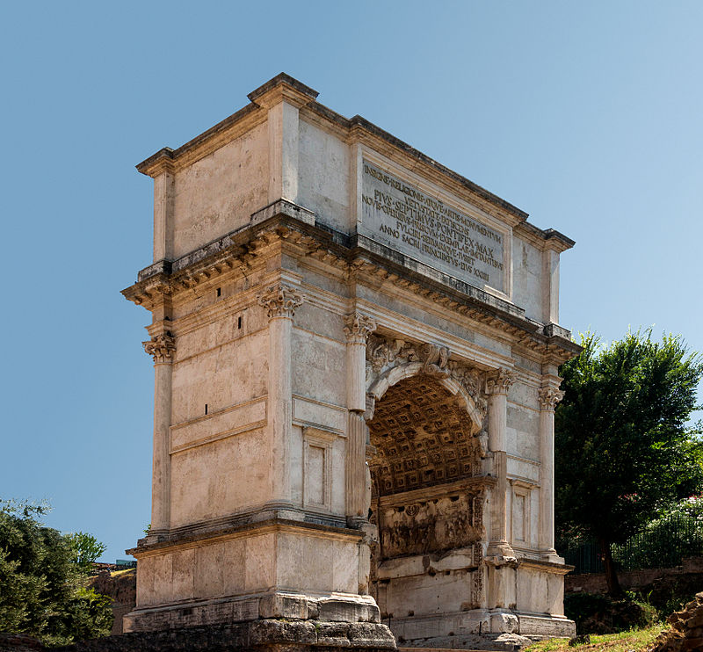

Slide 21
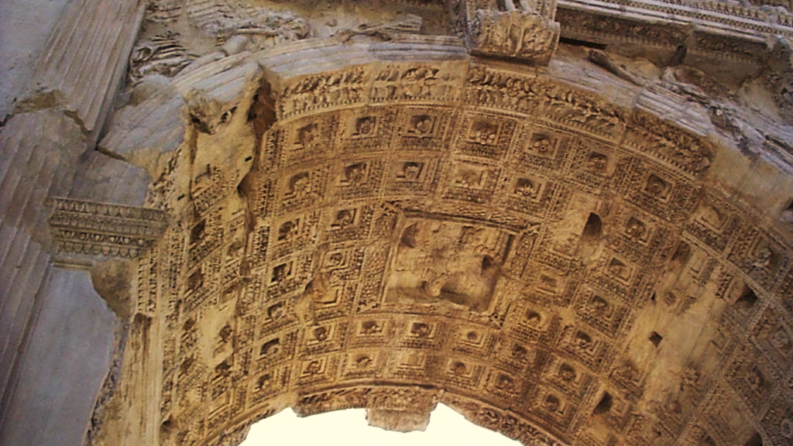

Slide 22
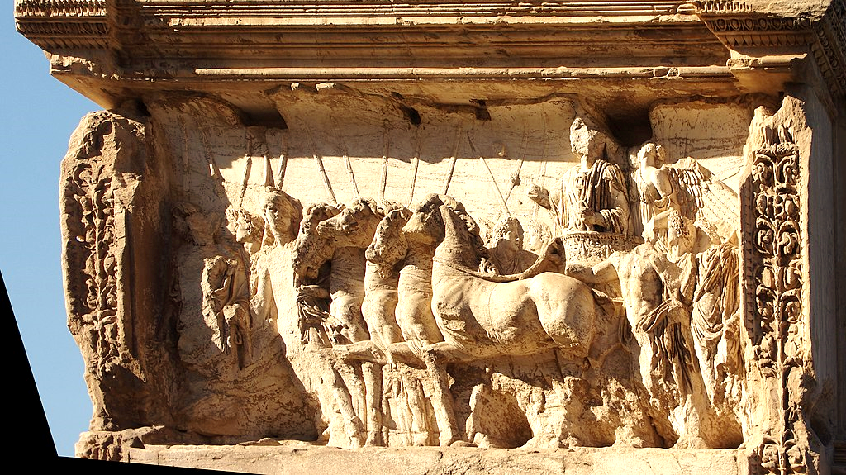

Slide 23
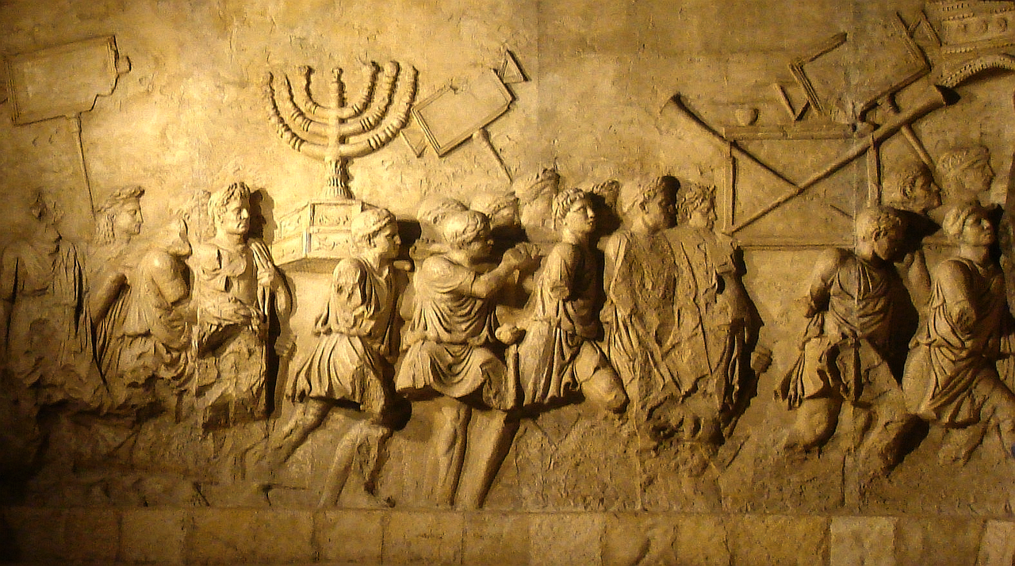
The Arch tells the story of the campaign in pictures and praises Titus. The most surprising part is the temple utensils, visibly the menorah, being carried into Rome by soldiers as spoils of war

Slide 24
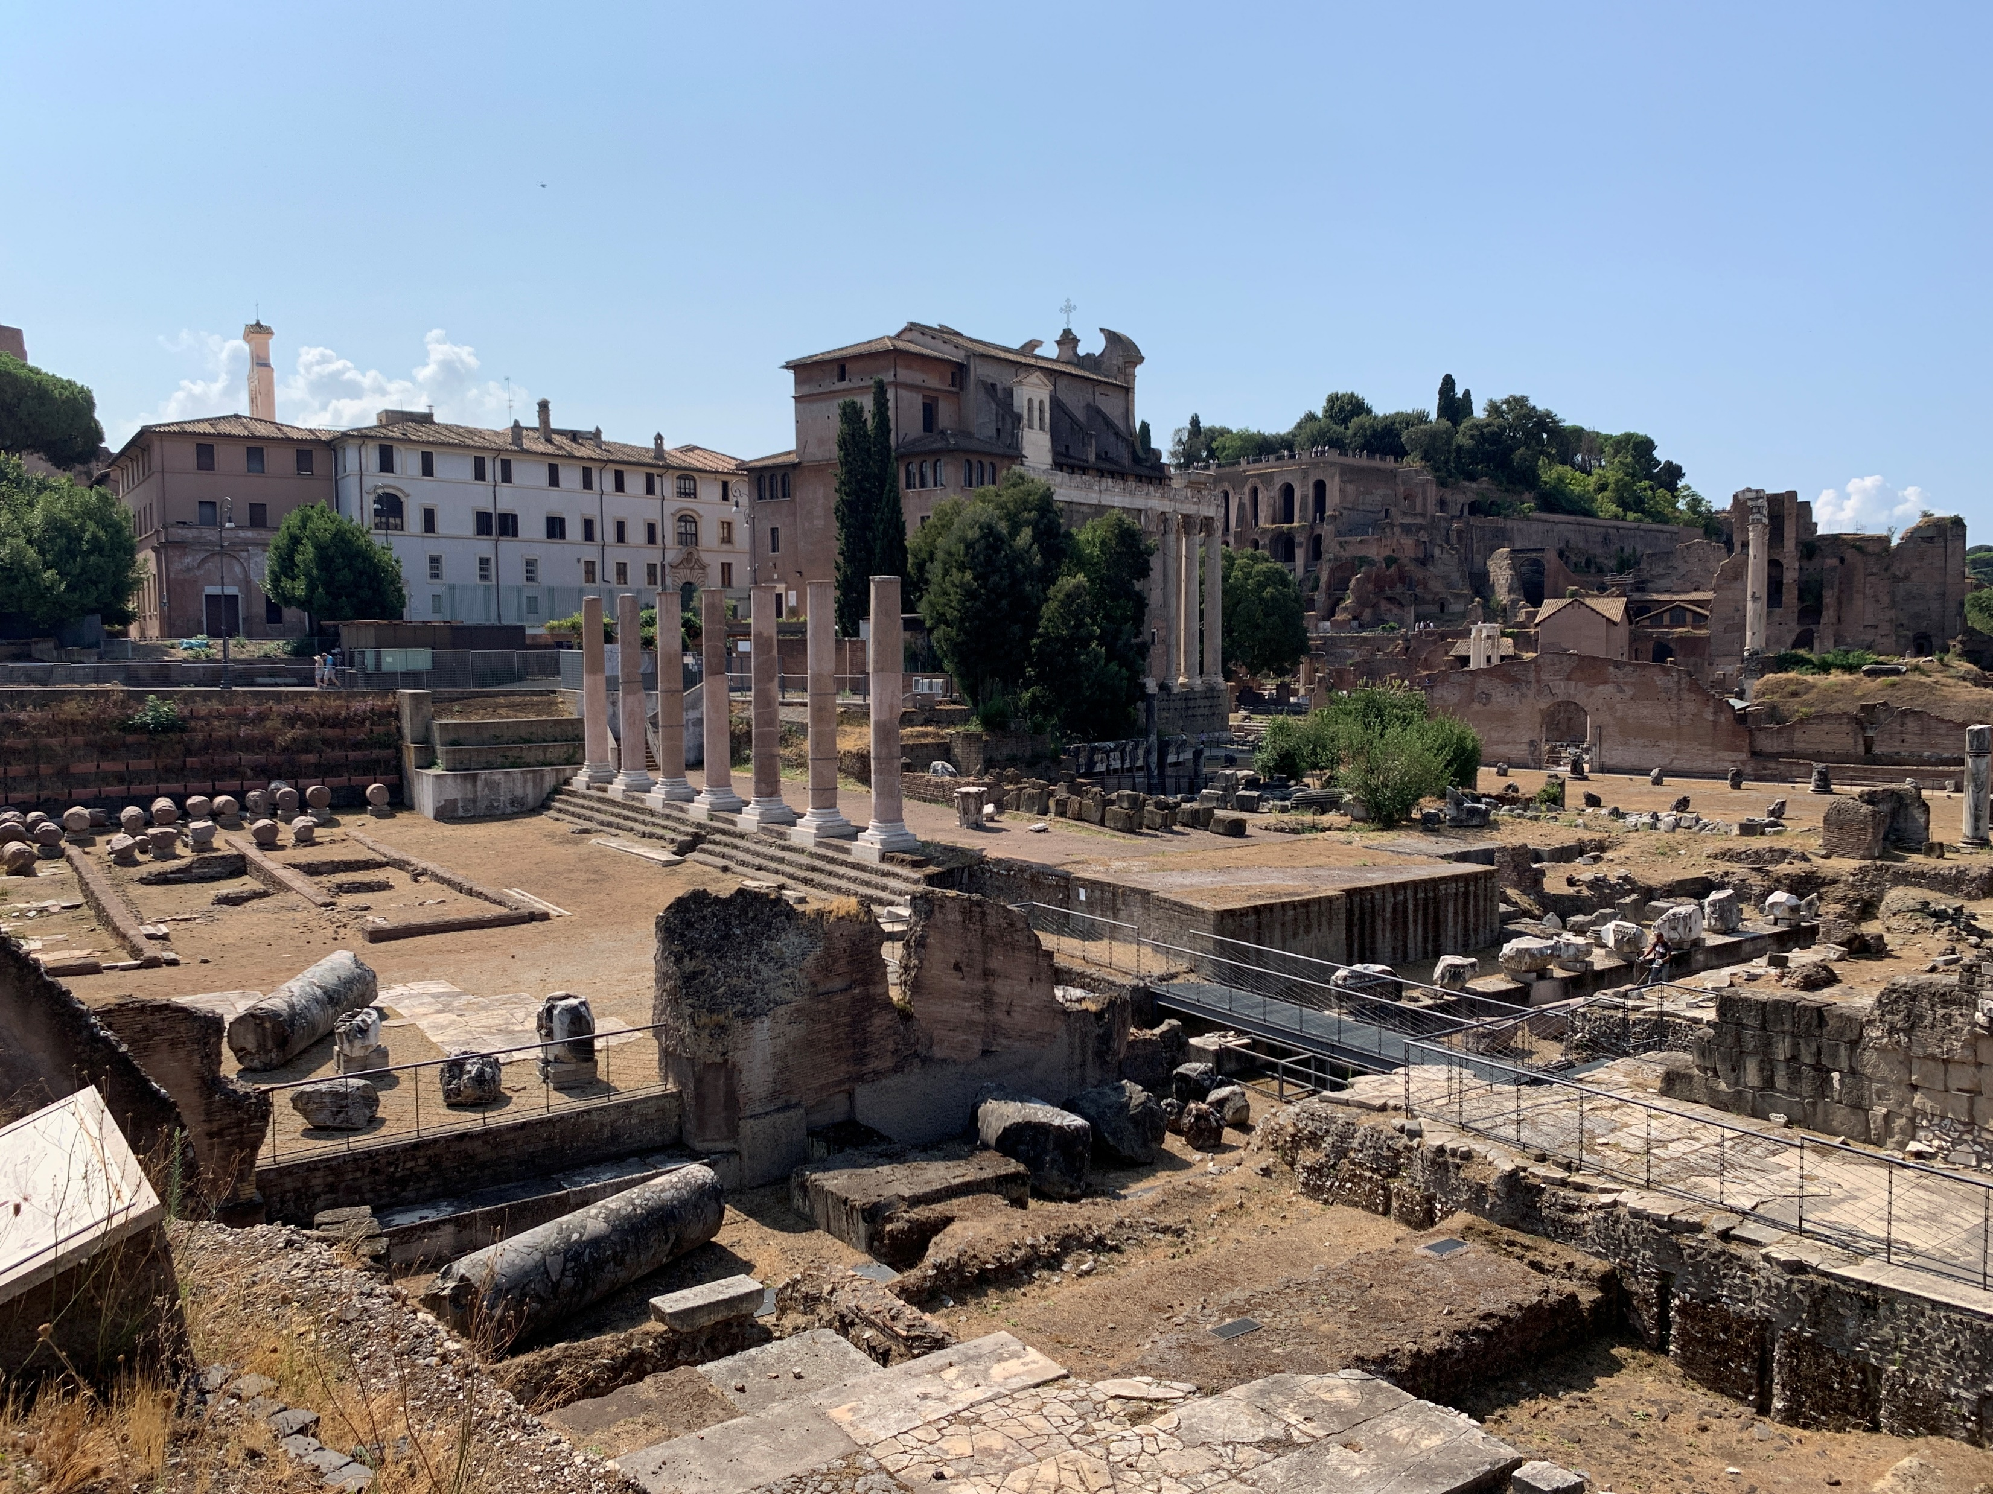
Temple of Pax (Rome)
Emperor Vespasian built this temple in 71 AD. According to Josephus, he decorated it with pillaged items from the temple in Jerusalem.

Slide 25
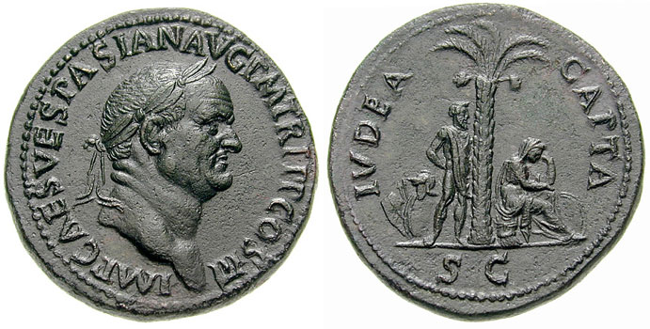
'Judea Capta' sestertius of Vespasian, struck in 71 AD to celebrate the victory in the Jewish Revolt. The inscription on the reverse says: IVDAEA CAPTA, "Judaea conquered".

Slide 26
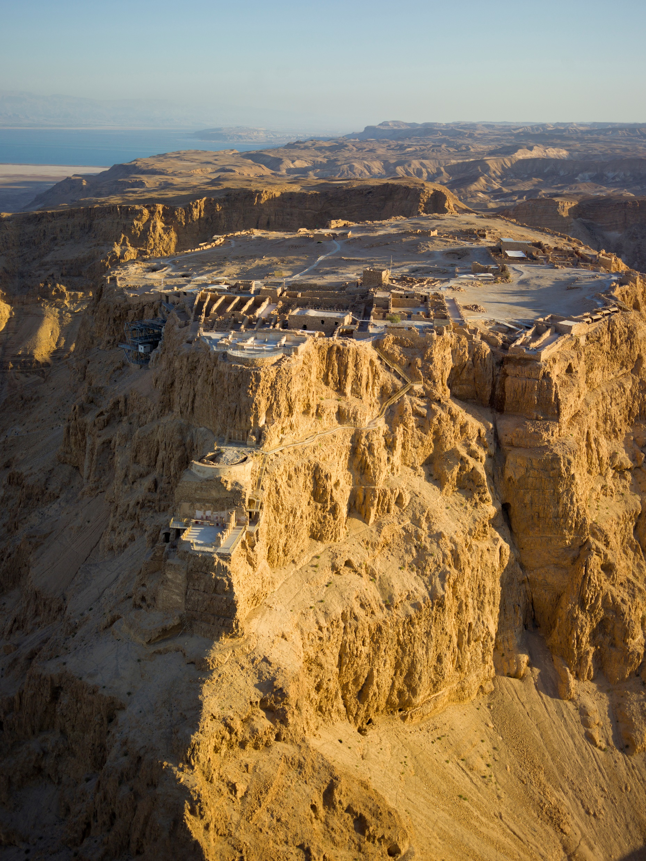
The final event of the Jewish Revolt happens in the Fortress of Masada in 73 AD. It is known through Josephus. Of the 967 Jews living in the compound, 960 Jews committed suicide when they perceived the approach of Romans through a side road they carved off the side of the mountain.

Slide 27
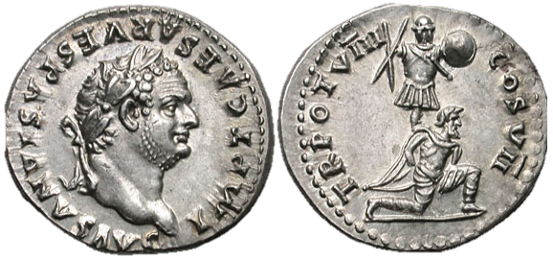
A Roman denarius depicting Titus, c. 79. The reverse commemorates his triumph in the Judaean Wars, representing a Jewish captive kneeling in front of a trophy of arms. Caption: IMP. T. CAESAR VESPASIANVS AVG. / TRibunus POTestas VIII, COnSul VII

Slide 28
Consequences:
The Jews lost any control of the Holy Land, which without them faced economic decline.
Collapse of the Jewish oligarchy and of a centralized leadership.
Disappearance of the temple utensils, taken to Rome.
Loss of the most rabbinic literature.
The gain in importance of the Synagogues and the Rabbis. Beginning of the “Rabbinic culture”.
Jews were banned from Jerusalem, except one time a year.

Slide 29
Further Wars
Jews continued to be dissatisfied. In 115-117 AD a new revolt ensued. It was called the Kitos War (sometimes called the Second Jewish War). A small number of Jews engaged in battle and soon they were defeated.
A Third and final war, called Bar Kokhba Revolt happened during 132-136 AD. It is named after its messianic leader Simon bar Kokhba. It involved the majority of the Jewish community in Judea. After initial success which led the Jews to declare another independent state, the Jews were defeated by the armies of Sextus Julius Severus.

Slide 30
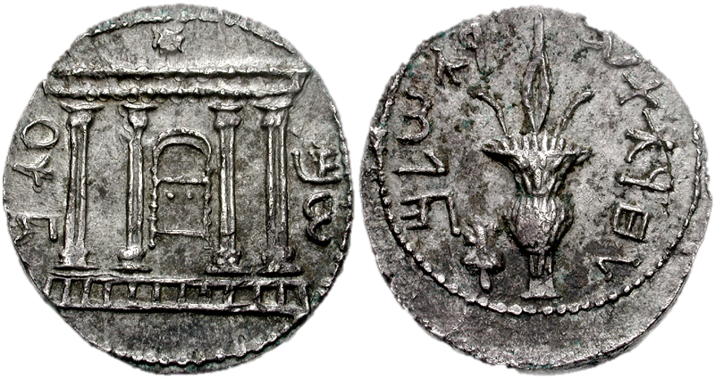
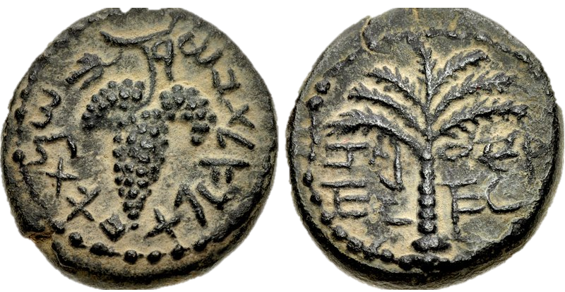
Bar Kokhba's tetradrachm overstruck on a denarius. It has the Jewish Temple facade on one side and a lulav, with the text "to the freedom of Jerusalem“ on the other.
Bar Kokhba's coin with Grapes. The text reads: "year 1 to the redemption of Israel". In the reverse is has a date palm with two branches of dates written “Eleazar the Priest” (in Hebrew) around it.

Slide 31
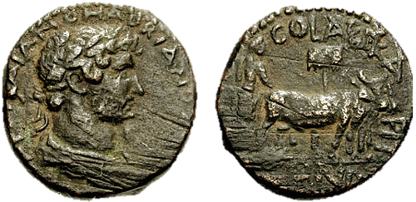
Final Consequences
Judaism was prohibited. Jews were expelled from Judea. The city of Jerusalem was renamed Aelia Captolina and the province Syria Palestina.
On the Temple Mount a Jupiter Temple was built.
Coin minted in Jerusalem after its name was changed. It contains the image the bust of Emperor Hadrian on one side and him plowing on the other. It reads “COLONIA AELIA CAPITOLINA CONDITA” (Foundation of the Colony of Aelia Capitolina).

Slide 32
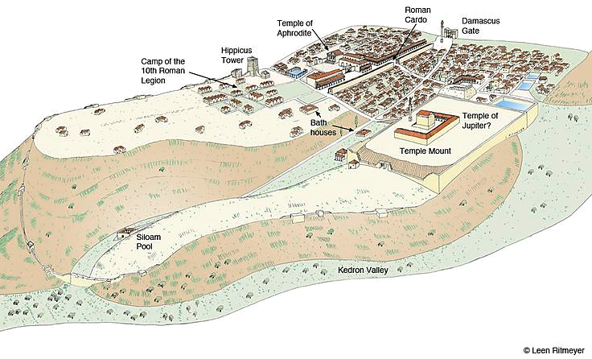
Aelia Capitolina

Slide 33
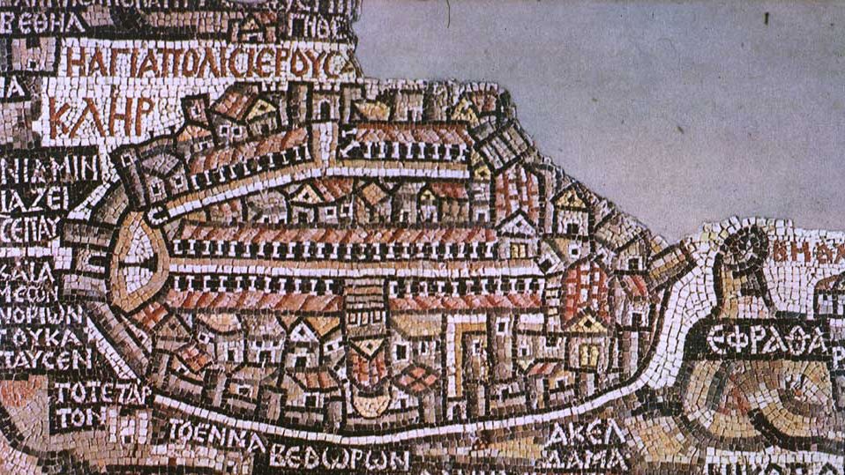
The map mosaic of Jerusalem from the Church of St. George in Madaba, Jordan (560–565 C.E.) shows the Byzantine Jerusalem.

Slide 34
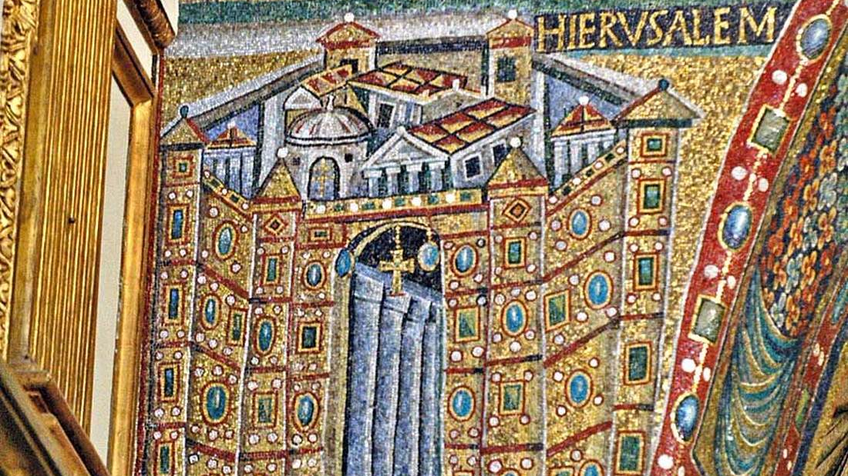
The mosaic of Jerusalem in the Basilica of Santa Maria Maggiore in Rome (circa 6th century) shows the city from the north.

Slide 35
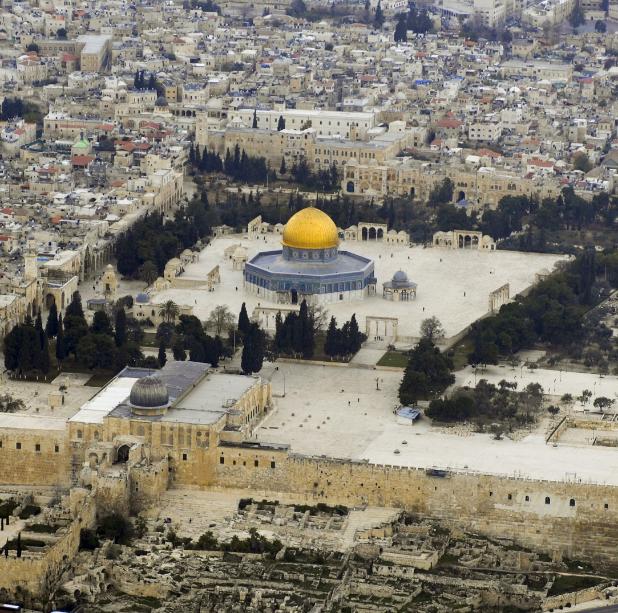
Al-Aqsa Mosque
The Arabs conquered Jerusalem in 638 AD. Sometime after that, the Caliph built a praying house on the temple Mount. Through the centuries it was destroyed, rebuilt, and expanded.

Slide 36
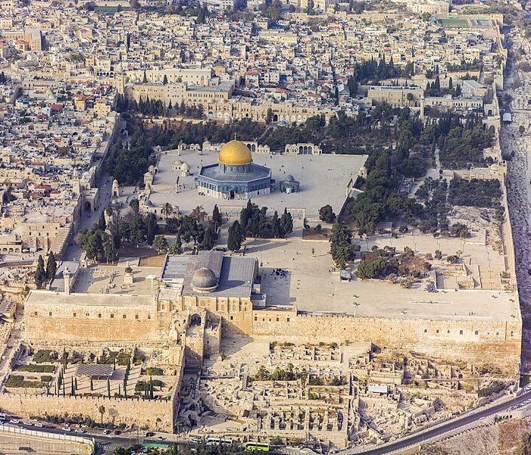
The actual configuration of the mosque was built in the 11th century and the buildings around the 13th century.

