Slide 2
We Are God’s People
Hymn 355*
Text: 1976, Fred Bock Music Co.
Music: 1976, Fred Bock Music Co.
Notes:
2

Slide 3
We are God's people, the chosen of the Lord,
Born of His Spirit, established by His Word;
Our cornerstone is Christ alone,
And strong in Him we stand:
O let us live transparently
And walk heart to heart and hand in hand.

Slide 4
We are God’s loved ones, the Bride of Christ our Lord,
For we have known it, the love of God outpoured;
Now let us learn how to return
The gift of love once given:
O let us share each joy and care,
And live with a zeal that pleases Heaven.

Slide 5
We are the Body of which the Lord is Head,
Called to obey Him, now risen from the dead;
He wills us be a family,
Diverse yet truly one:
O let us give our gifts to God,
And so shall his work on earth be done.

Slide 6
We are a temple, the Spirit’s dwelling place,
Formed in great weakness, a cup to hold God’s
grace;
We die alone, for on its own
Each ember loses fire:
Yet joined in one the flame burns on
To give warmth and light, and to inspire.

Slide 7
I Love You, Lord
Hymn 80
Text: Laurie Klein
Music: Laurie Klein; arr. Eugene Thomas
Notes:
7

Slide 8
I love you, Lord, and I lift my voice
to worship You. O, my soul, rejoice!
Take joy, my King, in what You hear:
may it be a sweet, sweet sound in Your ear.

Slide 9
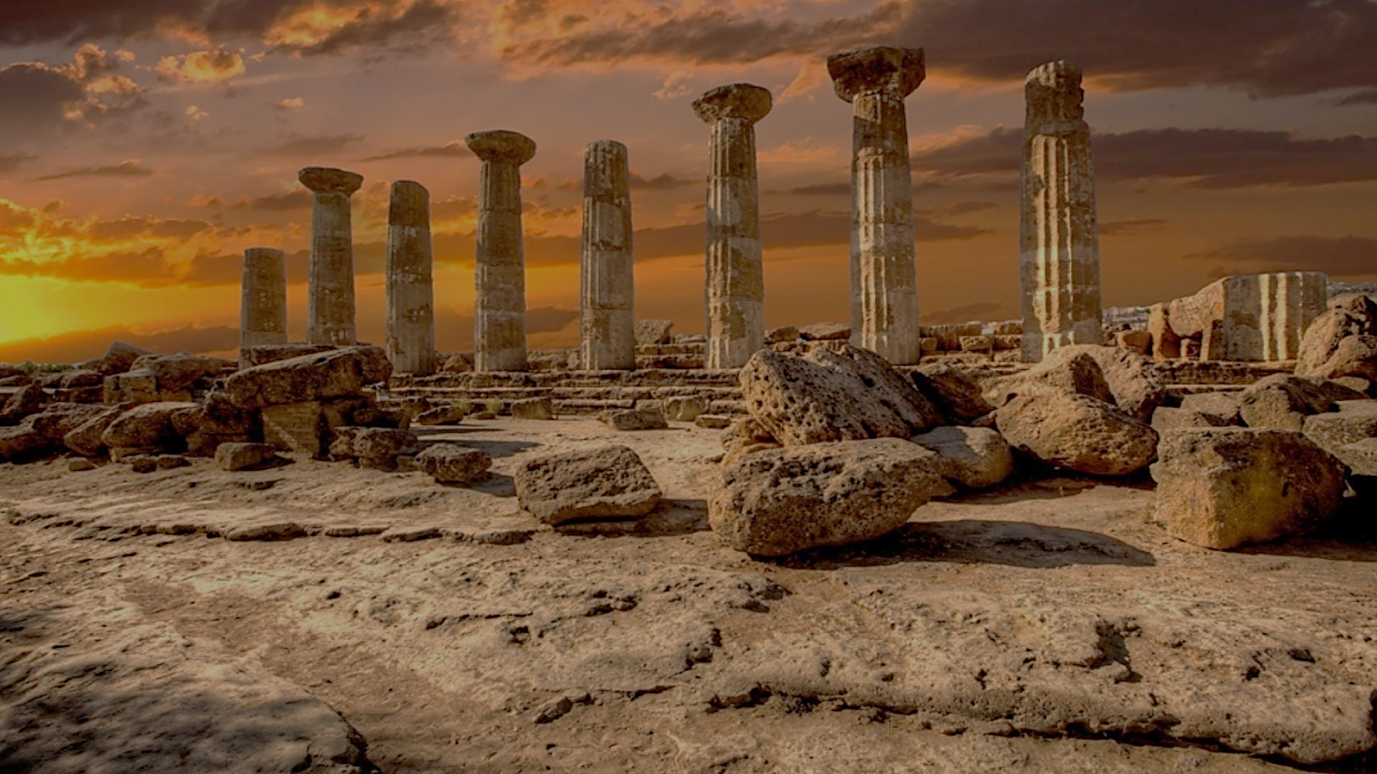
Archeology of Bible Times
Pastor John dos Santos - Faith Presbyterian Church

Slide 10
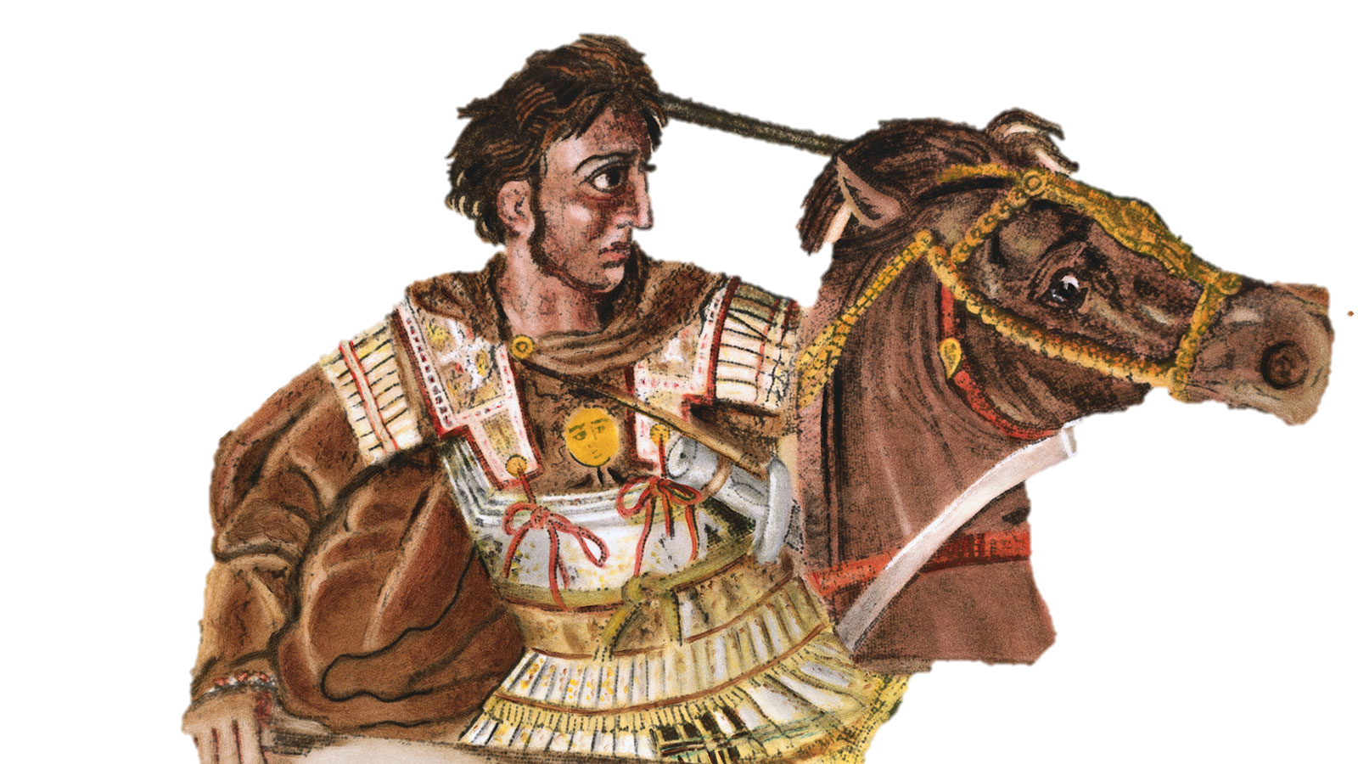
Chronology of Powers
330-323 B.C.
Babylonian
612-538 B.C.
Persian Empire
538-330 B.C.
Ptolemaic/Seleucid Empires
523-140 B.C.
Hasmonean
167-30 B.C.
Romans
27 B.C. on
Inter-Testaments - 400 Years of Silence
Last Prophet of the OT

Slide 11
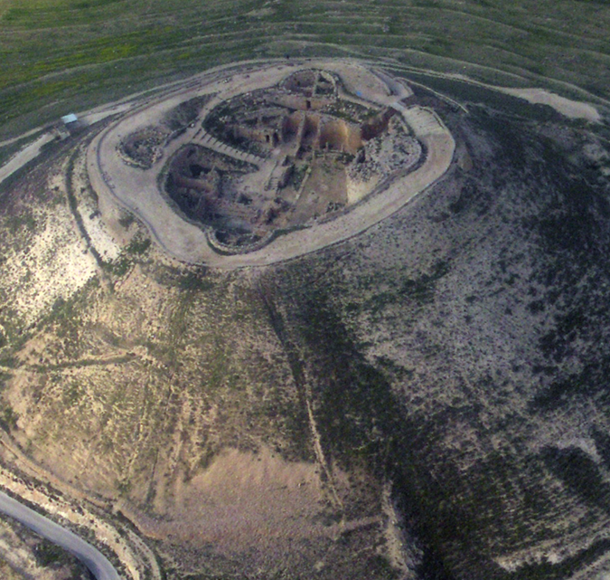
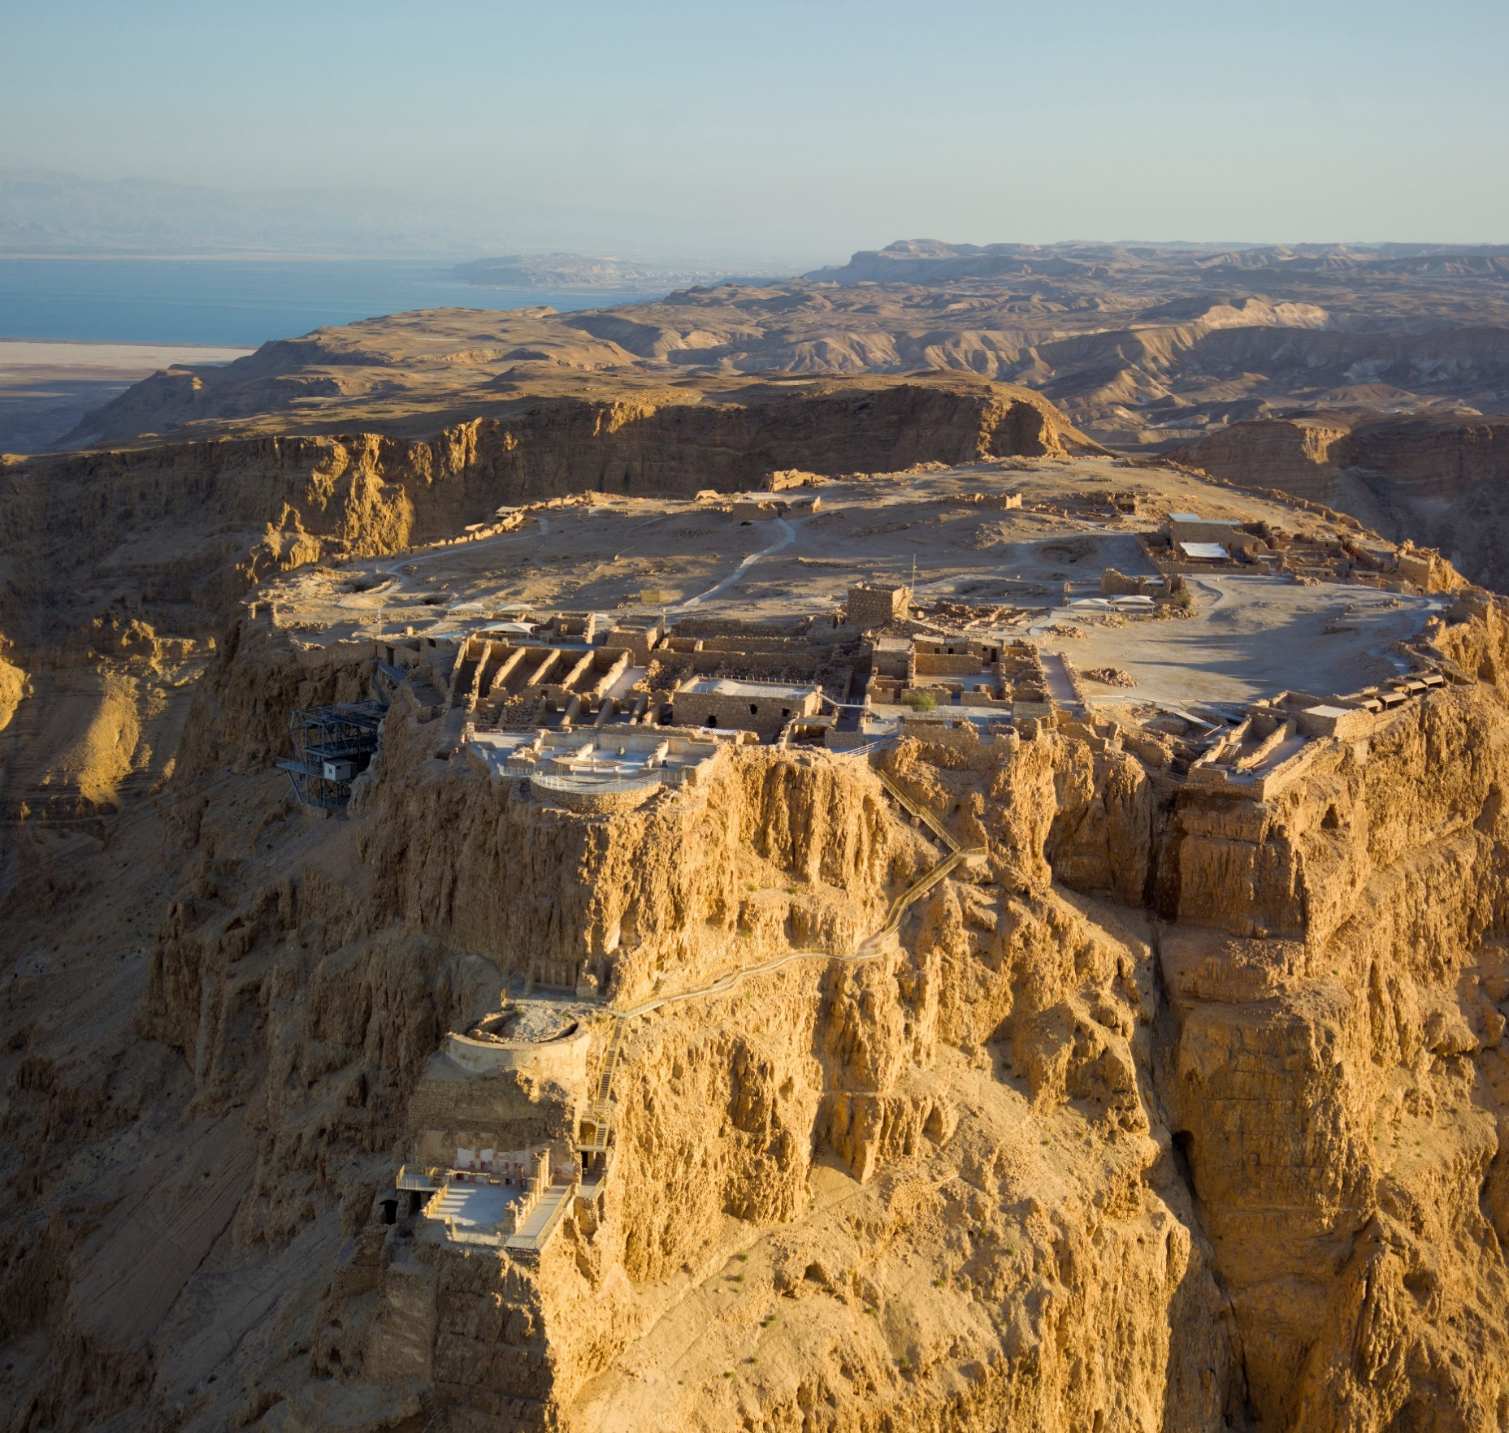
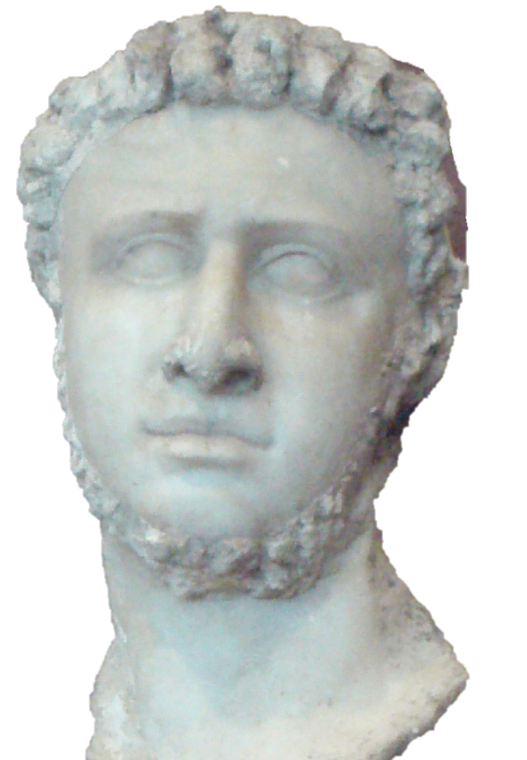
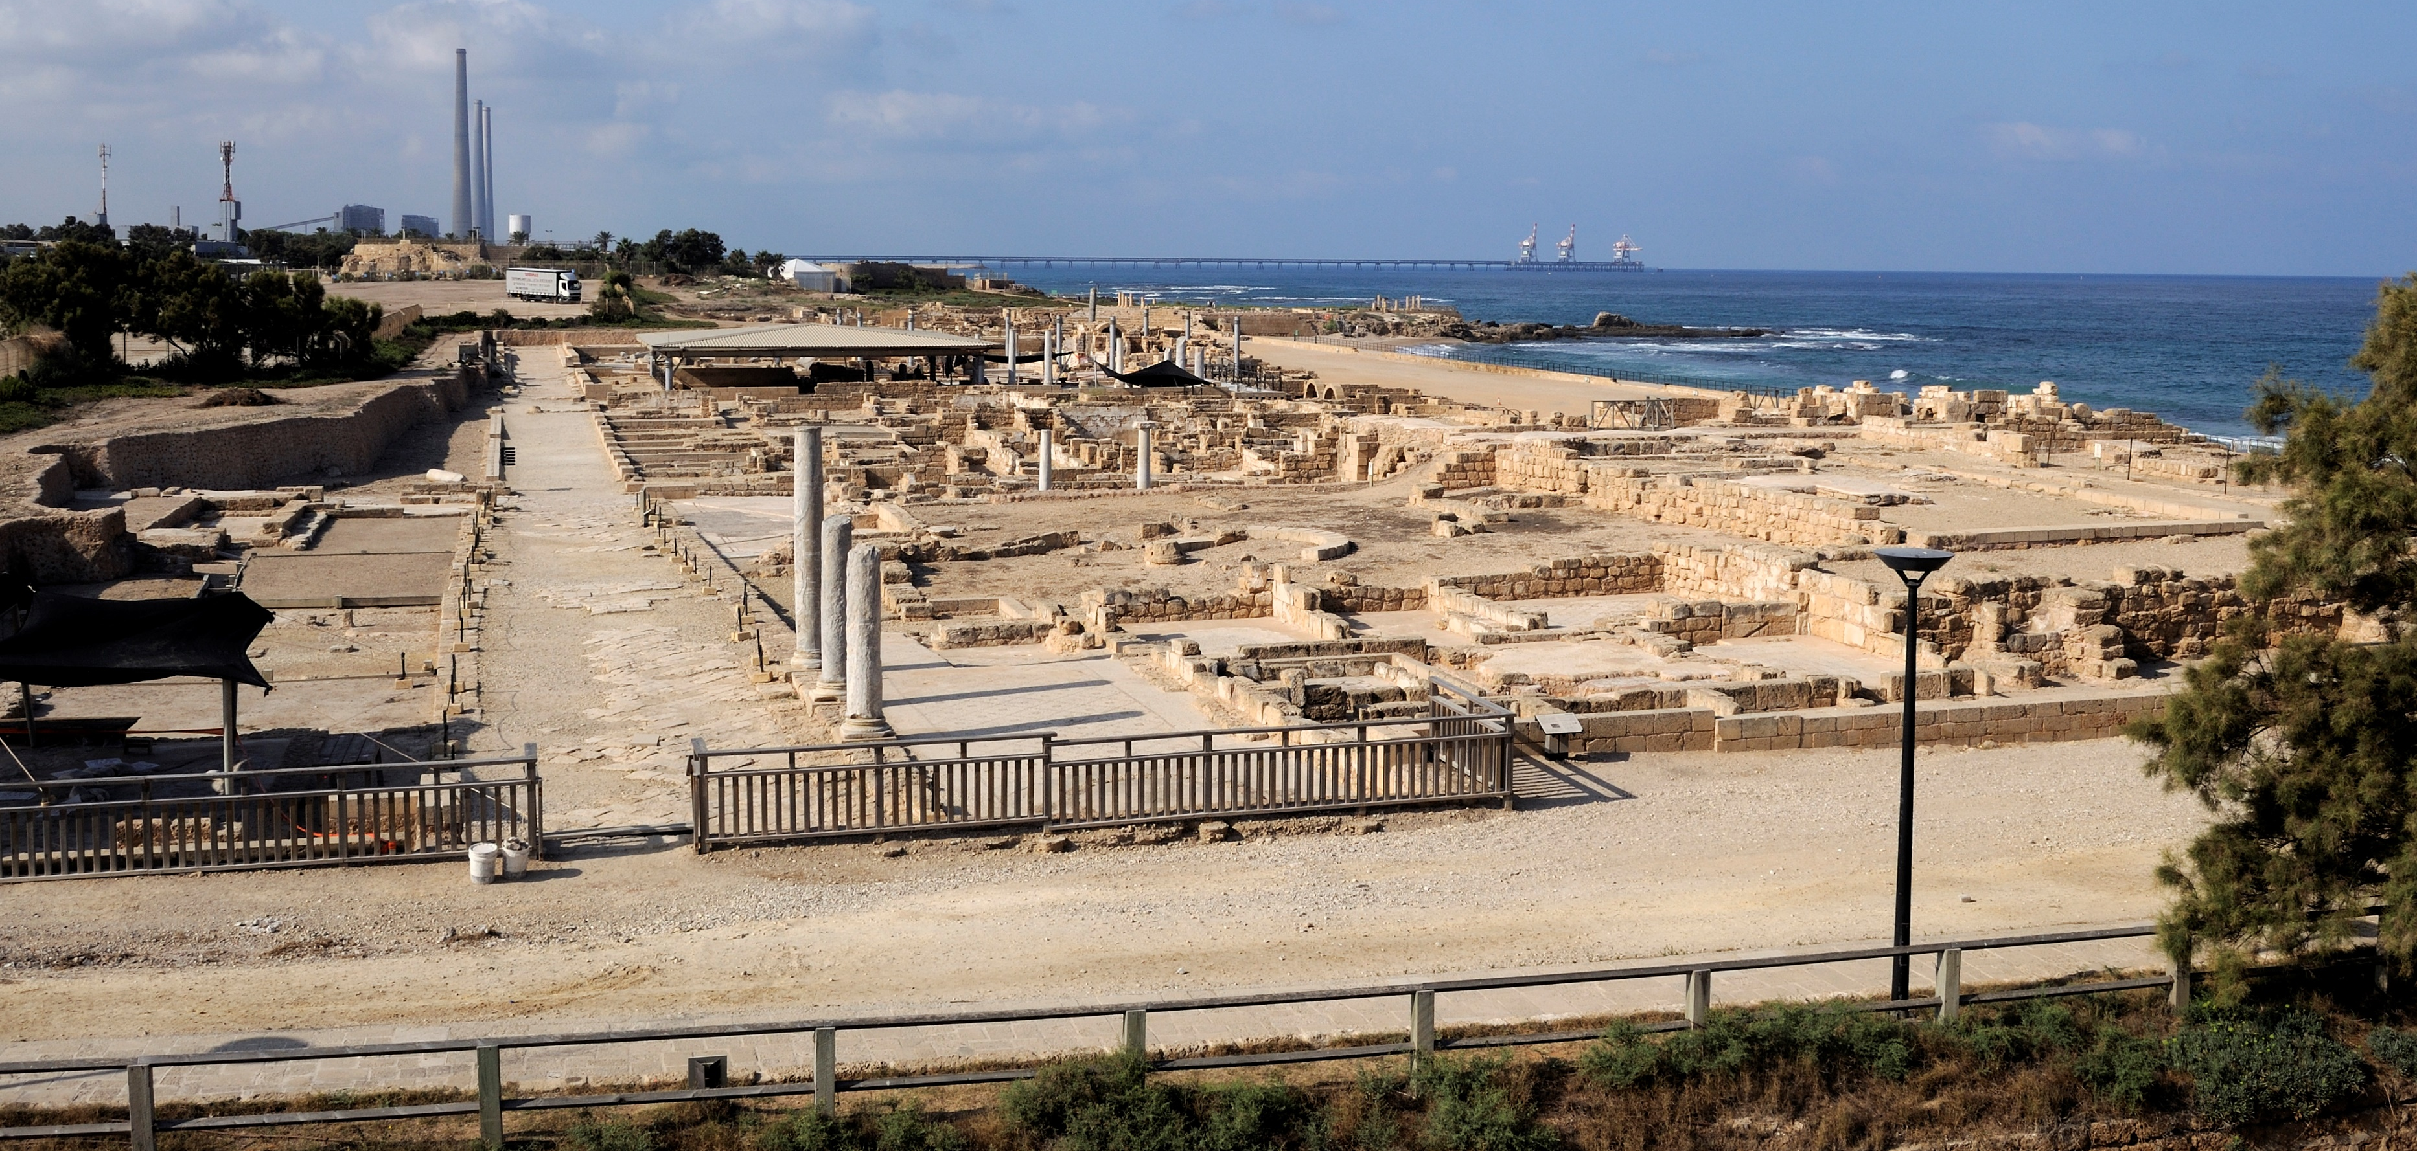
Herod the Great
Herod (72-4 BC) was a ruthless ruler and skilled politician, who identified as a Jew. He became known for his building projects.

Slide 12
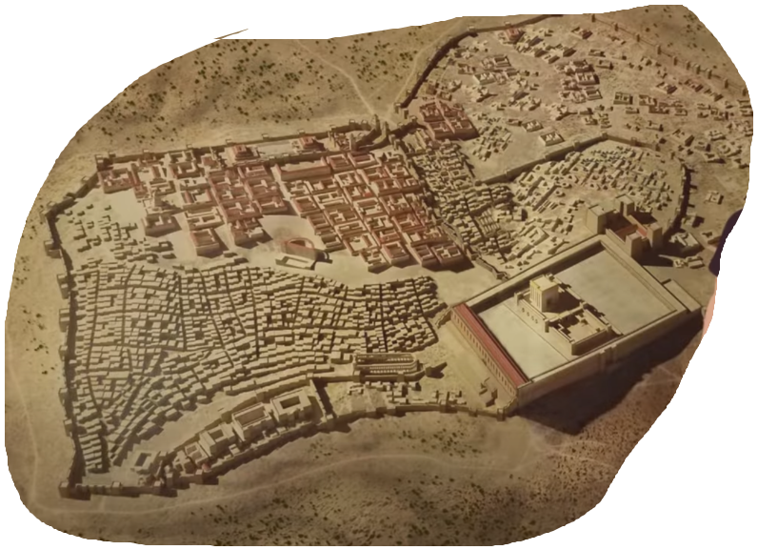
JERUSALEM
Herod promoted several reforms in the city of Jerusalem.
During his reign it is estimated the population of Jerusalem reached Half a million people.
After convincing the Jewish Leaders of his true intention of reforming the temple, the construction began in 19 B.C. and was finished 12 B.C.
It was expanded from 14 acres to 36 acres.

Slide 13
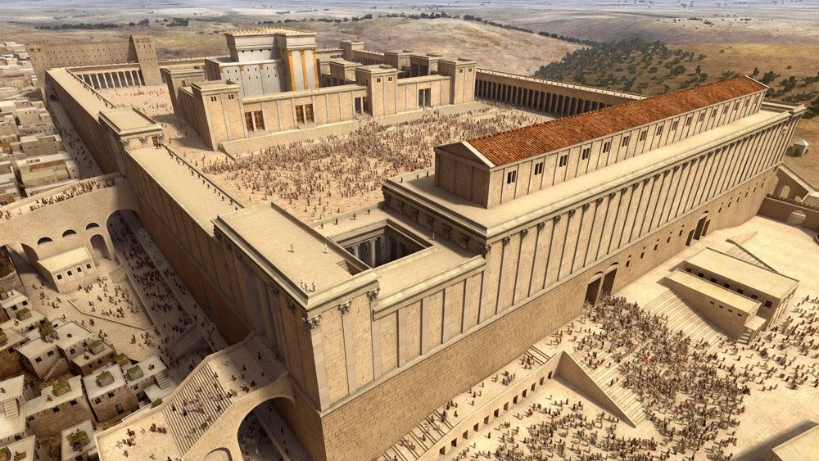
Temple of Jerusalem
12 a.C.

Slide 14
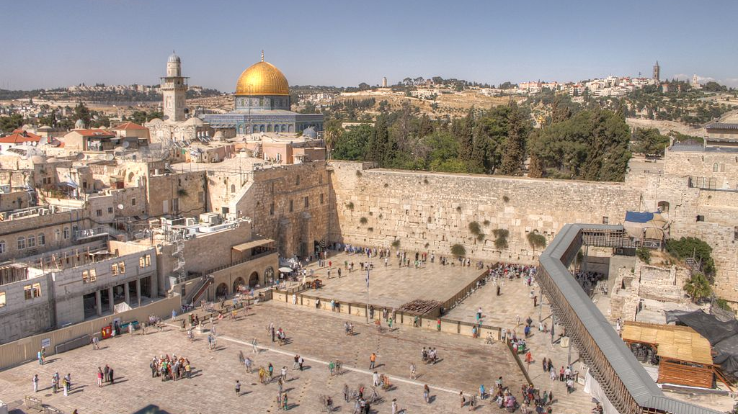
Western Wall (Wailing Wall)

Slide 15
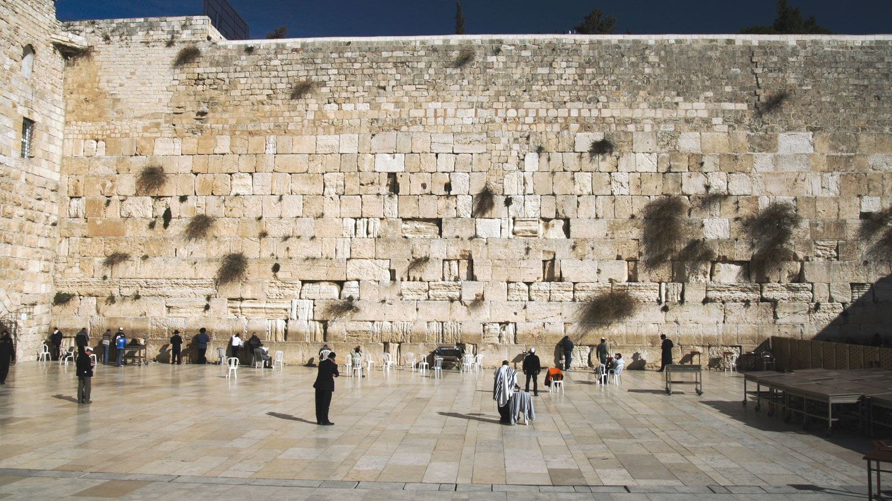

Slide 16
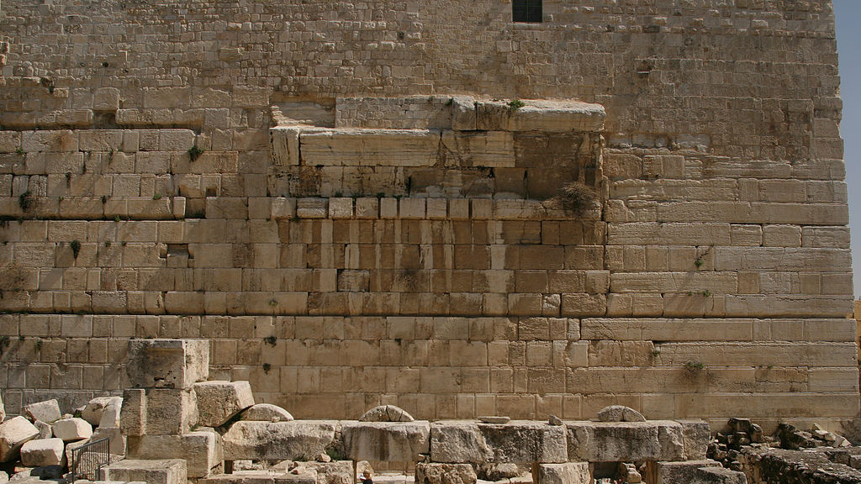
Robinson’s Arch

Slide 17
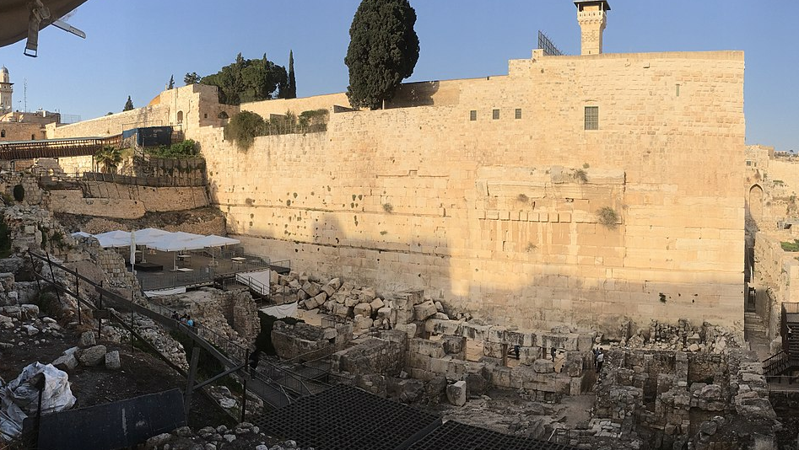

Slide 18
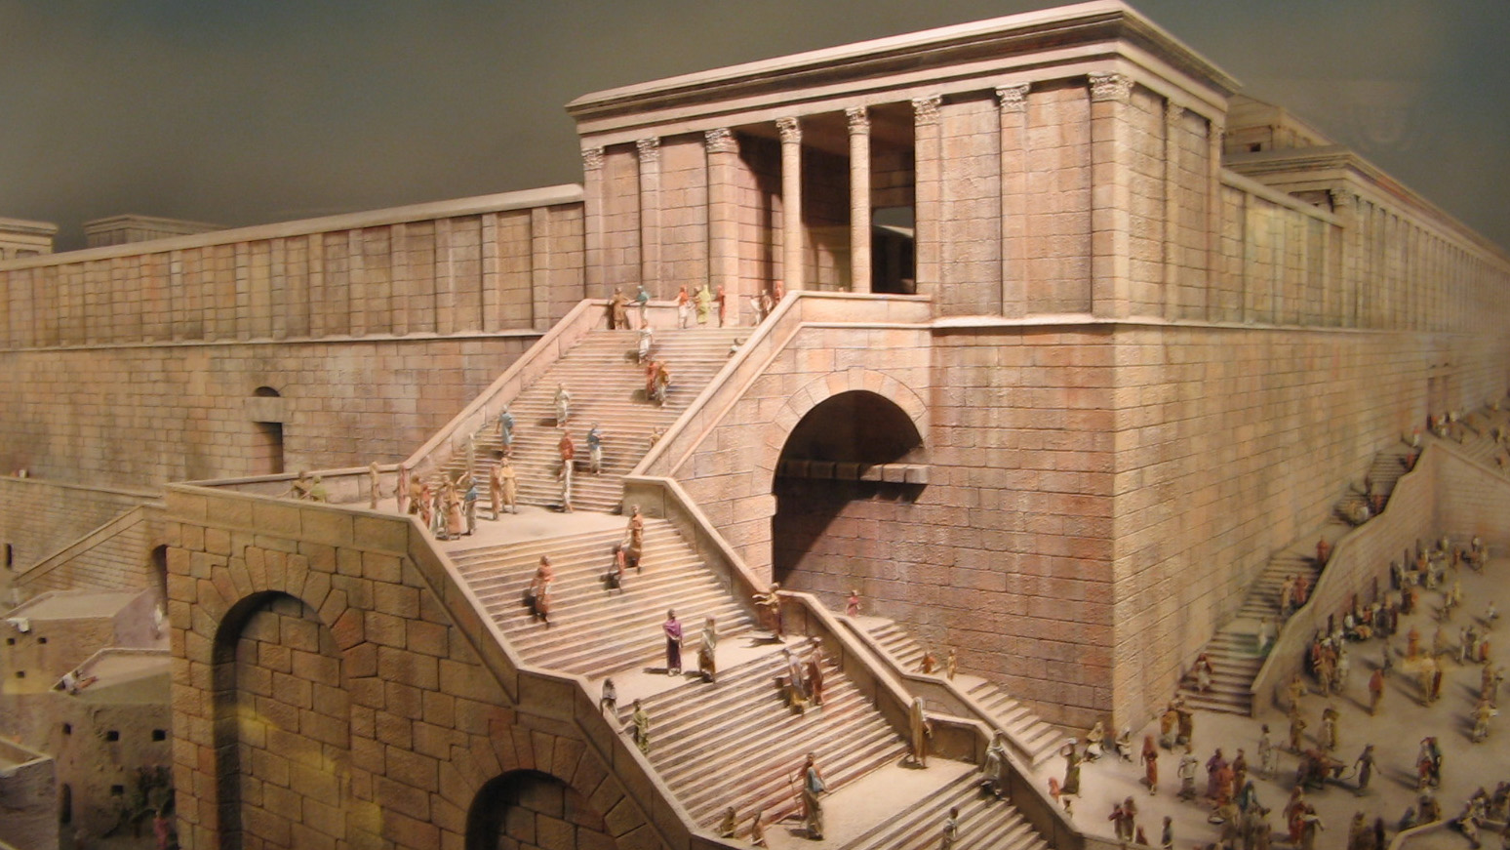

Slide 19
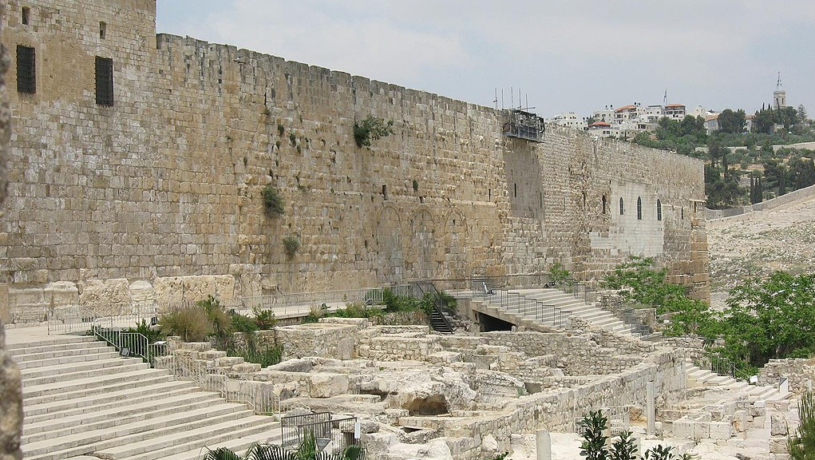
South Wall

Slide 20
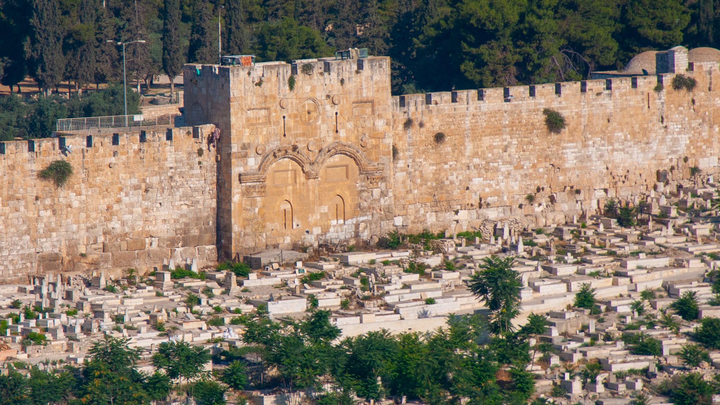
Eastern Wall
(Golden Gate)

Slide 21
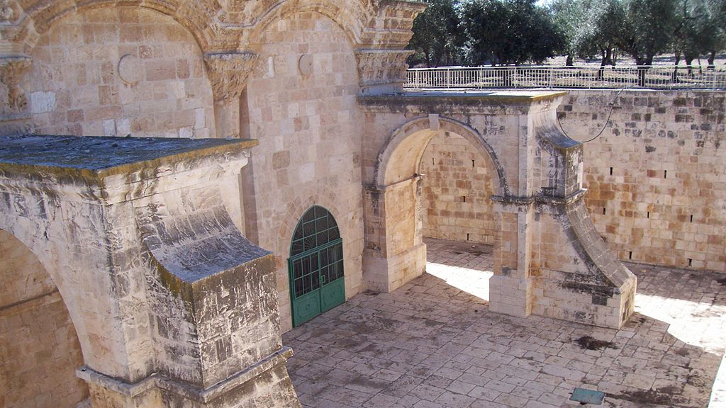

Slide 22
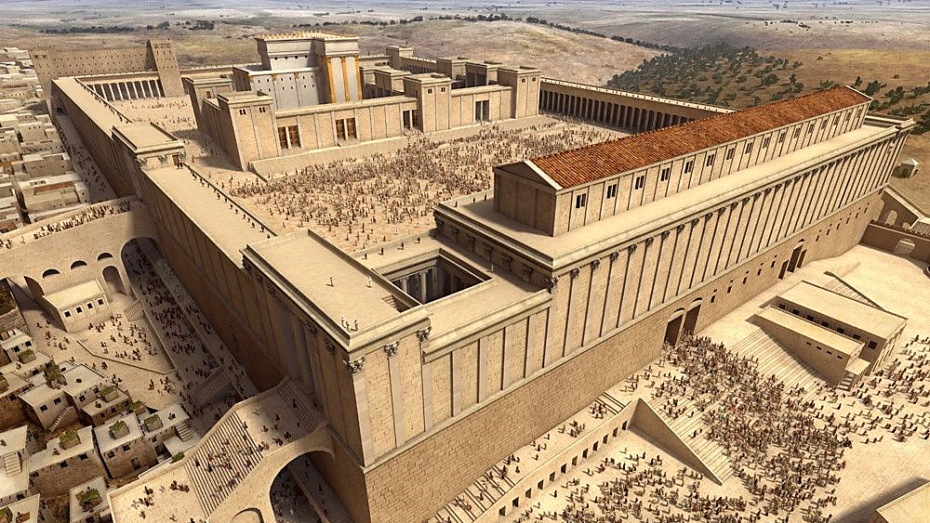
South Wall
Western Wall
Robinson’s Arch

Slide 23
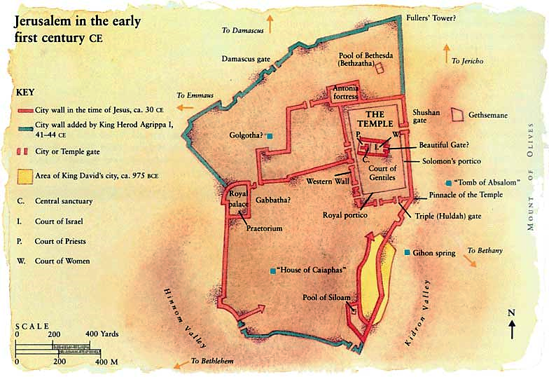
Image: Israel's 3 Temples - Wednesday in the Word

Slide 24
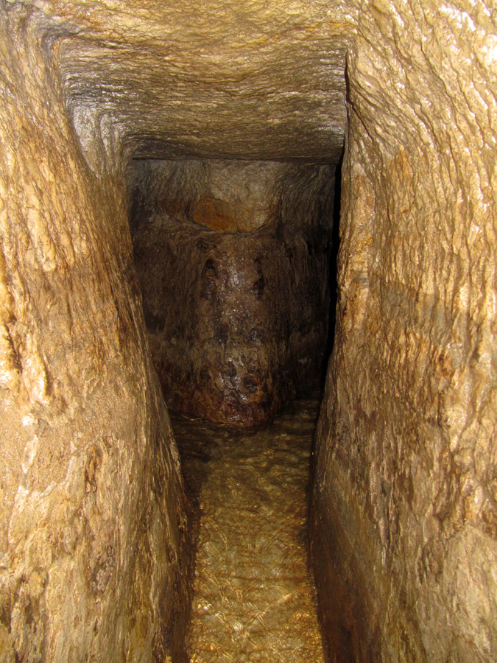
Hezekiah’s Pool
To defend against the advance of Assyrian against Jerusalem in the 8th Century BC, the good king Judah Hezekiah in preparations for the siege built a tune from the Gihon spring to a pool built on the south side of the city (2Ki 20.20). This pool was called Siloam. Jesus sent a blind man to wash in the pool (Joh 9.7,11). Archeologists in the 19th century and the beginning of the 20th century have claimed to have found it.

Slide 25
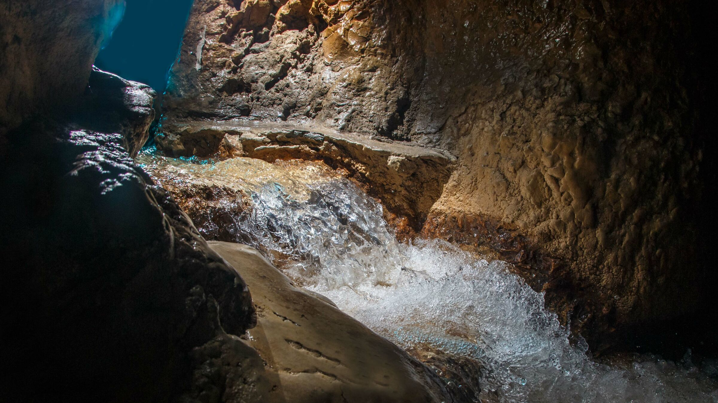
Source: Hezekiah's Tunnel | ArmstrongInstitute.org

Slide 26
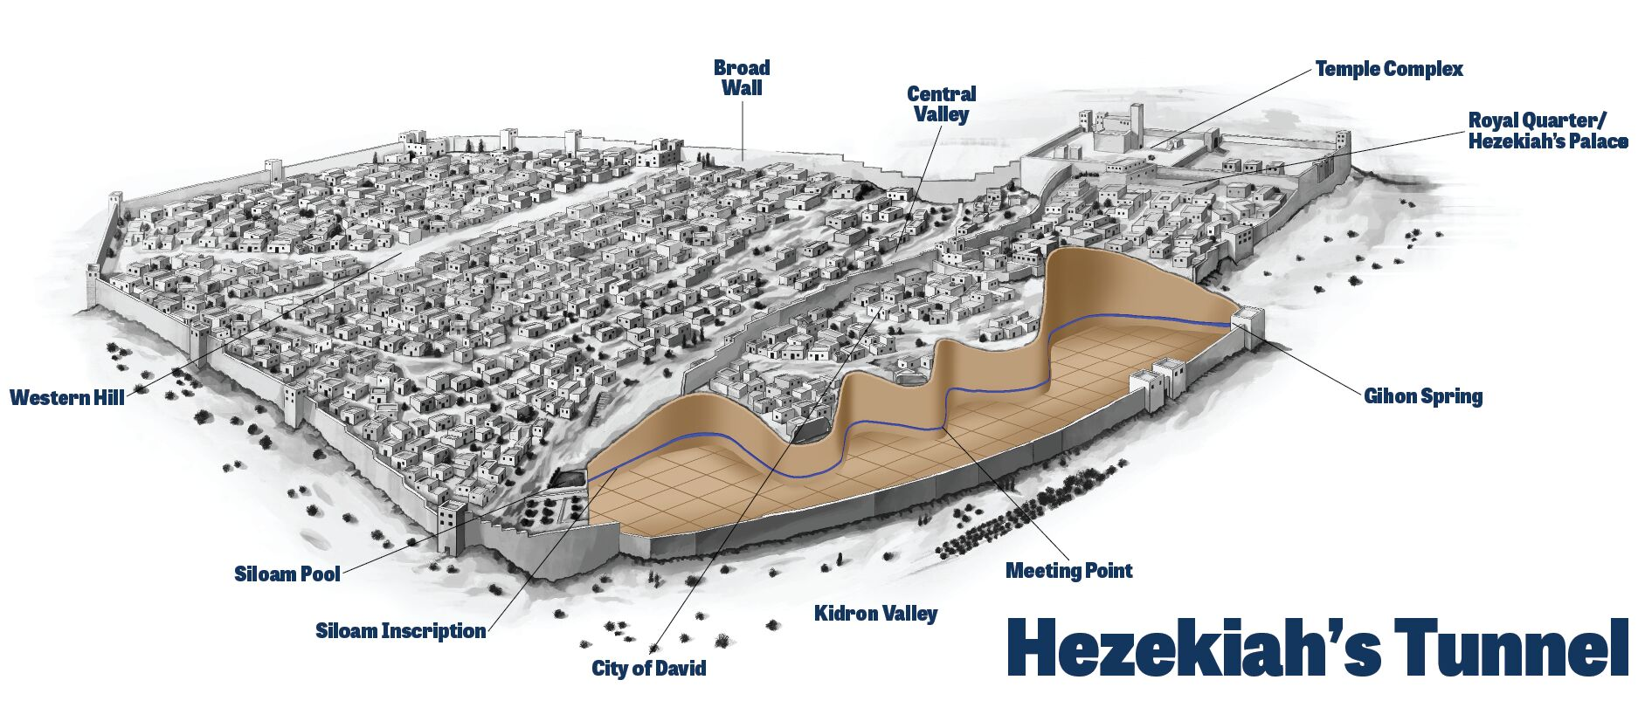
Source: Hezekiah's Tunnel | ArmstrongInstitute.org

Slide 27
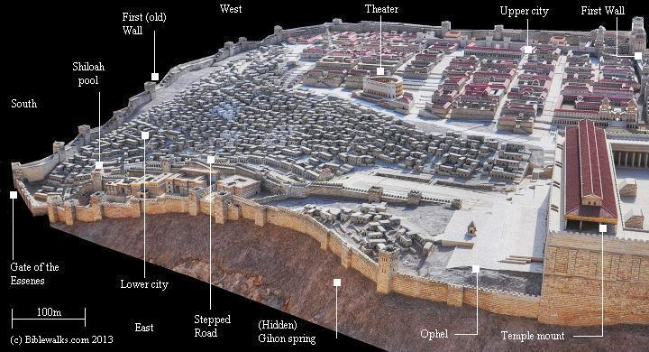

Slide 28
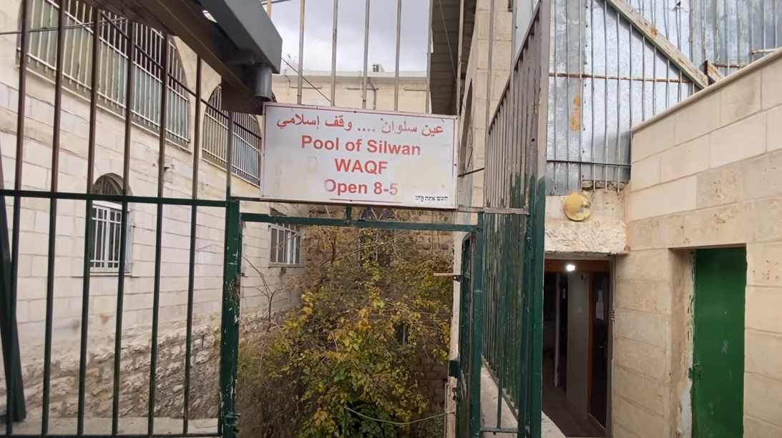

Slide 29
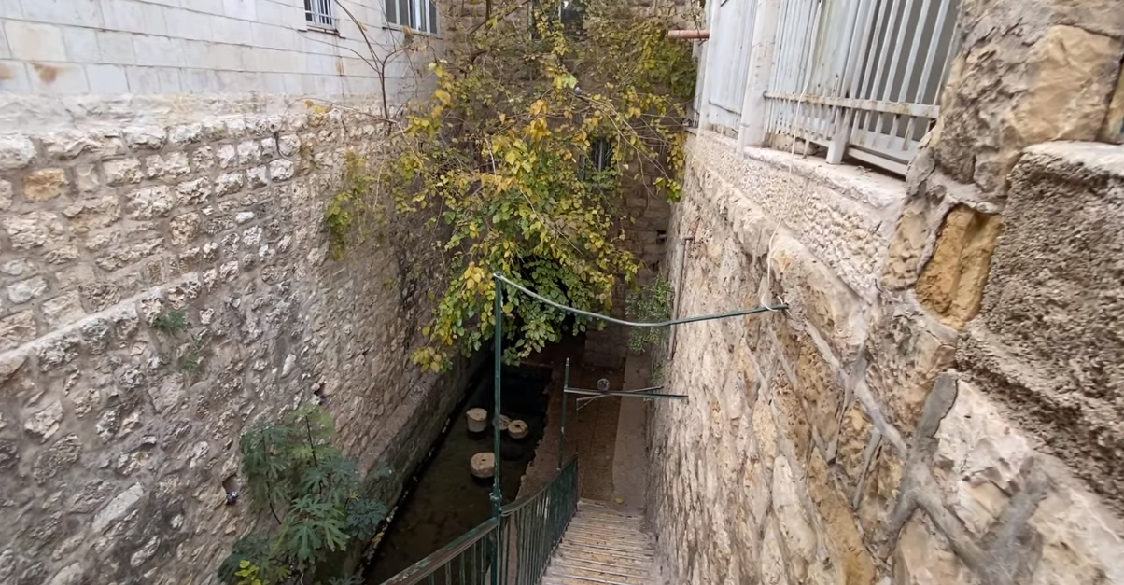

Slide 30
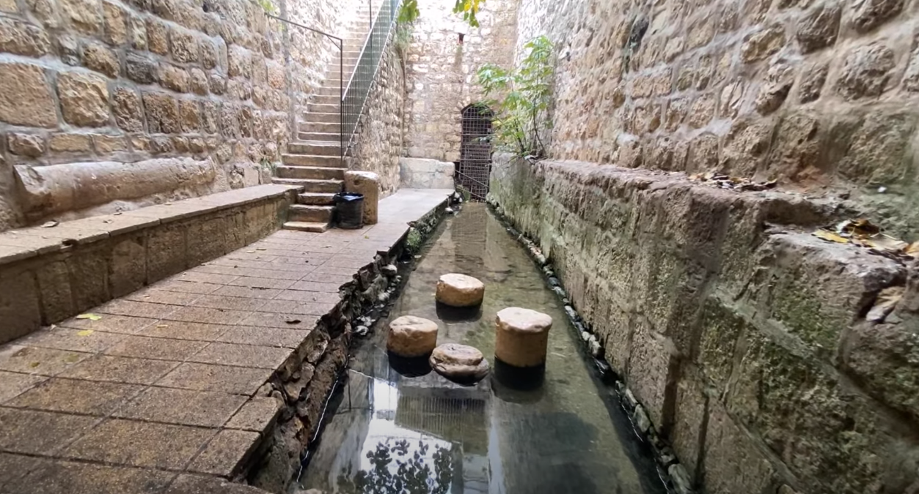

Slide 31
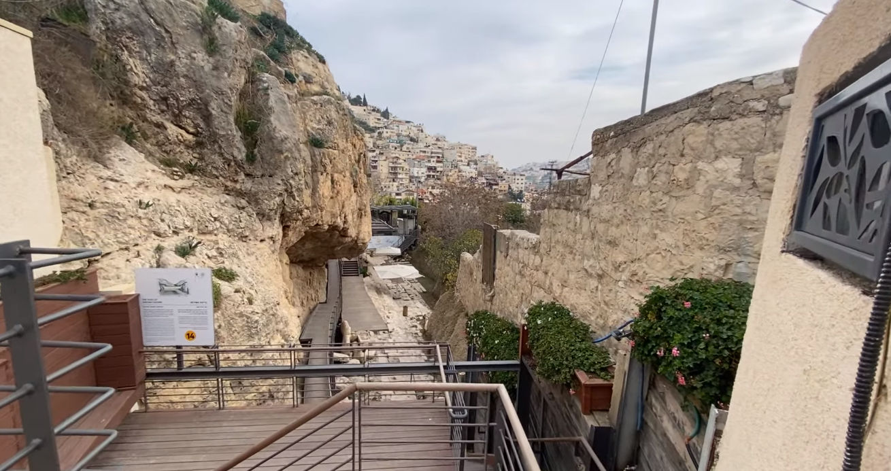

Slide 32
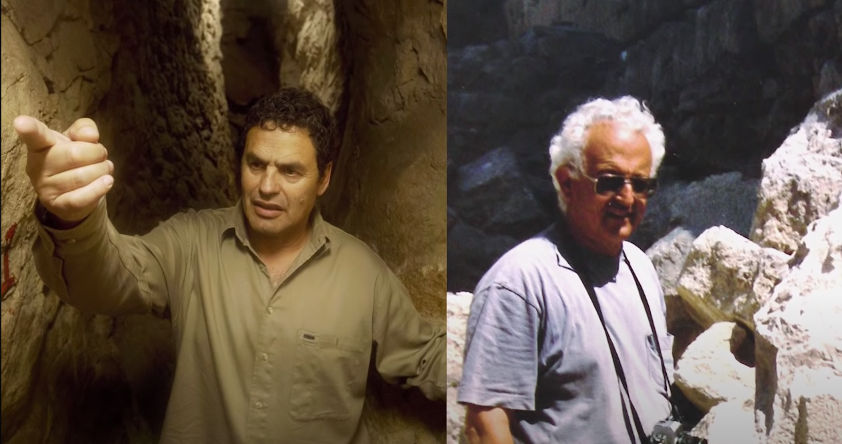
In 2004 the real pool of Siloam was found by archaeologists Ronny Reich and Eli Shukron

Slide 34
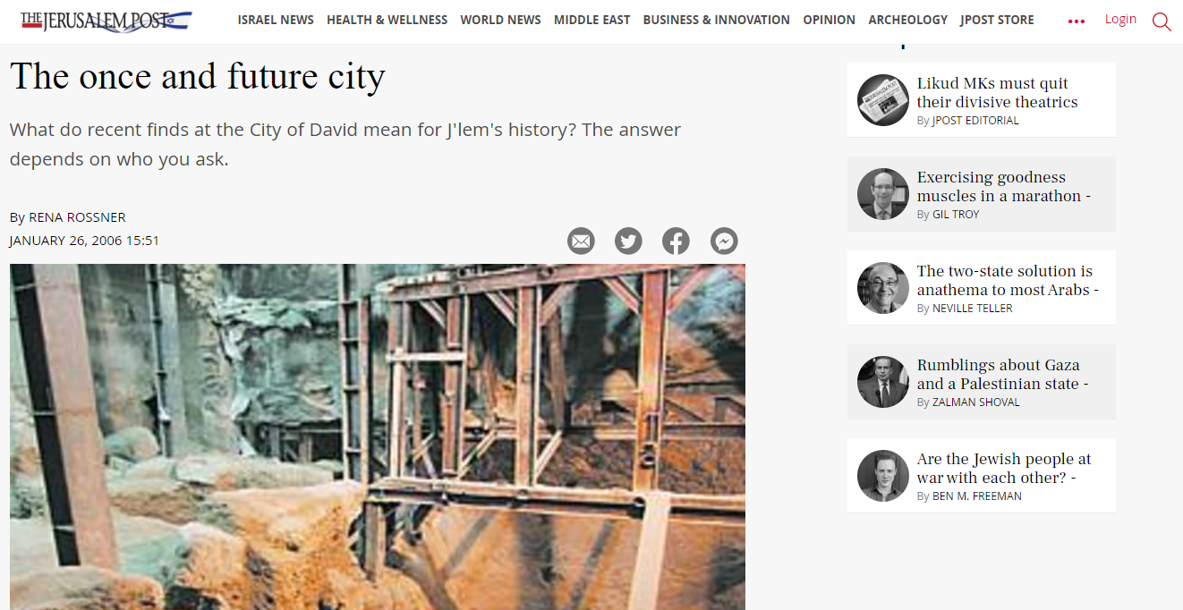

Slide 35
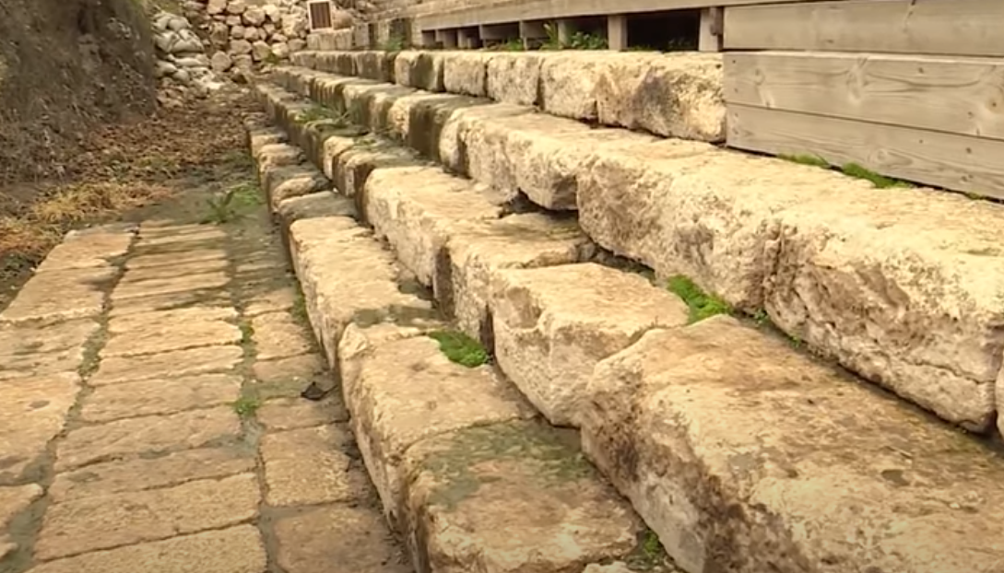

Slide 36
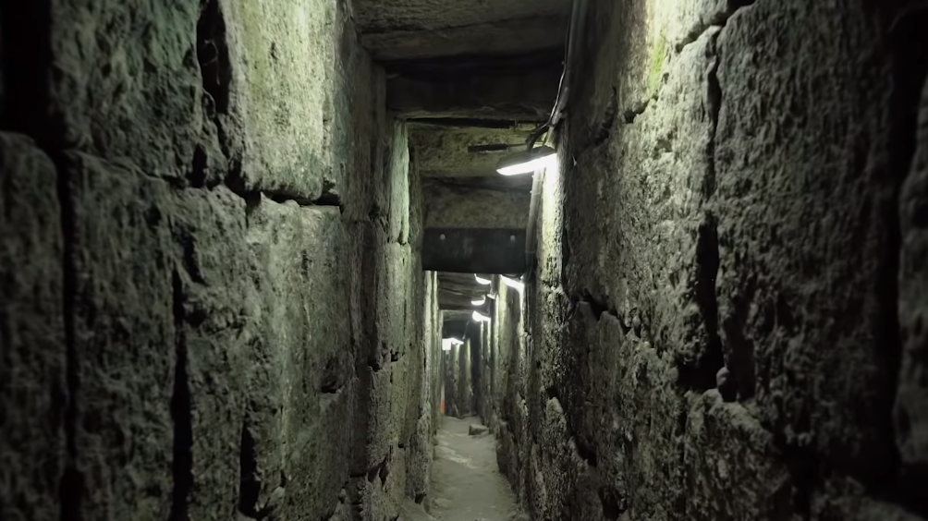
In 2007 the same archeologists found a drainage tunnel leading up to the Temple Mount.

Slide 37
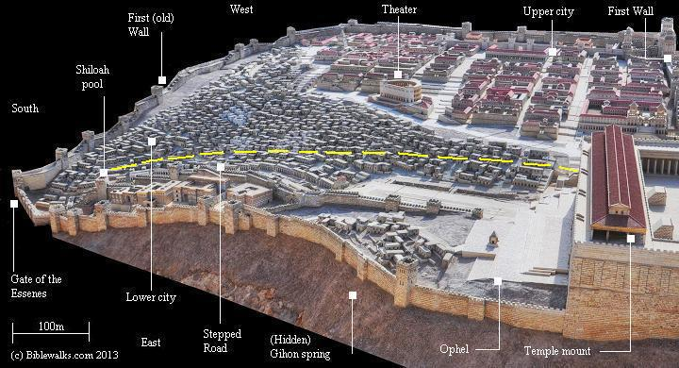

Slide 38
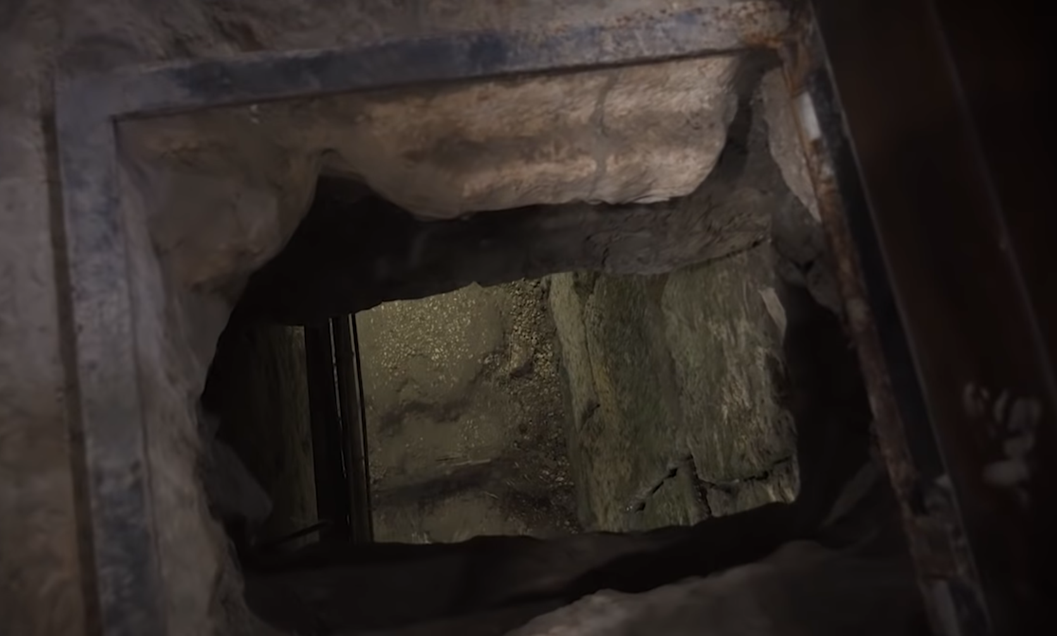

Slide 39
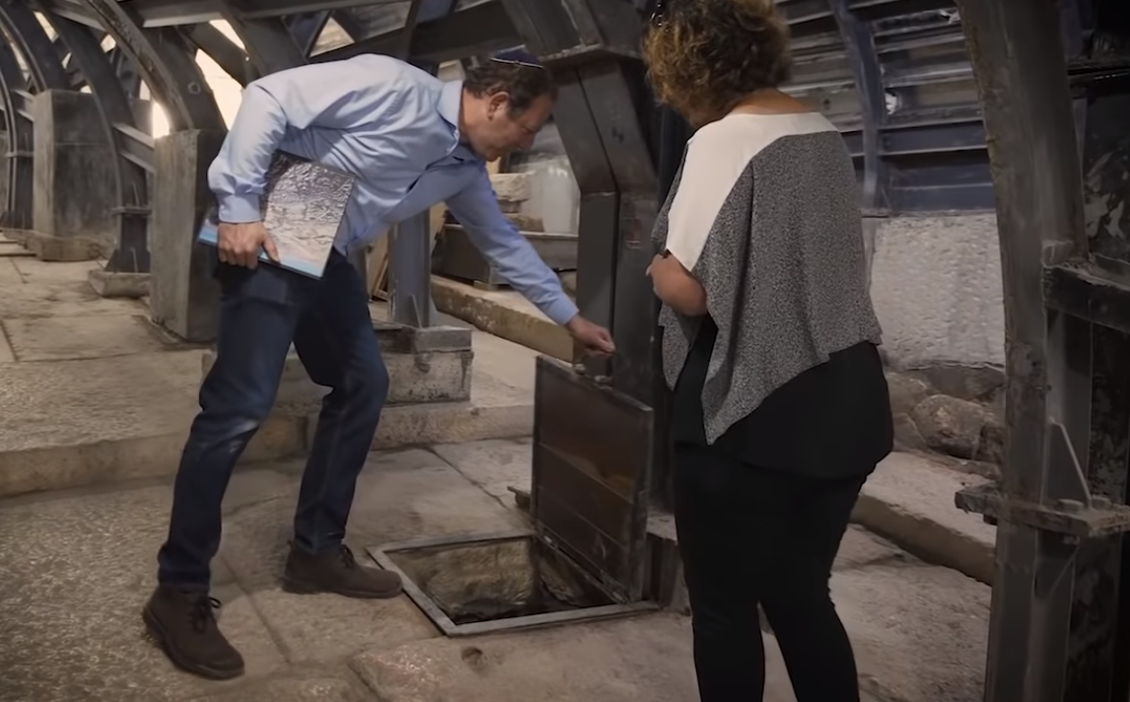

Slide 40
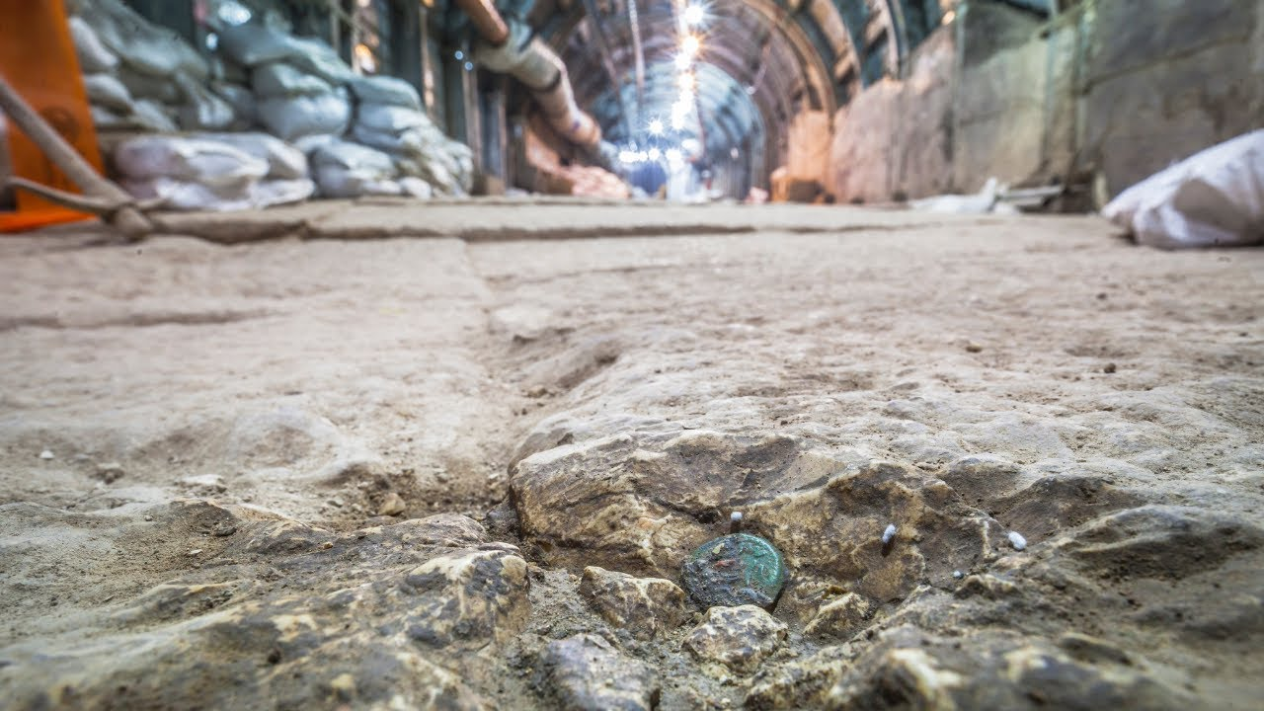

Slide 41
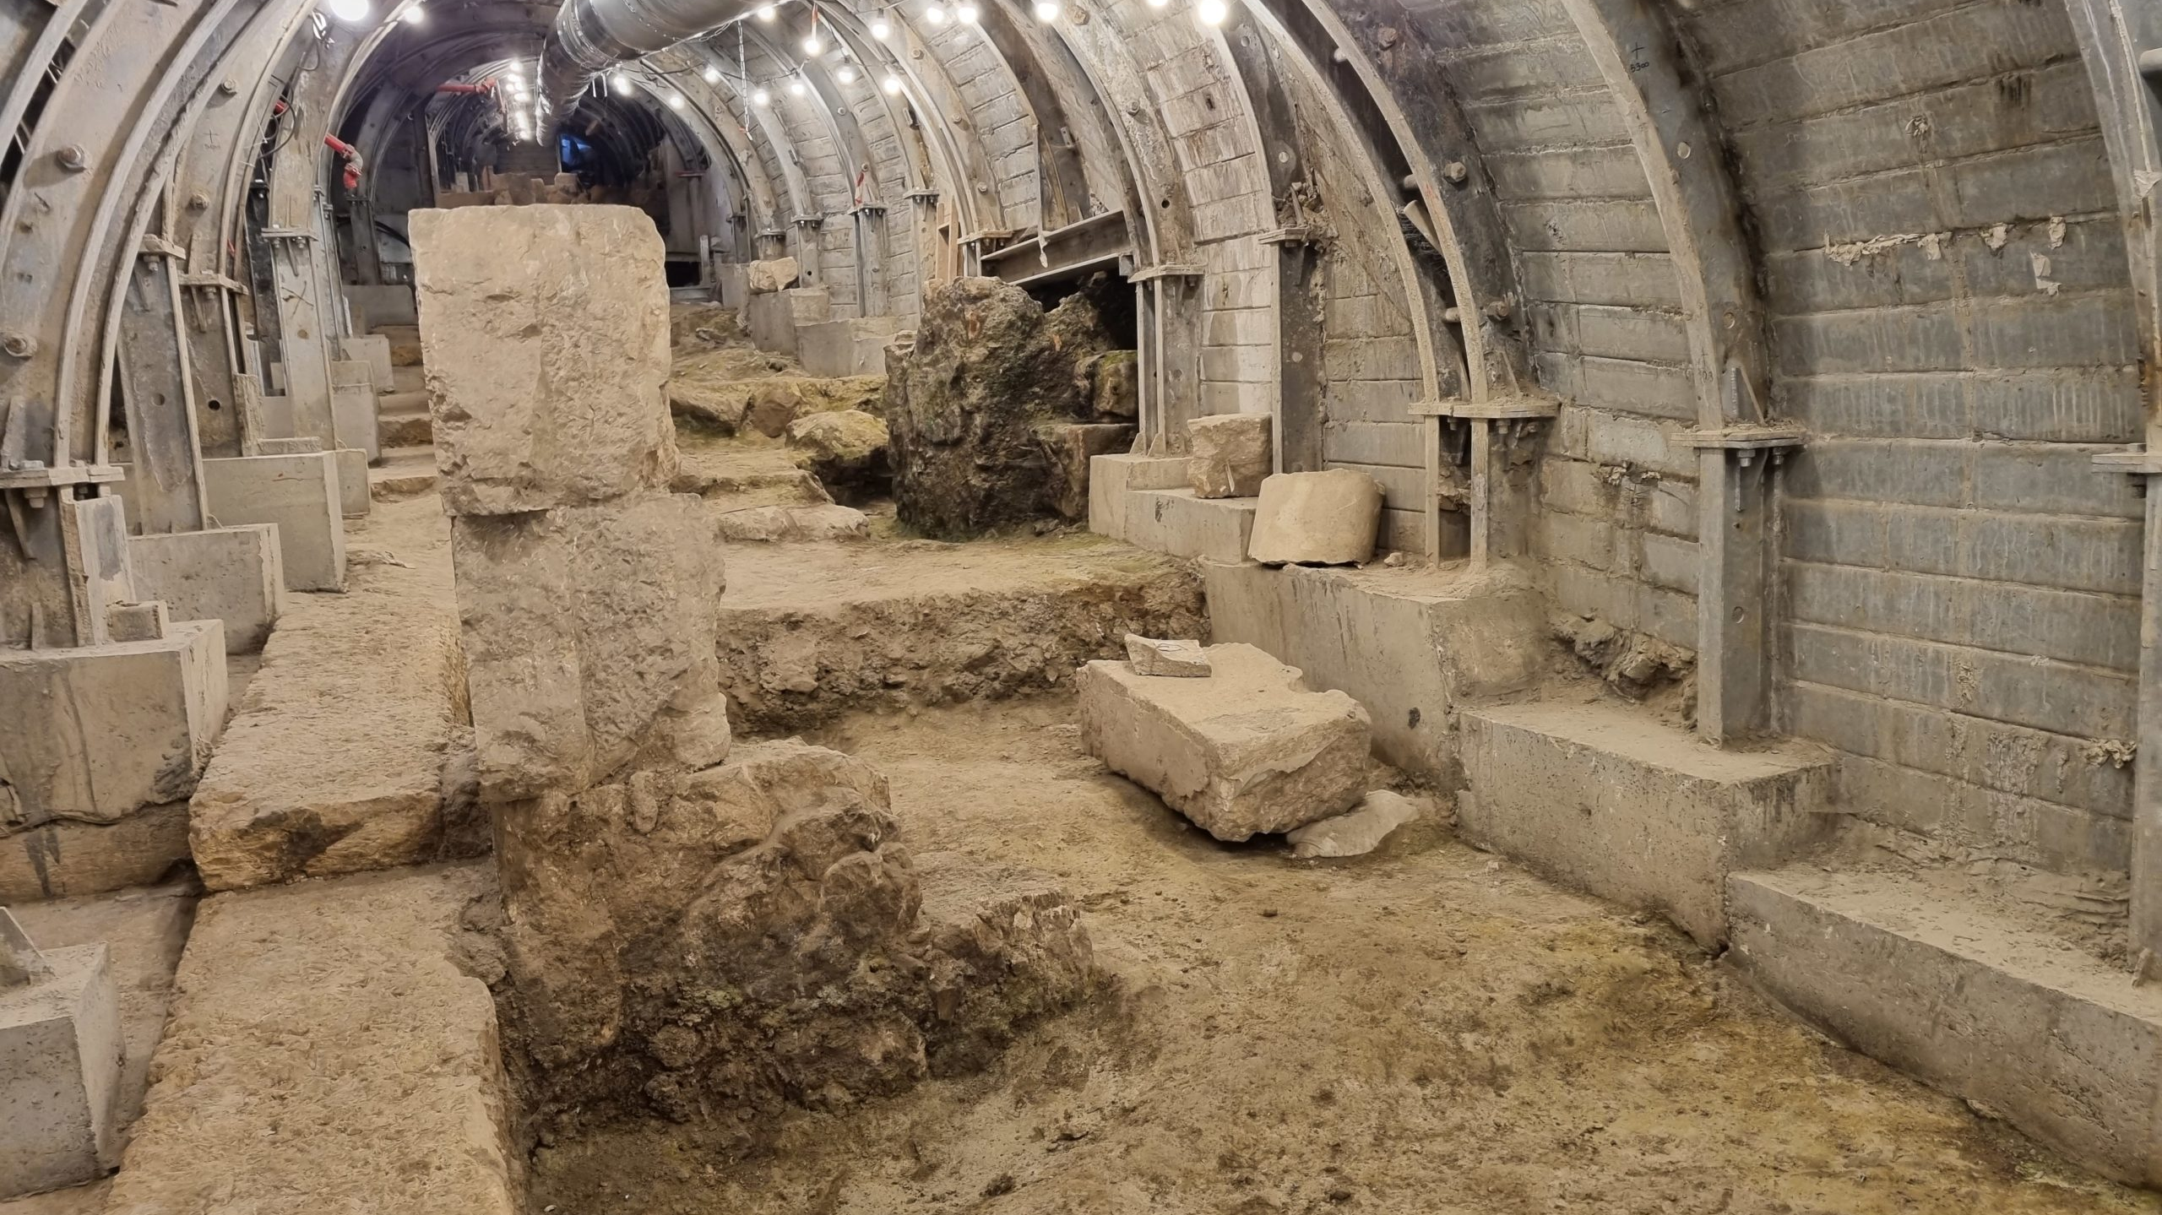

Slide 42
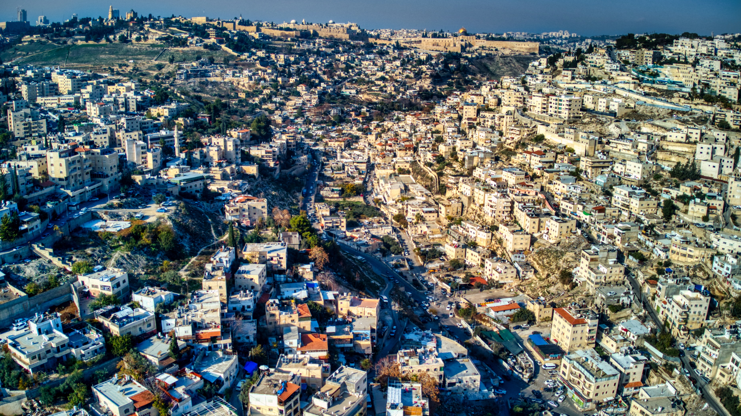

Slide 43
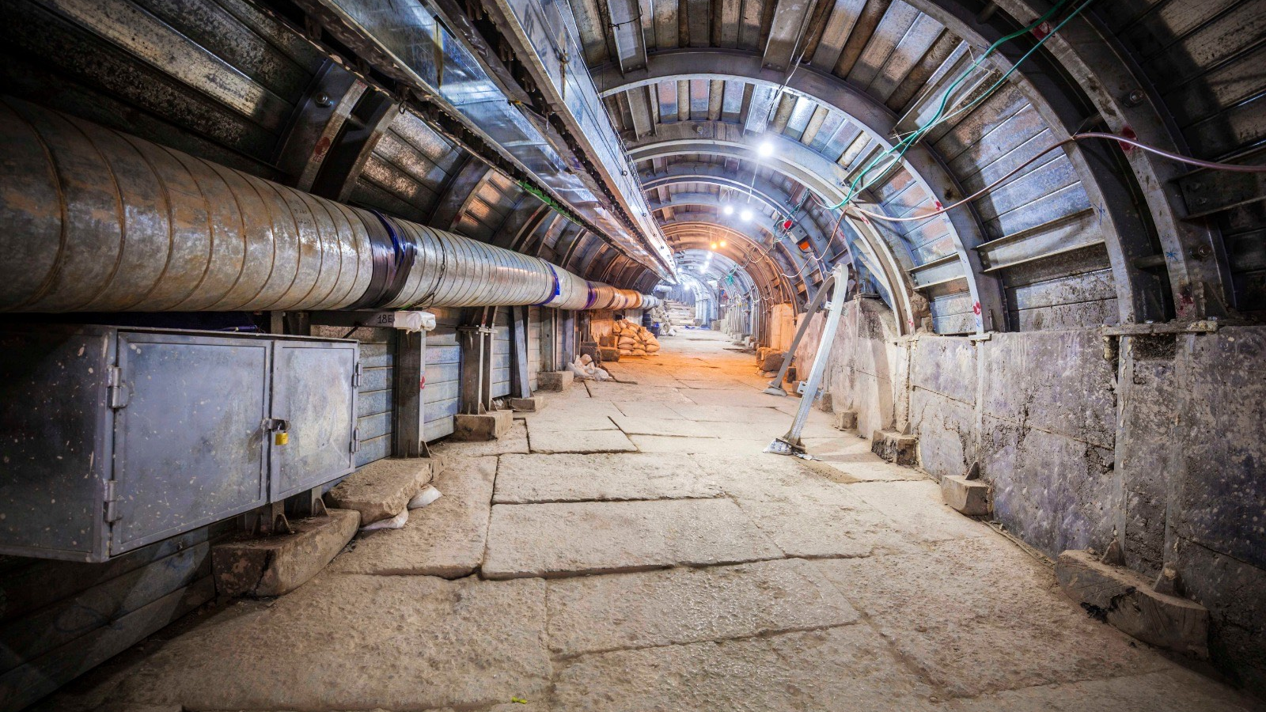

Slide 44
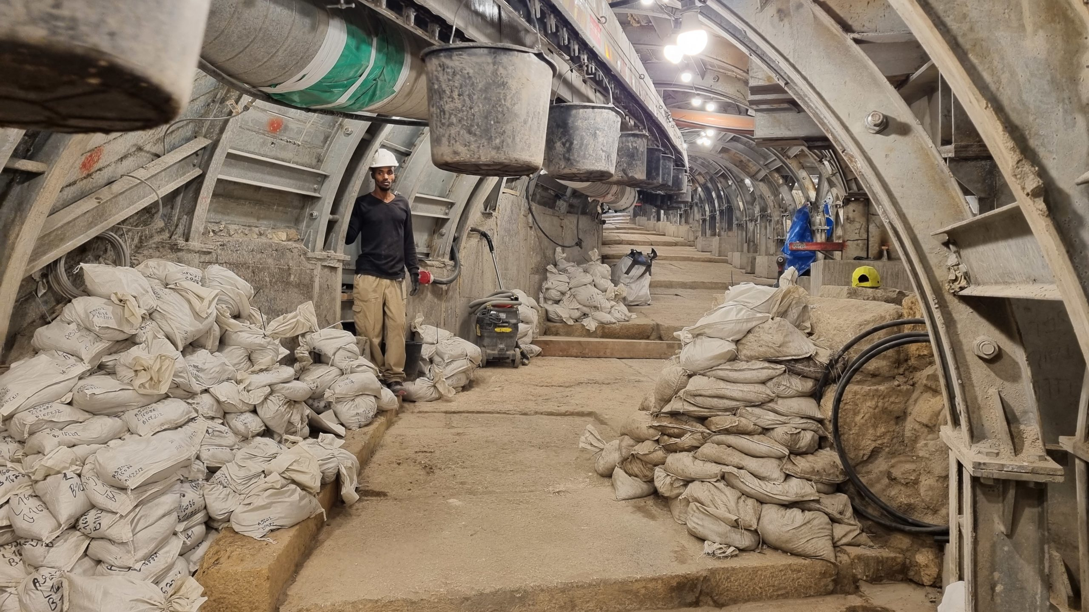

Slide 45
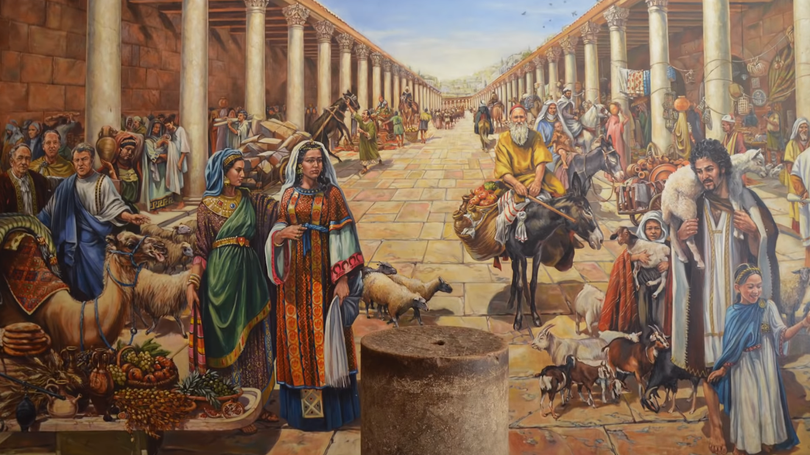

Slide 47
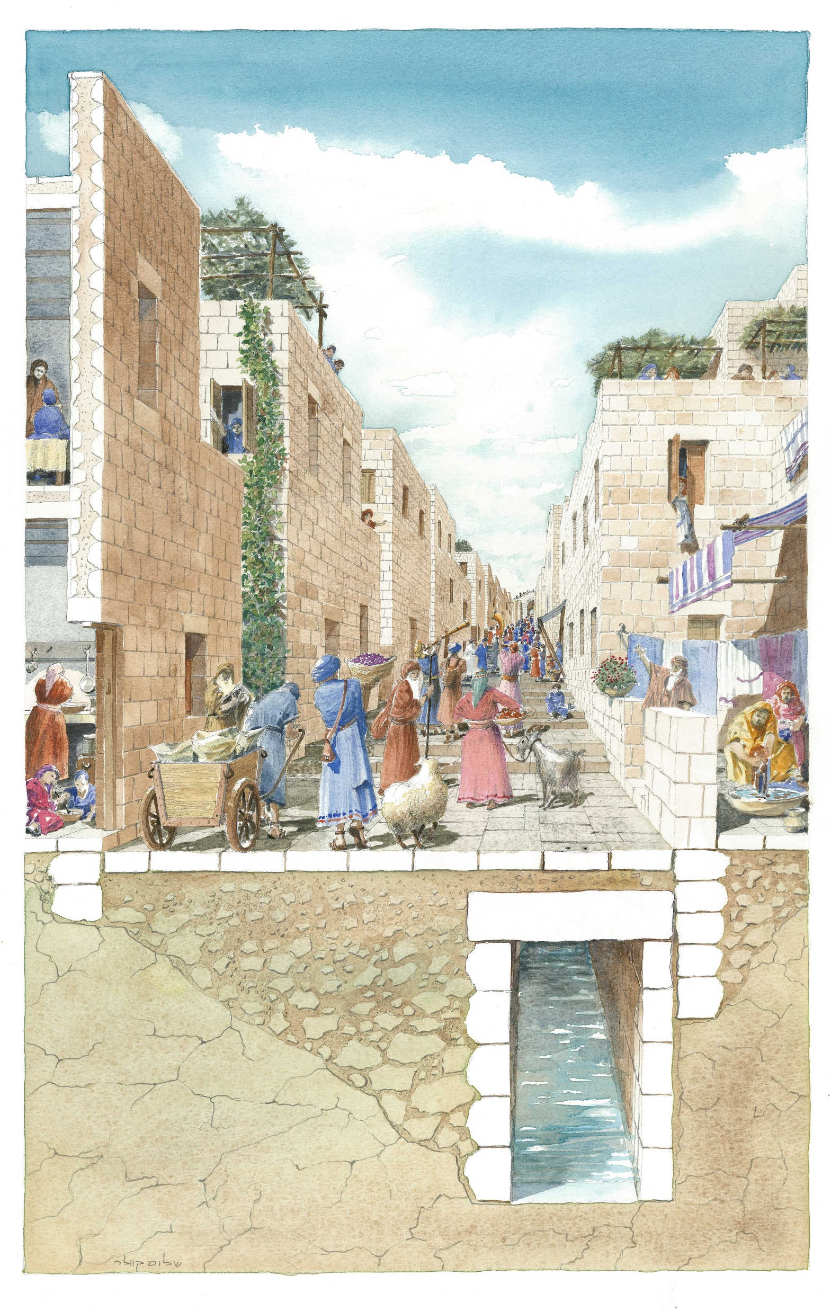

Slide 48
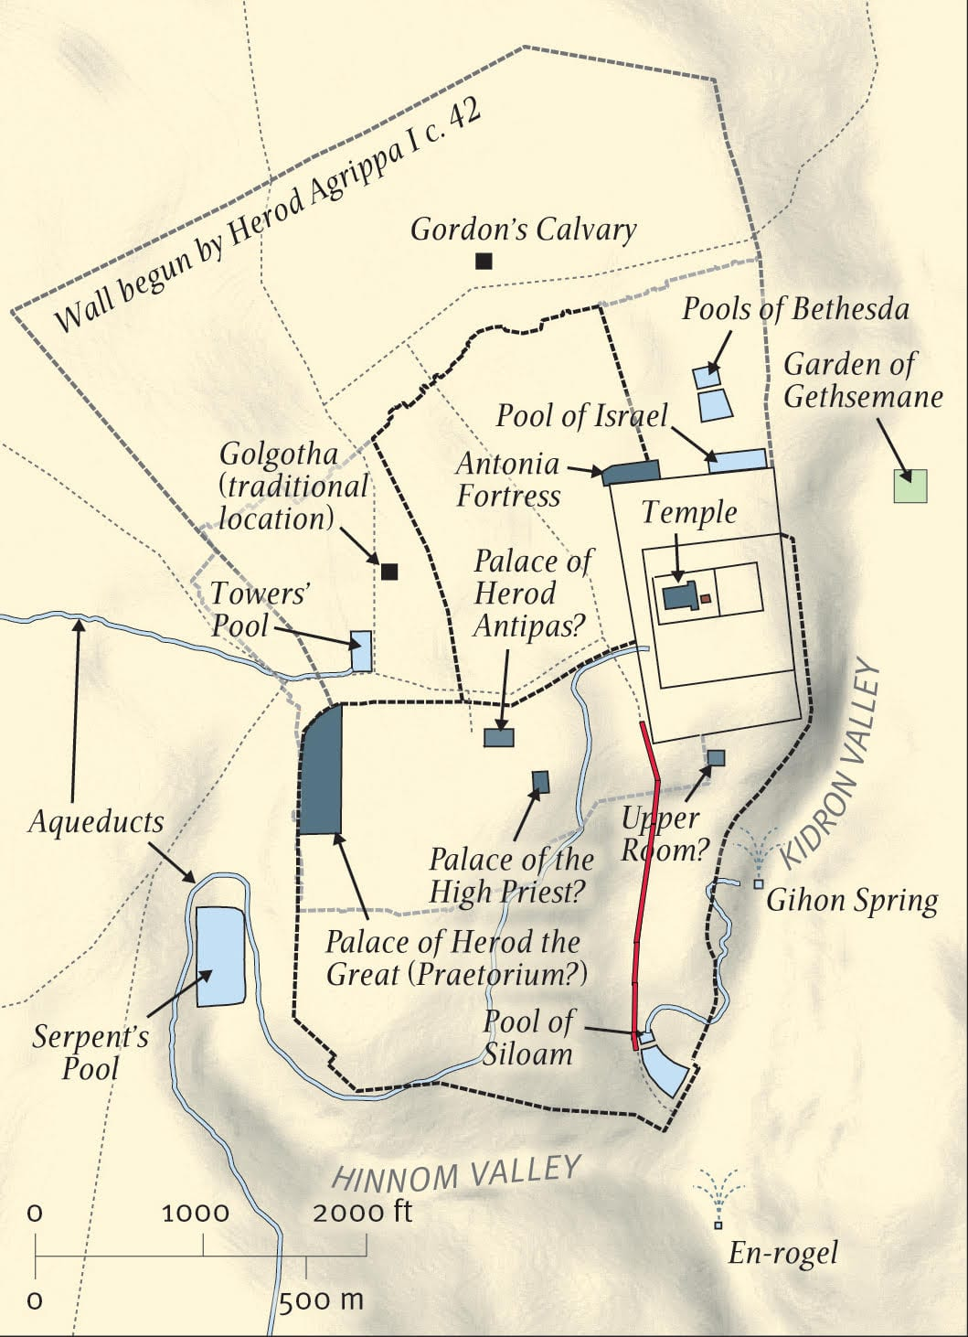
Image: Was the Road in Jerusalem Discovered by Archaeologists Really Built by Pontius Pilate? (thegospelcoalition.org)

Slide 49
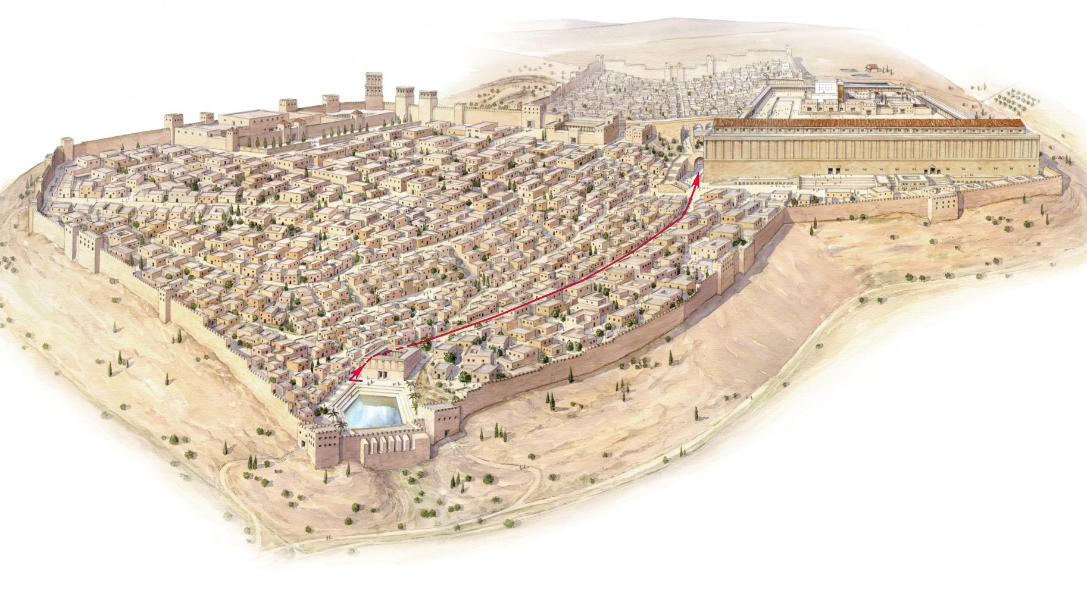
Distance
634 meters
(2,080 ft)
Height:
115 meters
(377 ft)
Image: Was the Road in Jerusalem Discovered by Archaeologists Really Built by Pontius Pilate? (thegospelcoalition.org)

Slide 50
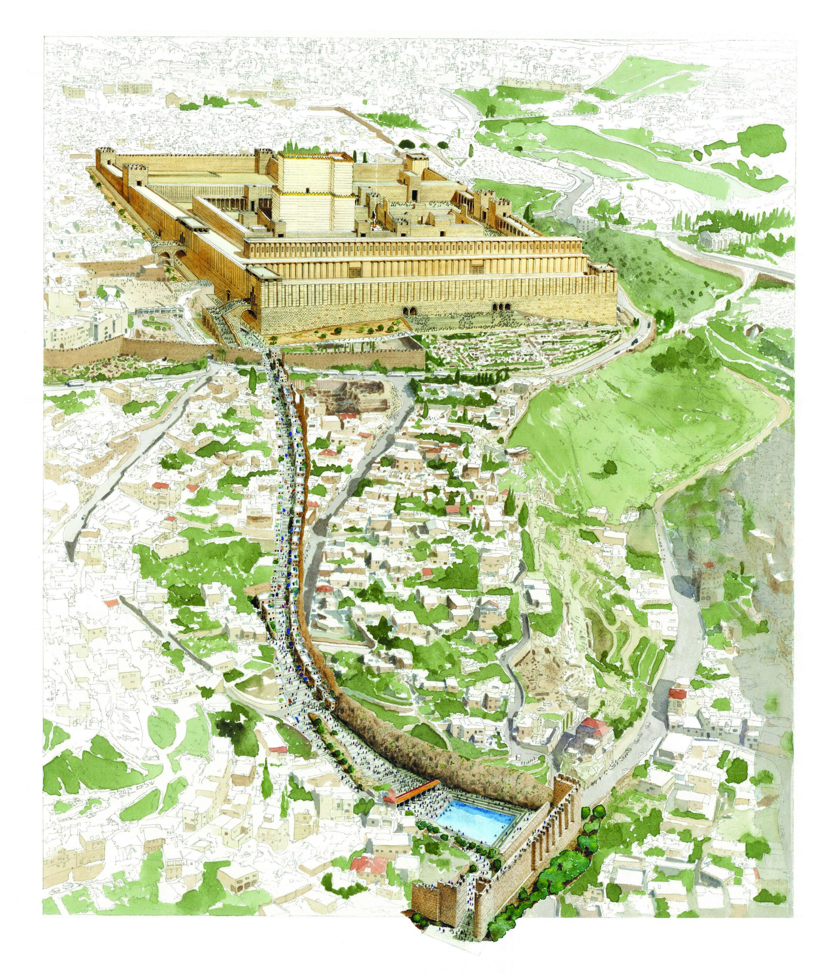
Drawing of the Pilgrimage Road, running from the Pool of Siloam to the Second Temple.
Rights to Shalom Kveller, City of David Archives.
Image: Second Temple Period Receipt Found in the City of David (biblicalarchaeology.org)

Slide 53
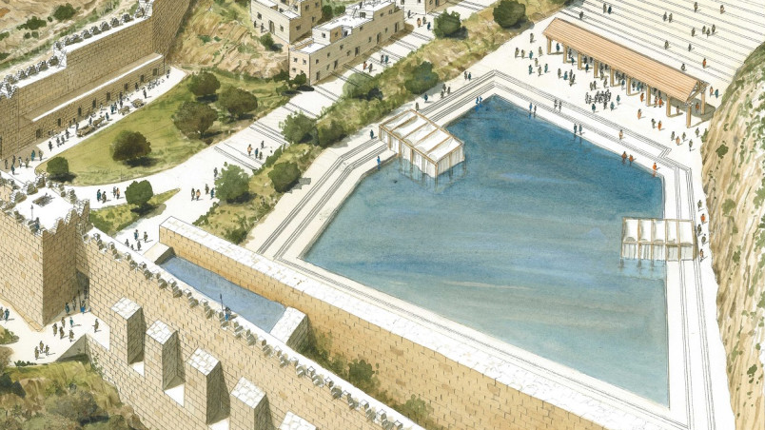

Slide 54
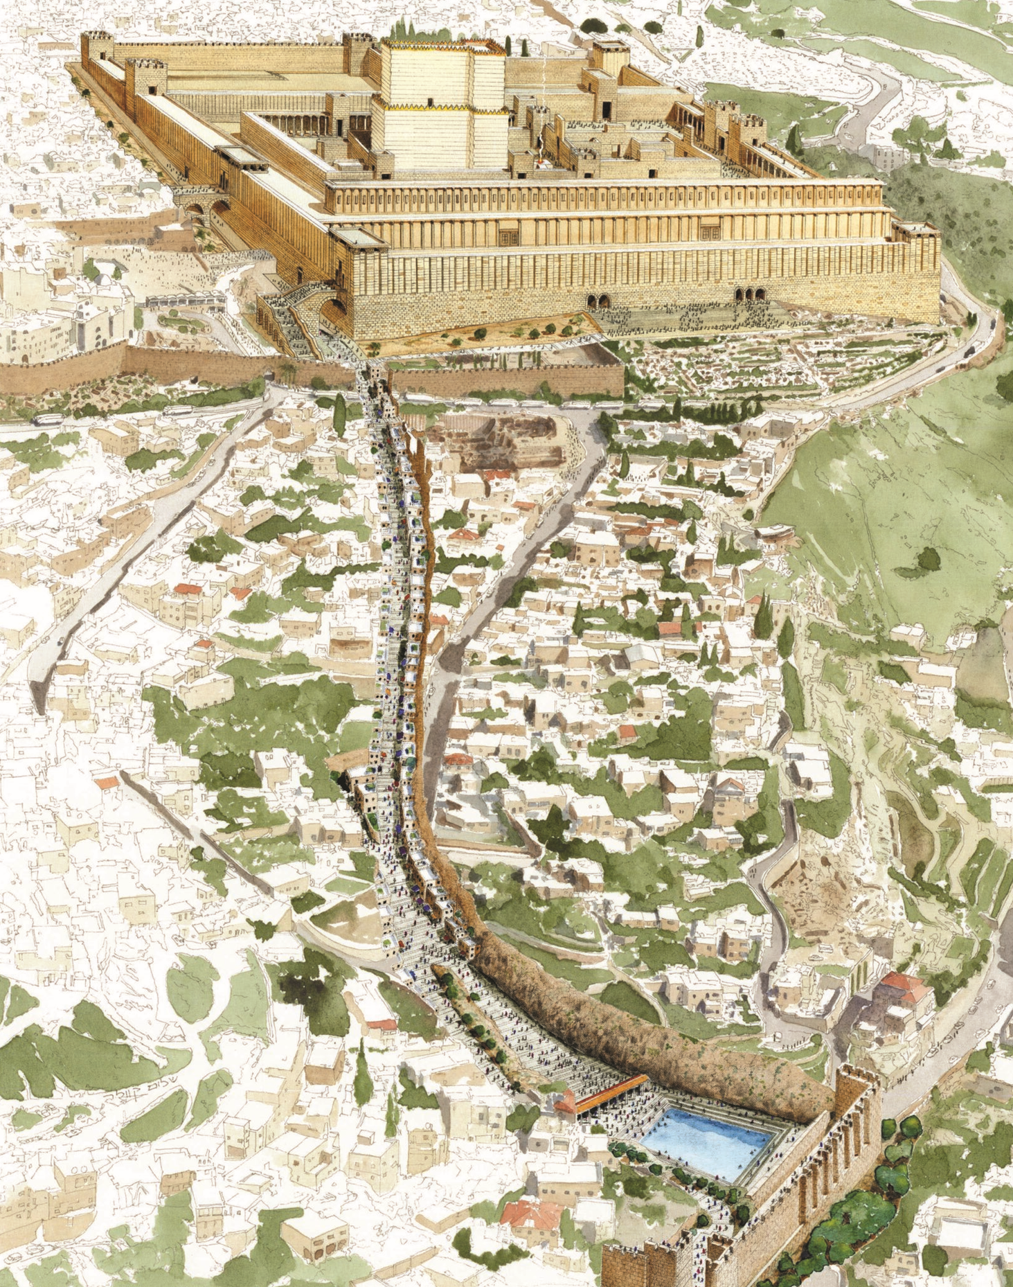
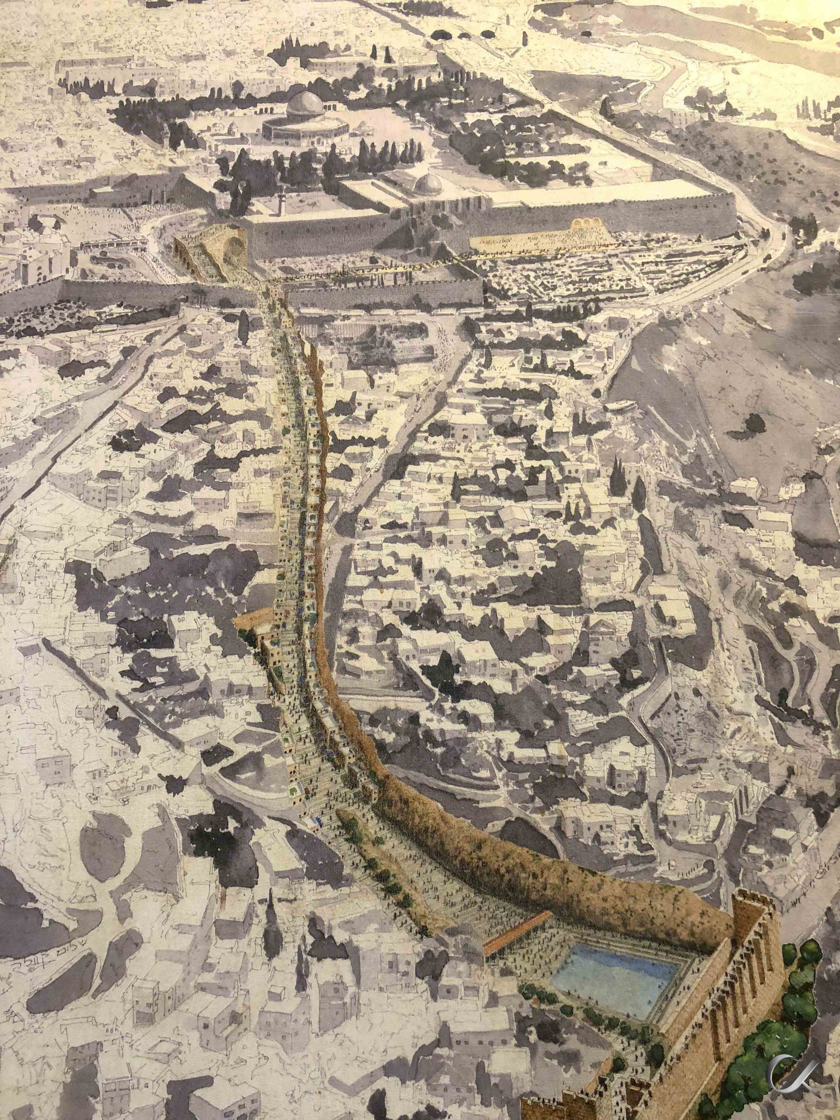

Slide 56
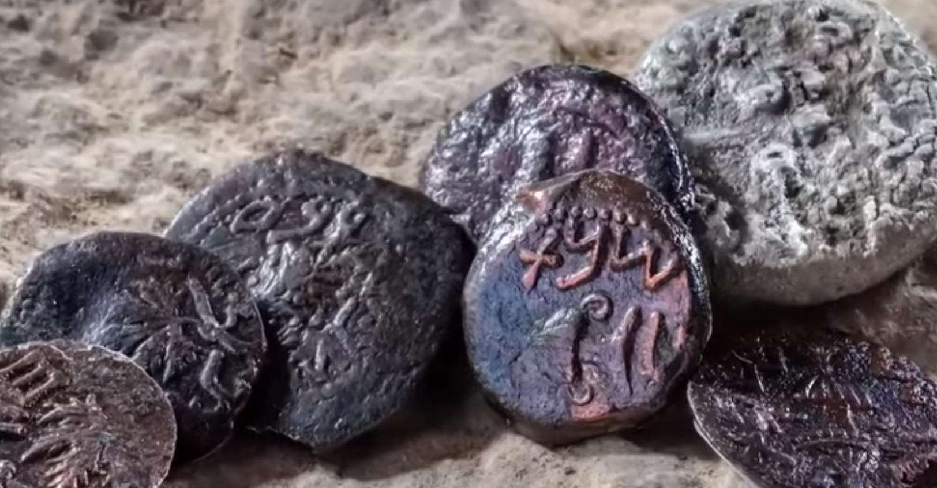
Several Coins of the First Century AD were found on the digs, mainly coins of the time of the Jewish revolt against the Romans 66-70 AD.

Slide 57
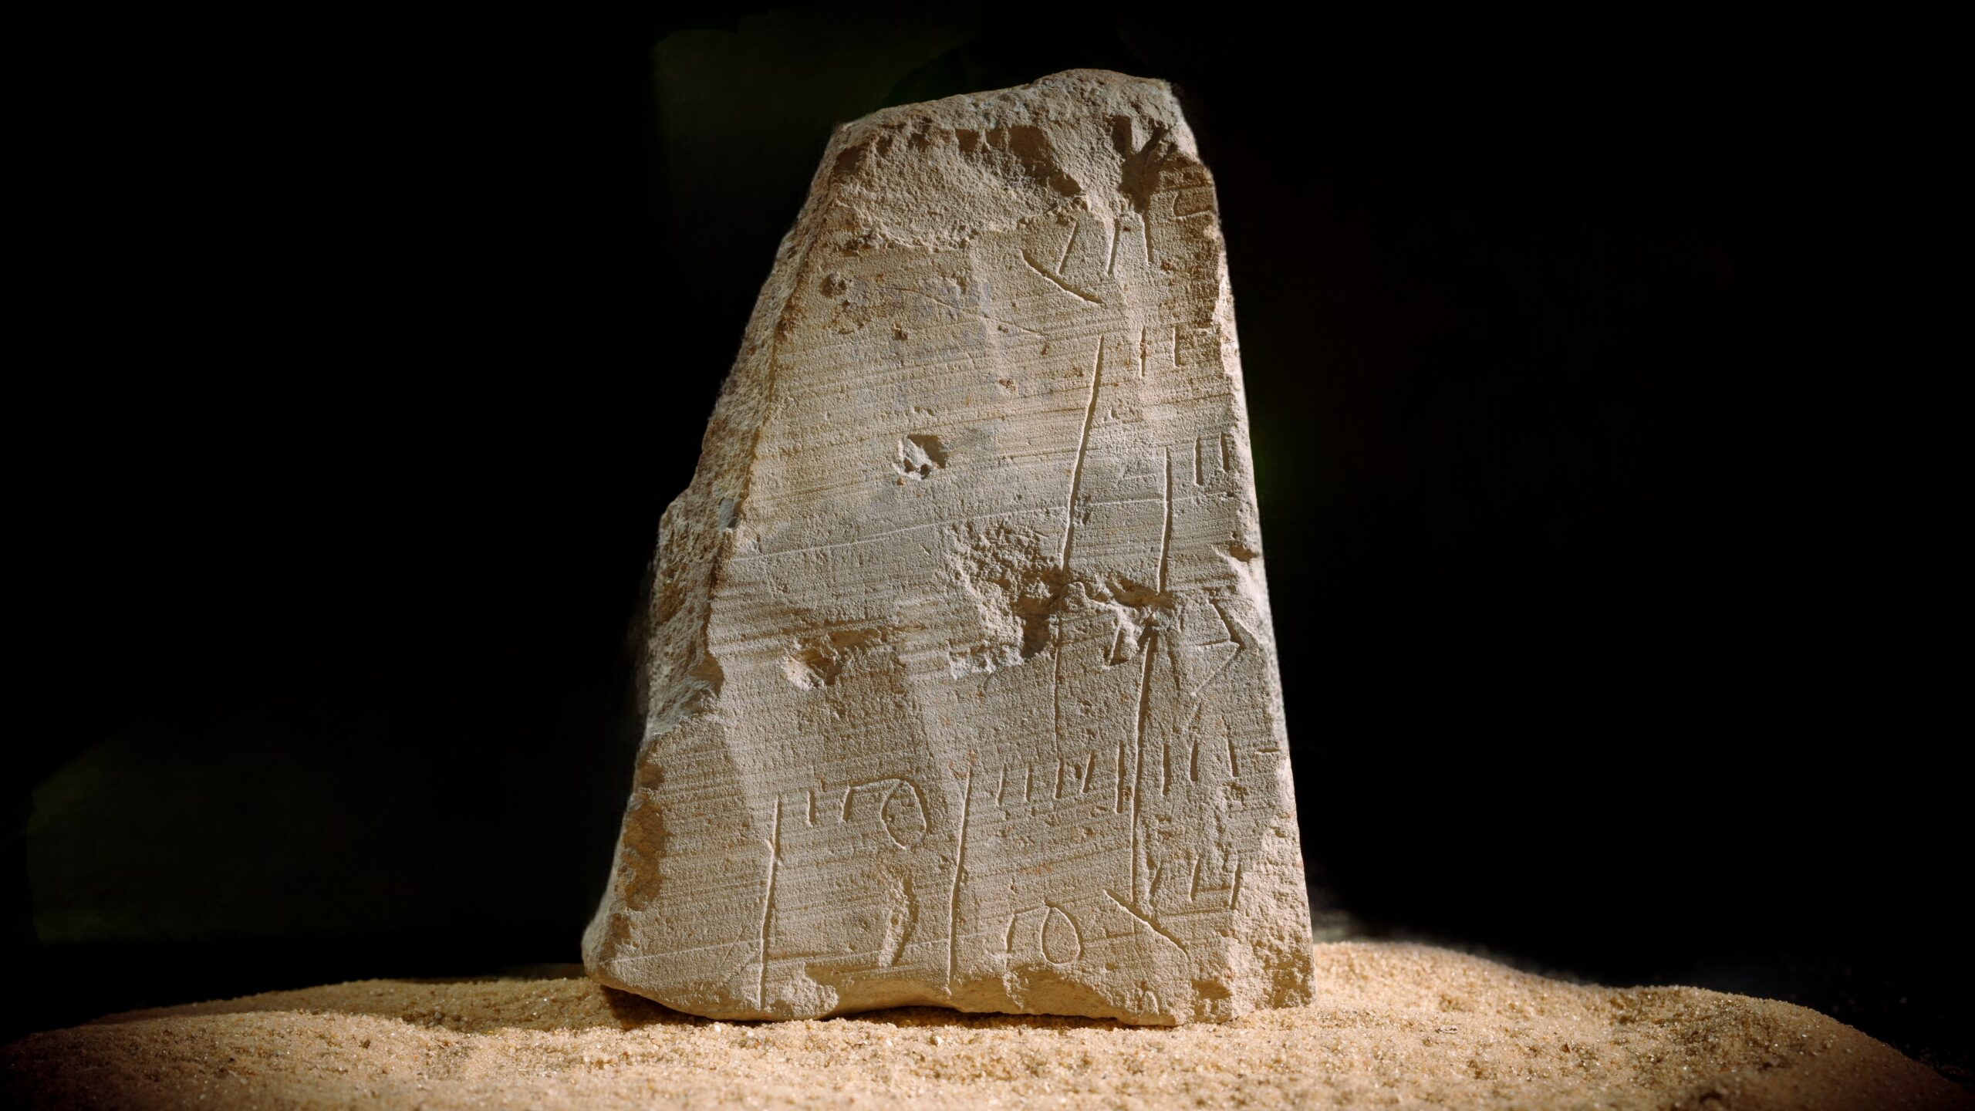
An interesting artifact measuring 2,5” x 3,5” was found in the road excavations. It contains seven lines of text, which seems to be some sort of bill or receipt belonging to Shimon.

Slide 58
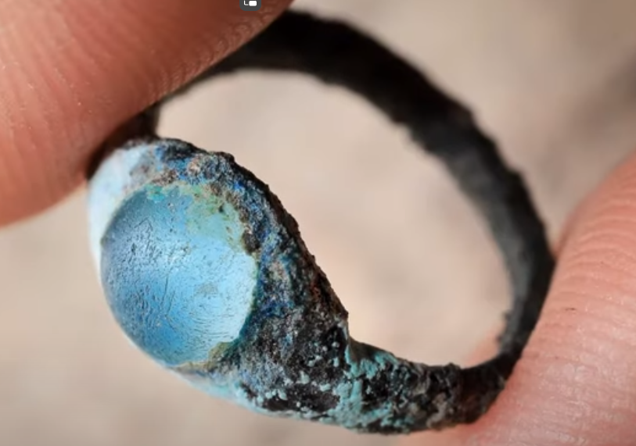
Among the finds is a ring.

Slide 59
