Slide 1
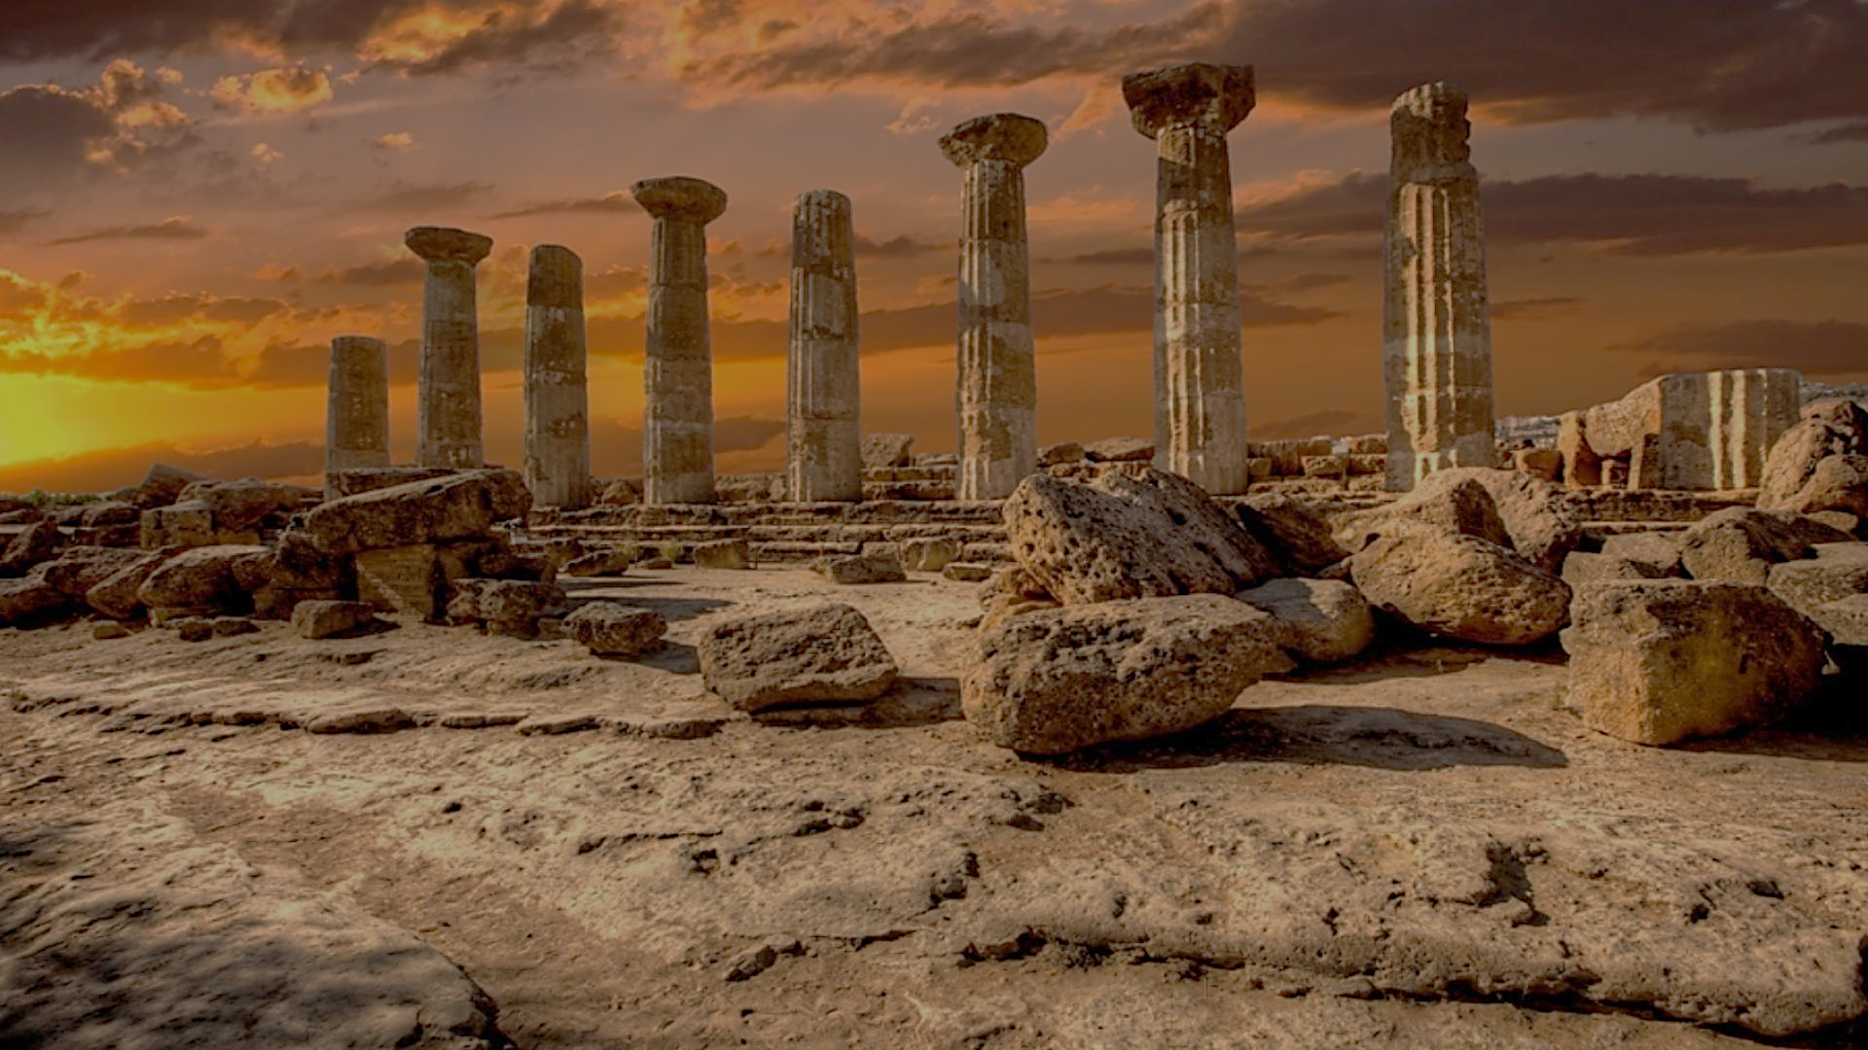
Archeology of Bible Times
Pastor John dos Santos - Faith Presbyterian Church

Slide 2
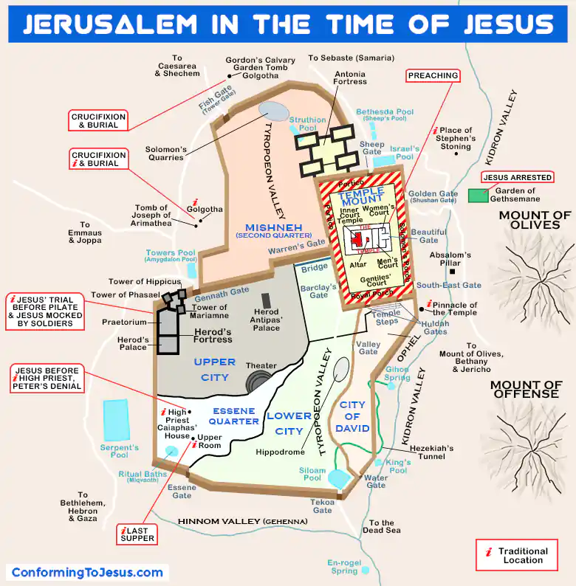

Slide 3
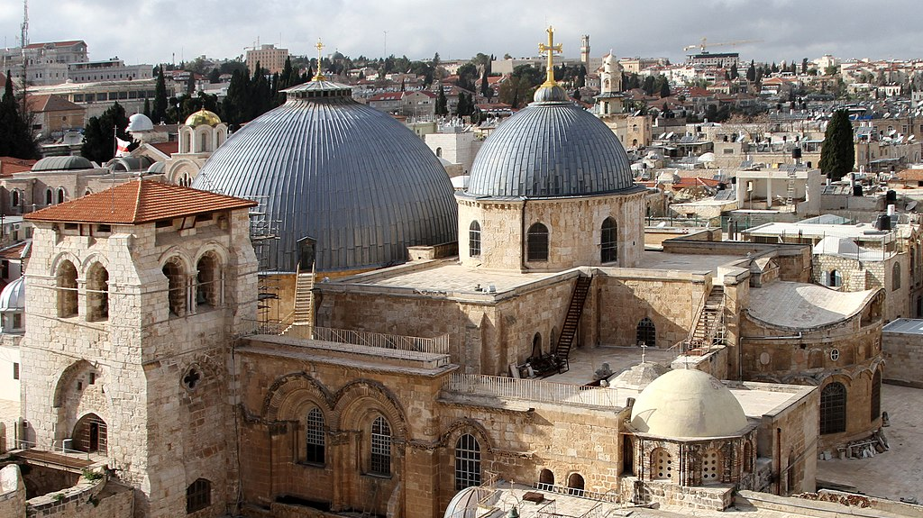
Church of the Holy Sepulcher

Slide 4
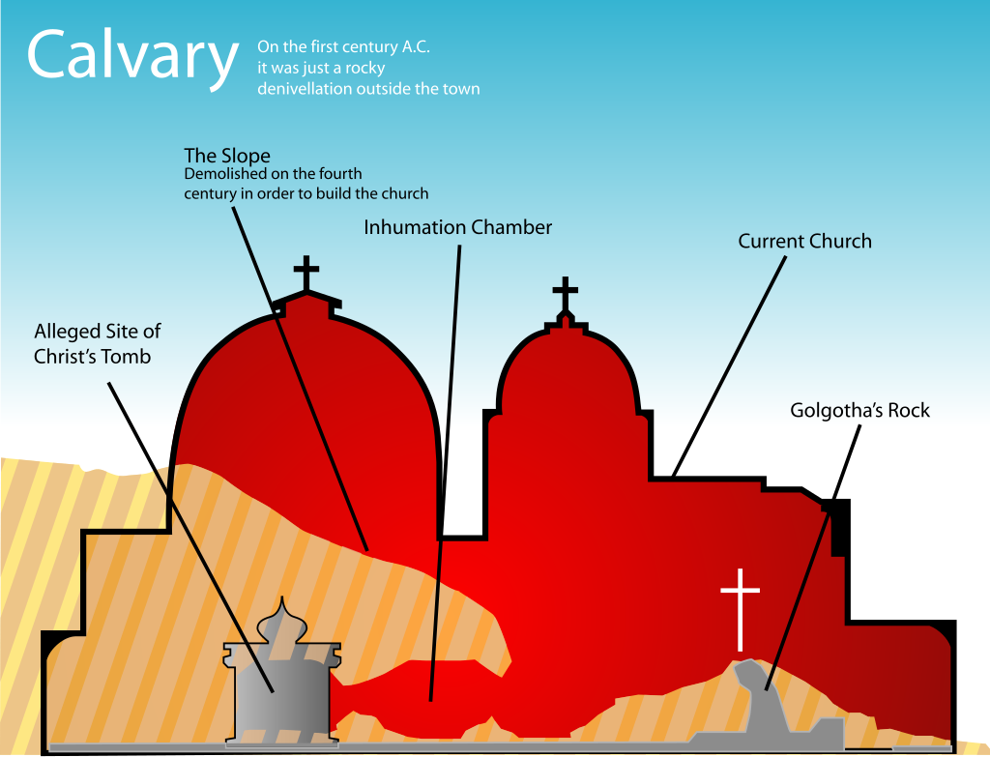

Slide 5
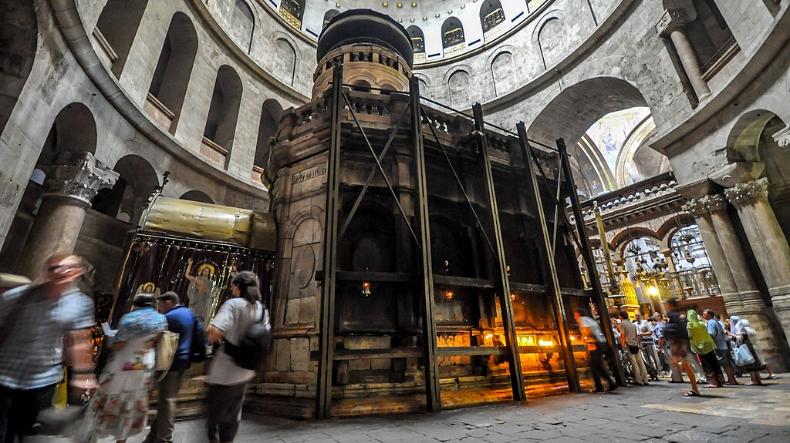
Rotunda
Aedicule

Slide 6
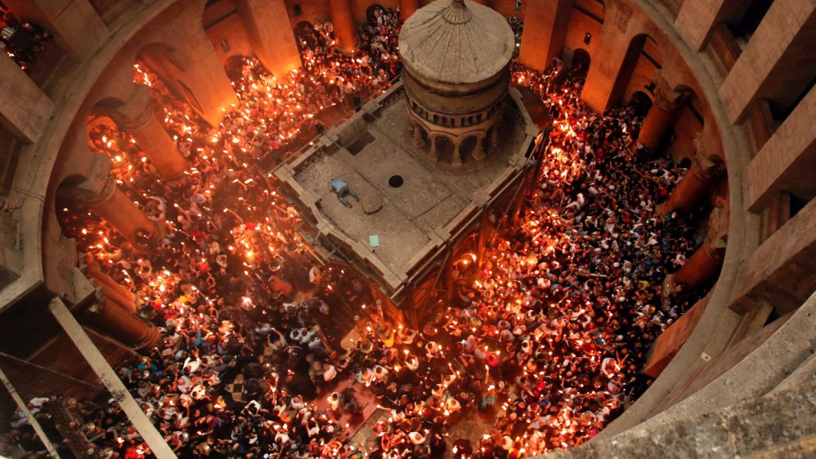

Slide 7
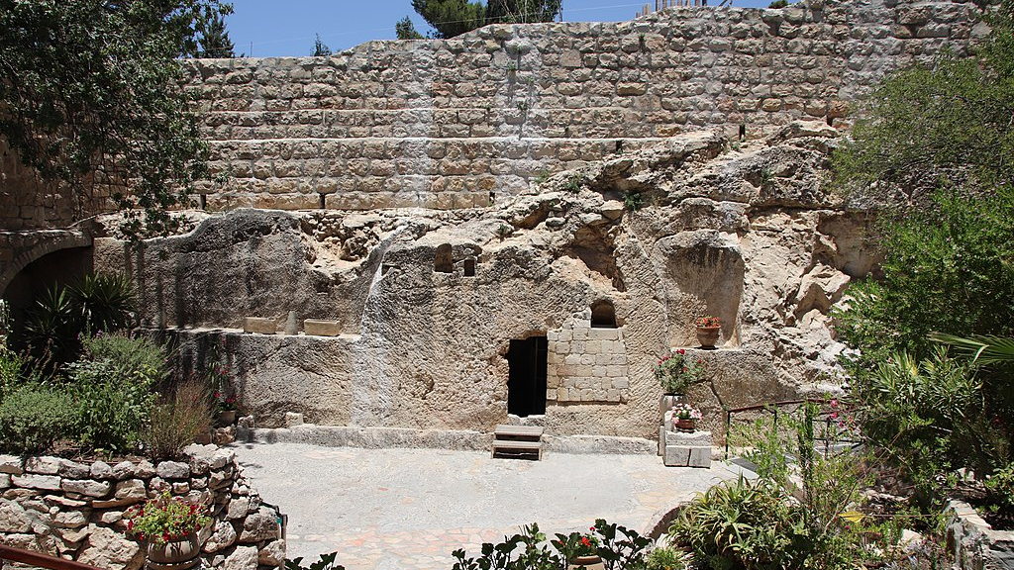
The Garden Tomb

Slide 8
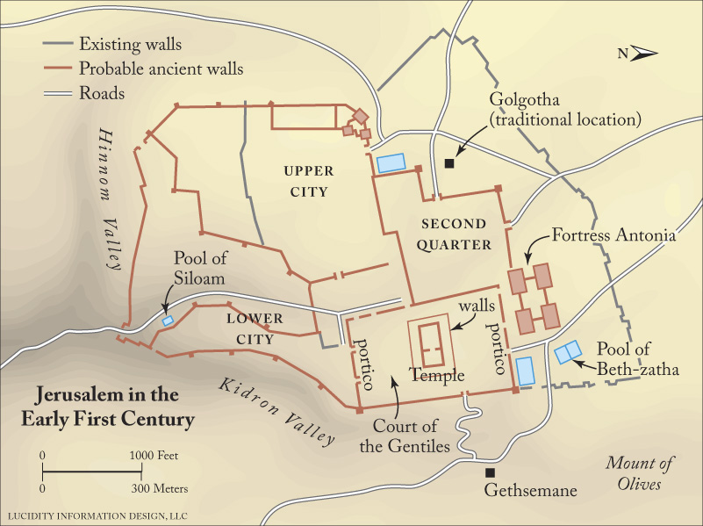
The challenge!
Through the centuries some have questioned the traditional site of Jesus’ burial. The basic dispute has been whether the traditional site is inside the city walls or not. Those who contend the site is not correct argue it was located inside the city walls in Jesus’ time. The reformers questioned the location of the holy sites and denounced their idolatry. Protestants in general became skeptical of them.

Slide 9
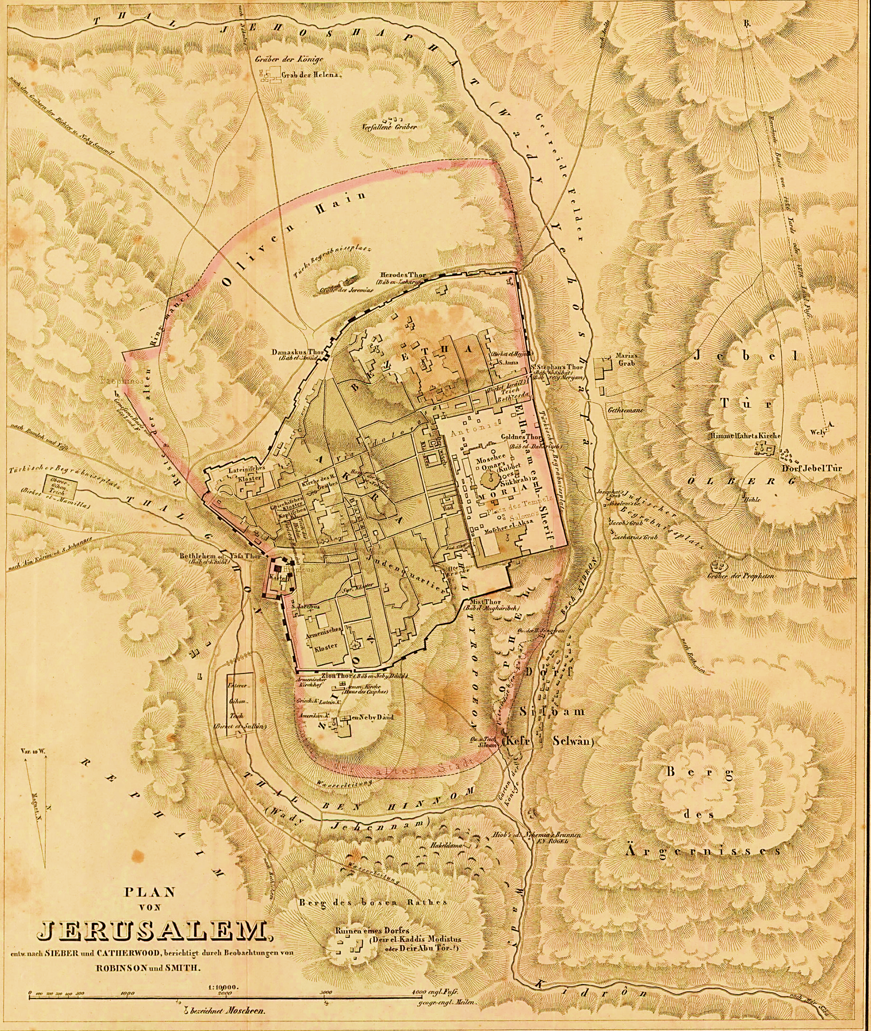
Robinson’s Research
In 1841 British archeologist Edward Robinson published the most extensive research on Jerusalem’s topography. Based on his study Robinson questioned the traditional site of the burial, suggesting someplace in the north.

Slide 11
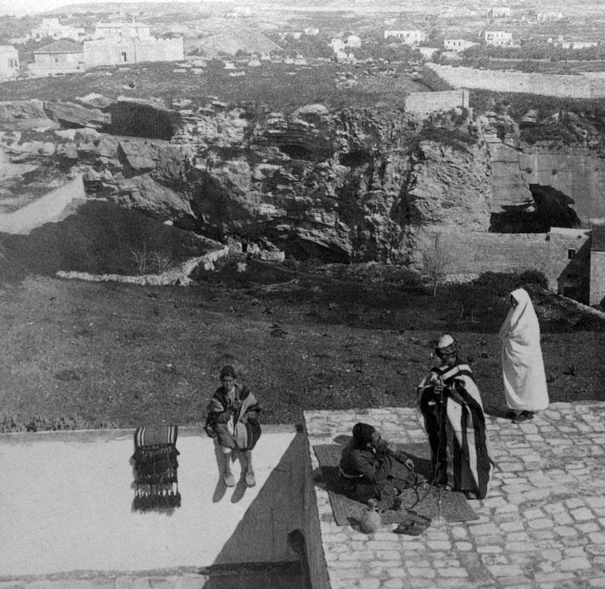
Rocky Hill
Otto Thenius in 1842 based on Robinson’s study was the first to propose a place called Rocky Hill as the Golgotha. He identified it because of a “skull” shape on the side of the Hill. Many others endorsed Otto Thenius’ proposal, but it was Charles Gordon, Major-General of the British army, who made it widespread.

Slide 12
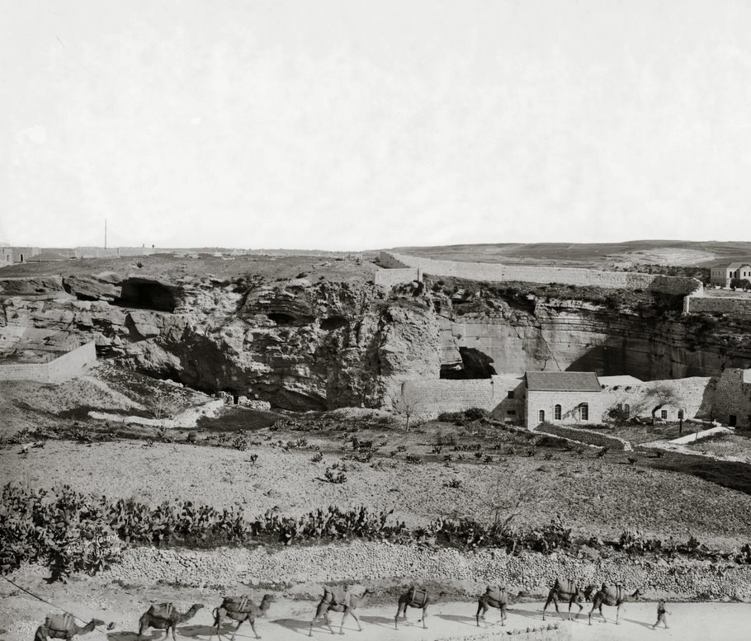
Various tombs were discovered around the Rocky Hill. One of them, called “Jeronimo Grotto”, was identified by Gordon as the real tomb of Jesus.

Slide 13
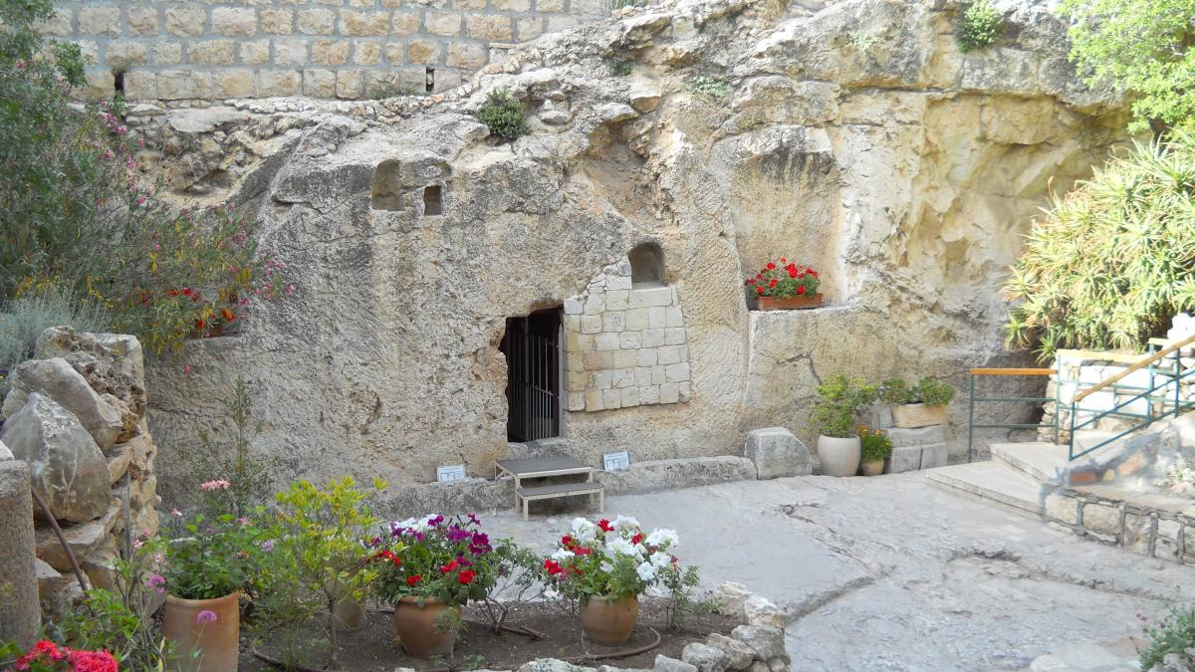

Slide 14
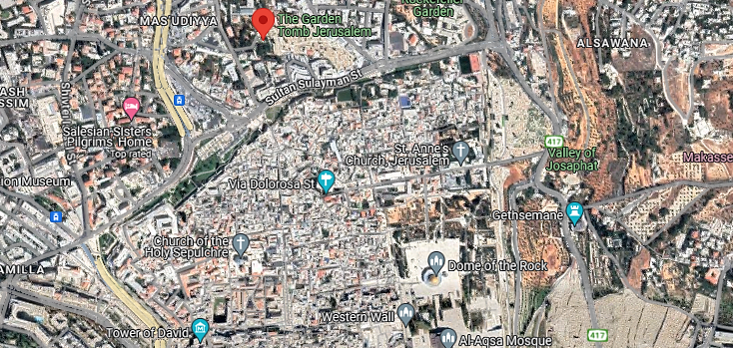

Slide 15
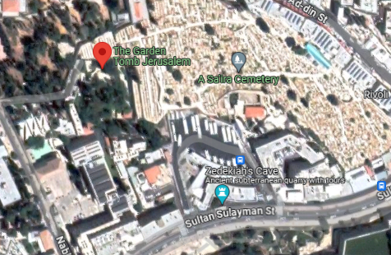

Slide 16
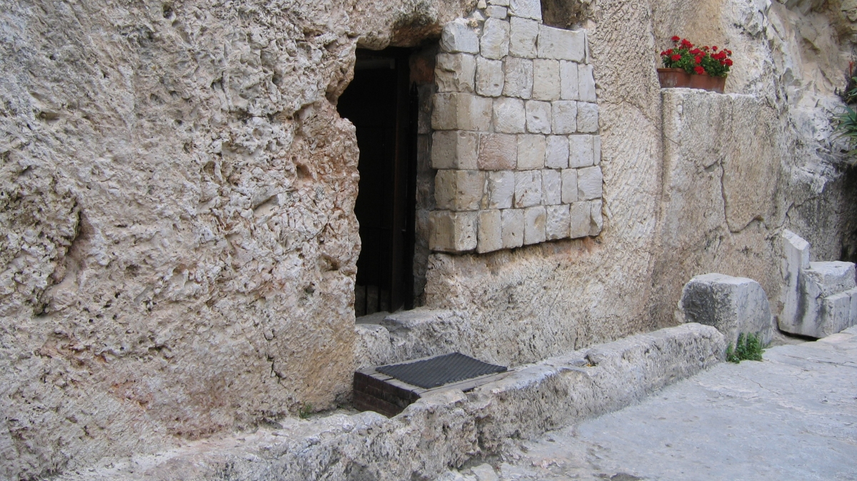

Slide 17
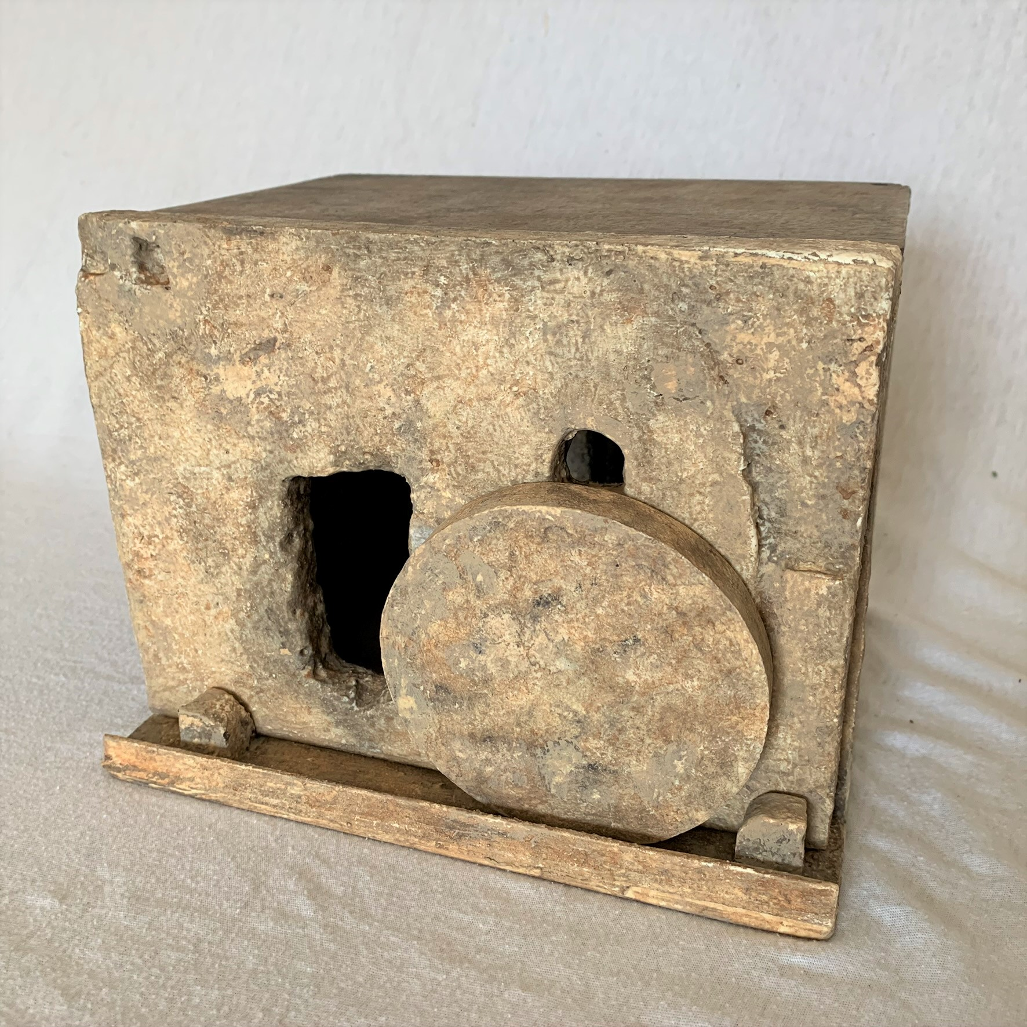

Slide 18
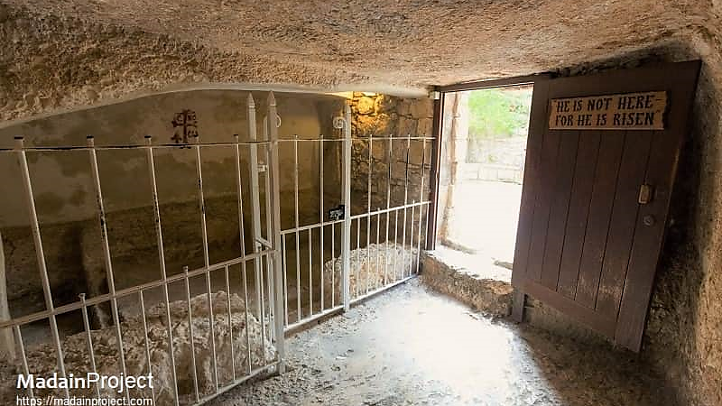

Slide 19
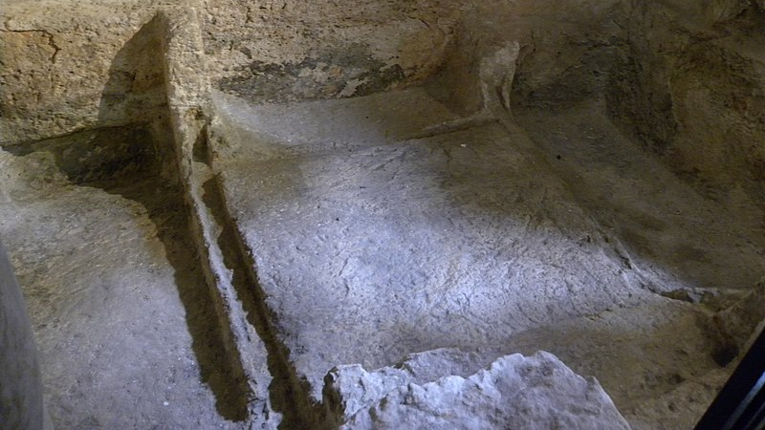

Slide 20
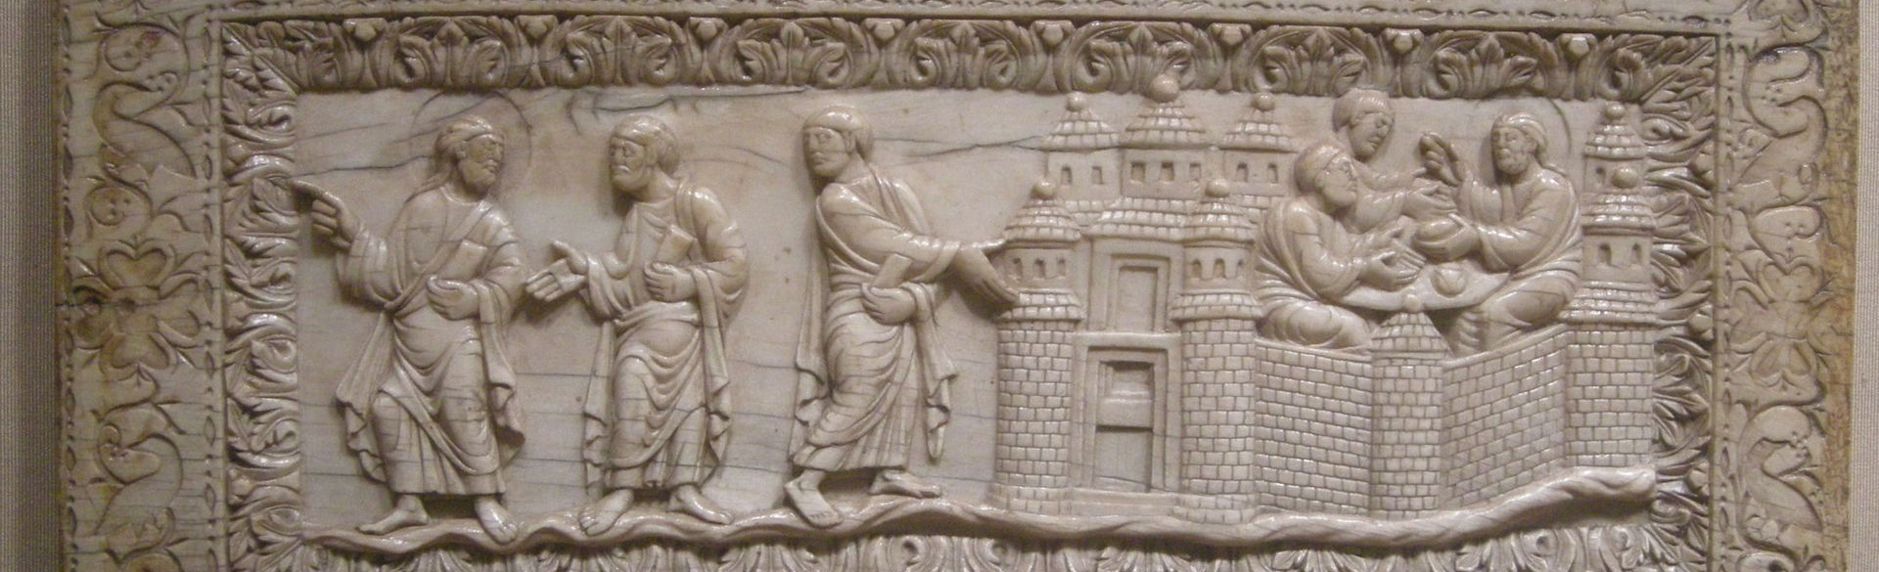
Metz ivory relief of the road to Emmaus from the 9th century
After Jesus’ resurrection, he first appeared to Mary at the tomb site and secondly to two of his disciples on the way to Emmaus. Jesus follows along with them and reveals himself to them when they arrive in Emmaus. This place is identified in the gospels as being “60 stadia” from Jerusalem (Luke 24.13). The word Emmaus is a Hebraism for “hot spring”. Flavius Josephus tells of an important battle fought in Emmaus in 165 AD during the time of the Maccabees (some 165 stadia from Jerusalem). He mentions another Emmaus during the Jewish Revolt closer (around 36 stadia).

Slide 21
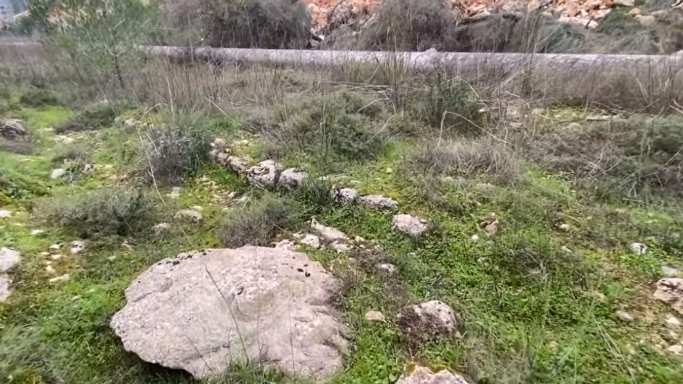

Slide 22
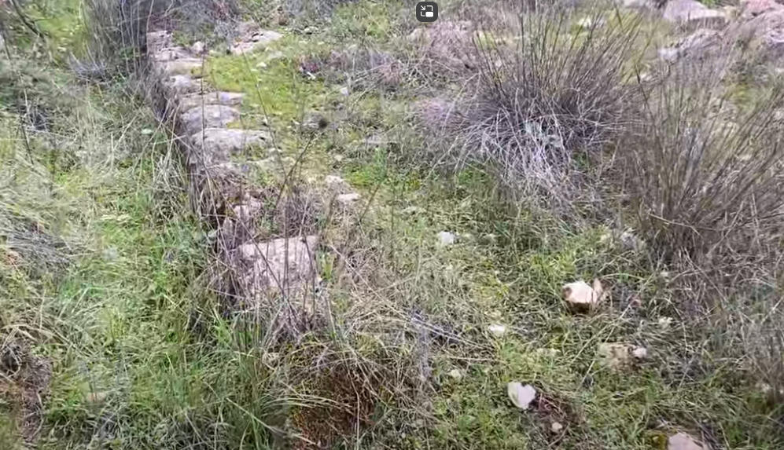

Slide 23
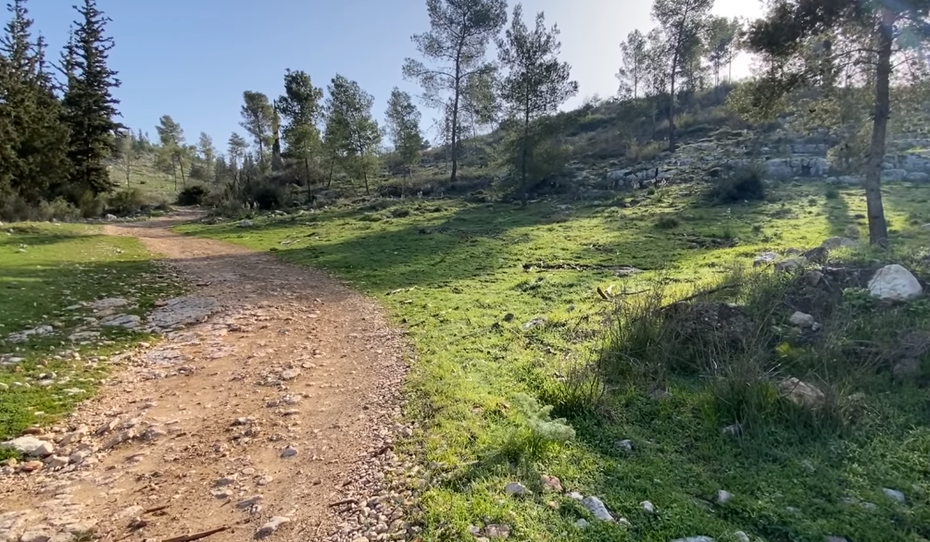

Slide 24
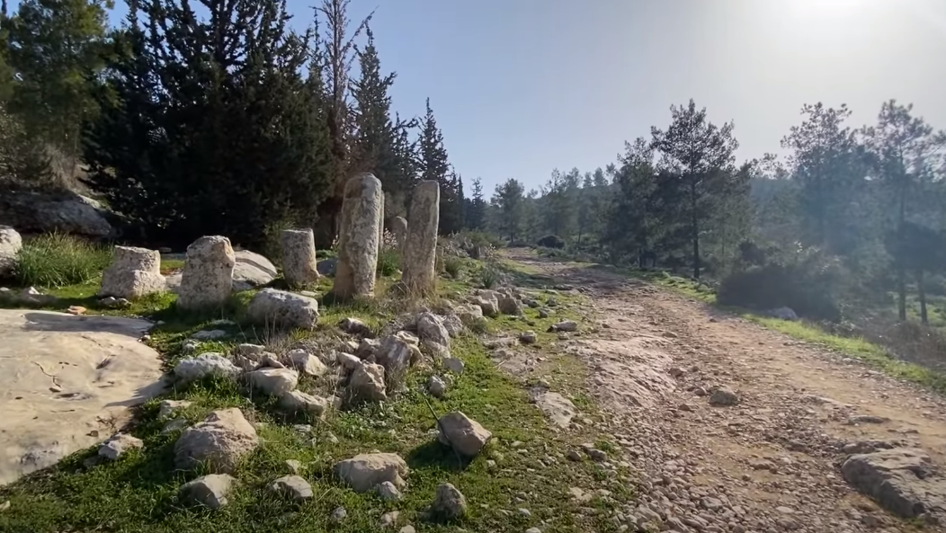

Slide 25
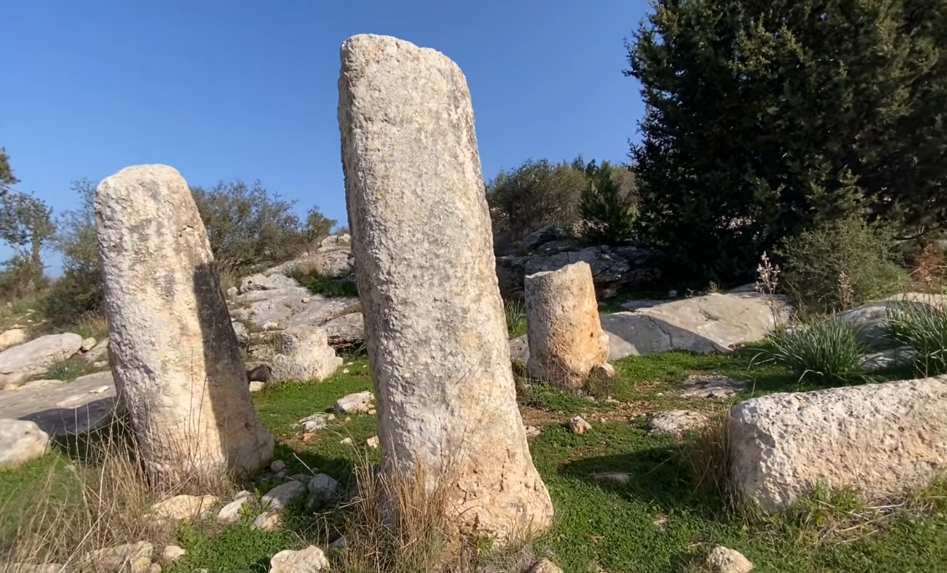

Slide 26
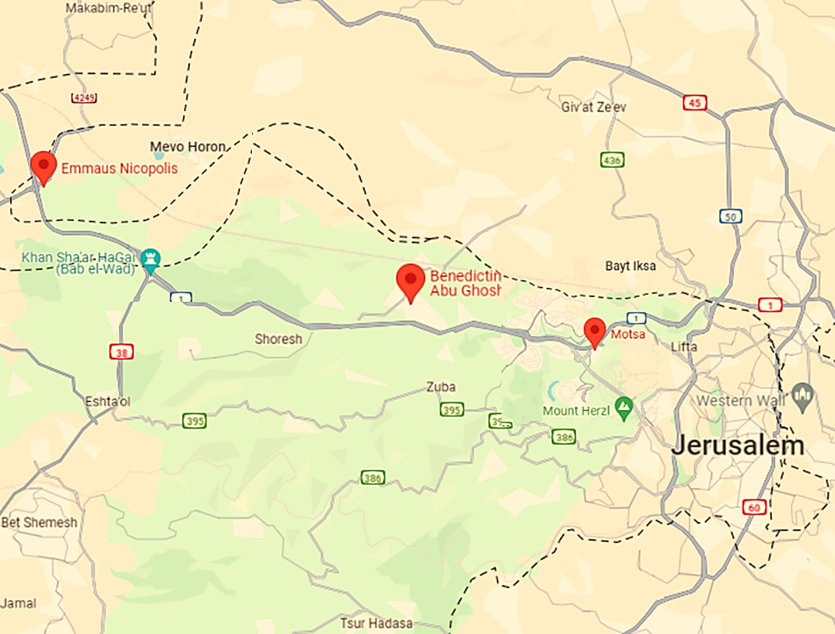
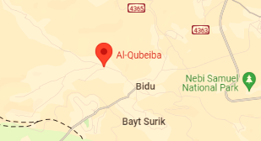
Candidates?
There are some candidates for Emmaus:
Nicopolis (18 miles),
Abu Gosh (11 miles),
El-Kubeibeh (8 miles)
Colonyia/Motza (6 miles).

Slide 27
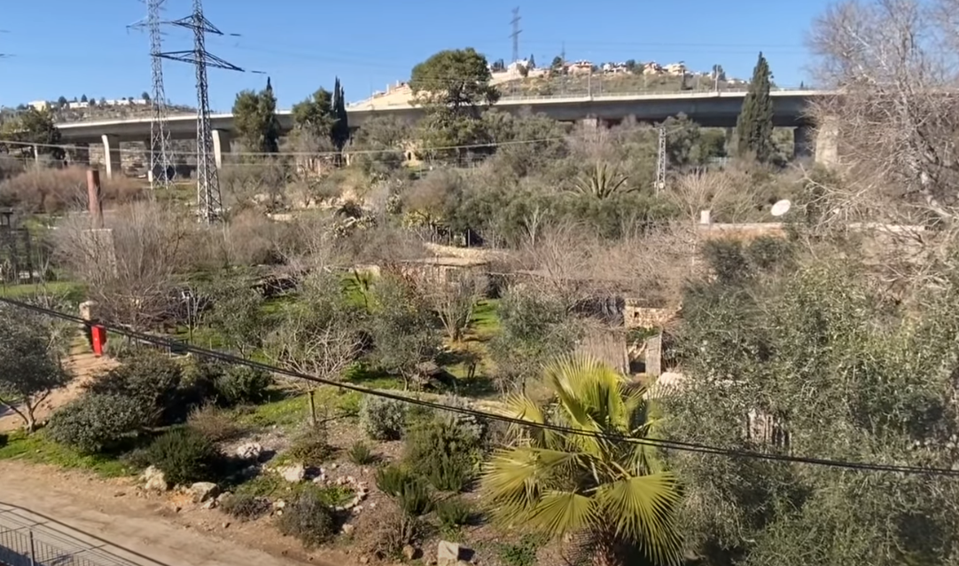
Colonyia
36 Stadia away

Slide 28
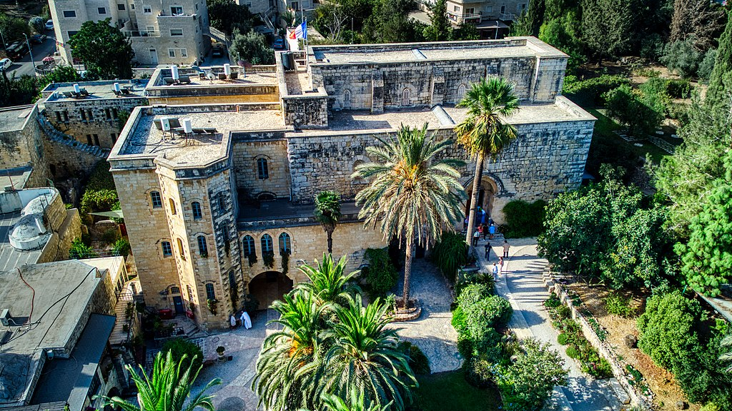
Abu Gosh
83 stadia away

Slide 29
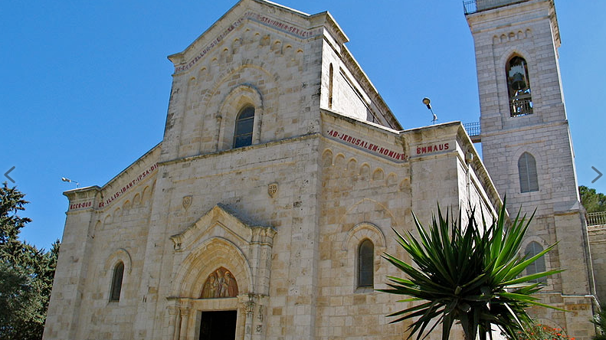
el-Kubeibeh
St. Cleopas Church
60 stadia away

Slide 30
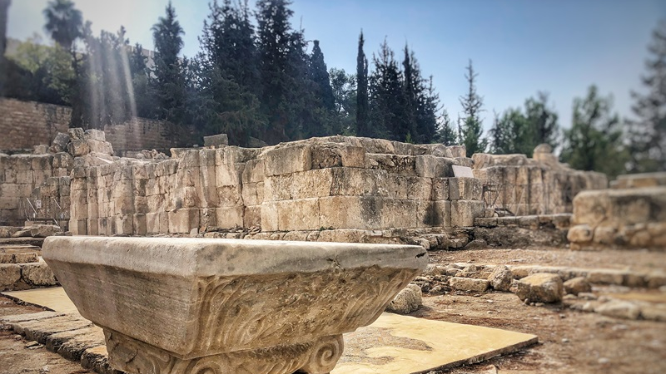
Nicopolis
160 stadia away

Slide 31
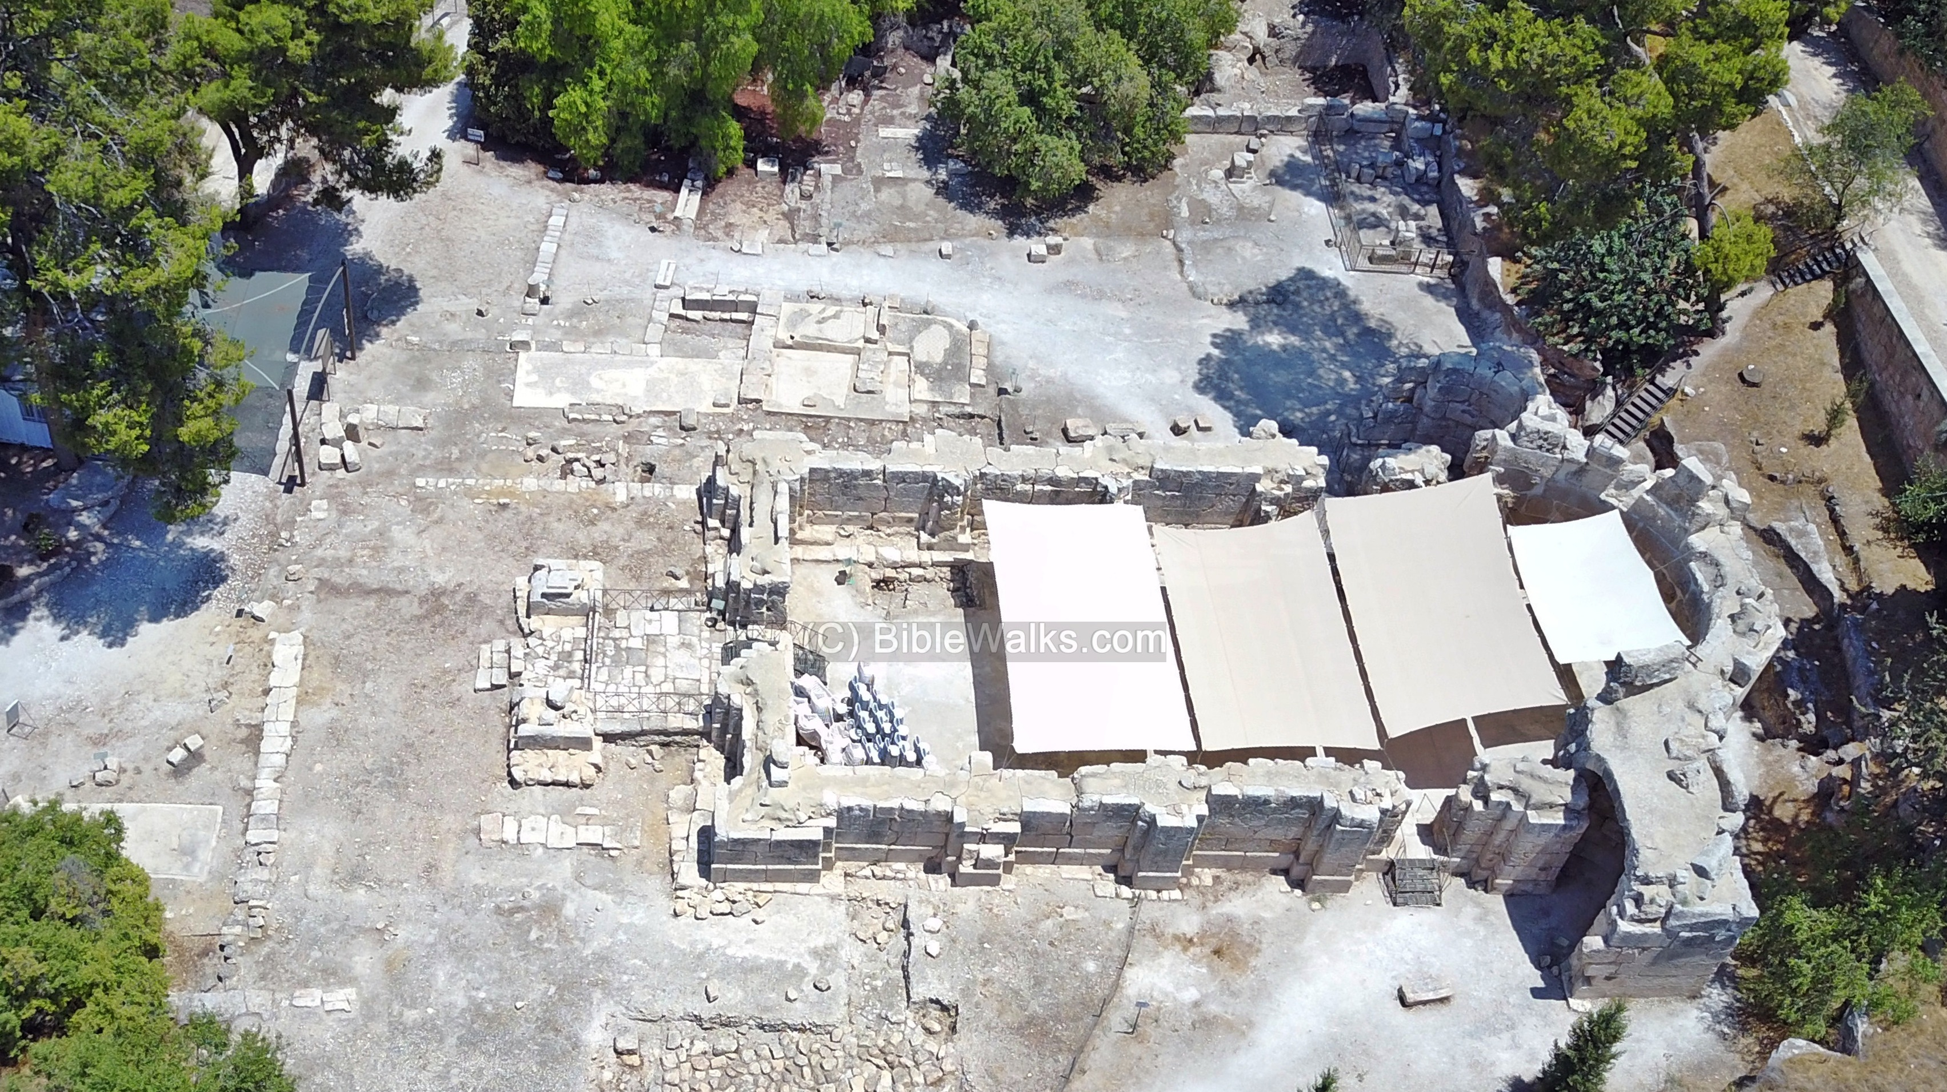

Slide 32
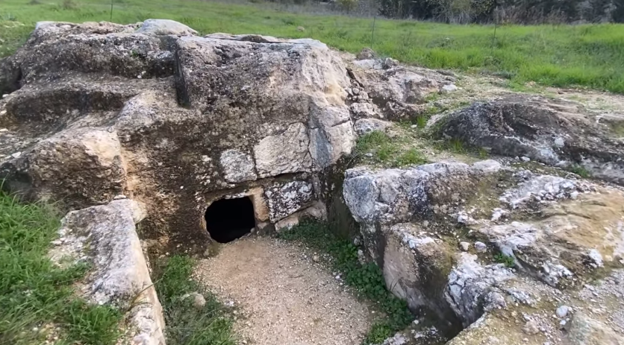

Slide 33
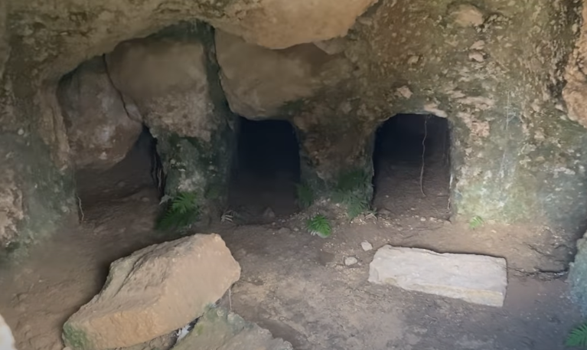

Slide 34
Candidates?
There are some candidates for Emmaus:
Nicopolis (18 miles),
Abu Gosh (11 miles),
El-Kubeibeh (8 miles)
Colonyia/Motza (6 miles).

