Slide 1
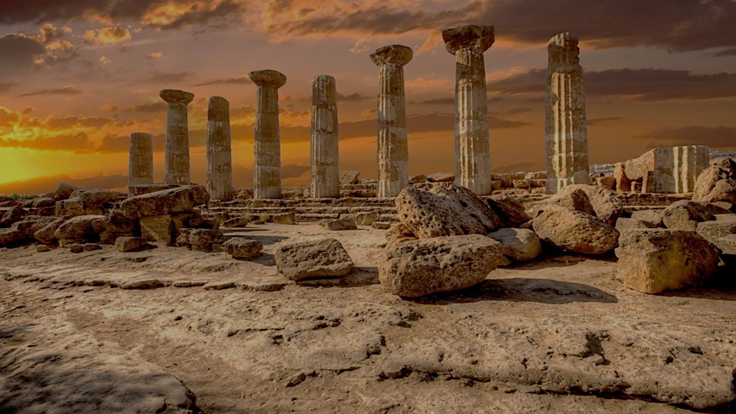
Archeology of Bible Times
Pastor John dos Santos - Faith Presbyterian Church

Slide 2
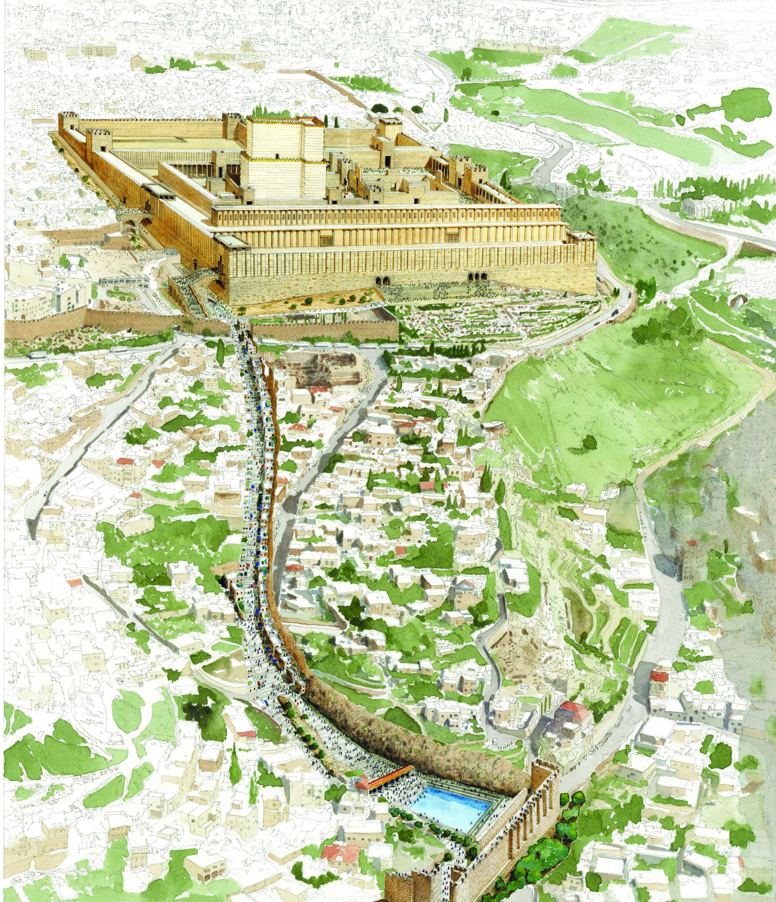
Drawing of the Pilgrimage Road, running from the Pool of Siloam to the Second Temple.
Rights to Shalom Kveller, City of David Archives.
Image: Second Temple Period Receipt Found in the City of David (biblicalarchaeology.org)

Slide 3
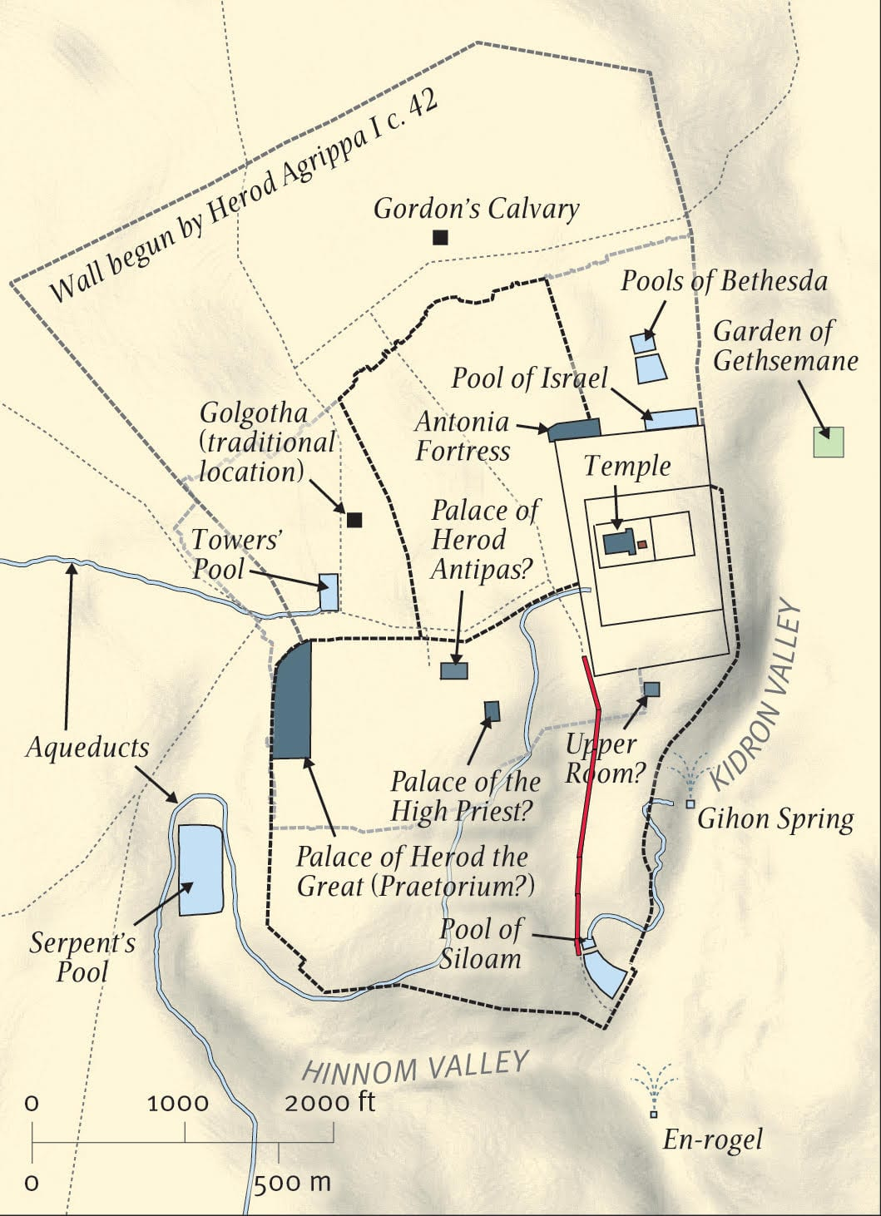
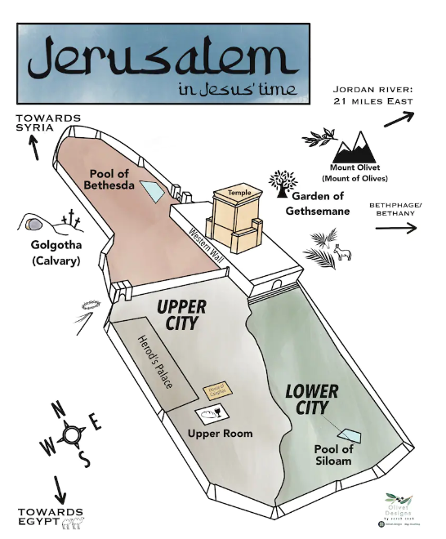
Image: Was the Road in Jerusalem Discovered by Archaeologists Really Built by Pontius Pilate?
Image: DIGITAL DOWNLOAD Map of Jerusalem in Jesus' Time Holy Land Christ Bible Scripture Study New Testament Kids Easter Holy Week - Etsy

Slide 4
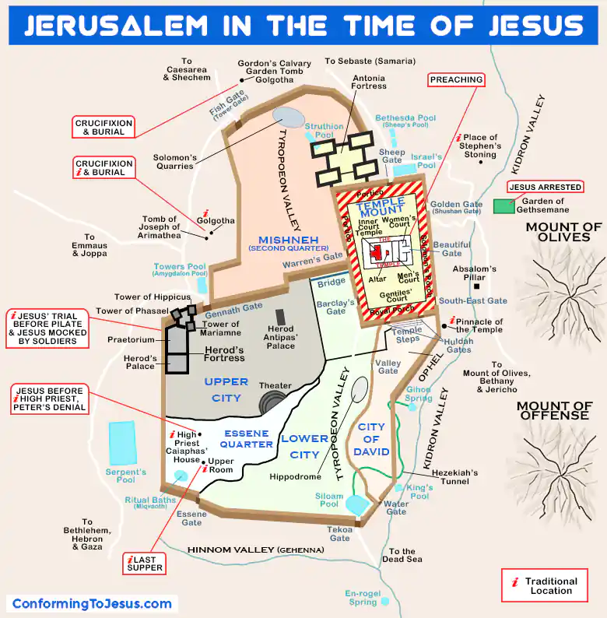

Slide 5
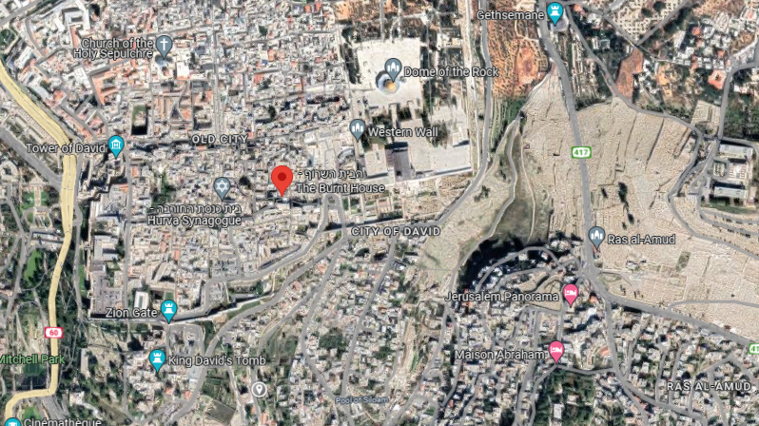
Petrus in Gallicantu

Slide 6
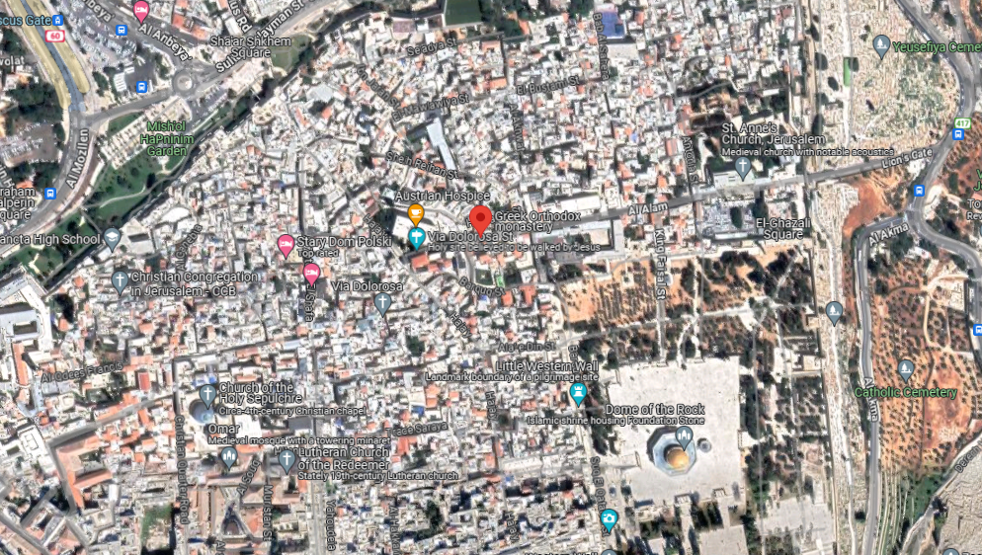

Slide 7
Praetorium

Slide 8
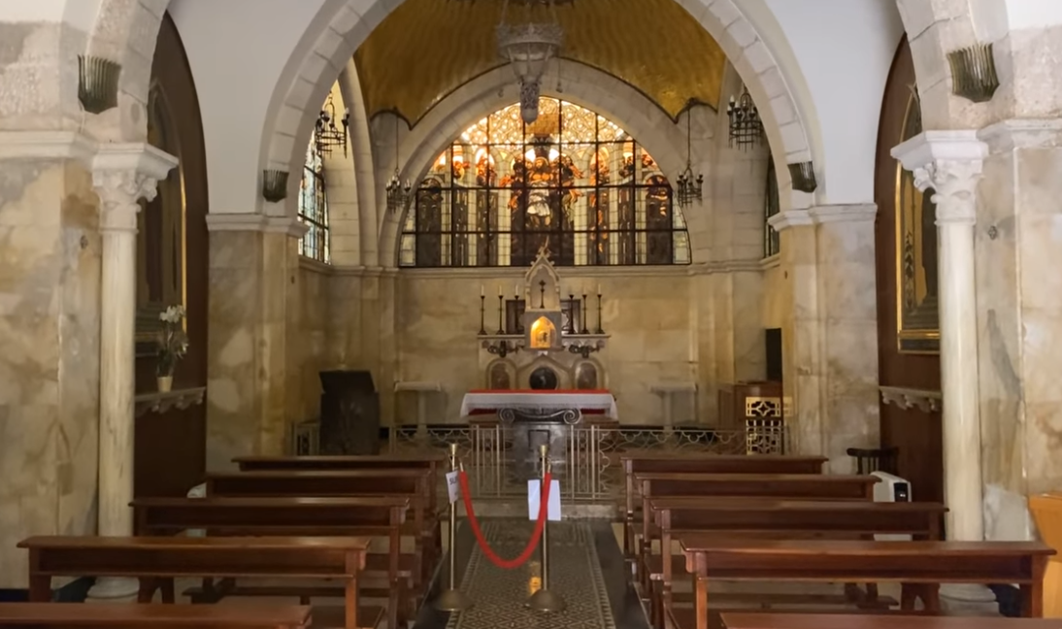

Slide 9
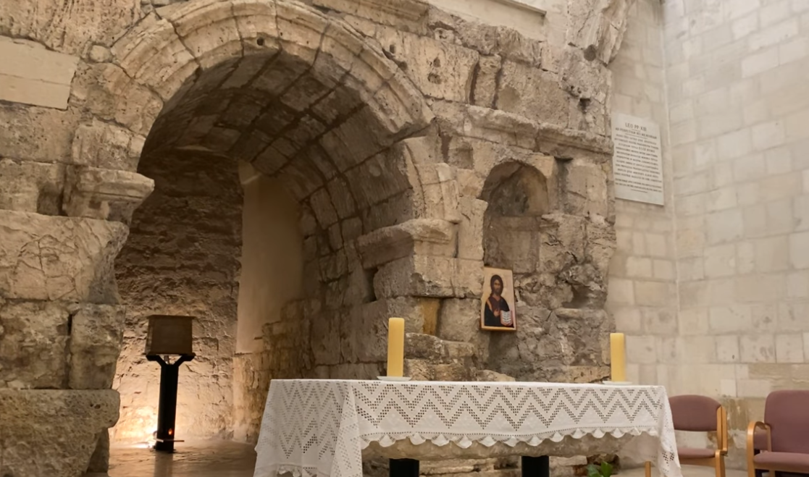

Slide 10
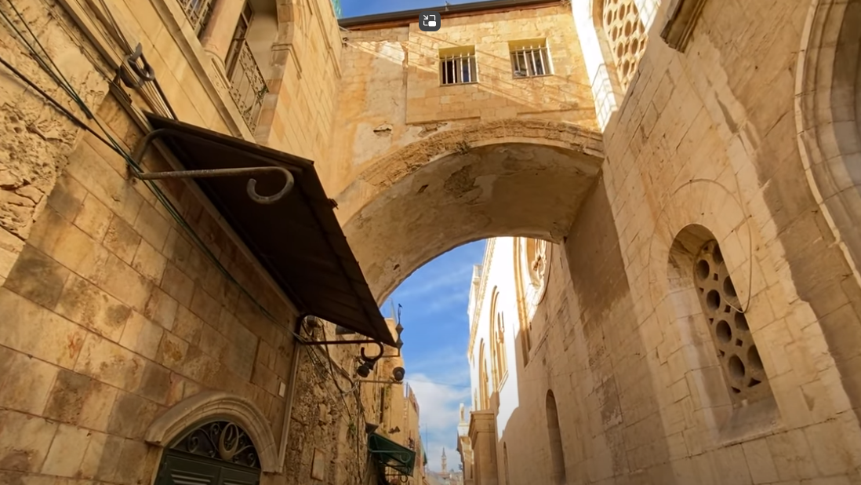

Slide 11
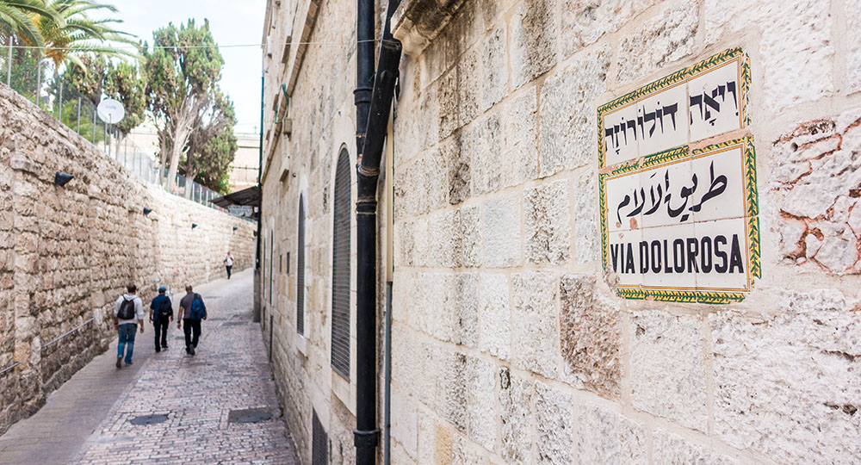

Slide 12
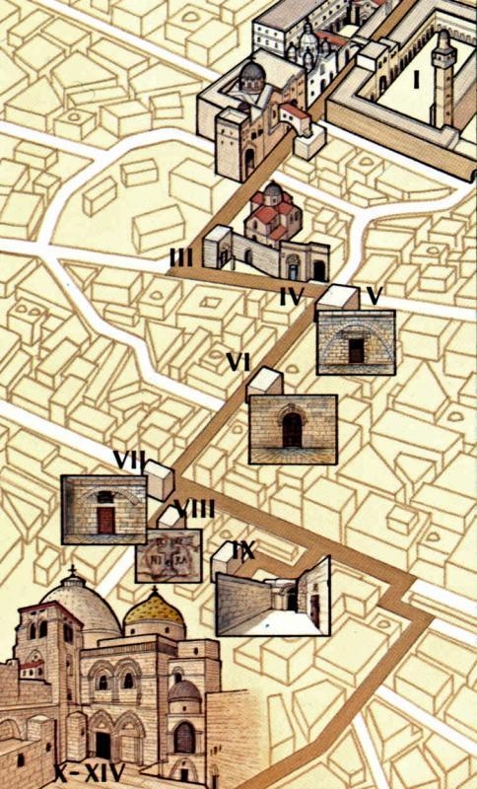
The Via Dolorosa is a processional route composed of 14 stops (stations) of around 2000 ft which is believed to be the way Jesus took up to Calvary. Through the centuries these sites have been attributed to different places, but the current route was established in the 18th century as a consensus among Christians.

Slide 13
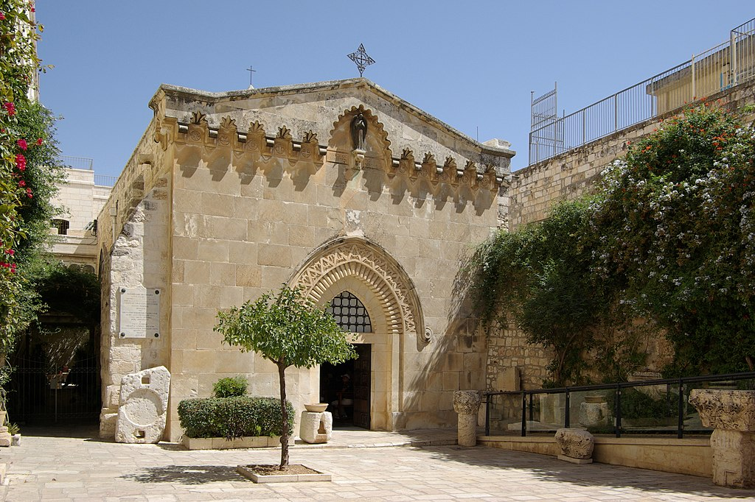
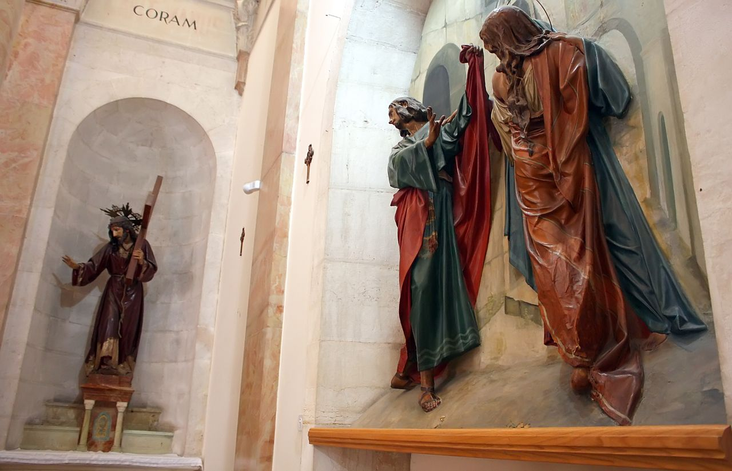
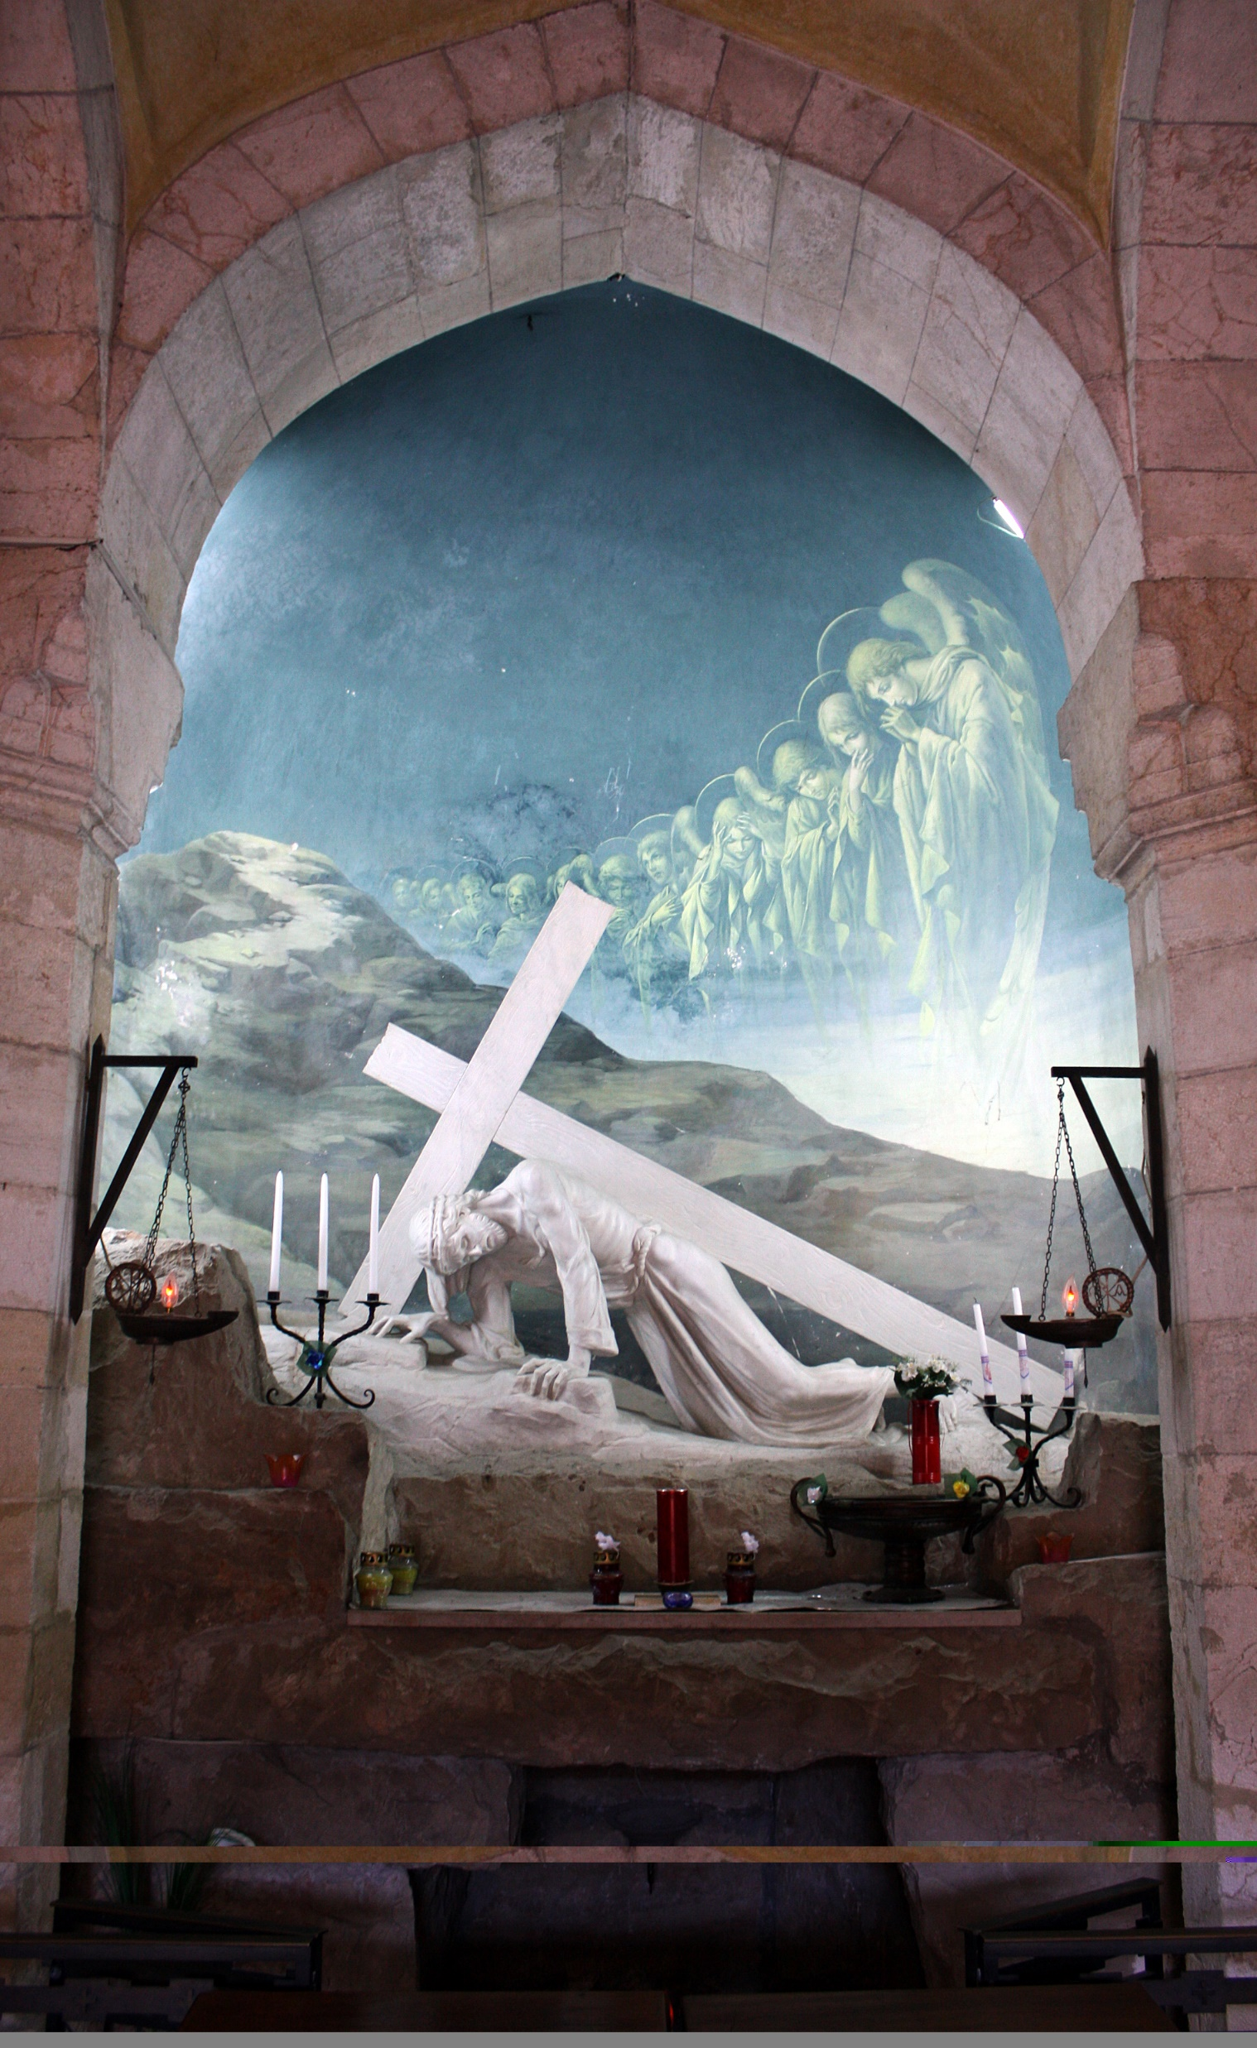
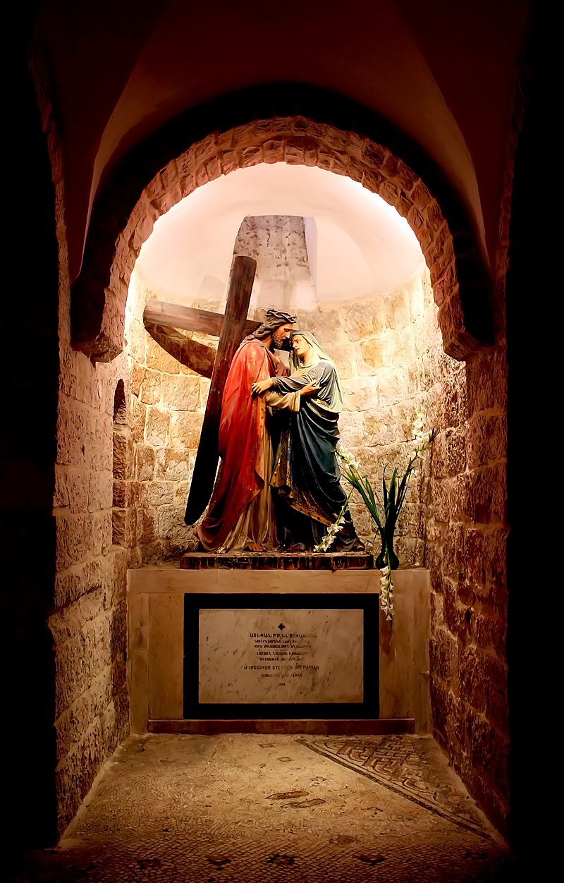
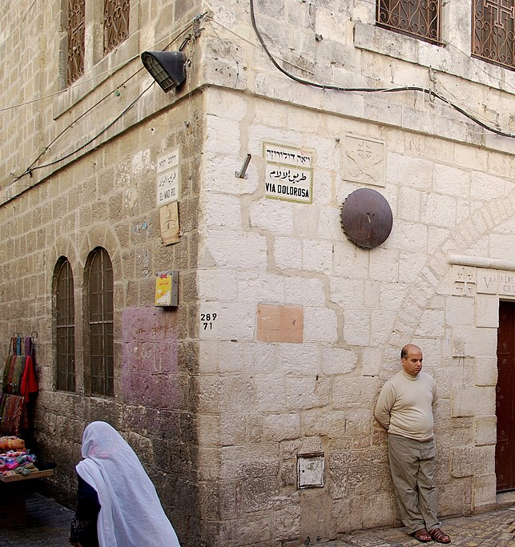
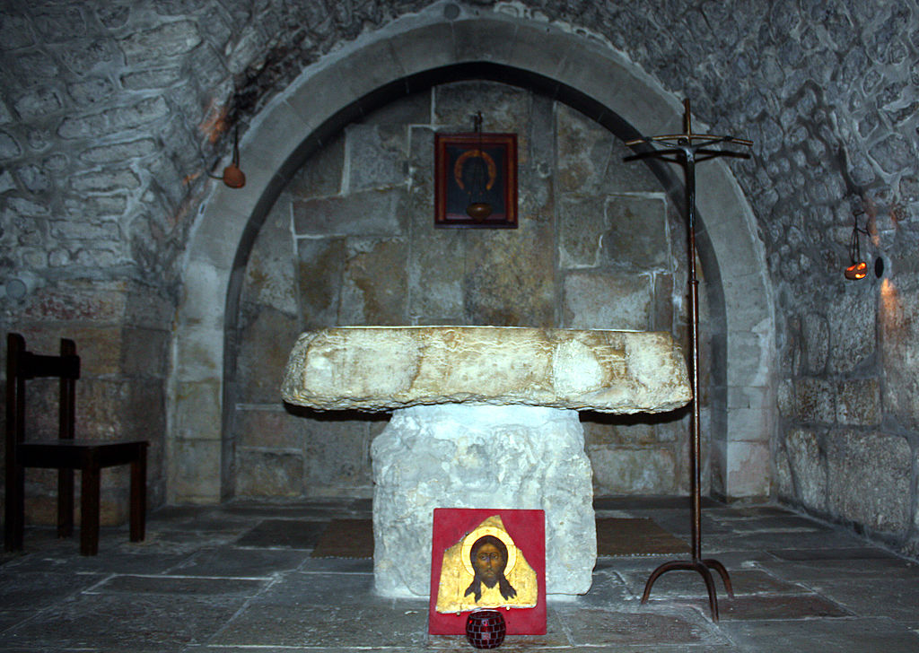
1
Jesus is condemned
2
Jesus is handed the Cross
3
Jesus falls
4
Jesus talks to Mary
5
6
St. Veronica Wipes Jesus’ face
Simon of Cirene Helps Jesus

Slide 14
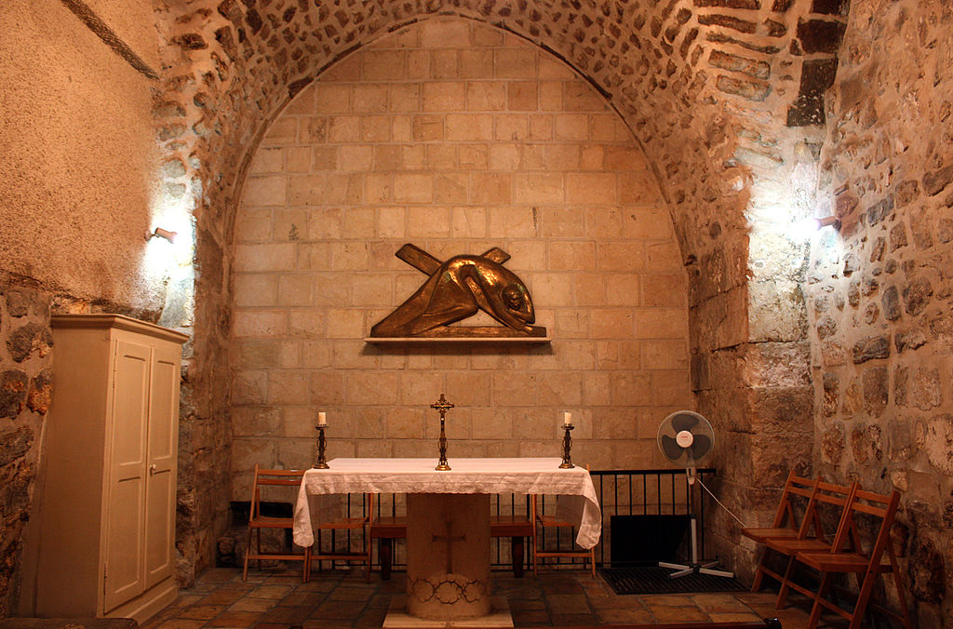
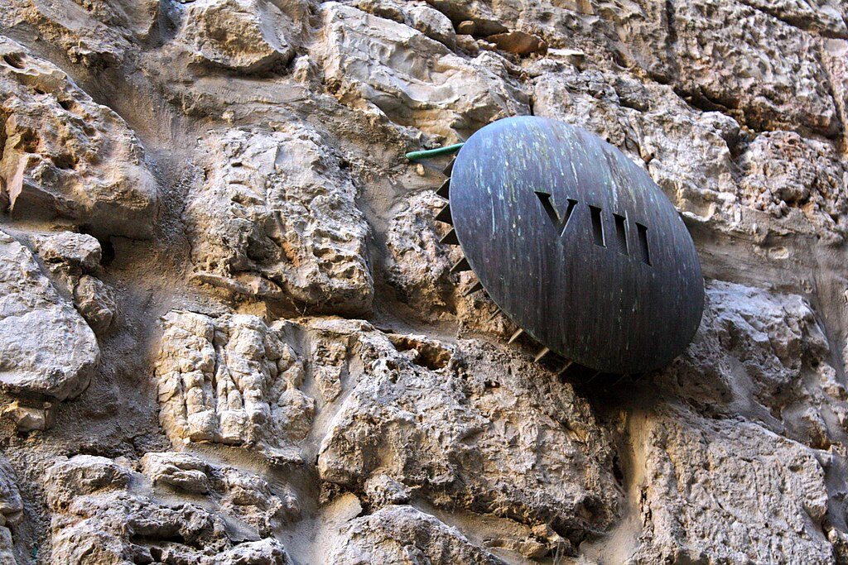
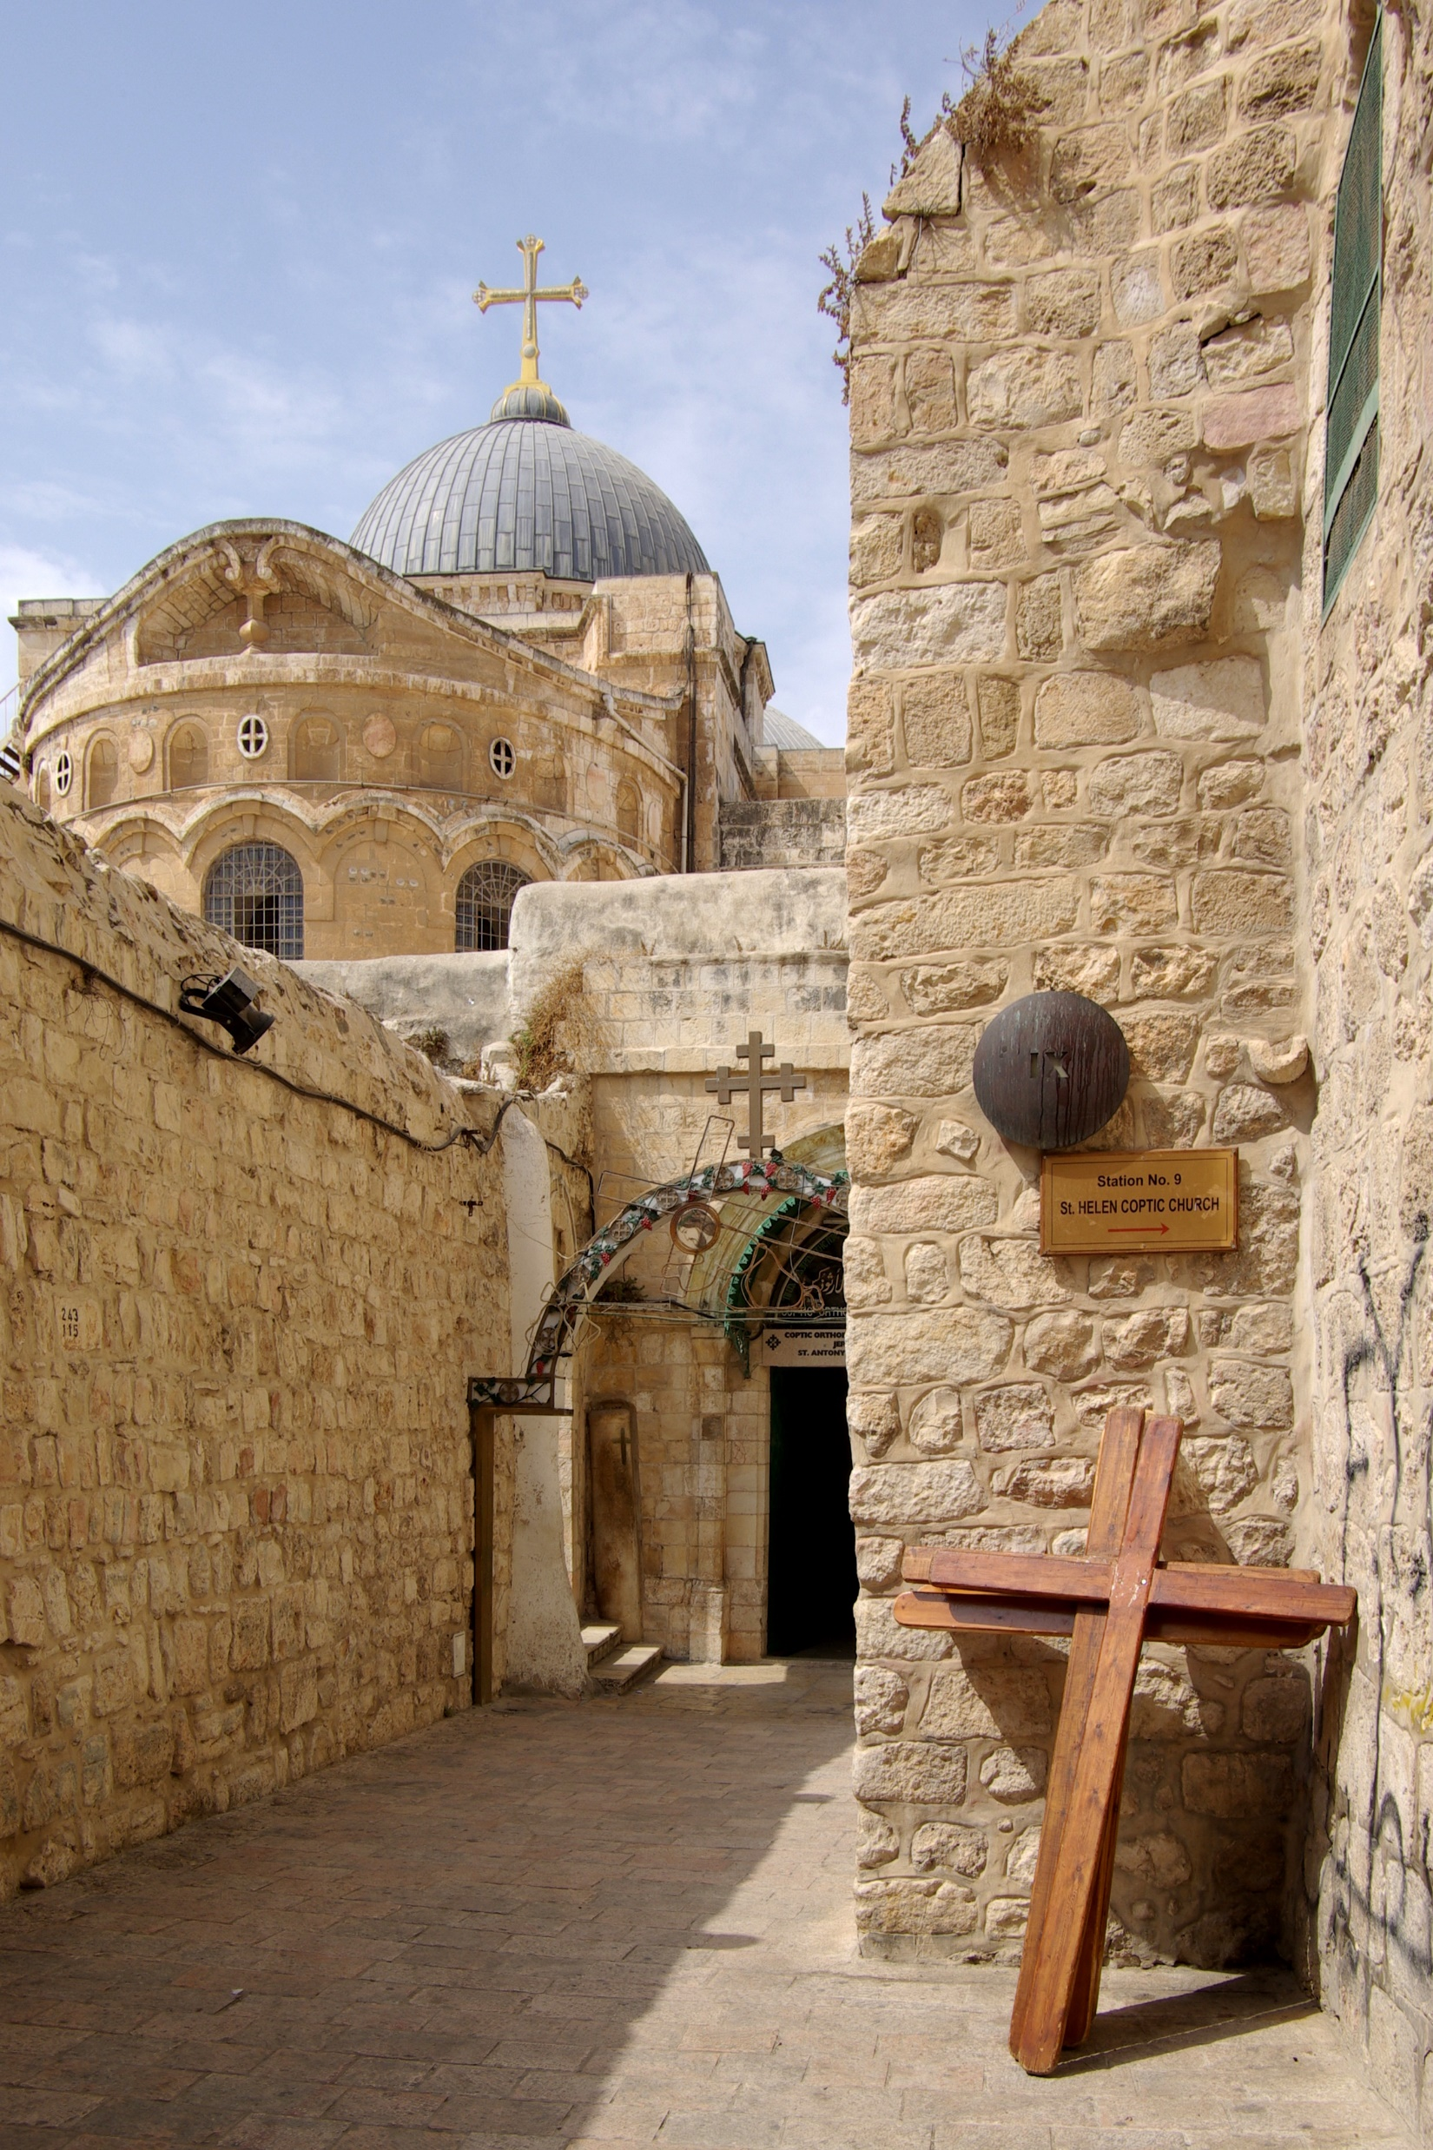
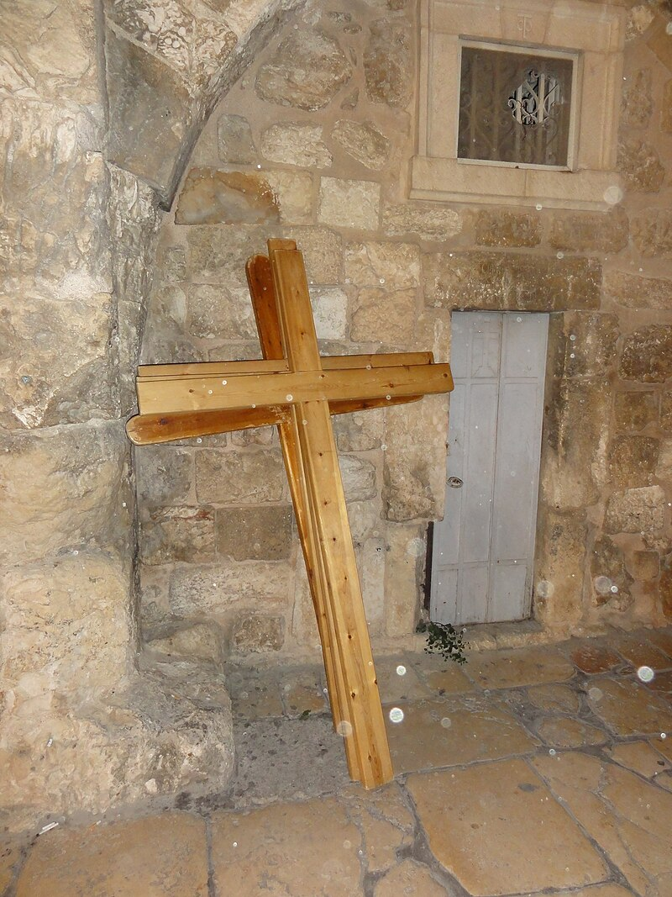
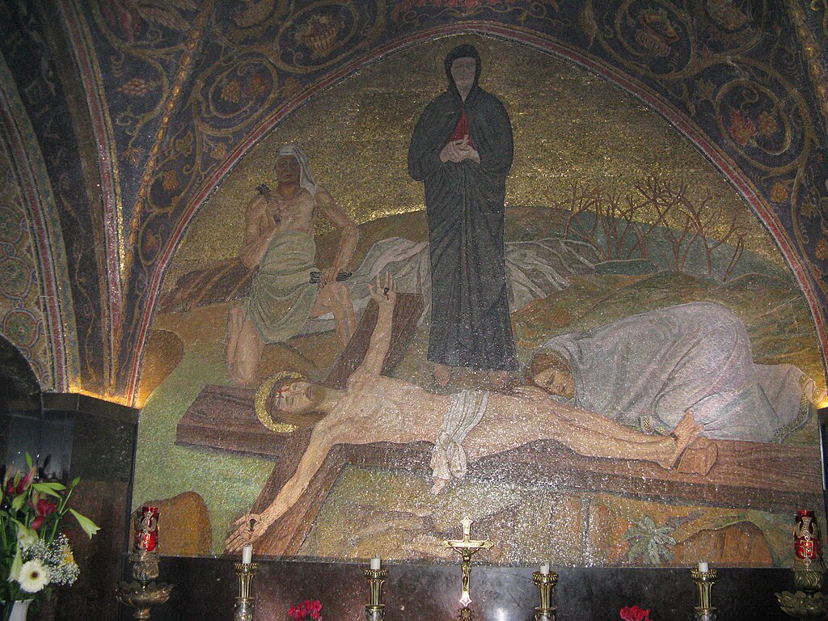
7
Jesus falls
8
Jesus consoles the women
9
Jesus falls
10
Jesus is undressed
11
Jesus is Nailed to the Cross

Slide 15
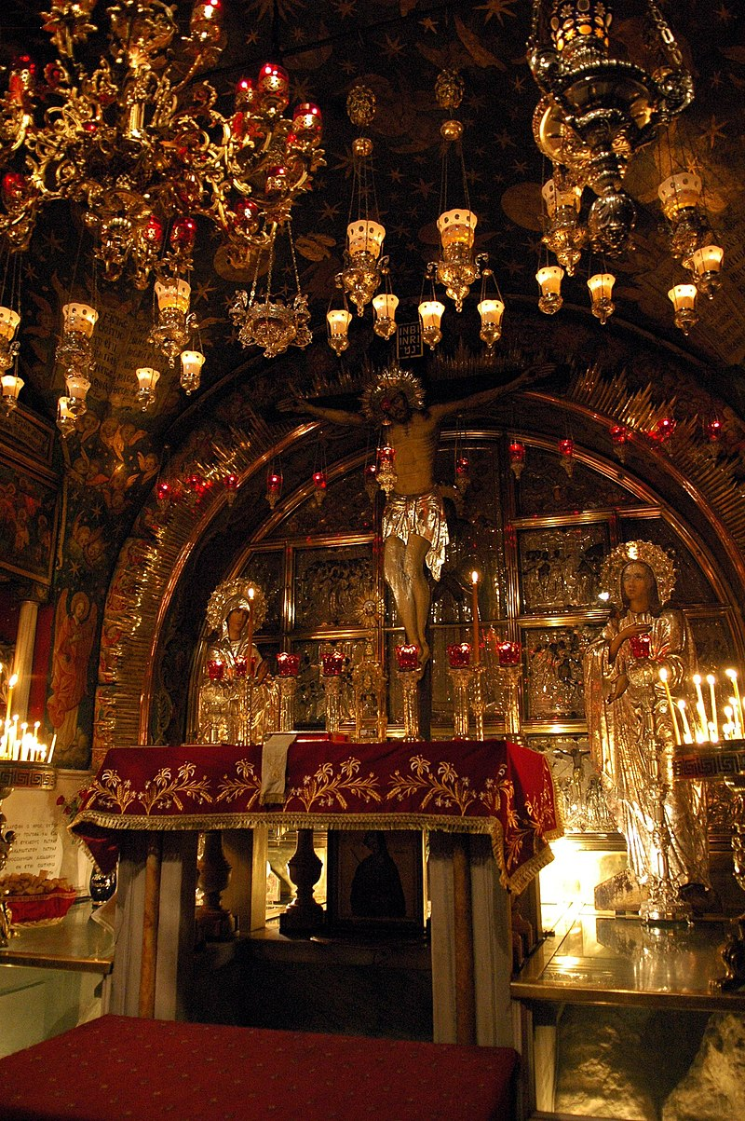
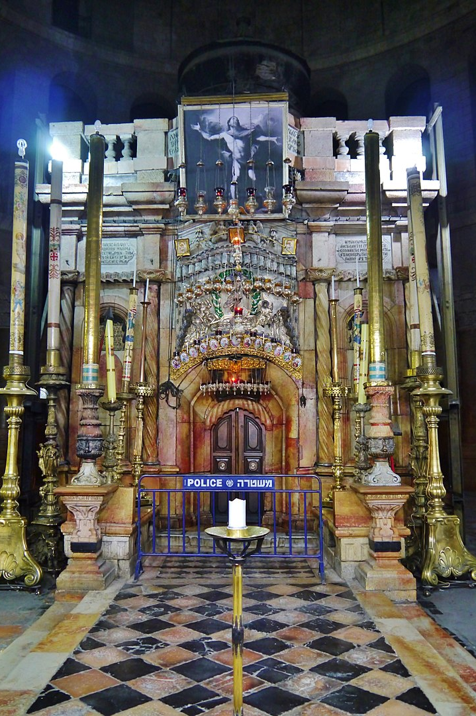
12
Jesus dies
13
Jesus is Taken from the Cross
14
Jesus’ body is place in the Sepulcher

Slide 17
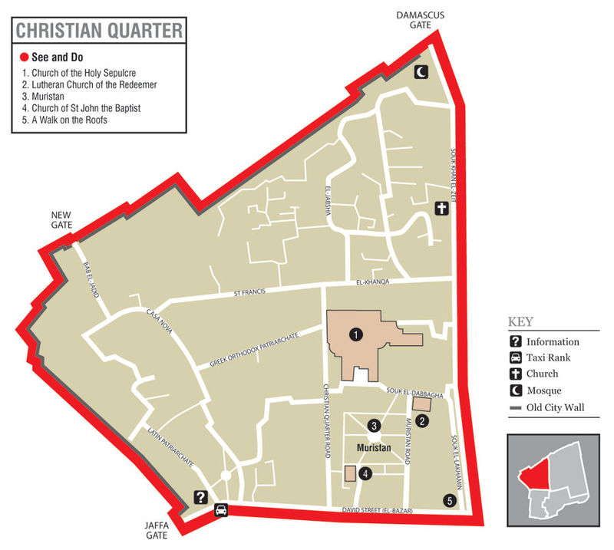

Slide 18
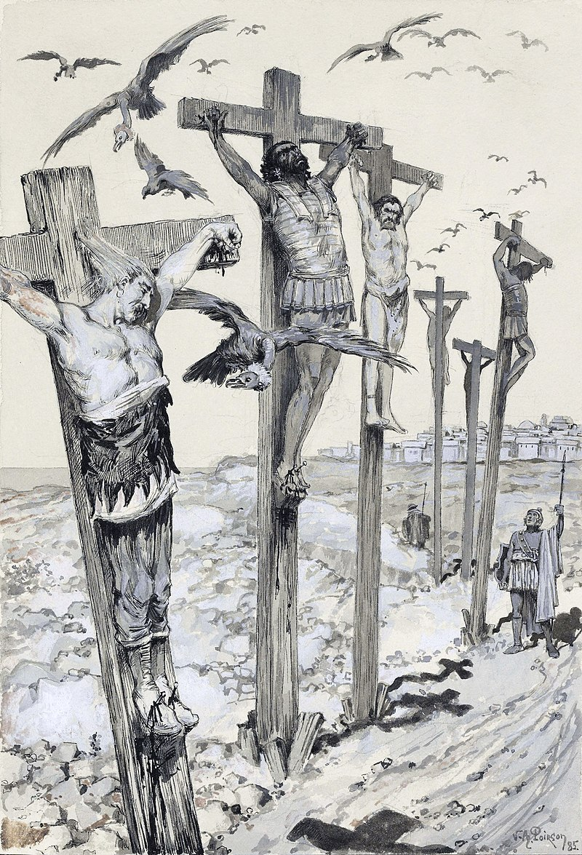
The first records of the execution by crucifixion come from the Persians. The Greek historian Herodotus records that Polycrates of Salmos after being defeated by the Persians was crucified around 522 BC (Herodotus, Histories, 3.125). However, this method of execution was also used by Carthaginians and some Greeks. Even Jews have used it. But undeniably it became infamous through Christianity.
19th-century illustration of Carthaginians crucifying rebels around 238 BC.
Image: Wikipedia

Slide 19
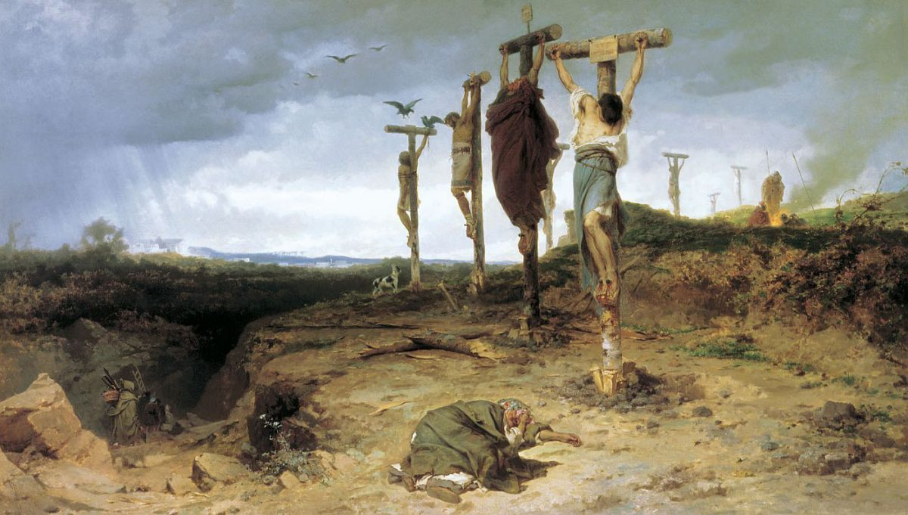
Cursed Field (1878), Fyodor Bronnikov
Tretyakov Gallery, Moscow, Russia.
Depiction of the punishment of six thousand rebels crucified along the Via Appia after their defeat on Third Servile War (73-71 BC).

Slide 20
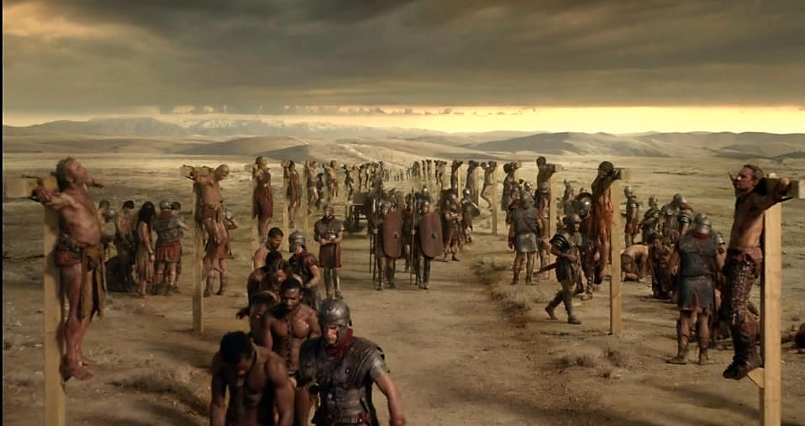
Image: The Appian Way where 6000 slaves were crucified in 71 BC. | Vampiro, Roma (pinterest.com)

Slide 21
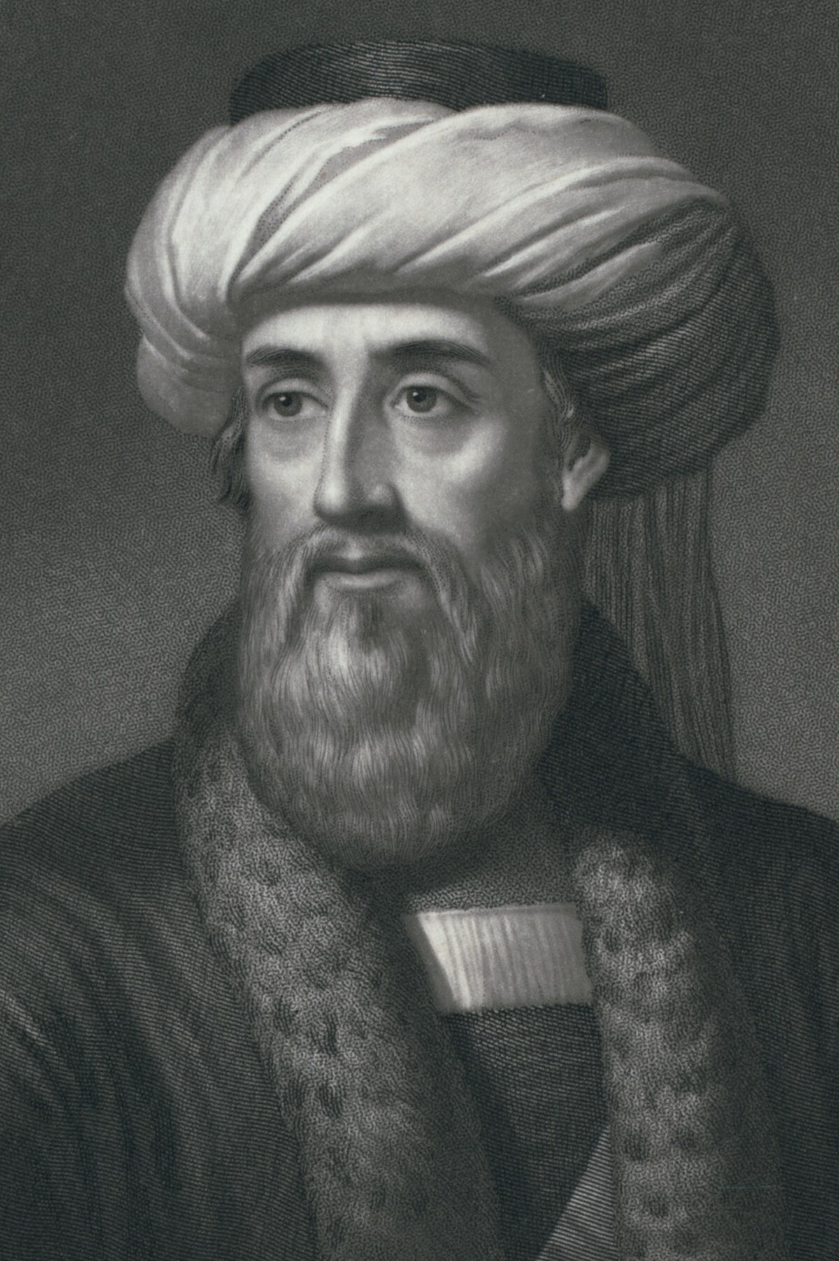
Describing the crucifixion of the Jews after the squashing of the Jewish Revolt (70 AD) Flavius Josephus says:
“They were first whipped and then tormented with all sorts of tortures, before they died, and were crucified before the wall of the city... the soldiers, out of wrath and hatred they bore the Jews, nailed those they caught to the crosses in different postures, by way of jest.”
Flavius Josephus, Wars of the Jews (5.11.1).
From: Flavius Josephus. The Works of Flavius Josephus. Translated by. William Whiston, A.M. Auburn and Buffalo. John E. Beardsley. 1895. (Flavius Josephus, The Wars of the Jews, Book V, Whiston chapter 11, Whiston section 1 (tufts.edu)

Slide 22
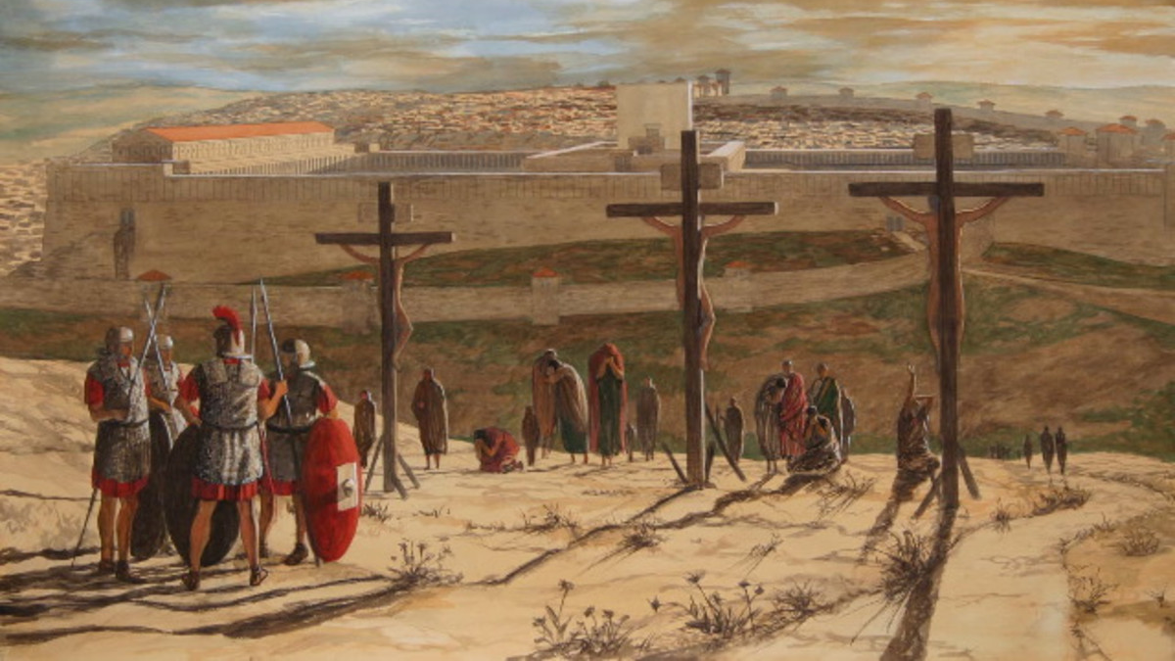

Slide 23
Crucifixion was not only a mode of death sentence but a display of force to impart fear and shame. The main pole is estimated between 6 to 8 ft. and remains fixed on the ground in a high place. As we know by the gospels the person sentenced to death was made to carry the crossbar (patibulum), as a display to the population.
Image: The Crucifixion of Jesus in Excruciating Detail | Crucifixion, Crucifixion of jesus, Jesus death (pinterest.com)

Slide 24
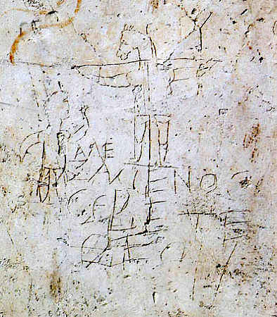
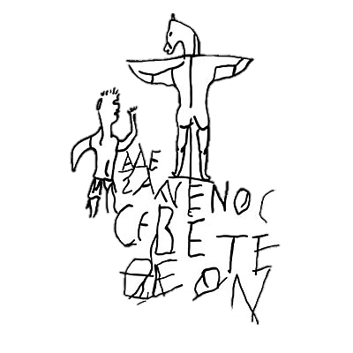
One graffito found in Rome in 1857 in a plaster wall near Palatine Hill, which was the imperial training school for slaves in Rome, has been interpreted as a mockery to Christians. The date of the inscription is not possible to define. It reads: “Alexamenos worships God”. The inscription is illustrated by the crucifixion of a man with the head of a donkey and another man standing by its side.
Source: Jesus and the Cross - Biblical Archaeology Society

Slide 25
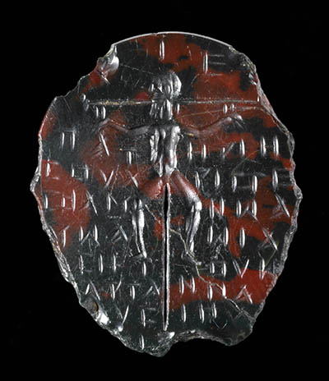
“This third-century C.E. gem in the British Museum depicts Jesus’s crucifixion with an inscription that lists various Egyptian magical words.”
Source: Jesus and the Cross - Biblical Archaeology Society
Photo: British Museum/CC BY-NC-SA 4.0.

Slide 26
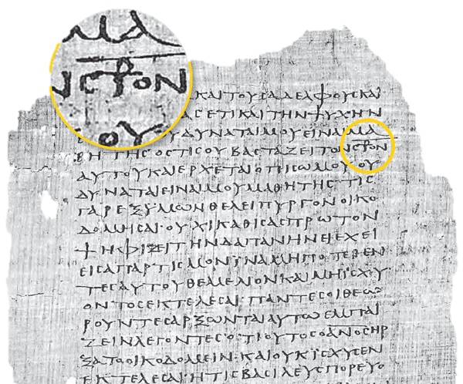
Quote: The Staurogram - Biblical Archaeology Society
Photo: Foundation Martin Bodmer.
“The staurogram combines the Greek letters tau-rho to stand in for parts of the Greek words for “cross” (stauros) and “crucify” (stauroō) in Bodmer papyrus P75. Staurograms serve as the earliest images of Jesus on the cross, predating other Christian crucifixion imagery by 200 years.”

Slide 27
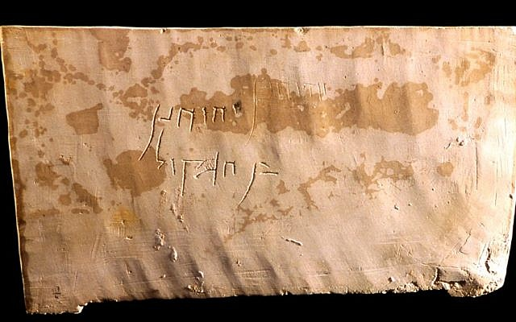
In 1968 contractors digging in Giv’at ha-Mivtar (north-east Jerusalem) found a series of first-century Jewish graves. In one the them it was found an ossuary box with the inscription “Yehoḥanan ben Hagqol”. Inside the ossuary, there were the bones of a man who died by crucifixion. It was the first archeological evidence in the holy land of Roman Crucifixion.

Slide 28
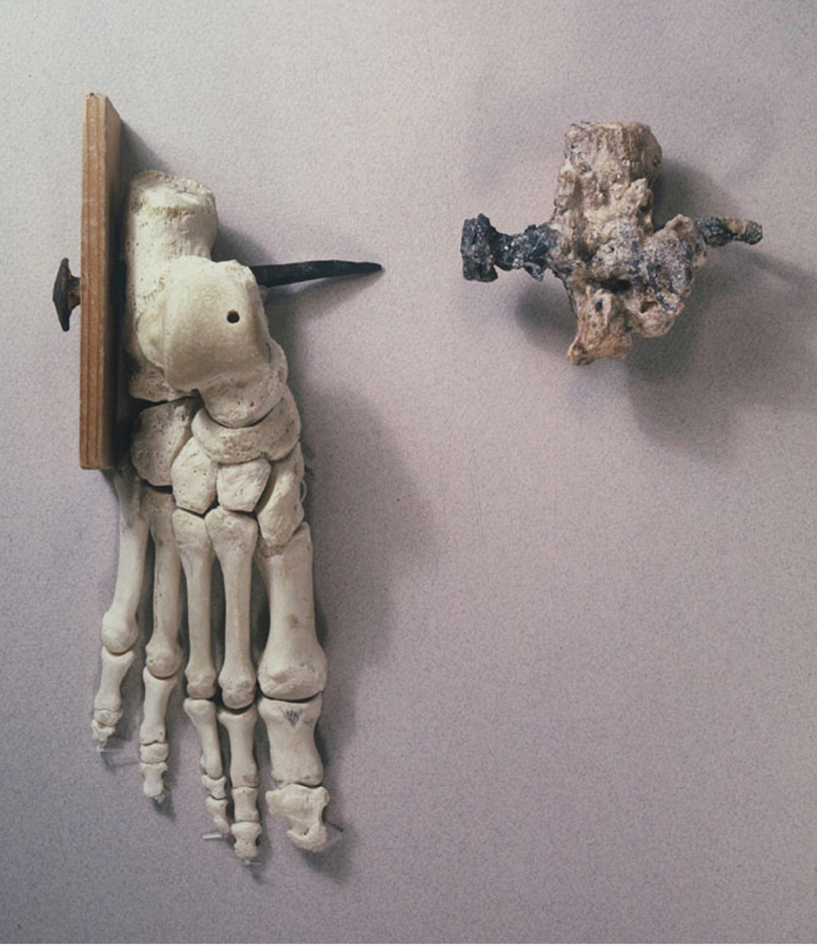
Archeologists conclude he was crucified because they found a nail piercing the calcaneum.

Slide 29
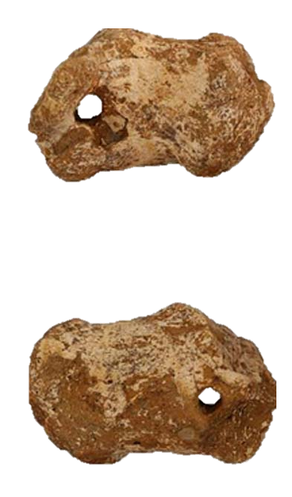
The second archaeological evidence of the Roman practice of crucifixion came from a skeleton found in Gavello (Italy), north of Venice, in 2007. In the unusual grave dug on the ground, the skeleton shows signs of violence and perhaps a rushed burial. The right foot heel bone was perforated. This the researcher considered evidence of crucifixion.

Slide 30
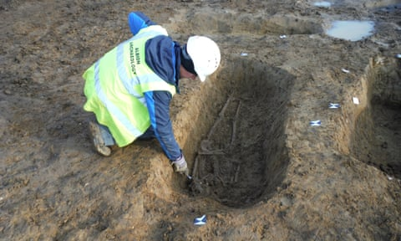
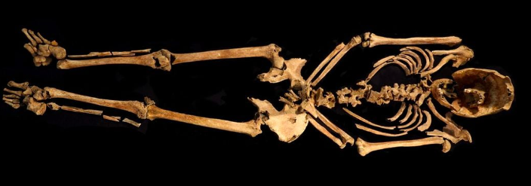
Contractors opening ground for a new development in Cambridgeshire (England) in 2017 found an ancient Roman settlement. Besides the architectural remains and other objects, some skeletons were found. One of them labeled 4926 was peculiar. Upon analysis, it was concluded in 2021 that it was the skeleton of a male between 25-35 years of age dating from 130-360 AD. The peculiar find in the skeleton was a nail piercing the heal. They concluded he died crucified.

Slide 31
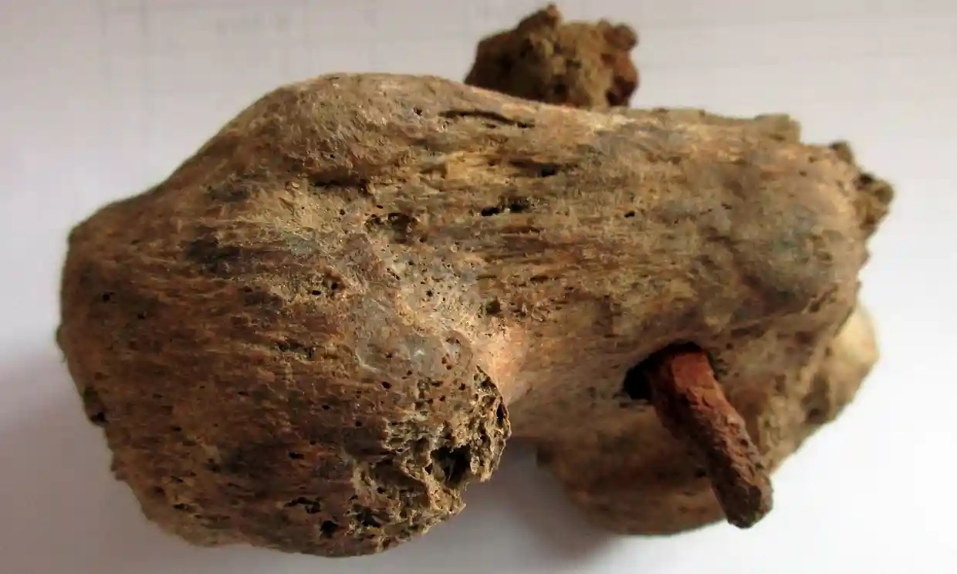
The 11,5 cm iron nail pierced the calcaneum (heel bone). In it were found traces of wood. The lack of injuries to the hand or wrist led researchers to conclude the man was tied by arm.

Slide 32
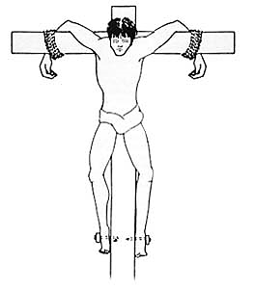
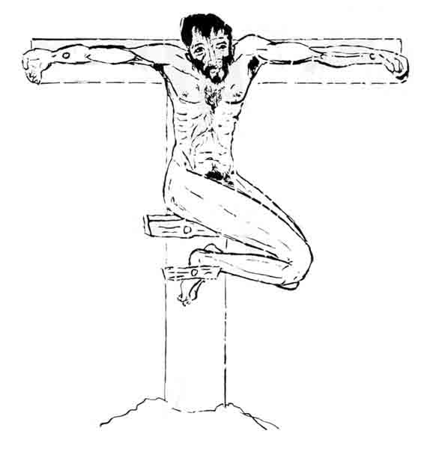
Mode of Crucifixion
The first to analyze the 1968 discovery of the Yehohanan ossuary was the Greek Orthodox monk Vassilios Tzaferis who proposed this mode of cruficiation in an article published in 1970.
Reinterpreting the data Nico Haas has proposed the nailing of one foot on each side.
Source: Roman Crucifixion Methods Reveal the History of Crucifixion - Biblical Archaeology Society
Photo: Courtesy Israel Exploration Journal, Vol. 35, No. 1 (1985)

