Slide 1
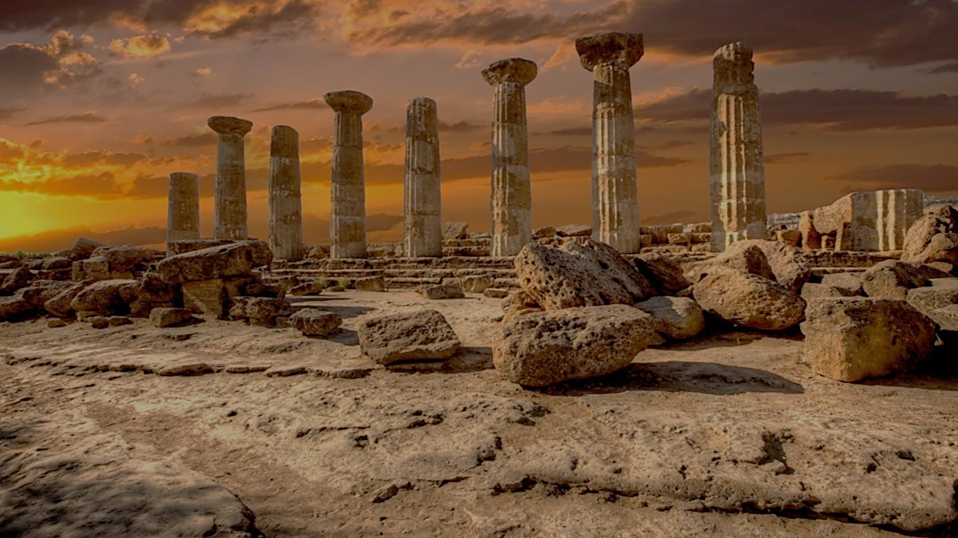
Archeology of Bible Times
Pastor John dos Santos - Faith Presbyterian Church

Slide 2
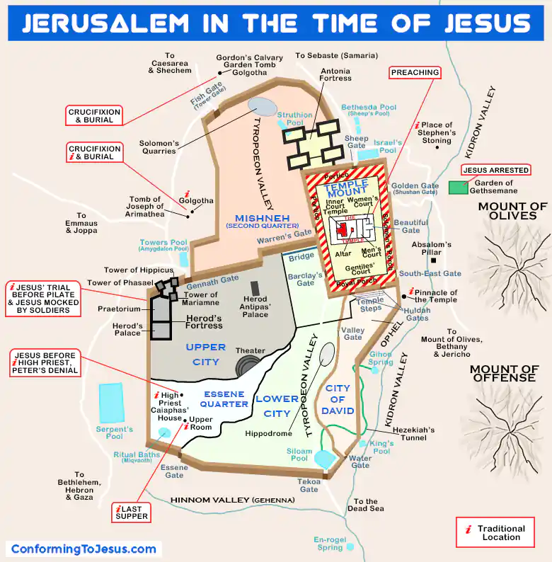

Slide 3
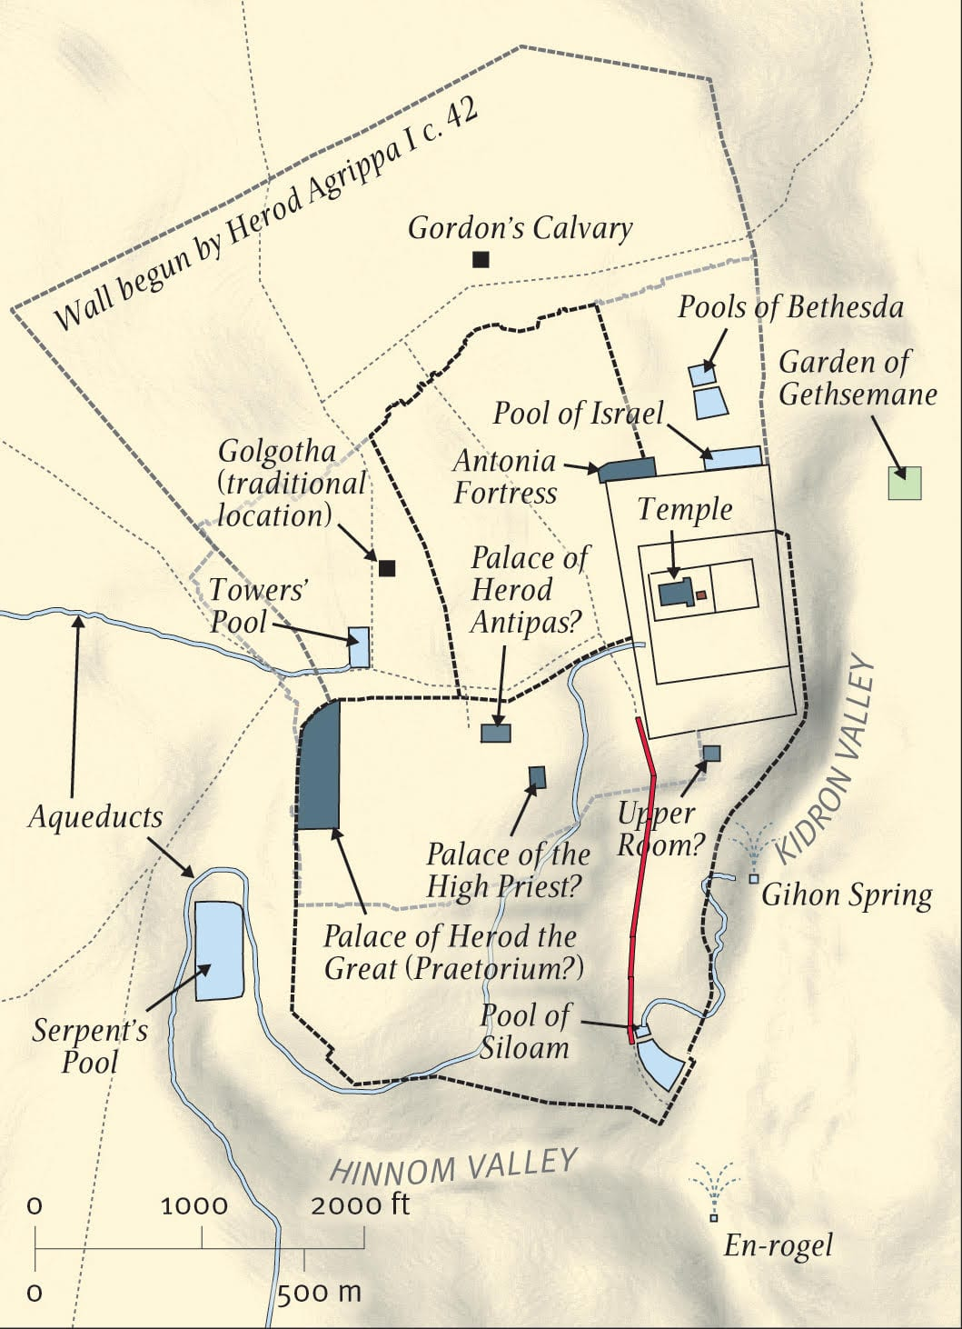
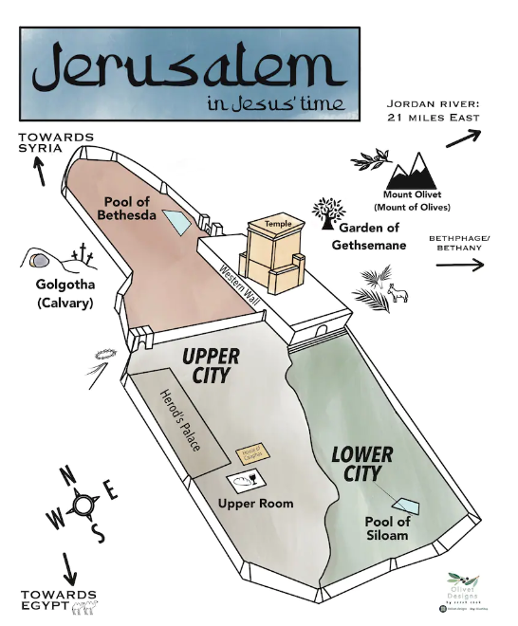
Image: Was the Road in Jerusalem Discovered by Archaeologists Really Built by Pontius Pilate?
Image: DIGITAL DOWNLOAD Map of Jerusalem in Jesus' Time Holy Land Christ Bible Scripture Study New Testament Kids Easter Holy Week - Etsy

Slide 4
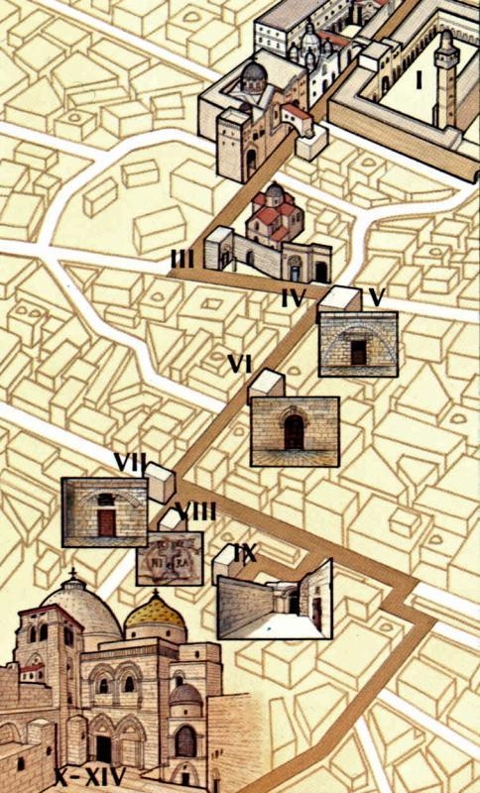
The Via Dolorosa is a processional route composed of 14 stops (stations) of around 2000 ft which is believed to be the way Jesus took up to Calvary. Through the centuries these sites have been attributed to different places, but the current route was established in the 18th century as a consensus among Christians.

Slide 5
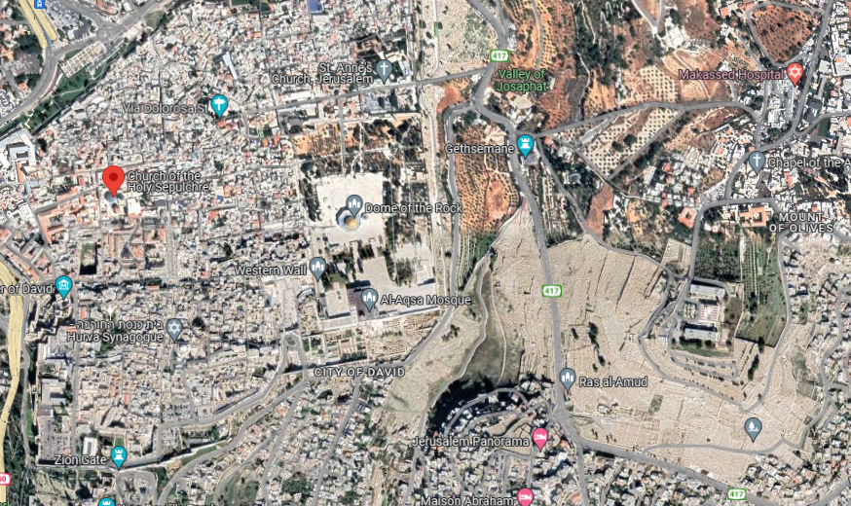

Slide 6
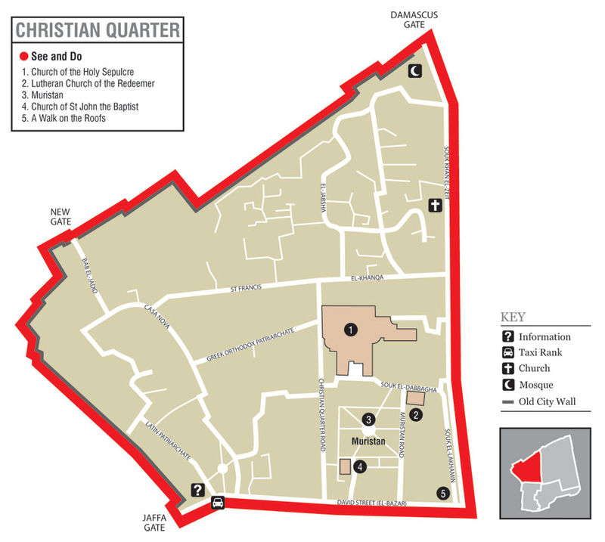

Slide 7
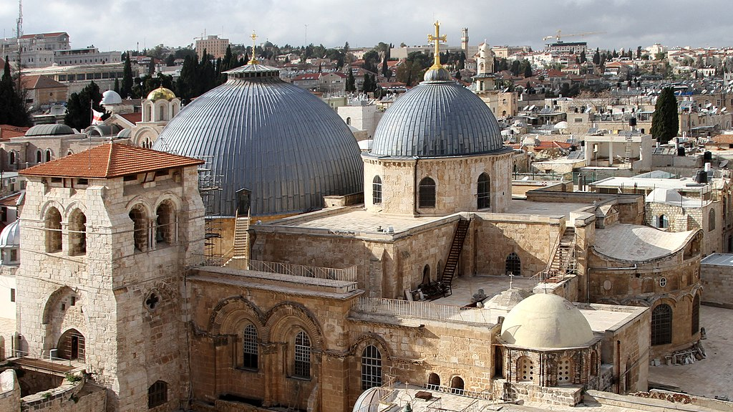
Church of the Holy Sepulcher

Slide 8
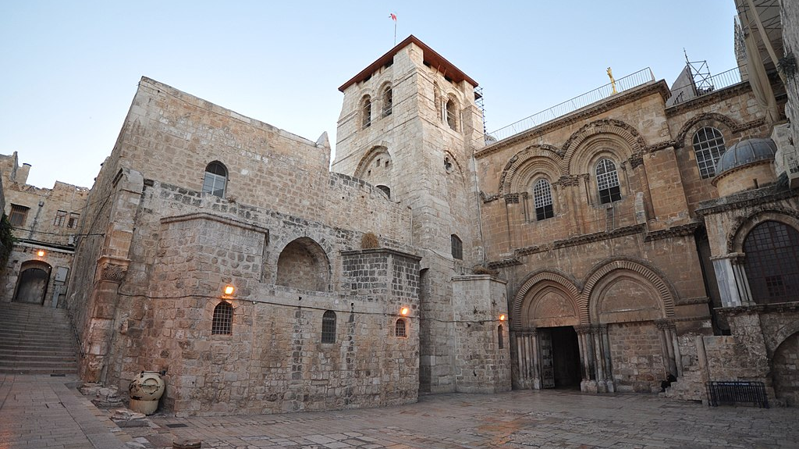

Slide 9
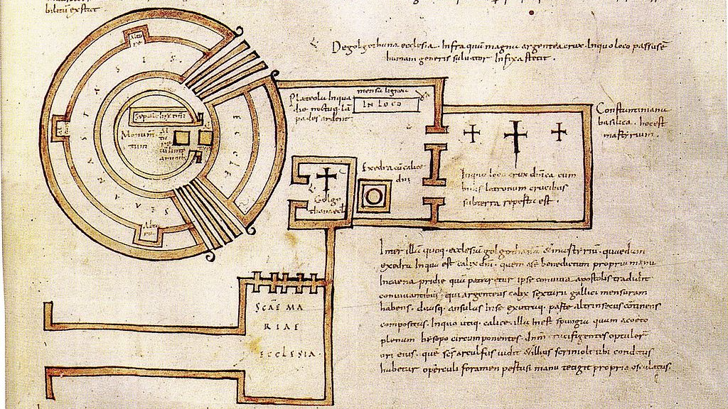
This church was built a consecrated in 13 September of 335. This is the oldest known floor plan of the church, from De Locis Sanctis (c. AD 680). The church was destroyed in the 7th century and rebuilt in the 11th century.
680)^{[20]}

Slide 10
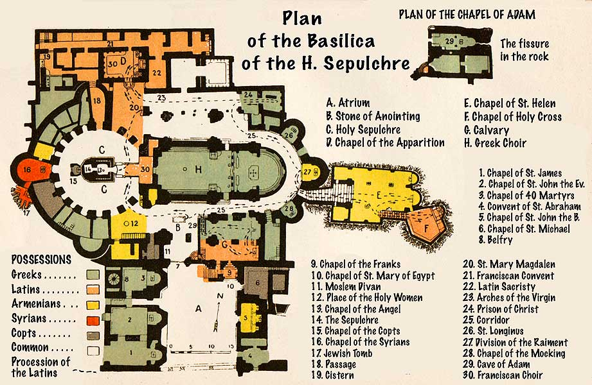

Slide 12
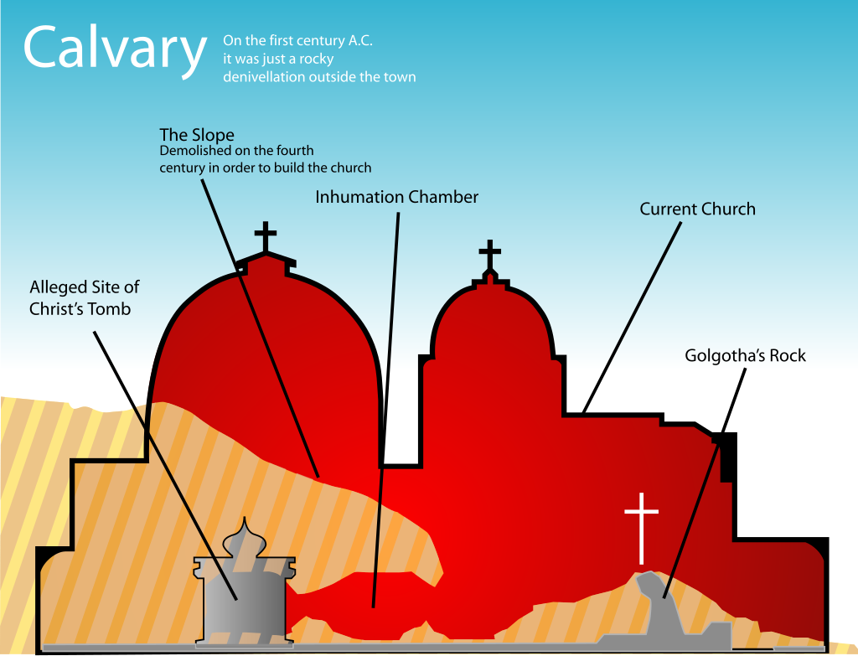

Slide 14
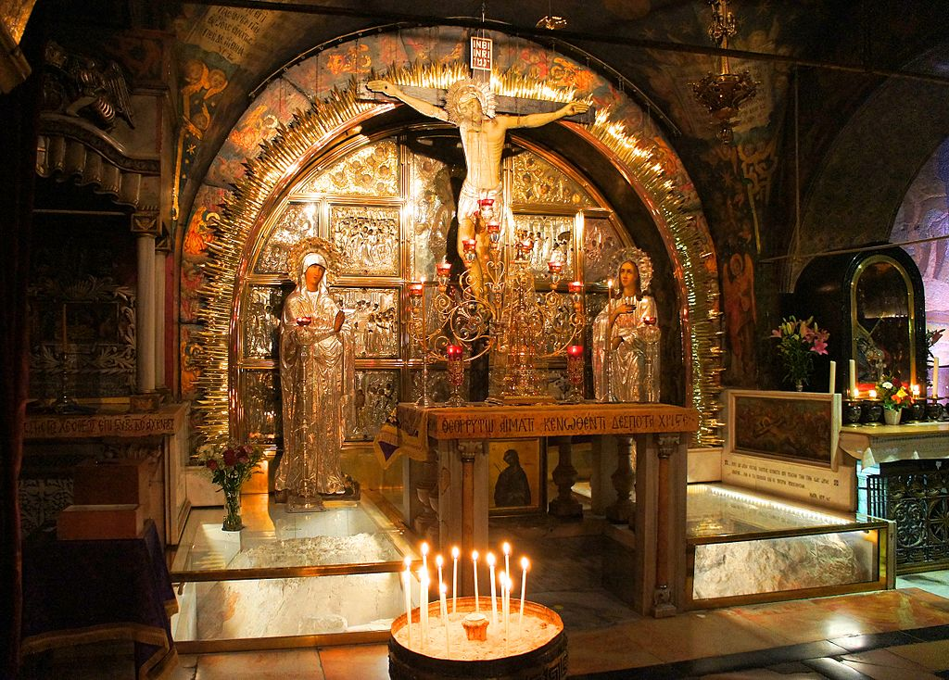
The Altar of the Crucifixion, where The Rock of Calvary (bottom) is encased in glass

Slide 15
Stone of the anointing, where Jesus’ body was anointed to be buried

Slide 16
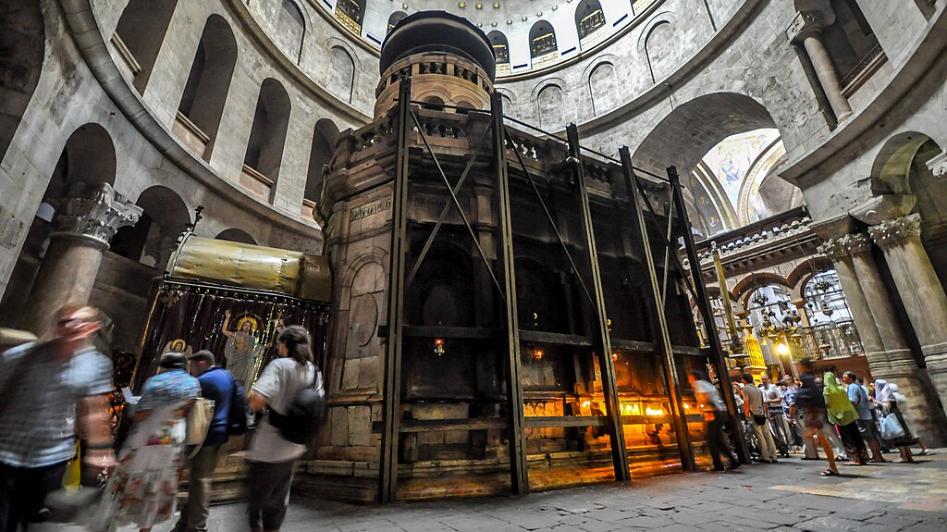
Rotunda
Aedicule

Slide 17
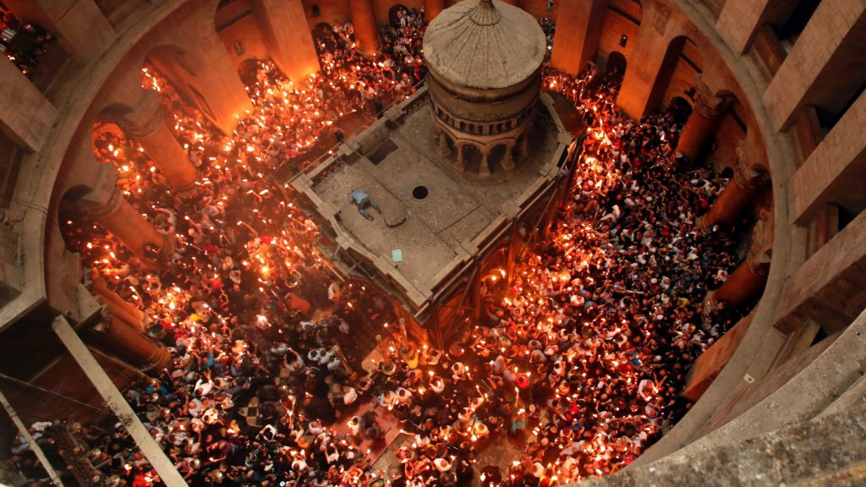

Slide 18
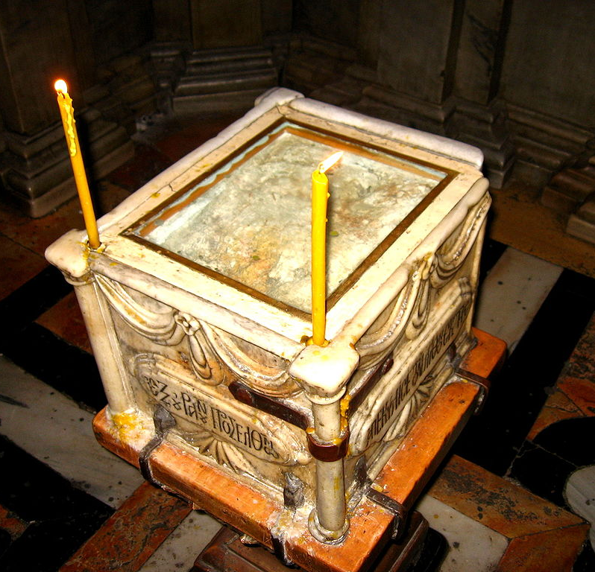
The Angel's Stone is a fragment of the stone with was part of the Stone that sealed the tomb after Jesus. It is found in the first of the two chambers of the Edicule, the second one being the tomb itself.

Slide 19
Jewish Burial Practice
Jews buried their dead. They are against cremation because of the belief in resurrection and their laws against desecration of the body.
They did not embalm but prepared the body with scented oil.
The body was wrapped in white cloth (linen if possible).
Second Temple Judaism adopted the practice of family burial caves, whenever possible dug on the rock.
The body was placed in a bed carved in the rock.
After no less than a year the family would return to site and mourn again the loss of the dead. After which his bones would be placed in a closed ossuary made of limestone.

Slide 20
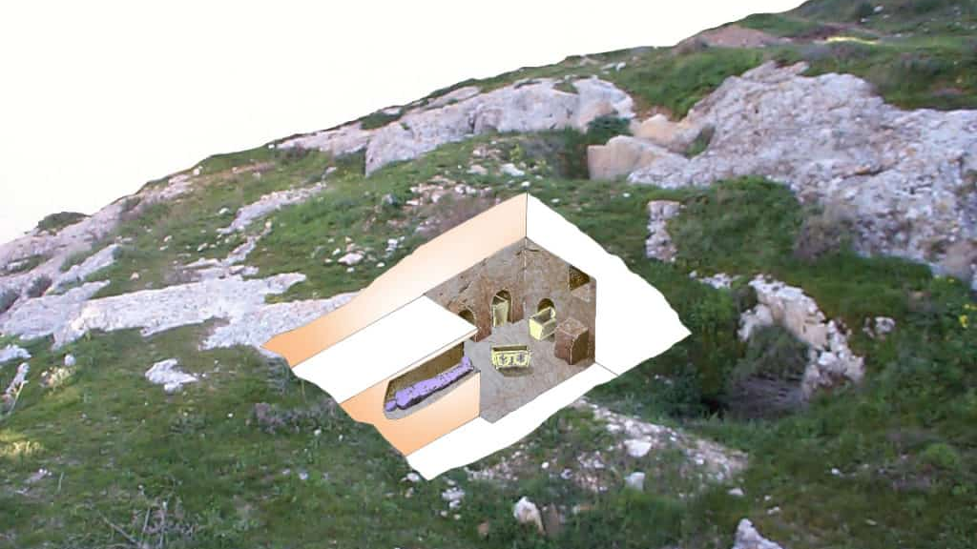

Slide 21
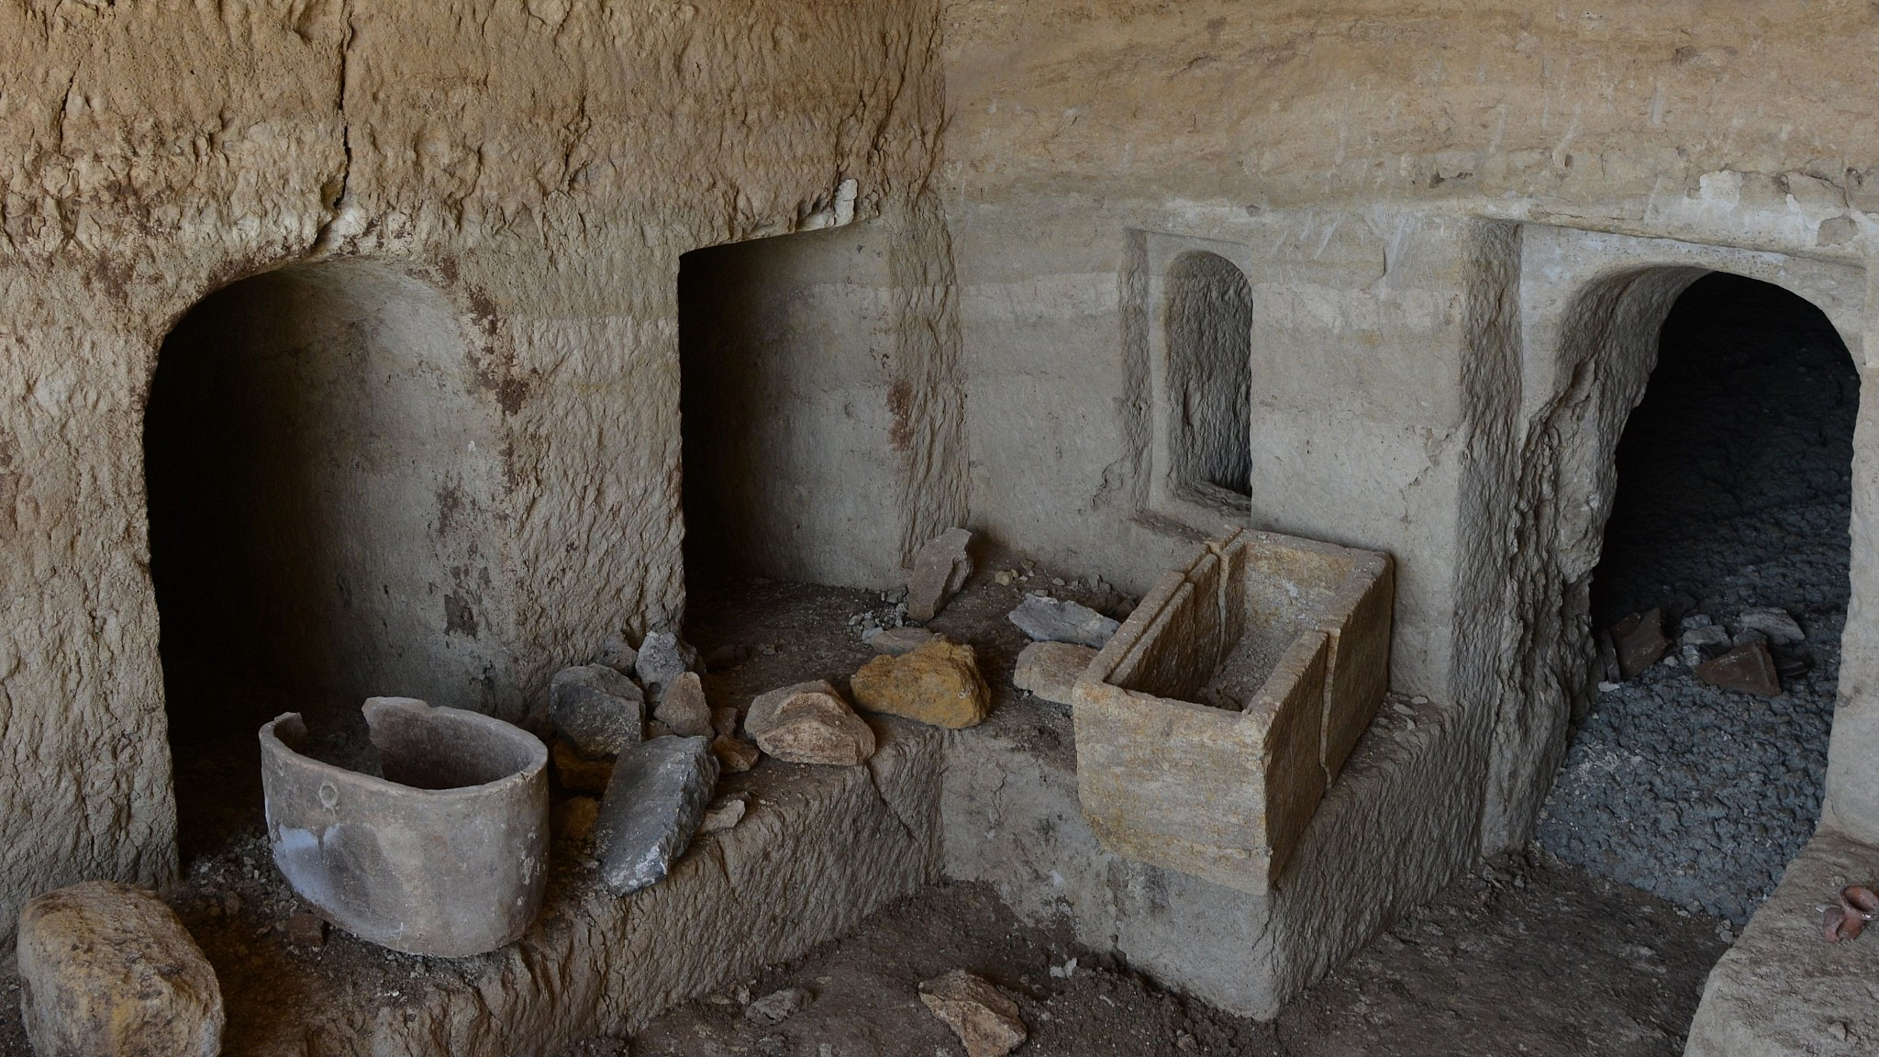

Slide 22
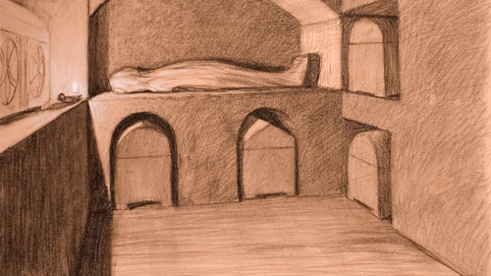

Slide 23
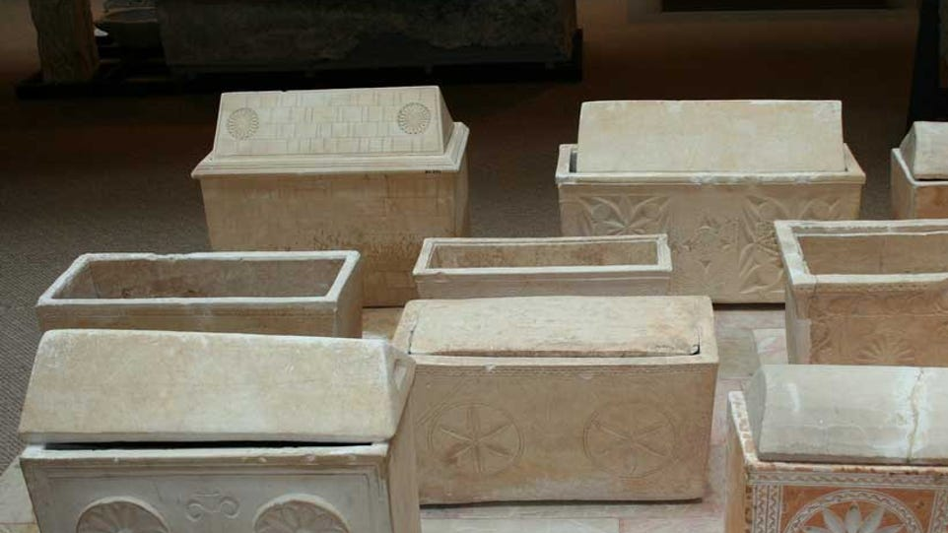

Slide 25
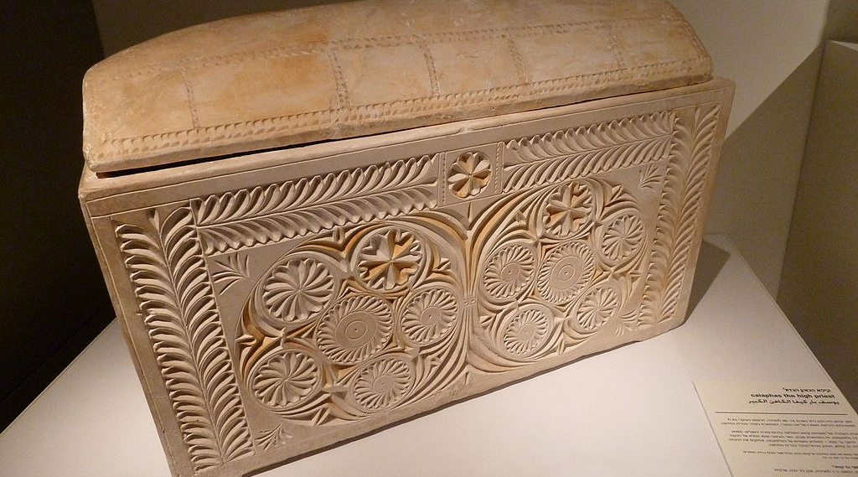
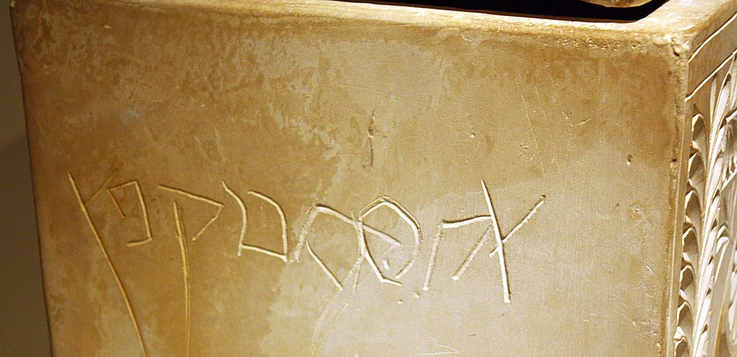
Caiaphas Ossuary

Slide 26
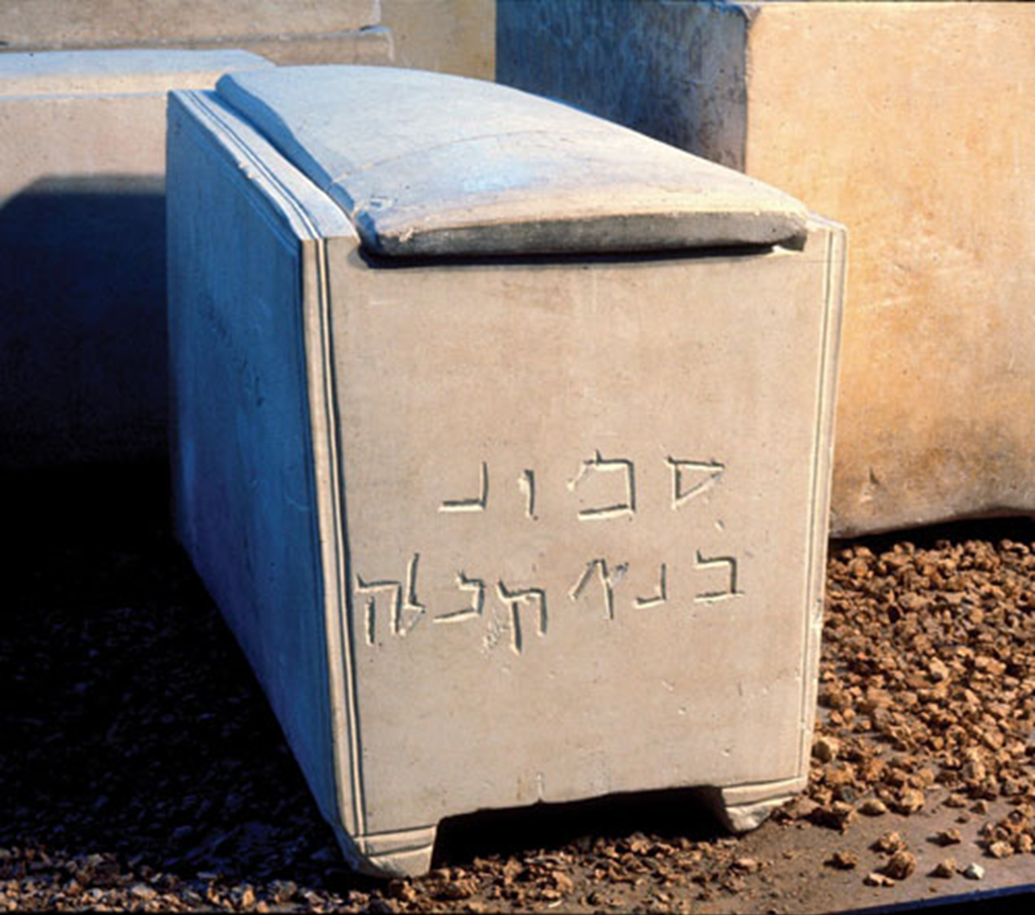
The ossuary of “Simon the Temple Builder” is believed to have belonged to someone who worked on the construction of the temple by Herod. Perhaps a foreman or engineer.

Slide 27
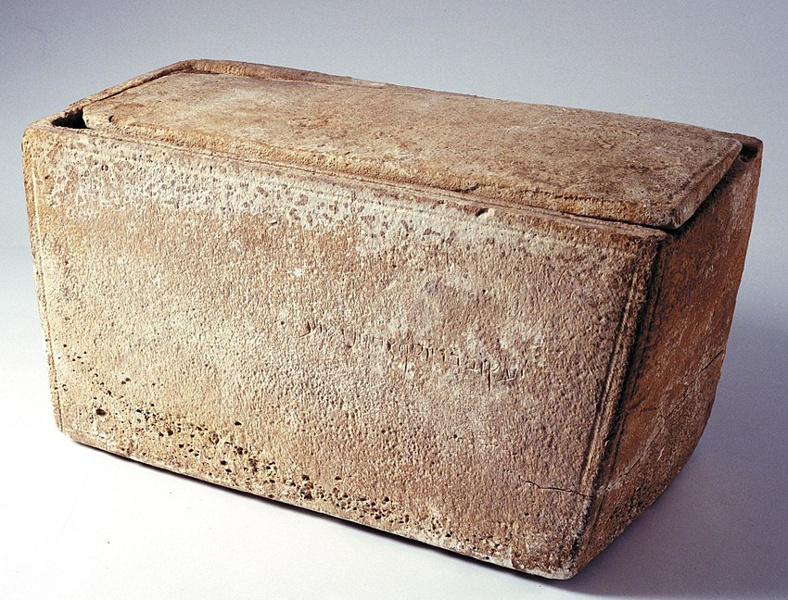
The ossuary of “James, son of Joseph, brother of Jesus” was presented to the world in 2002 by a Jewish collector. Its authenticity has been highly debated.

Slide 28
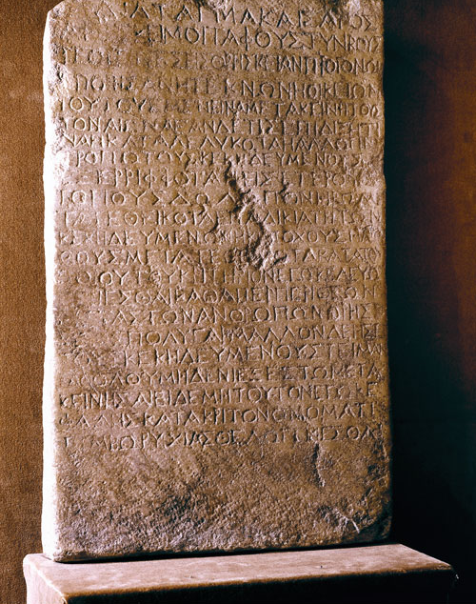
The Claudius Inscriptions is a stone inscription of an edict from Emperor Claudius (41-54 AD), making illegal and crime punishable with death the violation of burial sites and graves.
It was sold to the Louvre Museum (Paris) in 1927 by someone who allegedly brought it from Nazareth. It has been commonly associated with Matthew 28.13,15.

Slide 29
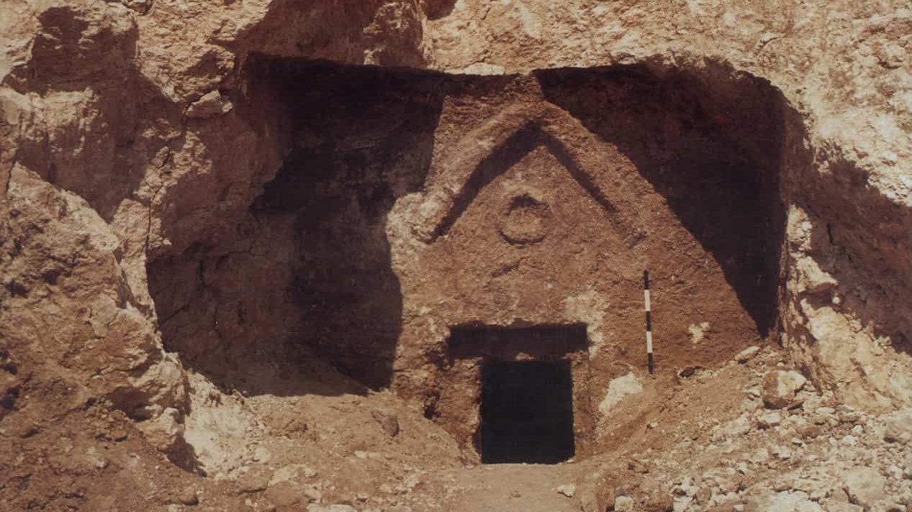

Slide 30
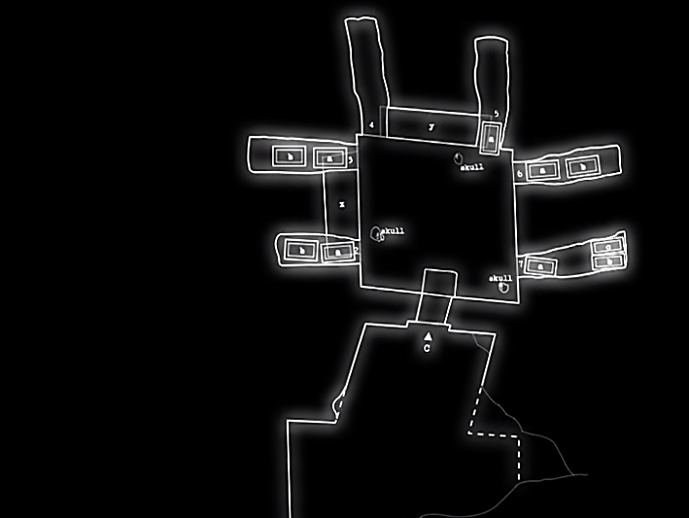
In this first century burial complex, several ossuaries were found. Among them: “Jesus, son of Joseph”, “Maria”, “Mariame” and “Judas, son of Jesus”.

Slide 31
