Slide 1
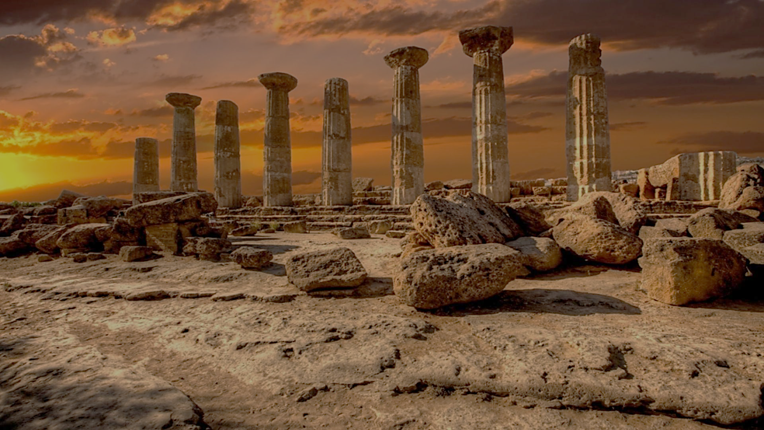
Archeology of Bible Times
Pastor John dos Santos - Faith Presbyterian Church

Slide 2
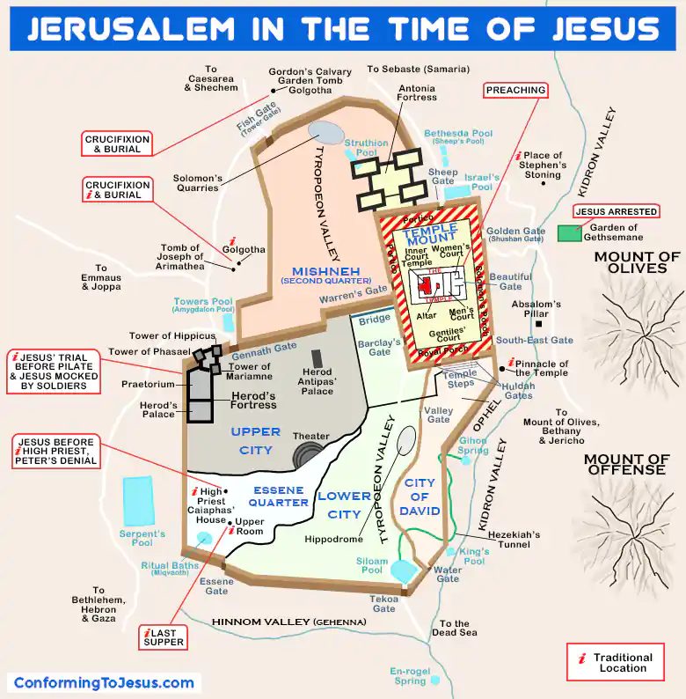

Slide 3
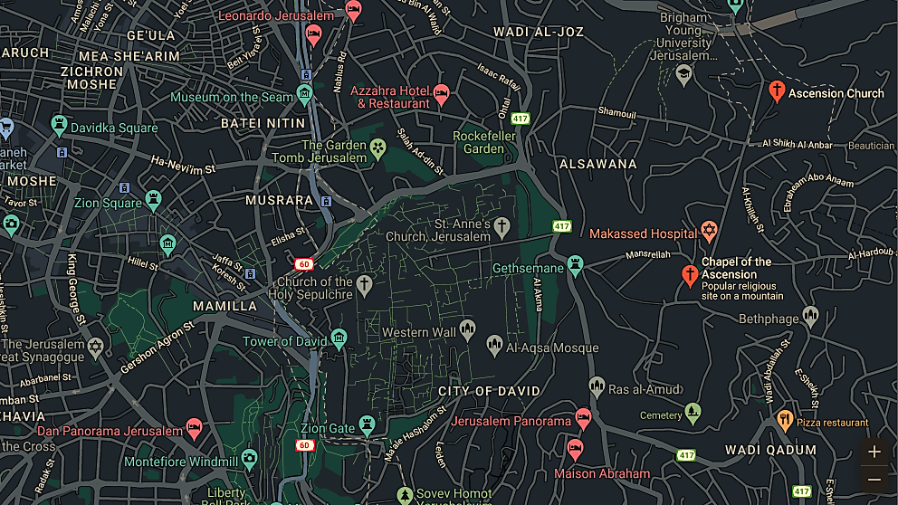

Slide 4
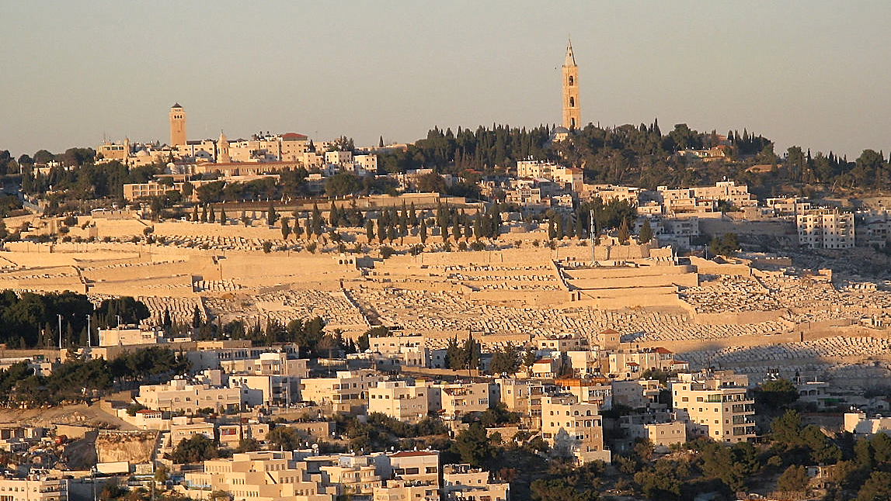
Church of Ascension
(Lutheran)
Convent of Ascension
(Russian Orthodox)

Slide 5
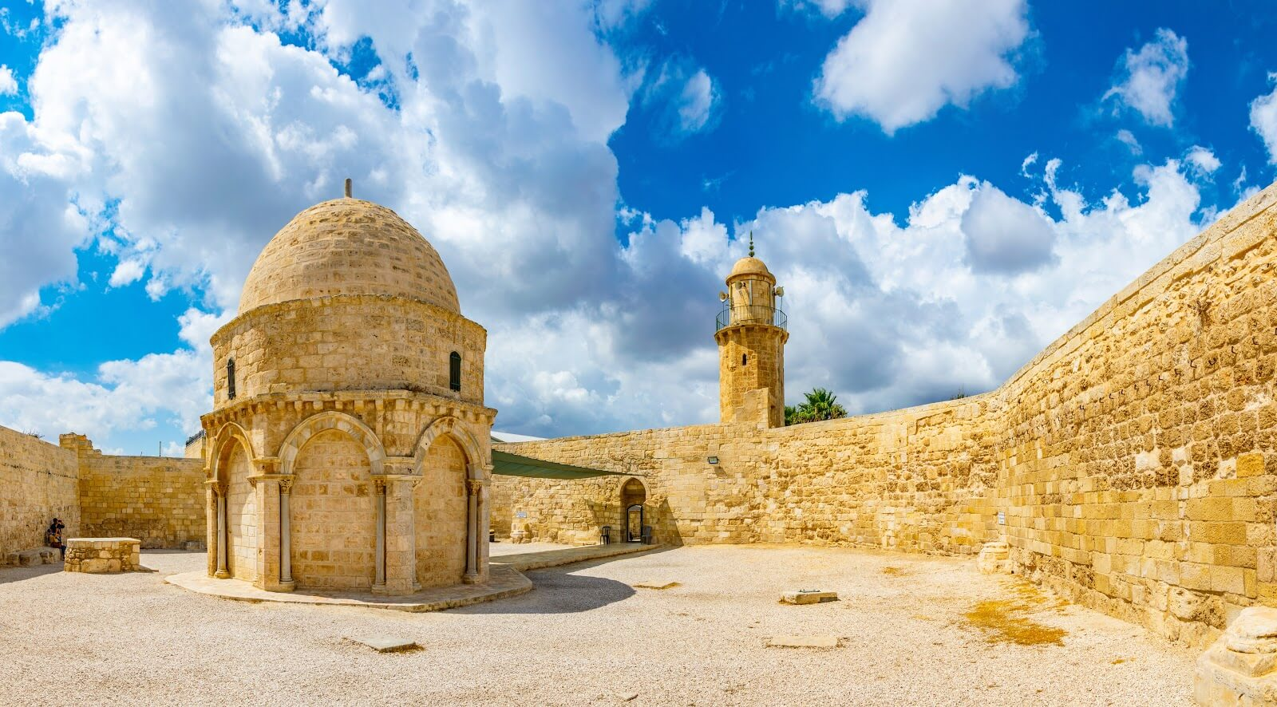

Slide 6
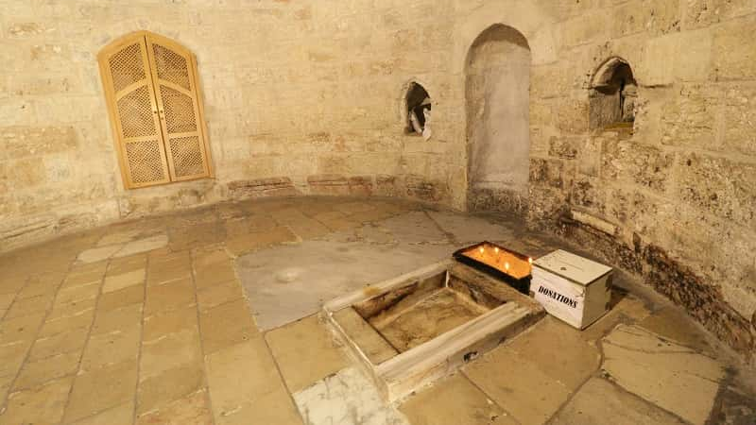

Slide 7
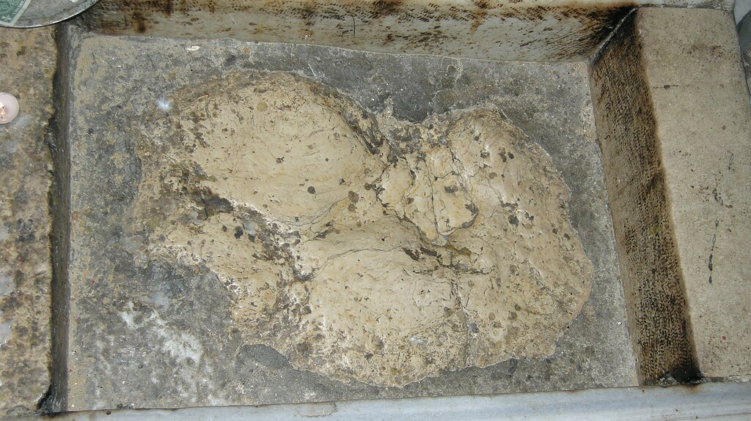

Slide 8
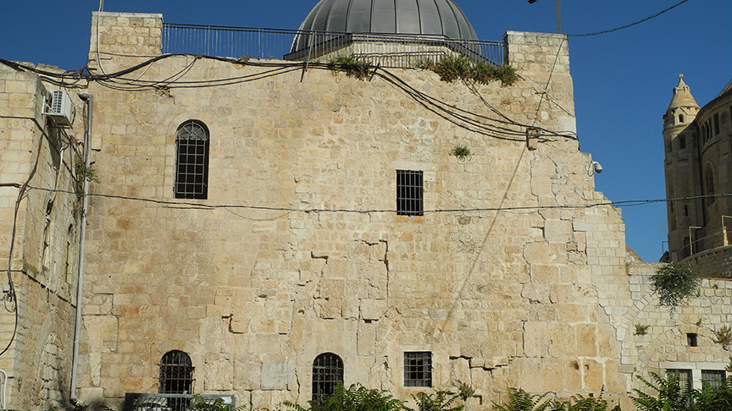
Upper Room

Slide 9
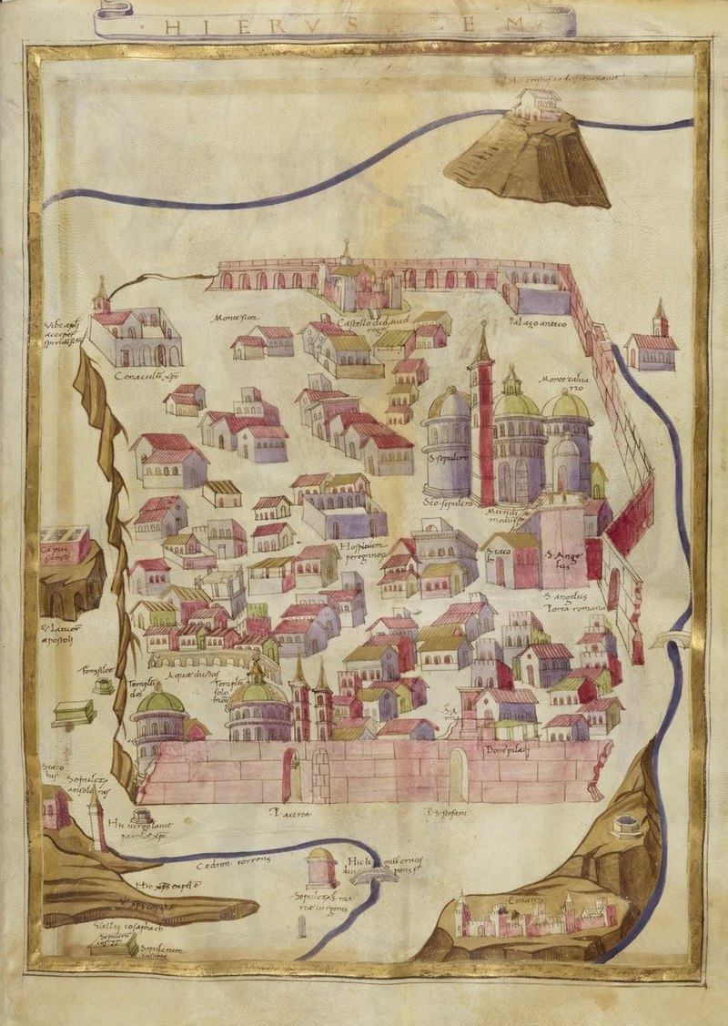
A 1472 map of Jerusalem notes the place of the Pentecost, "Ubi apostoli acceperunt spiritum sanctum", at the location of the Cenacle (top left).

Slide 10
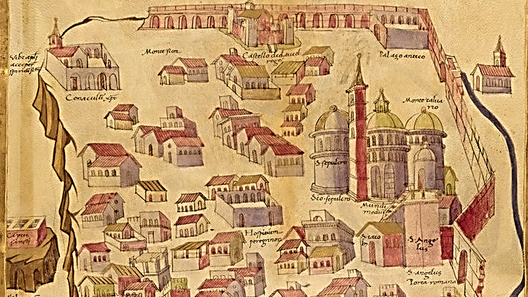

Slide 11
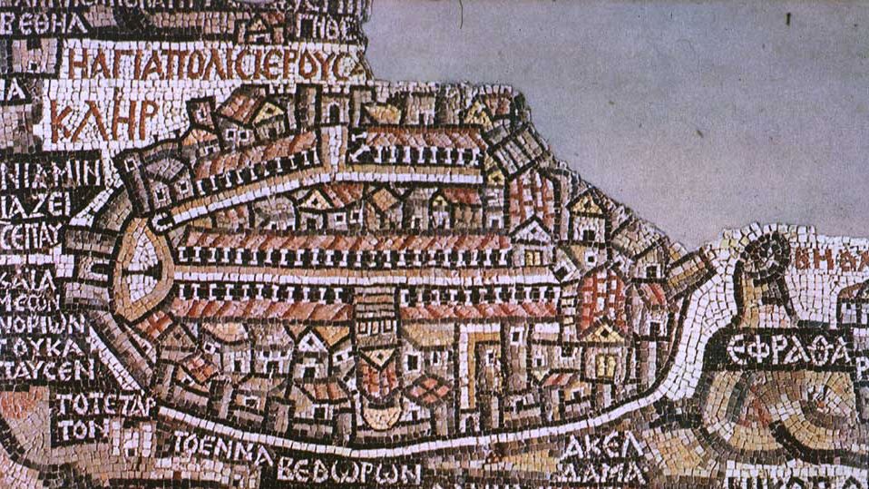
The map mosaic of the Church of St. George in Madaba, Jordan (560–565 C.E.) shows the Hagia Sion and the Upper Room side by side

Slide 12
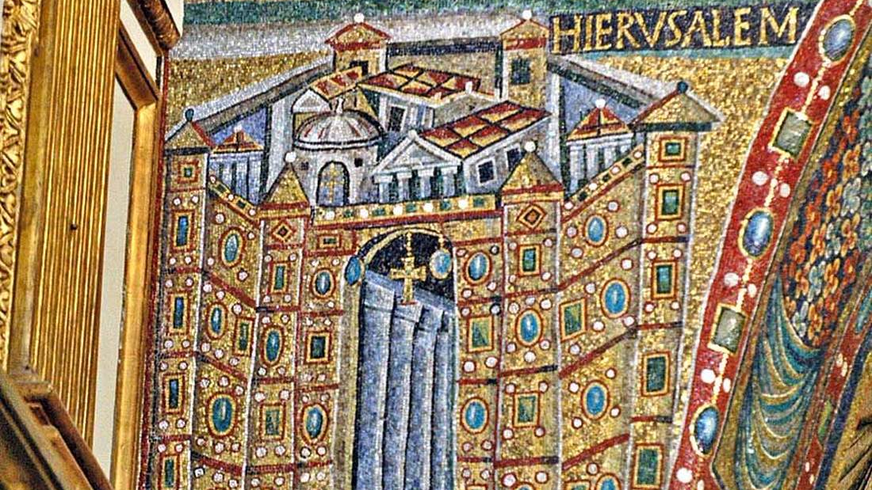
The mosaic of Jerusalem in the Basilica of Santa Maria Maggiore in Rome (circa 6th century) shows the city from the north. The image shows the tomb rotunda and the Upper room beyond it.

Slide 13
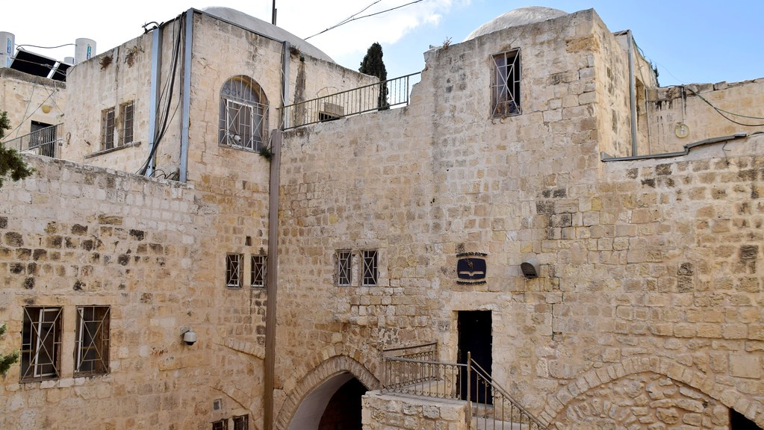

Slide 14
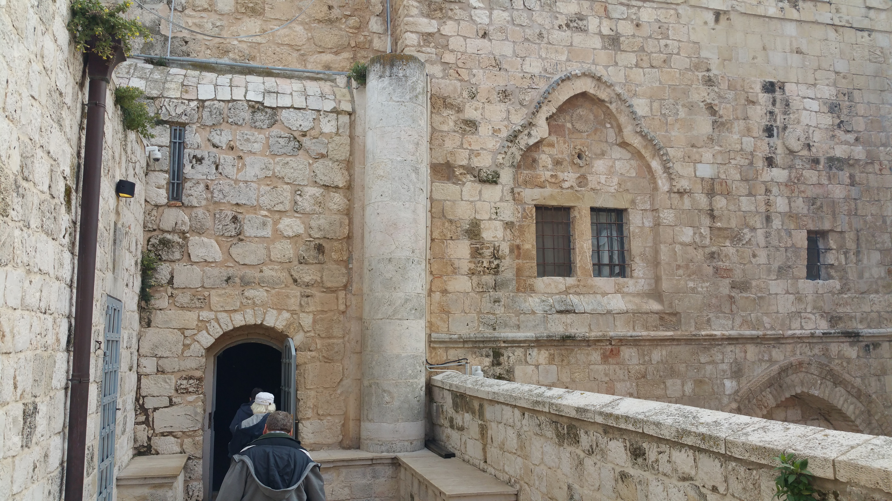

Slide 15
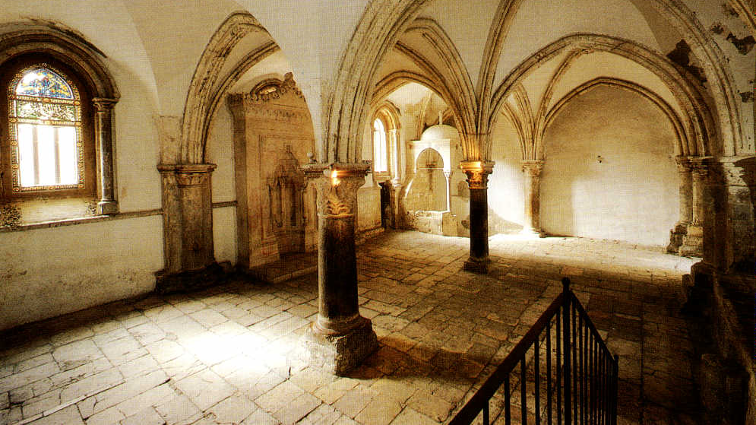

Slide 16
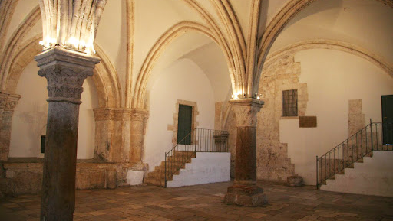

Slide 17
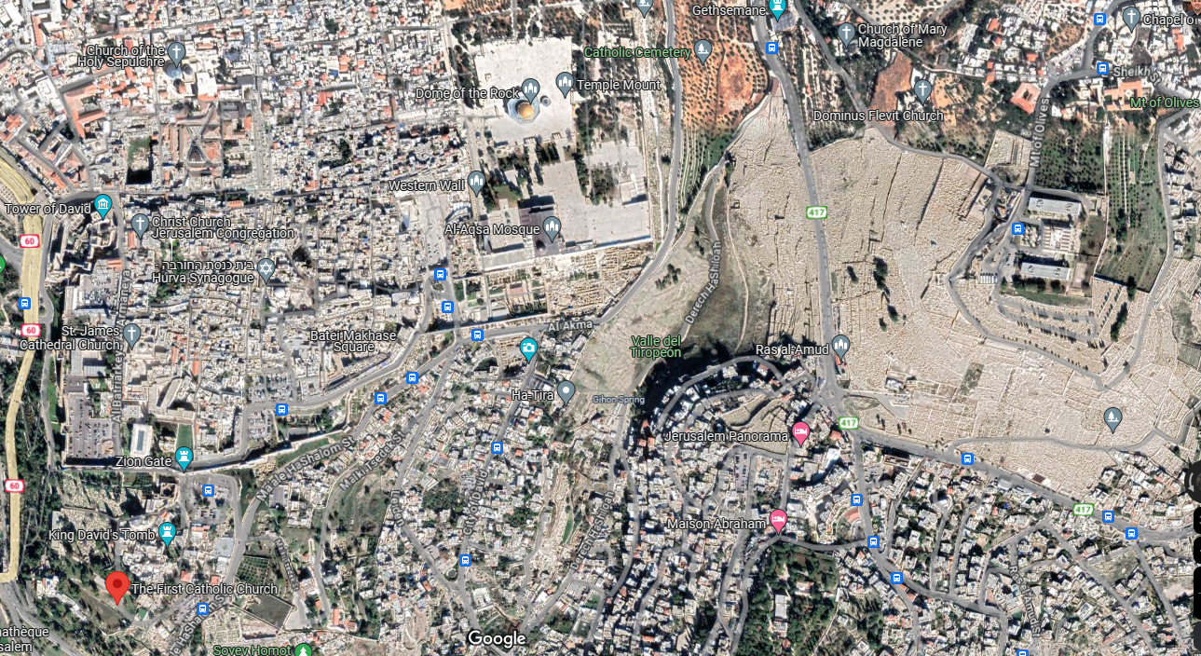

Slide 18
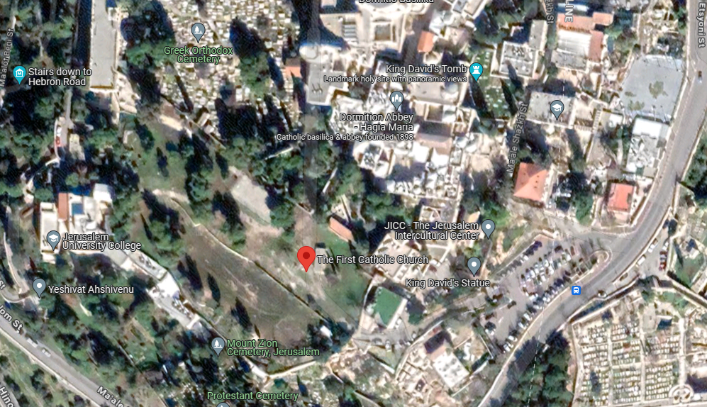

Slide 19
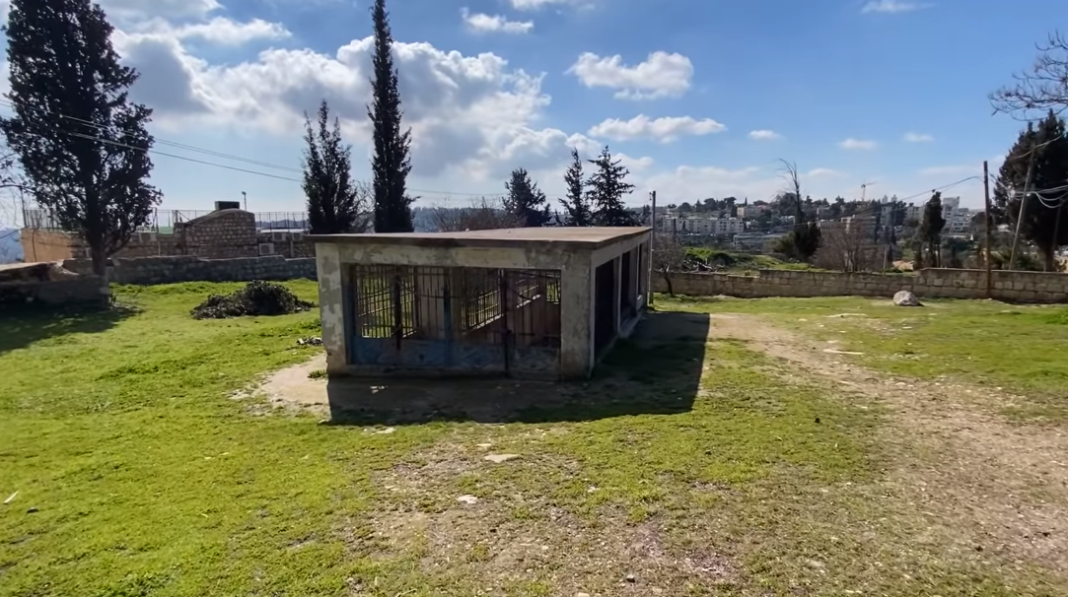
Image: Following Jesus in Jerusalem #37: First Century Church? (youtube.com)

Slide 20
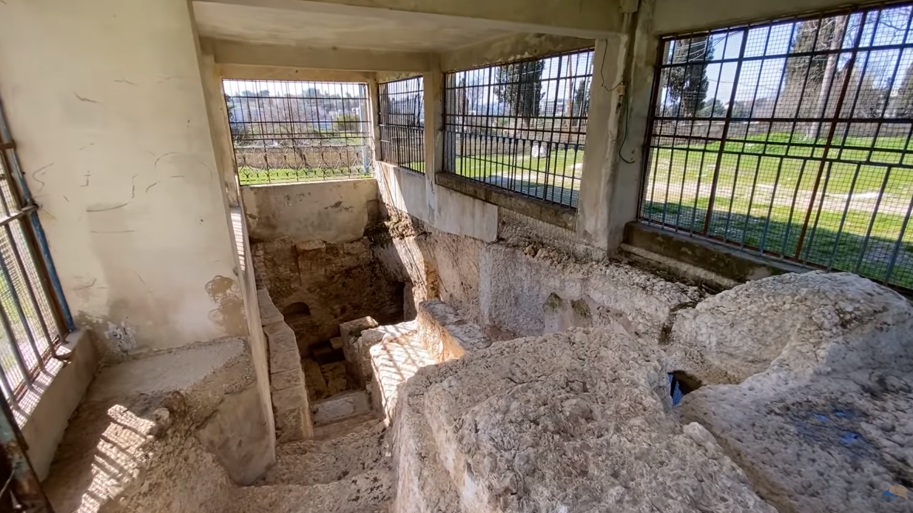
Image: Following Jesus in Jerusalem #37: First Century Church? (youtube.com)

Slide 21
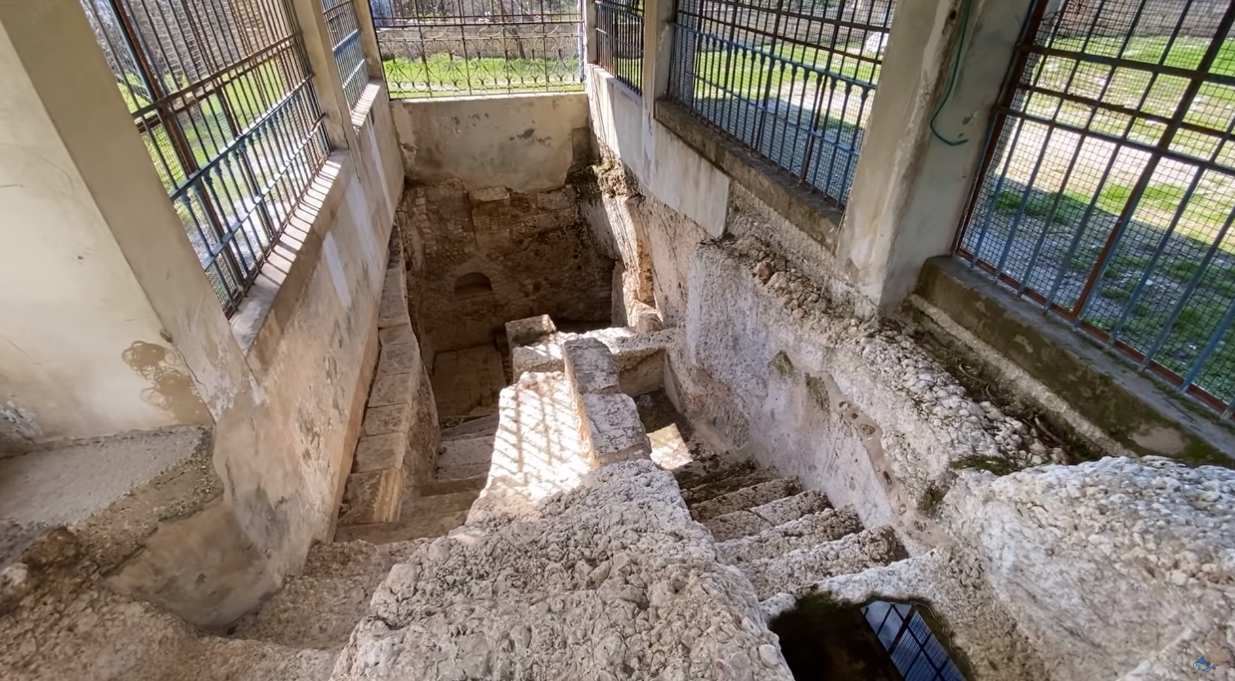
Image: Following Jesus in Jerusalem #37: First Century Church? (youtube.com)

Slide 22
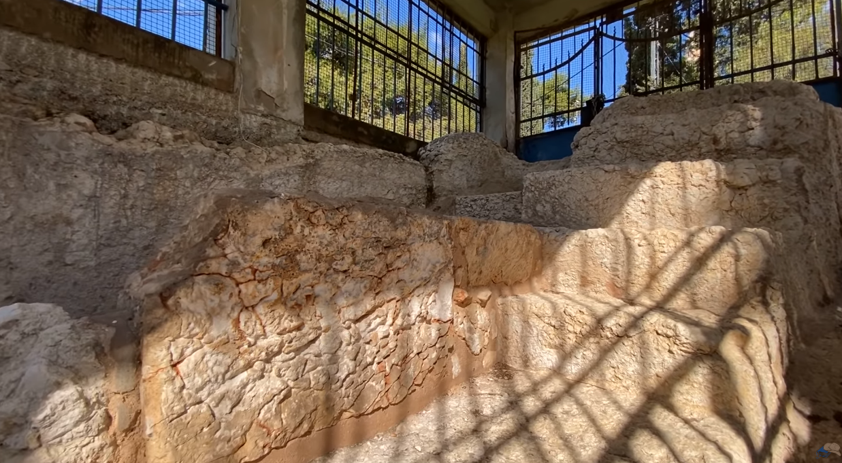

Slide 23
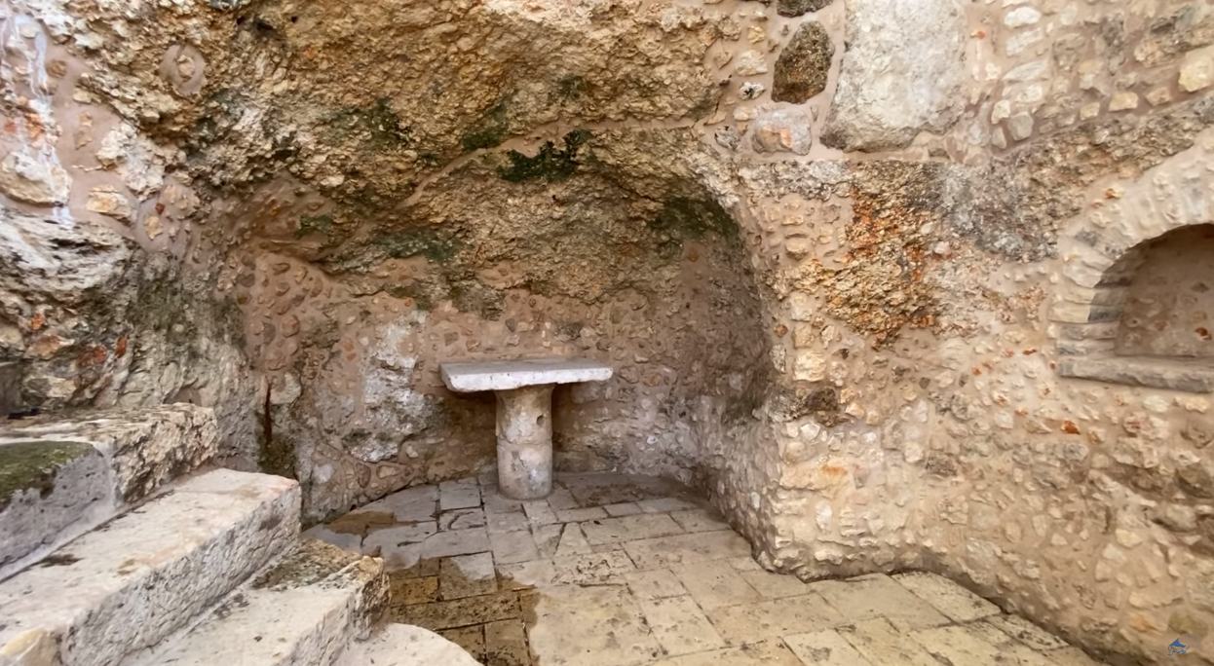

Slide 24
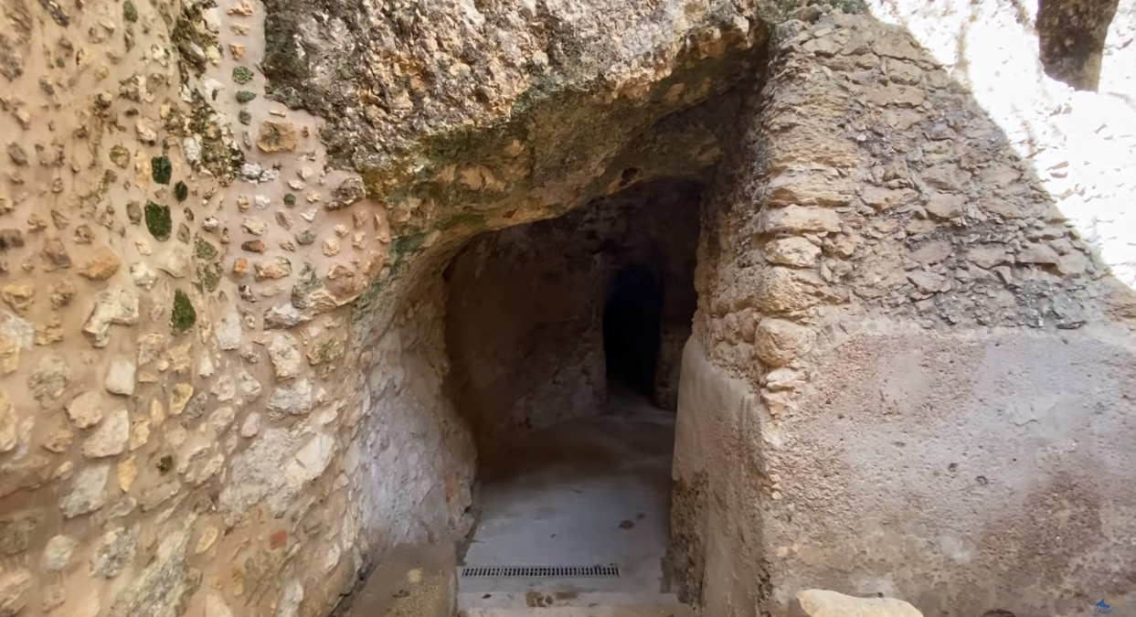

Slide 25
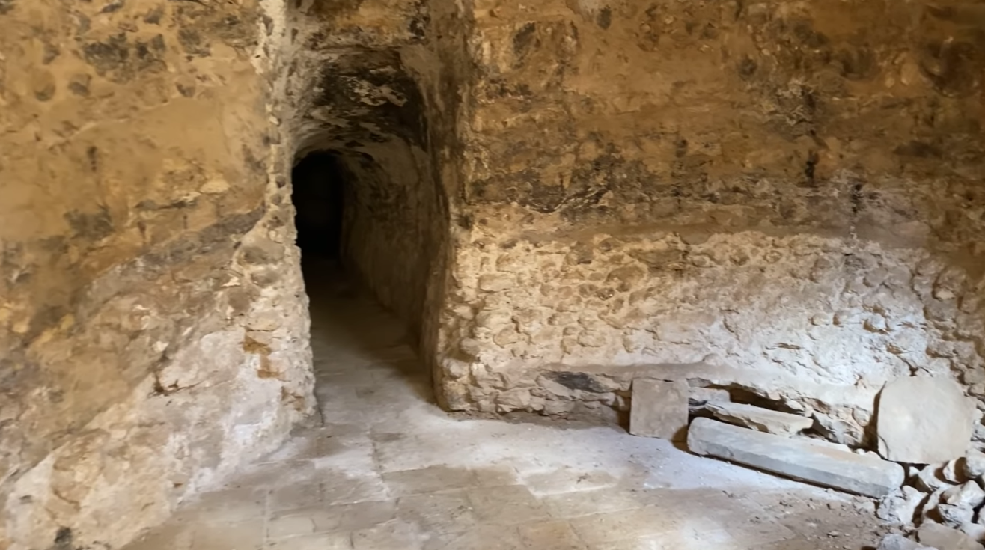

Slide 26
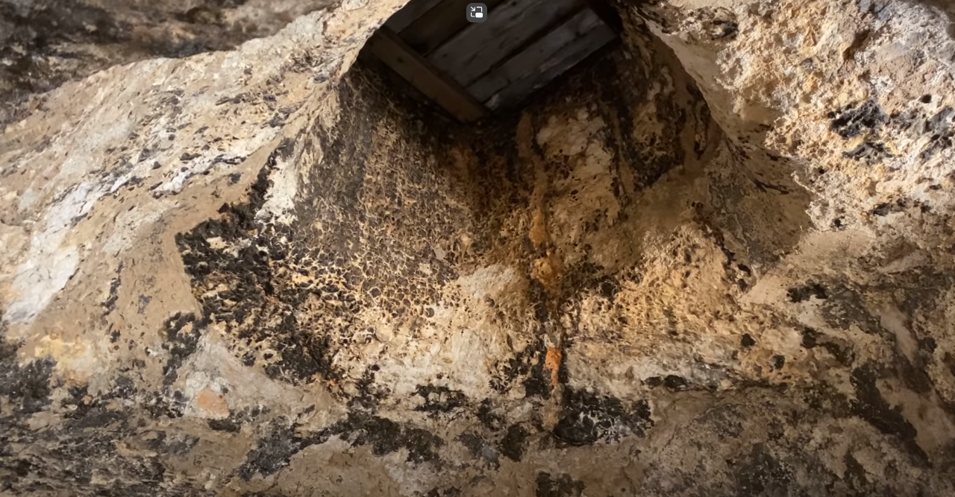

Slide 27
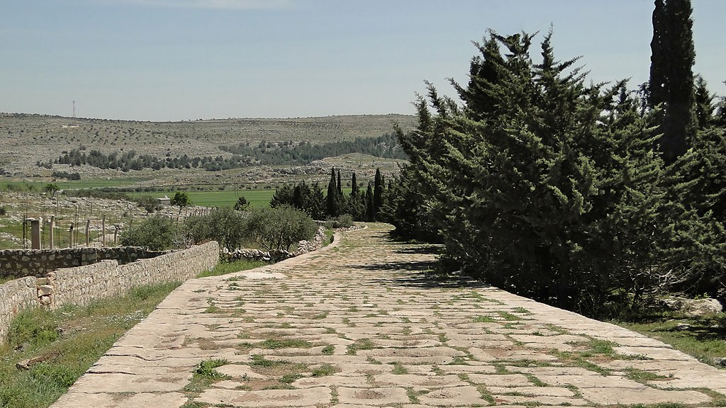
The second church to the founded in Acts was the gentile church of Antioch (Acts 11.20-22). It was founded around 40 AD. The ancient city of Antioch was destroyed by an earthquake.
Ancient Roman road that led to Antioch

Slide 28
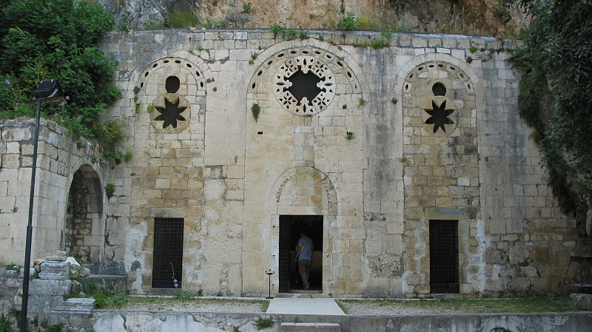
St. Peter Church of Antioch
This building from the 4th/5th century is believed by tradition to be the original site where the church was founded through the preaching of Peter.

Slide 29
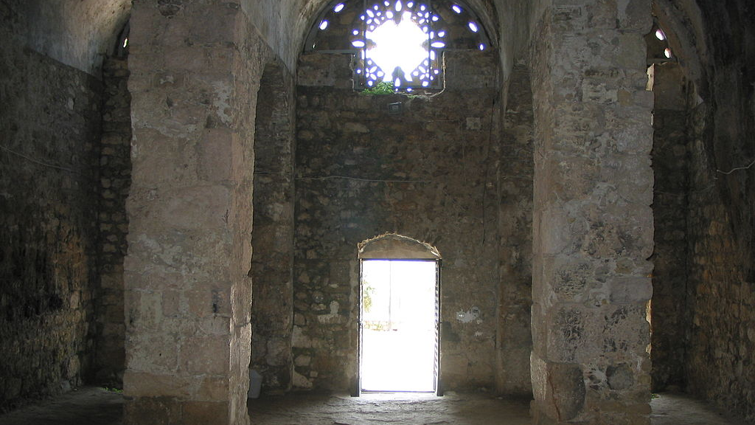

Slide 30
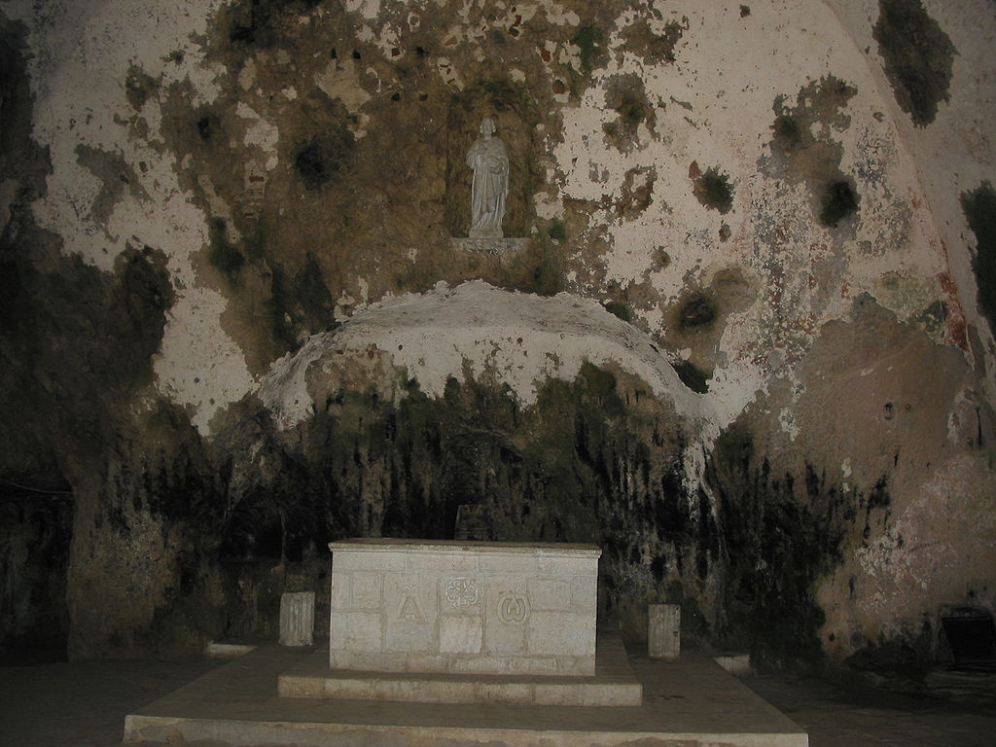

Slide 31
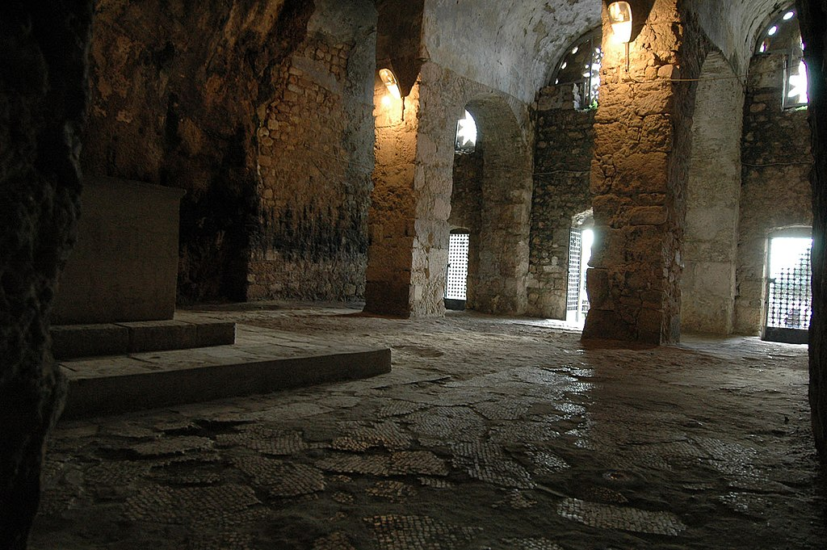

Slide 32
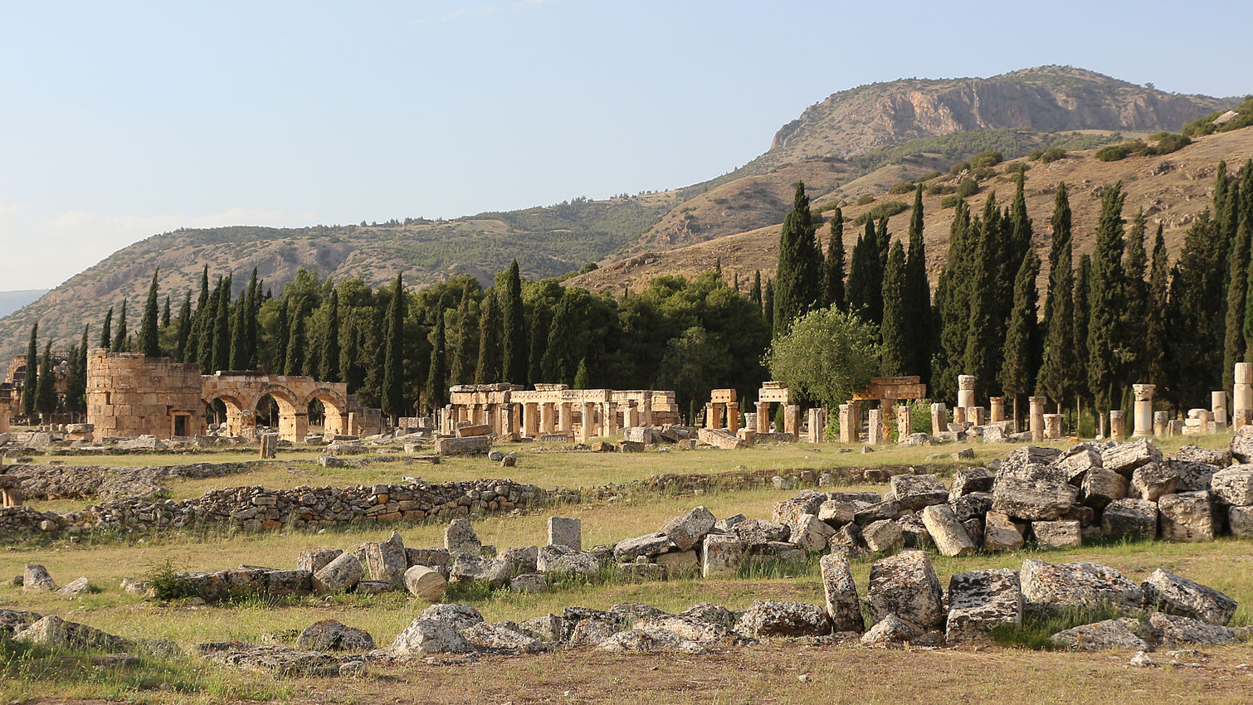
Hierapolis
Tomb of Apostle Phillip
By Bernard Gagnon - Own work, CC BY-SA 3.0, https://commons.wikimedia.org/w/index.php?curid=41335571

Slide 33
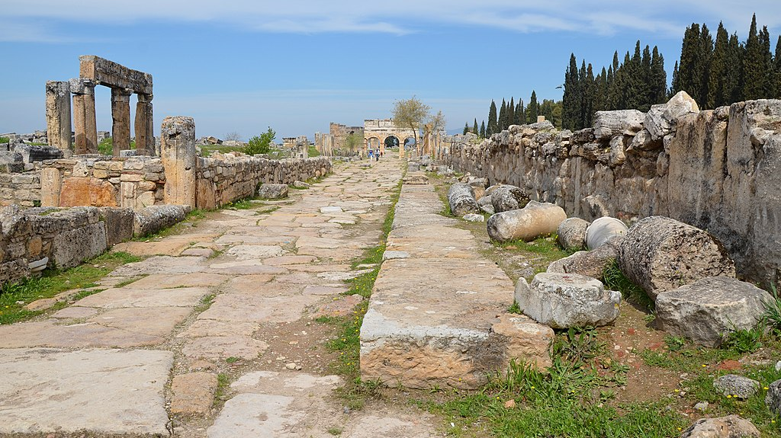
By Carole Raddato from FRANKFURT, Germany - Frontinus Street extending in the north-south direction of the city, Hierapolis, Phrygia, Turkey, CC BY-SA 2.0, https://commons.wikimedia.org/w/index.php?curid=75325834

Slide 34
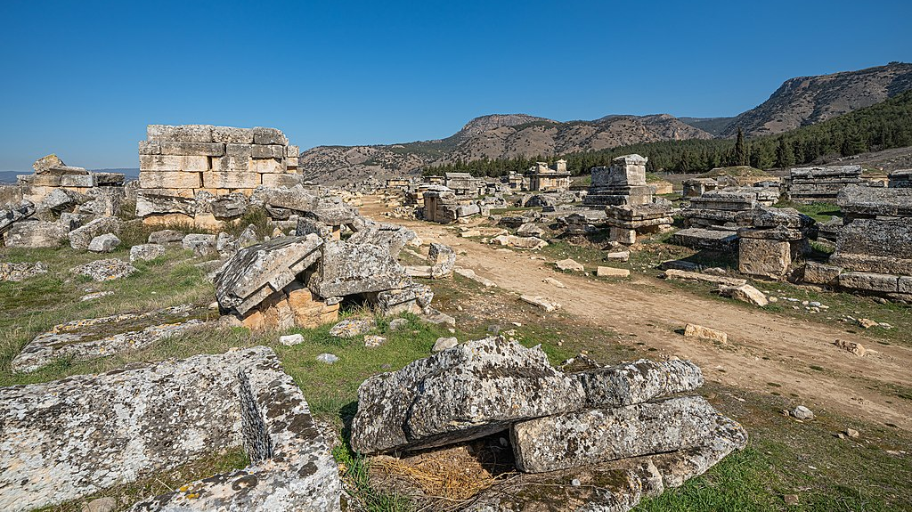
By A.Savin - Own work, FAL, https://commons.wikimedia.org/w/index.php?curid=94308622

Slide 35
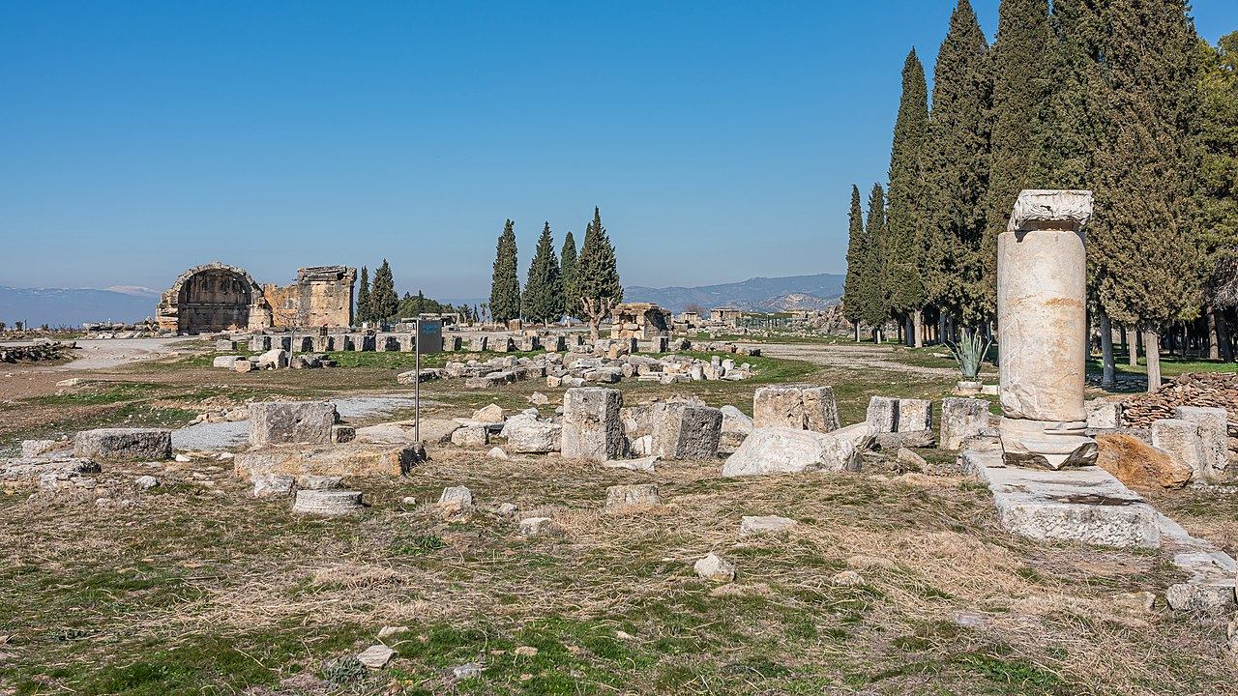
By A.Savin - Own work, FAL, https://commons.wikimedia.org/w/index.php?curid=94308413

Slide 36
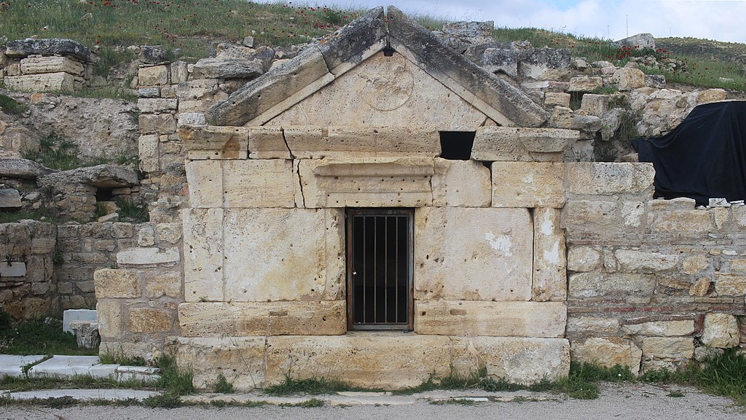
In the Ruins of a Fourth Century Church, it was found a tomb of the first century which is attributed to the apostle Phillip
By Blcksprt - Own work, CC BY-SA 4.0, https://commons.wikimedia.org/w/index.php?curid=78321412

Slide 37
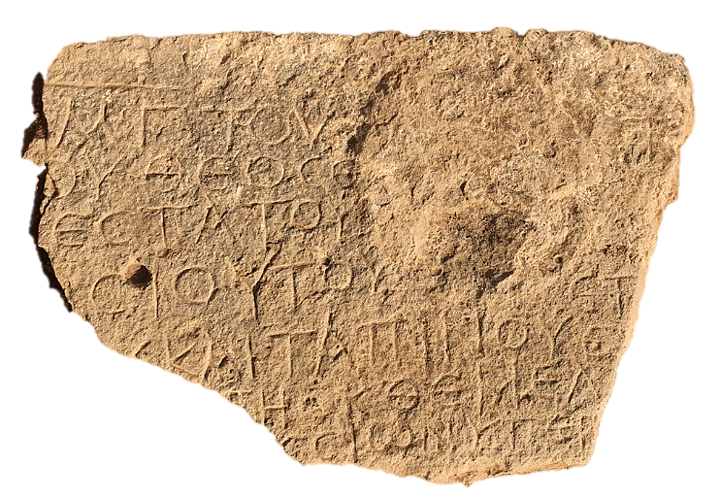
Fifth-century engraving found repurposed in a Byzantine church building’s wall in the Jezreel Valley
“Christ born of Mary. This work of the most God-fearing and pious bishop [Theodo]sius and the miserable Th[omas] was built from the foundation.”
Source: Tzachi Lang and Einat Ambar-Armon / Israel Antiquities Authority
Image: Inscription Offers Earliest Evidence of Christianity in Israel's Jezreel Valley | Smart News| Smithsonian Magazine

Slide 38
Why So Little Evidence?
First Christians did not see themselves and did not live differently than Jews. A Christian household in the first two decades would resemble any Jewish household and they met in houses (Acts 5.42).
Christians were persecuted first by the Jews and later by the Romans. They met in secret places and did not identify it for safety reasons.
Christian symbology was well established only after the peace enjoyed in the fourth century.
Some symbols have been interpreted to be associated with early Jewish Christianity by some scholars (the fish, anchor, cross, and others), but this is also contested by many others who claim real evidence for it.

Slide 39
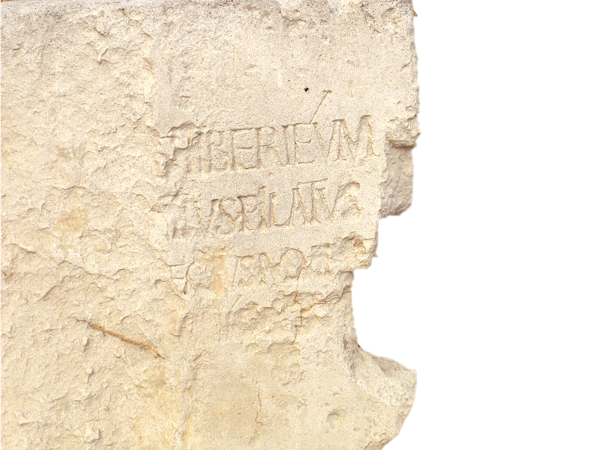
Pilate Stone
A carved limestone with a dedication of a Building contains the names of two biblical people. It was found in Caesarea Maritma in 1961. It reads:
To the Divine Augusti [this] Tiberieum
  ...Pontius Pilate
  ...prefect of Judea
  ...has dedicated [this]

Slide 40
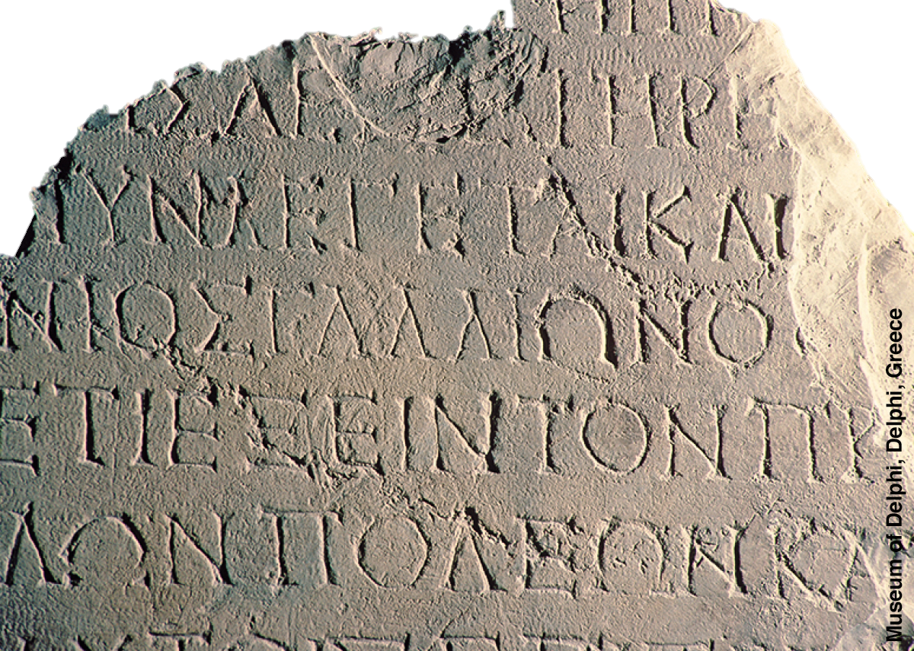
Gallio Inscription
The Gallio inscription is part of a letter written by Emperor Claudius around 52 AD in stone to “Proconsul Gallio”, who is mentioned in Acts 18.12 as the proconsul of Achaia. It was found in the Temple of Apollo in Delphi, Greece.

Slide 41
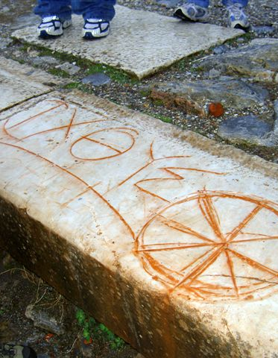
Symbology
The Ichthus marble inscription in Ephesus is considered to be from the early centuries.
Early Christians used symbols as a code of secret communication. It is difficult however to prove, because of the element of secrecy, when and what symbols were first used. It is usually agreed the ΙΧΘΥΣ, i.e. “Fish”, was a symbol used for early Christians, but examples of its use are from a later period. The symbol is an acronym:
Ἰησοῦς Χριστὸς Θεοῦ Υἱὸς Σωτήρ
Jesus Christ God’s Son Savior

Slide 42
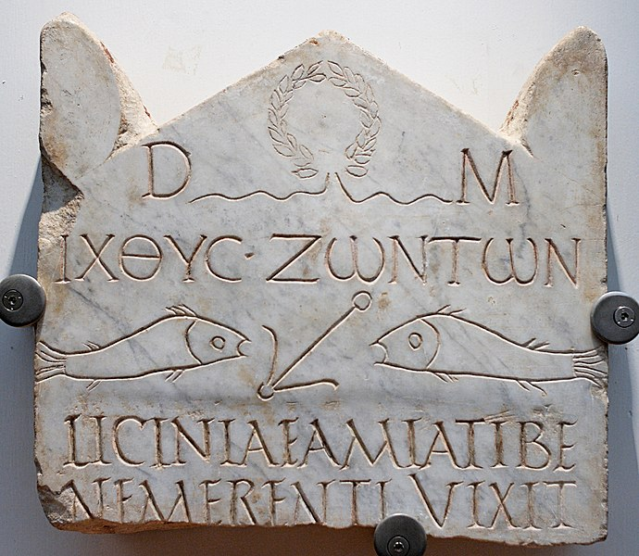
Funerary stele of Licinia Amias
This early 3rd century AD (perhaps 2nd century AD) Greek tombstone dedicated to Licinia Amias was found in the Vatican Necropolis, near St. Peter Basilica. It is considered one of the most ancient Christian inscriptions in Marble containing Christian symbology: fish and anchor. Part of It reads: “fish of living”.

Slide 43
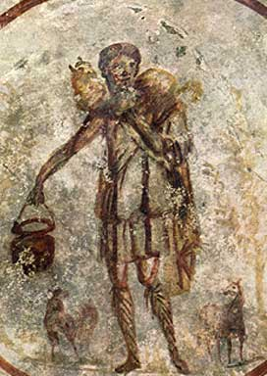
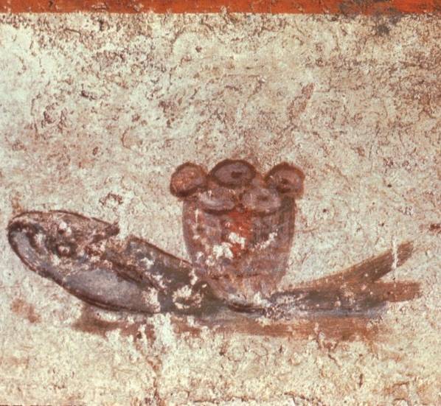
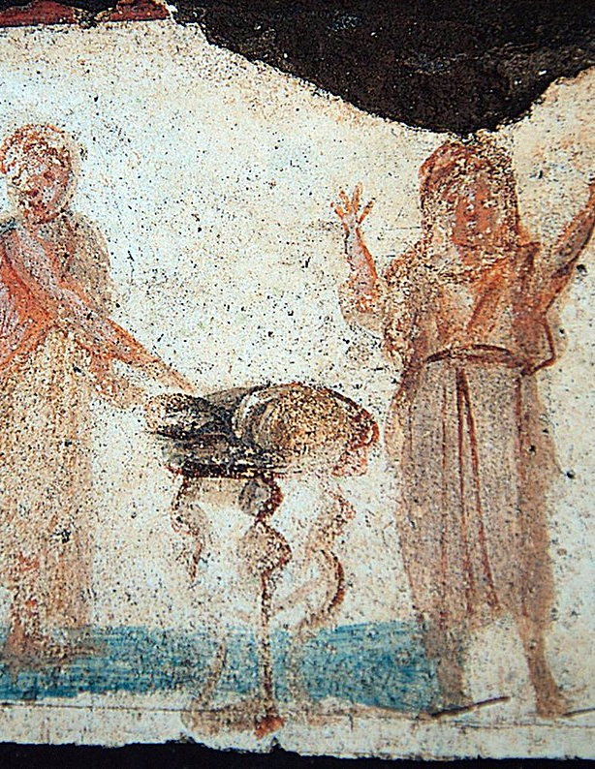
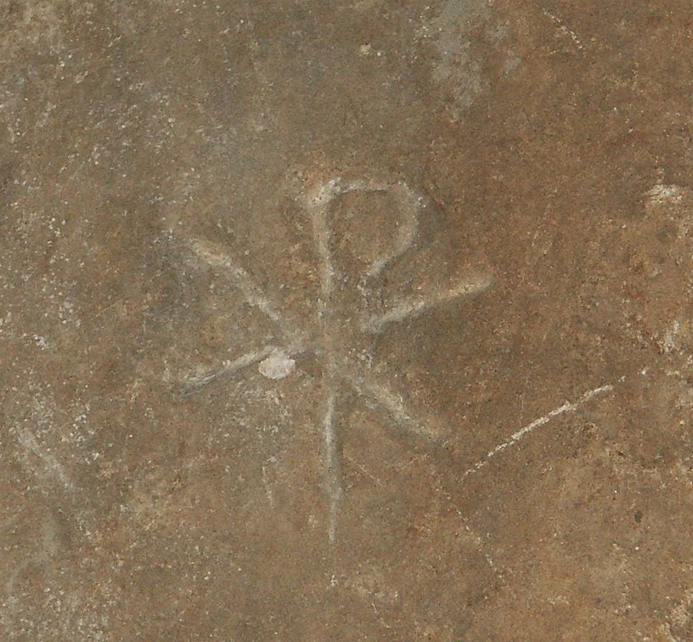
Catacombs of Rome
The catacombs of Rome are a complex of burial caves dating from the 2nd to the 4th century AD, created after the imperial ban on burials inside the city. From the drawings inside them comes a trove of early Christian symbology. Among them, the most known is the Catacomb of St. Callixtus, which is believed to be the burial site of the Popes of the early centuries.

Slide 44
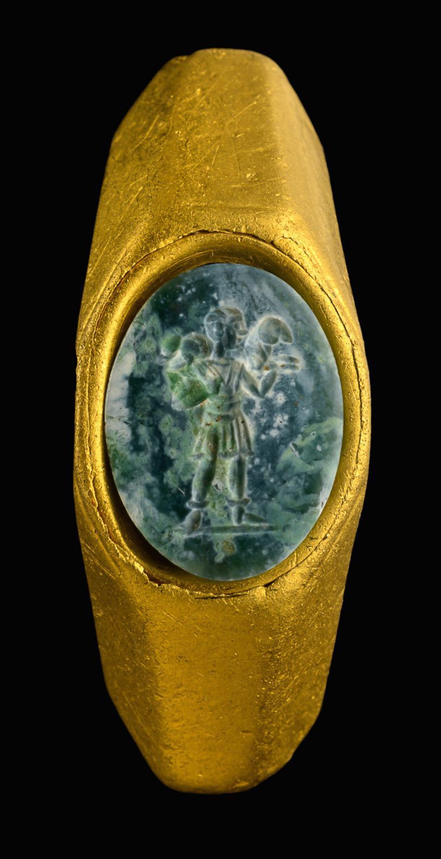
Good Shepperd Ring
Israel Antiquities Authority announced in 2021 that on the site of a shipwreck on the coast of Caesarea dated from the 1st to 3rd century AD they found a golden ring with the image of a shepherd carrying a sheep on his shoulders. This is believed to have belonged to some Christians since the “good shepherd” was an early symbol used by Christians.
Source: Early Christian Symbol of Jesus Discovered - Biblical Archaeology Society
Image: Dafna Gazit, Israel Antiquities Authority

Slide 45
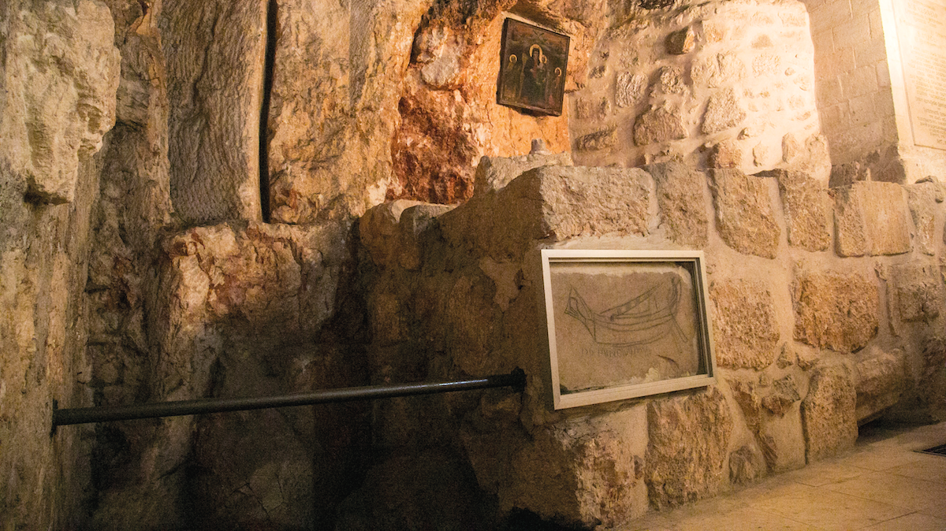
DOMINE IVIMUS inscription

Slide 46
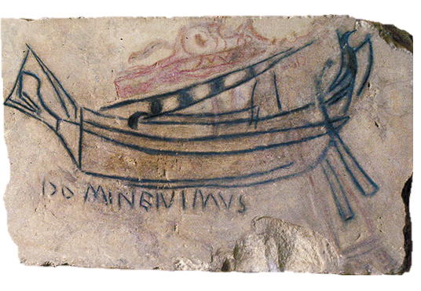
The DOMINE IVIMUS inscription (“Lord, we have come”) is found in Vartan Chapel, part of the complex of the holy Sepulcher. They represent the earliest Latin inscription of a pilgrim to Jerusalem.

Slide 47
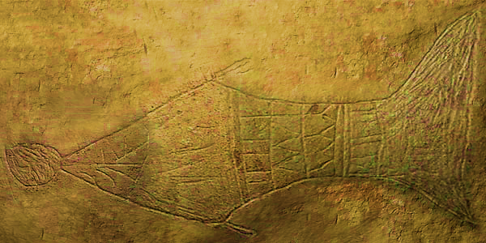
The depiction of “Jonah’s Fish” found in an ossuary at the Talpiot Tomb is interpreted to have been an early Christian symbol of resurrection.

Slide 48
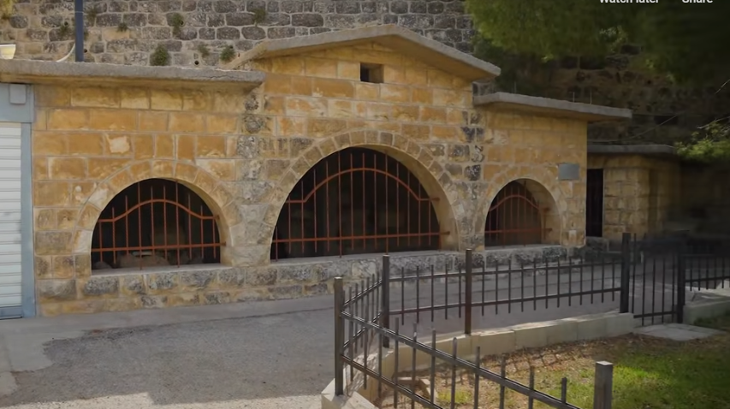
Dominus Flevit Cemetery

Slide 49


Slide 50



Archaeologist P. Bagatti studied the markings in the ossuaries of the Dominus Flevit Cemetery and concluded they were from Christians Jews buried before 70 AD.
Cross?
Shimon Bar Jonah

Slide 51


𝔓⁵² Fragment
This papyri fragment contains the Greek text of John 18.31-33 and 18.37-38 dated circa 130 AD.
Front
Back

Slide 52

Fragment 7Q5
This papyri fragment was found in the Dead Sea Scrolls. Scholars have dated it from the early 50s. It contains 18 letters of the text of Mark 6.52-53. This conclusion has been contested. If true it is the earliest archeological find in Christianity.

Slide 53


Dura-Europos Church (Syria)
Circa 233 AD

Slide 54

By Utilisateur:Bel Adone - Own work, Public Domain, https://commons.wikimedia.org/w/index.php?curid=6794957

Slide 55

Image: Discover a video on the History of the first Christian settlements (the-map-as-history.com)

Slide 56





