Slide 1
Reformation Fall Series 2023
Faith Presbyterian Church
The Foundation of the Reformation
Lecture 2: Replacement of the Authority

Slide 2
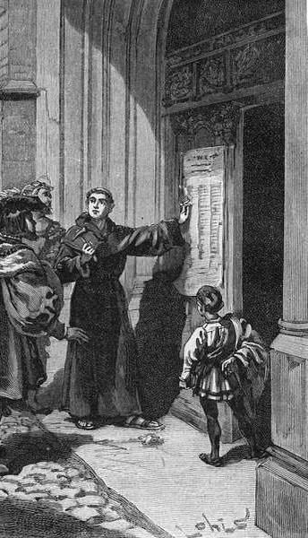
After the 95 Theses
Luther’s 95 theses fixated at the door of Wittenberg Cathedral on October 31, 1517, created a turmoil bigger than he or the Roman Catholic Church initially expected. Soon Luther was questioned about all his beliefs and had to defend himself. One of the first questions posed to him was how could he challenge something that was decreed by the Pope?

Slide 3
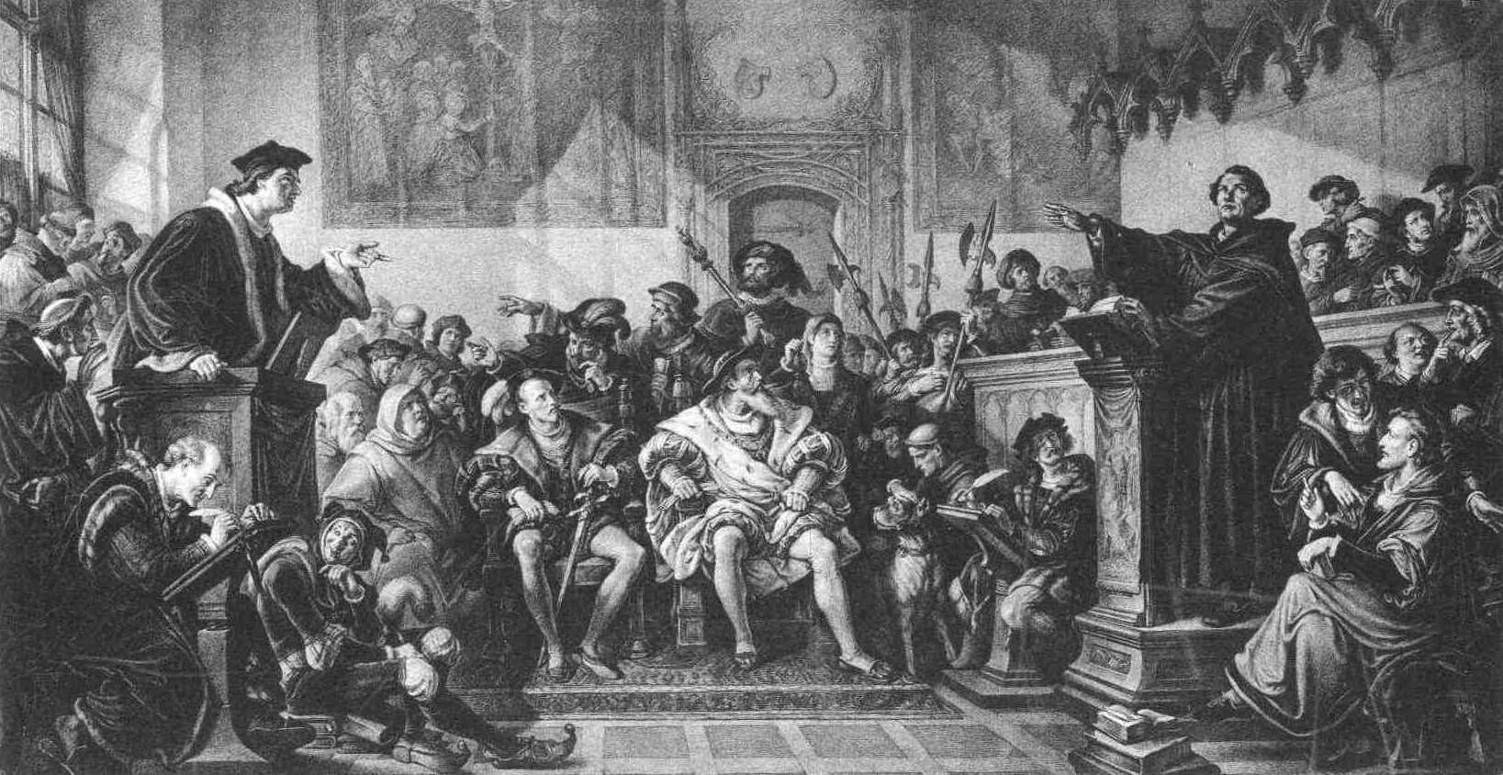
The Leipzig Debate - Julius Hubner(c. 1863-66)
Oil on Linen (replica heiotype), Galerie Neue Meister
Source: Wikicommons
“There is only one thing we must believe, that is, what Scripture teaches.”
In 1519 Luther’s associate Andreas Karlsdadt (1486-1541) was challenged to debate the Dominican Friar doctor in theology Johann Eck (1486-1543) about Luther’s teachings. At last, Luther himself attended the debate in June-July of 1519 at Pleissemburg Castle, Leipzig.

Slide 4
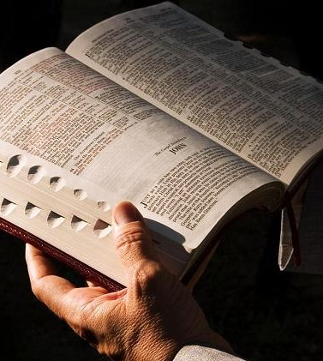
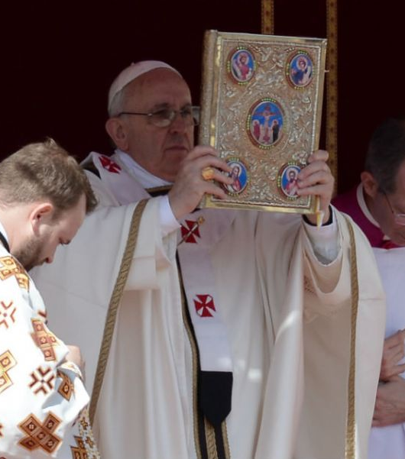
Authority of the Bible
VS.
Authority of The Church

Slide 5
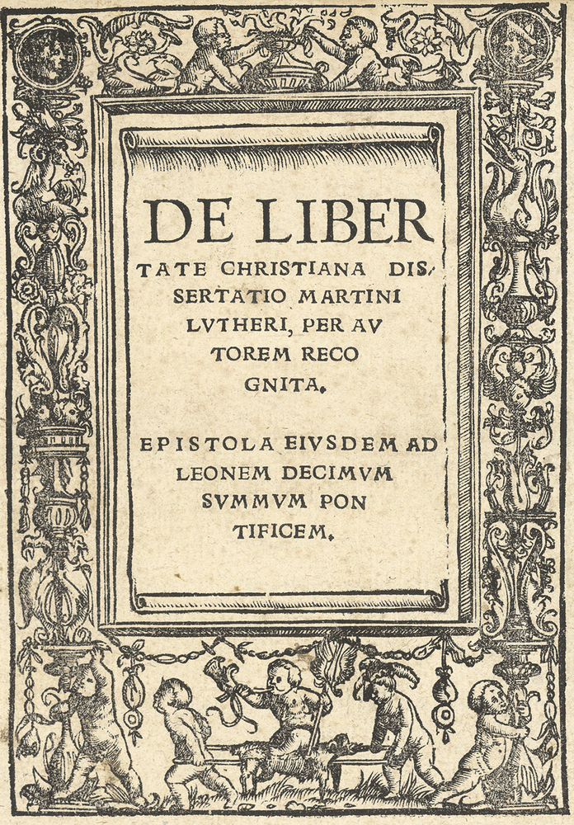
Martin Luther On the Christian Liberty Internet History Sourcebooks: Modern History
They are in error, who raise you above councils and the universal Church. They are in error, who attribute to you alone the right of interpreting Scripture.
For Holy Scripture makes no distinction between them, except that those, who are now boastfully called popes, bishops, and lords, it calls ministers, servants, and stewards, who are to serve the rest in the ministry of the Word, for teaching the faith of Christ and the liberty of believers. For though it is true that we are all equally priests, yet we cannot, nor, if we could, ought we all to minister and teach publicly.

Slide 6
No prophecy of Scripture comes from someone's own interpretation. For no prophecy was ever produced by the will of man, but men spoke from God as they were carried along by the Holy Spirit.
2Peter 1.20-21
2Ti 3:16

Slide 7
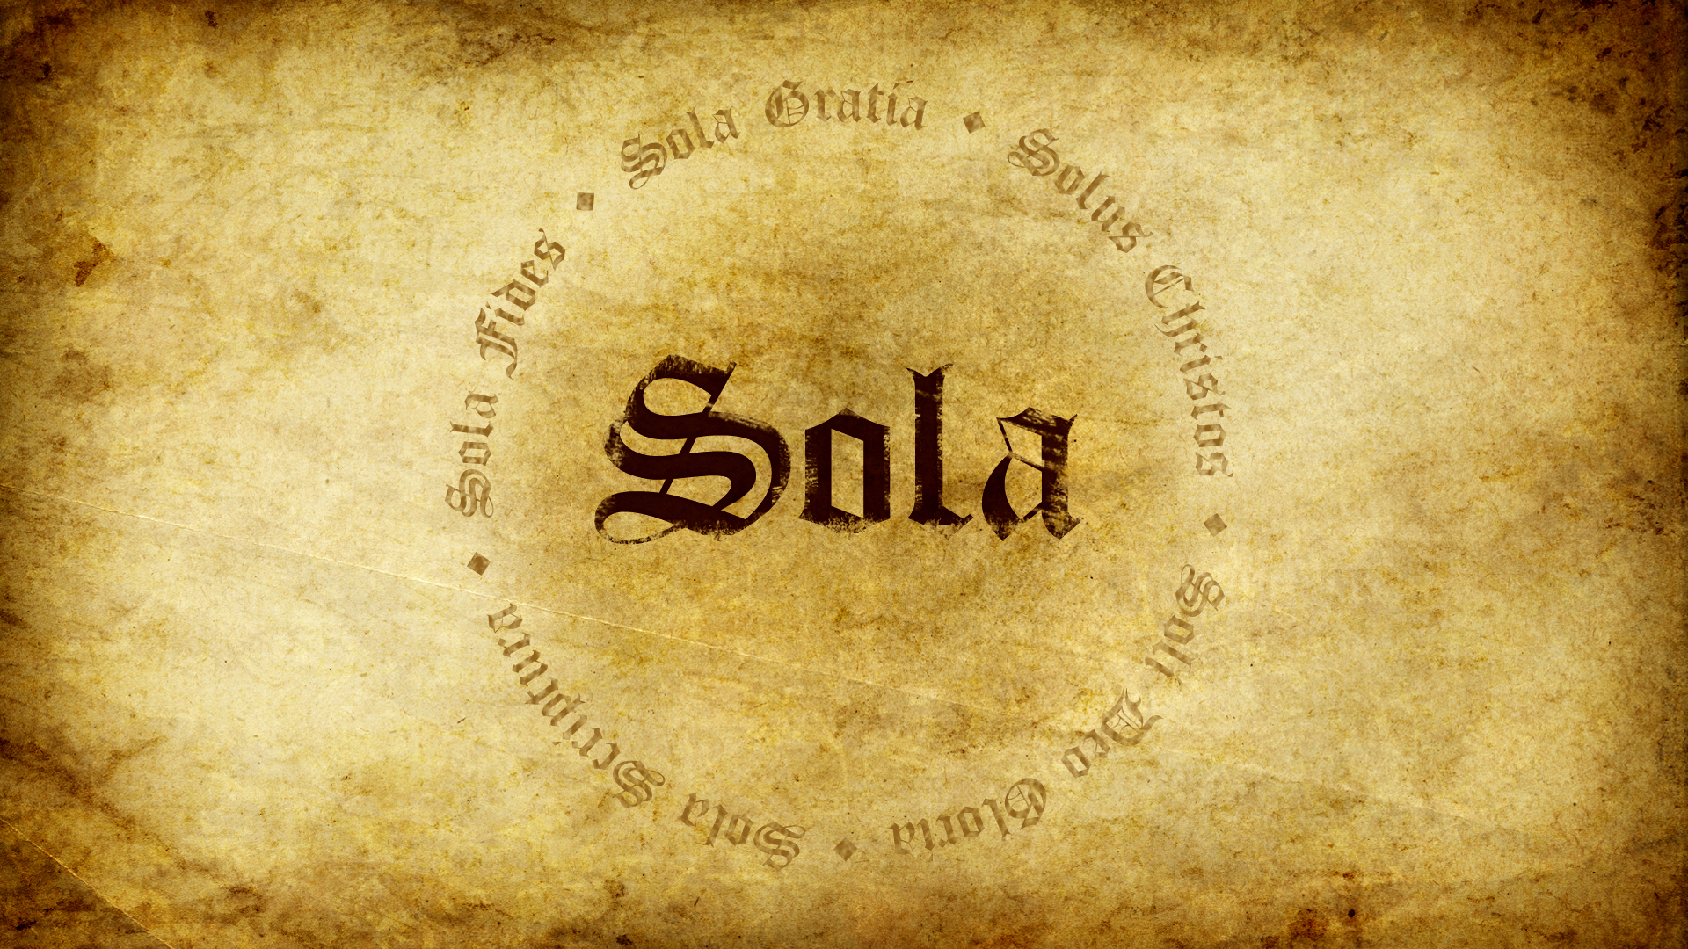

Slide 8
Difference in the Positions Illustrated
Roman Catholic
Protestants
Bible
Church
Church
Bible

Slide 9
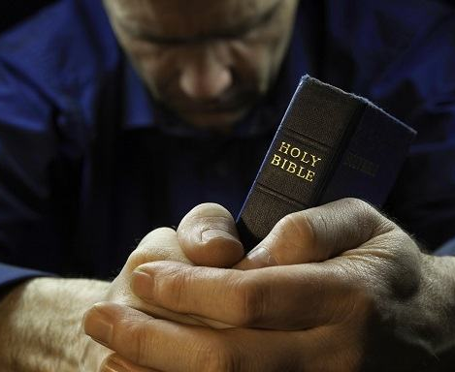
1. Sufficiency of Scripture
Understanding of Scripture causes faith that justifies. Scripture alone is sufficient for salvation.

Slide 10
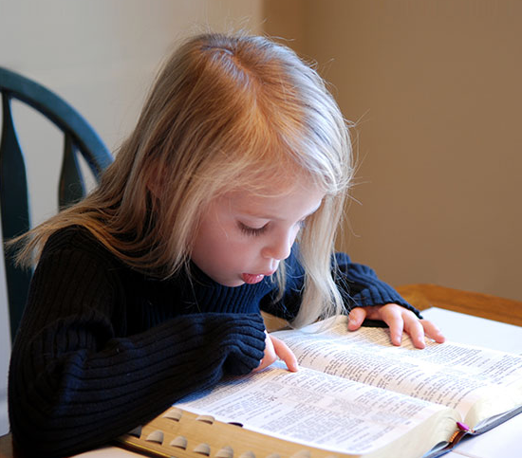
2. Clarity (Perspicuity) of Scripture
Any person can understand Scripture when enlightened by the Holy Spirit. This is the foundation of the universal priesthood of all Saints.

Slide 11
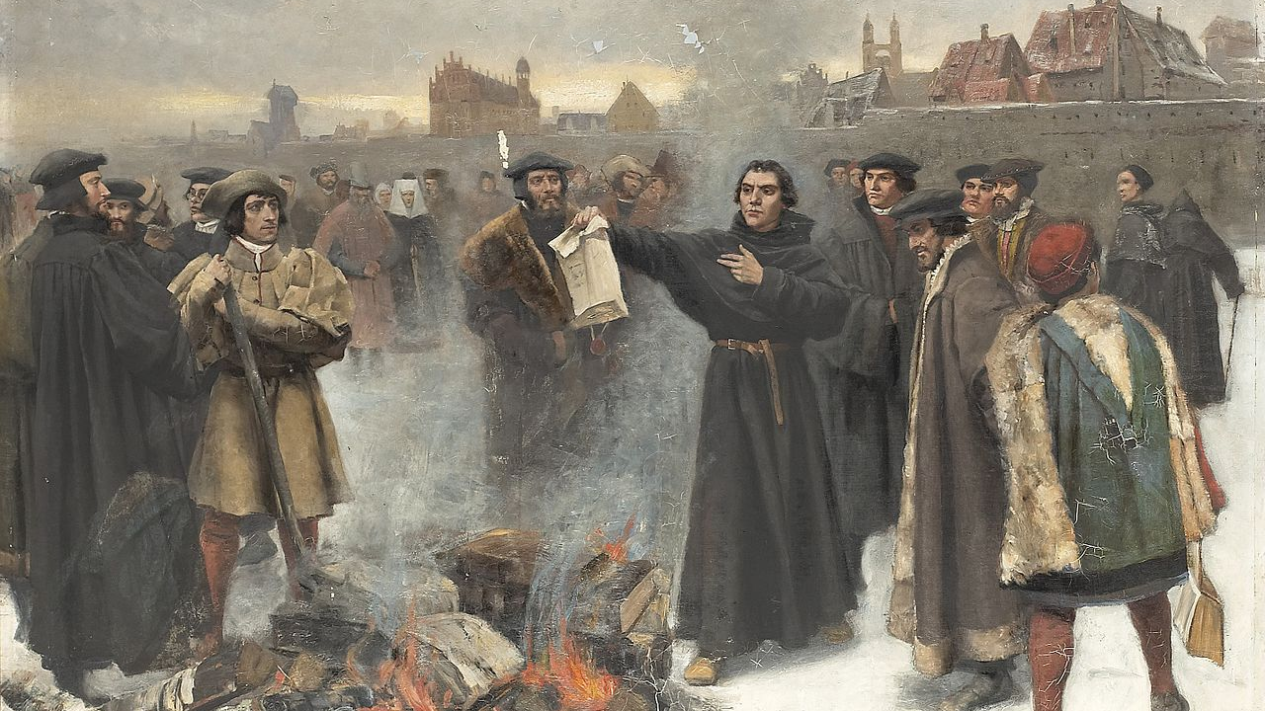
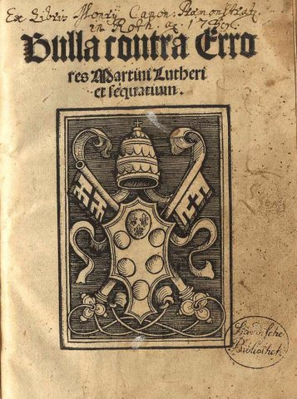
Luther burning the Papal Bull December 10, (1885).
Karl Aspelin (Oil on Canvas)
Source: Wikicommons
The Debate of Leipzig leads the church to officially condemn Luther’s writings as heretical. At this point, conciliation is not possible anymore. After being made aware of his excommunication Luther published three books challenging the authority of the Pope and stating the supremacy of Scripture.
Bull Exsurge Domine
Promulgated Julho 15, 1520. Ratified in January 3, 1521.
Source: Wikicommons

Slide 12
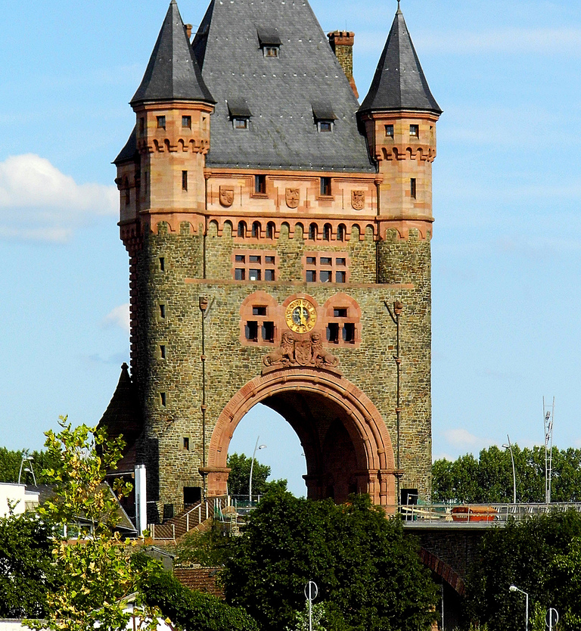
DIET OF WORMS
Luther’s excommunication does not solve the problem of the church. Rome presses the Emperor, who himself is in political trouble with a divided kingdom. Luther is summoned to a Diet in the city of Worms in April 1521. The official purpose was to mediate a compromise between the Church and Luther. The unofficial was to draw Luther out of Saxony to kill him. None work and Luther ends up hidden by his friends in a castle.

Slide 13
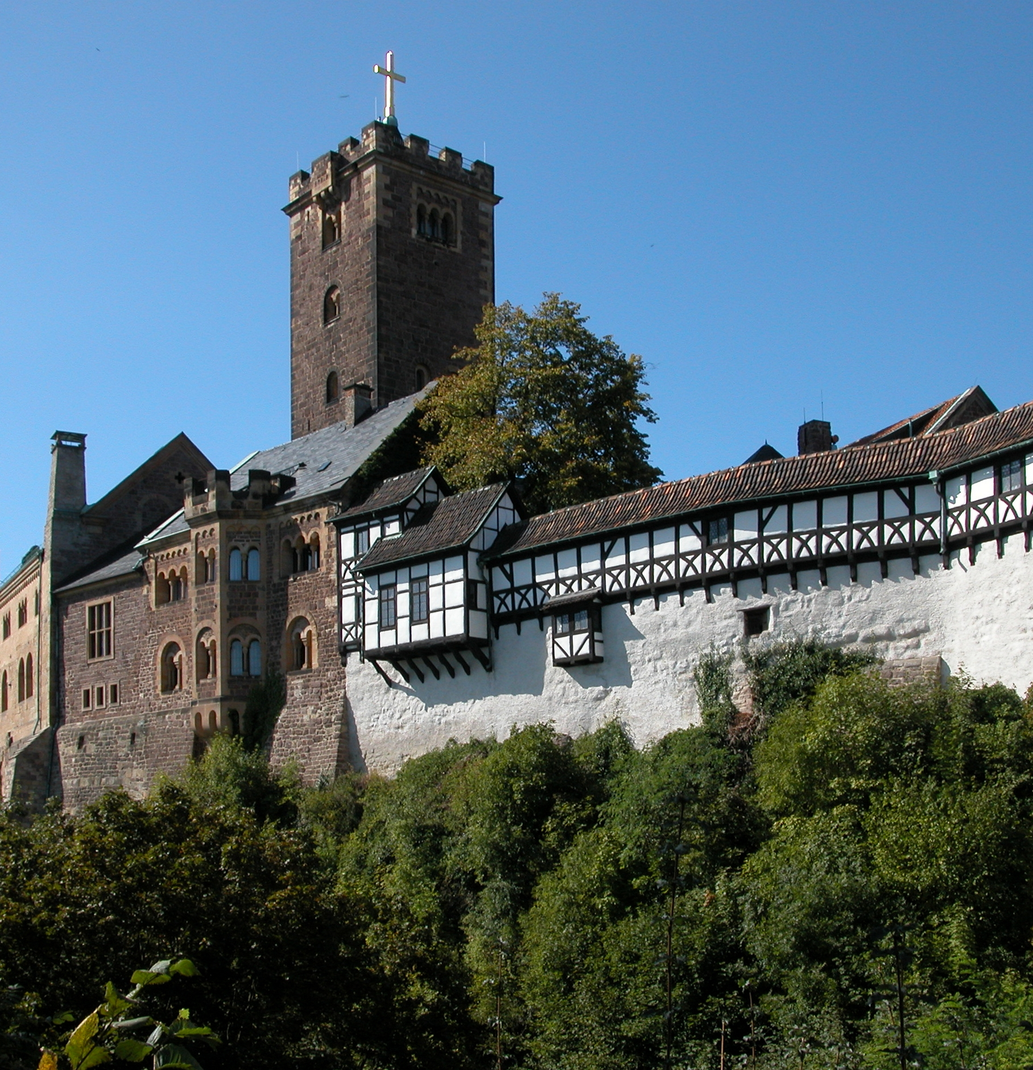
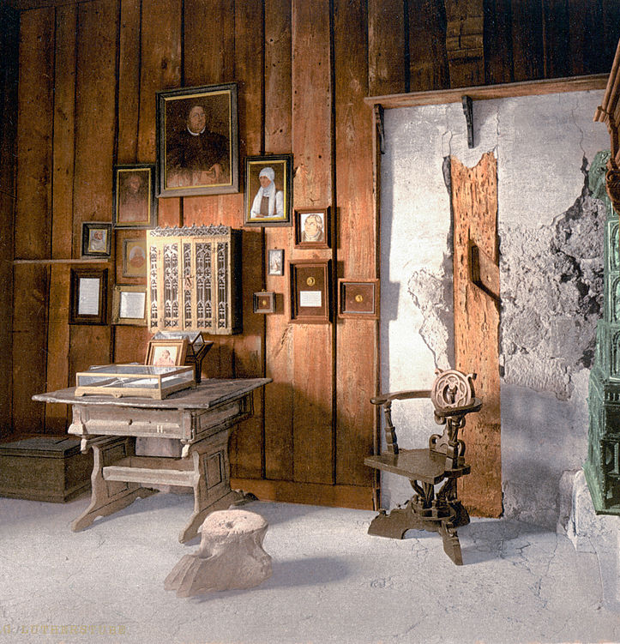
Hidden at the Wartburg Castle, Eisenach, from May of 1521 to March of 1522, Luther used this time to translate the Bible into German.
Source: wikicommonsused

Slide 14
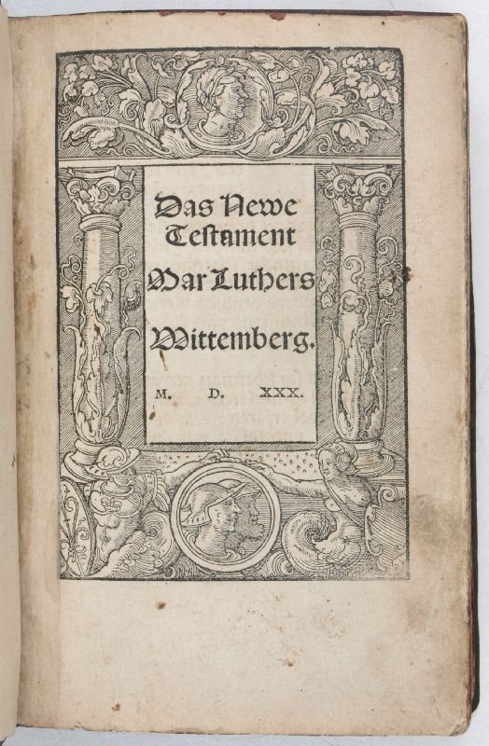
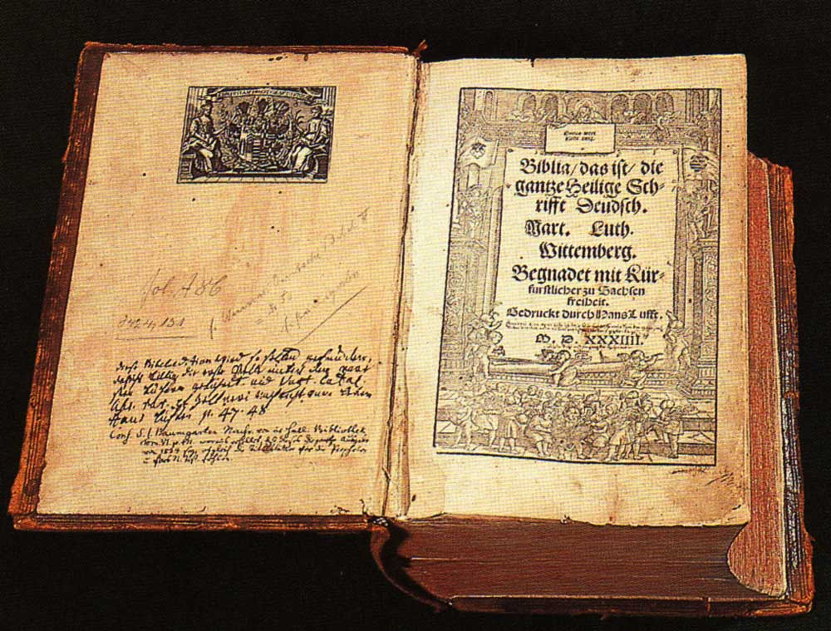
Luther’s Bible
Luther’s NT translation was published in September of 1522. The whole Bible in 1534. It was a fundamental step in the advancements of protestant cause and literacy among Germans.
(left) Luther’s New Testament Front Page;
(bottom) Luther’s Bible

Slide 15
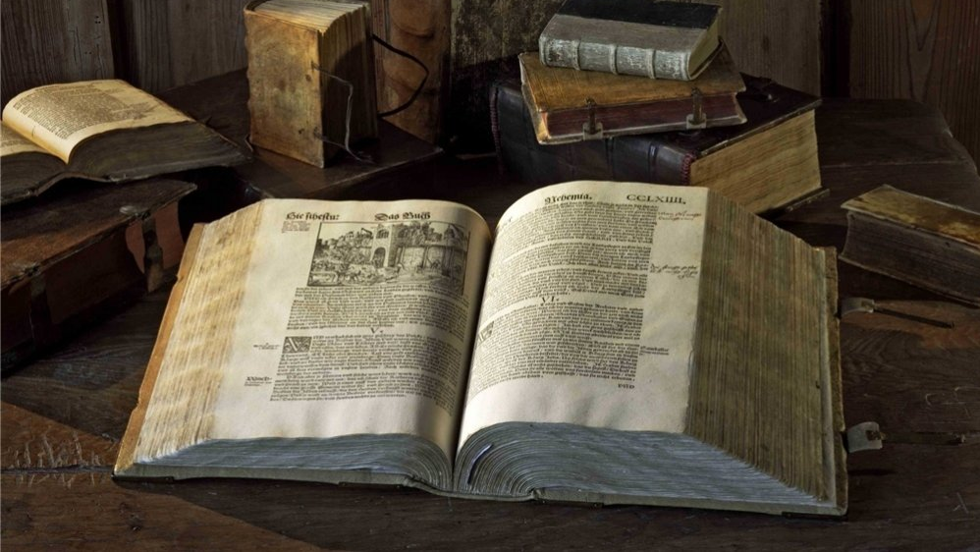
Bible in the Common Language

Slide 16
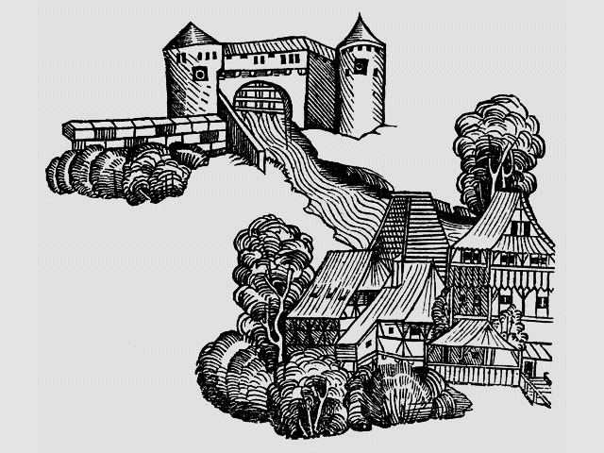
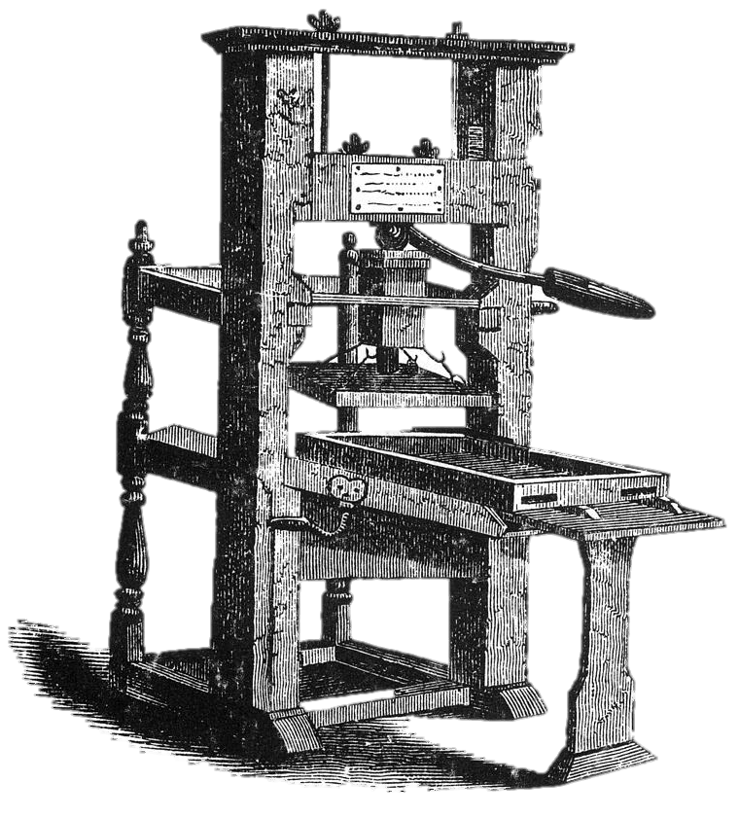
Technology: Paper and Press

Slide 17
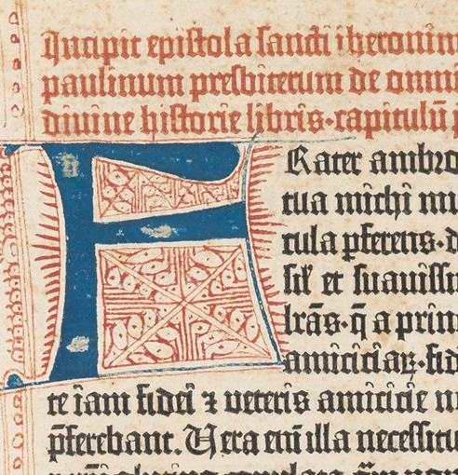
Gutemberg Bible (1445)

Slide 18
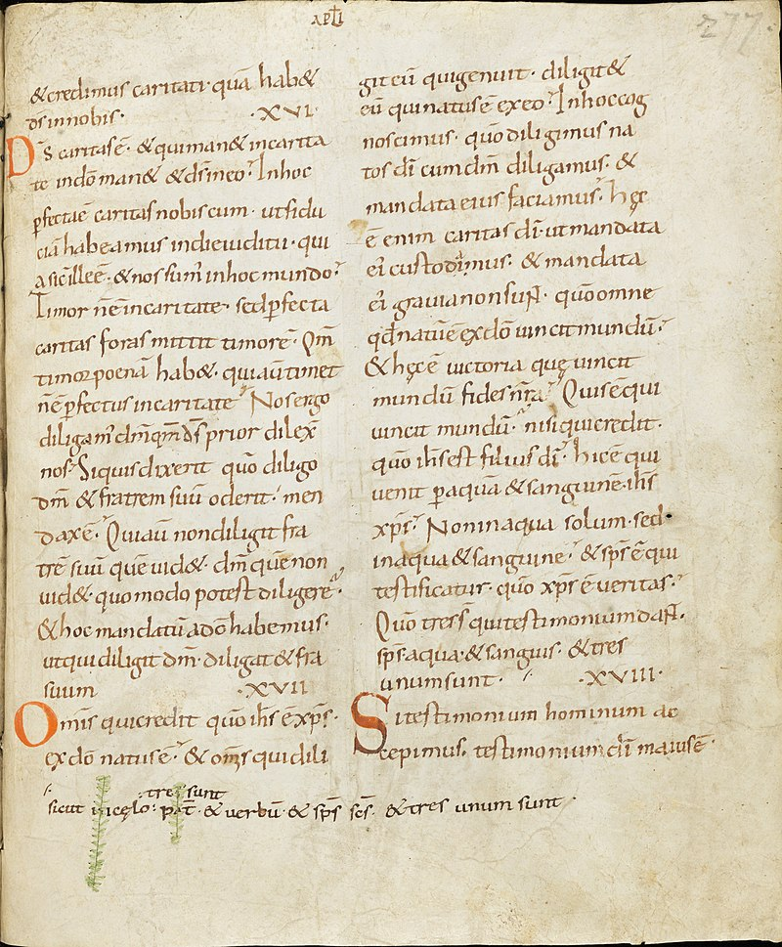
Vulgate
The Vulgata is a Latin bible translation made by the church Father Jerome around 382 AD. It gained the unofficial status of approved text of the Roman Church through the Middle Ages. The Council of Trent (1545-1563) declared it the authorized Bible. A revised version completed in 1590 was promulgated by Pope Sixtus V as the standard version.

Slide 19
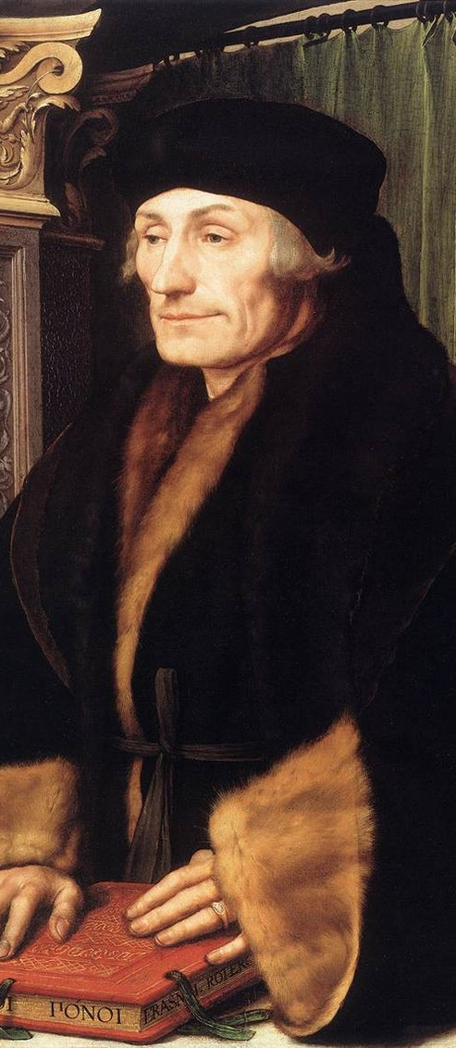
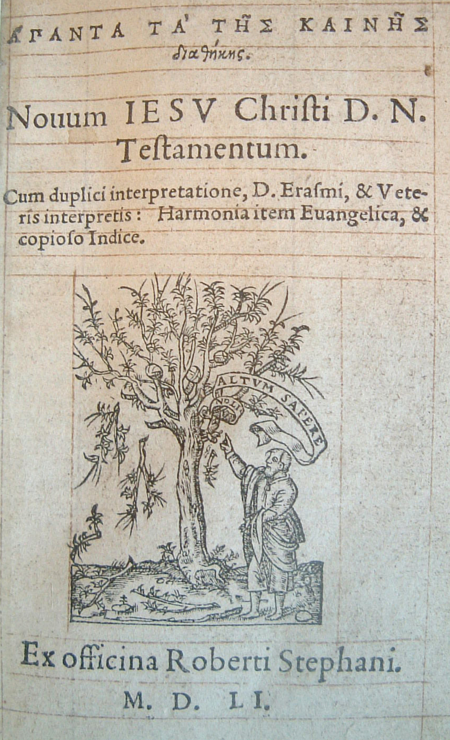
Textus Receptus (1516)
The compilation of the best ancient Bible manuscripts in the original language made by Erasmus of Rotterdam (1466-1536) was fundamental for the new translations of the Bible produced by protestants.
Erasmo de Roterdã (1523)
Hans Holbein – Óleo em Painel
Fonte: Wikicommons

Slide 20
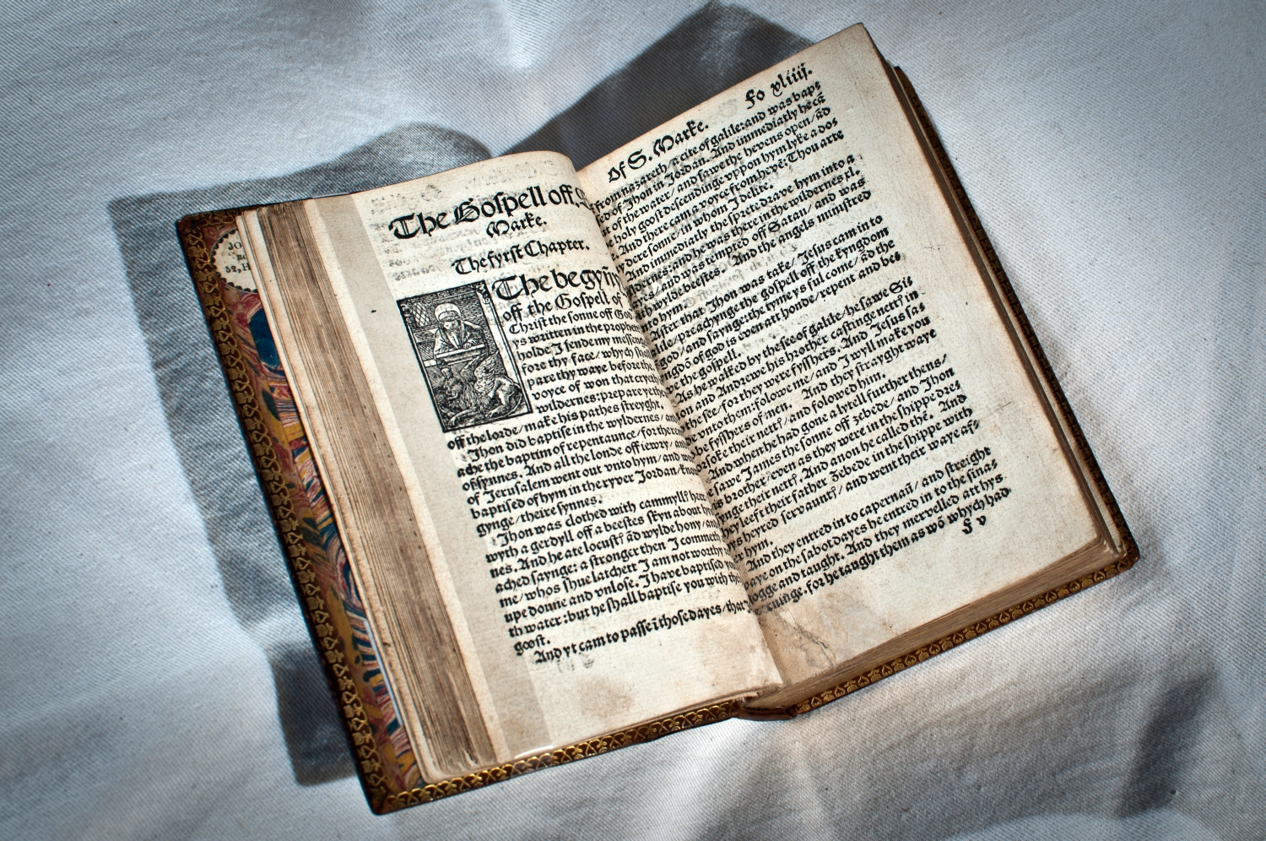
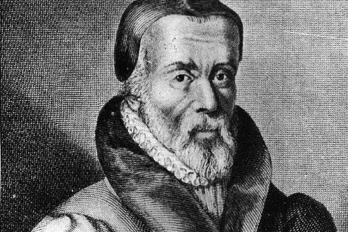
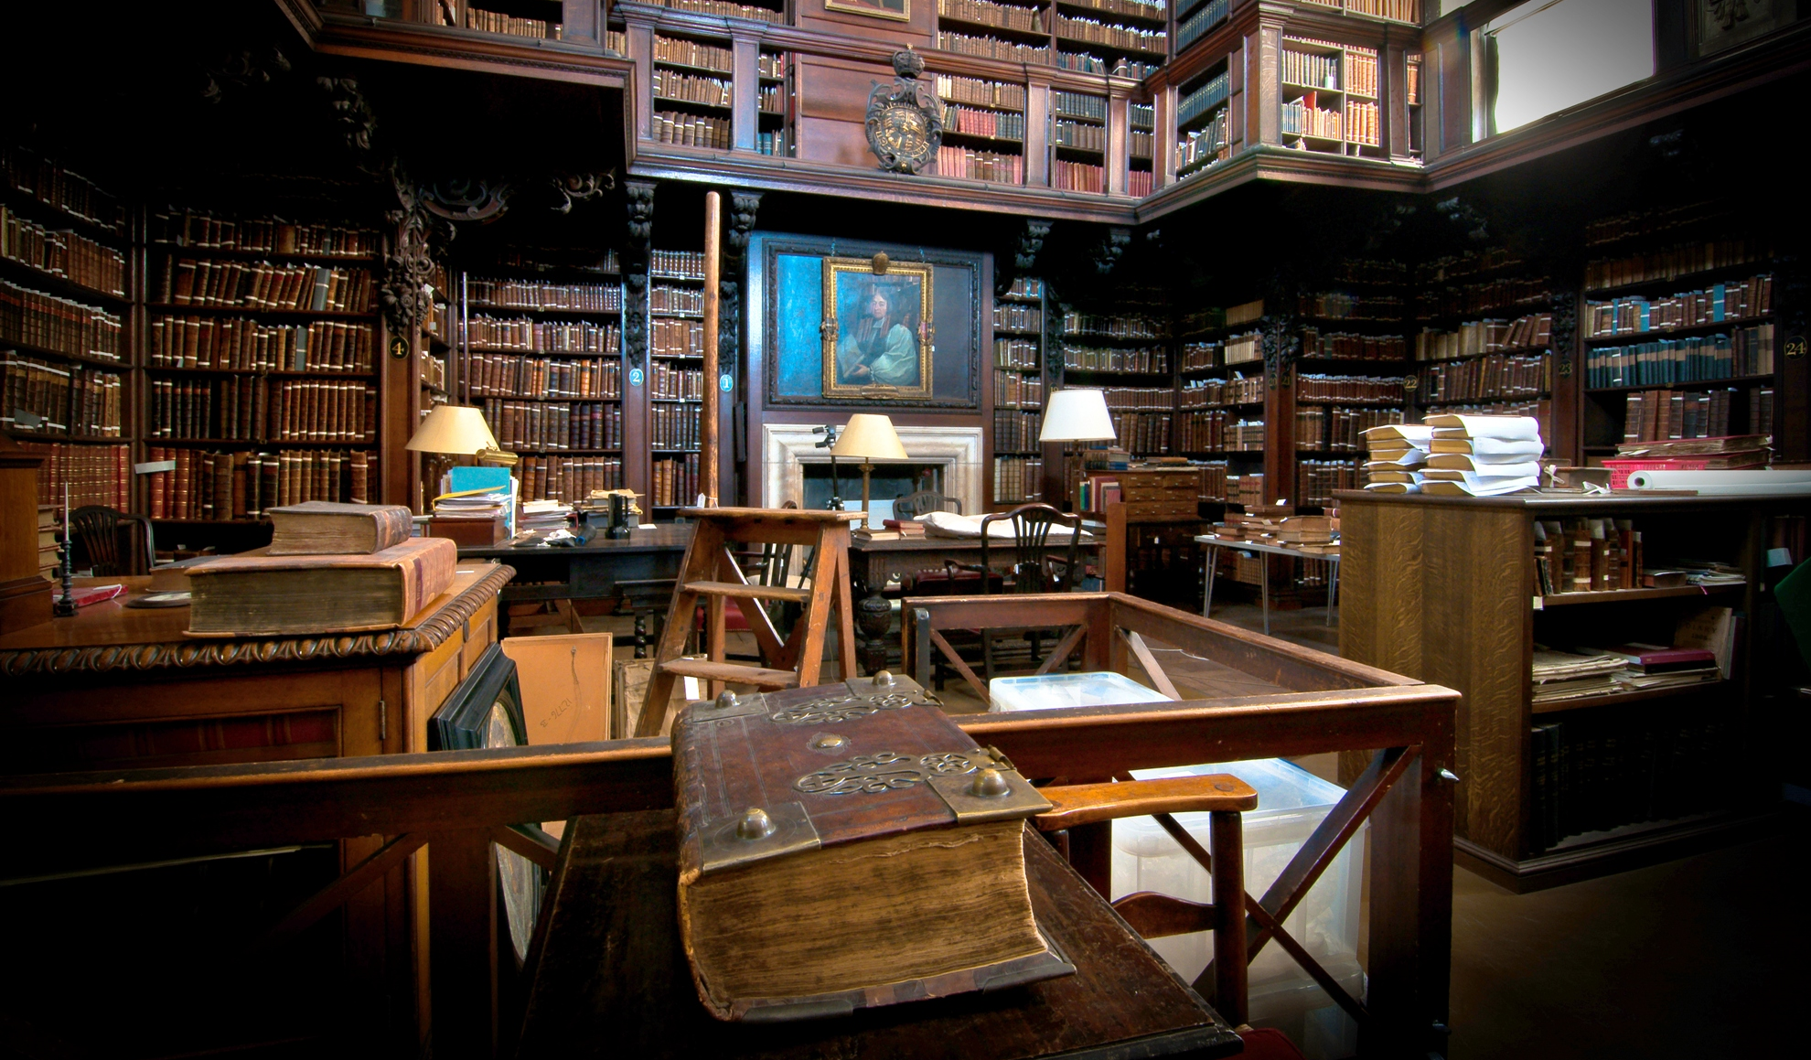
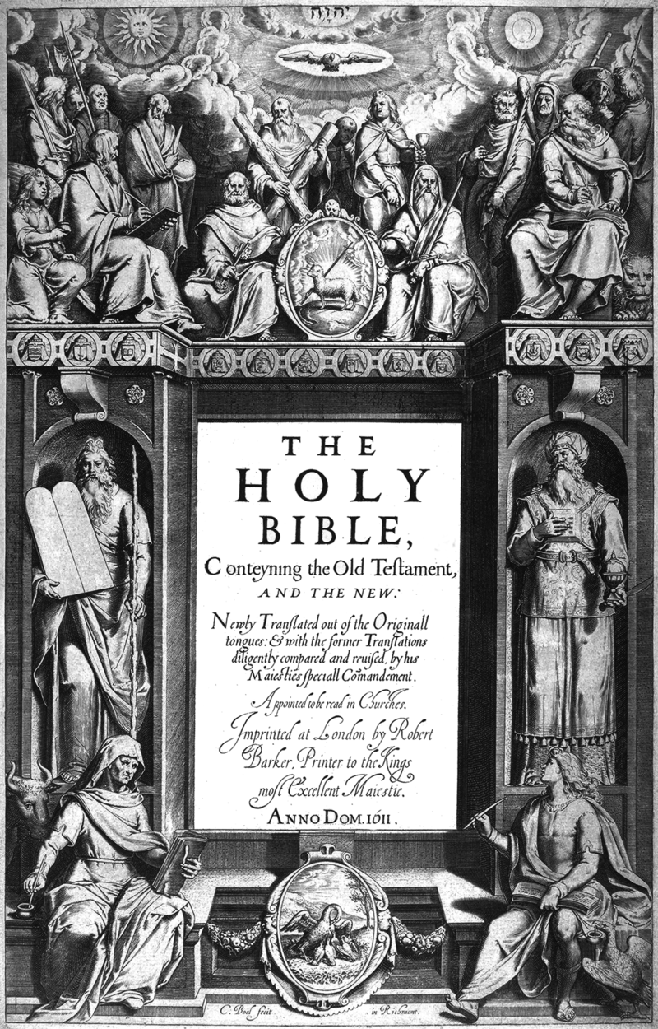
Tyndale Bible (1526)

Slide 21
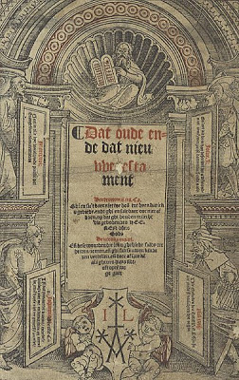
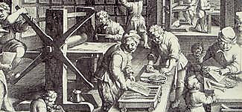
Dutch Bible (1526).
This translation was published in Antwerp by Jacob Van Liesvelt and was based on Luther’s translation. This led the Synod of Dort (1618) to approve a new translation, which was concluded in 1537.
Printing Press of Antwerp, 16th century.
Fonte: http://flemishamerican.blogspot.com.br/2008/12/flemish-influence-on-pilgrims-part-2.html

Slide 22
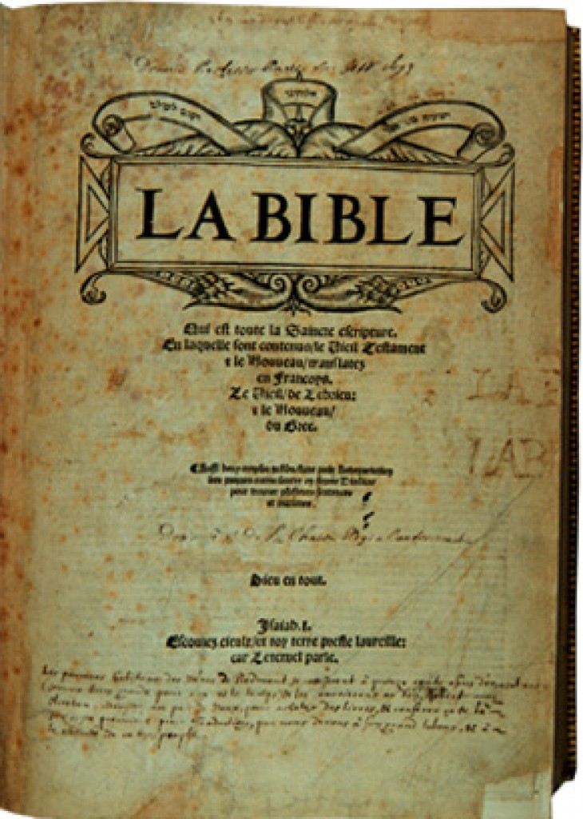
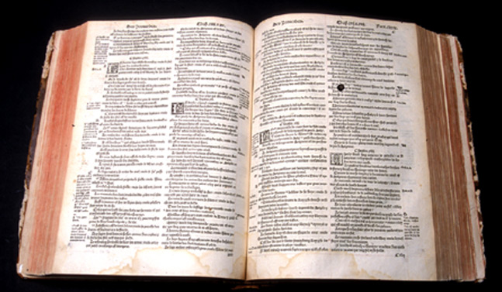
French Bible (1535)
Translated from the Erasmian text and based on the NT version of Jacques D’Etaples (1526), this version was made by Pierre Robert Olivetan (1506-1538), John Calivn’s cousin, to whom is attributed decisive role in Calvin’s conversion. It was prefaced by John Calvin.
Fonte: Wikicommons / https://www.museeprotestant.org/en/notice/humanism-and-translations-of-the-bible-into-the-vernacular/

Slide 23
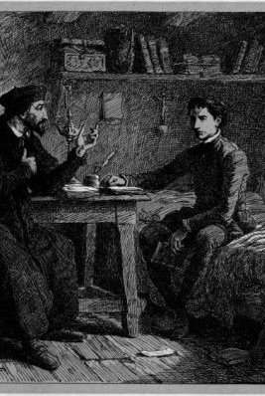
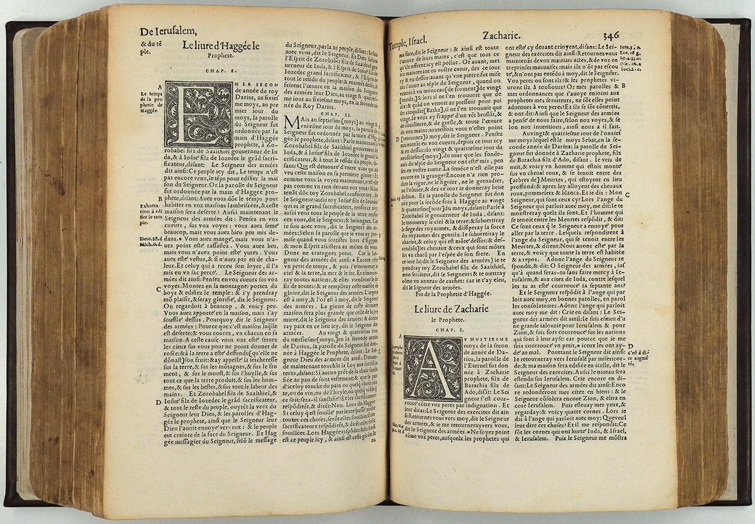
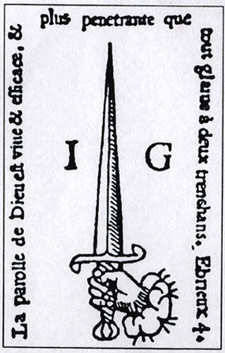
Olivetan’s Bible did not sell as expected. Its large size and small fonts seemed to have a factor in its sales failure. From Geneva, Calvin revised it and published it in 1546.
Calvino e Olivetan (Imagem Ilustrativa)
https://www.smu.edu/Bridwell/SpecialCollectionsandArchives/Exhibitions/ReformationHighlights/CalvinFrenchBible

Slide 24
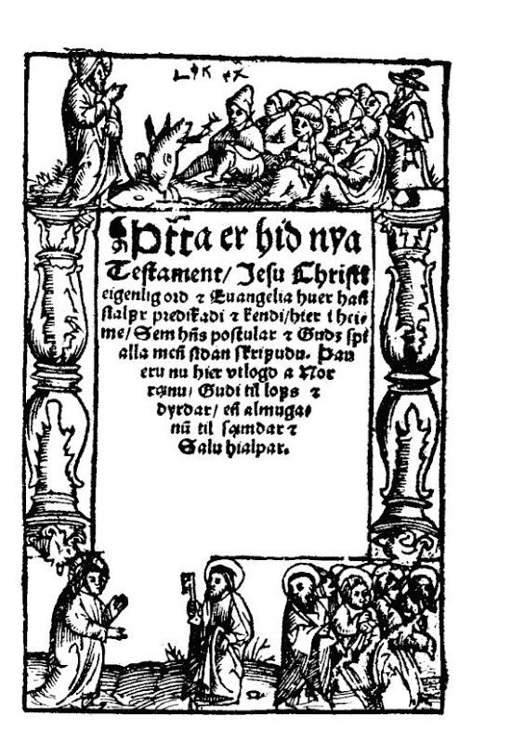
Icelandic New Testament (1540)
Translated by one of Luther’s disciples from his German translation and based on the Vulgate, it was made secretly in a stable.
“Jesus, our Lord, was born in a stable alongside donkeys and now his Word is translated into my native language in a stable alongside cows.”
Oddur Gottskálkssonusing (1514-1556)

Slide 25
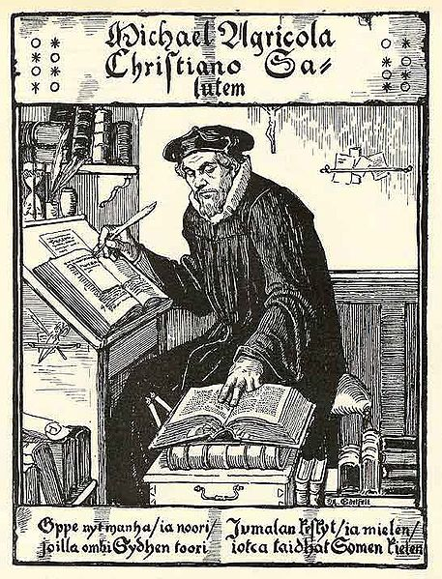
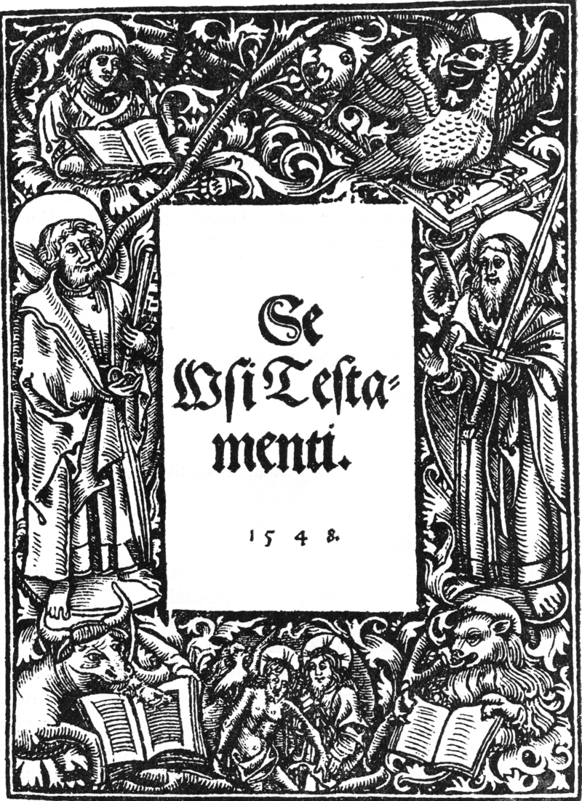
Finish New Testament (1548)
Mikael Agricola
Albert Edelfelt (Sec. 19)
Produced by the leader of the protestant finish movement, Mikael Agricola (1510-1557), this version is considered the text that consolidated the modern Finish language. Agricola studied under Luther and returned to Finland to lead the protestant movement.
Front Page
Fonte: Wikicommons

Slide 26
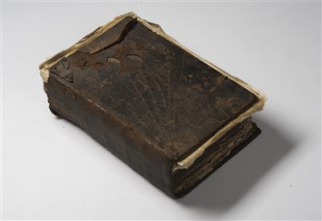
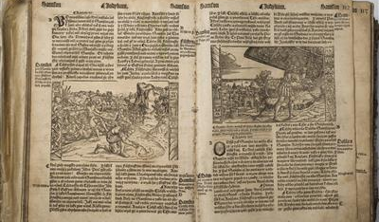
Melantrich
Bible (1549)
Translated to Czech (Slavic) from the text of Erasmus, this Bible is known by the name of his editor Jirik Melantrich Rozdalovsky of Aventin (1511-1580).
Second Edition of the Melantrich Bible (1556-57) in auction (€ 1150).
Fonte: https://www.dorotheum.com/en/auctions/current-auctions/kataloge/list-lots-detail/auktion/11490-art-and-antiques/lotID/584/lot/1969511-melantrichs-bibles-2nd-edition-155657.html?currentPage=11&img=1

Slide 27
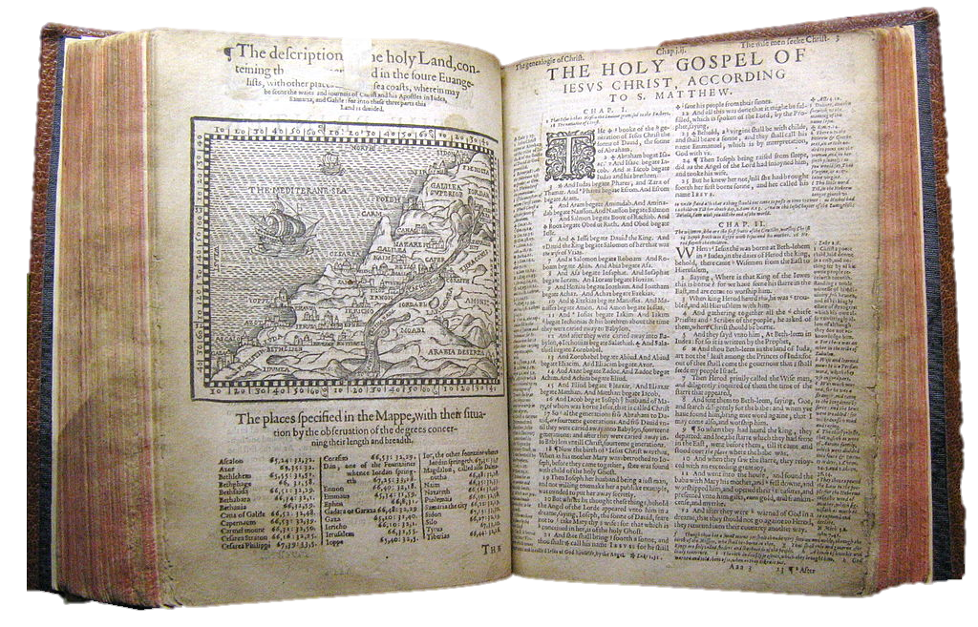
Geneva Bible (1560)
This English translation was called “Geneva” because it was made in the city of Geneva under the auspices of John Calvin by exiled Puritans. It used Erasmus’s text and comparisons with the Tyndale (1526) and Coverdale (1535) versions.

Slide 28
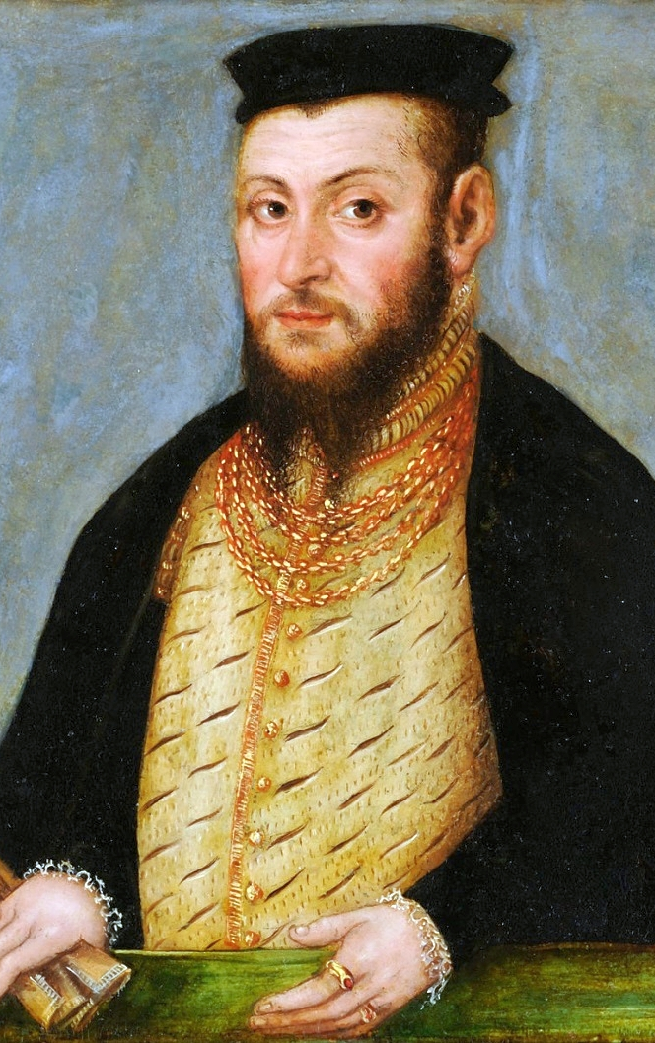
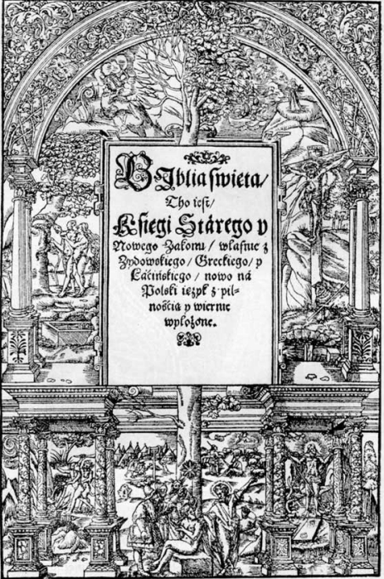
Polish Bible (1563)
Made by the decision of the Reformed Synod of 1559-60 this translation was produced by a committee. It was dedicated to King Sigmund II Augustus.
Sigmund II Augustus
Lucas Crannach, the young – Oil on Cooper (1553)
Museum Czartorysky, Cracow, Poland (Source: Wikicommons)
Front Page of the Polish Bible (1563)
Source: Wikicommons

Slide 29
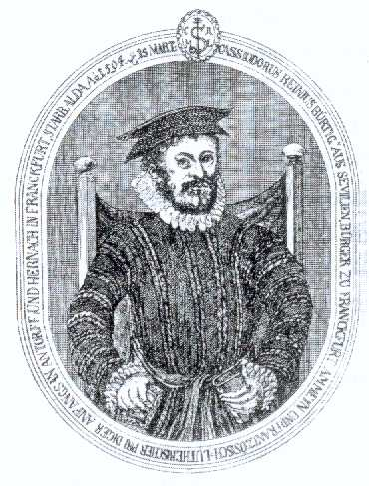
Biblia Del Olso (1569)
This Spanish translation was made by a Jew converted to Lutheranism named Cassioro de Reina (1520-1594).
It became known as the “Bear Bible” because its front
page had a drawing of a bear eating honey from a tree. It was revised and re-published in 1602 as Reina-Valera Bible.

Slide 30
Protestant Effort For Christian Education
Luther soon in the Reformation defended the need for the diffusion of literacy to give spiritual freedom from the captivity of the church.

Slide 31
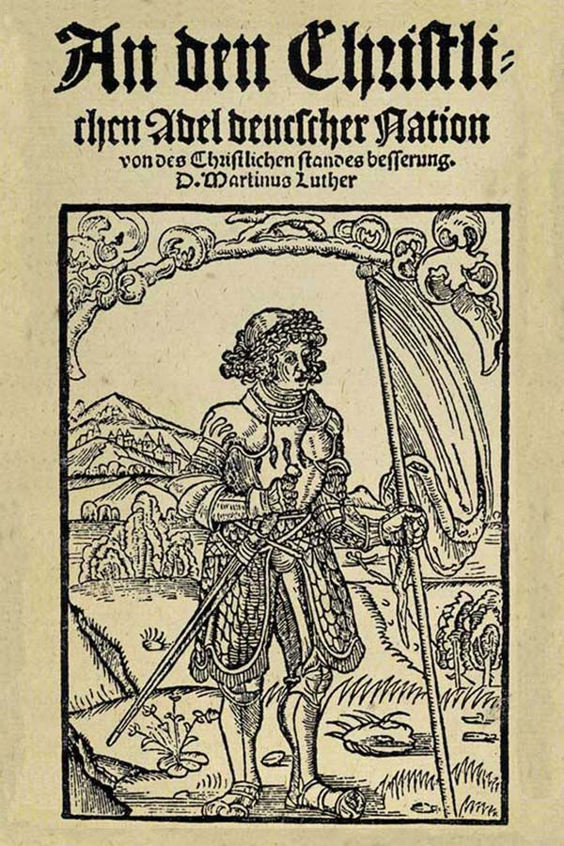
Martin Luther Address To The Nobility of the German Nation 1520 Internet History Sourcebooks: Modern History (fordham.edu)
We must also lessen the number of theological books, and choose the best, for it is not the number of books that makes the learned man, nor much reading, but good books often read, however few, makes a man learned in the Scriptures and pious…
Above all, in schools of all kinds the chief and most common lesson should be the Scriptures, and for young boys the Gospel; and would to God each town had also a girls' school, in which girls might be taught the Gospel for an hour daily, either in German or Latin!...
Oh, how badly we treat all these poor young people that are entrusted to us for discipline and instruction! and a heavy reckoning shall we have to give for it that we keep them from the word of God;

Slide 32
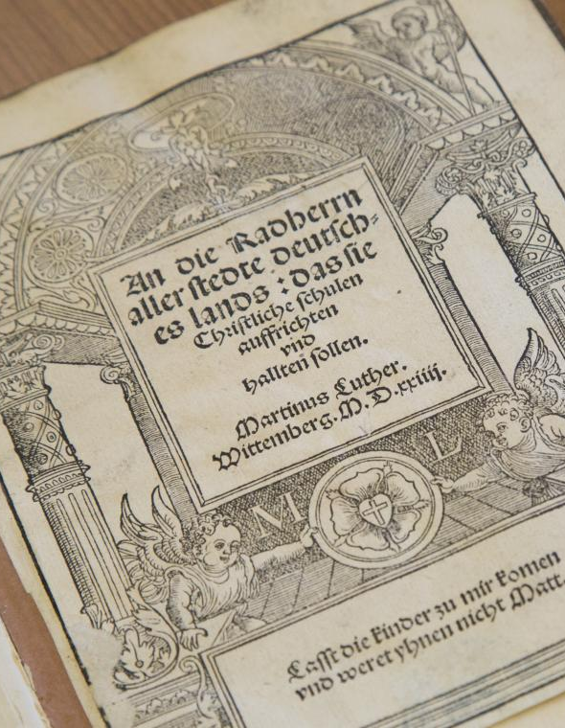
Luther’s Defense of Christian Education
In 1524 Martin Luther published a pamphlet “To the Councilmen of All Cities in Germany that they Establish and Maintain Christian Schools”, urging civil authorities to invest in public education.

Slide 33
“To the Councilmen of All Cities in Germany that they Establish and Maintain Christian Schools” (AE, vol. 45, p. 350)
My dear sirs, if we have to spend such large sums every year on guns, roads, bridges, dams, and countless similar items to ensure the temporal peace and prosperity of a city, why should not much more be devoted to the poor neglected youth–at least enough to engage one or two competent men to teach?

Slide 34
“To the Councilmen of All Cities in Germany that they Establish and Maintain Christian Schools” (AE, vol. 45, p. 351)
Now that he is, by the grace of God, rid of such pillage and compulsory giving, he ought henceforth, out of gratitude to God and for his glory, to contribute a part of that amount toward schools for the training of the poor children. That would be an excellent investment.

Slide 35
Jean Sturm Gymnasium
In 1538 Johannes Sturm (1507-1589) founded an elementary school in the protestant city of Strasbourg at the request of the civil authority. His educational method became almost standard in Germany.
Gymnasium building in the 16th century
Source: Gymnase Jean Sturm (Strasbourg) – Archi-Wiki

Slide 36
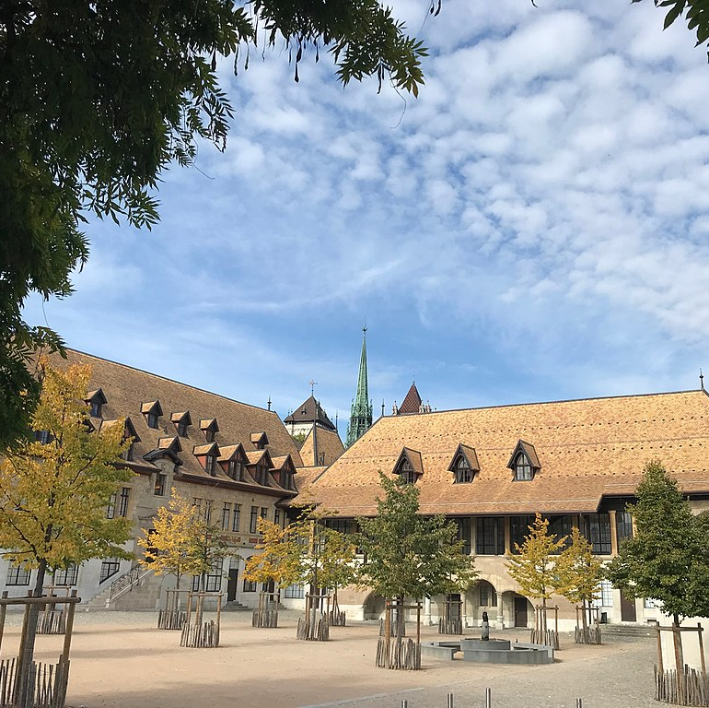
Collège Genève
When Geneva adopted the Protestant Faith in May of 1536 it made school obligatory to all and free to the poor. In 1559 under the leadership of Calvin an academy for higher education was opened. Later it was named after the reformer.

Slide 37
New Criteria of Authority
Scripture
Church
State
Synods
Civil Authorities
Clergy
Institutions

