Slide 1
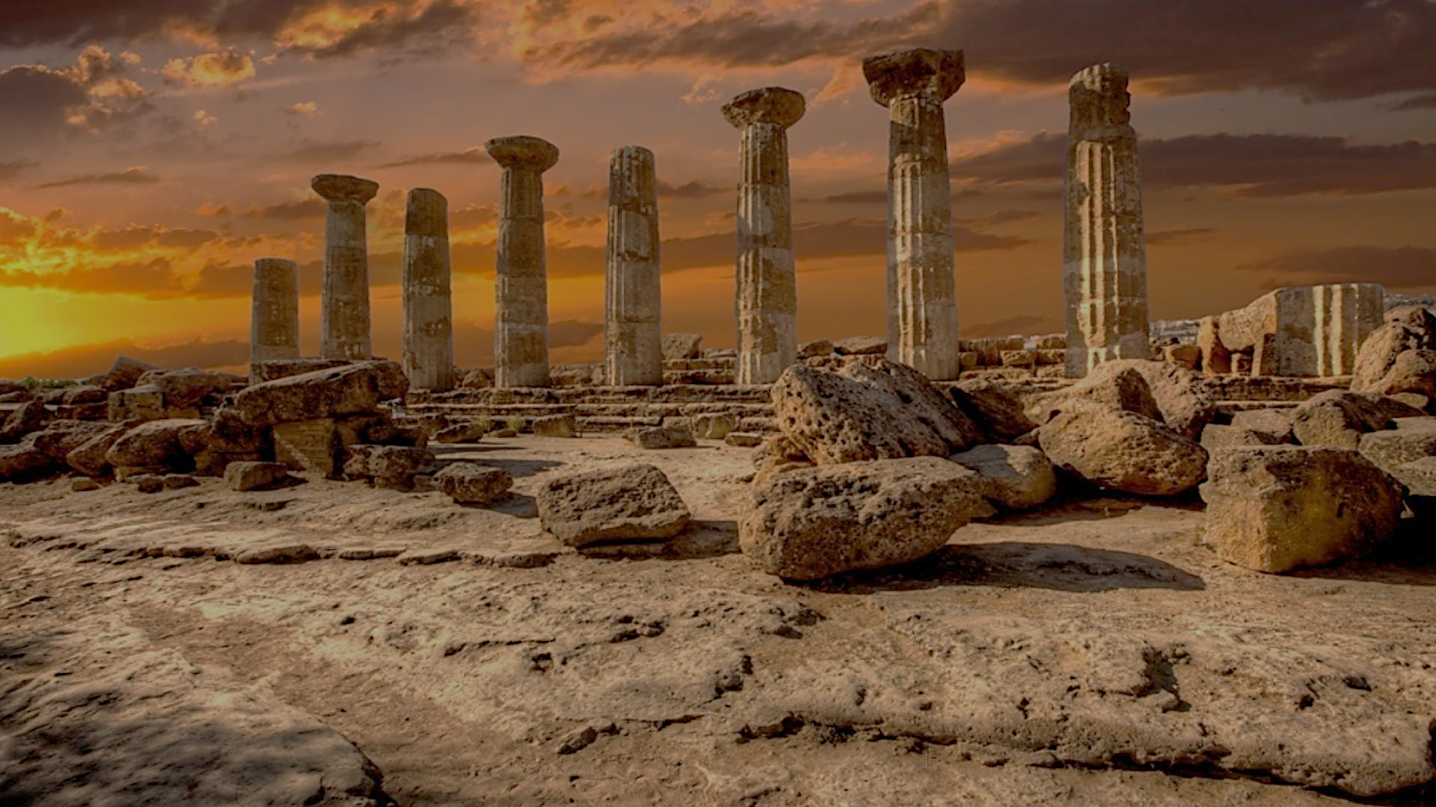
Archeology of Bible Times
Pastor John dos Santos - Faith Presbyterian Church

Slide 2
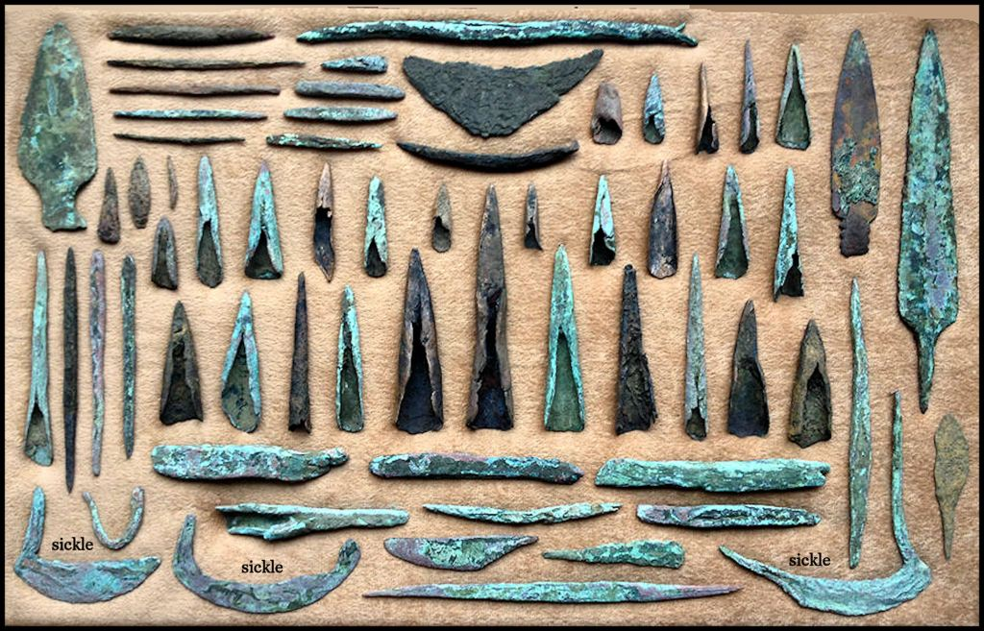
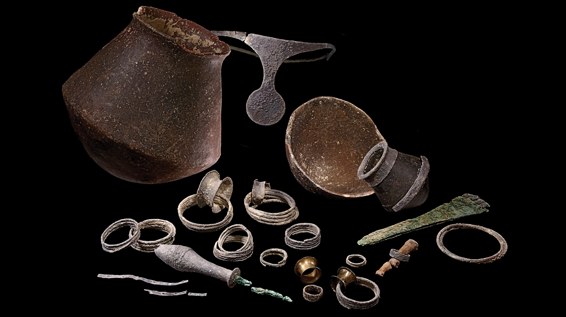
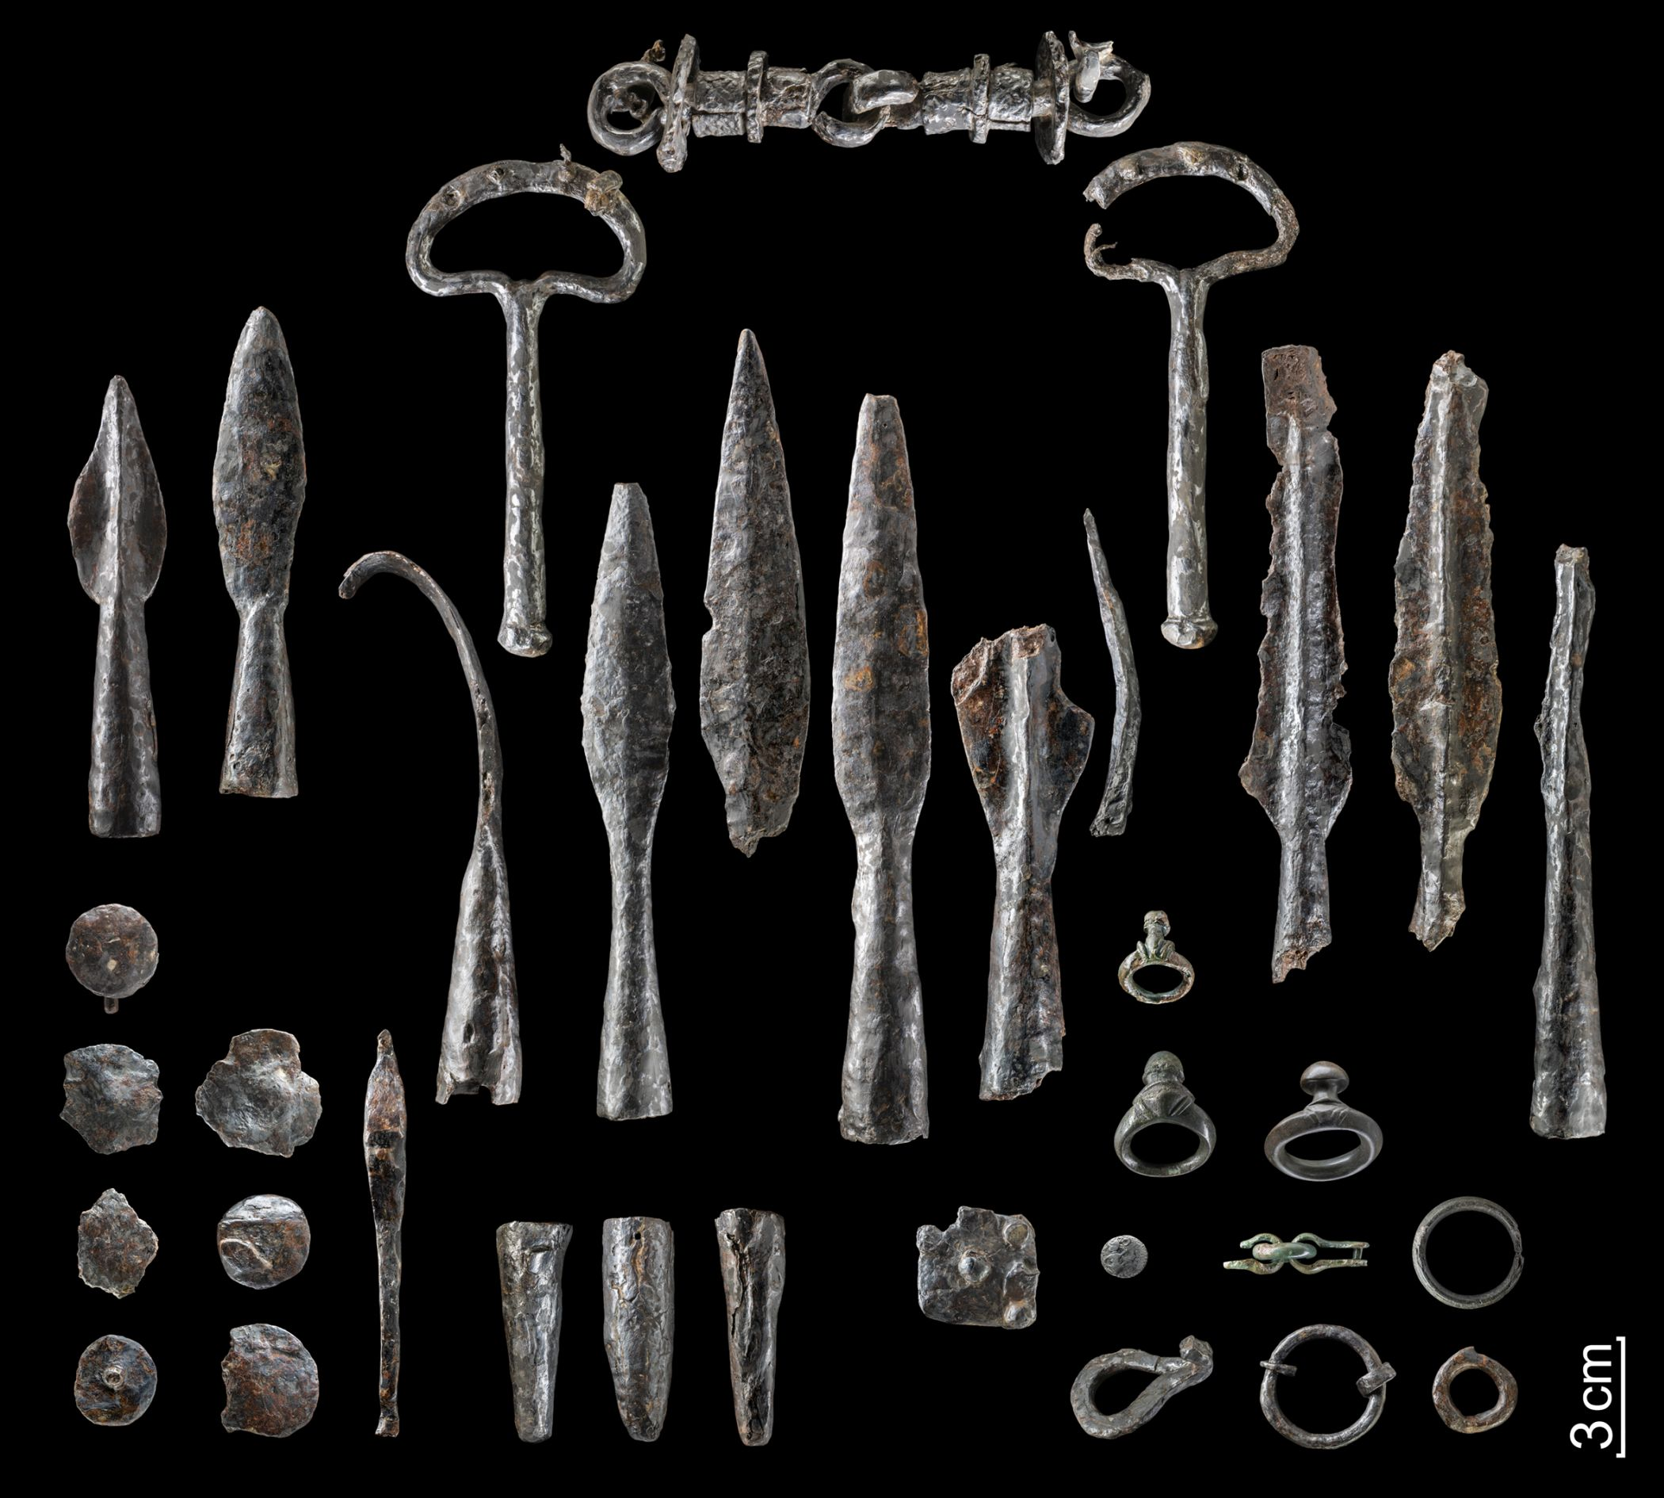
Metal Ages
Copper Age
Bronze Age
Iron Age
3200 – 2300 bce
2300 - 700 bce
700 - 0 bce

Slide 3
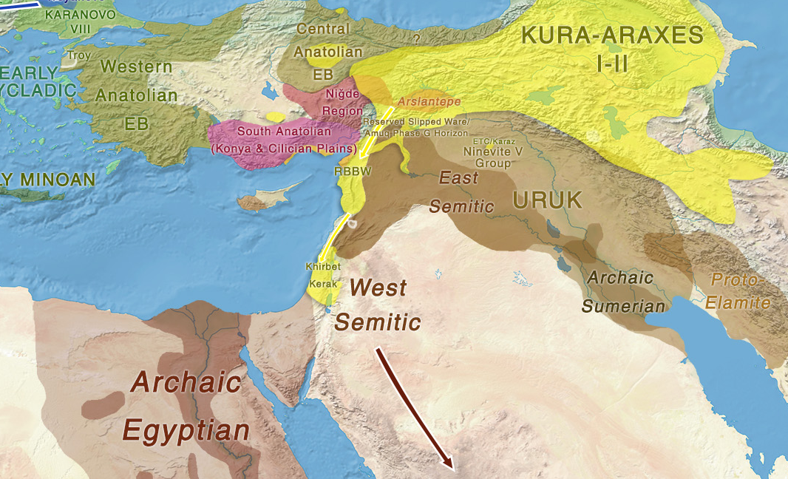
Ancient Near East
2000 b.C.
Source: 10-chalcolithic-early.jpg (7000×2738) (indo-european.eu)

Slide 4
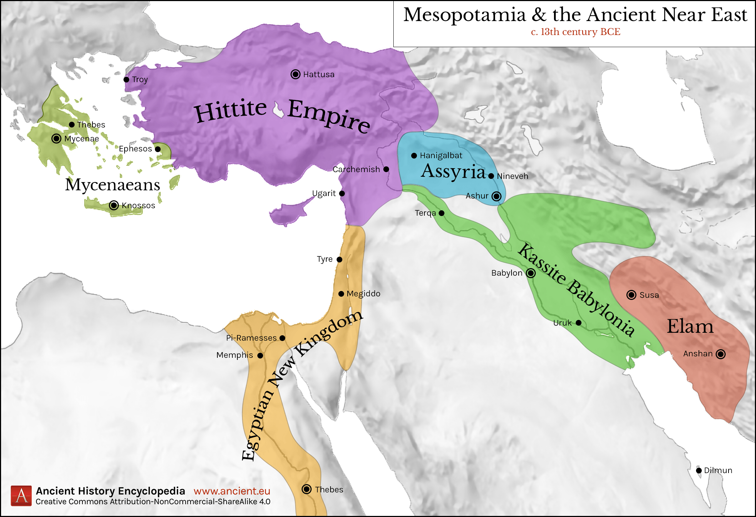
Ancient Near East
1300 b.C.

Slide 5
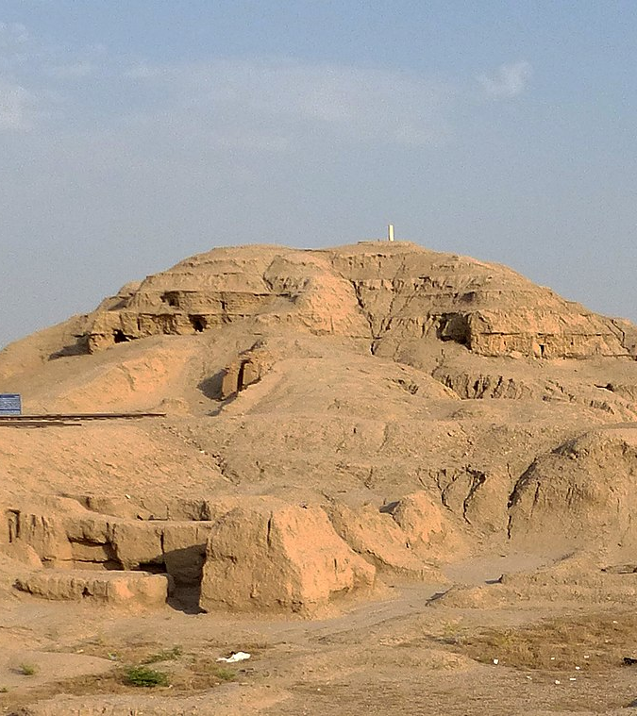
Tower of Babel
The last event of the old world is the division of humanity. God confused the language of people building the tower of Babel in the plain of Shinar and by that formed difference ethnicities which spread throughout the world.
White Temple ziggurat in Uruk
Source: wikicommons

Slide 6
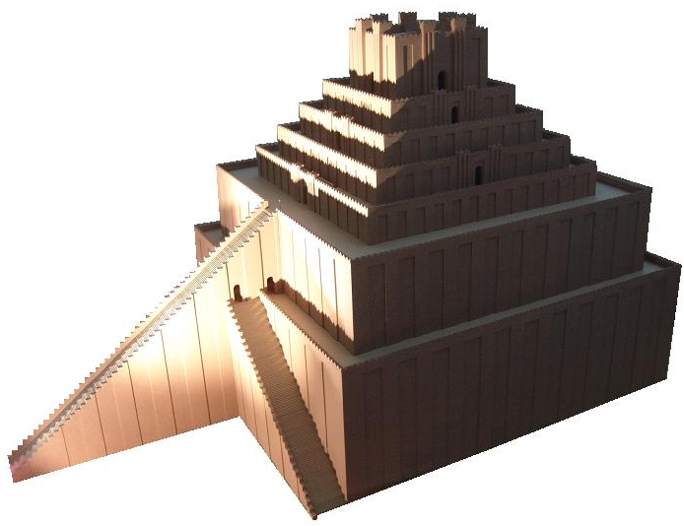
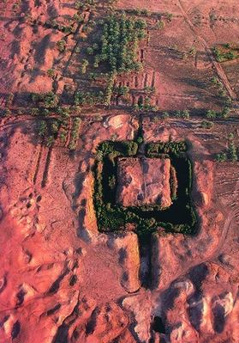
Etemenanki
On the left a drawing of how it was believed to be with 300 ft in height.
Below an aerial view of the site.
The Etemenanki ziggurat,
located 56 miles south of
Bagdad, where was ancient Babylon, is one the candidates to be the “Tower of Babel”. It was build in honor to God Marduk and it is mentioned in the Eluma Elish account. Its date is debated. But most schoolars believe it is from the 27th century b.C. Some defend it was never finished.

Slide 7
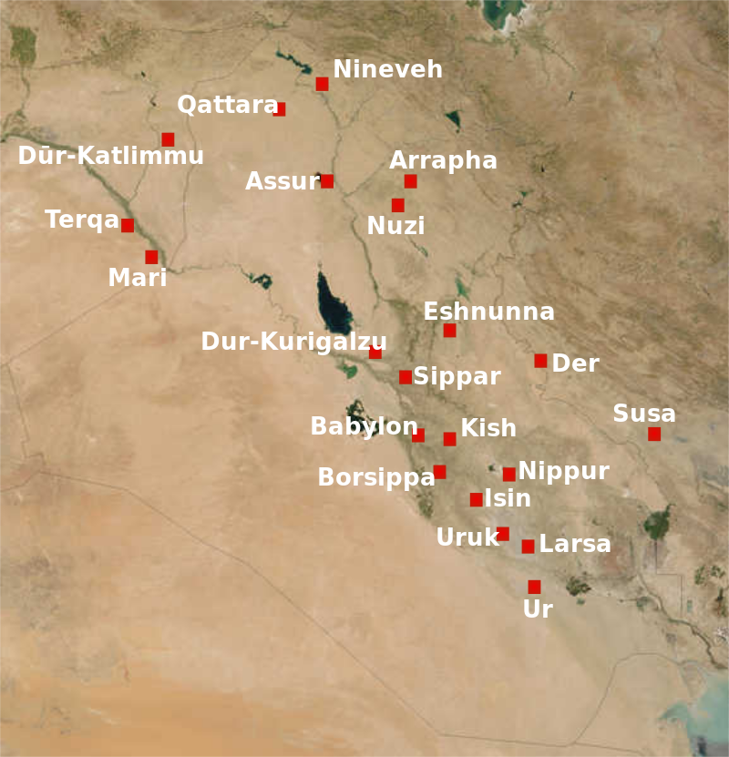
Plains of Shinar
In Genesis, after the flood, the majority of the people settled in the “Plains of Shinar” (Gen 10.10; 11.2; 14.1,9), which is lower Mesopotamia.
Archeology found there some of the most ancient cities on earth and from there is believed a major migration started to the corners of the earth.
Map of the cities of Mesopotamia (now Iraq) in the 2nd millennium BC.
Source: Wikicommons

Slide 8
Source: Discover Ur, Iraq - YouTube

Slide 9
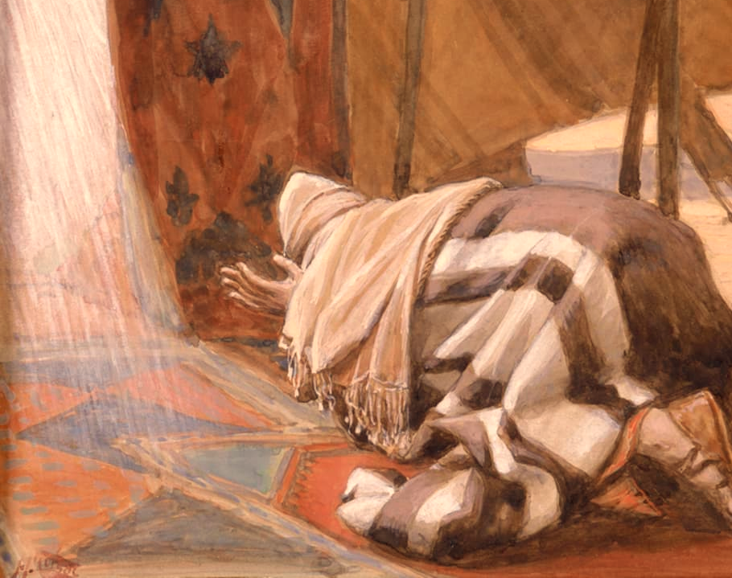
Abram’s Calling
God’s Promises to Abram,
James Tissot (1896-1902), Gouache on board
Source: The Jewish Museum - Collection - God's Promises to Abram
In Genesis chapter 12 God calls a Chaldean from the city of Ur to leave his city and his family, establishing a covenant with him, to make of him a new people to bless to the nations upon the earth.

Slide 10
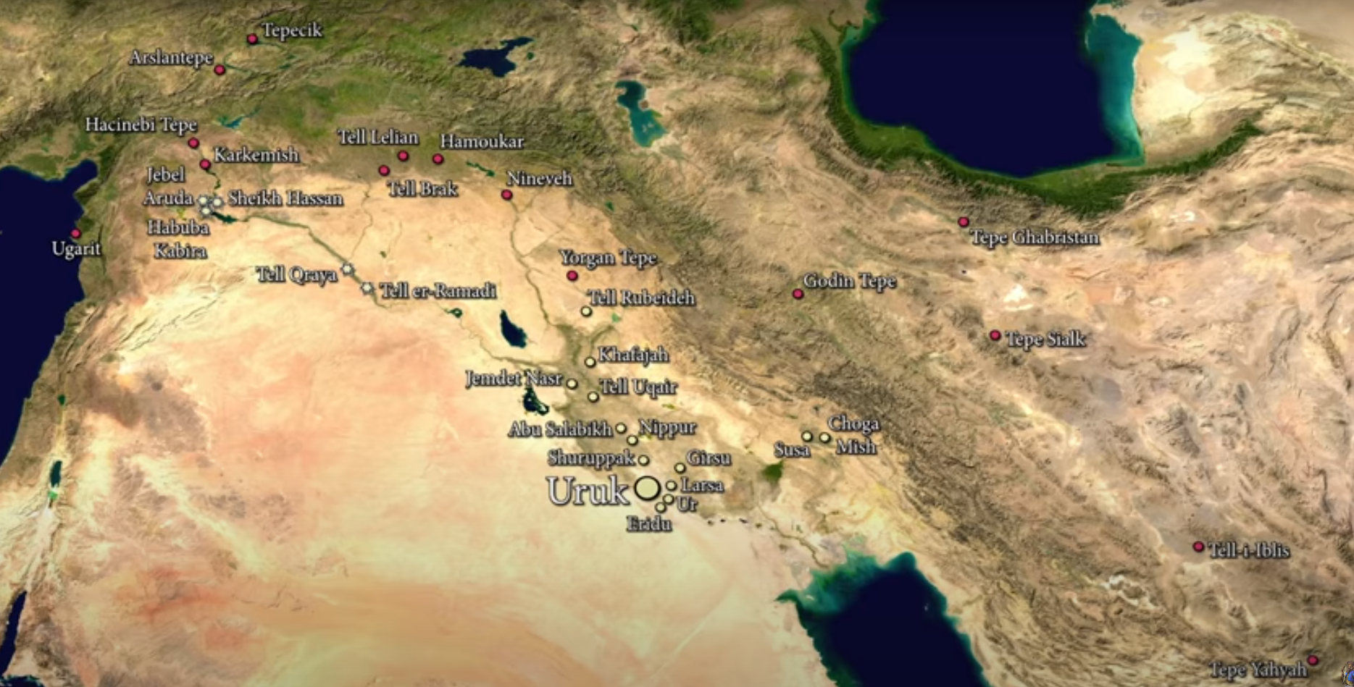
Source: The Birth of Civilisation - Rise of Uruk (6500 BC to 3200 BC) - YouTube

Slide 11
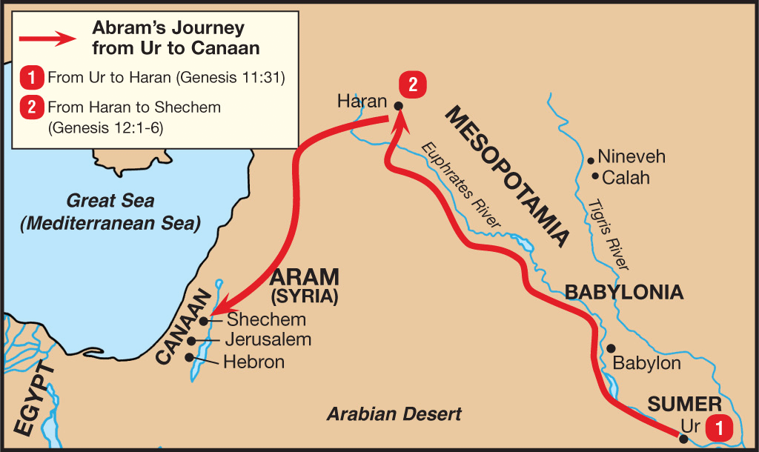
Source: The Beginning of the Blessing – Abraham – Genesis 12-25 | Upwards Church

Slide 12
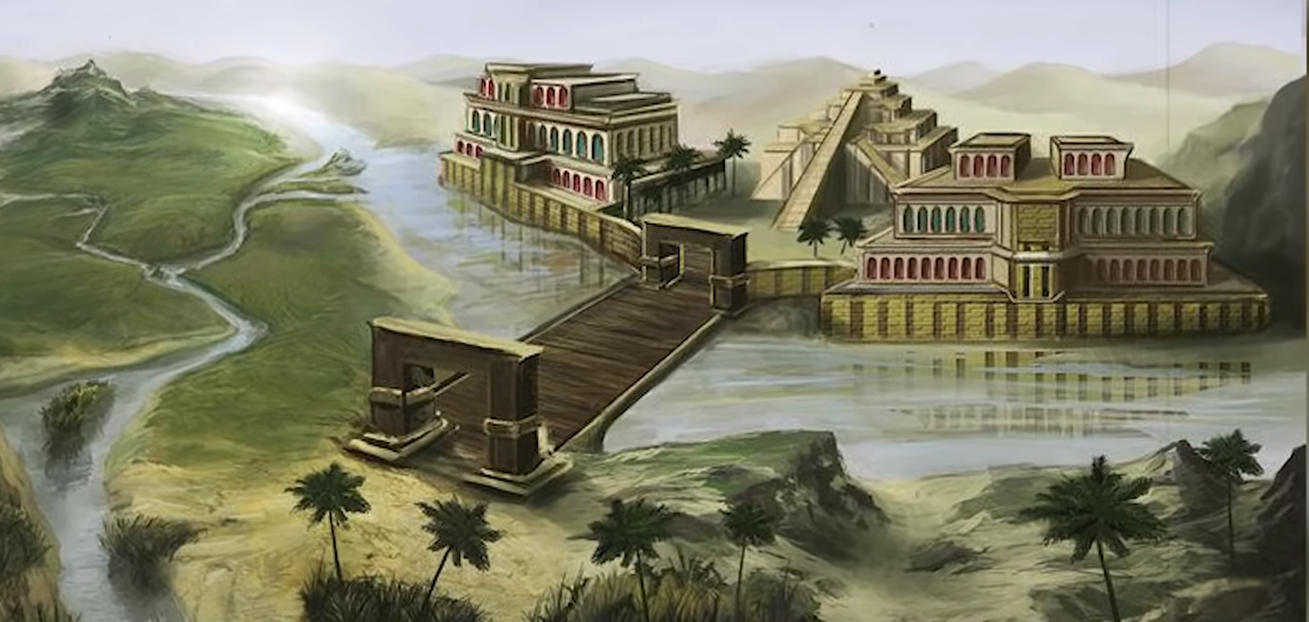
Source: The Rise and Fall of the Sumerian City of Ur - YouTube

Slide 13
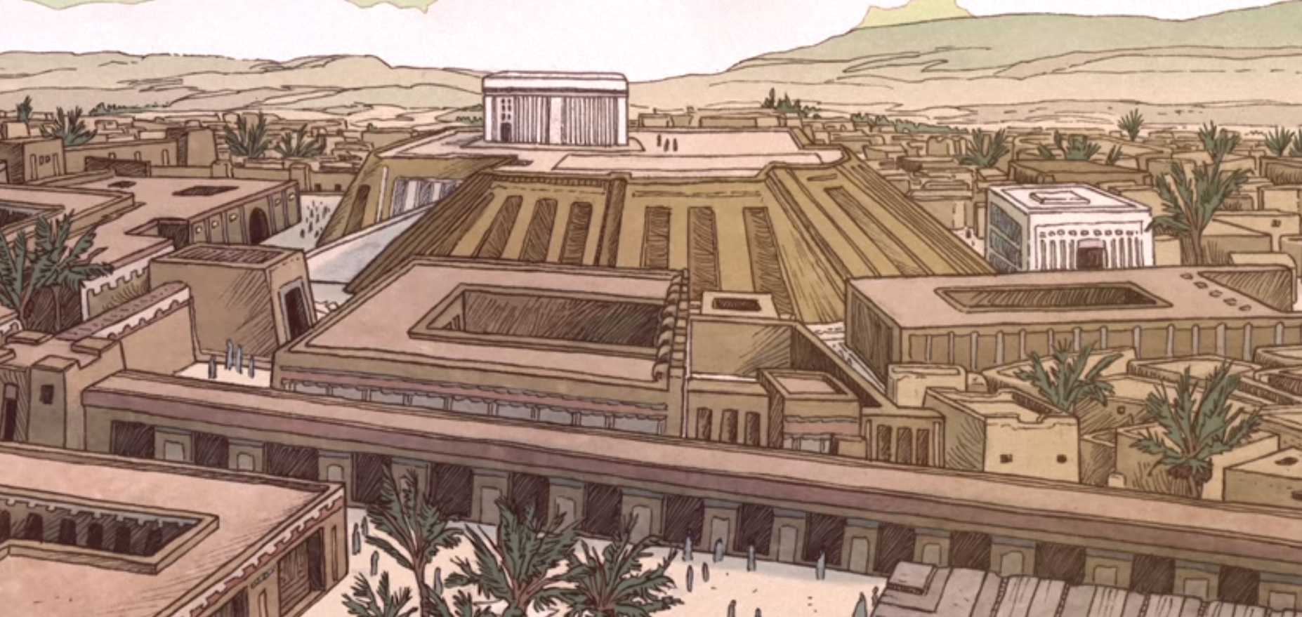
The Birth of Civilisation - Rise of Uruk (6500 BC to 3200 BC) - YouTube

Slide 14
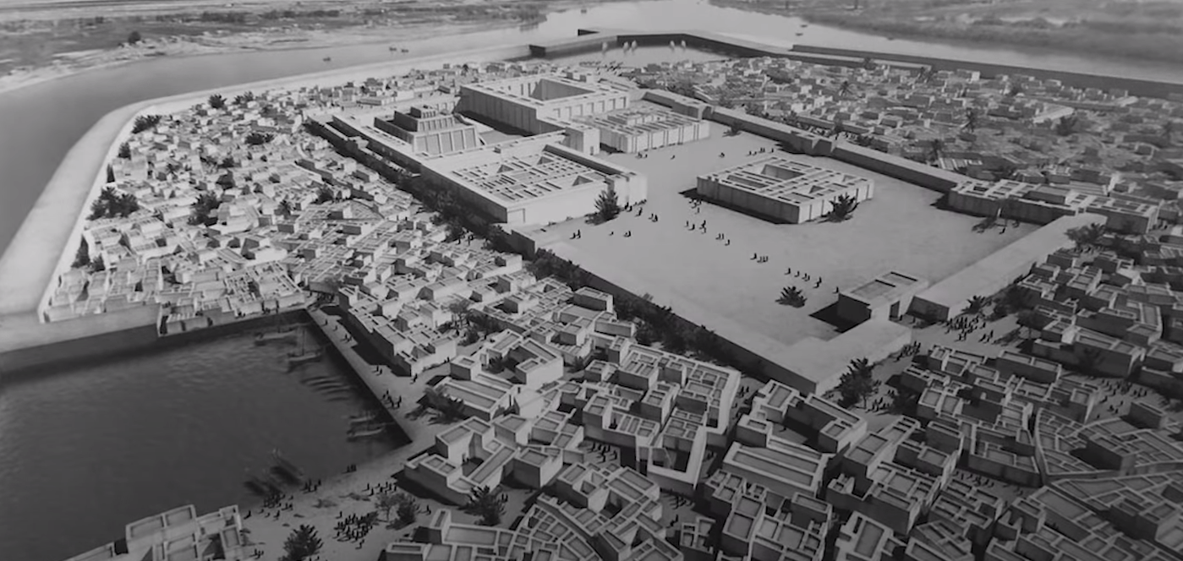
Source: The Rise and Fall of the Sumerian City of Ur - YouTube

Slide 15
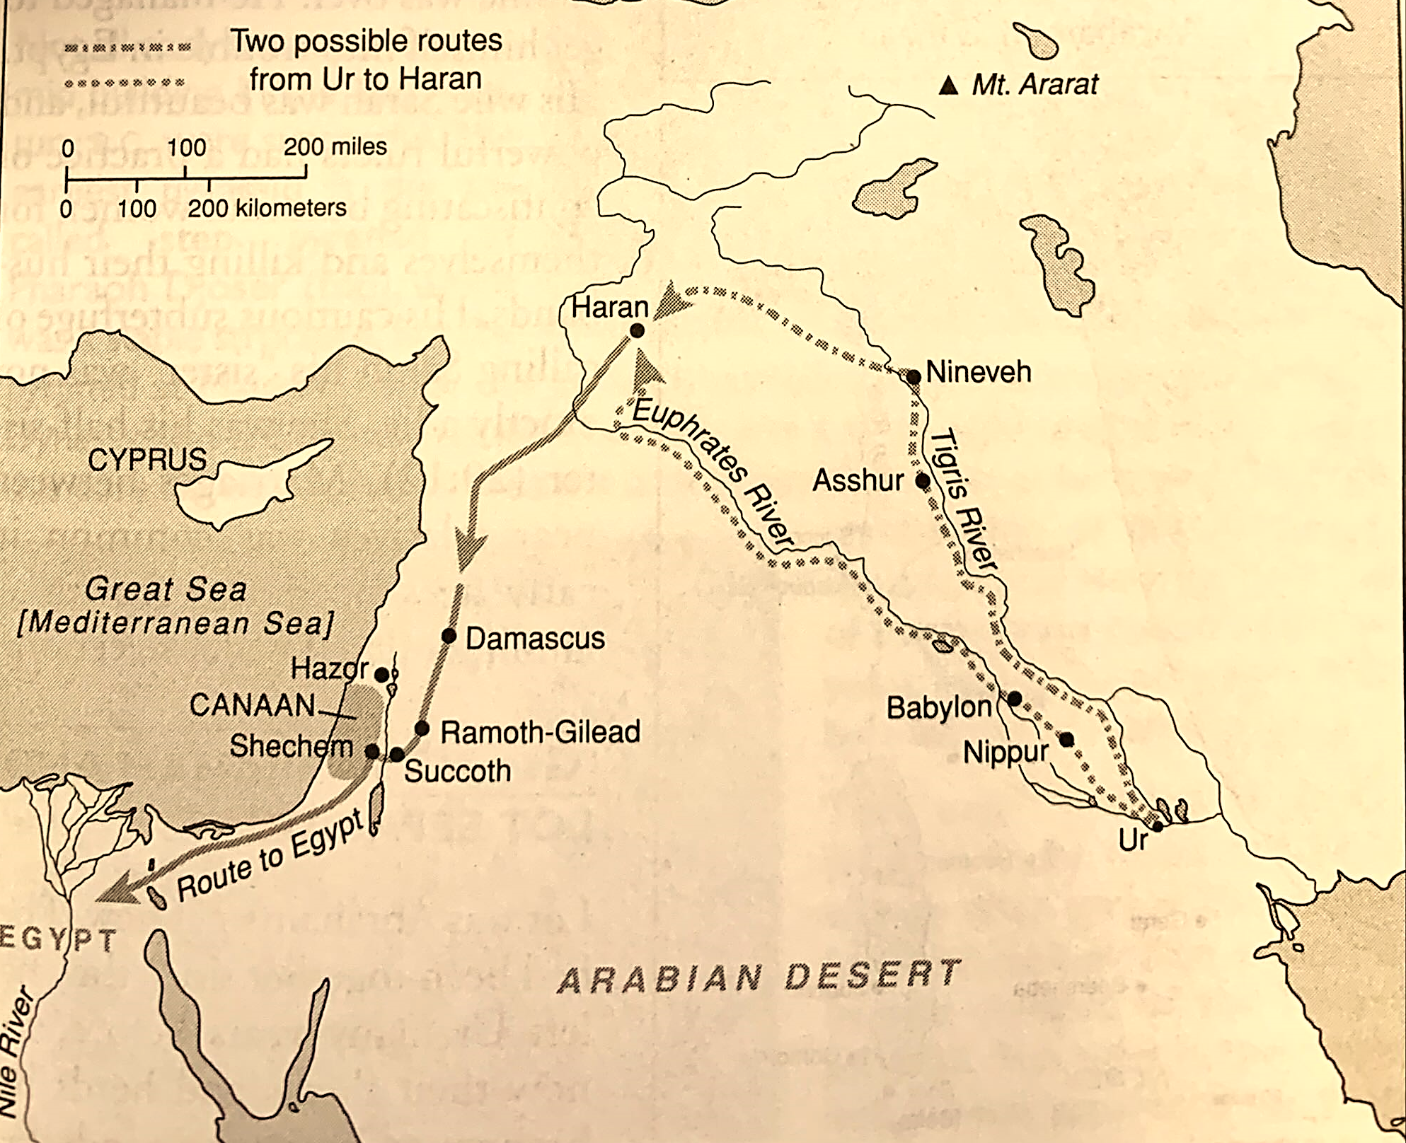
Abraham’s Journeys
H. H. Halley, Halley’s Bible Handbook (Grand Rapids: Zondervan, 2000) 109.

Slide 16
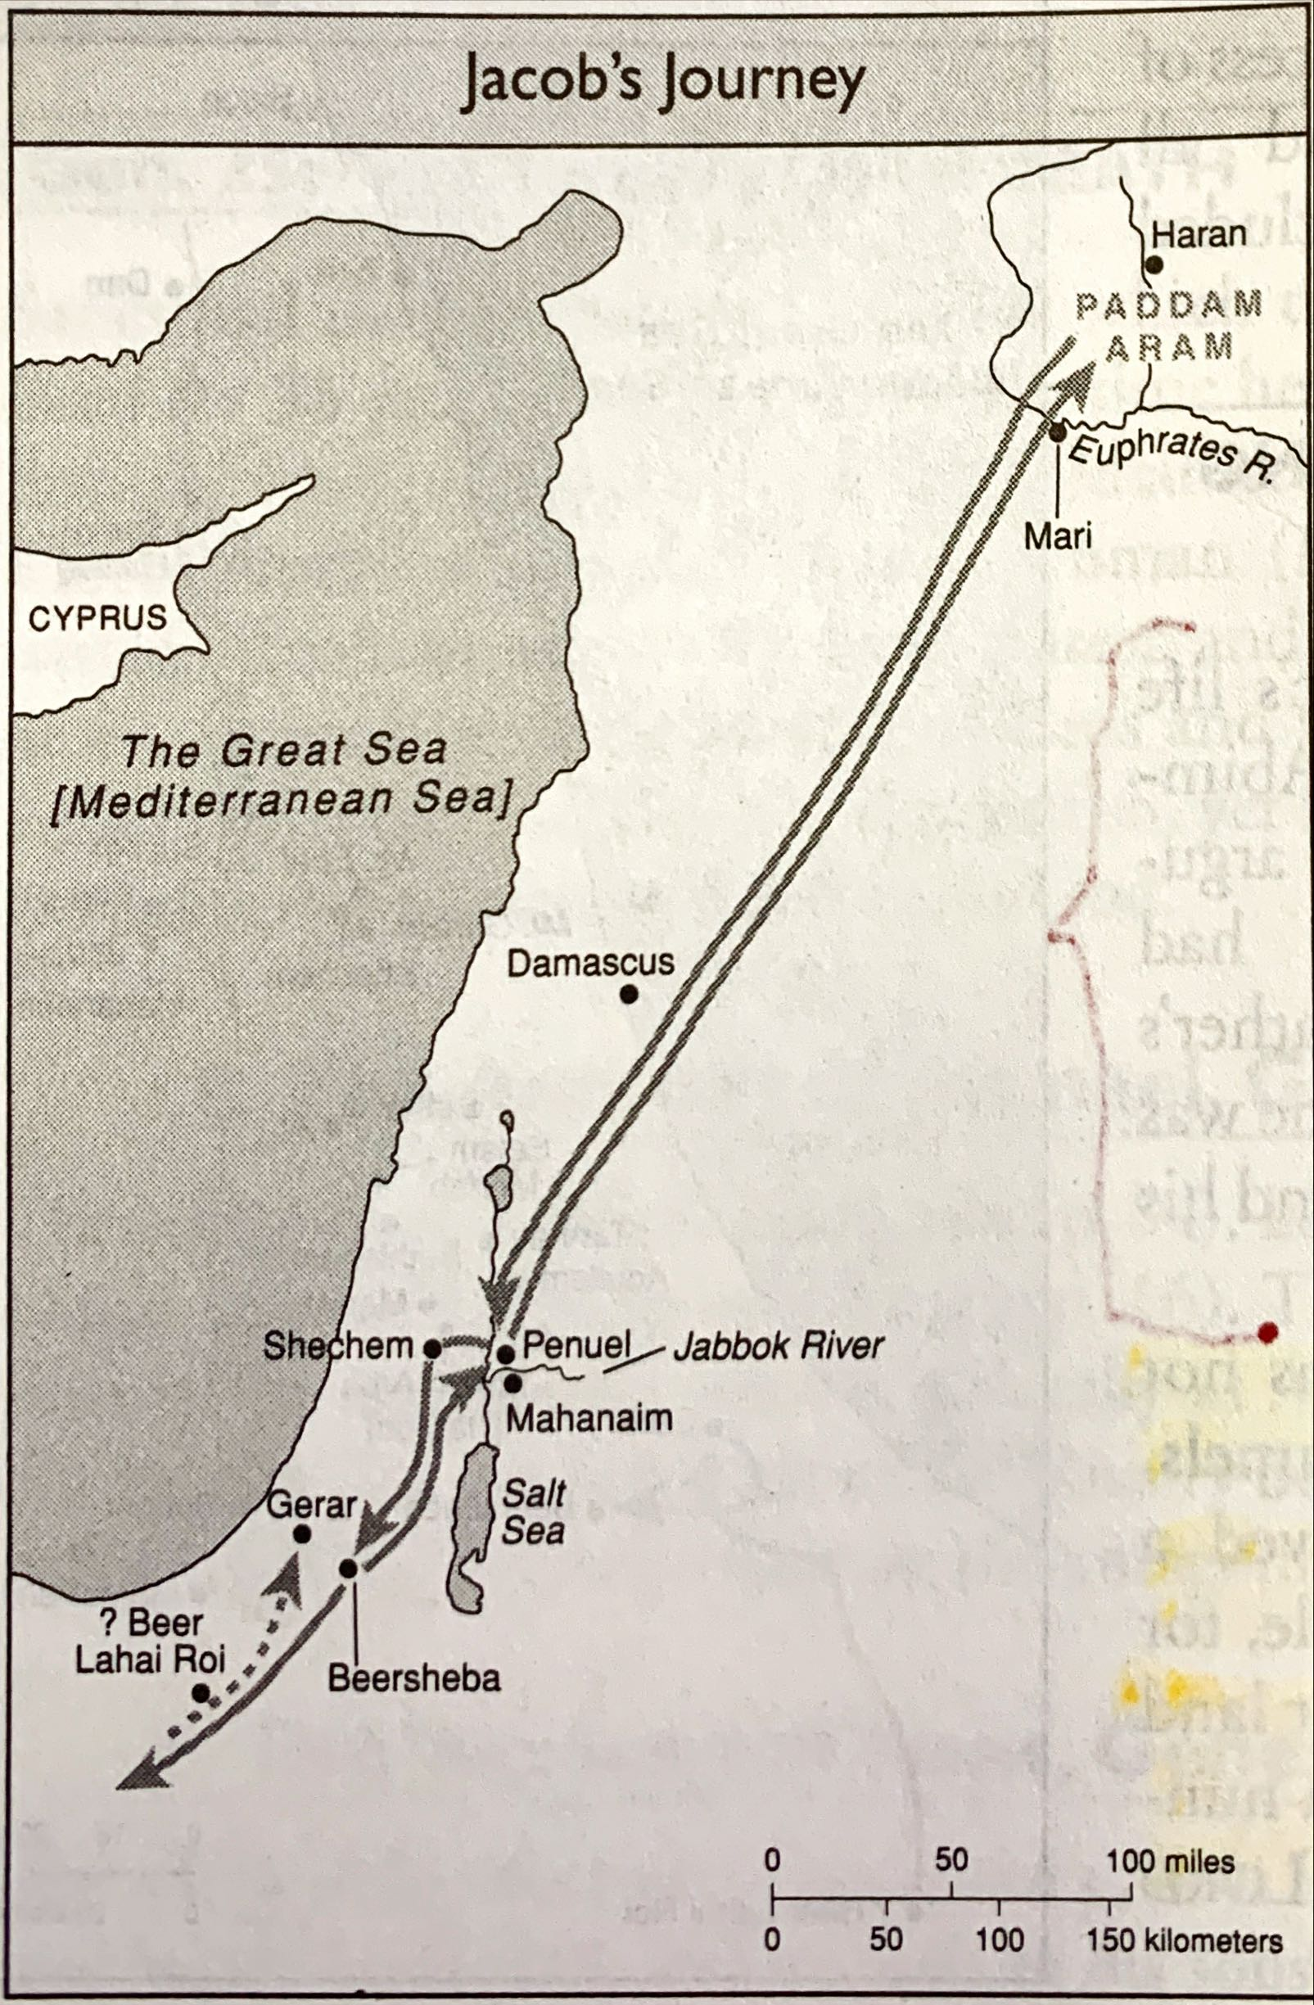
Jacob’s Journeys
H. H. Halley, Halley’s Bible Handbook (Grand Rapids: Zondervan, 2000) 125.

Slide 17
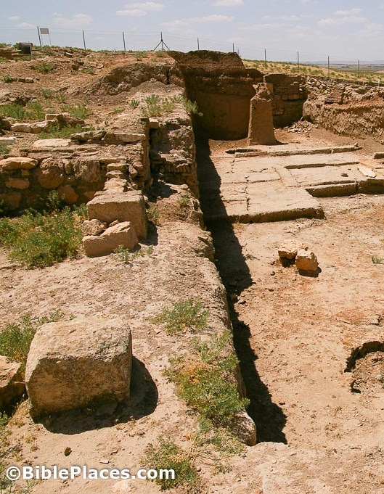
Ancient City of Haran
The ancient city of Haran is a well-known archeological site that dates to the early 3rd millennia B.C. Scholars believe it was founded by tradesmen from Sumer. It plays an important role in the lives of Abraham and his sons. In the Bible, it seems to be founded by Tera (Gen 11.31-32)

Slide 18
Domesticated Camels
It has been contested that the account of Abraham’s life is not accurate because the details of the history do not match the archeological facts, for instance, the use of camels, which some say were not domesticated, as mentioned in Genesis (12.16; 24.10-11; 31,17). But a small copper statue of a camel with a harness dated from the late 3rd millennia B.C. was discovered in Bactria.
Source: Bactrian camel | Bactria-Margiana Archaeological Complex | Bronze Age | The Metropolitan Museum of Art (metmuseum.org)

Slide 19
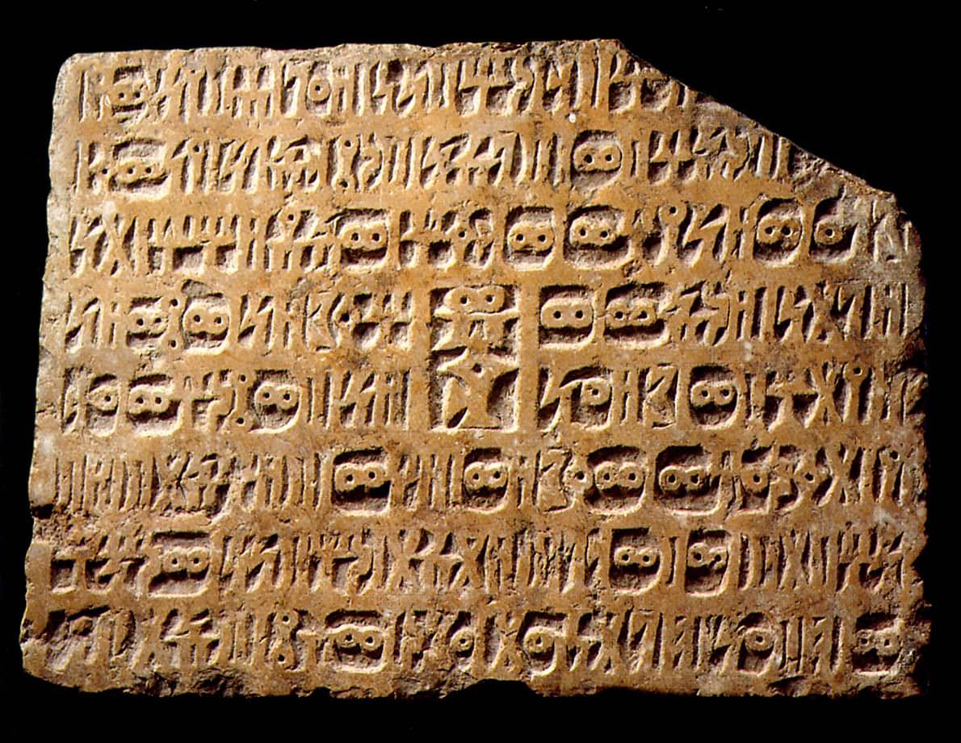
Among the 20 thousand tablets found in the city of Mari, one contains an important piece of law from the time of King Zimri-Lim (18th century B.C.). If a man without sons has a son with his wife’s maidservant, he can be recognized as his wife’s son and therefore his heir.
Source: Mari - World History Encyclopedia
Source: Wikicommons

Slide 20
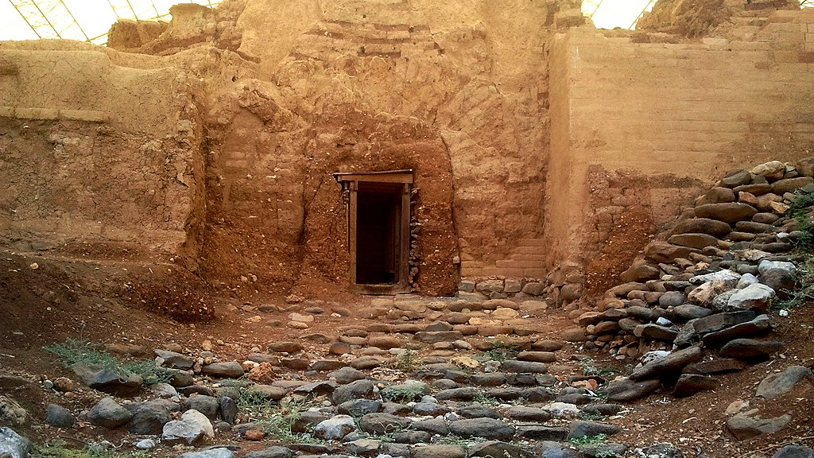
Abraham’s Gate
In Genesis 14 Abraham marches north up to Dan to persecute men who made his nephew Lot captive (14.14). A gate from the late 2nd millennia has been found in the site of ancient Tel-Dan. It has been named Abraham’s Gate.
Source: Wikicommons

Slide 21
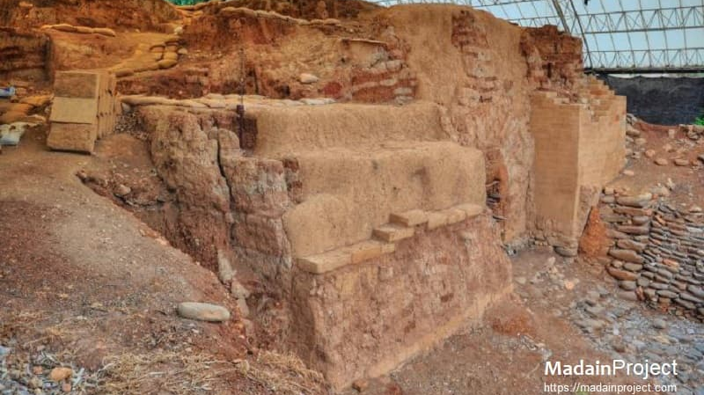

Slide 22
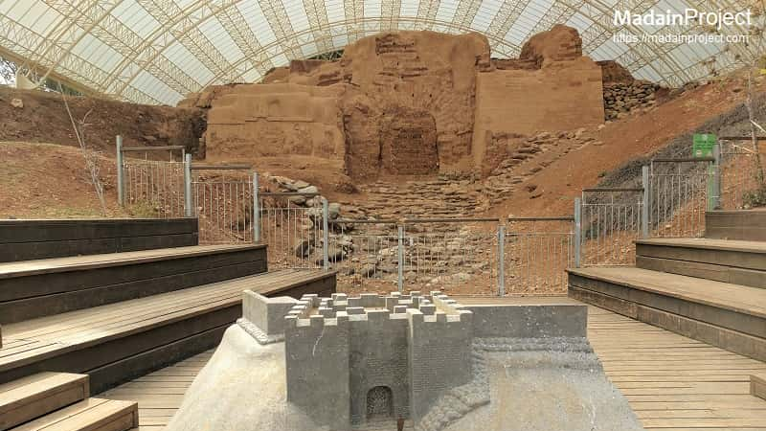

Slide 23
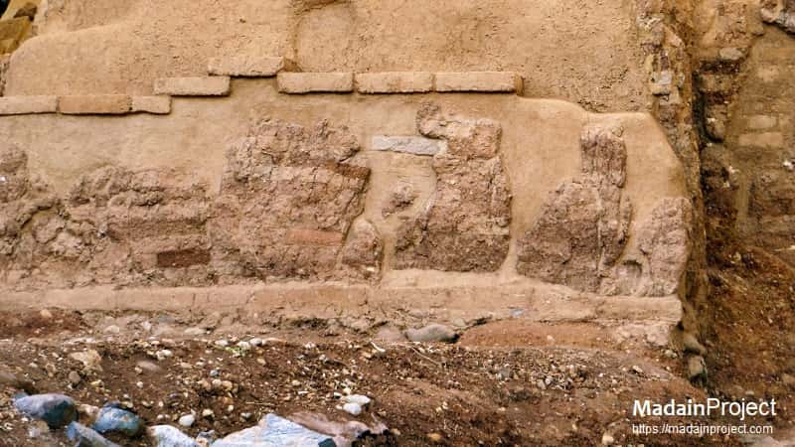

Slide 24
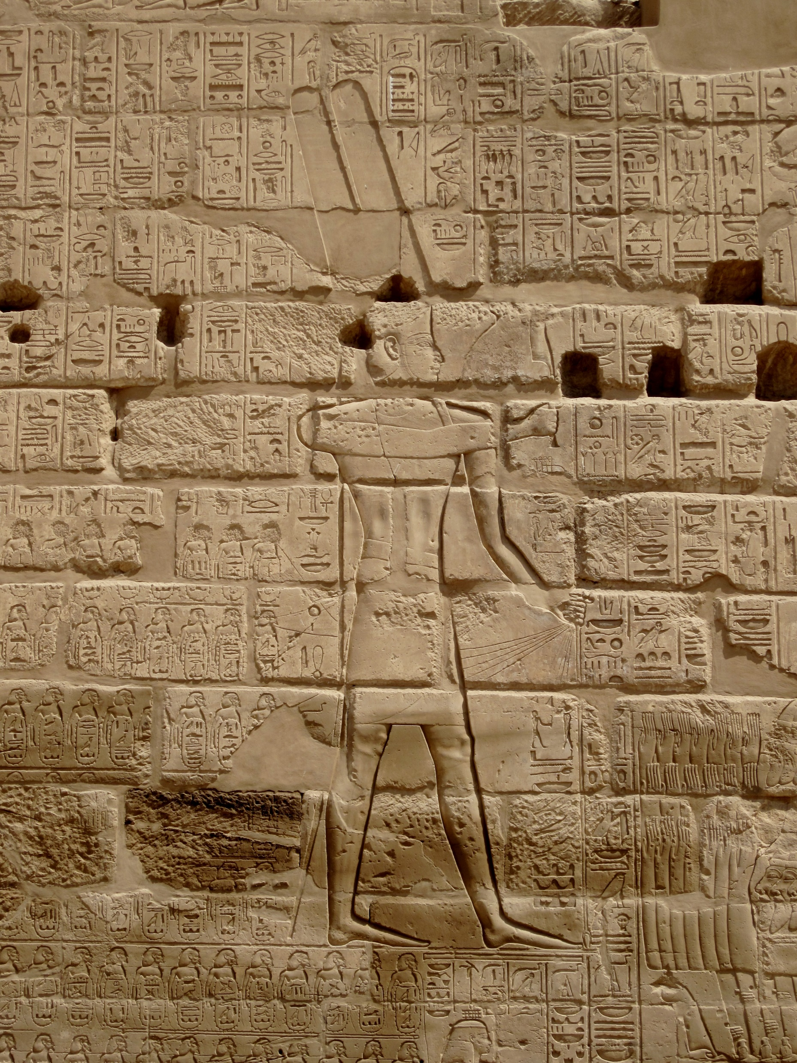
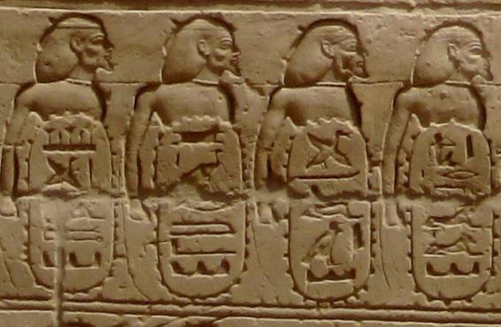
“Abram Fort” Carthouche
A military campaign of Egyptian King Shoshenq I (943-922 b.C.), also called Shishak (1Kings 14.25), is recorded in a relief in the Karnak temple, at Thebes. Among the cities conquered is are mentioned “Fort of Abram”.
It is the only extrabiblical source of the name Abram.
Source: Karnak Tempel 19 - Shoshenq I - Wikipedia

Slide 25
Canaanite Procession into Egypt
In the tomb of Khnumhotep II, an Egyptian chief, it is found a depiction of Canaanites migrating to Egypt with their herds. Some believe they are a people called “Hyksos”, but others that they are Israelites. Independently, it proves the commerce and relation of Semite peoples with Egyptians.
Source: Khnumhotep II - Wikipedia

Slide 26
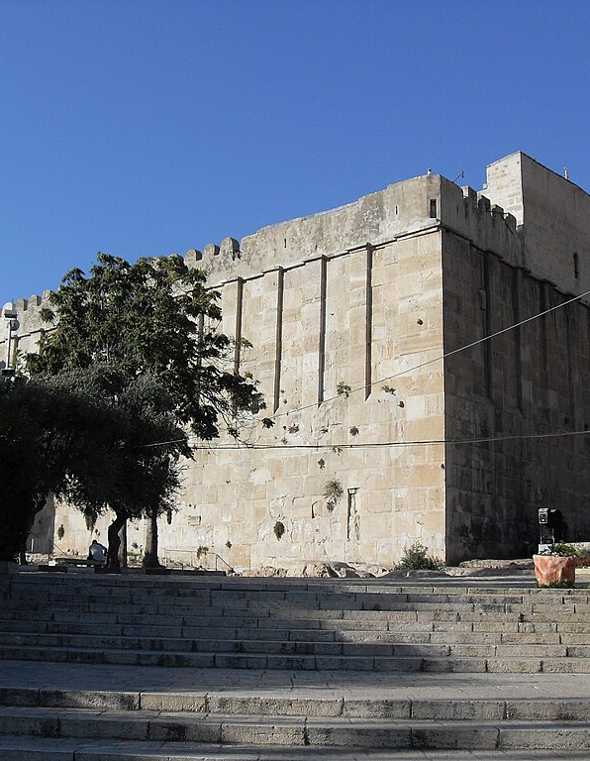
Cave of the Patriarchs
A mausoleum in southern Judah is held to be the place where Abraham buried his wife and later was buried. Isaac and Rebekah were also buried there (Gen 49.31-32).
Source: Tell-Haran-possible-predecessor-of-Sin-temple-3rd-millennium-BC-from-east-adr1005201916.jpg (1024×681) (bibleplaces.com)

