Slide 1
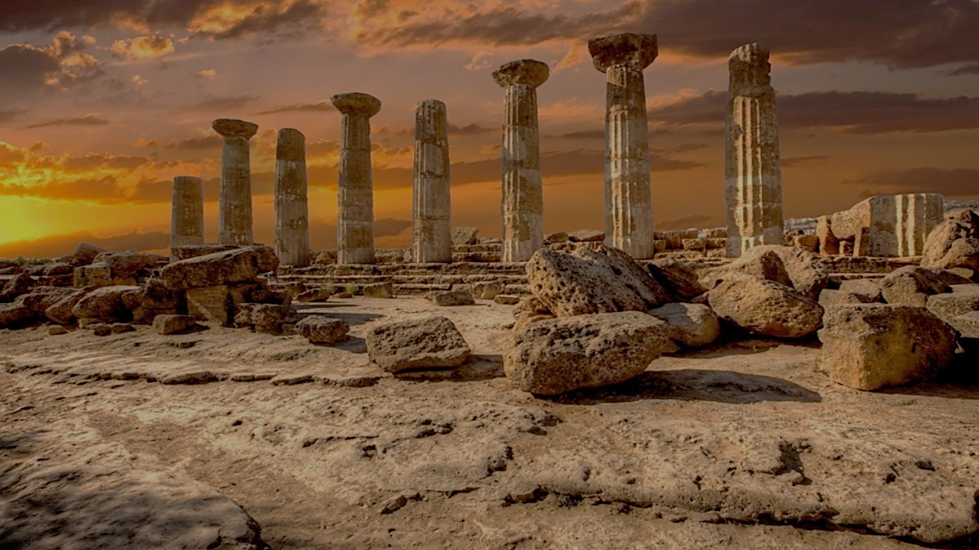
Archeology of Bible Times
Pastor John dos Santos - Faith Presbyterian Church

Slide 2
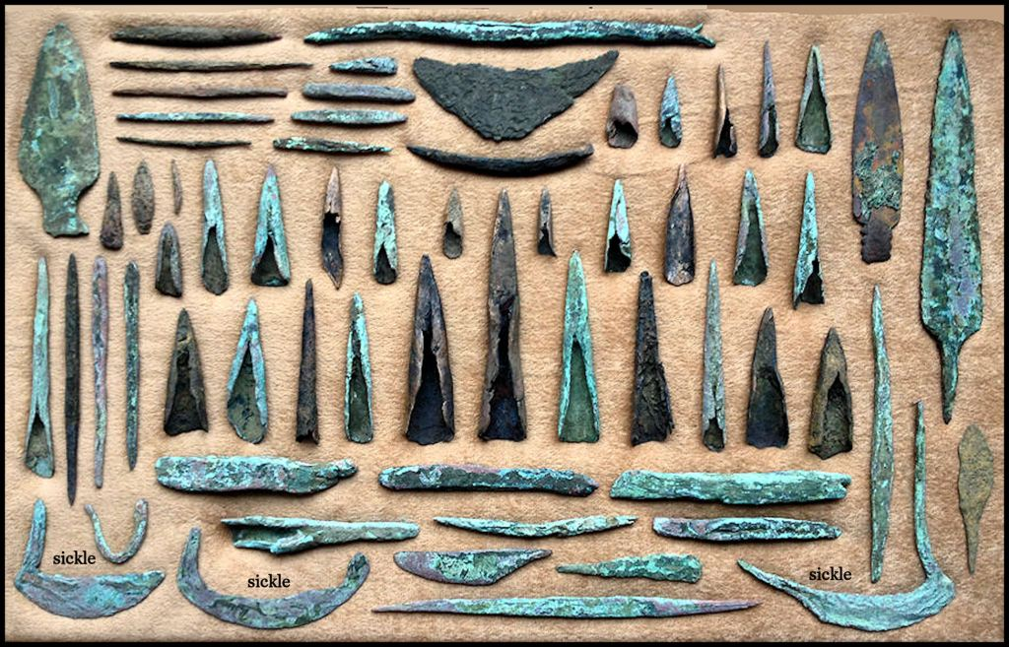
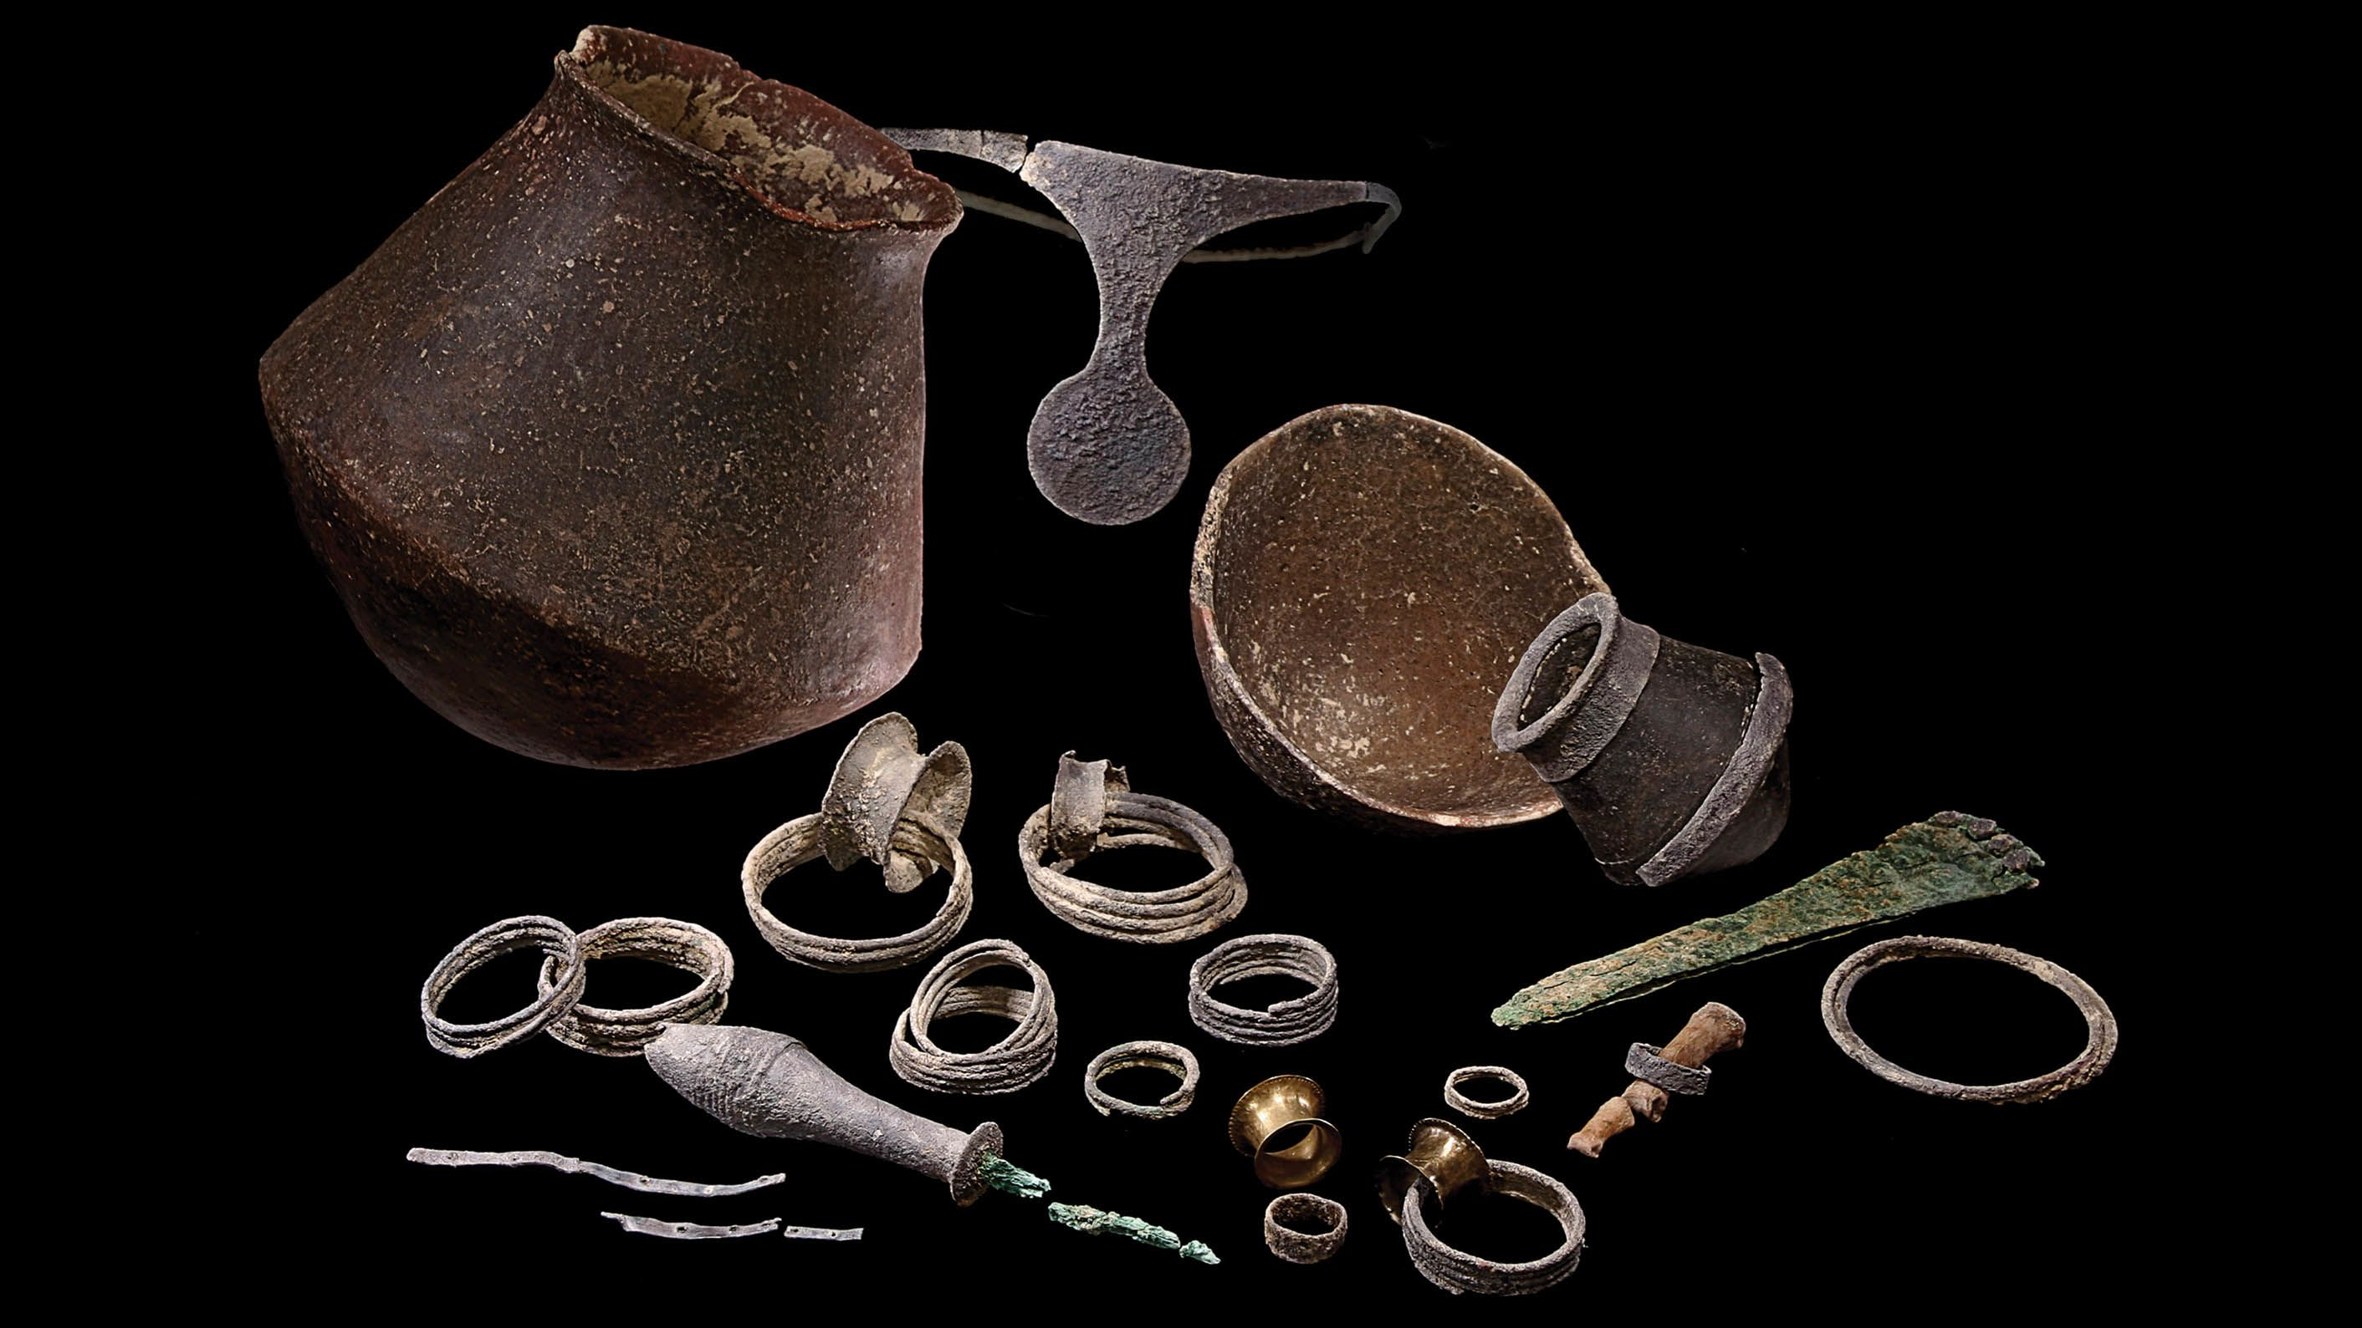
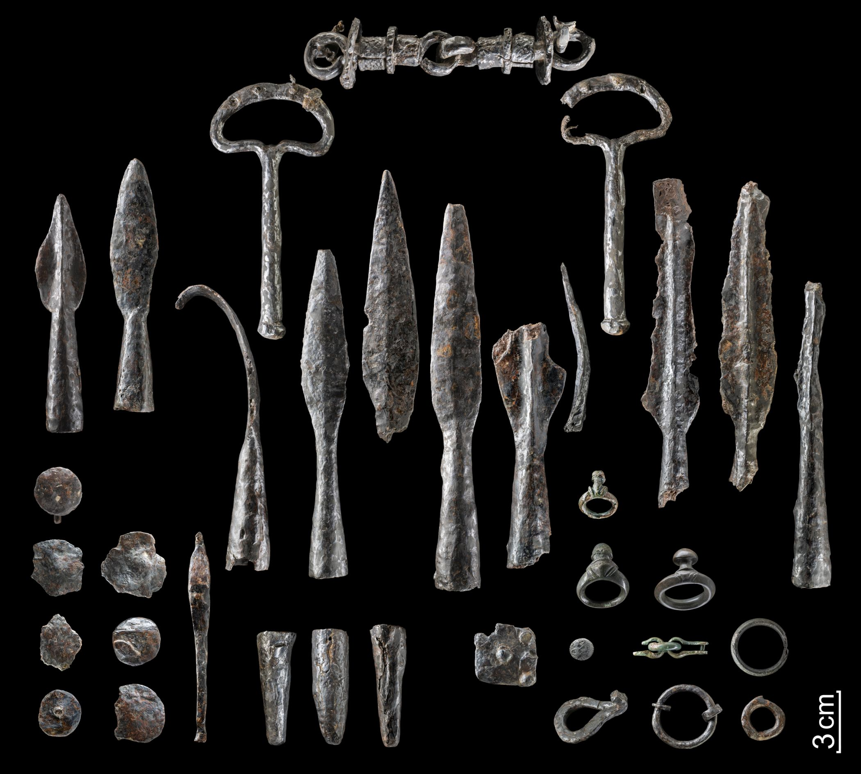
Metal Ages
Copper Age
Bronze Age
Iron Age
3200 – 2300 bce
2300 - 700 bce
700 - 0 bce

Slide 3
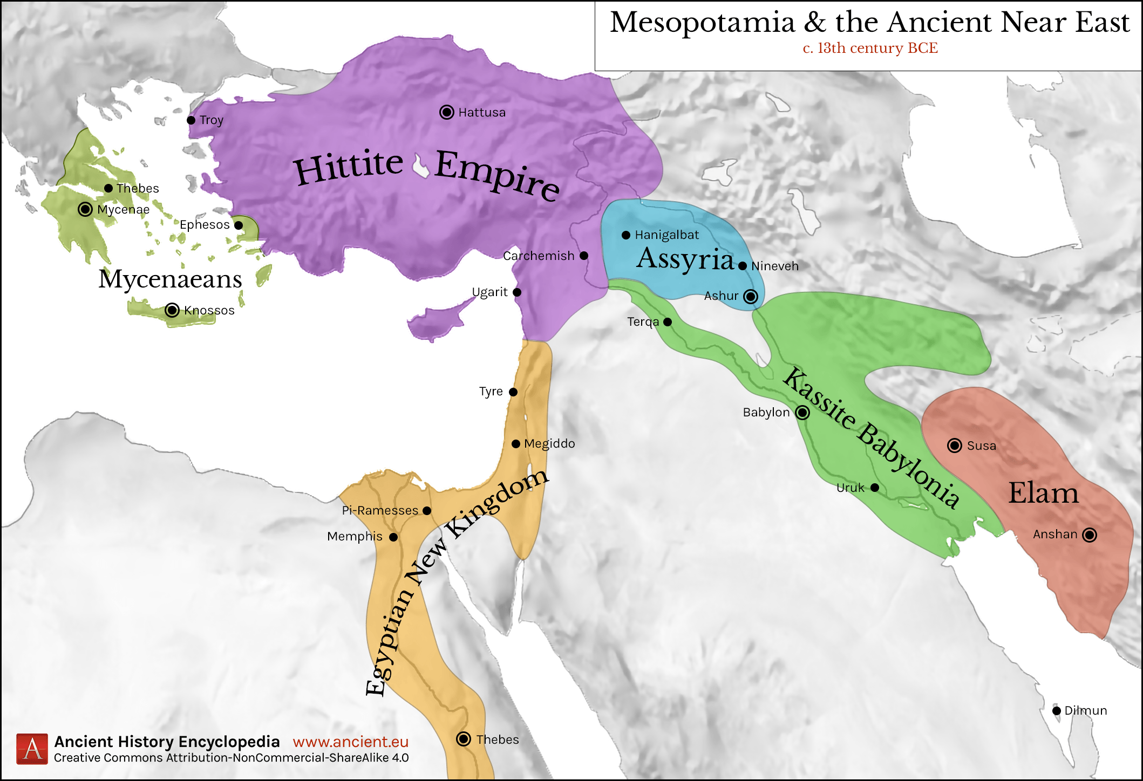
Ancient Near East
1300 b.C.

Slide 4
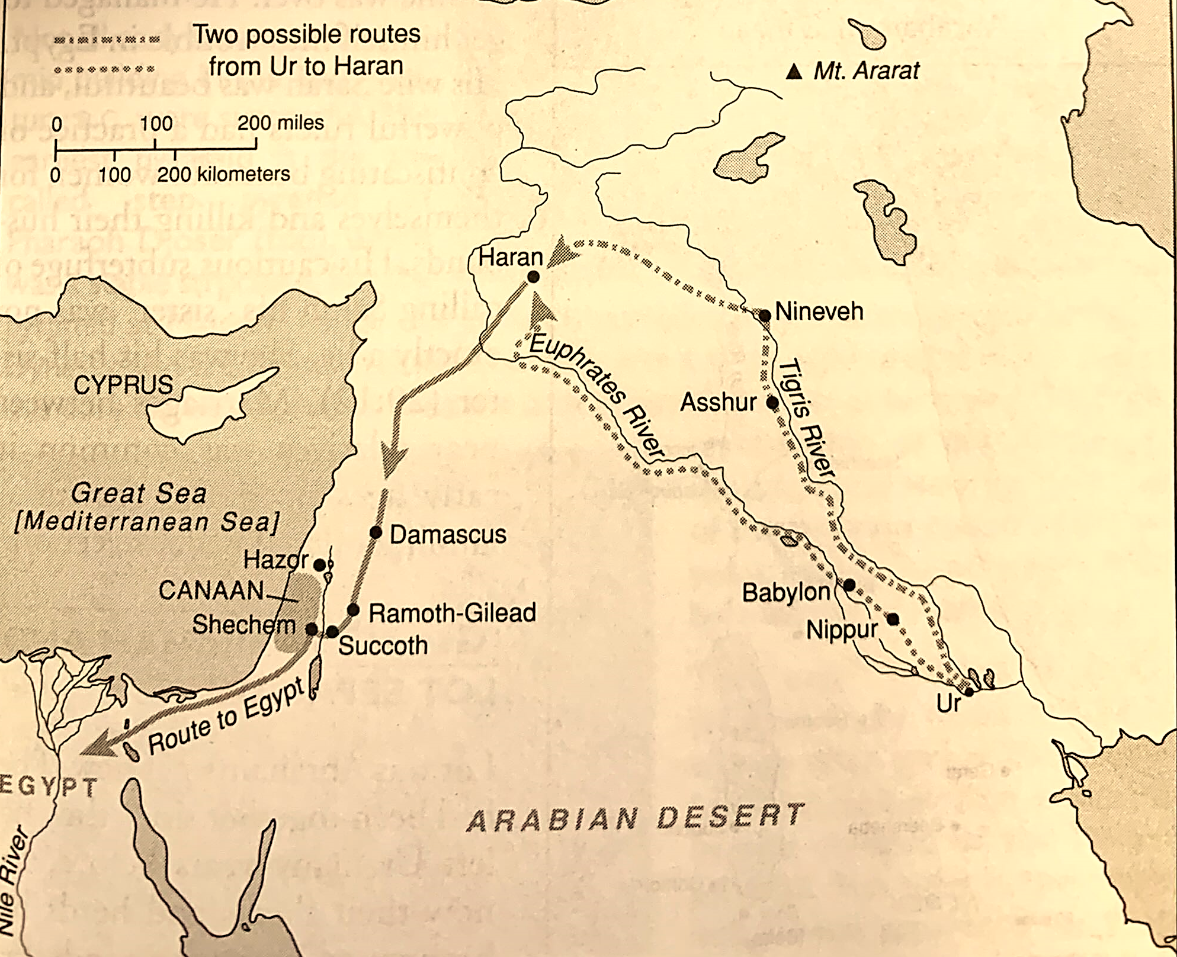
Abraham’s Journeys
H. H. Halley, Halley’s Bible Handbook (Grand Rapids: Zondervan, 2000) 109.

Slide 5
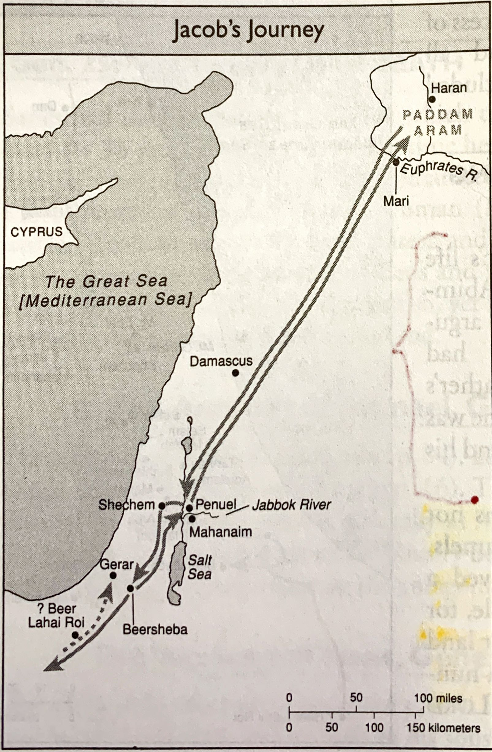
Jacob’s Journeys
H. H. Halley, Halley’s Bible Handbook (Grand Rapids: Zondervan, 2000) 125.

Slide 6
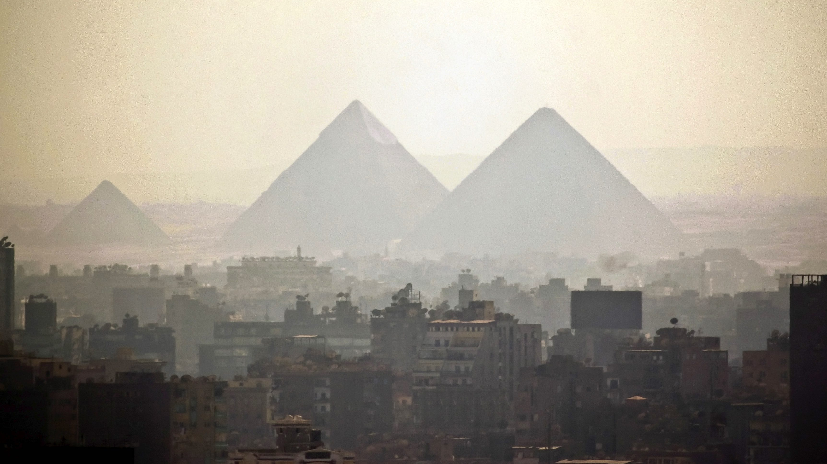
Source: » Ancient Egyptian chronology and historical framework (smarthistory.org)

Slide 8
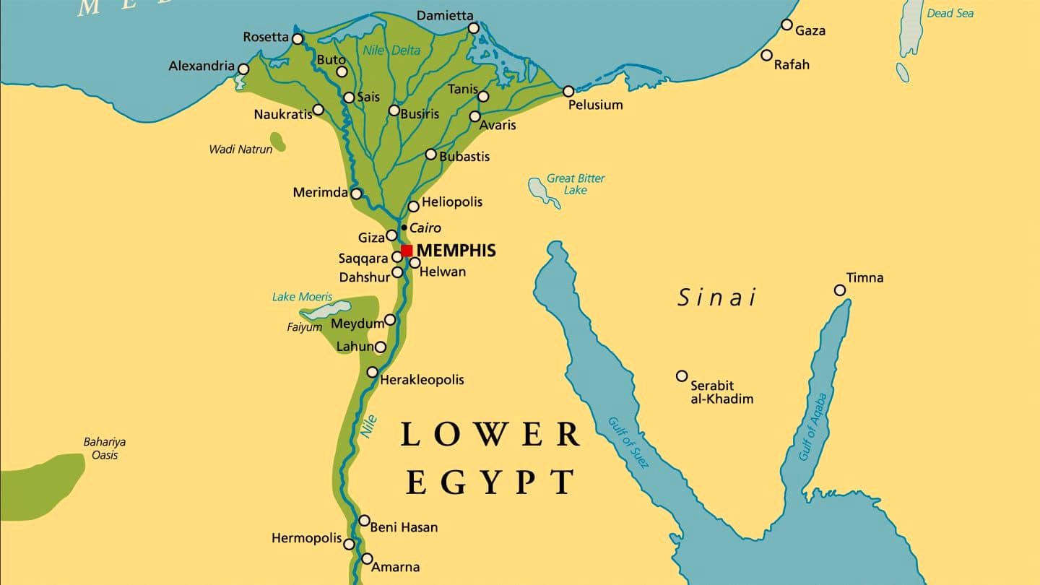
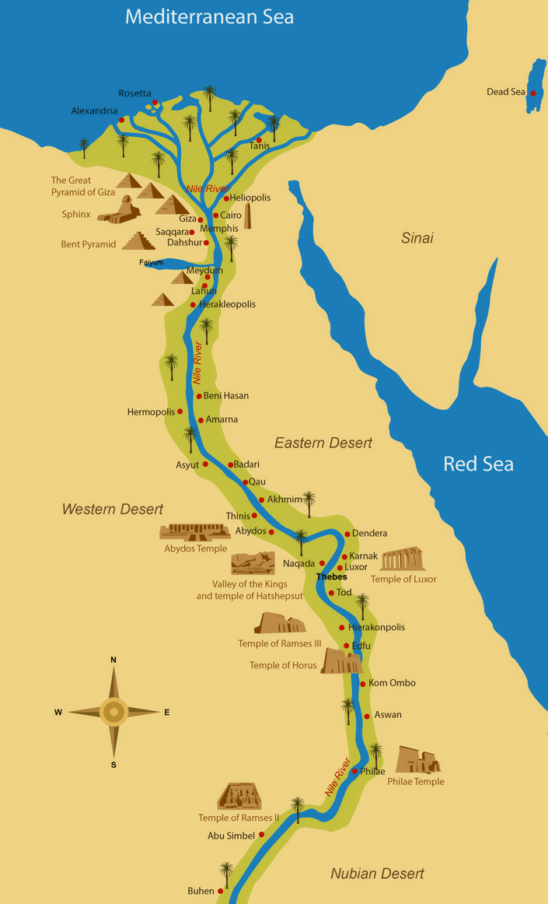
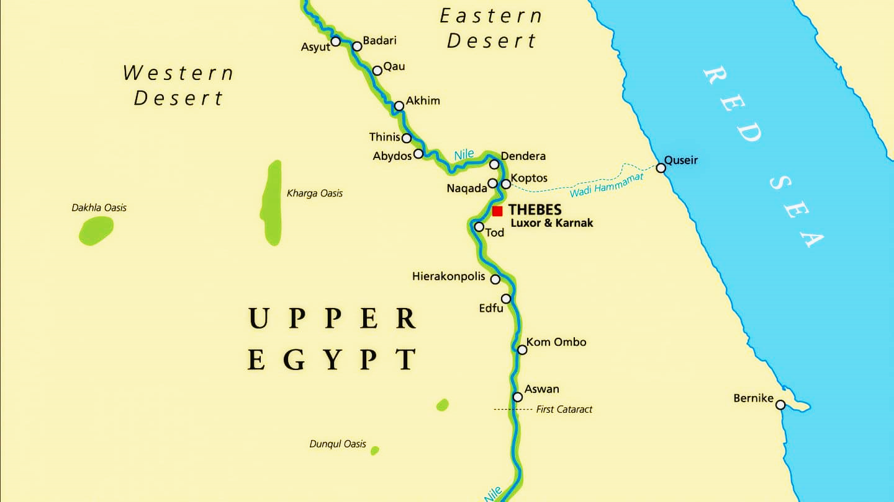

Slide 9
Tentative Chronology
Event | Bible Text | Historical Reference | Data
Destruction of Jerusalem | 2Chronicles 36.11 | King Zedekiah was 27 years old | 586 BC
Destruction of Samaria | 2Kings 18.13 | 14th Year of king Hezekiah | 722 BC
Fourth Year of Solomon | 1Kings 6.1 | 480 years after the Exodus | 966 BC
Exodus | Exodus 12.40-41 | 430 Years in Egypt | 1445 BC
Israel Moves Into Egypt |  |  | 1875 BC
Isaac Died | Genesis 35.28 | Isaac died with 180 years old
Jacob and Esau are born | Genesis 25.20 | Isaac is 40 years old
Isaac was born | Genesis 21.5 | Abraham was 100 years old
Abraham Covenant with God | Galatians 3.15-16 Genesis 17.24 | Abraham is 99 years of age; This is 430 years before the Covenant of the Sinai

Slide 10
Canaanite Procession into Egypt
In the tomb of Khnumhotep II, who served Pharaoh Senusret II (estimated 1897-1878 BC), depicts the migration of “Asian people” into Egypt. Some believe this is the family of Israel. But we cannot be sure. However, in the account of Genesis, we are told caravans of Ishmaelites were coming from Gilead going into Egypt to trade (Gen 37.25). The depiction proves this is true.
Source: Khnumhotep II - Wikipedia

Slide 11
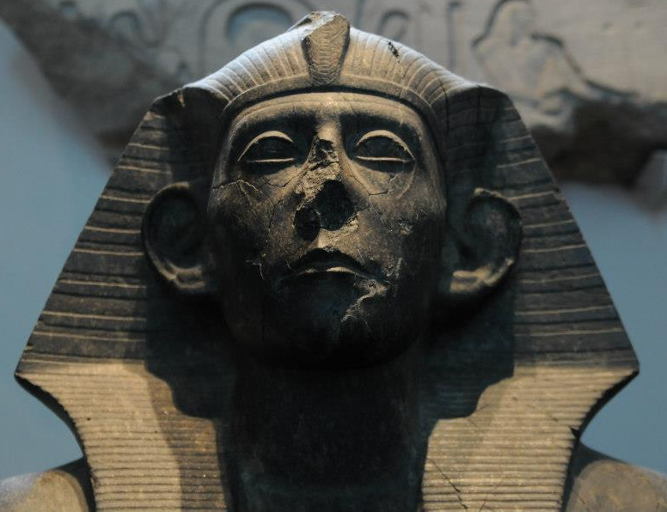
Sesostris III
The best candidate for Joseph’s friend Pharaoh is Sesostris III (also called Senwosret III), belonging to the 12th dynasty, whose reign is dated to the early 17th century. He was a powerful Pharaoh who made Egypt into a regional power. Drought and famine in the region are described during his reign.
Source: Khnumhotep II - Wikipedia

Slide 12
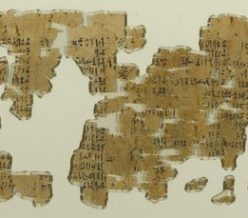
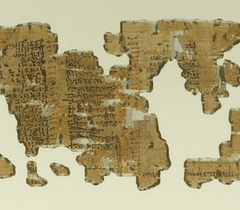
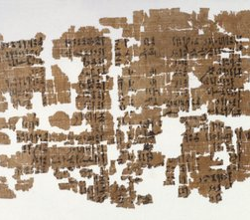
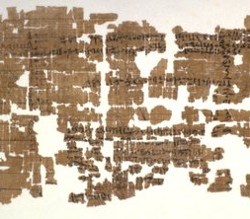
Papyrus Brooklyn 35.1446
A papyrus from the late 17th century (12th-13th dynasties) describes a transaction of a noblewoman named Senebtisi, who registered 95 slaves, of which 45 have Semitic names. The price is set at 20 shekels per slave (like in Gen 37.28).
Source: Brooklyn Museum

Slide 13
Change in Power
During the later “Intermediary Egypt,” a foreign contingent coming from Asia migrated to Egypt and reached power during the fifteenth ruling from lower Egypt. These foreigners were called “Hyksos” by later historians. They were later overthrown and expelled from Egypt. The records of their accomplishments and ruling were expunged by later dynasties, but Ptolemaic historian Manetho described them as rulers of Egypt between the 17th and 16th centuries BC.

Slide 14
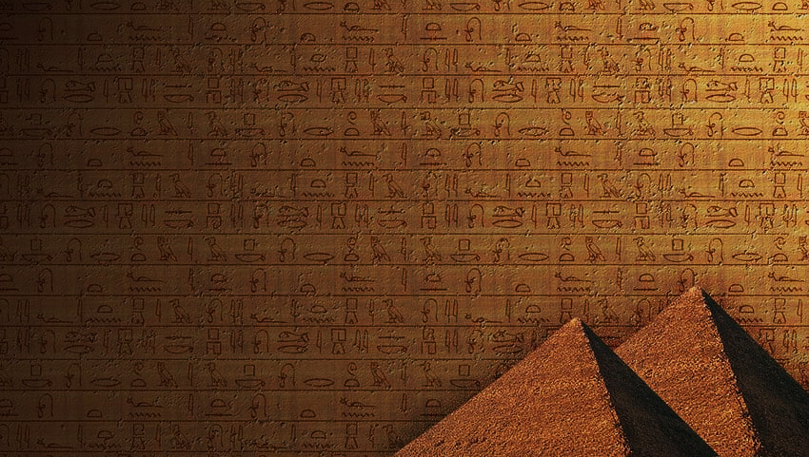
Manetho apud Josephus Contra Apionen 1.14 75-82
"Tutimaeus.​ In his reign, for what cause I know not, a blast of God smote us; and unexpectedly, from the regions of the East, invaders of obscure race marched in confidence of victory against our land. By main force they easily seized it without striking a blow;​ and having overpowered the rulers of the land, they then burned our cities ruthlessly, razed to the ground the temples of the gods, and treated all the natives with a cruel hostility, massacring some and leading into slavery the wives and children of others. Finally, they appointed as king one of their number whose name was Salitis.​ He had his seat at Memphis, levying tribute from Upper and Lower Egypt, and always leaving garrisons behind in the most advantageous positions. Above all, he fortified the district to the east, foreseeing that the Assyrians,​ as they grew stronger, would one day covet and attack his kingdom.

Slide 15
Manetho apud Josephus Contra Apionen 1.14 75-82
"In the Saïte [Sethroïte] nome​ he found a city very favourably situated on the east of the Bubastite branch​ of the Nile, and called Auaris after an ancient religious tradition.​ This place he rebuilt and fortified with massive walls, planting there a garrison of as many as 240,000 heavy-armed men to guard his frontier. Here he would come in summer-time, partly to serve out rations and pay his troops, partly to train them carefully in manoeuvres and so strike terror into foreign tribes. After reigning for 19 years, Salitis died; and a second king, named Bnôn,​succeeded and reigned for 44 years. Next to him came Apachnan, who ruled for 36 years and 7 months;​ then Apôphis for 61, and Iannas for 50 years and 1 month; then finally Assis for 49 years and 2 months. These six kings, their first rulers, were ever more and more eager to extirpate the Egyptian stock. Their race as a whole was called Hyksôs,​ that is 'king-shepherds': for hyk in the sacred language means 'king', and sôs in common speech is 'shepherd' or 'shepherds'; hence the compound word 'Hyksôs'. Some say that they were Arabs."

Slide 16
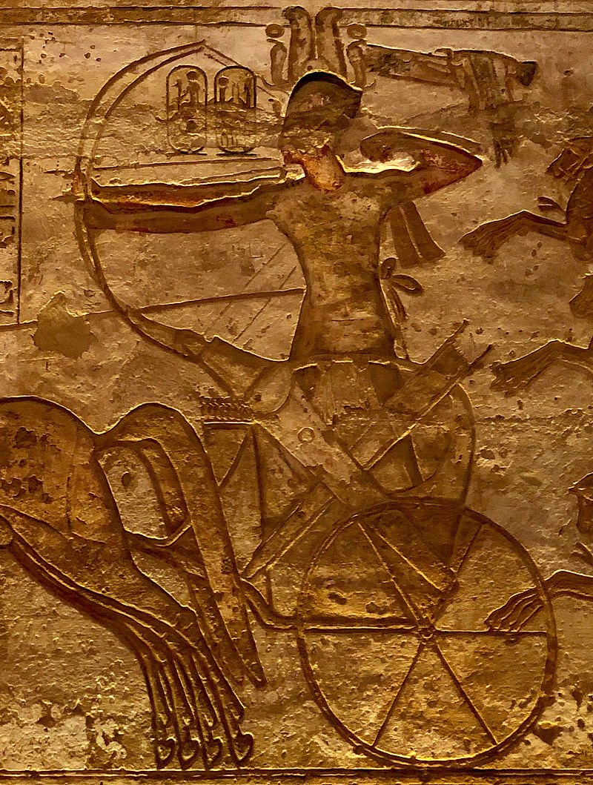
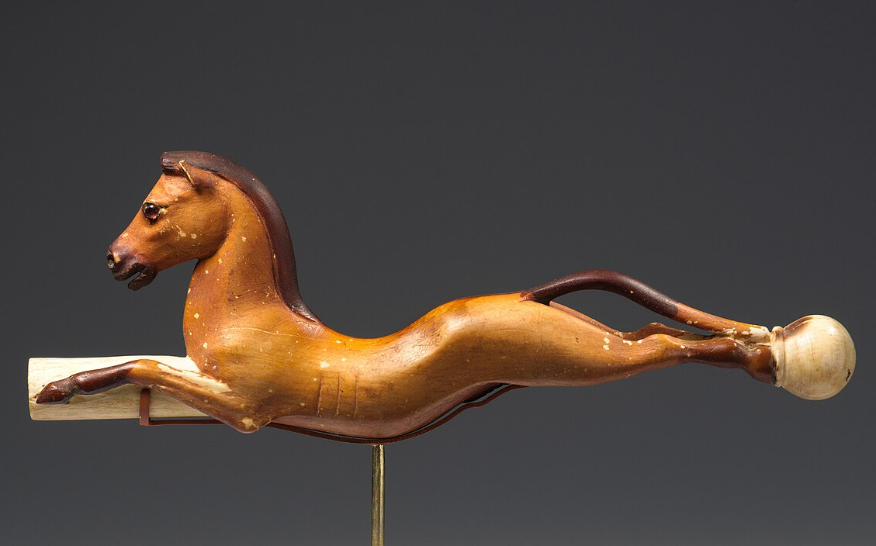
Hyksos Technology
The Hyksos brought new technology to Egypt. They perfected the warfare techniques by introducing the sickle sword and composite bow. They invested in improving the mobile war with the use of horses and chariots.

Slide 17
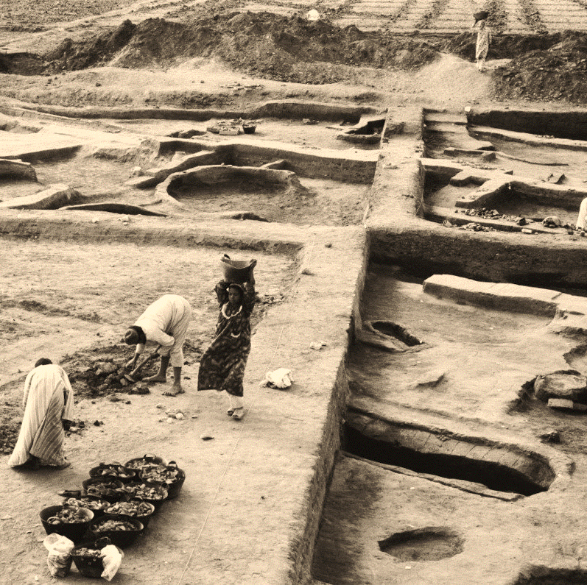
Are the “Hyksos” Israelites?
Many believe they were Israelites. However, it seems that Hyksos are Semitics who migrated gradually to Egypt and climbed the social ladder until they became the dominant group. The Israelites were probably part of this group of people. The Hyksos 15th dynasty made their capital the city of Avaris, on the west side of the Nile delta, the land of Goshen. Their art, architecture and names point to an Asian culture.

Slide 18
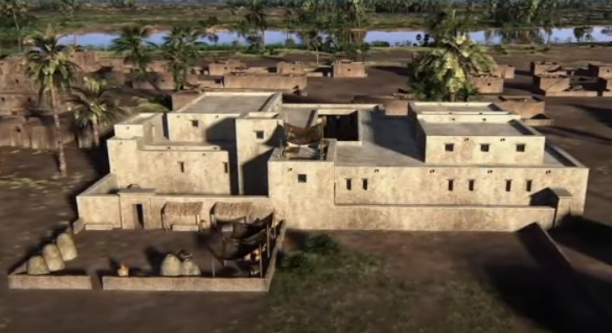
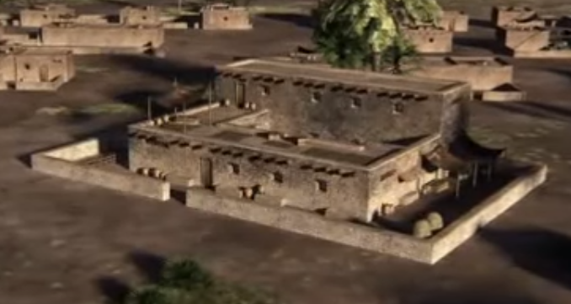
Joseph’s House
A house very peculiar was found in Avaris. It seems to be a Semitic construction. It was later rebuilt into a major palace. It has twelve tombs in the yard. One of the tombs has a pyramidal shape and a big statue of a Semitic man inside. It has been called the house of Joseph.

Slide 19
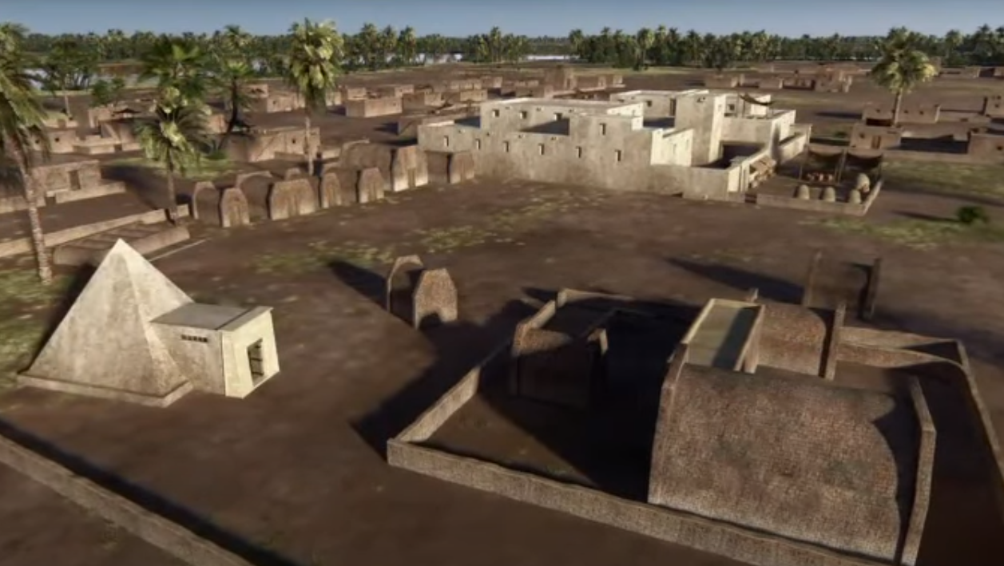

Slide 20
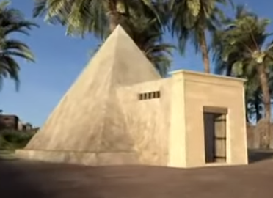
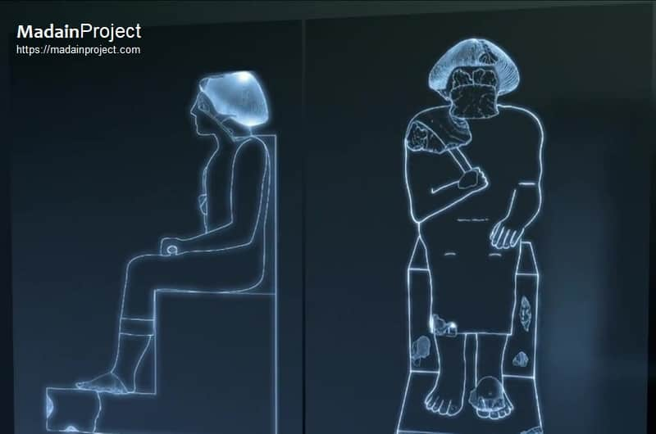
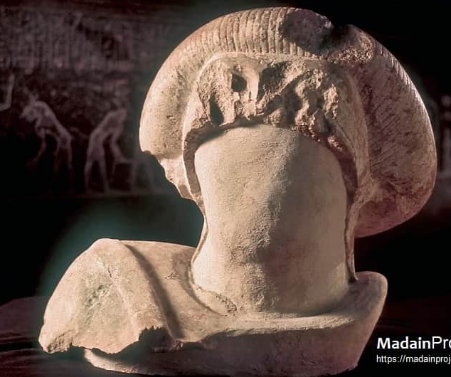
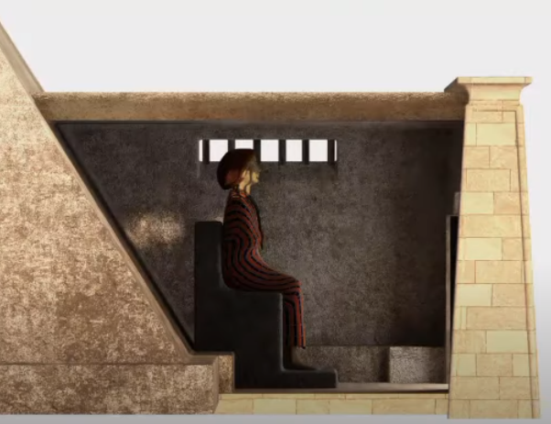
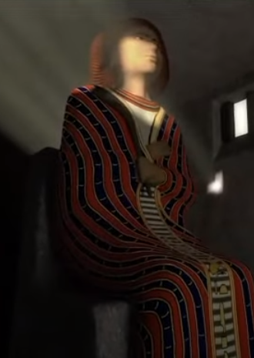
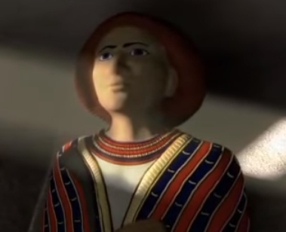

Slide 21
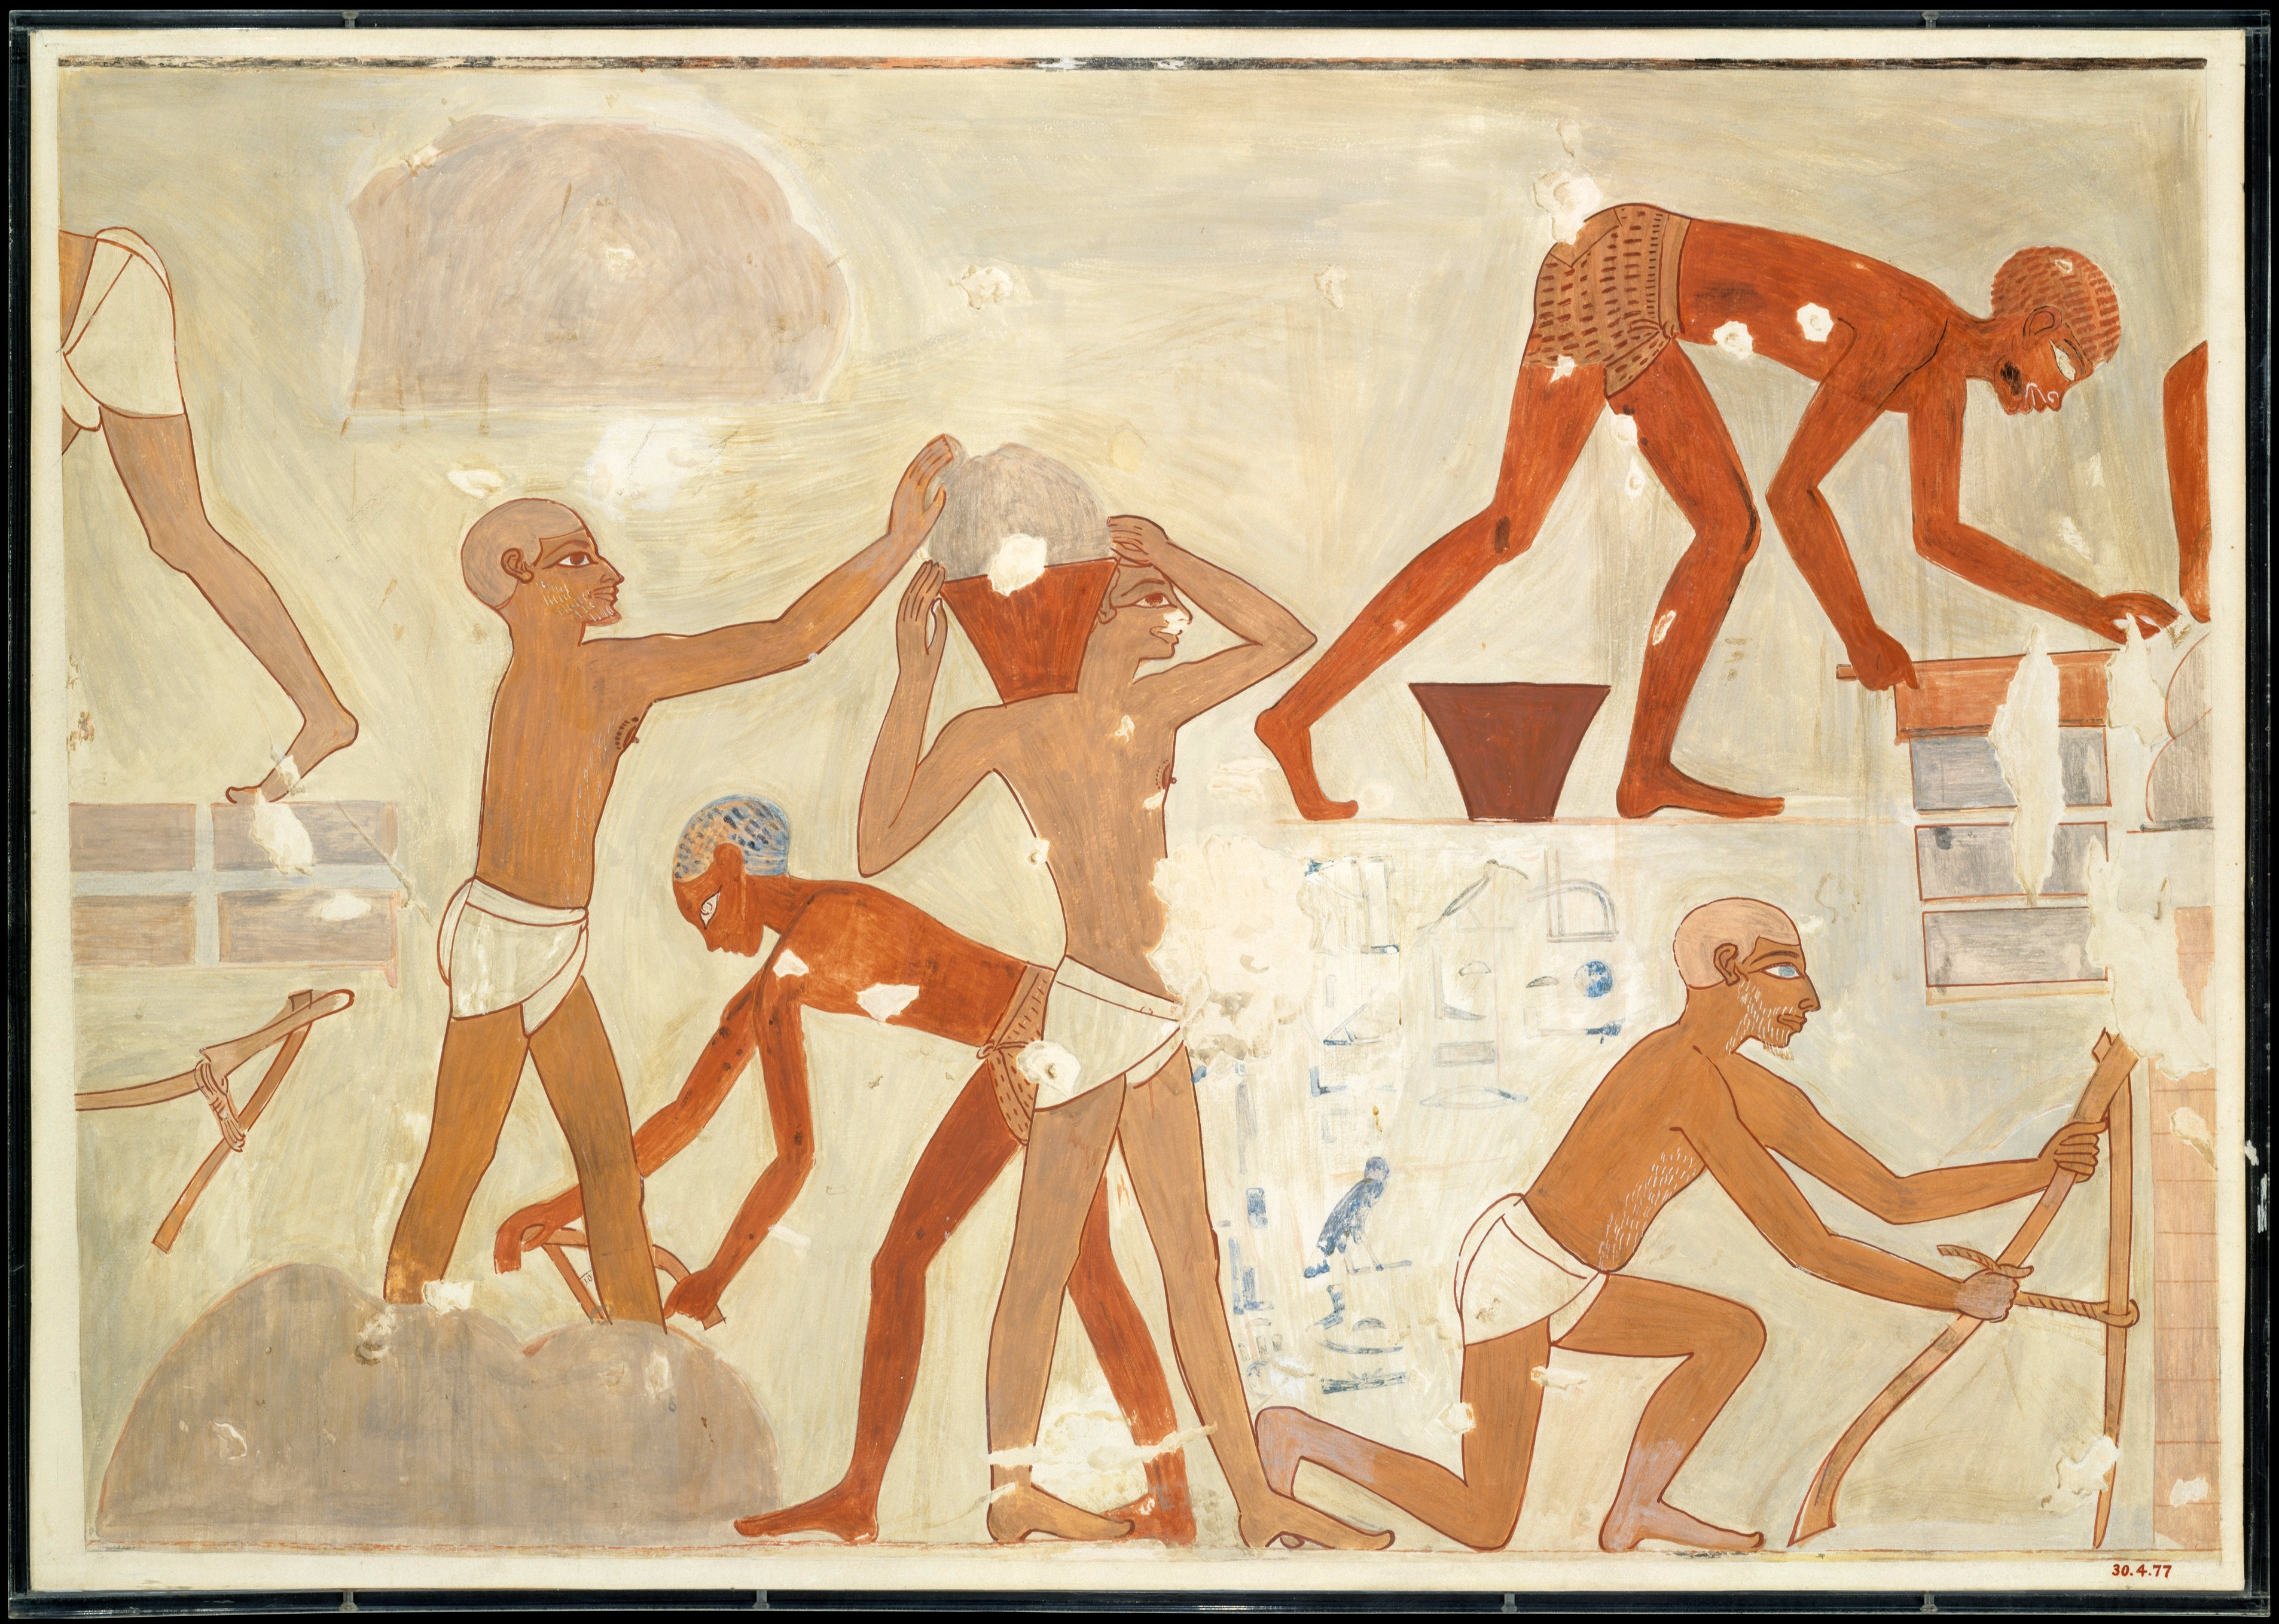
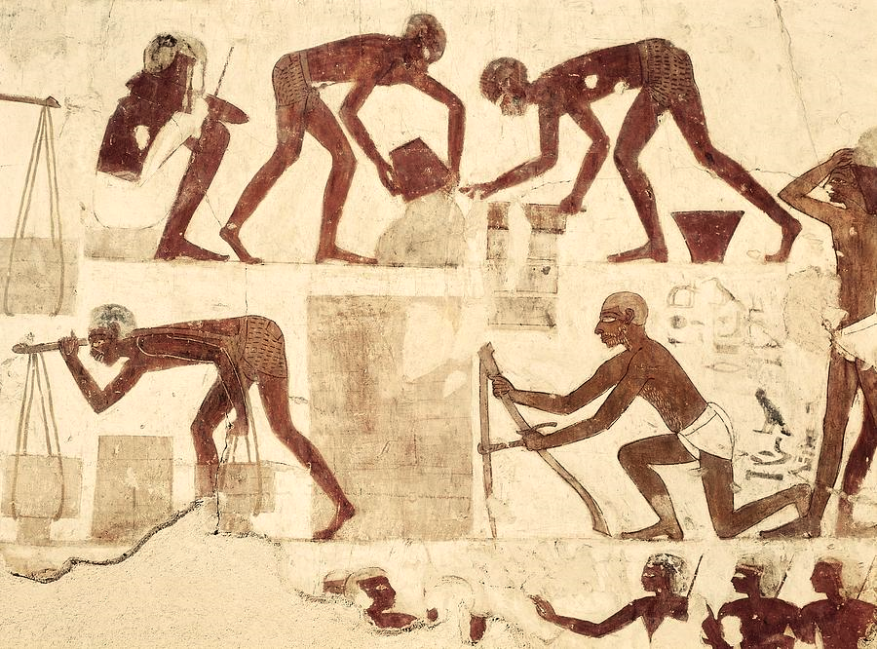
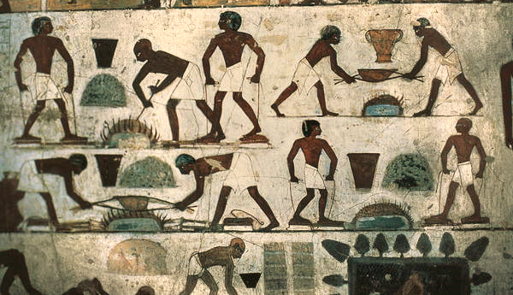
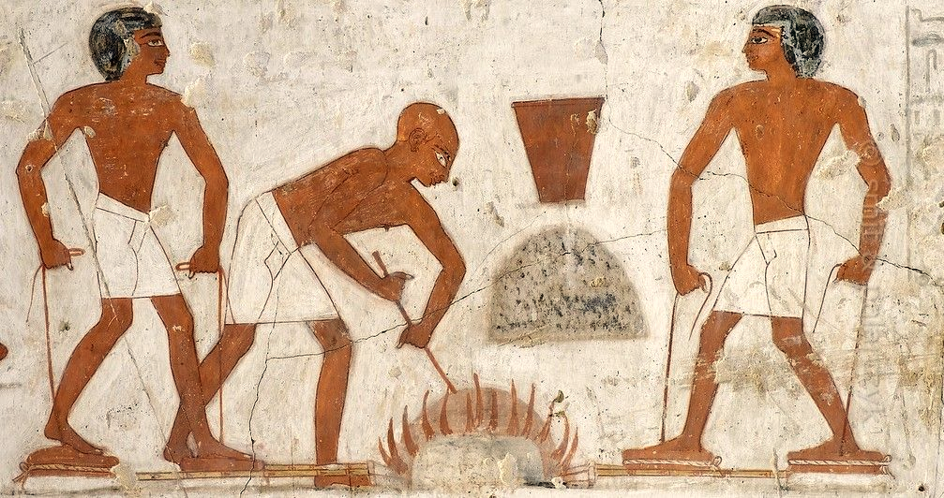
The tomb of Vizier Rehkmire who served the 18th dynasty (circa 1500 BC) depicts slaves making bricks.

Slide 22
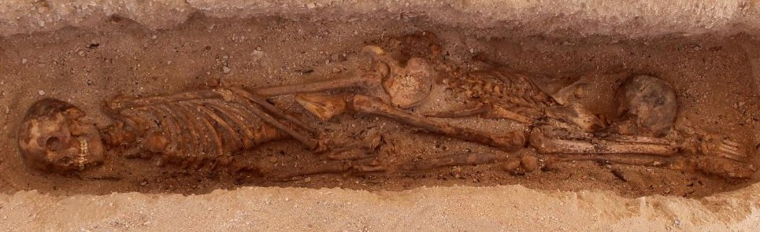
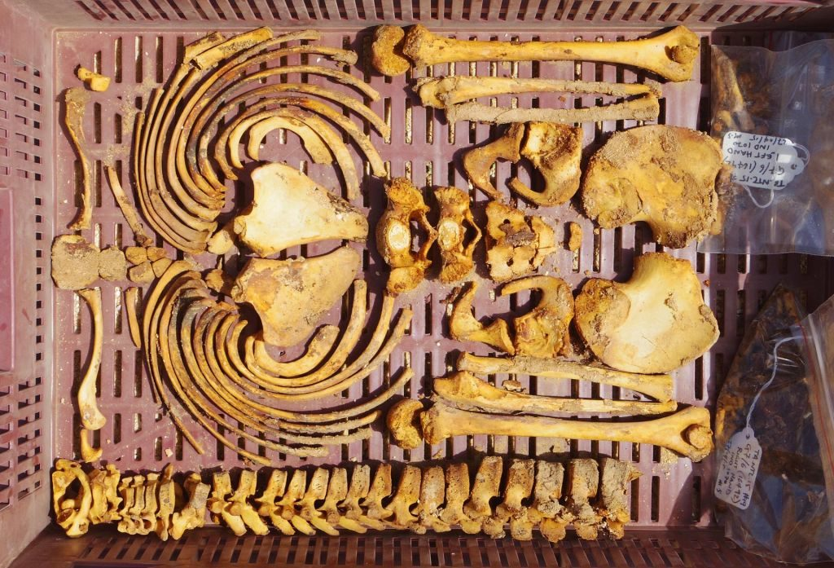
Graves of Amarna
A large number of graves found in the site of Amarna dated circa 1500 BC are believed to be of 105 slaves. The analysis of the bones shows that the individuals are between 7 and 25 and present abnormalities, compatible with forced heavy labor.
Ancient Graveyard of Slaves Discovered in Egypt | Patterns of Evidence

Slide 23
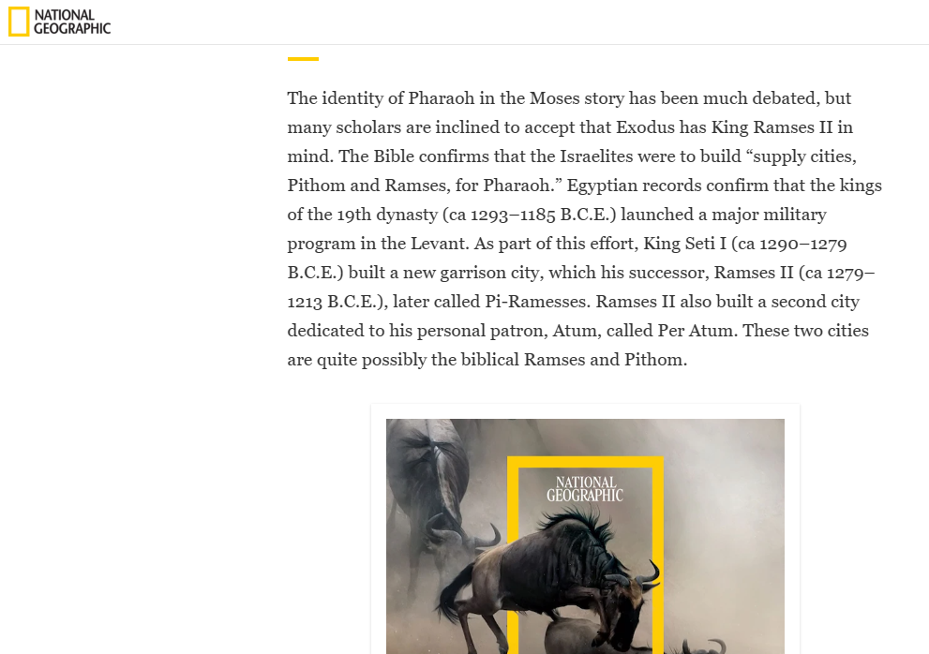

Slide 24
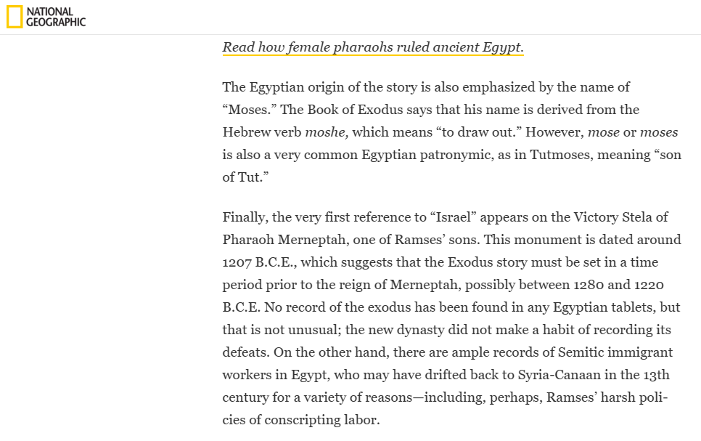

Slide 25
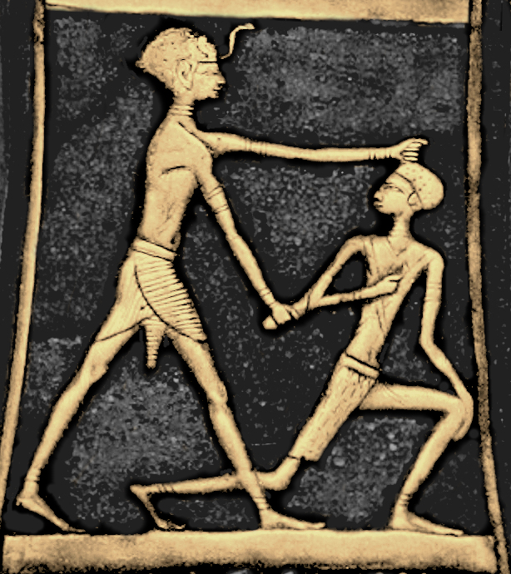
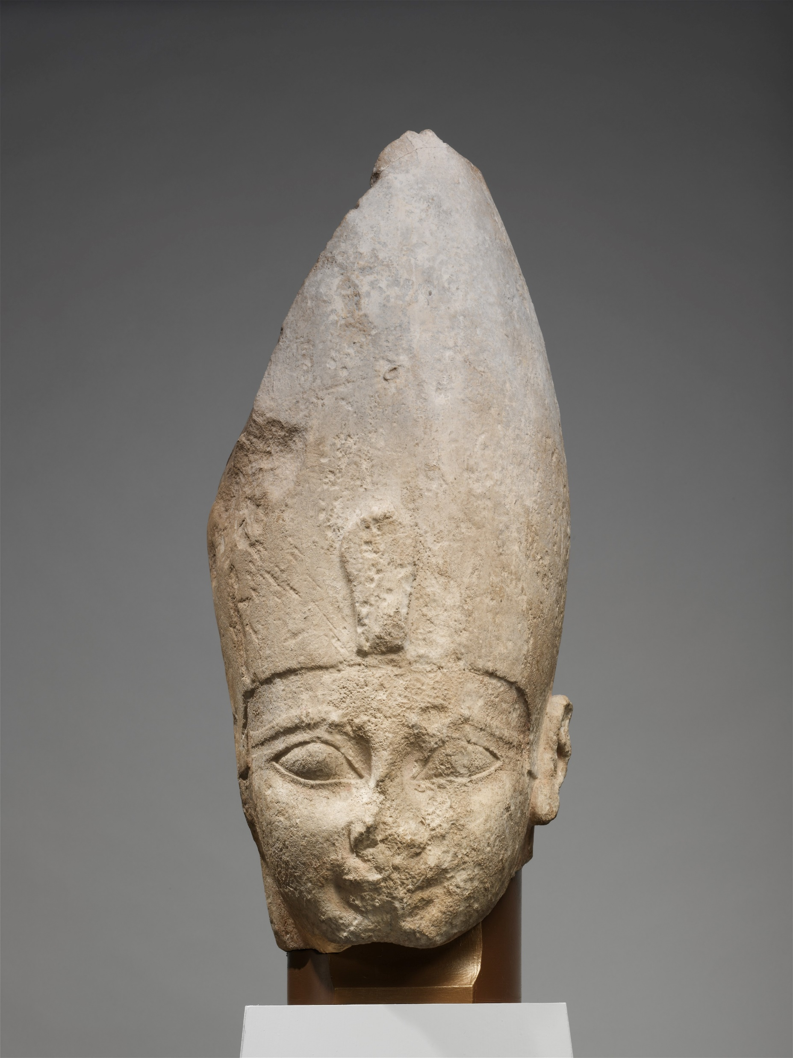
Expulsion of the Hyksos
The 16th dynasty marks the beginning of the decline of the influence of the foreign peoples, especially the Hyksos. They disappeared from Egypt in the 17th dynasty, who made their policy to expel them from the land. The 18th dynasty started with Pharaoh Ahmose, whom many believed to be the one who did not know Joseph (Exo 1.8). This is a period of intense nationalism in Egypt.
On the left Ahmose killing a Hykso and on the right the bust of Ahmose.
Source: Wikicommons

Slide 26
Pharaoh | Theorist | Information
Pharaoh “Thutmose” | Flavius Josephus | Ancient Jewish historian of the first century AD.
One the “Amenhoteps” | Manetho | Greek-Egyptian historian of the third century BC
Bakenranef (725-720) | Tacitus | Roman historian of 1st century AD
Hatshepsut (1479-158) | Diodorus | Greek historian from 1st century BC
Ramses II (1303-1213) | Hollywood | Pharaoh of movies “Ten Commandments” and “Prince of Egypt”. He died at 90.
Akhenaten (1353-1336) | Sigmund Freud | Promoted a religious change to monotheism. Faced revolts of people in Caanan
Amenhotep II (1427-1401/1397) | Immanuel Velikovsky; Christopher Eames; Scott Stripling | A very good candidate, but we have his mummy.
Dedumose ii (date unknown) | David Rohl | Some place him in the 13th dynasty but Roth revised dates a place him 18th century
Neferhotep i | Alfred Edersheim; David Down | Belonged to the thirteenth dynasty
Merenre Nemtyemsaf ii | Herman Hoeh | 6th dynasty
Merneptah (1213-1203) | Isaac Asimov | He was the 12th son of Ramses II

Slide 27
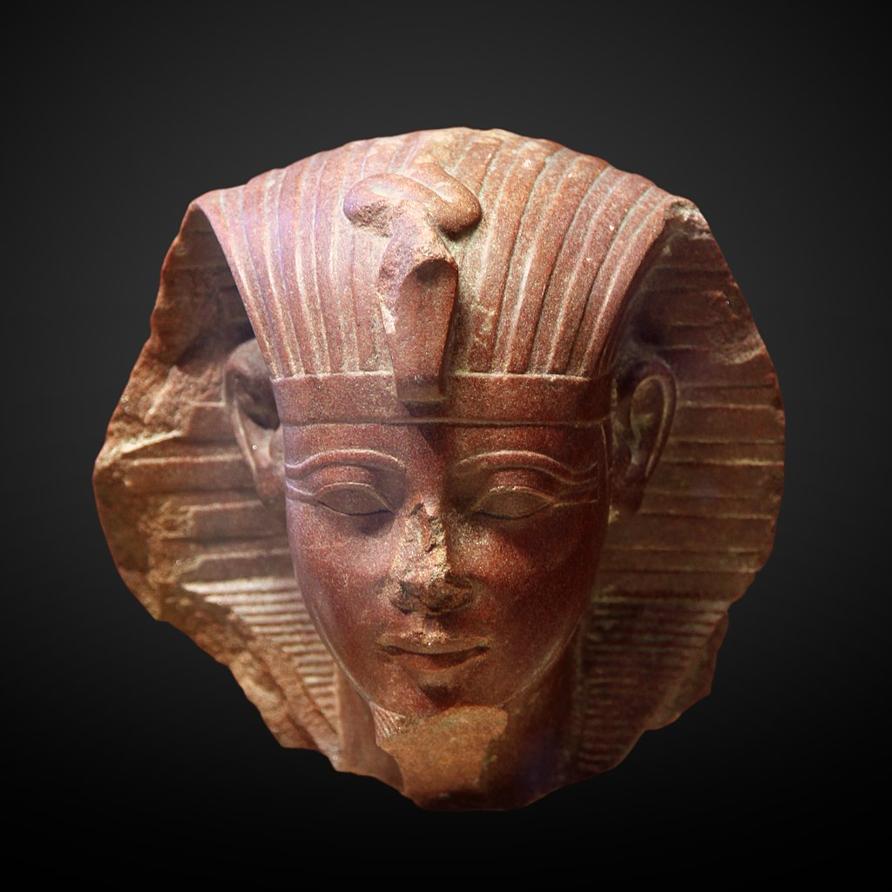
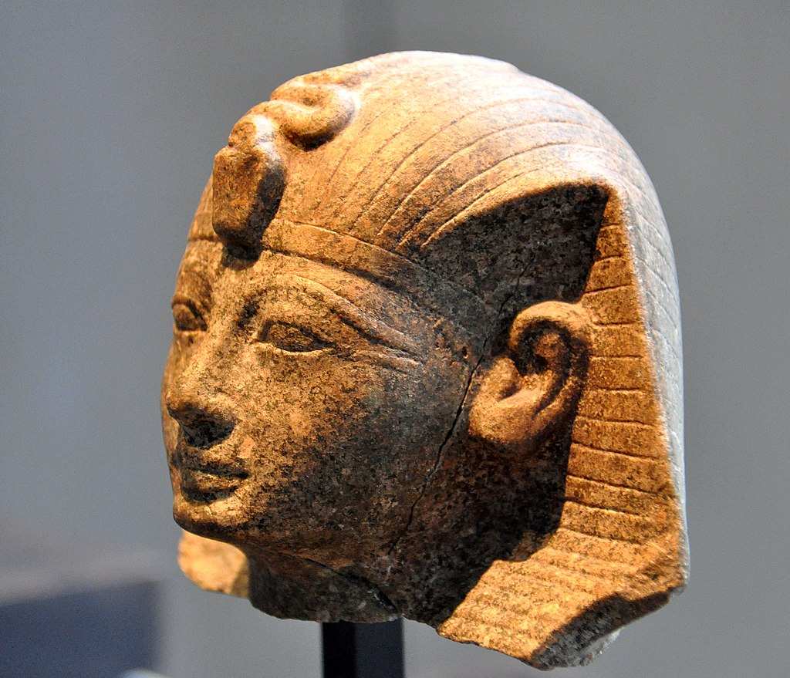
Amenhotep II
Second son of Thutmose III, who has the most successful Pharaoh. He was vicious against his enemies, having done a few victorious military campaigns in the years 3, 7 and 9. He built numerous monuments during the first half of his reign, but the later years of his throne are not chronicled. Many monuments were left incomplete. He was succeeded by Thutmose IV, who was not his firstborn, but the son of a consort. He reigned for 26 years.

Slide 28
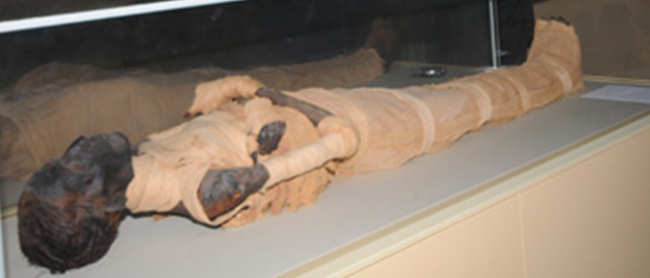
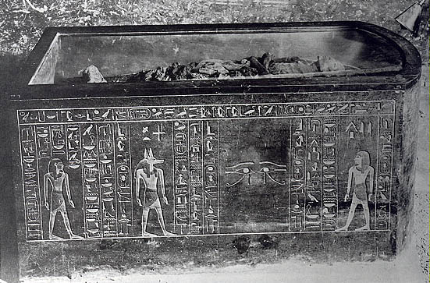
The Problem
There is no record of the Israelite’s Exodus in the Chronicles of Egypt. Also, no archeological evidence was found of the destruction of the Egyptian army.
Amenhotep II was buried in the Valley of the Kings. His tomb was found in 1898. Upon analysis, the cause of death was not able to be determined. His age was estimated between 40-50 years old.

