Slide 2
Our Mighty Fortress is Our God
1. A mighty fortress is our God, a bulwark never failing; our helper he, amid the flood of mortal ills prevailing. For still our ancient foe does seek to work us woe; his craft and power are great, and armed with cruel hate, on earth is not his equal.
4. That Word above all earthly powers no thanks to them abideth; the Spirit and the gifts are ours through him who with us sideth. Let goods and kindred go, this mortal life also; the body they may kill: God's truth abideth still; his kingdom is forever!

Slide 3
He is Exalted
He is exalted the King is exalted on High I will praise Him He is exalted forever exalted And I will praise His name
He is the Lord Forever His truth shall reign Heaven and Earth Rejoice in His holy name He is exalted the King is exalted on high

Slide 4
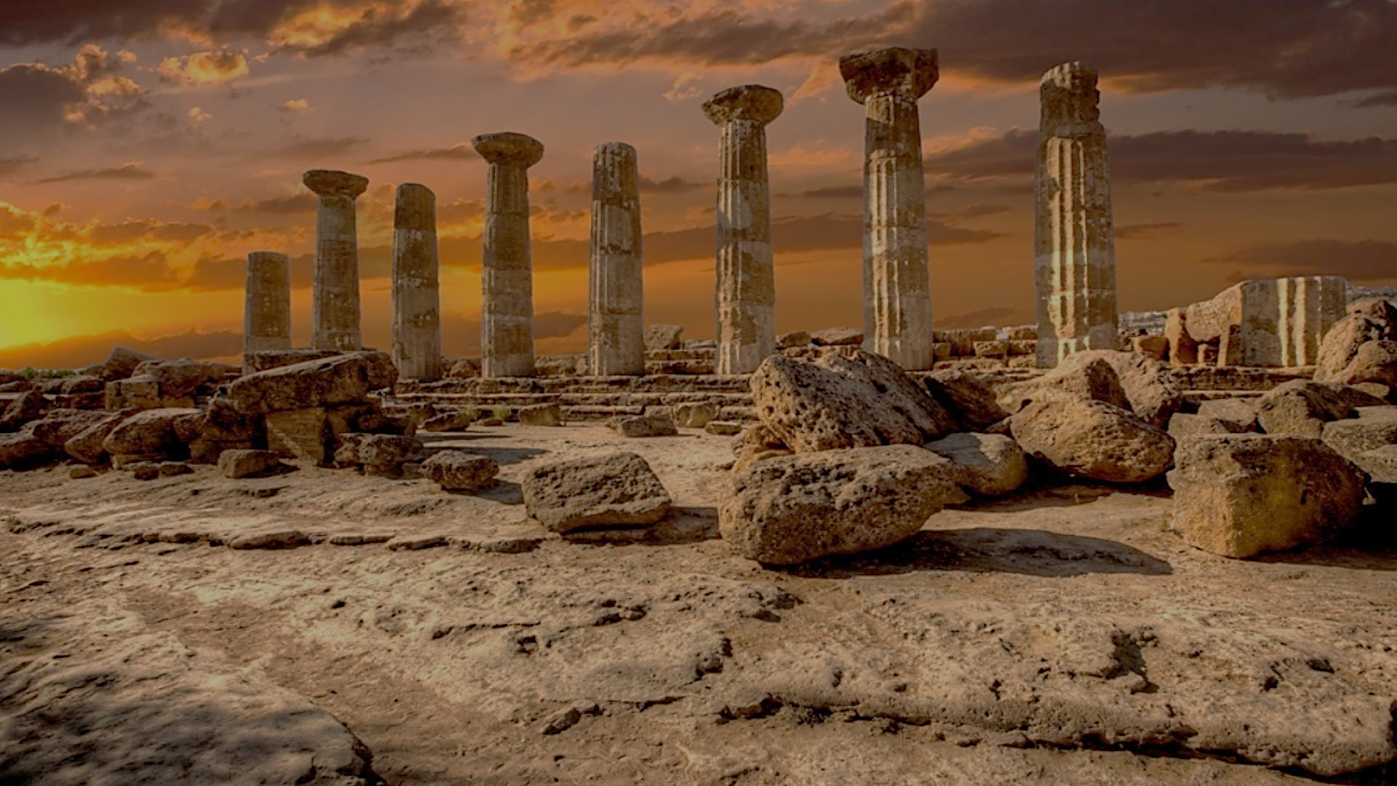
Archeology of Bible Times
Pastor John dos Santos - Faith Presbyterian Church

Slide 5
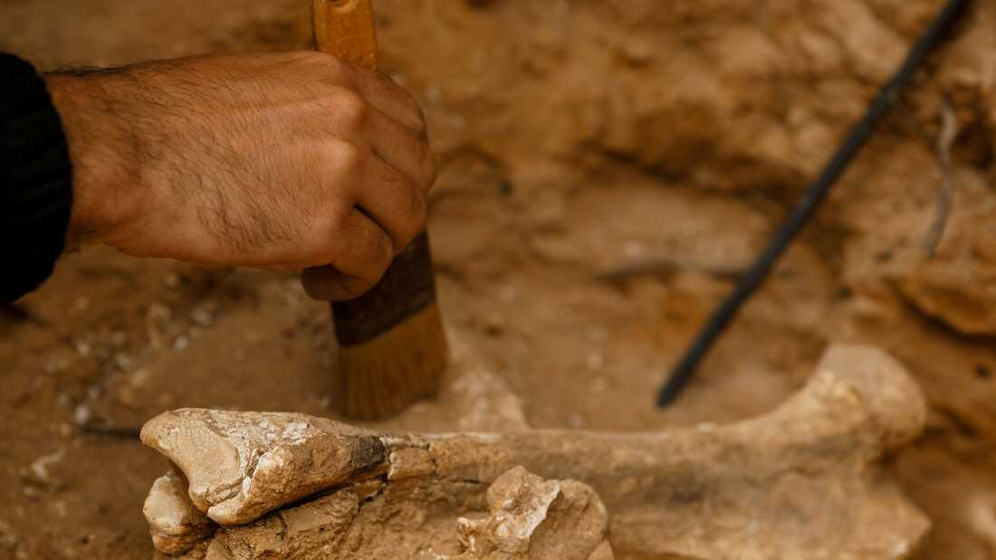
What is Archeology?

Slide 6
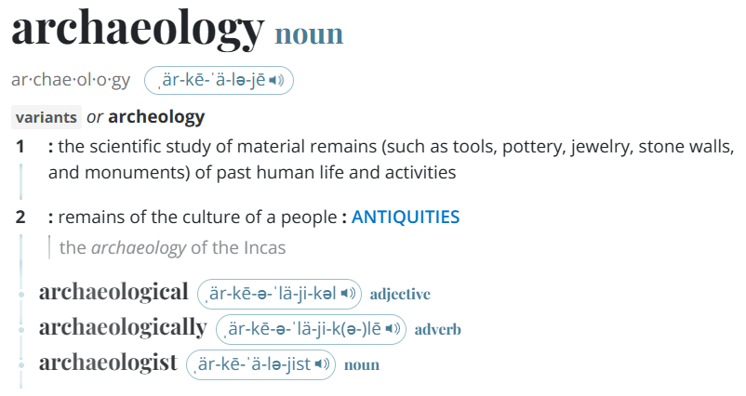
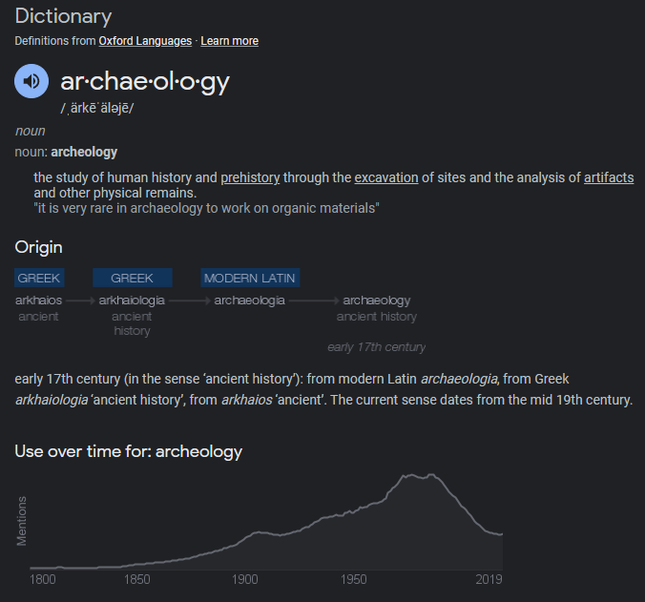
Archaeology is the study of the ancient and recent human past through material remains. Archaeologists might study the million-year-old fossils of our earliest human ancestors in Africa. Or they might study 20th-century buildings in present-day New York City. Archaeology analyzes the physical remains of the past in pursuit of a broad and comprehensive understanding of human culture.
Source: archeology meaning - Google Search

Slide 7
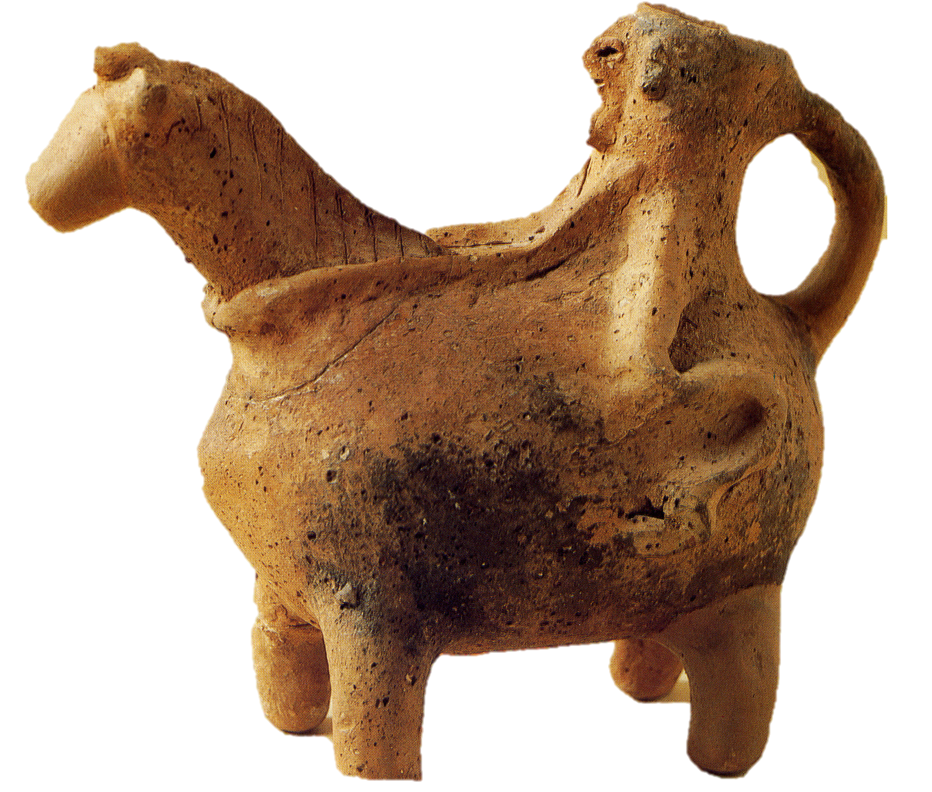
Objective Method!?!?
Assumptions: Date of layers
Culture
=
Conclusion about the object and the date

Slide 8
Scripture information is the “premise” from which we start!

Slide 9
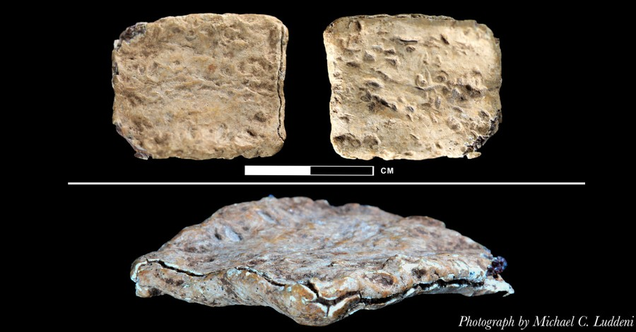
“Curse” Tablet
3,000-Year-Old Tablet with God's Name Affirms Biblical Timeline, Archaeologist Says - Michael Foust (christianheadlines.com)

Slide 10
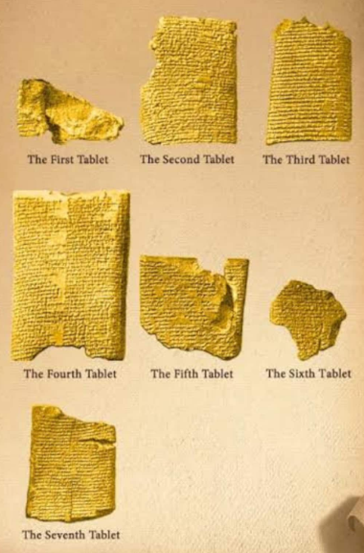
Enuma Elish
Seven Babylonian tablets dated of the 7th century b.C. found in excavations of the Assyrian royal palace of Ashur-banipal (668-628 b.C.), tell the history of how God Marduk (Bel) created the earth by defeating the crocodile God Tiamat, which was cut in two forming heaven and earth. They were found by British Assyriologist Sir Austen Henry Layard in 1849.

Slide 11
Criteria of Date
Qunran Copy of Genesis
1 century b.C.
Enuma Elish Tablet
7 century b.C.
X

Slide 12
Civilization pre-Flood
Farming and raising livestock (Gen 4.2,20)
Building of Cities (Gen 4.17)
Nomads in tents (Gen 4.20)
Music, lyre, and pipe (Gen 4.21)
Metallurgy, Bronze, and Iron (Gen 4.22)
Giants and renown men (Gen 6.4)
Filled with violence (Gen 6.11)
People lived long lives, Adam 930 and Methuselah 969 (Gen 5.5,27)

Slide 13
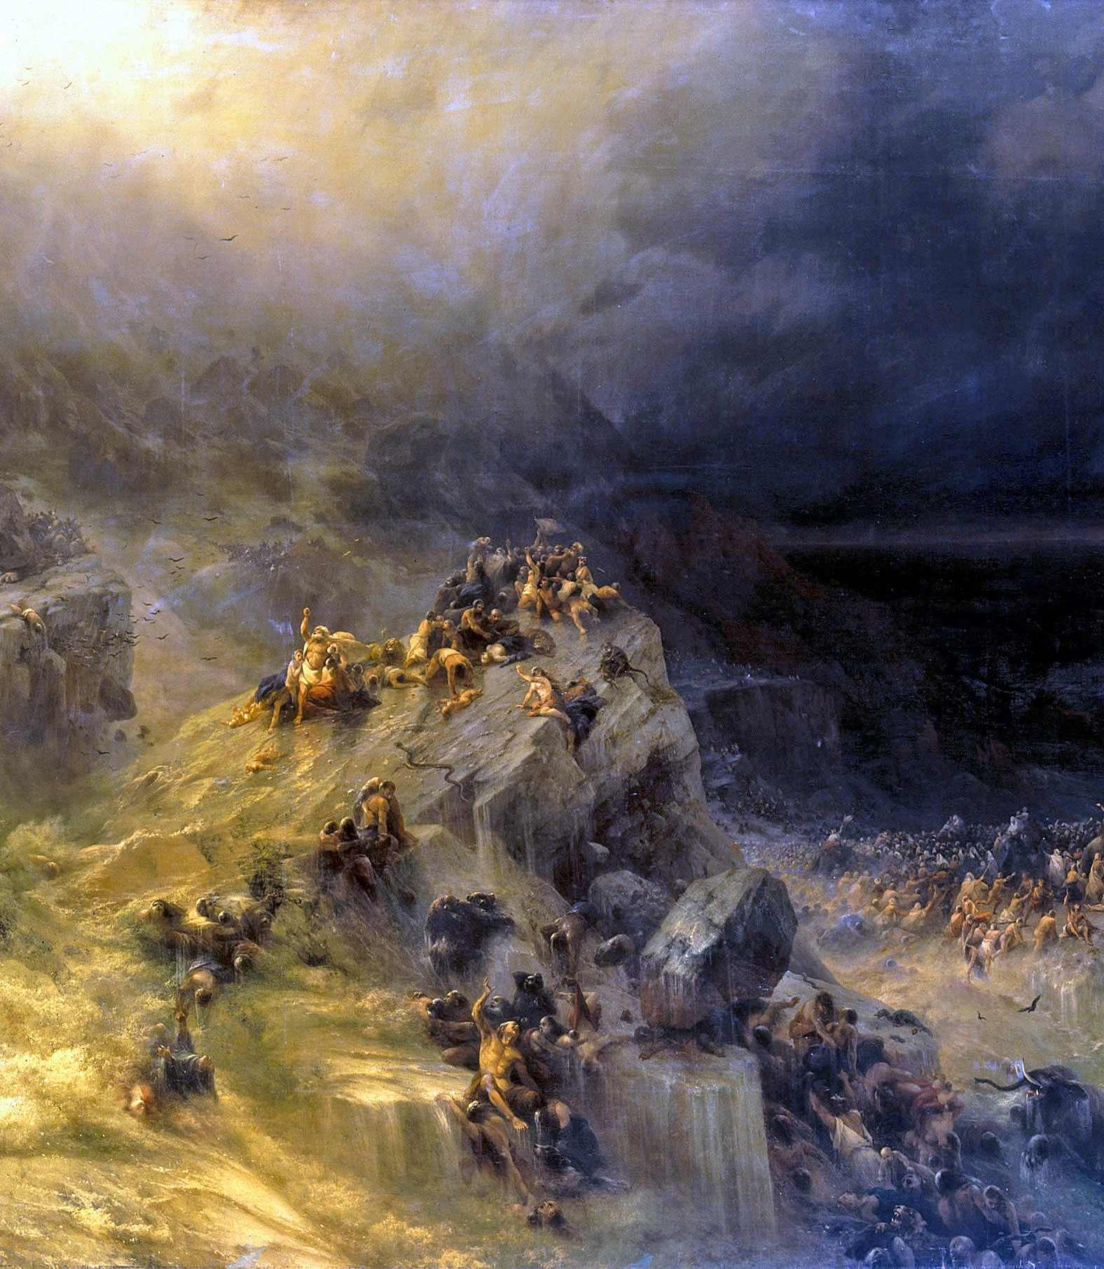
Where is all that?
…the heavens existed long ago, and the earth was formed out of water and through water by the word of God, and that by means of these the world that then existed was deluged with water and perished. (2Pe 3:5-6)
The Deluge, Ivan Aivazovsky 1864. Wikimedia Commons

Slide 14
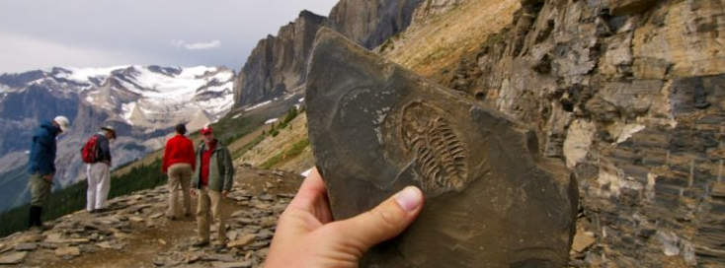
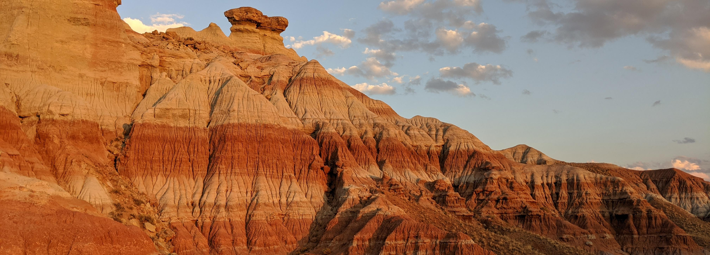
Archeological Evidence of the Flood
Marine Fossils on High Mountains
Concentration of fossils deposits
No evidence of time between layers
Source: MARINE FOSSILS FOUND ON THE HIGHEST MOUNTAIN TOPS – Evolution is a Myth
Source: A fossil site reveals an ancient sinkhole and its enormous occupant | Ars Technica
Source: Found on Lake Erie beach.. I’m told it’s a type of fossil? Any help? : r/fossilid (reddit.com)

Slide 15
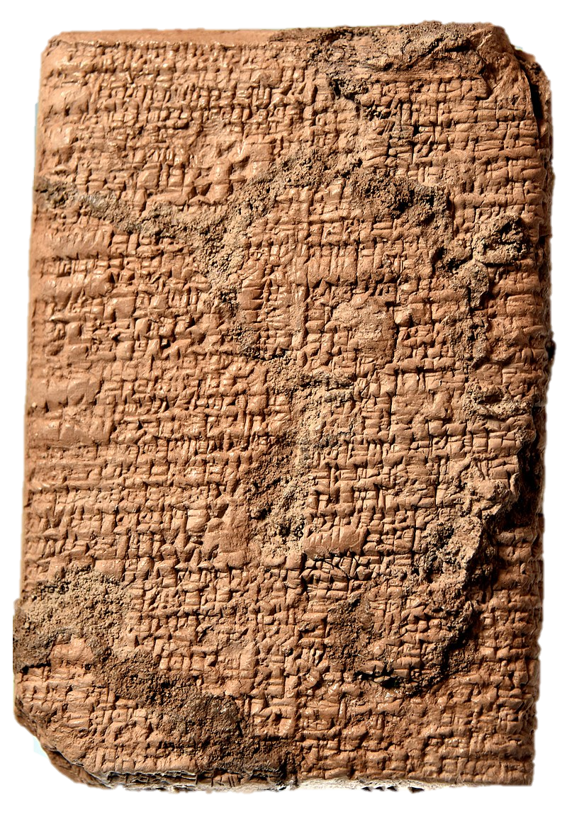
Flood Stories
As would be expected of historical events transmitted orally through thousands of years, hundreds of flood stories are known so far, which are found amongst peoples of all parts of the world. The most famous and used to challenge the Bible is the Babylonian Epic Gilgamesh.
Clay tablet of the story of Gilgamesh. Old Babylonian period, 2003-1595 BCE.
Sulaymaniyah Museum, Iraqi Kurdistan.

Slide 16
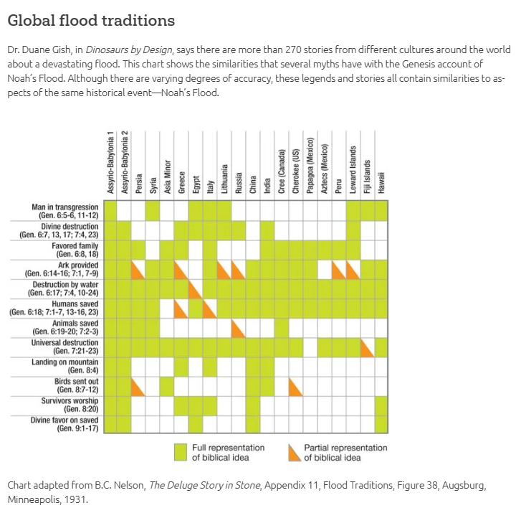
Source: Flood Legends | Answers in Genesis

Slide 17
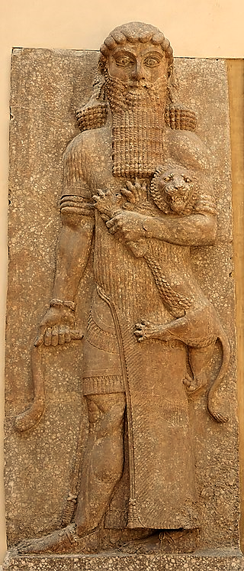
Epic Gilgamesh
Gilgamesh was a mighty demi-God king of Babylon described as tall, strong, and handsome. He had many adventures fighting and defeating mythical creatures and conquering riches and power. Upon losing a mighty warrior friend Enkidu, he starts a quest for immortality. He finds a wise man called Utnapishtim, who received immortality for obeying God’s command to build a boat to survive the great Babylonian flood. He tells Gilgamesh that there is a plant at the bottom of the ocean that can give him eternal life. Gilgamesh finds the plant, but in his travels back home the plant is eaten by a serpent. Arriving home empty-handed he comes to grips with his mortality and starts to enjoy life.
Hero mastering a lion. Relief from the façade of the throne room, Palace of Sargon II at Khorsabad (Dur Sharrukin), 713–706 BCE.
Source: Wikicommons

Slide 18
Details
Gilgamesh has many versions and different languages. The versions point to the addition and editing of the text through time. The complete form is from the 7th century B.C. in twelve tablets. It includes the reference to:
Building a boat reed and covered with bitumen to be saved from the flood
He sends a dove twice to assess the condition of the waters
He offers a sacrifice and incense upon coming out of the boat
He is blessed by the god
Tablet XI (or the Flood Tablet) of the Epic of Gilgamesh.
British Museum
Source: Wikicommons

Slide 19
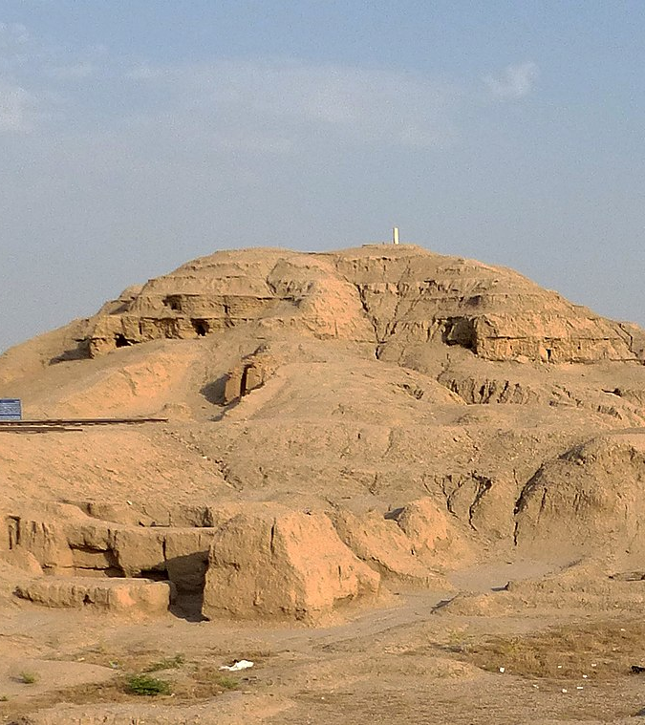
Tower of Babel
The last event of the old world is the division of humanity. God confused the language of people building the tower of Babel in the plain of Shinar and by that formed difference ethnicities which spread throughout the world.
White Temple ziggurat in Uruk
Source: wikicommons

Slide 20
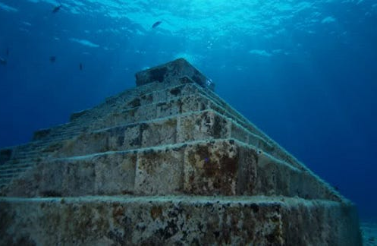
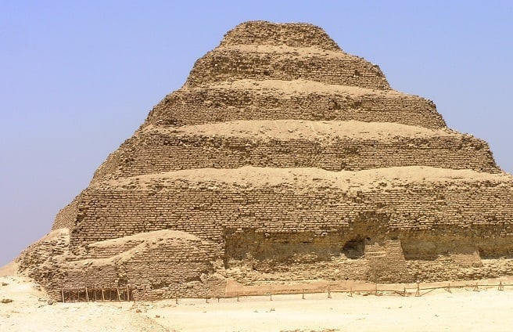
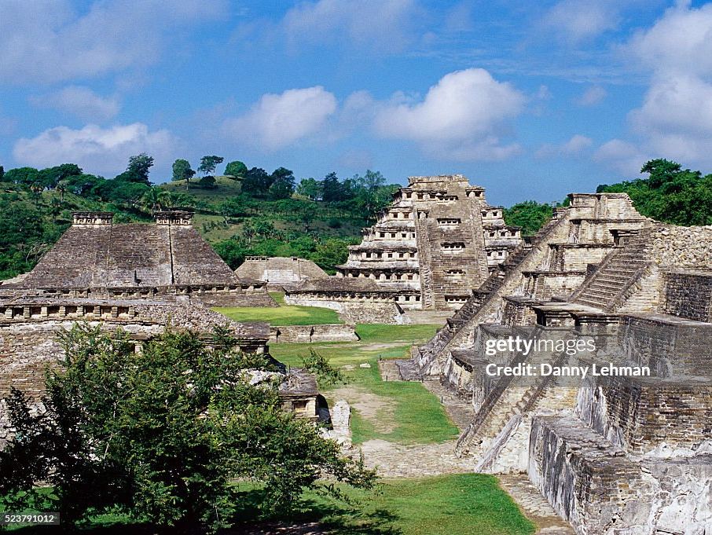
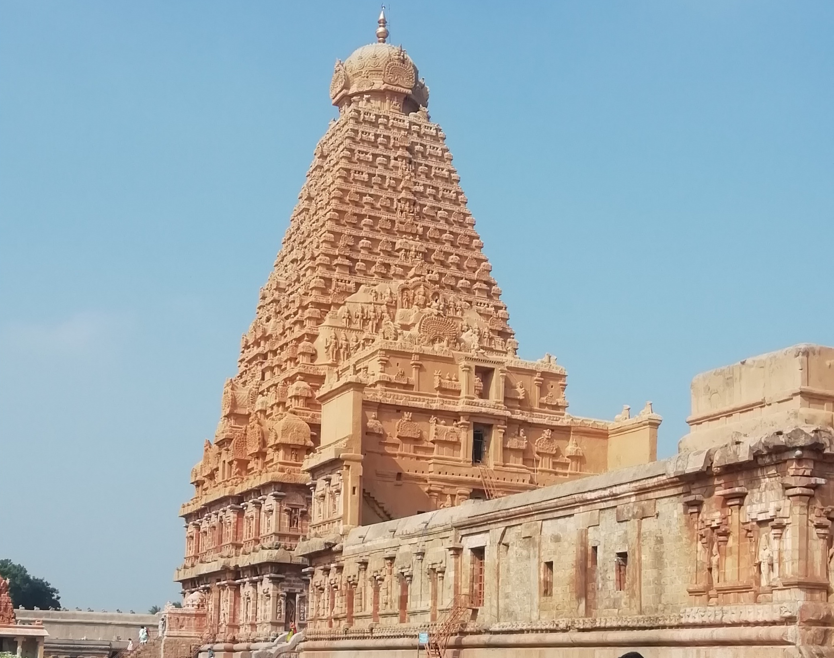
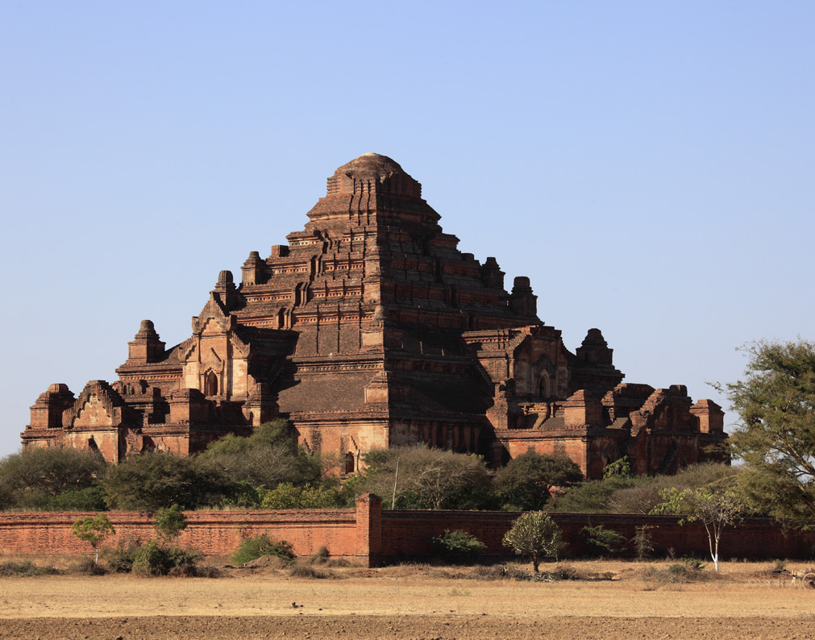
The Yonaguni Monument Underwater
Japan (date unknown)
The Pyramid of Djoser
Egypt (26th century b.C.)
Chola dynasty's great temple in Tamilnadu
India (11th century a.C.)
Niches in El Tajin
Mexico (7th to 13th Century a.C.)
Dhammayangyi temple. Ancient City of Bagan.
Burma (11th century a.C.)

Slide 21
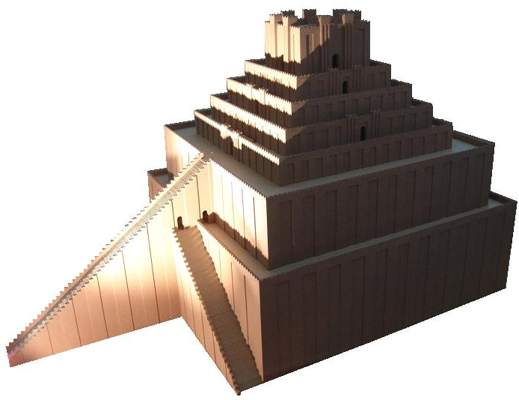
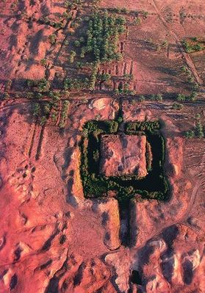
Etemenanki
On the left a drawing of how it was believed to be with 300 ft in height.
Below an aerial view of the site.
The Etemenanki ziggurat,
located 56 miles south of
Bagdad, where was ancient Babylon, is one the candidates to be the “Tower of Babel”. It was build in honor to God Marduk and it is mentioned in the Eluma Elish account. Its date in debated. But most schoolars believe it is from the 27th century b.C. Some defend it was never finished.

Slide 22
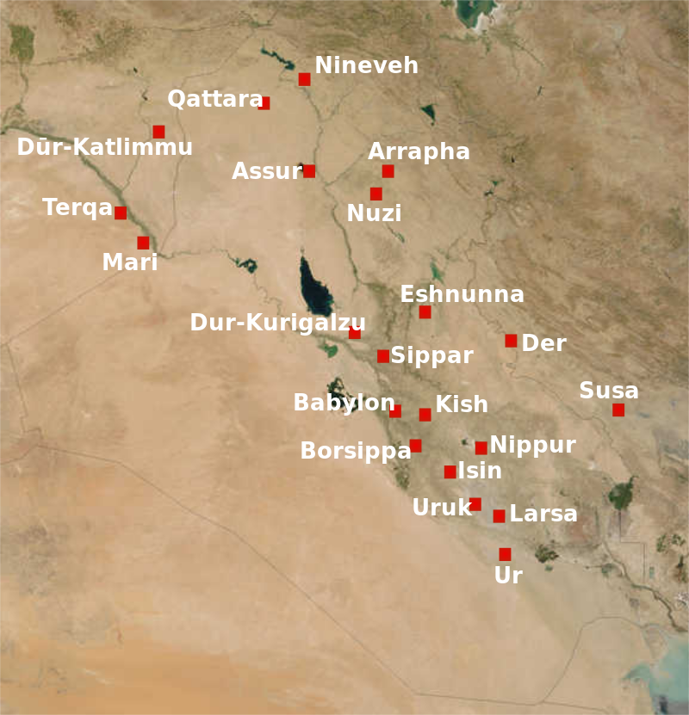
Plains of Shinar
In Genesis, after the flood, the majority of the people settled in the “Plains of Shinar” (Gen 10.10; 11.2; 14.1,9), which is lower Mesopotamia.
Archeology found there some of the most ancient cities on earth and from there is believed a major migration started to the corners of the earth.
Map of the cities of Mesopotamia (now Iraq) in the 2nd millennium BC.
Source: Wikicommons

Slide 23
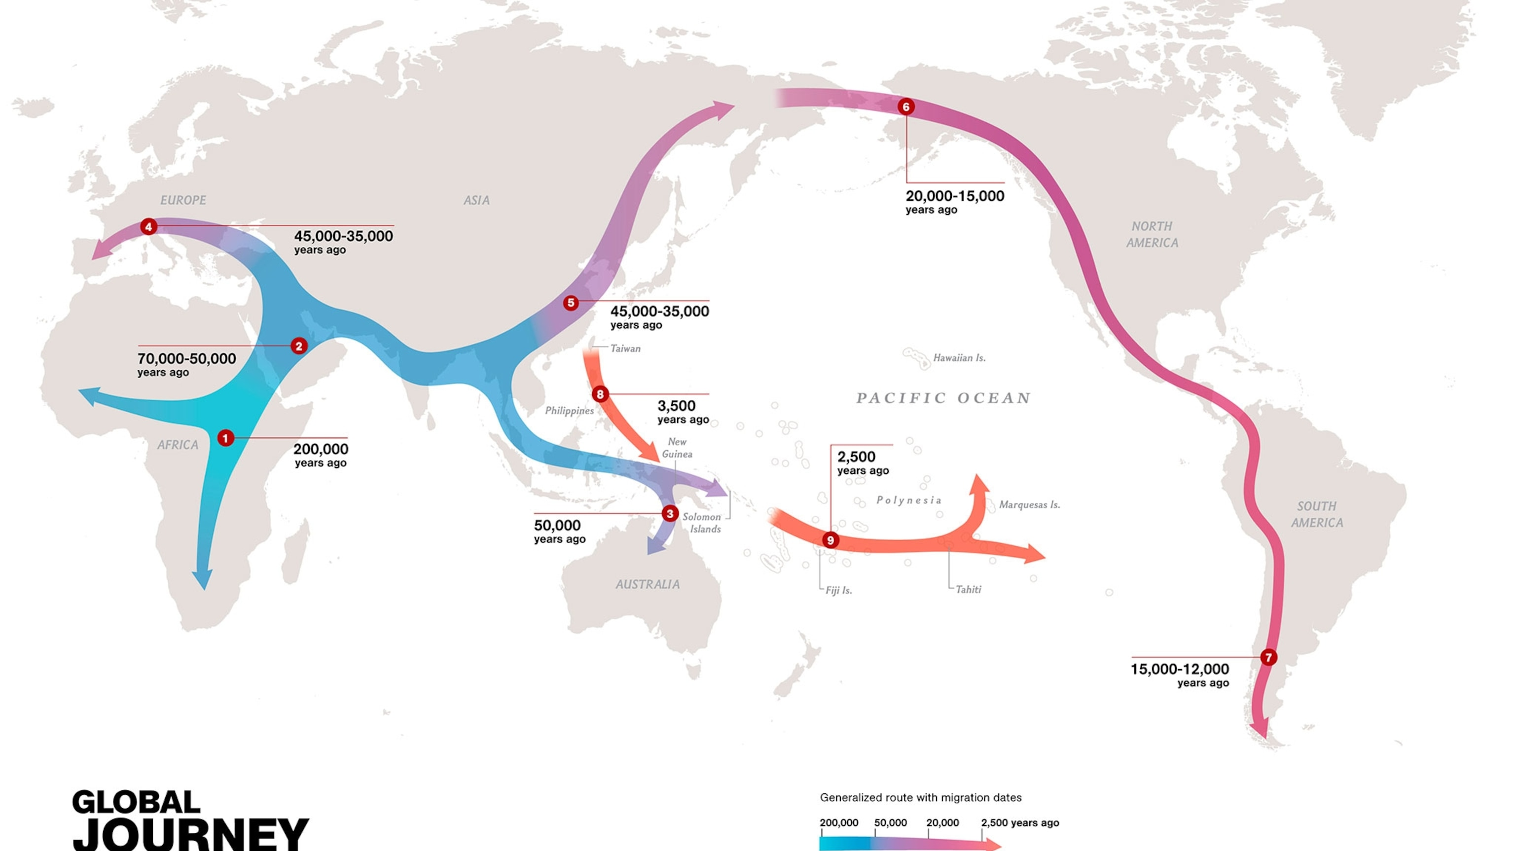
Evidence Points To Mesopotamia This map made by National Geographic® points to the incontestable fact that that civilization was dispersed from Mesopotamia. Source: Migration facts and information (nationalgeographic.com)

Slide 24
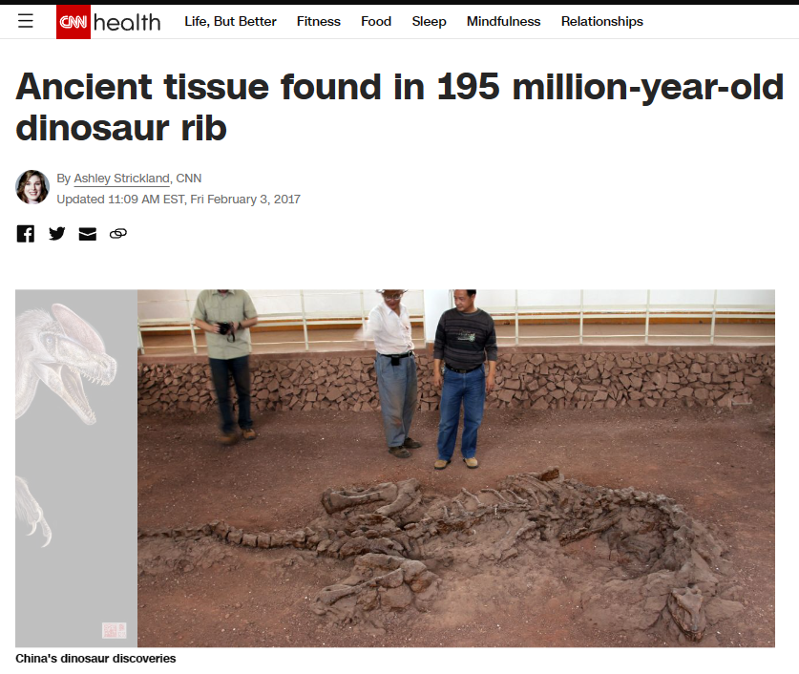
Bonus Info
Some soft tissue (cells, protein, and blood vessels) were seen in a T-rex bone excavated in Montana in 2005 by North Carolina University reserchers. This shook the world of archeology. Later other similar soft tissues were found on dinosaurs bones.

Slide 25
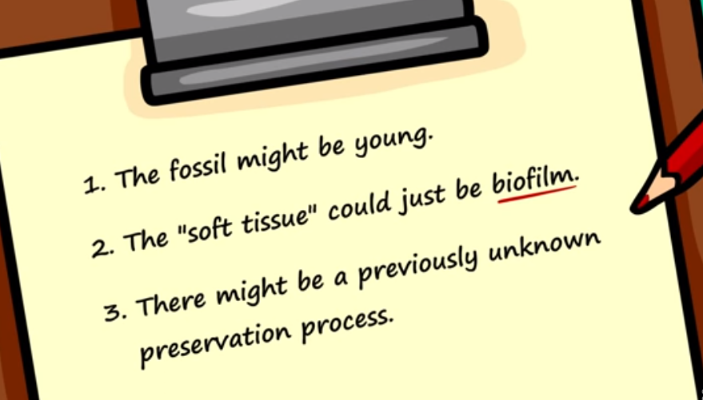
The Theories?

Slide 26
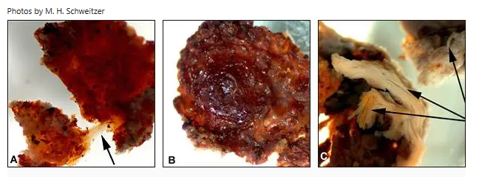
Science?!?!
Paleontologist Dr. Mary Schweitzer concluded initially they were biofilm. But upon being contested and without evidence, a conclusion was reached they were original bone sells. She devised an experiment with femur of an ostrich for 2 years and
concluded the preservation
of cells for those millions of
years is “possible”.

