Slide 1
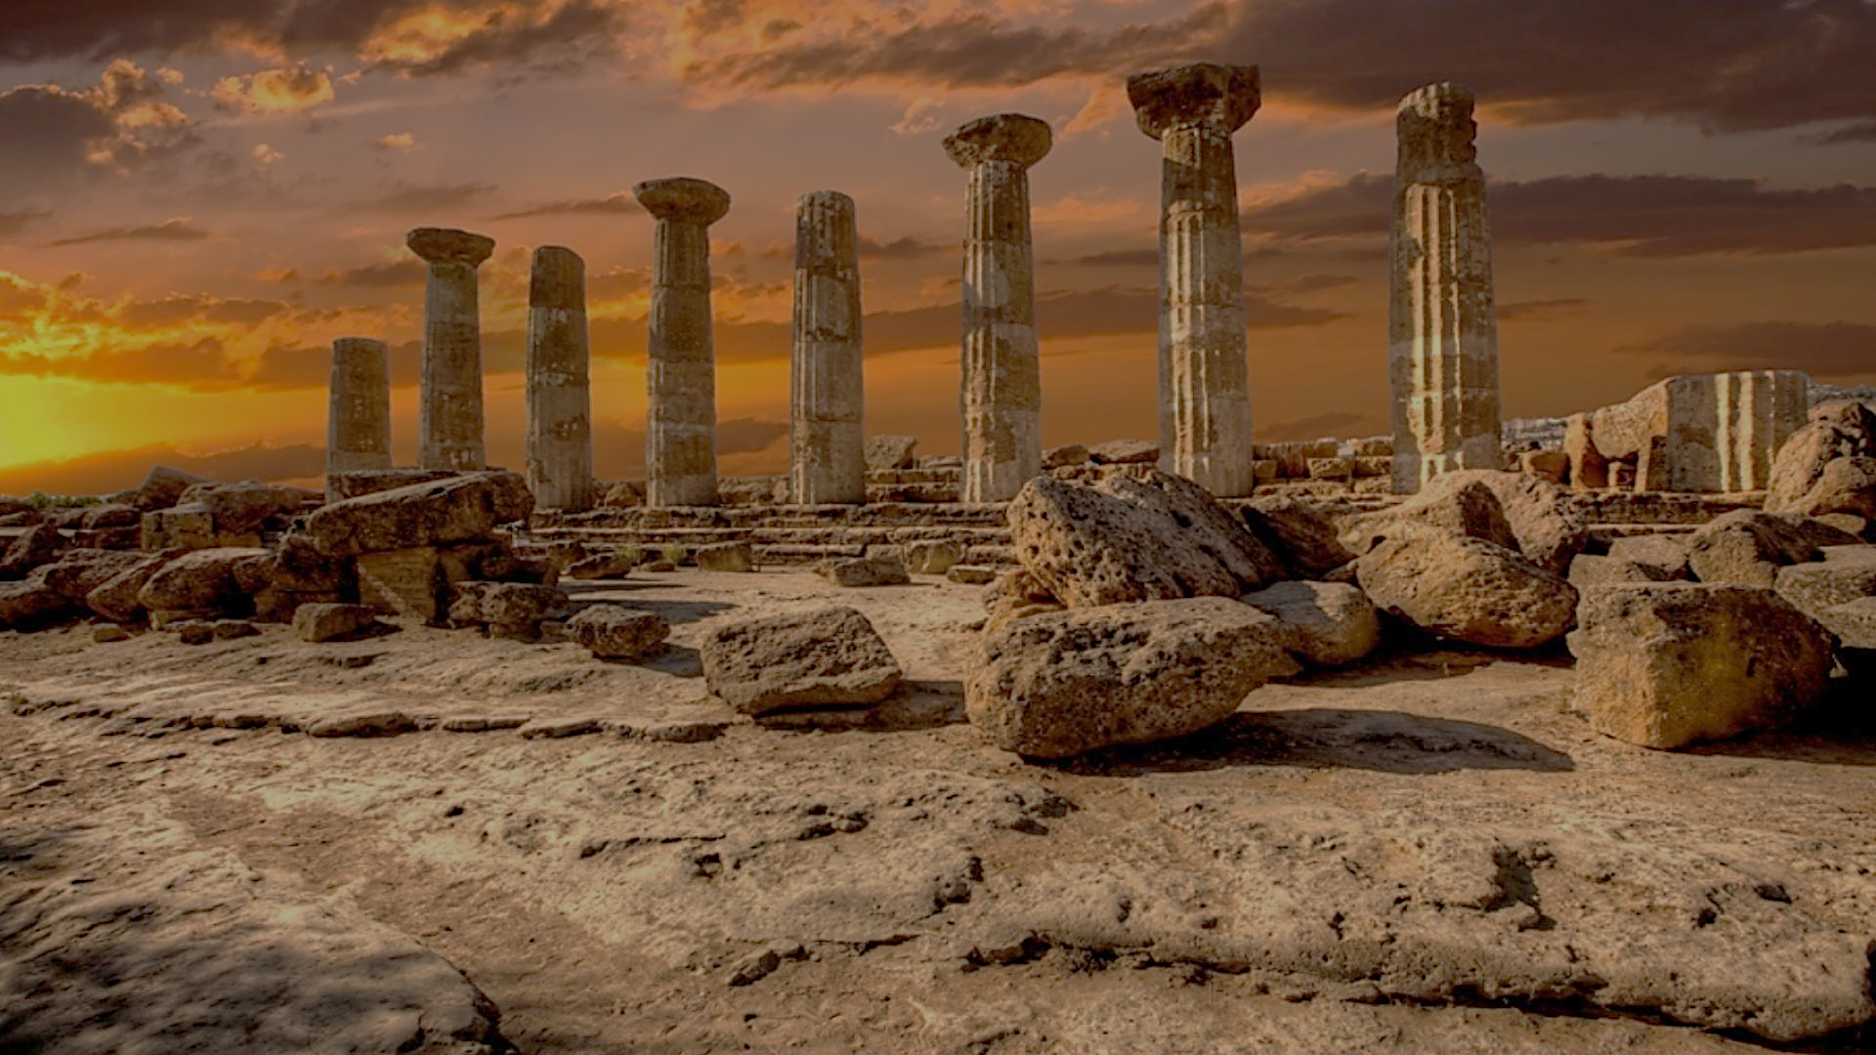
Archeology of Bible Times
Pastor John dos Santos - Faith Presbyterian Church

Slide 2
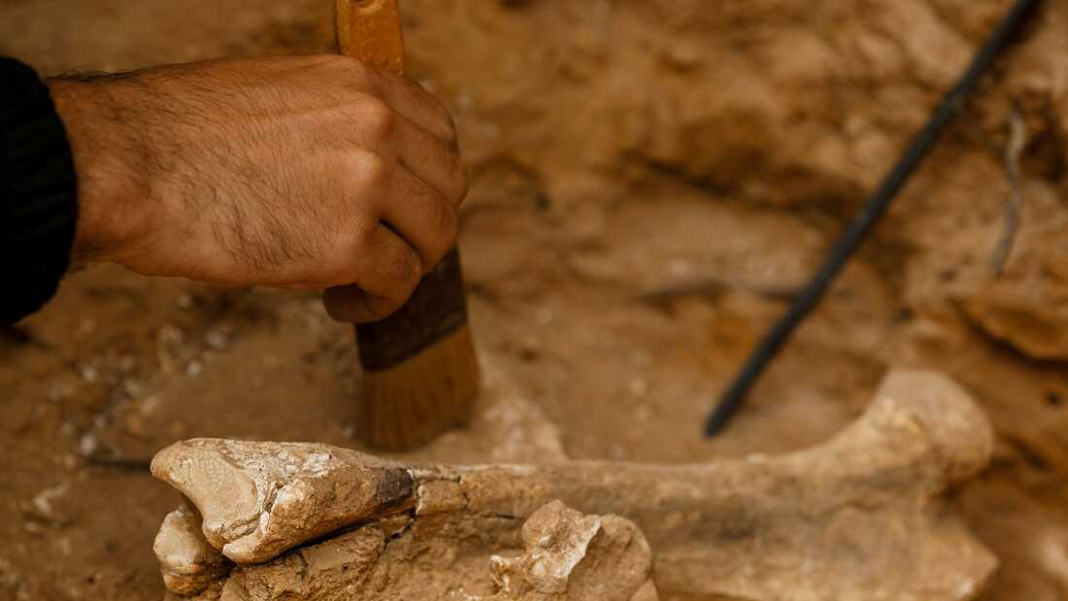
What is Archeology?

Slide 3
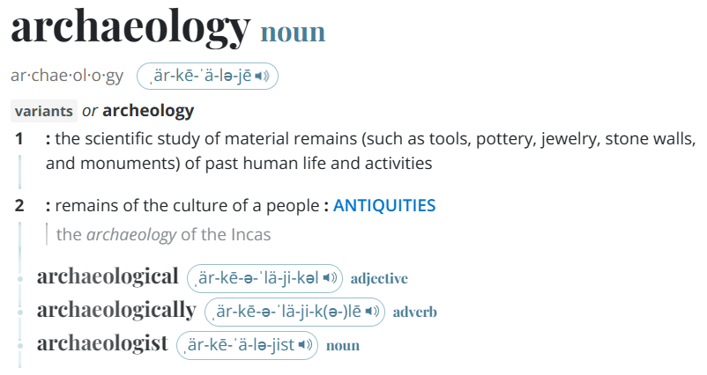
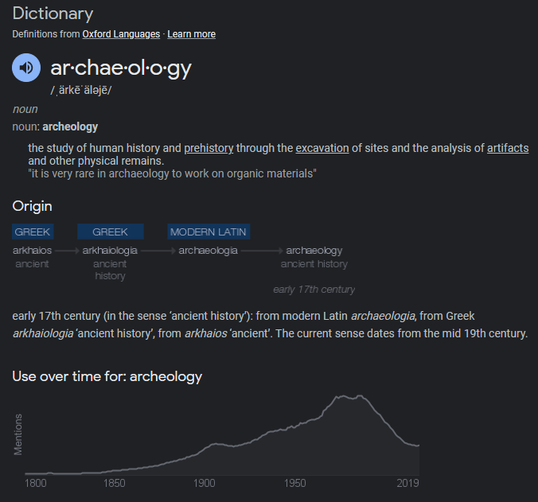
Archaeology is the study of the ancient and recent human past through material remains. Archaeologists might study the million-year-old fossils of our earliest human ancestors in Africa. Or they might study 20th-century buildings in present-day New York City. Archaeology analyzes the physical remains of the past in pursuit of a broad and comprehensive understanding of human culture.
Source: archeology meaning - Google Search

Slide 4
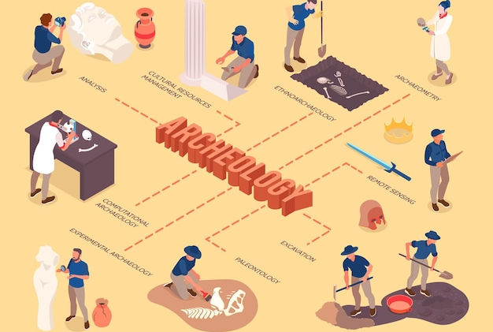
Archeological Method

Slide 5
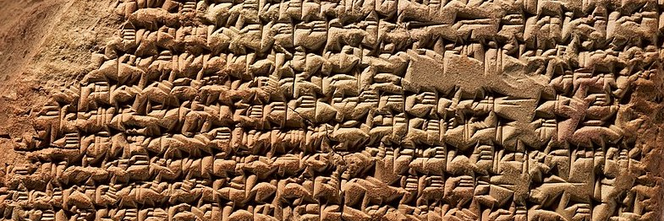
How to date a find?
Chemical Dating
Stratigraphy
Use of literature

Slide 6
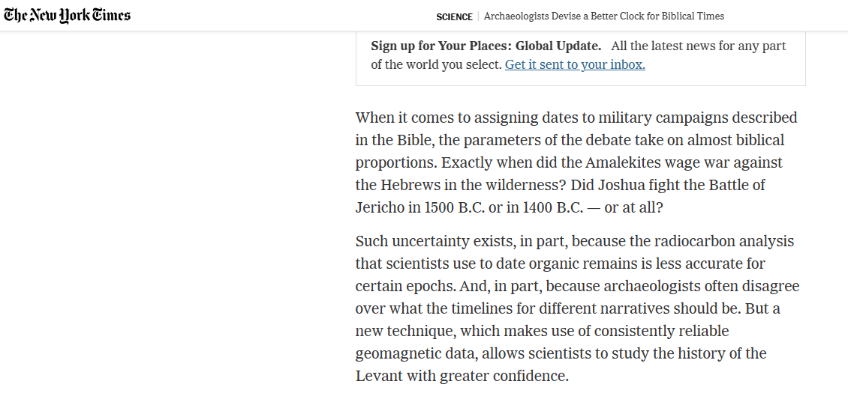
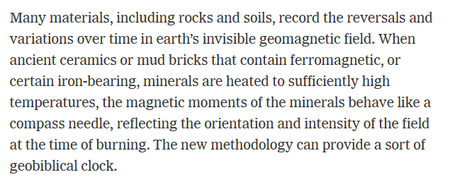
But…
Source: Archaeologists Devise a Better Clock for Biblical Times - The New York Times (nytimes.com)

Slide 7
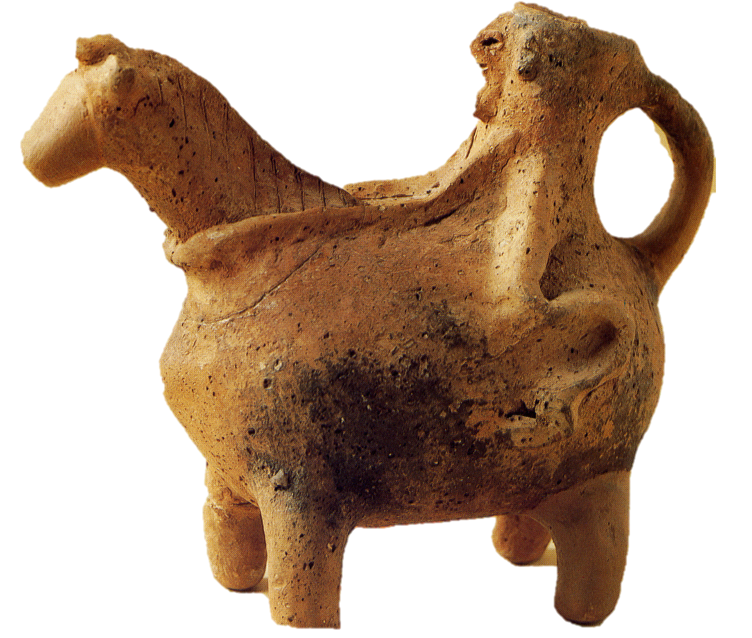
Objective Method!?!?
Assumptions:
Earth Ages
Date of layers
Culture
Events
=
Conclusion about the object and the date

Slide 8
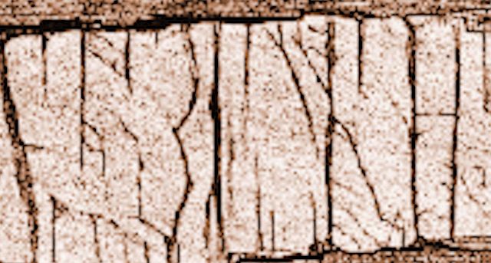
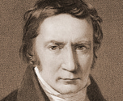
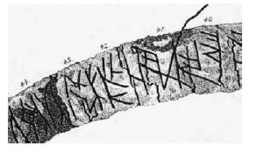
Finnur Magnussún
Runamo
Case
Source: Wikicommons
Jöns Jacob Berzelius

Slide 9
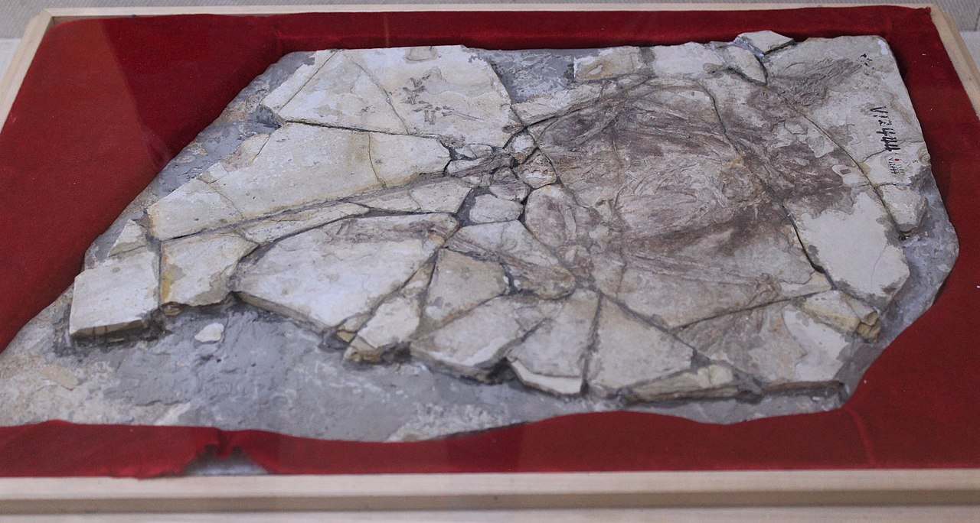
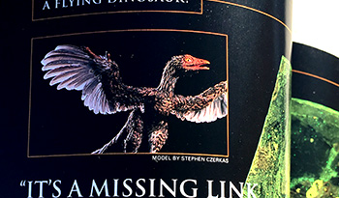
The Piltdown Chicken
Simons, Lewis M. "Report to Members: Archaeoraptor Fossil Trail." National Geographic (October 2000): 128-132.
Sloan, Christopher P. "Feathers for T. rex?" National Geographic (November 1999): 98-107.

Slide 10
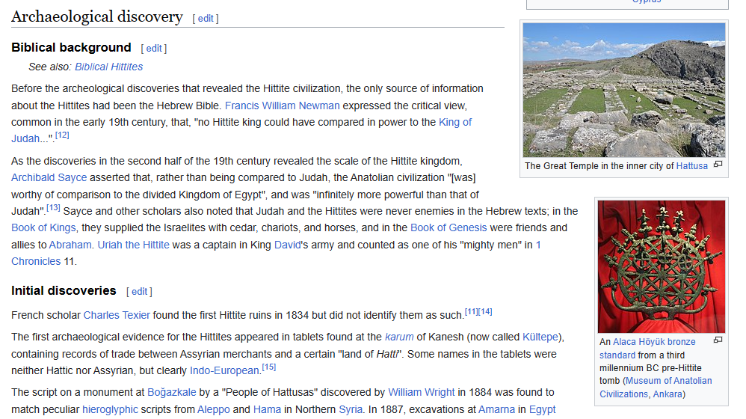
The Hittites

Slide 11
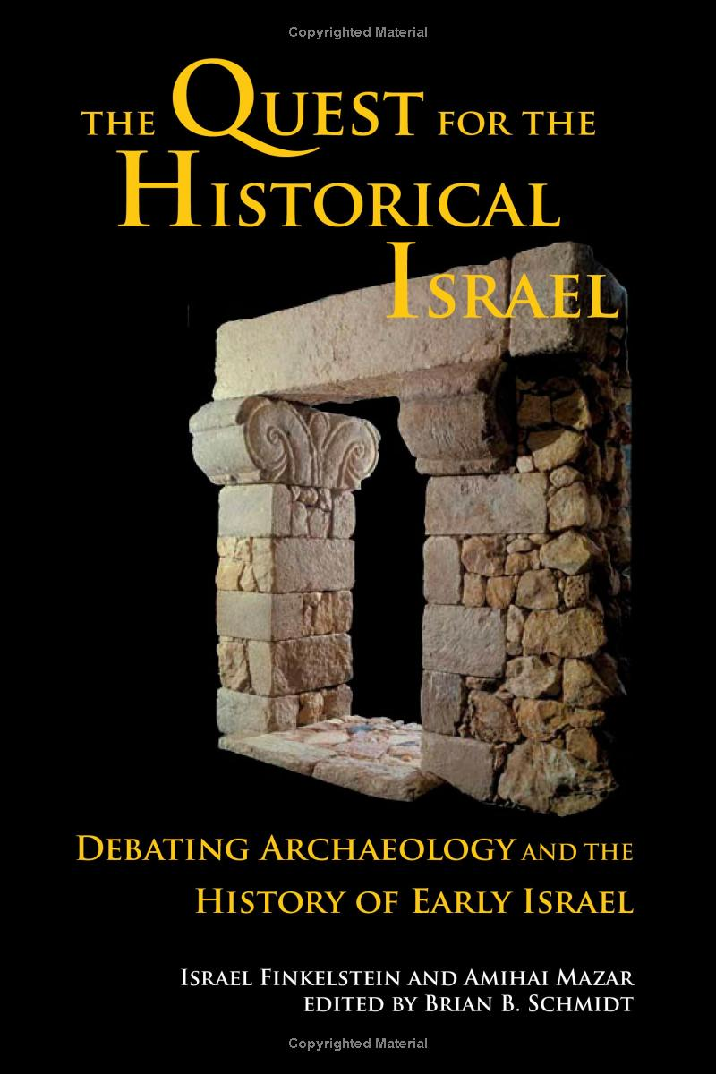
Question Raised About Bible Narrative and Archeological Finds
Some of the places mentioned in the Bible did not exist.
Some places are named with more recent names than they had during the time of the events narrated in the Bible.
Some people mentioned did not exist during the time they are mentioned in the text of the Bible.
Some people were not living where they were mentioned at that particular time in the bible narrative.
Some routes were not used during the time they are attributed in the narrative
Some costumes, like foods, use of animals, certain tools, or labor practices, were not current during the time they were described in the Bible.
Notes:
For instance, the use of camels during the time of Joseph. Finkelstein claims camels were not domesticated until the late bronze age. For him, this implies a later writer narrating the patriarch’s history according to his own culture and world. Doesn’t that defeat the purpose itself of the text? If this writer is supposedly telling his readers history why would he introduce “un-factual” elements to weaken the factual authority of his account?

Slide 12
Scripture information is the “premise” from which we start!

Slide 13
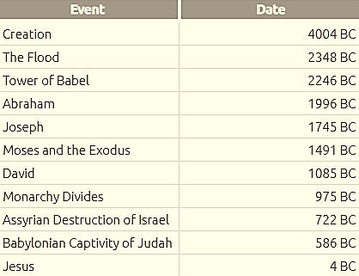
The Question of Bible Chronology
Answers in Genesis Chronology

Slide 14
Source: Pin on HE>i (pinterest.com)

Slide 15
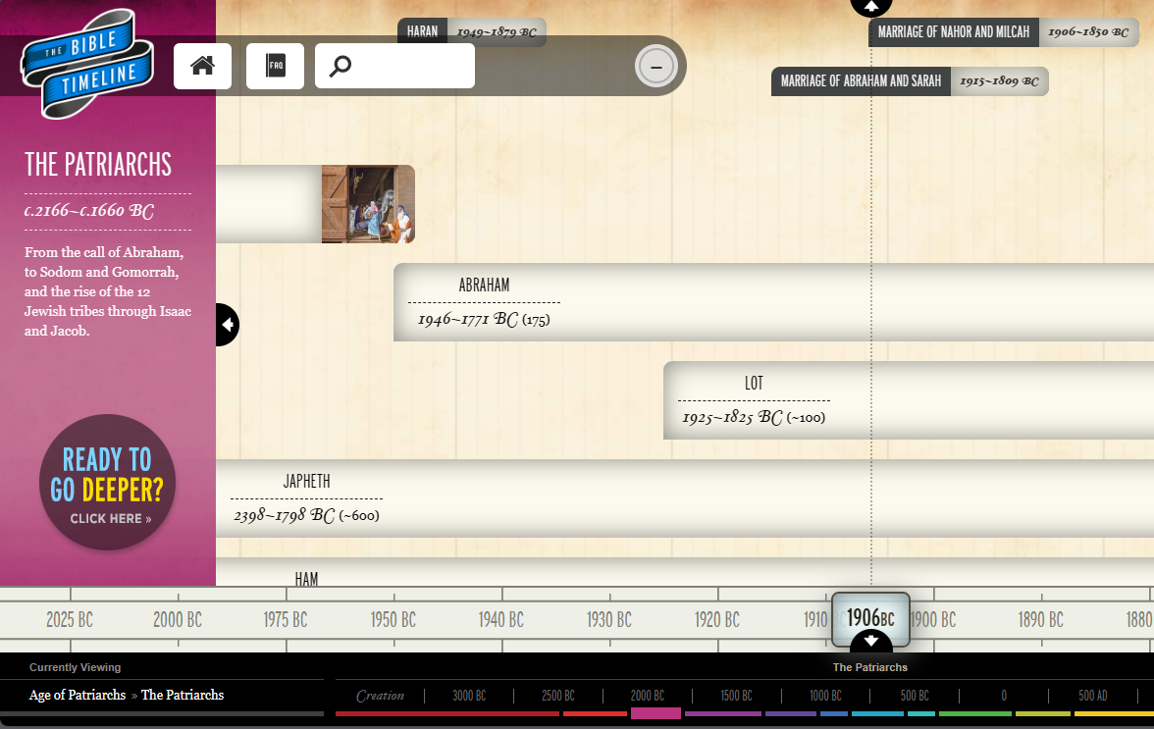

Slide 16
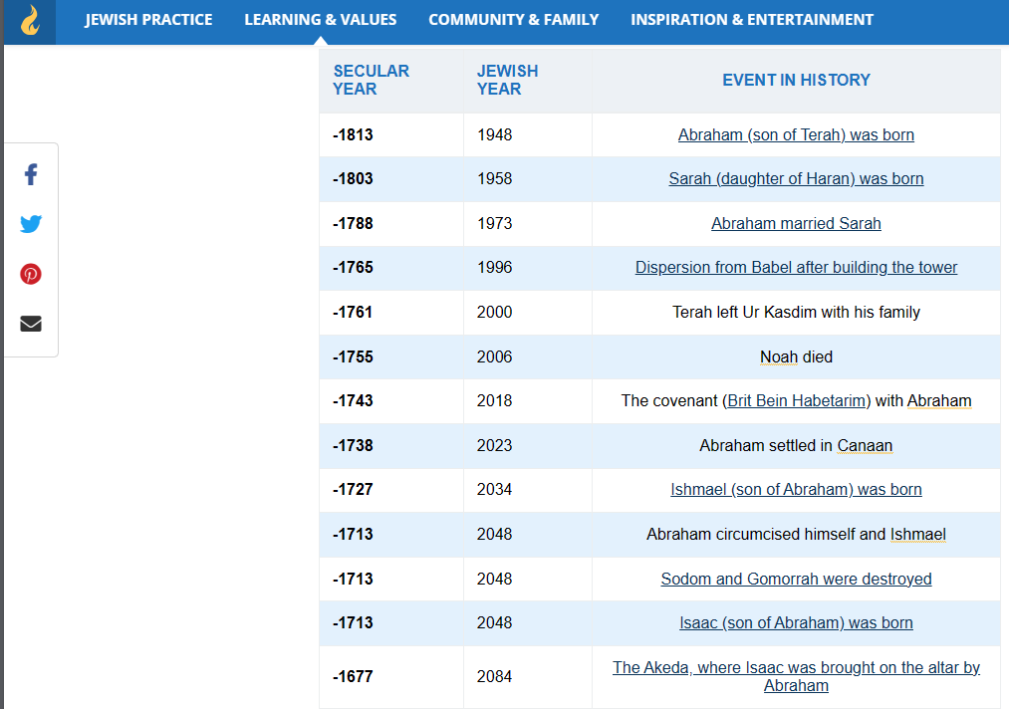

Slide 17
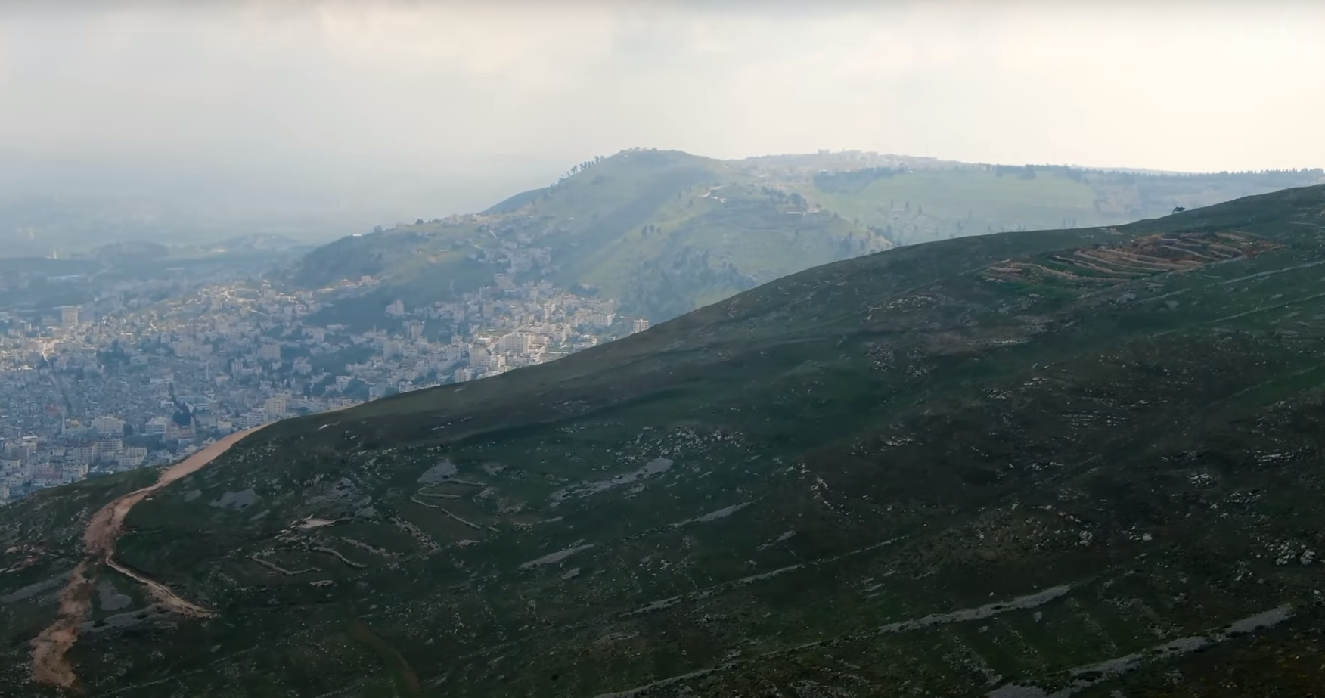
Joshua’s Altar: Mount Ebal

Slide 18
Renewal of the Covenant
Joshua 9.30-35 records a ceremony of renewal of the Covenant done after the conquests of Jericho and Ai. Sacrifice was offered on an altar of “uncut stones” on Mount Ebal, the Mount of Curse, opposite to Mount Gerizim, the Mount of Blessing. The people divide stayed on both sides while the ark passed in the middle.
Source: Mount Ebal: The Importance of Mountains in the Bible - GANTS HILL URC

Slide 19
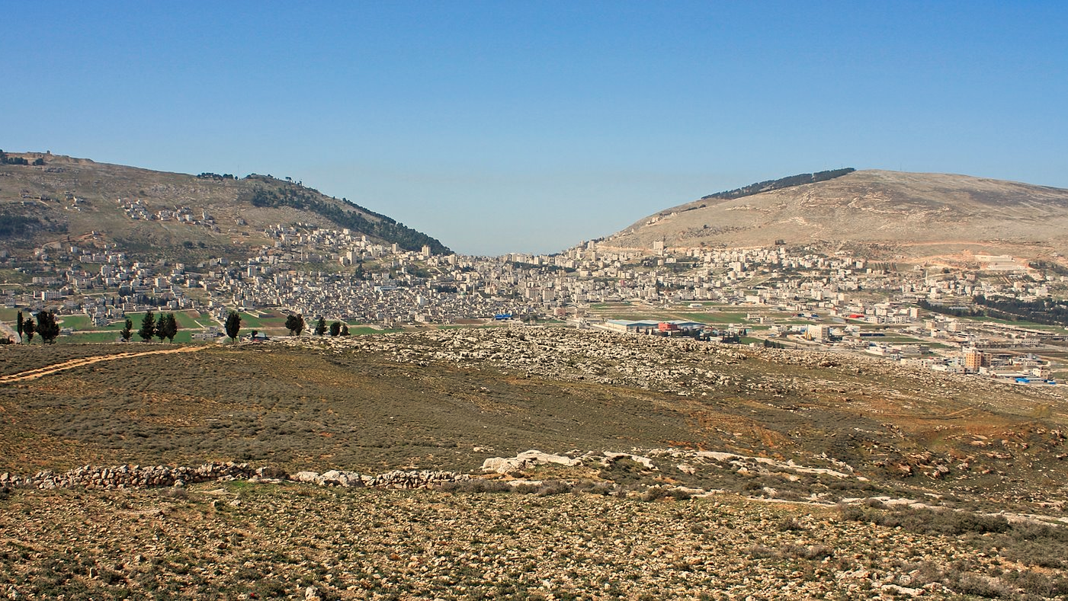
Mt. Gerizim
blessing
Mt. Ebal
curse
Shechem
Source: Mount Gerizim and Mount Ebal | Страница Диксы Игоря (igordiksa.com)

Slide 20
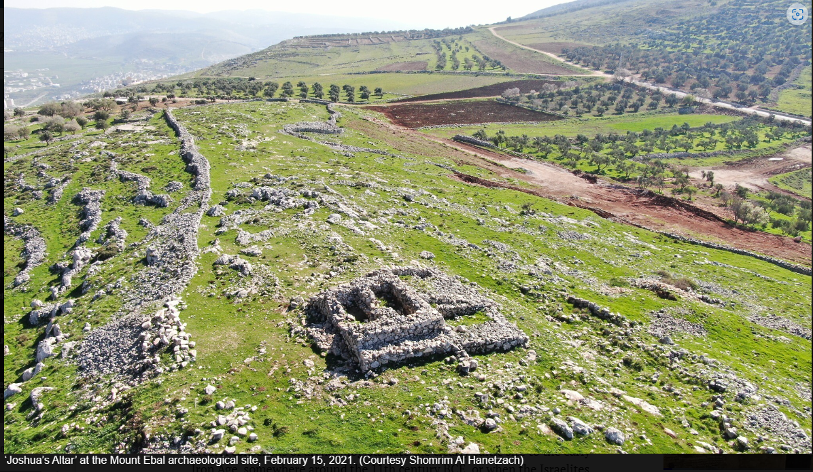
The site was dug and researched by Prof. Adam Zertal from 1982-89, who concluded it was “Joshua’s altar” from the 13th century b.C.
Academic article on controversial 3,200-year-old 'curse tablet' fails to sway experts | The Times of Israel

Slide 21
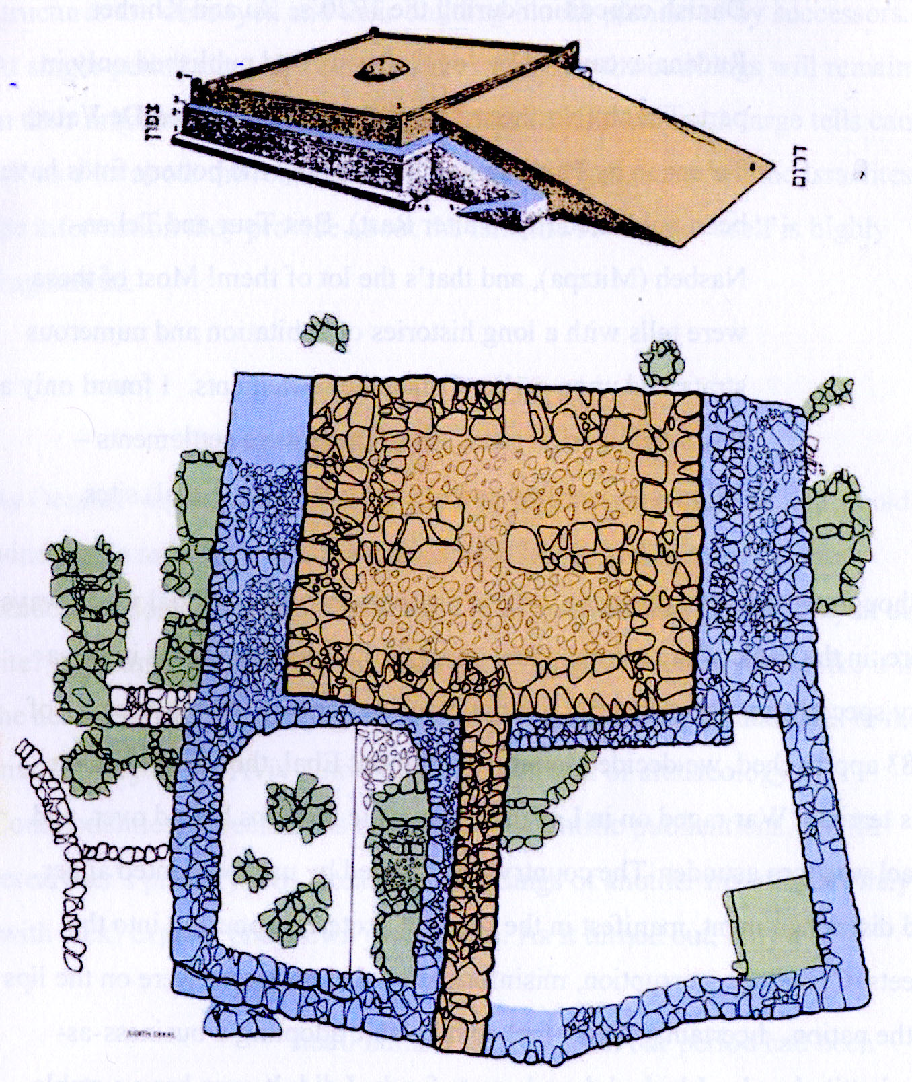
Source: Diagram-of-Altar.jpg (1356×1608) (setapartpeople.com)

Slide 22
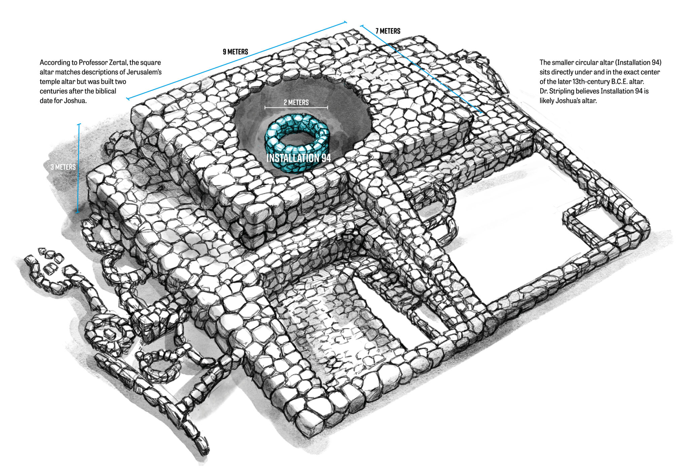
Source: Joshua's Altar | ArmstrongInstitute.org

Slide 23
Against this finding, Israel Finkenstein said: “It is clear that the description of the construction of the Mount Ebal altar by Joshua reflects a later reality—and historically it is difficult to accept that there was a central worship site of the early Israelites at such an early date as Zertal suggested.”
Source: Wikipedia apud "הארכאולוגיה של תקופת ההתנחלות והשופטים", ת"א 1986. עמ' 79

Slide 24
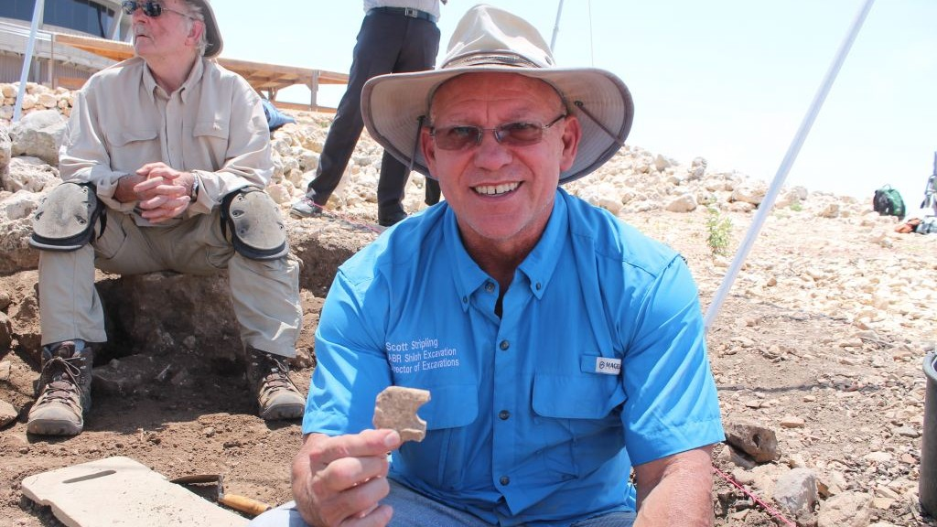
Dr. Scott Stripling, head of the current excavation at biblical Shiloh, exhibits a find. May 22, 2017. (Amanda Borschel-Dan/Times of Israel)

Slide 25
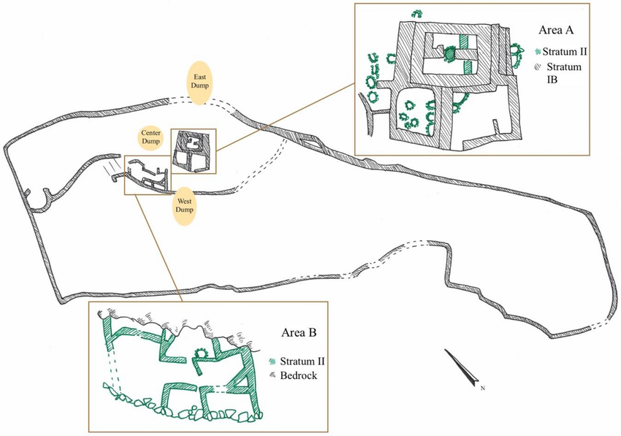
The foot-shaped enclosures and archaeological remains at el-Burnat (A).... | Download Scientific Diagram (researchgate.net)

Slide 26
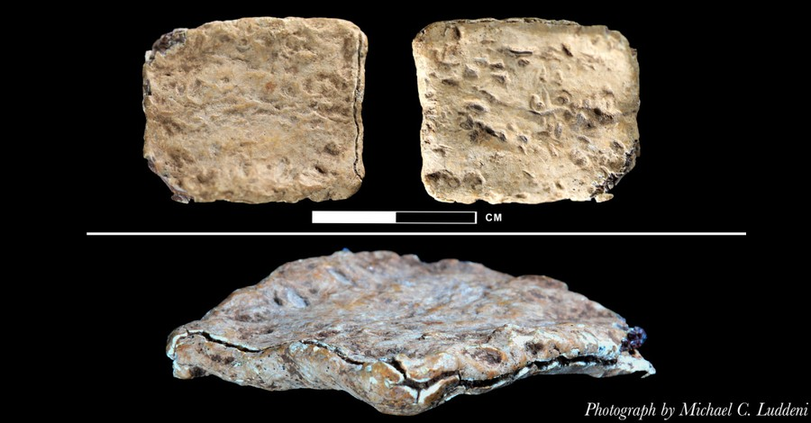
“Curse” Tablet
3,000-Year-Old Tablet with God's Name Affirms Biblical Timeline, Archaeologist Says - Michael Foust (christianheadlines.com)

Slide 27
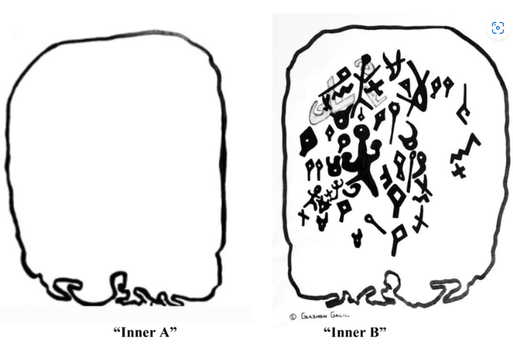
Source: Object structure. Drawings by Gershon Galil | Download Scientific Diagram (researchgate.net)

Slide 28
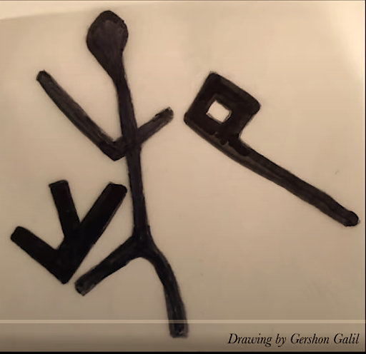
“YHW” Inscription
3,000-Year-Old Tablet with God's Name Affirms Biblical Timeline, Archaeologist Says - Michael Foust (christianheadlines.com)

Slide 29
“YHW” Inscription
3,000-Year-Old Tablet with God's Name Affirms Biblical Timeline, Archaeologist Says - Michael Foust (christianheadlines.com)

Slide 30
Source: Academic article on controversial 3,200-year-old 'curse tablet' fails to sway experts | The Times of Israel

