Slide 1
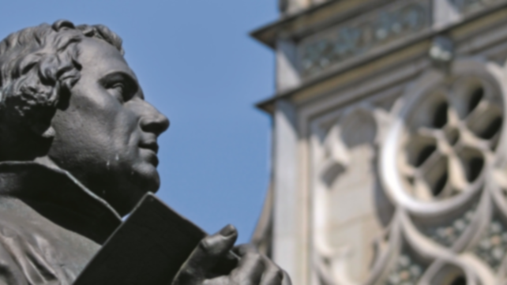
Protestant Reformation
Lecture 3:
Reformed Movement
https://www.visit-luther.com/reformation-heroes/

Slide 2
Reformation Hymn
Notes:
2

Slide 3
We will trust God’s Word alone,
Where his perfect will is known;
Our traditions shift like sand
While his Truth forever stands.
We will live by faith alone,
Clothed in merit not our own;
All we claim is Jesus Christ
And his finished sacrifice.

Slide 4
Glory be, glory be to God alone,
Through the church he redeemed and made his own.
He has freed us, he will keep us till we’re safely home
Glory be, glory be to God alone!

Slide 5
We are saved by grace alone—
Undeserved, yet freely shown;
No accomplishment on earth
Can achieve the second birth.
We will stand on Christ alone,
The unyielding Cornerstone;
Nations rage and devils roar,
Still he reigns forevermore!

Slide 6
Glory be, glory be to God alone,
Through the church he redeemed and made his own.
He has freed us, he will keep us till we’re safely home
Glory be, glory be to God alone!

Slide 7
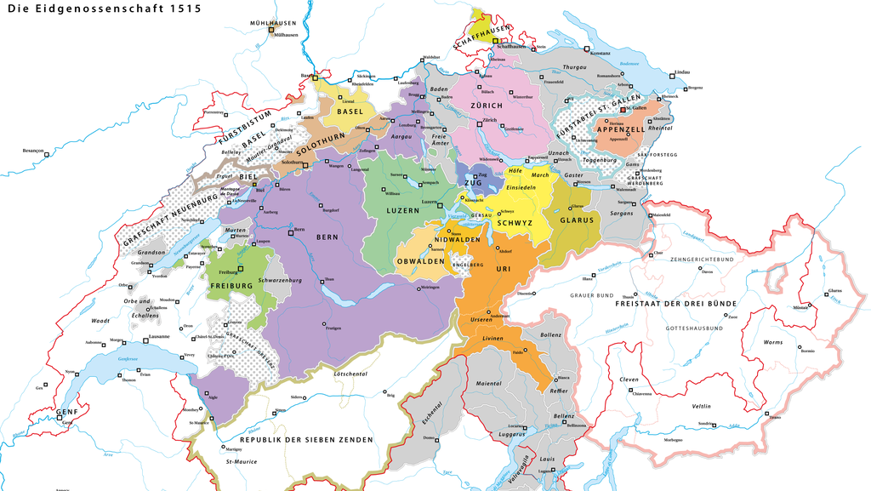
13 Cantons formed the Swiss Federation in 1515

Slide 8
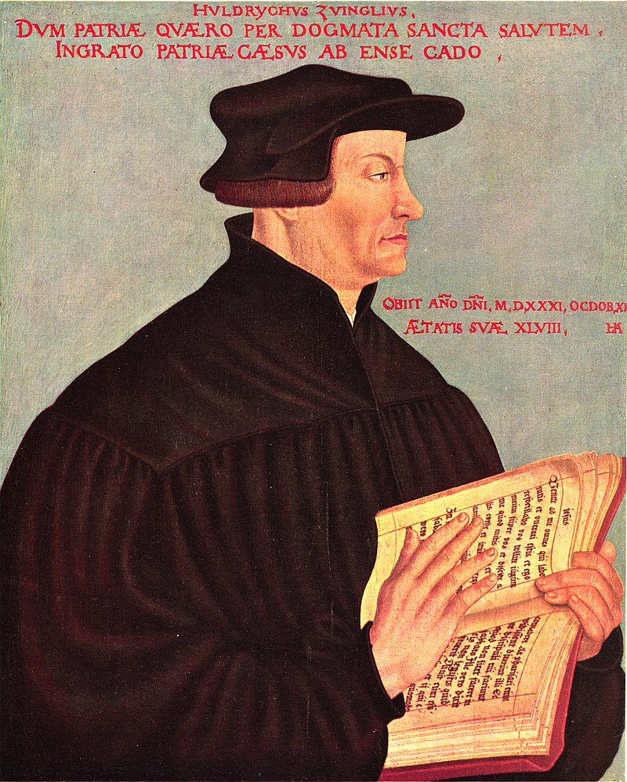
Ulrich Zwingli
Zwingli became a priest in Zurich in 1519 and started from the get-go, preaching a reformist message. The city council finally voted to break with the Roman Church in 1524. This created a Civil War in the Swiss federation.
Ulrich Zwingli (1549)
Hans Asper
Source: wikicommons

Slide 9
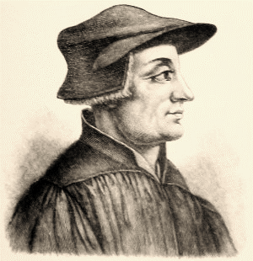
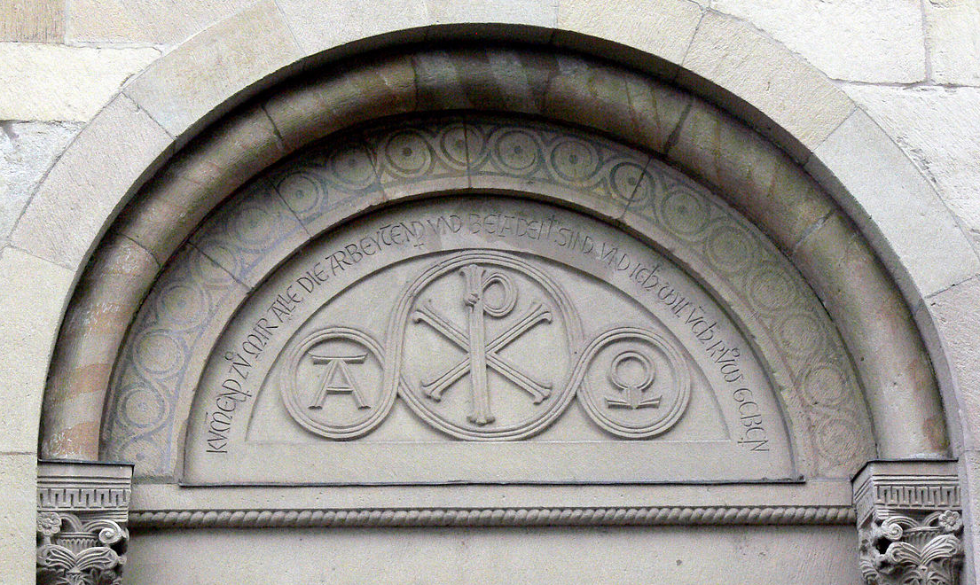
Zwingli always denied being influenced by Luther. In fact, he did not agree with Luther in many aspects. He believed Luther did not promote a reformation as far as necessary. Zwingli was known for his strong leadership and radical positions.
A rendition of Huldrych Zwingli from the 1906 edition of the Meyers Konversations-Lexikon
Entrance of the Grossmünster Church. Mathew 11:28

Slide 10
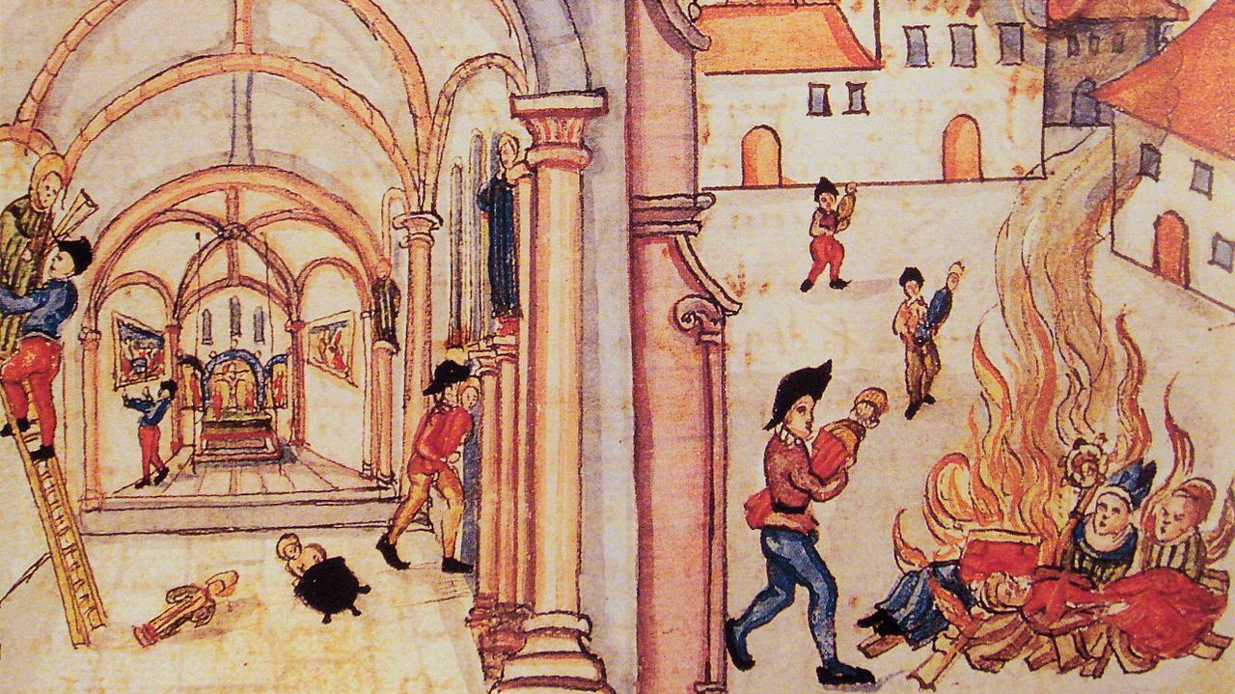
Reformist fervor in Zurich
Source: wikicommons

Slide 11
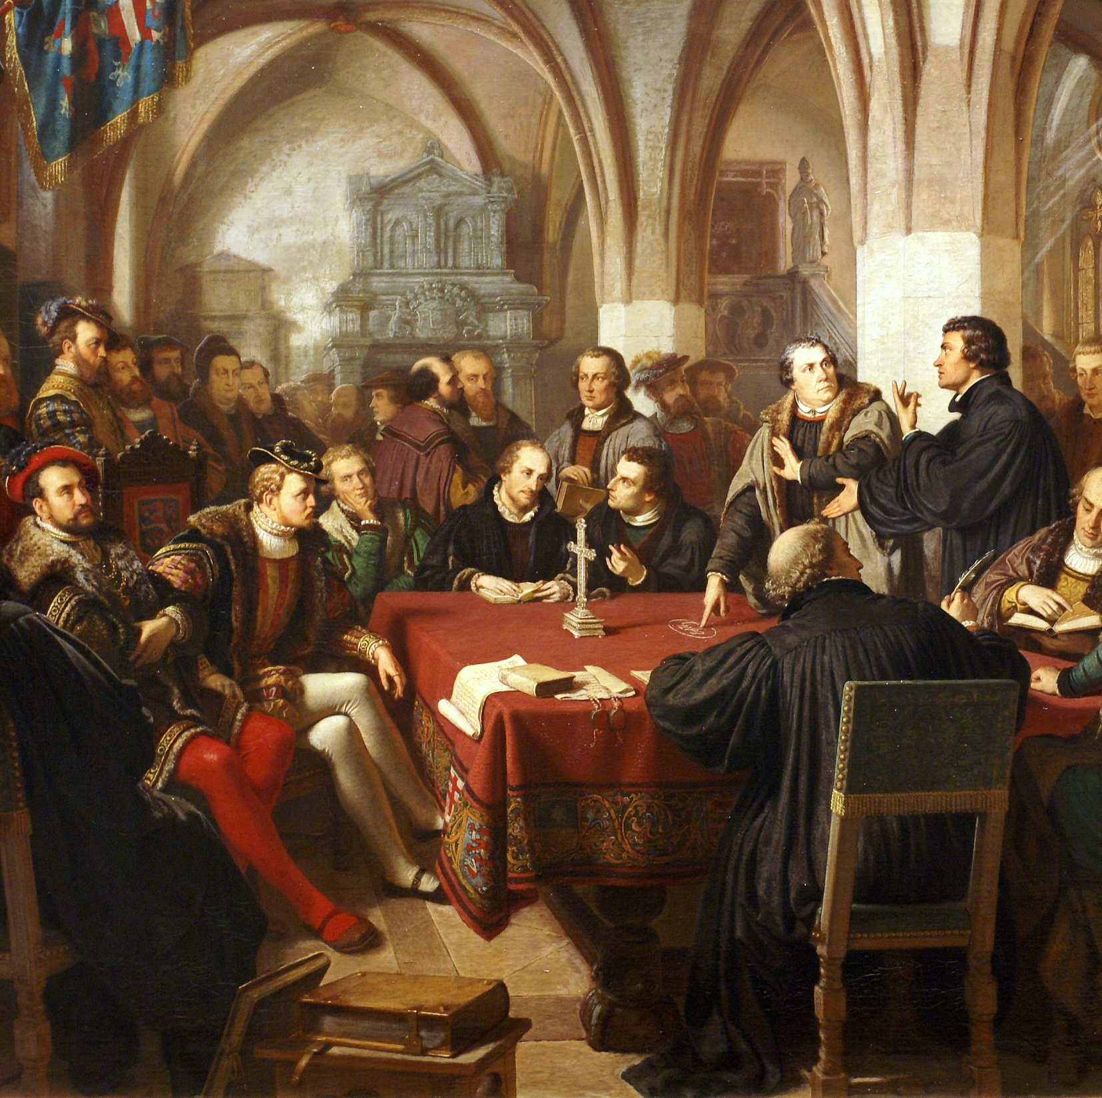
Marburg Colloquy (1529)
The Lutheran movement in Germany and the Zwinglian movement in Switzerland had a common enemy. Taking that into account, they tried to find a common group for unity and mutual support. A colloquy was convened in the city of Marburg to achieve this agreement. But it never did. Their positions were irreconcilable.
Marburg Colloquy (1867)
Christian Karl Noack (1822-1905)
Oil painting
Source: wikicommons

Slide 12
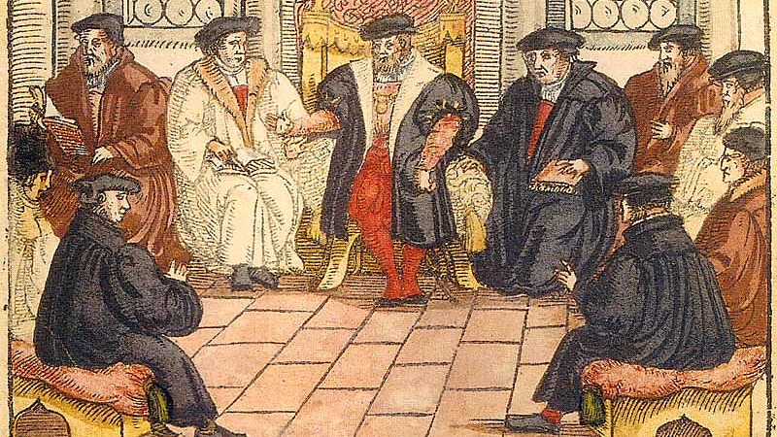
Marburg Colloquy (1557)
Anonymous – Woodcut
Source: wikicommons

Slide 13
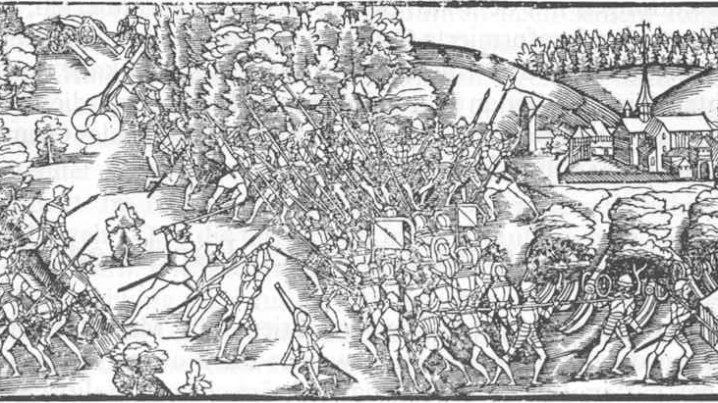
Battle of Kapel in 1531 when Zwingli died.
Source: wikicommons

Slide 14
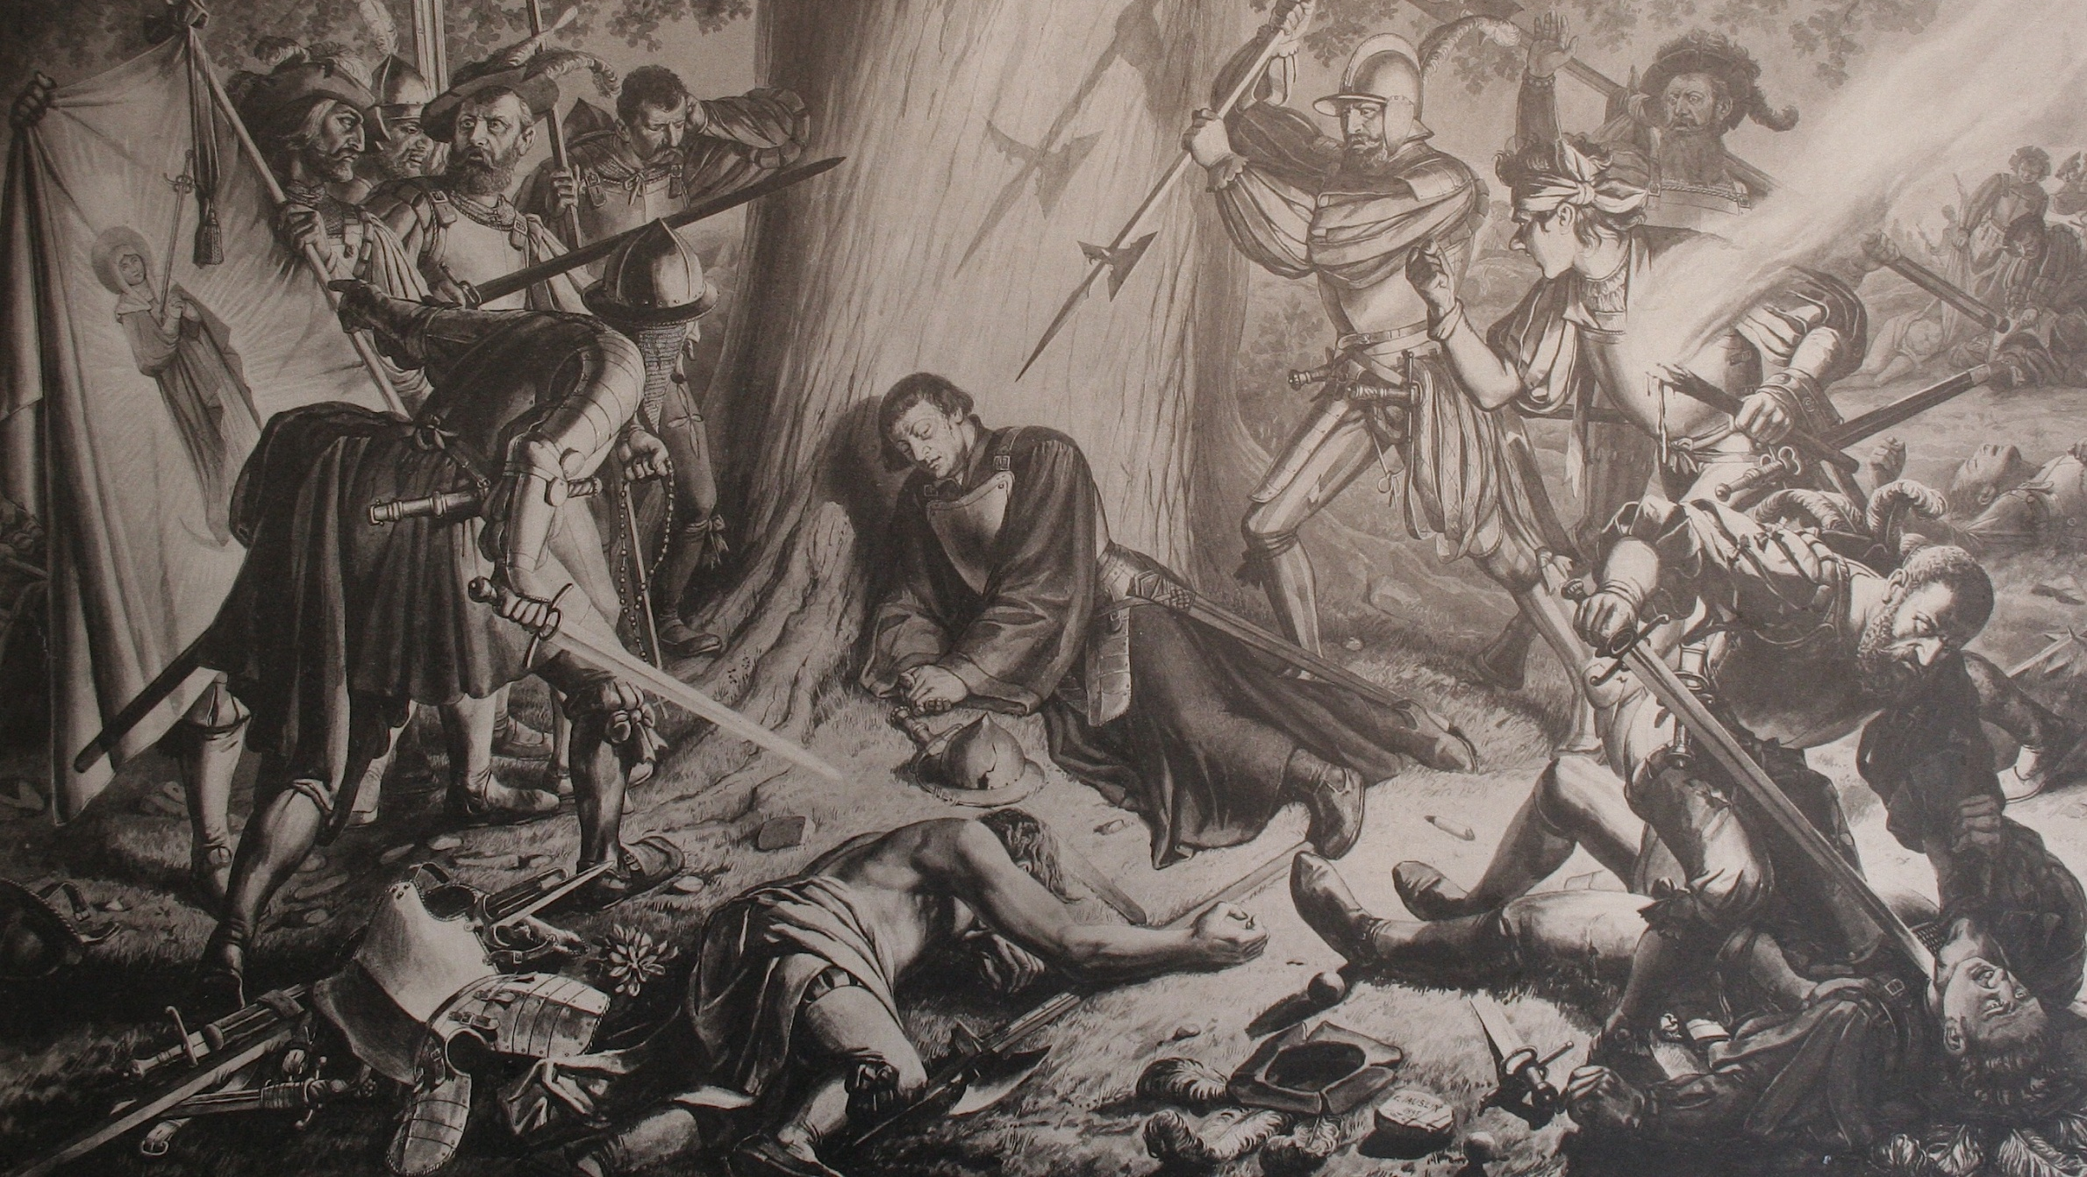
The Death of Zwingli
Karl Jauslin (1842-1904)
Source: wikicmmons

Slide 15
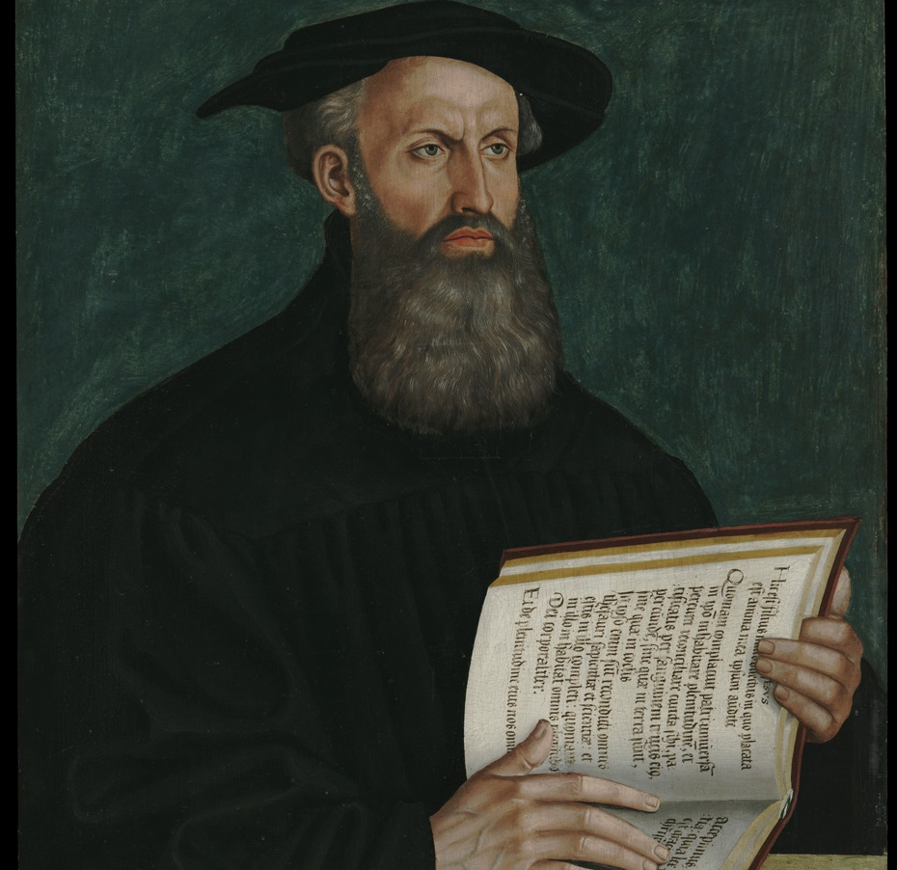
Bullinger
Zwingli’s death was a great defeat. He was replaced in the pulpit of Grossmünster by Henry Bullinger (1504-1575). He was an eloquent preacher and qualified theologian but lack the leadership power of Zwingli.
Portrait of Bullinger
Hans Asper (1550)
Painting
Source: wikicommons

Slide 16
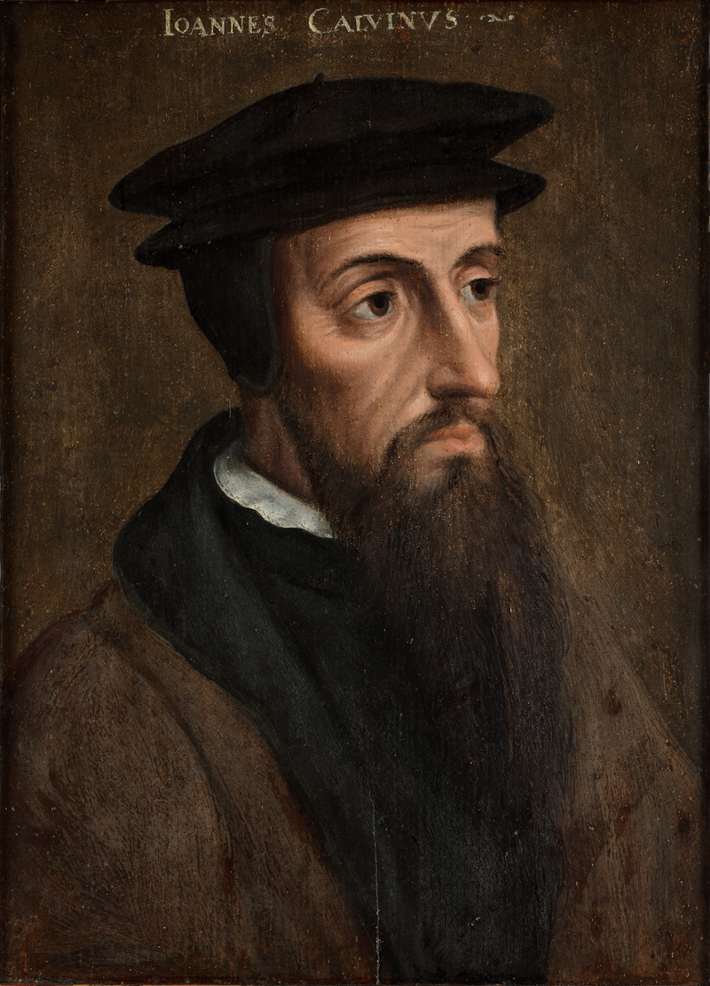
On is way to Basel Calvin sleeps in Geneva for one night

Slide 17
Institutes
Up to this point in time John Calvin was not very well known. We don’t even know for sure when his conversion happened. But in 1535, he published a book of Reformed Theology called “Institutes of Christian Religion” which became a best seller.

Slide 18
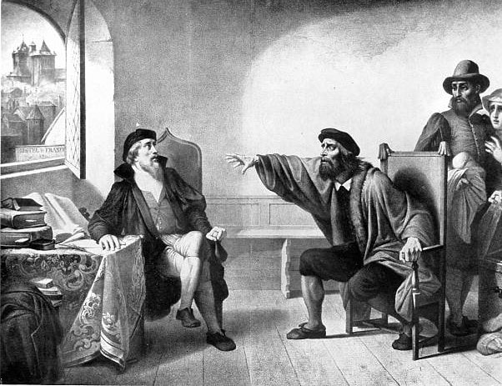
The Appeal of Farrel
A preacher who was trying to cause the religious reformation in Geneva, Guilhem Farrel (1489-1565), on learning John Calvin was in town, appeals rather strongly for his help. He curses Calvin’s plans if he turns his back on God’s work.

Slide 19
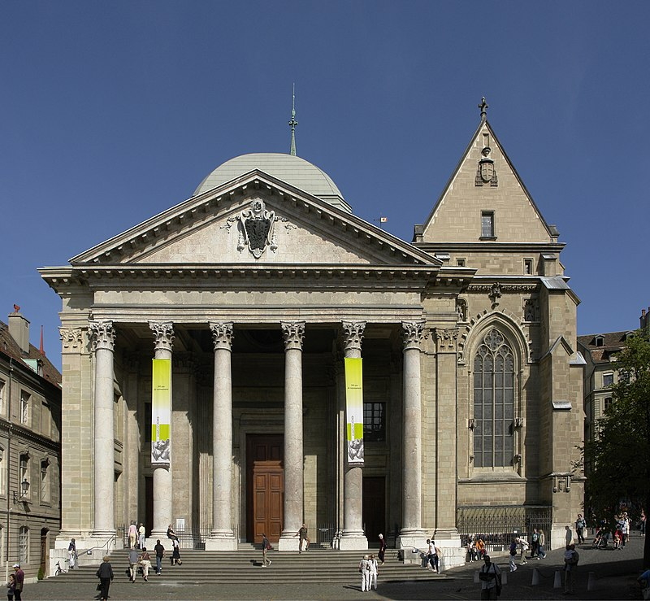
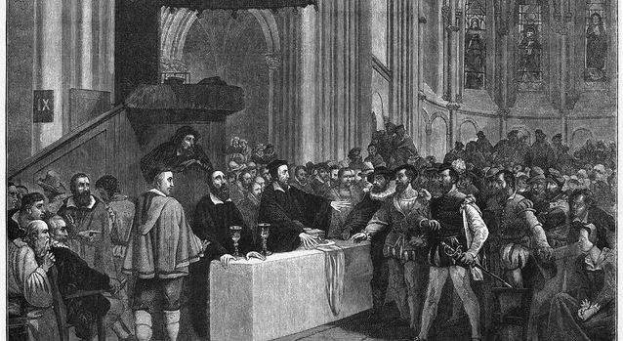
Calvin Stays!
Cathedral of Saint Pierre, Geneva
Source: wikicommons
Calvin refuses the Lord’s Supper to Libertines
Source: wikicommons
Calvin decides to stay and is hired as “reader” and later in 1537 becomes pastor of Geveva. Aided by Farrel he starts to work of the religious reformation of Geneva, which had voted to oust catholicism earlier in 1536.

Slide 20
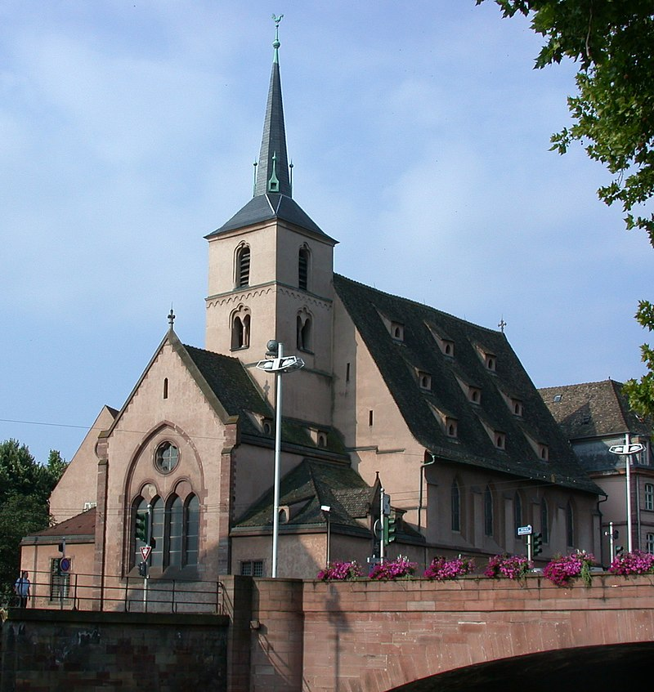
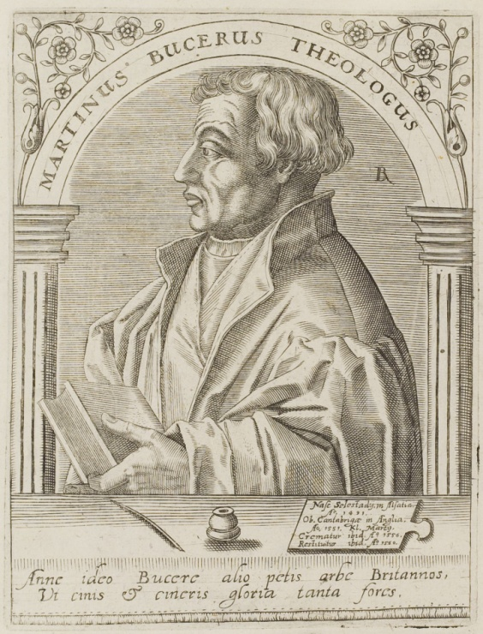
Exile in 1538-1541
Calvin faced strong opposition in his first years in Geneva. In fact, he was expelled from the city in 1538 and finally went to Basel. After three years Geneva called him back. Calvin decided to return, now married, to assume the position of main pastor of Geneva.
Martin Bucer (1560)
Jean Jacques Boissard (1528-1602)
Source: wikicommons
Saint-Nicolas Church, Strasbourg
Source: wikicommons

Slide 21
Idelette Calvin
Calvin married in August of 1540 a French widow exiled in Basel. He describes his marriage years as the happiest days of his life. After a lengthy illness, Idelette died in 1549.
Portrait d'Idelette de Bure, Calvin’s wife (1909)
Reproduction of Xavier Wurth (1869-1933) from the original from Lucas Cranach l'Ancien (1472-1553)
Source: Wikicommons

Slide 22
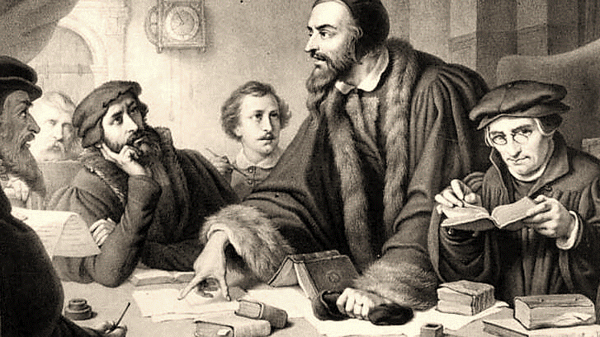
Leadership of Geneva
Gradually Geneva is influenced by Calvin’s preaching and teaching. It becomes a center for exiles from all over Europe. The city grows and assumes the leading position of the Reformed movement. Calvin works directly on the reformation of morals and the creation of schools.

Slide 23
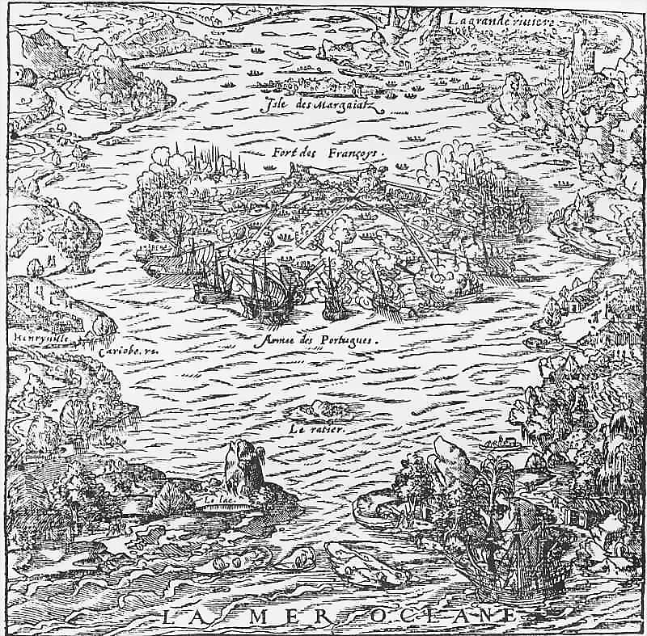
Center for Missions
Upon consolidating the reformation in Geneva, Calvin expands his horizon to help the church throughout Europe and establishment of a new reformed settlement in the new world. Calvin also continued to edit and expand his Institutes. The final 5th version was published in 1559.
Island of Villegaignon under Portuguese Atack 1560
Illustration from THEVET, André. "La Cosmographie Universelle" (Paris, 1575).
Source: wikicommons

Slide 24
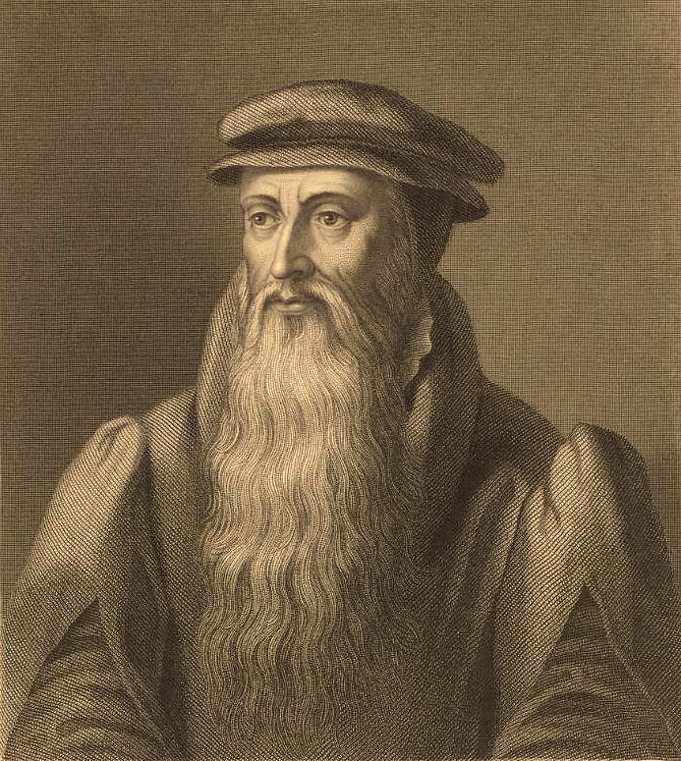
John Knox (1514-1572)
John Knox spent some time in Geneva after fleeing Scotland (1554, 1556-1559), from where he returned to be the spiritual leader in a revolution which led to the independence of Scotland from the English throne and the adoption of the reformed faith. The first presbyterian church was created in Scotland in 1560.
Print Portrait - William Holl (1807-1871)
Source: wikicommons

Slide 25
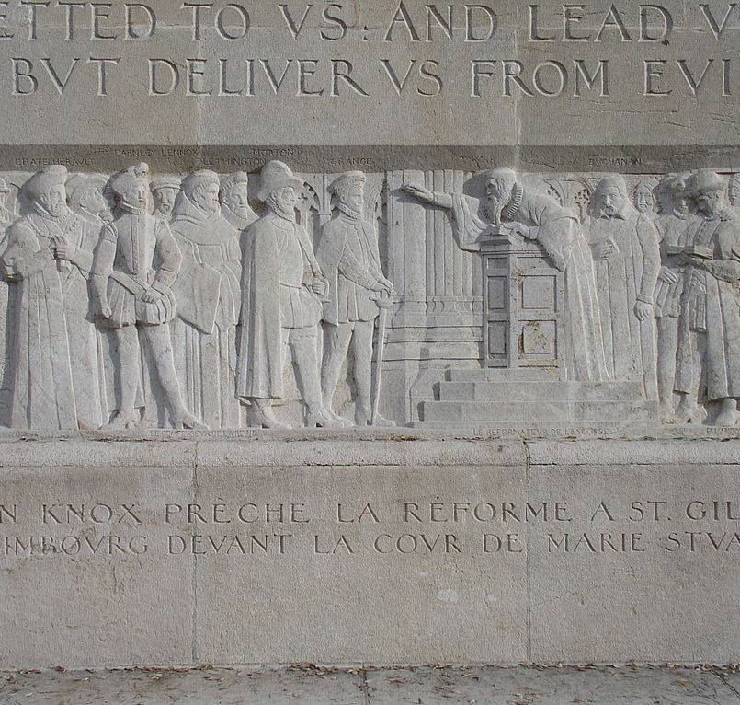
Practical Calvinism
The church of Scotland adopted a presbyterian system of government proposed and formatted by John Knox. The Presbyterian Church of Scotland was the realization of Calvin’s theology. It opposed the Anglican system of government of the church by the state.

Slide 26
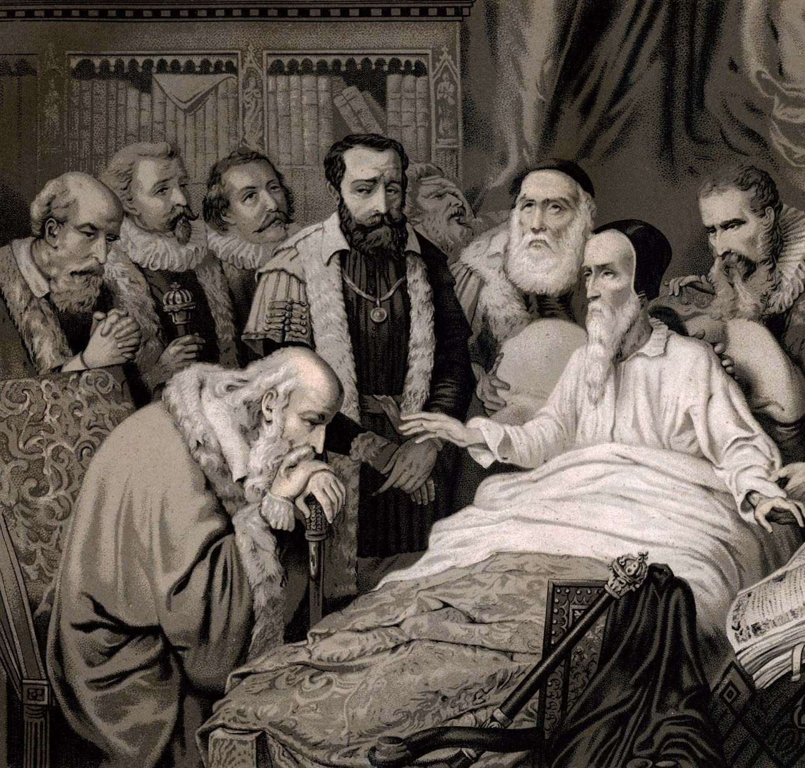
Calvin’s Death
Calvin health was very poor. He had many ailments. He finally succumbed after weeks in bed in his home in Geneva on 27 May 1564. His leadership was replaced by Theodore Beza (1519-1605). Calvin is hailed as the Father of the Reformed Faith.
The Death of John Calvin, print after the painting by J. Hornung. John Calvin is shown speaking to his followers on his deathbed.
Source: John Calvin | Biography, Beliefs, Predestination, Writings, Reformation, & Facts | Britannica

Slide 27
Let’s See Who knows

Slide 28
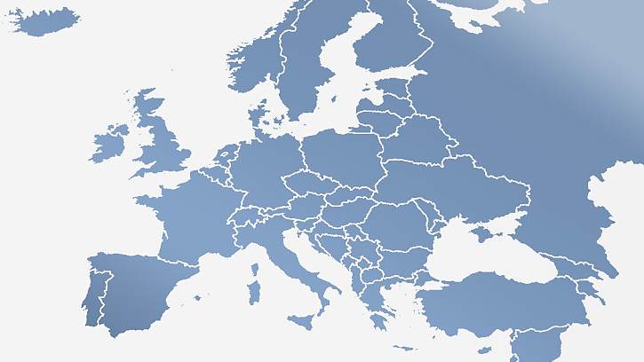
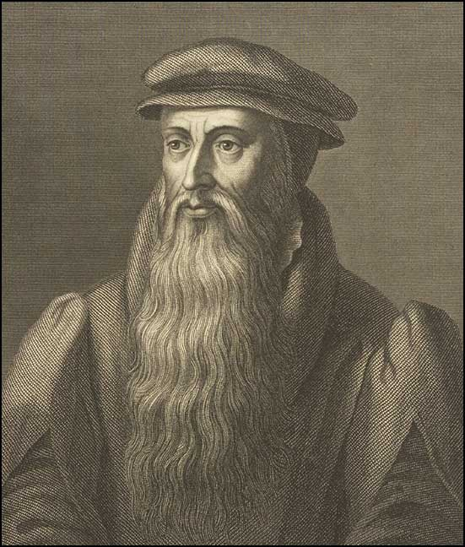
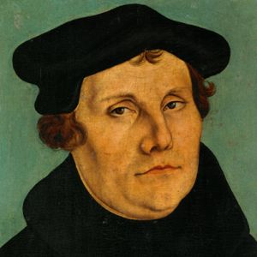
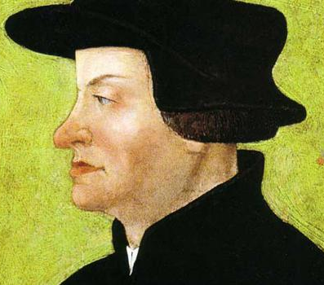
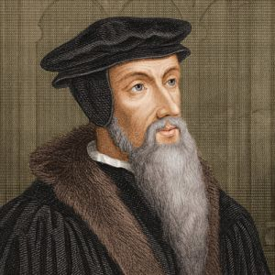
Edinburgh
Wittenberg
Zurich
Geneva
Write the Name of Each Reformer

Slide 29
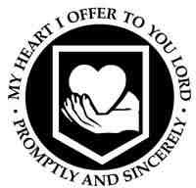
1
2
Connect each Symbol to a Reformer
3
4

Slide 30
Association Game

Slide 31
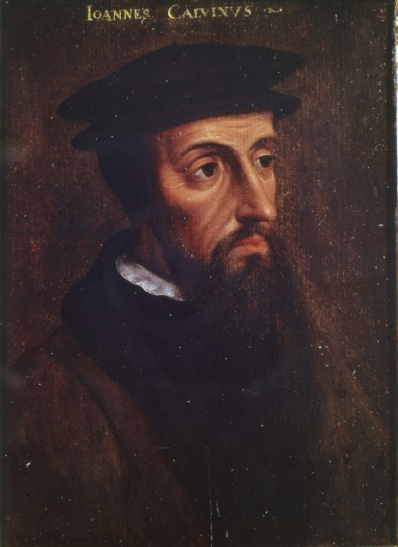
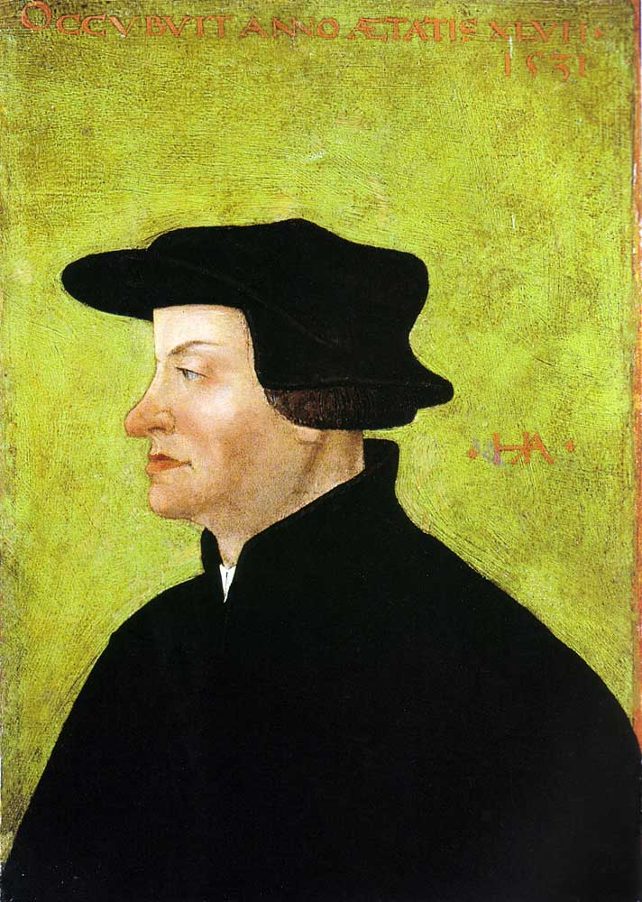
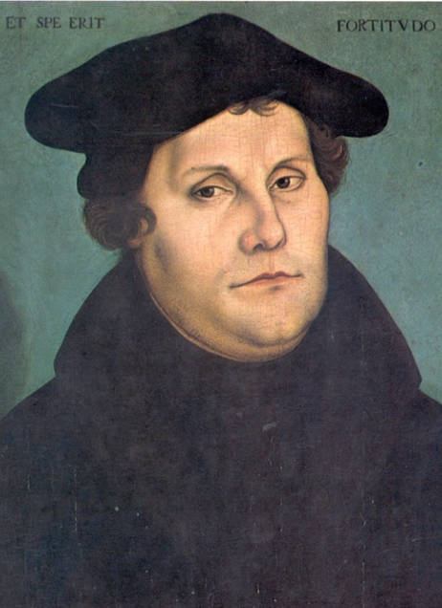
1
2
3
4
John Knox
John Calvin
Martin
Luther
Ulrich
Zwingli
A
B
C
D

Slide 32
Memory Game
Protestant Reformation

Slide 33
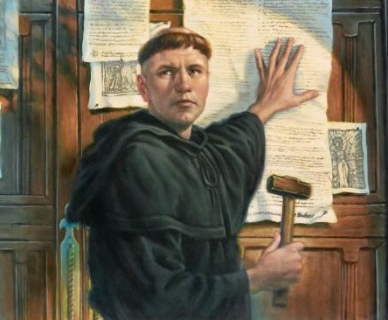

Slide 34
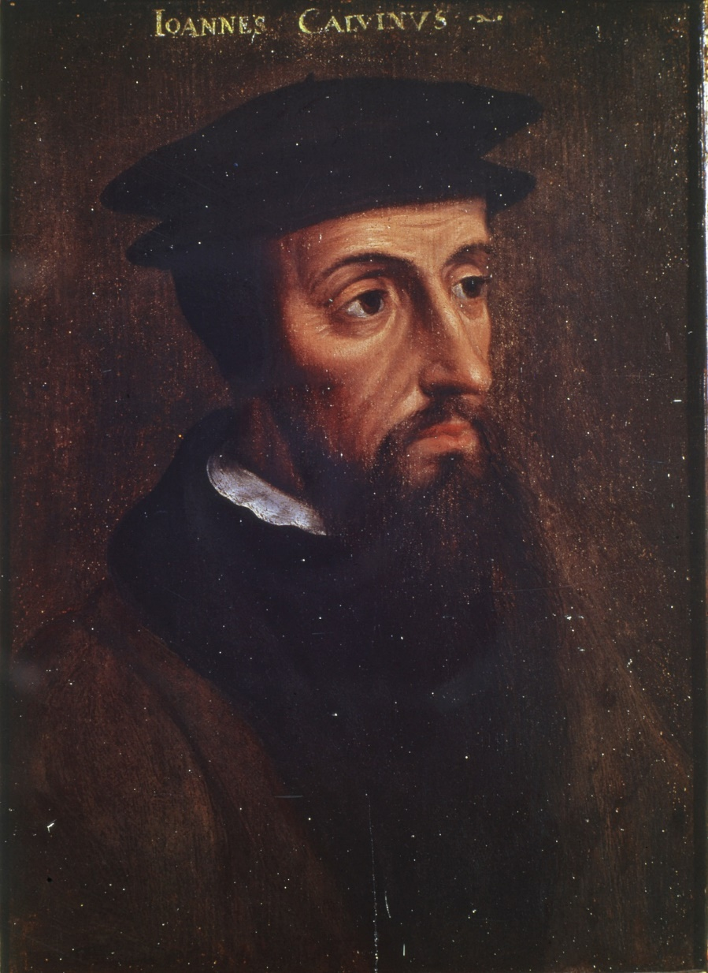
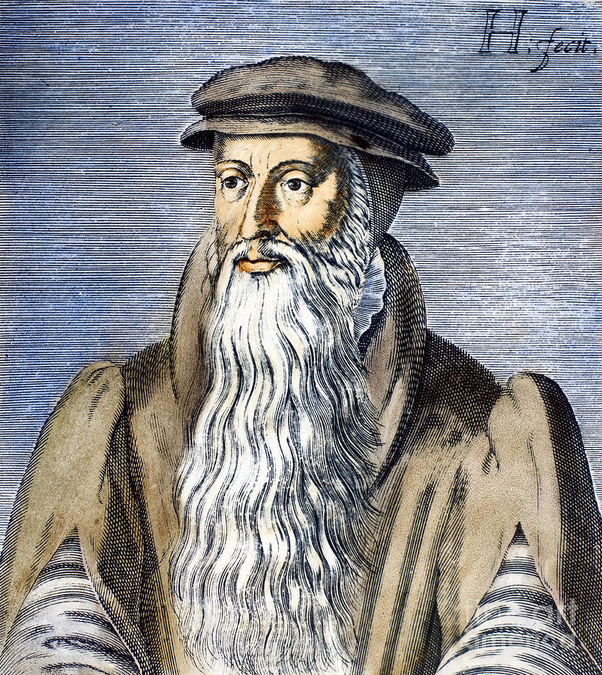

Slide 35
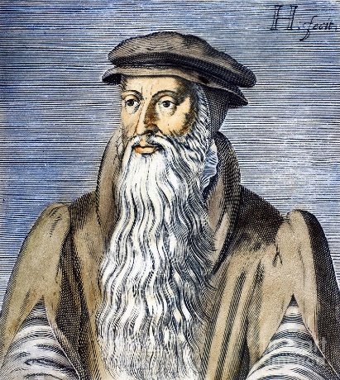
1
2
3
4
5
6
7
8
9
10
11
12
13
14
15

Slide 36
Quiz
What date do we consider the beginning of the Reformation?
Which event happened that day?
Where did it happen?
Which Bible text led to Martin Luther’s Conversion?
What Led Luther to write the 95 theses?
What was the name of the wife of the King of England, from who we wanted to divorce?
Who was the priest who helped to make de reform of the church of England?
In what city did the Reformation start in Switzerland, and who led it?
How did Zwingli die?
What other city of Switzerland became the center of the reformation after Zwingli died?
What was the nationality of John Calvin?
How did John Calvin end up in Geneva?
What is the name of John Calvin’s most famous book?
What is the first presbyterian church to be created, and who was important for that?
When was the Presbyterian Church of Schotland founded?

Slide 37
Notes:
37

Slide 38
I Greet Thee, Who My Sure Redeemer Art
Hymn 168*
Text: Strasbourg Psalter, 1545; tr. Elizabeth L. Smith (*Trinity Hymnal)
Music: Genevan Psalter, 1551
Notes:
38

Slide 39
I greet thee, who my sure Redeemer art,
my only trust and Savior of my heart,
who pain didst undergo for my poor sake;
I pray thee from our hearts all cares to take.
Thou art the King of mercy and of grace,
reigning omnipotent in ev’ry place:
so come, O King, and our whole being sway;
shine on us with the light of thy pure day.

Slide 40
Our hope is in no other save in thee;
our faith is built upon thy promise free;
O grant to us such stronger hope and sure
that we can boldly conquer and endure.

Slide 41
Notes:
41

Slide 42
All People That on Earth Do Dwell
Hymn 1*
Text: Psalm 100; William Kethe 1561 (*Trinity Hymnal)
Music: Genevan Psalter, 1551
Notes:
42

Slide 43
1 All people that on earth do dwell, sing to the Lord with cheerful voice. Serve him with joy, his praises tell, come now before him and rejoice!
2 Know that the Lord is God indeed; he formed us all without our aid. We are the flock he comes to feed, the sheep who by his hand were made.
3 O enter then his gates with joy, within his courts his praise proclaim. Let thankful songs your tongues employ. O bless and magnify his name.
4 Trust that the Lord our God is good, his mercy is forever sure. His faithfulness at all times stood and shall from age to age endure.

Slide 44
3. O enter then his gates with joy, within his courts his praise proclaim. Let thankful songs your tongues employ. O bless and magnify his name.
4 Trust that the Lord our God is good, his mercy is forever sure. His faithfulness at all times stood and shall from age to age endure.

Slide 45
Notes:
45

Slide 46
A Mighty Fortress Is Our God
Hymn 92*
Text: Based on Psalm 46; Martin Luther 1529; tr. By Frederick Hedge 1853 (*Trinity Hymnal)
Music: Martin Luther 1529
Notes:
46

Slide 47
1 A mighty fortress is our God, a bulwark never failing; our helper he amid the flood of mortal ills prevailing. For still our ancient foe doth seek to work us woe; his craft and pow'r are great; and armed with cruel hate, on earth is not his equal.
2 Did we in our own strength confide, our striving would be losing; were not the right man on our side, the man of God's own choosing. Dost ask who that may be? Christ Jesus, it is he, Lord Sabaoth his name, from age to age the same, and he must win the battle.
3 And though this world, with devils filled, should threaten to undo us, we will not fear, for God hath willed his truth to triumph through us. The prince of darkness grim, we tremble not for him; his rage we can endure, for lo! his doom is sure; one little word shall fell him.
4 That Word above all earthly pow'rs, no thanks to them, abideth; the Spirit and the gifts are ours through him who with us sideth. Let goods and kindred go, this mortal life also; the body they may kill: God's truth abideth still; his kingdom is forever.

Slide 48
2 Did we in our own strength confide, our striving would be losing; were not the right man on our side, the man of God's own choosing. Dost ask who that may be? Christ Jesus, it is he, Lord Sabaoth his name, from age to age the same, and he must win the battle.
3 And though this world, with devils filled, should threaten to undo us, we will not fear, for God hath willed his truth to triumph through us. The prince of darkness grim, we tremble not for him; his rage we can endure, for lo! his doom is sure; one little word shall fell him.
4 That Word above all earthly pow'rs, no thanks to them, abideth; the Spirit and the gifts are ours through him who with us sideth. Let goods and kindred go, this mortal life also; the body they may kill: God's truth abideth still; his kingdom is forever.

Slide 49
3 And though this world, with devils filled, should threaten to undo us, we will not fear, for God hath willed his truth to triumph through us. The prince of darkness grim, we tremble not for him; his rage we can endure, for lo! his doom is sure; one little word shall fell him.
4 That Word above all earthly pow'rs, no thanks to them, abideth; the Spirit and the gifts are ours through him who with us sideth. Let goods and kindred go, this mortal life also; the body they may kill: God's truth abideth still; his kingdom is forever.

Slide 50
4 That Word above all earthly pow'rs, no thanks to them, abideth; the Spirit and the gifts are ours through him who with us sideth. Let goods and kindred go, this mortal life also; the body they may kill: God's truth abideth still; his kingdom is forever.

Slide 51
Notes:
51

Slide 52
Doxology
Hymn 731*
Text: Thomas Ken (*Trinity Hymnal)
Music: Genevan Psalter, 1551; attr. Louis Bourgeois
Notes:
52

Slide 53
Praise God from whom all blessings flow;
Praise him, all creatures here below;
Praise him above, ye heav’nly host;
Praise Father, Son, and Holy Ghost.
Amen.

